Slide 1
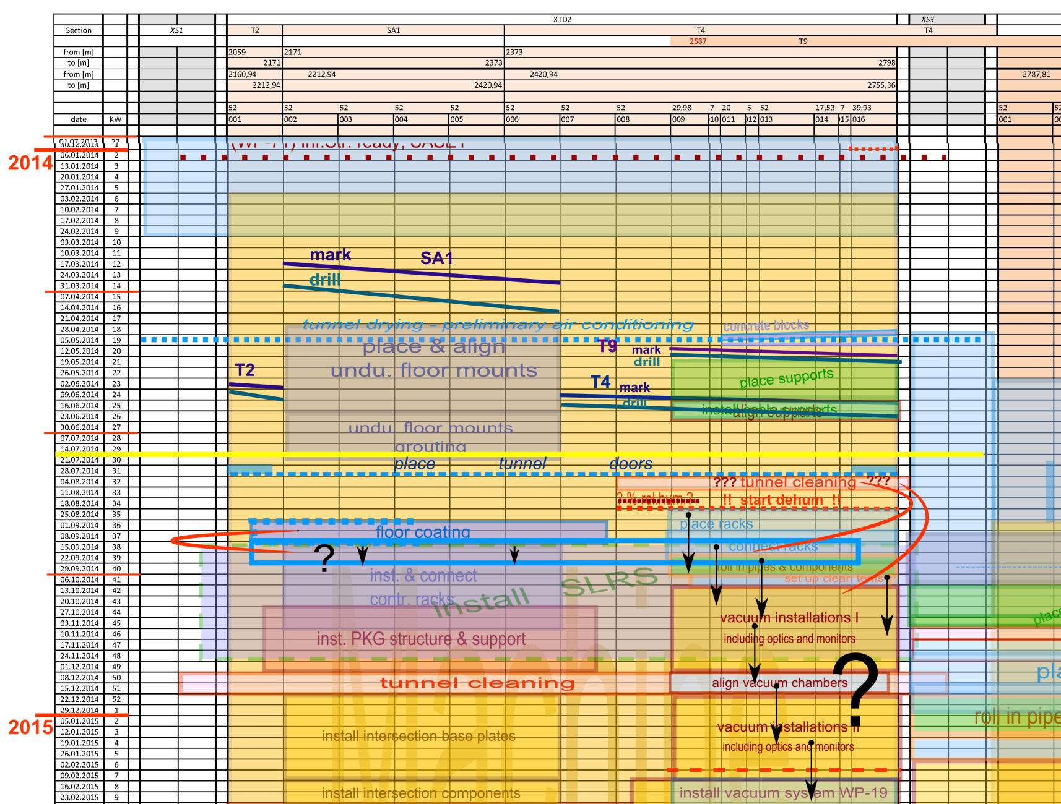
Time shifts in XTD2 ?
  floor coating
  2 weeks later
  dehumidification now on a good way
  tunnel cleaning not yet
  what further effects are to be expected?
now

