Slide 1

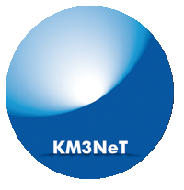
KM3NeT
The next generation neutrino telescope
in the Mediterranean
Detector Design and Technology for
Next Generation Neutrino Observatories
8-10 December 2014, Aachen
Maarten de Jong

Slide 2
Introduction
KM3NeT is a new Research Infrastructure
  network of cabled observatories
  located in deep waters of Mediterranean Sea
  hosting multi-km³ Neutrino Telescope
Discovery and subsequent observation of
high-energy neutrino sources in Universe
Measurement of neutrino mass hierarchy
Synergy with Earth & Sea sciences

Slide 3
Detection principle
wave front
neutrino
muon
1
2
3
4
5
~ 100 m
interaction
Water properties
~ km
time resolution 1 ns
position resolution 10 cm
angular resolution 0.1 deg

Slide 4

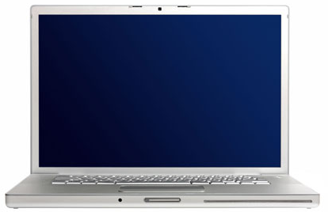
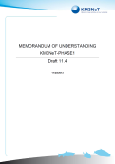
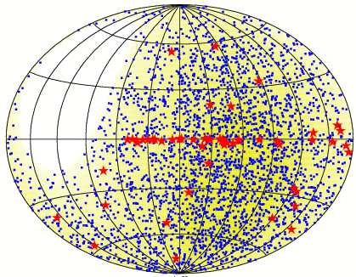
Architecture
10−100 Mb/s
computer
center
0.1−1 Tb/s
shore station
neutrino telescope
KM3NeT
remote
operation
remote access
to data
on
off

Slide 5
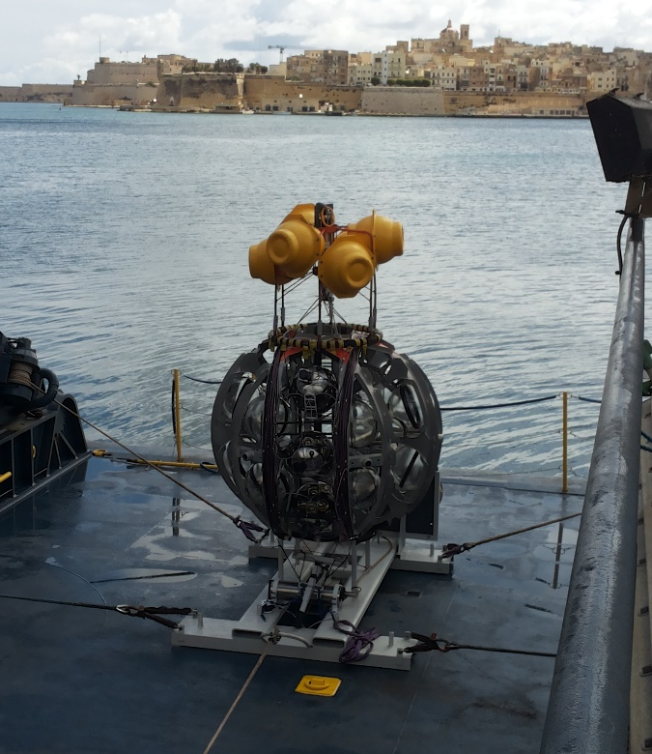
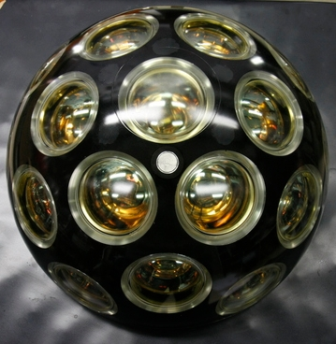

Design
Launcher vehicle
Optical module
~ 600 m
17”
31 x 3” PMTs
low-power HV
LED & piezo inside
FPGA readout
White Rabbit
DWDM
rapid deployment
autonomous unfurling
recoverable

Slide 6
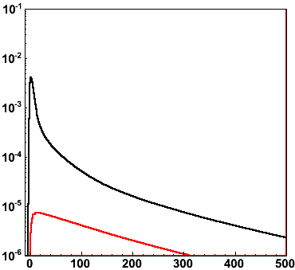
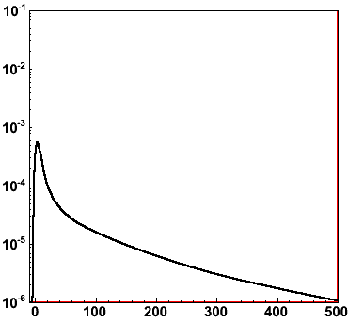

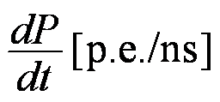
PDF of muon light
R = 50 m
R = 100 m
R
optical background
1 TeV
muon
S/N ~10²
Δt [ns]
Δt [ns]

Slide 7
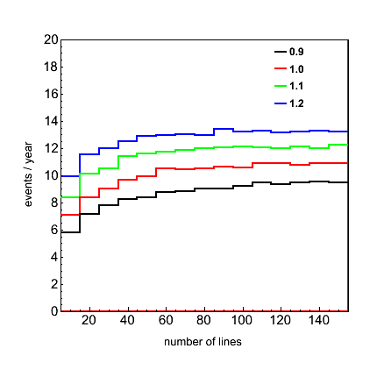
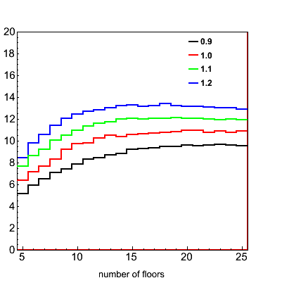
Building block
λ_{abs} scaling factor
λ_{abs} scaling factor
RXJ1713 events / year
number of lines
number of floors
Smallest detector with optimal efficiency ~ 1/6 total size

Slide 8
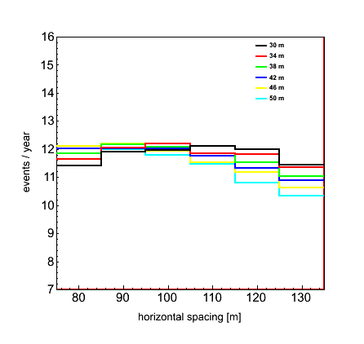
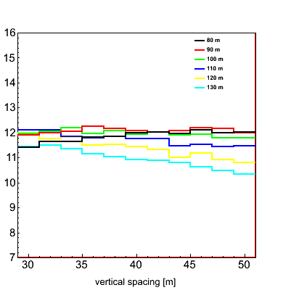
Example
vertical spacing
horizontal spacing
RXJ1713 events / year
λ_{abs} scaling factor 1.1
λ_{abs} scaling factor 1.1
horizontal spacing [m]
vertical spacing [m]
There is a maximum

Slide 9
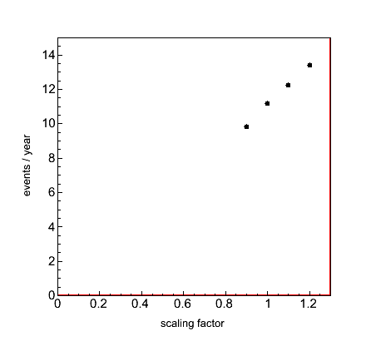
Absorption length
optimal detector
RXJ1713 events / year
λ_{abs} scaling factor
There is a linear dependence

Slide 10
PDF of shower light (I)
ν_{e}
wave front
~ 100 m
~ m log(E/TeV)
time resolution 1 ns
position resolution 10 cm
angular resolution ?

Slide 11
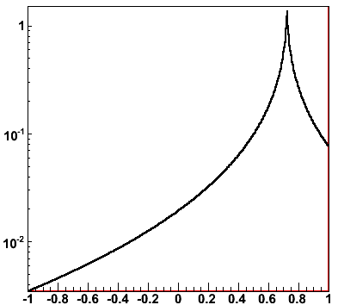
PDF of shower light (II)
θ₀
ν_{e}
cos(θ₀)
θ_{C}
time resolution 1 ns
position resolution 10 cm
angular resolution ?

Slide 12
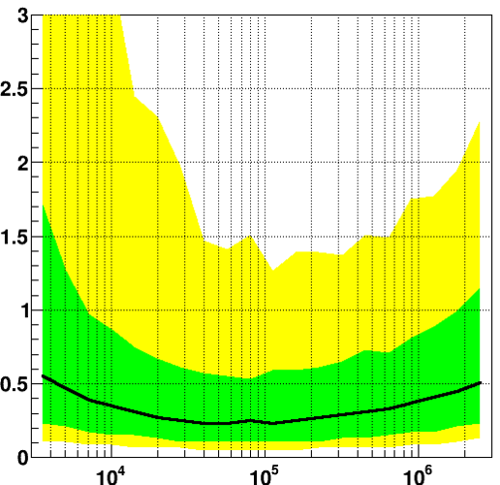
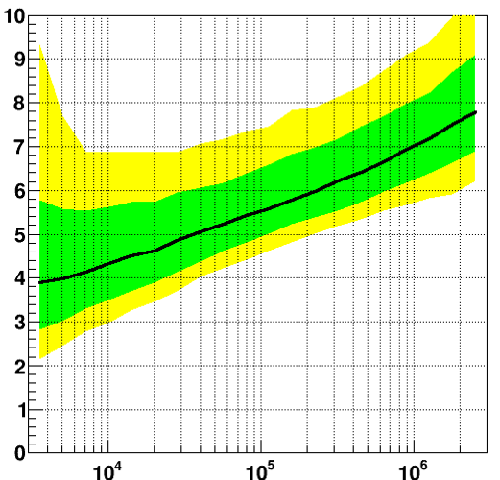
Shower reconstruction (I)
68%
90%
ΔR [m]
Δz [m]
position of shower maximum
E_{ν} [GeV]
Δz
E_{ν} [GeV]
ν_{e}
ΔR

Slide 13
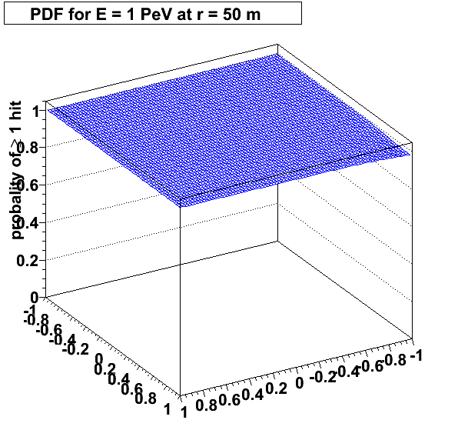
P(≥ 1 hit)
θ₁
cos(θ₁)
θ₀
cos(θ₀)

Slide 14
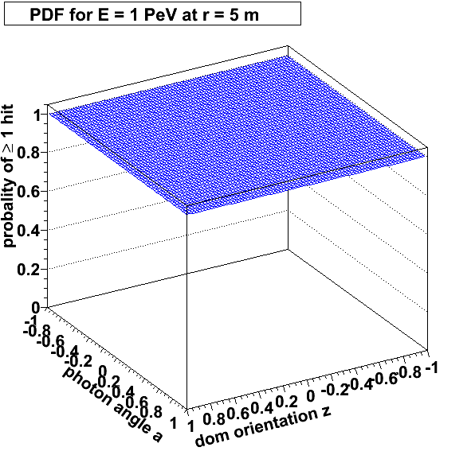
P(≥ 1 hit)
θ₁
cos(θ₁)
θ₀
cos(θ₀)

Slide 15
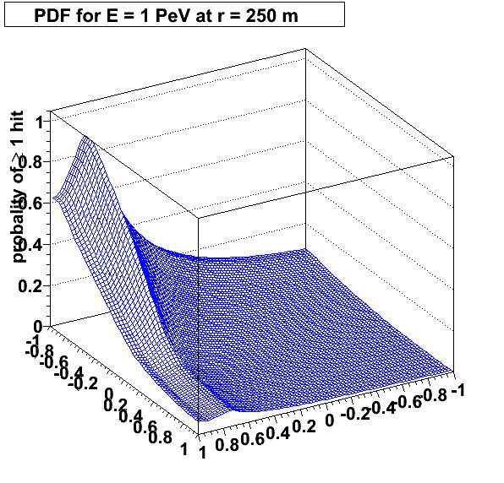
P(≥ 1 hit)
θ₁
cos(θ₁)
θ₀
cos(θ₀)

Slide 16
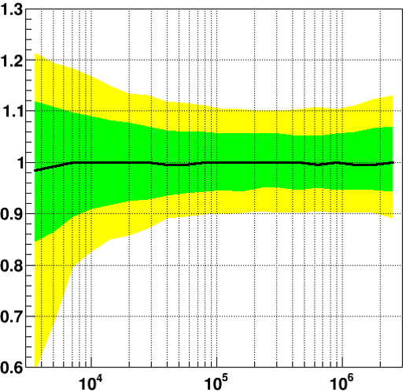
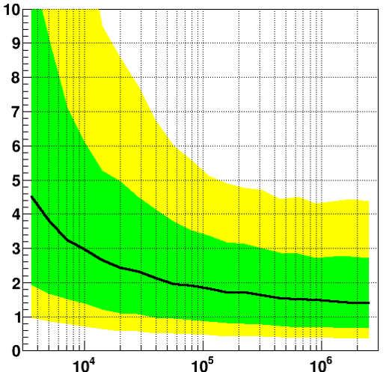
Shower reconstruction (II)
68%
90%
E_{R}/E_{T}
Δθ [m]
E_{ν} [GeV]
Δθ
E_{ν} [GeV]
ν_{e}
E_{R}/E_{T}

Slide 17
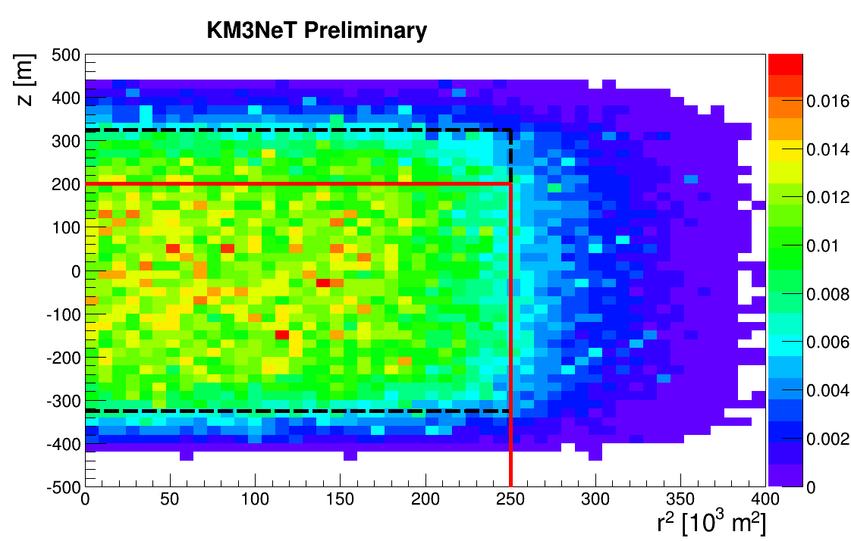
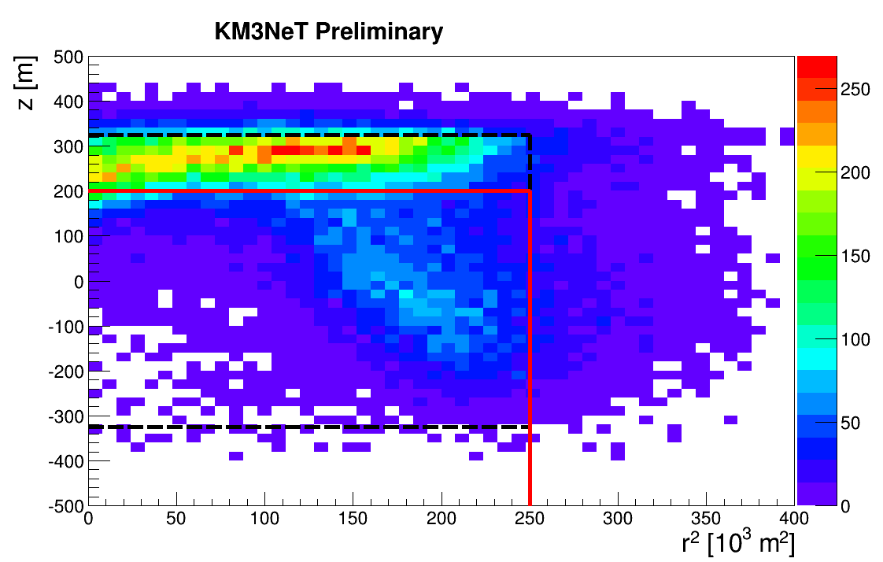
Atmospheric muon veto
cosmic neutrinos
atmospheric muons
z [m]
R² [10³ m²]
R² [10³ m²]
detector volume
vertex cut
Veto by timing

Slide 18
All neutrino flavour astronomy!

Slide 19
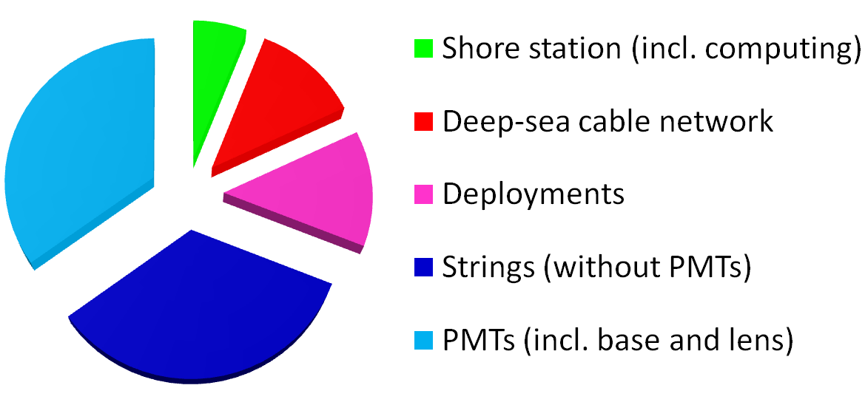
KM3NeT costs
€ KM3NeT string ~ ¼ of € Antares string

Slide 20
Siting
  single multi
Deep-sea infrastructure
  detection unit same
  interconnecting link cable, same
  deployment and connection
  junction boxes same
  main electro-optical cable¶ similar
Shore infrastructure
  real estate n.a.
  computing hardware same
  facilities same
¶ Price is mainly determined by number of fibres and thickness of copper conductor.

Slide 21
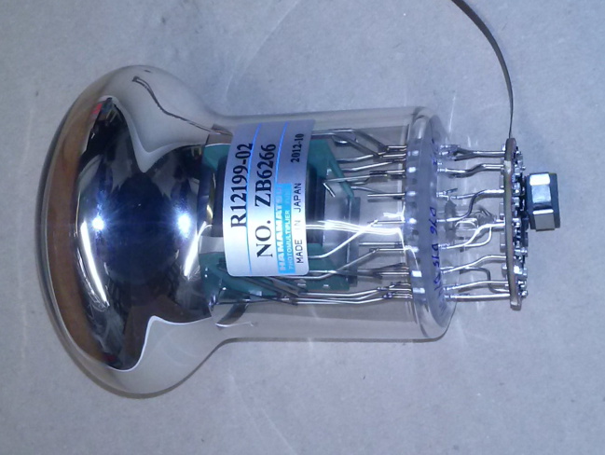
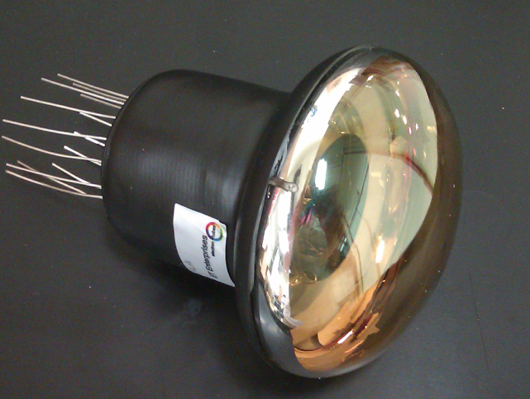
3-inch PMTs
Key features:
  timing ≤ 2 ns (RMS)
  QE ≥ 25-30%
  collection efficiency ≥ 90%
  photon counting purity 100% (by hits, up to 7)
  price/cm² ≤ 10” PMT
ETEL
ETEL D792
Hamamatsu R12199
HZC XP53B20

Slide 22
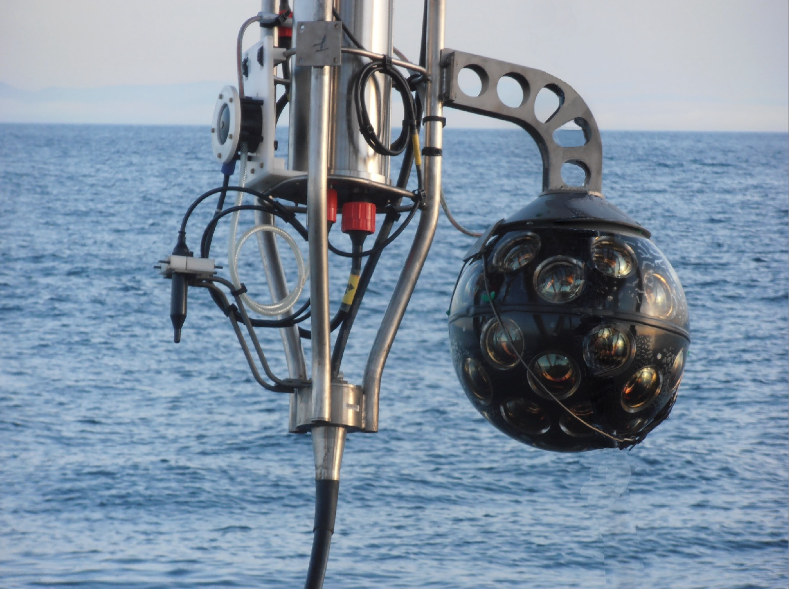
1st prototype (April 2013)

Slide 23
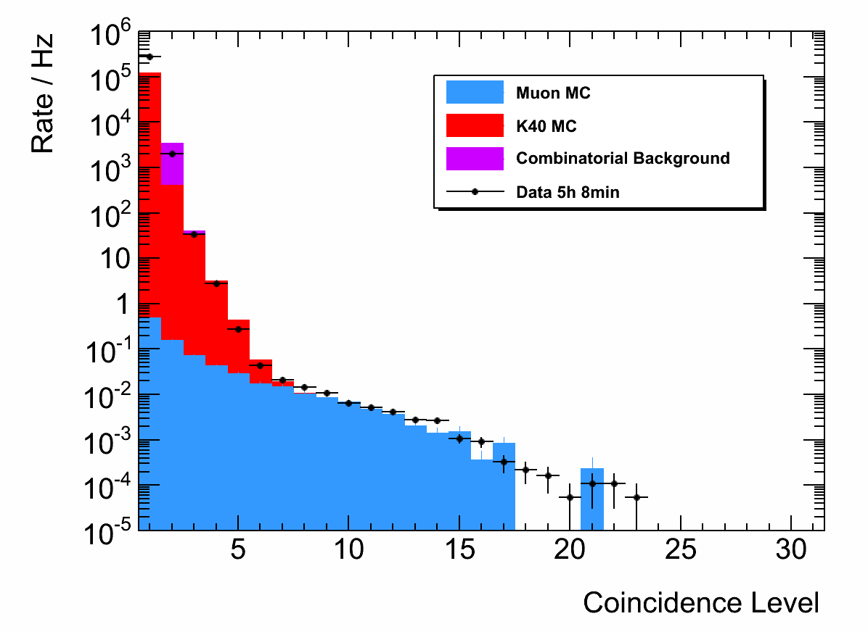
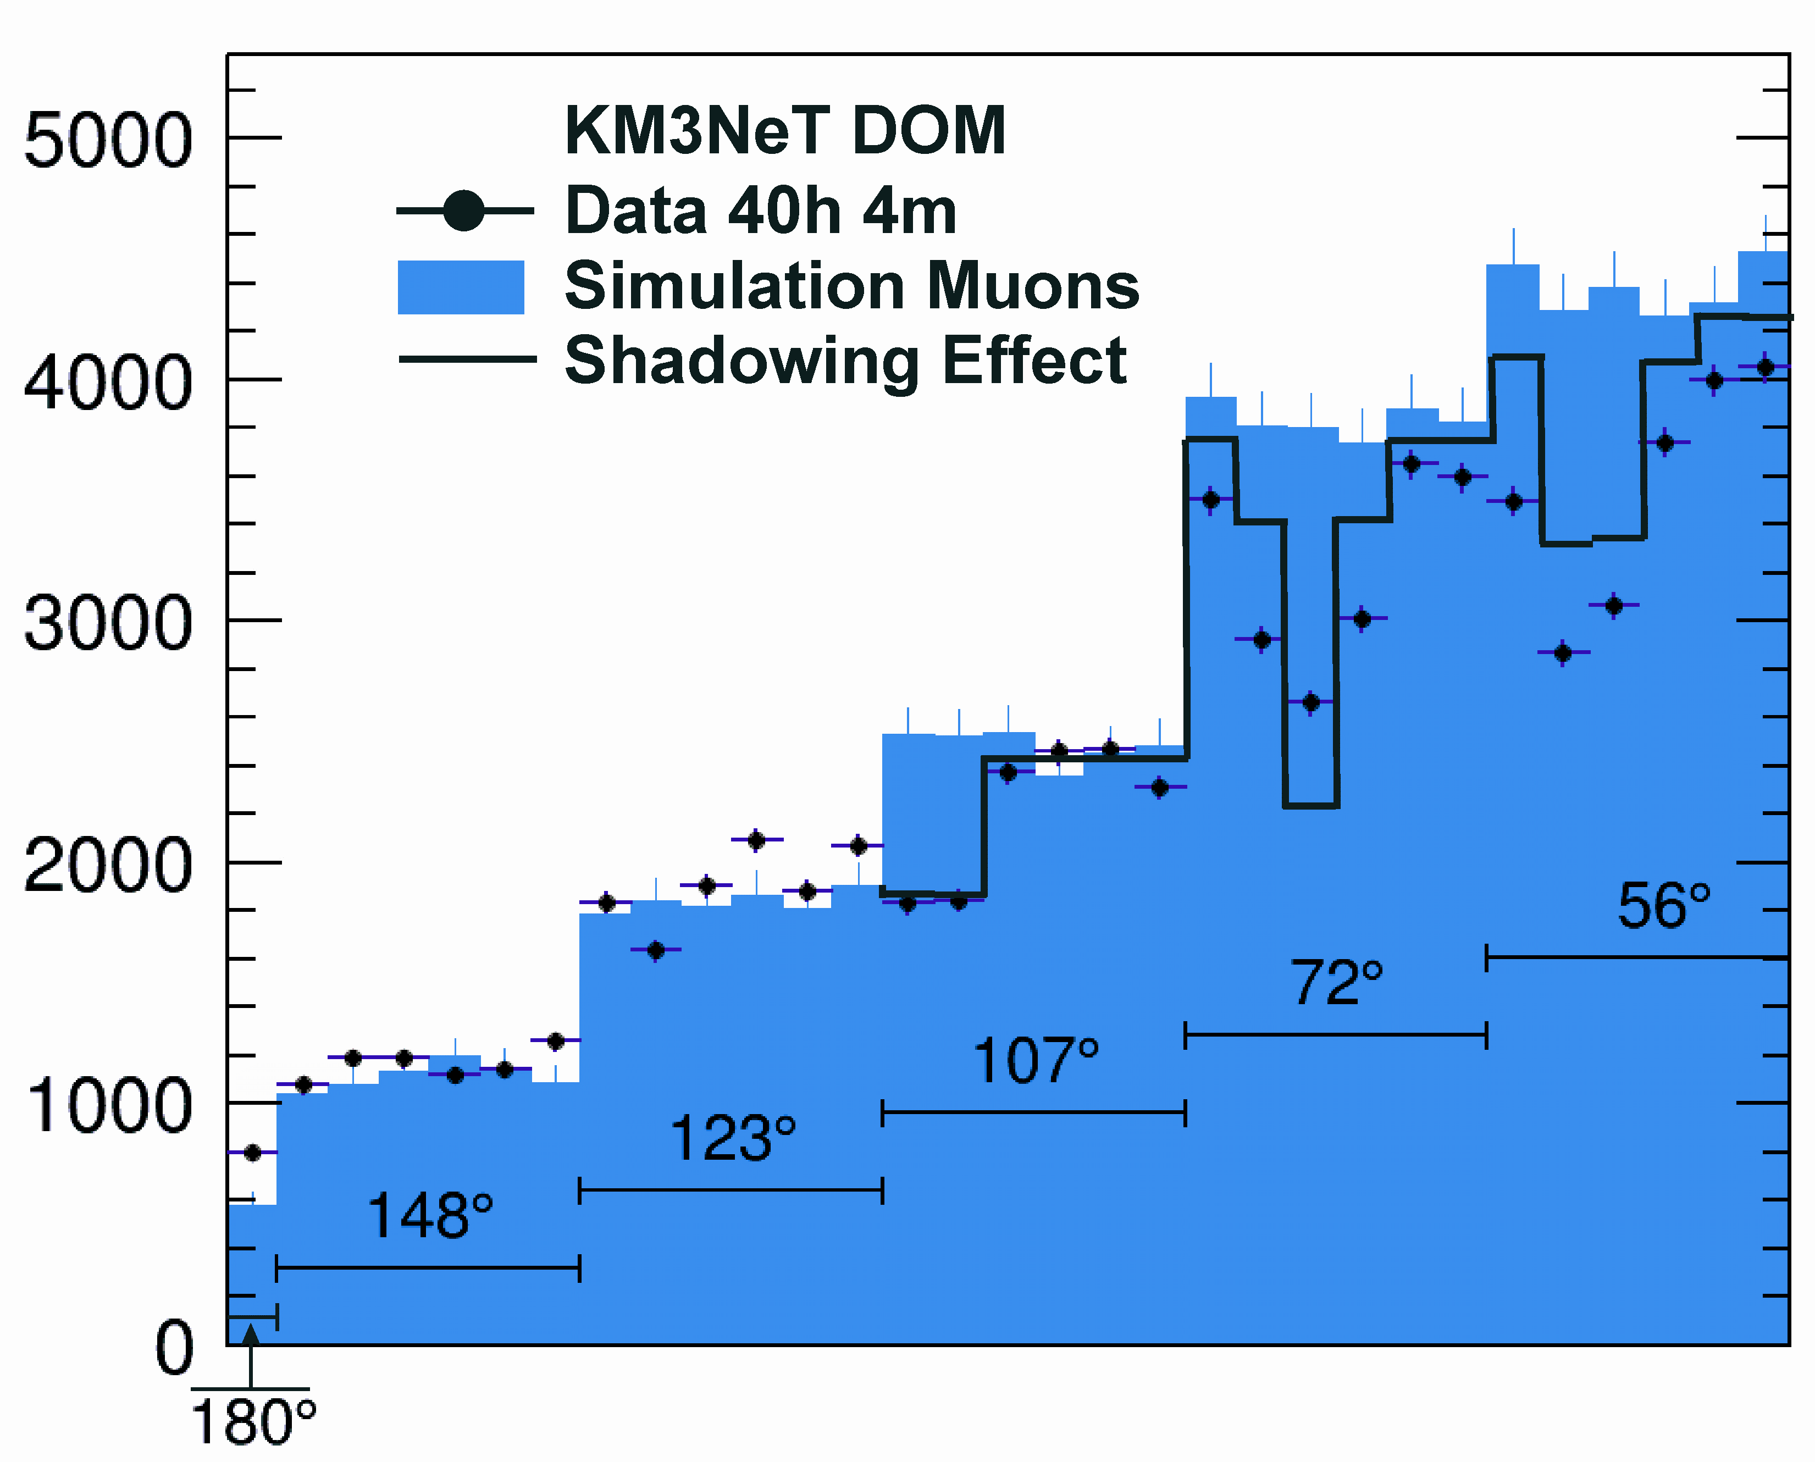
1st prototype¶
atmospheric muons
K40
random coincidences
+ data
50
atmospheric muons
+ data (M ≥ 7)
shadowing
40
Rate [Hz]
30
Rate [a.u.]
20
10
0
Multiplicity
PMT orientation [deg.]
photon counting
directionality
¶ Eur. Phys. J. C (2014) 74:3056

Slide 24
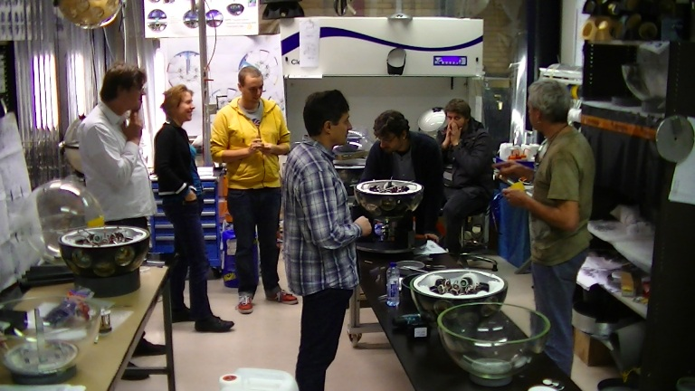
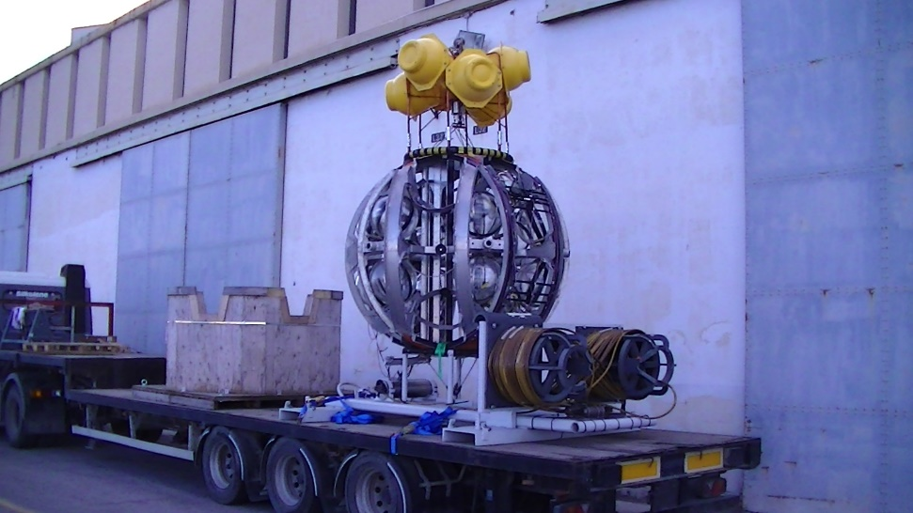
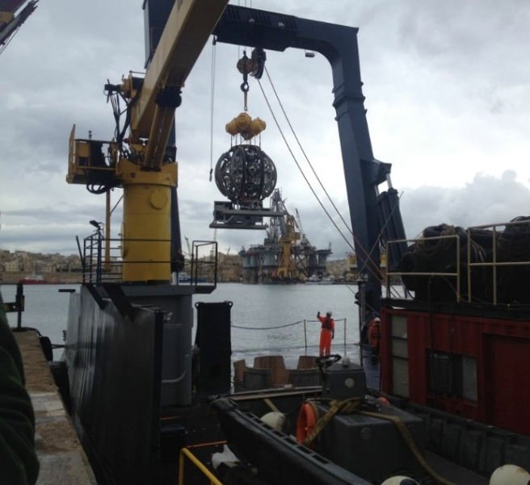
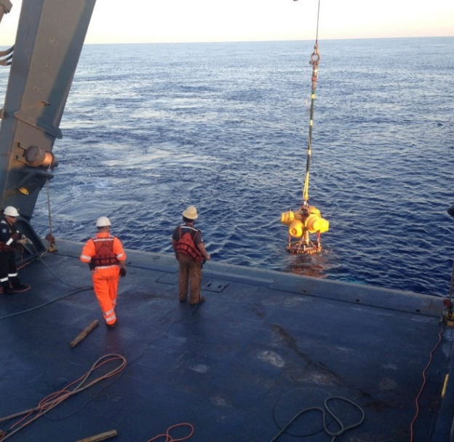
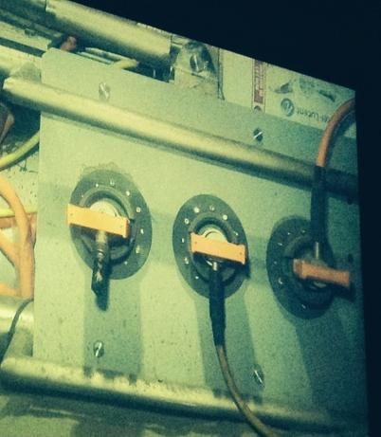
2nd prototype (May 2014)

Slide 25
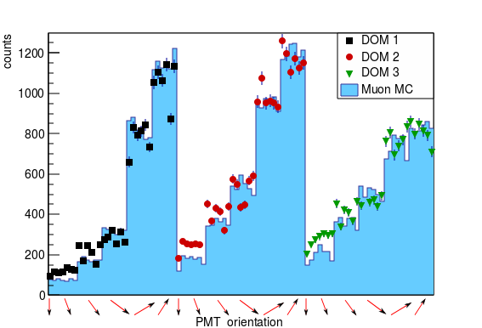
2nd prototype

Slide 26
Phased implementation
Phase | Additional costs [M€] | Blocks | Primary deliverables
1 | 0 | 0.2 | Proof of feasibility and first science results
1.5 | 50–60 | 2 | Measurement of neutrino signal reported by IceCube
ORCA¶ | 40 | 1 | Neutrino mass hierarchy
2 | 130–170 | 6 | Neutrino astronomy including Galactic sources
¶ Presentation by Antoine Kouchner at this workshop.

Slide 27
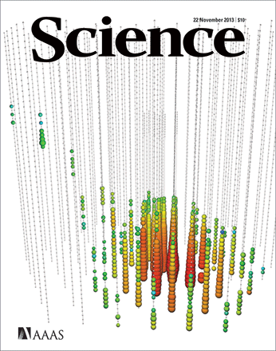
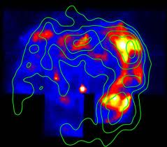
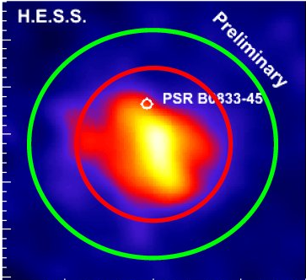
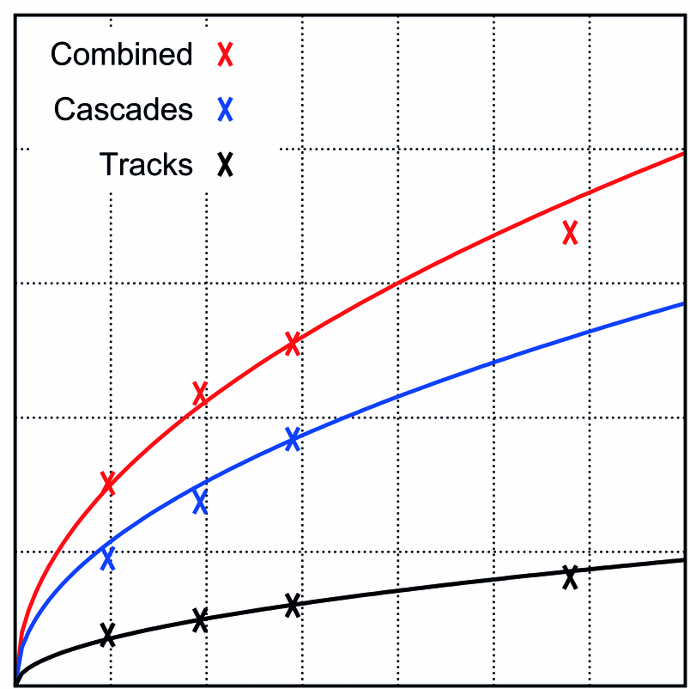
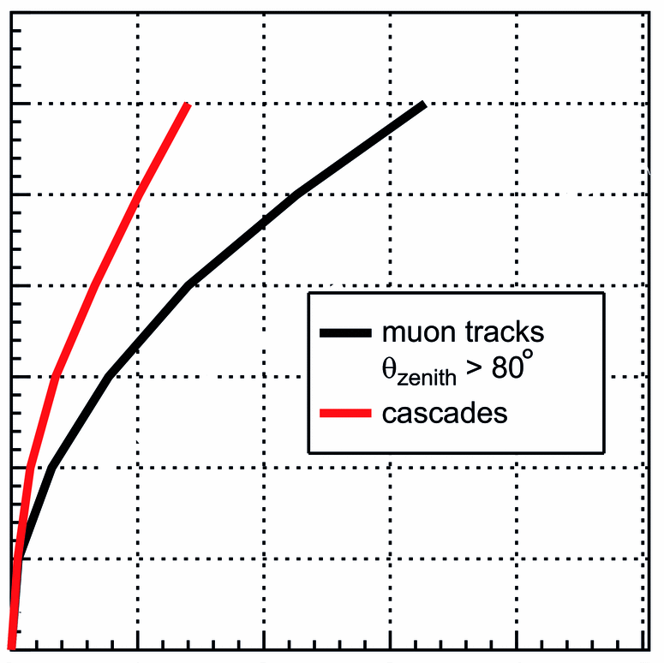
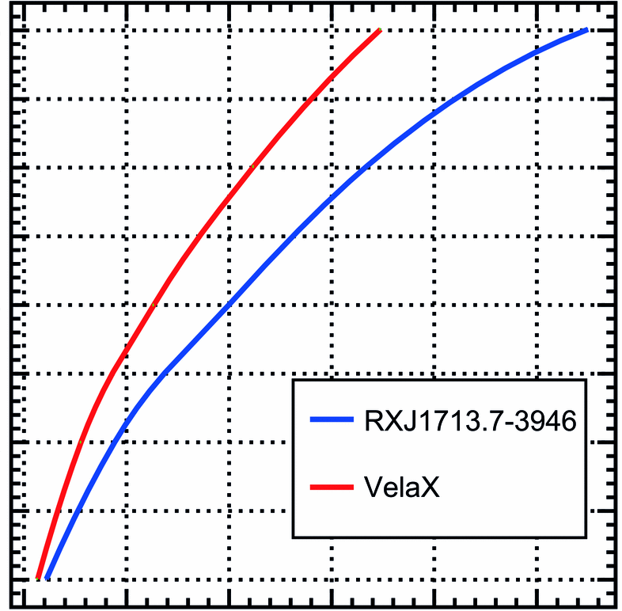
KM3NeT outlook
Neutrino physics
Neutrino astronomy
m_{ν}
ORCA
Phase-1.5
Phase-2
5
7
5
4
6
5
4
3
4
significance [σ]
3
2
3
2
2
1
1
0
0
1
0
1
2
3
0
1
2
3
4
5
0
1
2
3
4
5
years
years
years

