Slide 1
CMOS testing plans
Craig Buttar & Jens Dopke

Slide 2
TJ 180 Structures
PMOS measurements
Re-check TW structure
Ask Walter S. for input
Complete Ids vs. Vds measurements
Irradiate with X-rays at RAL 60kV, 50mA, tungsten target
Needs a ~3m long cable
Need PCB
Check during (in reg. intervals) and after irrad and annealing
Need to mount the structures
Selective bonding only to not shade the electronics
Need to understand/calibrate dose rate of the machine!
Kestutis & Jens

Slide 3
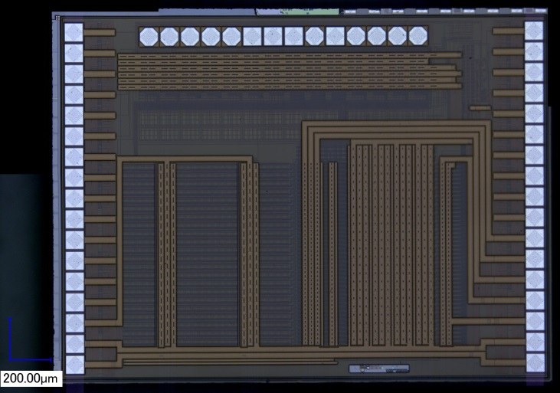
HVStripV1
Have 12 chips in hand, plus 4 already bonded to “dirty” boards
Motherboards almost out for production
Can do tests on three transistors without software
Tests on pixel array need the ATLys software & firmware
Need to configure chip
As soon as the motherboard is delivered -> fix up the software, calibrate, test and irradiate…

Slide 4
Chip distribution
Group | Contact | Amount | Plans
Oxford (UCL) | R. Nickerson | 3 | DAQ, Testing
Glasgow | C. Buttar | 2 | Testing
RAL | J. Dopke | 2 | Testing
Santa Cruz | A. Grillo | 2 | Testing
Ljubljana | I. Mandic | 2 | TCT, Testing
DESY | M. Stanitzki | 2 | Testing
Liverpool | T. Affolder | 2 | Testing
Argonne | J. Zhang | 2 | Testing
Geneva | S.Gonzalez Sevilla | 4 | TCT, testing
Total |  | 21 | 20 chips in-hand
Chips in-hand: 4 bonded and 16 bare chips
Need to revisit distribution and get more chips

Slide 5
Plans
Signal & noise measurements on passive & active pixels
Use fast amp for passive pixels
Use charge injection and sources
Make first measurements as soon as motherboard has returned
Setup at Oxford/RAL and then send to other groups?
Revisit distribution
Irradiations
X-rays at RAL
Neutrons at Ljubjiana
Protons at PS start in November
To do: figure out the biasing

