Slide 1
Digital Camera Trigger for the
Cherenkov Teleskope Array
March 2015
K.-H. Sulanke
DESY

Slide 2
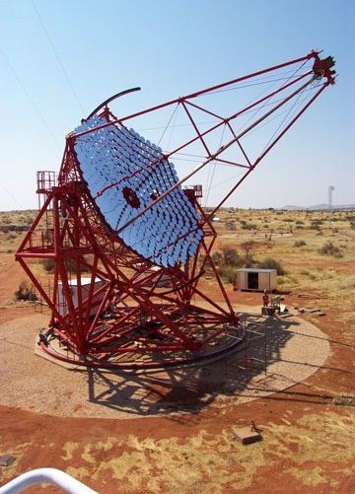
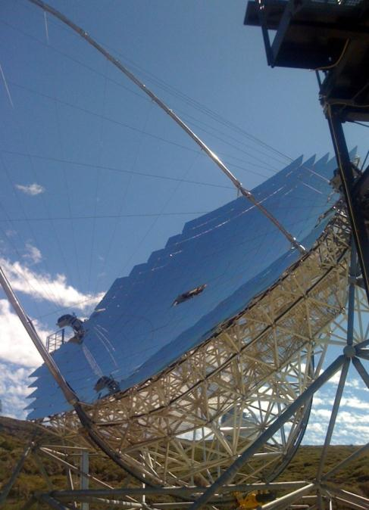
CTA, Cherenkov Telescope Array
about 100 telescopes, on the northern & the southern hemisphere
3 sizes: LSTs, MSTs and SSTs, similar already exist :
H.E.S.S. in Namibia
MAGIC auf La Palma
VERITAS in Arizona, USA

Slide 3
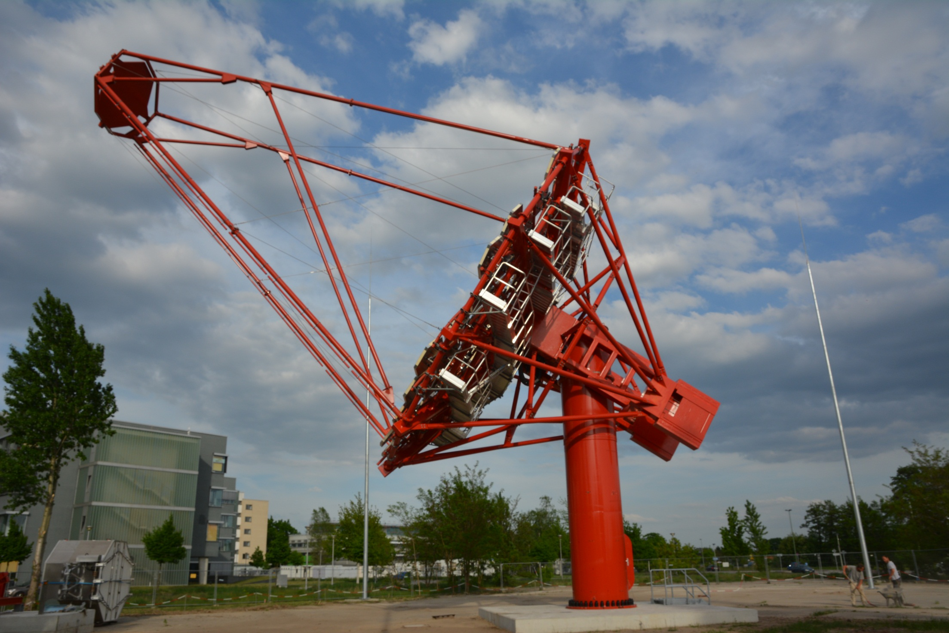
MST Prototype by DESY

Slide 4
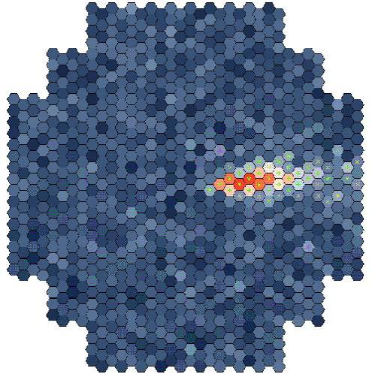
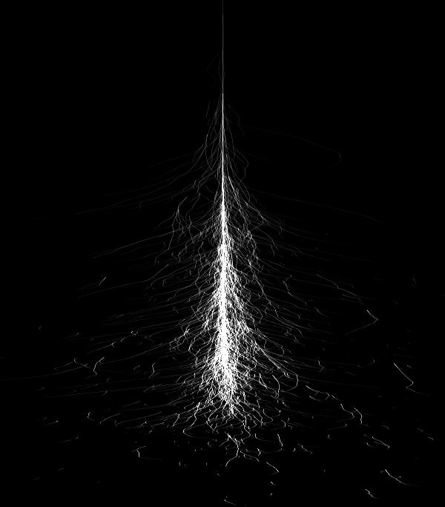
Atmospheric Cherenkov Light
γ-rays
~15 km
e⁺e⁻ shower
cherenkov-light
intensity ➞ energy
orientation ➞ direction
shape ➞ particle
stereo ➞ source

Slide 5
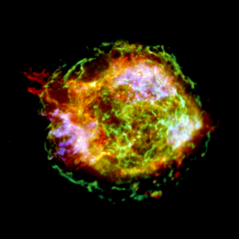
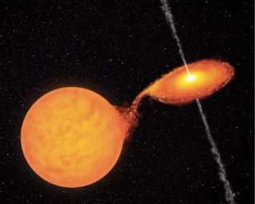
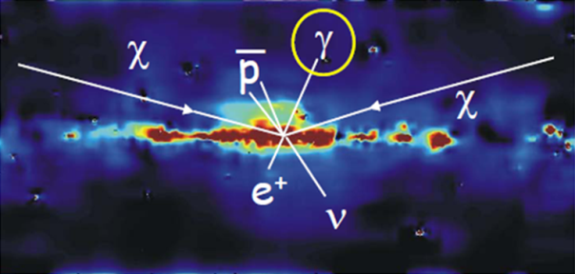
Sources of Cosmic Rays
Super Nova
Micro Quasare
Dark Matter

Slide 6
The MST (Medium Size Telescope) Camera
PMT based, 265 cluster a´ 7 PMTs
PMT-d : 38 mm (1.5 Zoll, z.B. Hamamatsu PMT R11920-100)
Pixel-grid : 50 mm by Winston cones
1855 Pixel
Size of the pixel-array : ~ 2 qm
Weight : up to 2000 kg
extrem light sensitive
„shutter“ time in the ns region
self triggered

Slide 7
Trigger Requirements
Design for the MST (Medium Size Telescope) Camera, „NectarCam“, France
  could also be used for LST (Large Size Telescopes), „DragonCam“, Japan
Because of the NSB (Night Sky Background), the trigger design is quite challenging
Single pixel rate can be greater than 100 Mhz
Basic requirements are
  Sensitive for weak PMT signals
  Fast
  Low latency
  Low power
  Cheap
Alternative to the „Analog Trigger“ designed by Spanish colleagues
  Based on analog sums of up to 21 pixel
  Theoretically better for weak and noisy signals (LST)
3/2/2015
K.-H. Sulanke, DESY
7
Notes:
7

Slide 8
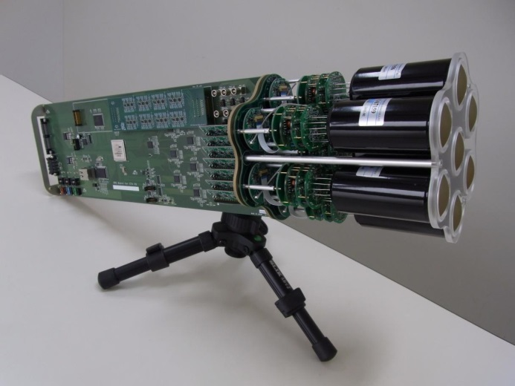
37 Pixel Trigger Region
15
10
f
62
12
a
14
c
60
c
e
a
25
13
63
65
f
d
76
d
64
f
24
20
e
71
g
e
52
75
a
23
b
70
f
53
c
22
d
72
a
74
d
50
c
34
c
73
e
54
a
7-pixel cluster
35
e
d
e
55
33
43
f
30
d
d
f
44
42
a
32
e
c
40
c
a
45
f
3/2/2015
K.-H. Sulanke, DESY
8
Notes:
8
I would like to present you two examples of fast link interfaces, designed in our lab.
For both cards block schemes, test results and conclusions will be presented.

Slide 9
37 Pixel Trigger Regions
7 cluster
trigger region
clusters (not pixel !) of a MST shown
Each heagon represents 7 pixel
the trigger region overlaps by four pixels always
3/2/2015
K.-H. Sulanke, DESY
9
Notes:
9

Slide 10
The Trigger Schema
DTB
L0_neighbor
L2
24V
FEB
L1
CTDB
L2CB
PMT
7
L0
7
#01
Sector_trig
#01
GPS_clock
FPGA
ethernet
L1
L0_neighbor
…
…
FEB
FPGA
#18
FPGA
PMT
7
L0
7
#15
Camera_trig
FPGA
PMT = Photomultiplier Tube
FEB = Frontend Board
DTB = Digital Trigger Backplane
CDTB = Clock & Trigger Distribution Board
L2CB = L2 Controller Board
FPGA
FPGA
FPGA
FPGA
FPGA
FPGA
FPGA
backplane connections
3/2/2015
K.-H. Sulanke, DESY
10
Notes:
10

Slide 11
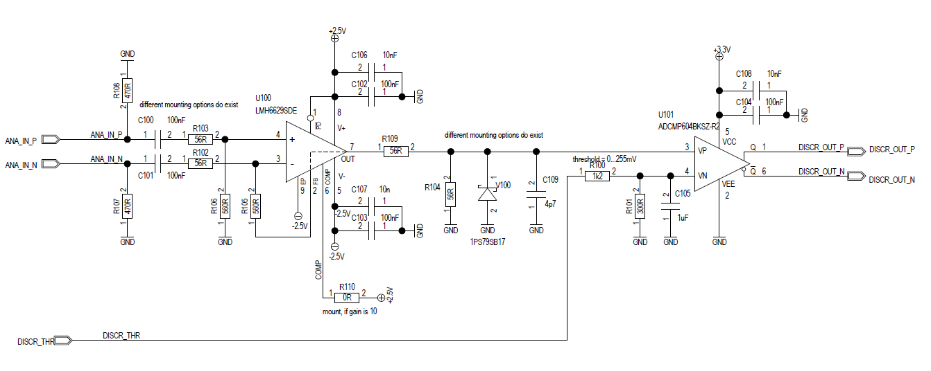
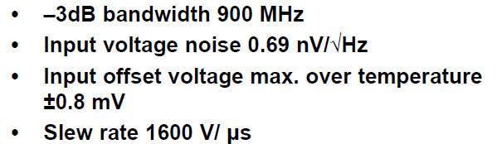
Digital Trigger L0 Mezzanine Board
Digital L0 Mezzanine
7 channels
Schematic simulated
LMH6629, very low noise, low offset preamplifier
Opamp
Comp
LVDS
DAC
Diff. Analog in
LVDS out
Preamp
LVDS Comparator
Trigger threshold
3/2/2015
K.-H. Sulanke, DESY
11
Notes:
11

Slide 12
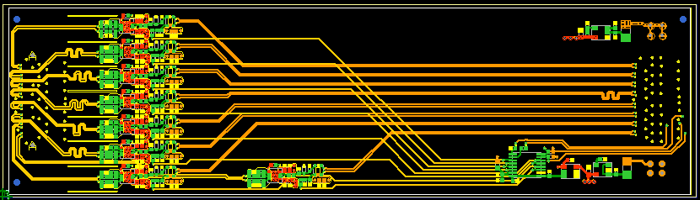
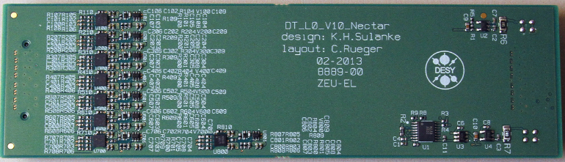
Digital Trigger L0 Mezzanine Board
6 layer PCB with length-tuned signal lines
Preamplifier
Comparator
Trigger-
Treshold-DAC
3/2/2015
K.-H. Sulanke, DESY
12
Notes:
12

Slide 13
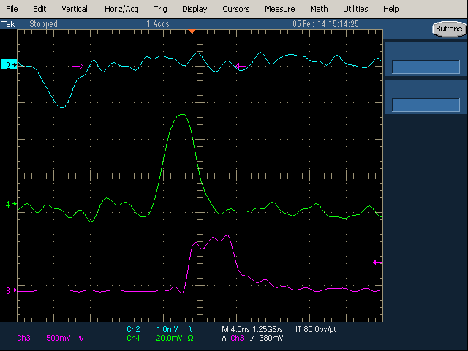
L0, minimum analog input Level
Analog_in, 1mV pk
Comp_in, gain = 27
Comp_out, thr=12mV
3/2/2015
K.-H. Sulanke, DESY
13
Notes:
13

Slide 14
L1, Digital Trigger Backplane Rev. 2
Frontend board connector
RJ-45
ethernet
ethernet
power
CLK
PPS
L0_trigger
camera_trigger
IP_addr
HV_ena
SPI / JTAG
calib_cyc
reserved
24V
power
vreg
flash
clock (opt.+power)
PPS
L1_trigger_out
L2_trigger_in
Xilinx
FPGA
osc
RJ-45
flash
L0 in /out and ...
connectors to neighbor clusters
3/2/2015
K.-H. Sulanke, DESY
14
Notes:
14

Slide 15
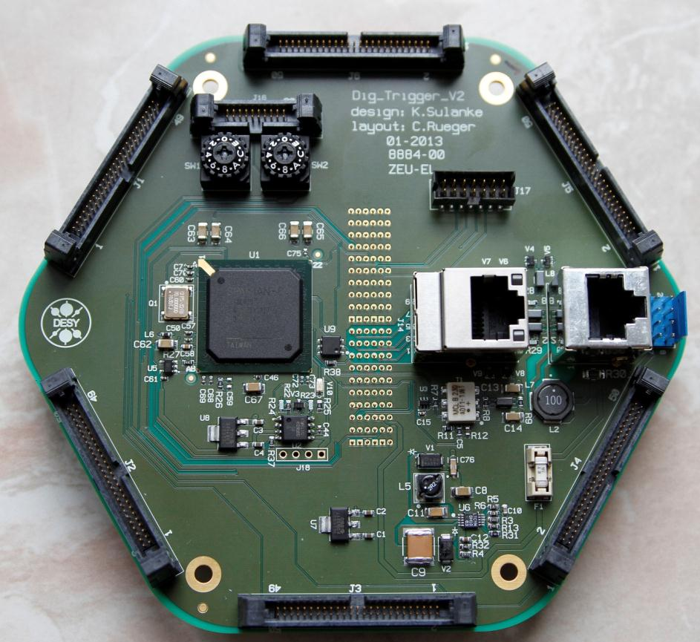
Digital Trigger Backplane, cont.
Xilinx JTAG port
FE-board
Gigabit port
Xilinx Spartan-6
FPGA
Power_in
Clock_in
PPS_in
L1_out
L2_in
64 bit
ID ROM
Local Oscillator
Temp. sensor
FE-board
24V-fuse
Atmel PROM
(Xilinx config.)
neighbor cluster connections
FE-Board connector
Local synchronous
DC-DC power supply
3/2/2015
K.-H. Sulanke, DESY
15
Notes:
15

Slide 16
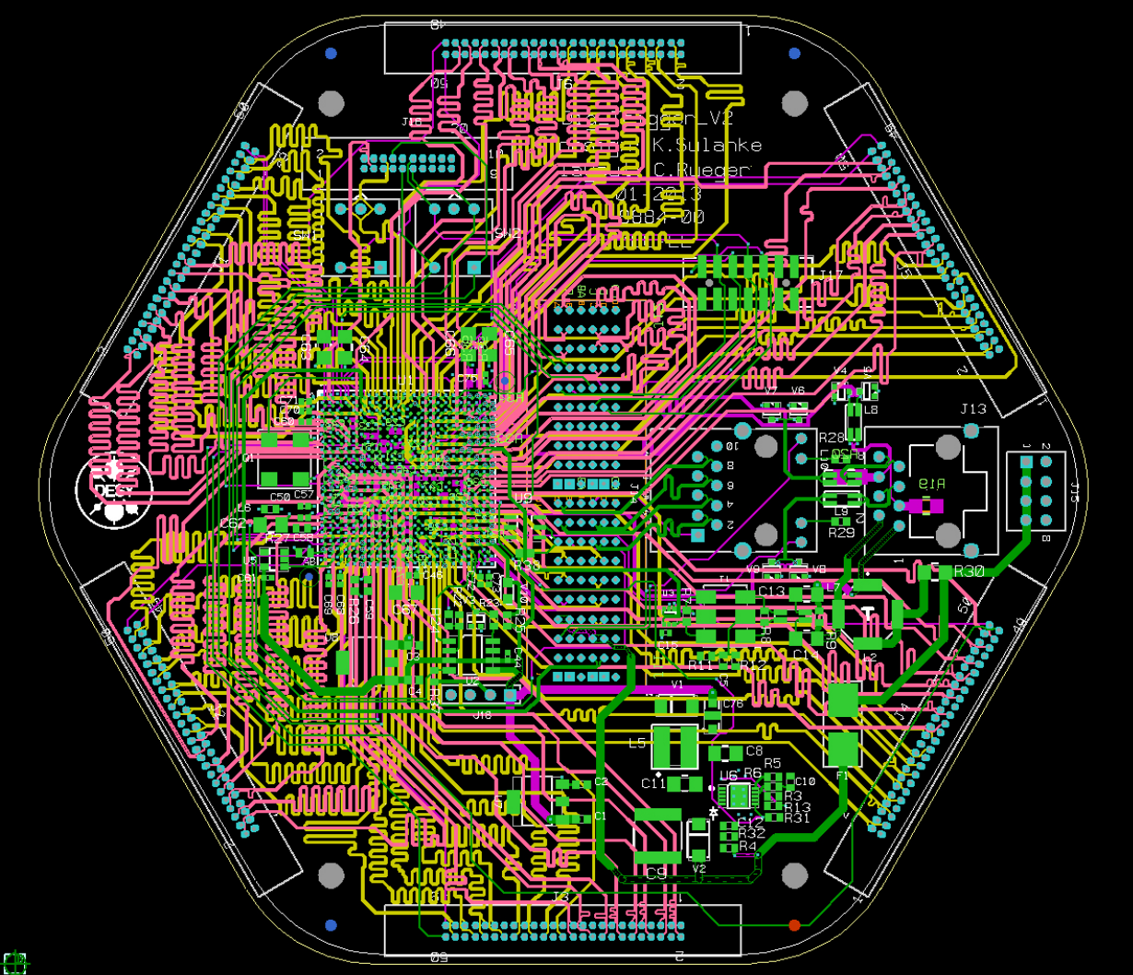
Digital Trigger Backplane, 8 Layer PCB
PCB design by
Carola Rueger DESY
3/2/2015
K.-H. Sulanke, DESY
16
Notes:
16

Slide 17
The L1-FPGA‘s Functionality
FPGA
FPGA
Xilinx Spartan 6 FPGA
FPGA
FPGA
FPGA
fanout
FPGA
to surrounding clusters
FPGA
from center cluster
L0_pix_[0][6..0]
L0*_pix_[0][4..0]
calibrate
STM
progr.
delays
from surrounding clusters
37 pixel
trigger
fabric
delay
to L2_trigger crate
L0_pix_[1][4..0]
delay
L1_trigger
delay
delay
delay
delay
L0_pix_[6][4..0]
delay
clock
PLL
3/2/2015
DESY
17

Slide 18
The L1-FPGA‘s Functionality, cont.
Xilinx Spartan 6 FPGA
clock
PLL
950 MHz
118.75 MHz
prog.
input
delay
iserdes 1:8
oserdes 8:1
L0_pix0
950 MHz
7 6 5 4 3 2 1 0
950 MHz
0 1 2 3 4 5 6 7
L1_trig
L0_pix1
118.75 MHz
7 6 5 4 3 2 1 0
trigger_logic_0
118.75 MHz
0 1 2 3 4 5 6 7
pix0_t0
pix1_t0
pix2_t0
…
trig_t0
trigger_logic_7
pix0_t7
pix1_t7
pix2_t7
…
trig_t7
L0_pix36
prog.
input
delay
7 6 5 4 3 2 1 0
950 MHz
118.75 MHz
7 6 5 4 3 2 1 0
calibrate
STM
pix36_t0
pix36_t7
3/2/2015
DESY
18

Slide 19
3NN Trigger Firmware
3NN ( 3 Next Neighbor) of 37 pixel
  about 500 possible combinations
Fully synchronous design
  local oscillator (25 Mhz) or external clock (100 MHz)
Trigger latency 120 ns
Trigger time resolution 1.05 ns (950 Mhz L0-sampling rate)
Trigger jitter +/- 1.05 ns
Firmware automatically detects missing neighbor clusters (bit masking)
3/2/2015
K.-H. Sulanke, DESY
19
Notes:
19

Slide 20
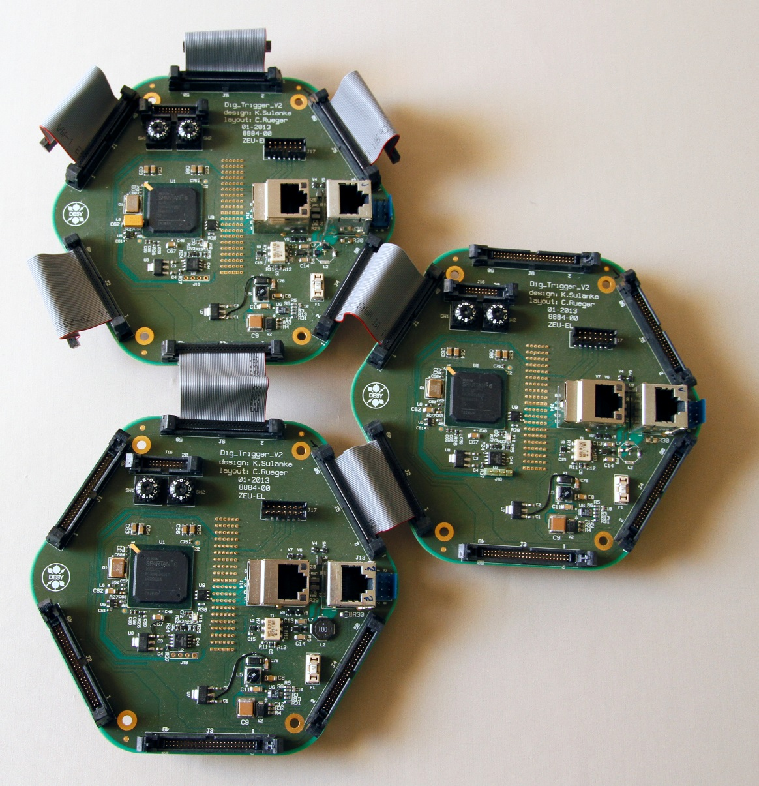
L1, Connecting the Trigger Backplanes
50 way 0.635 mm pitch cable
PCB design by
Carola Rueger DESY
3/2/2015
K.-H. Sulanke, DESY
20
Notes:
20

Slide 21
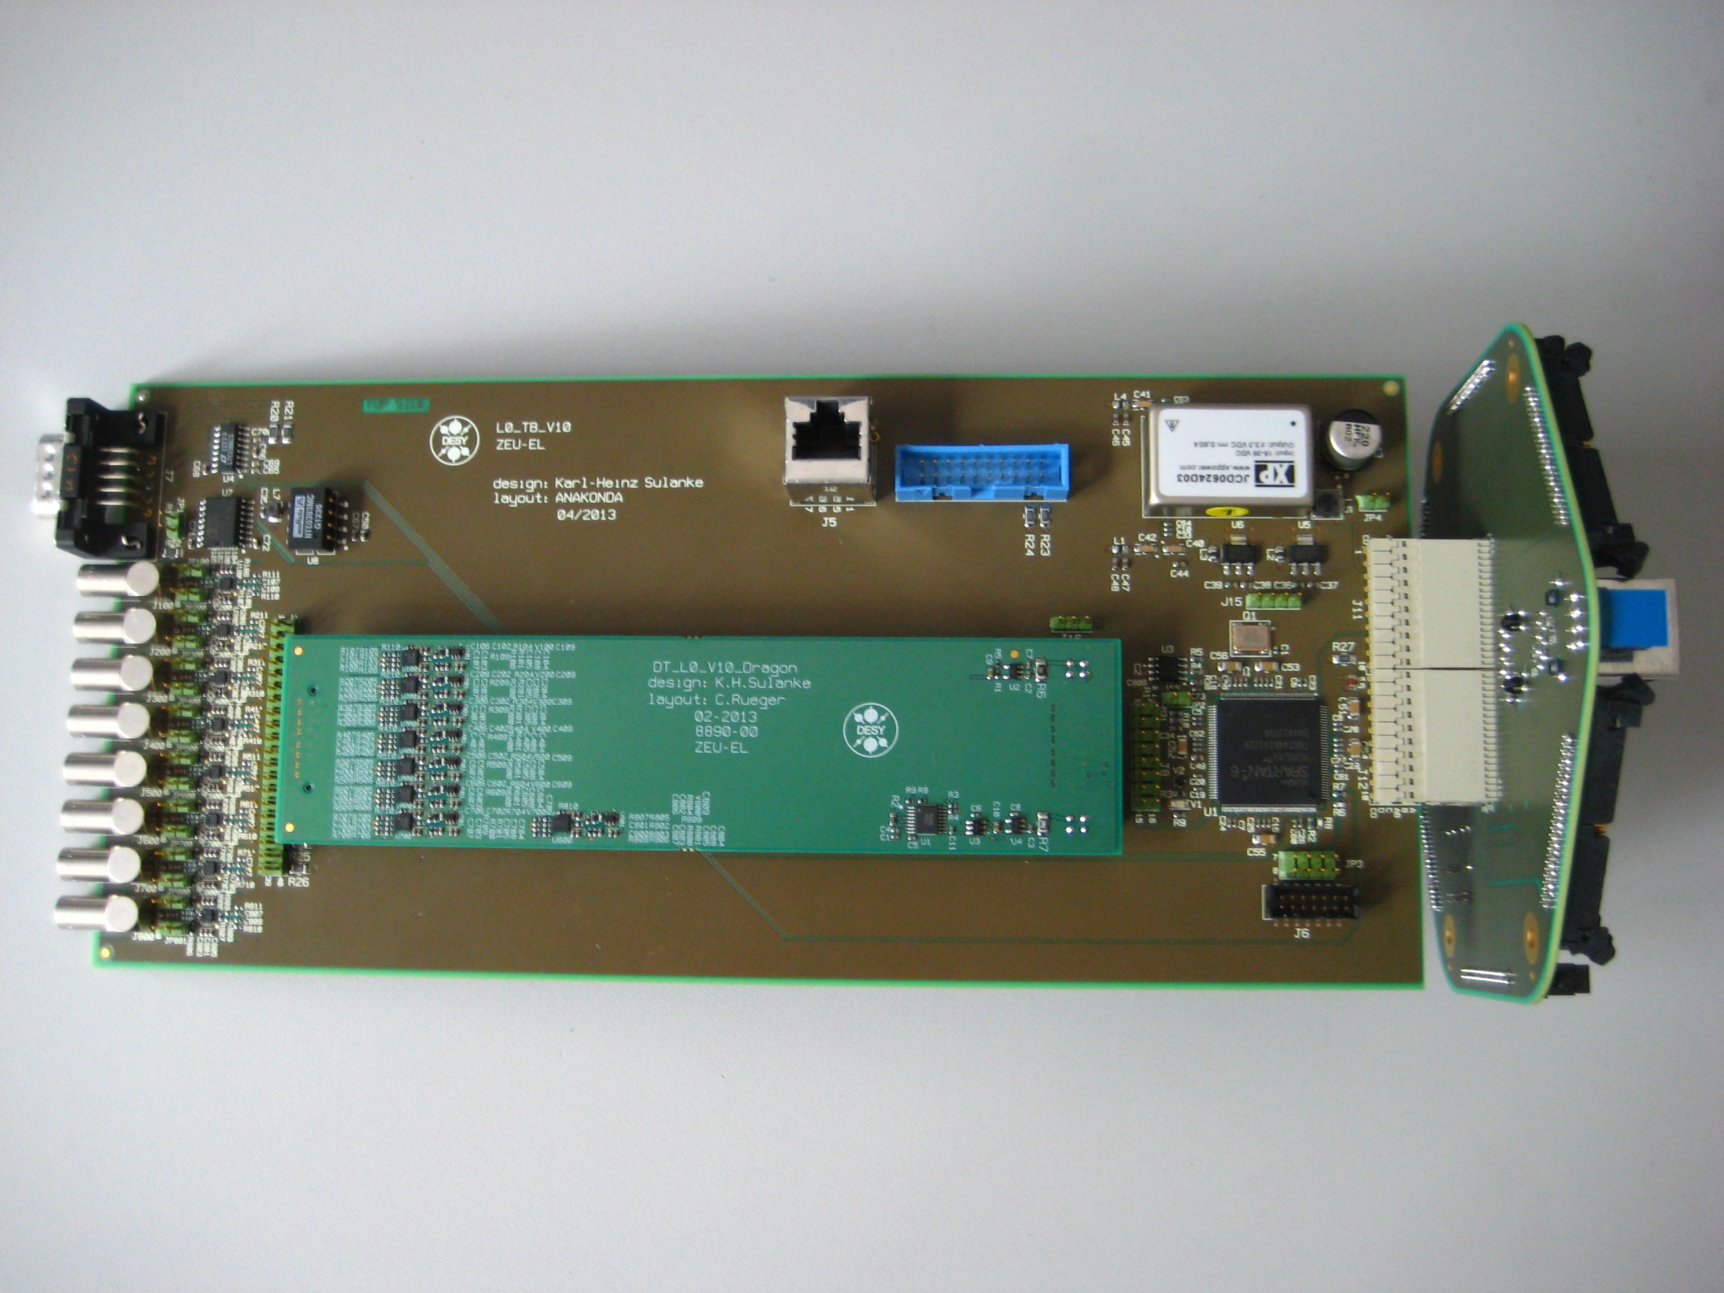
Digital Trigger Test Setup
120 mm x 260 mm, 6 Layer PCB, various analog and digital test points
L1 Trigger
Backplane
L0 Testboard
RS232 / 485 interface
L0-Mezzanine
Xilinx
Analog Inputs
3/2/2015
K.-H. Sulanke, DESY
21
Notes:
21

Slide 22
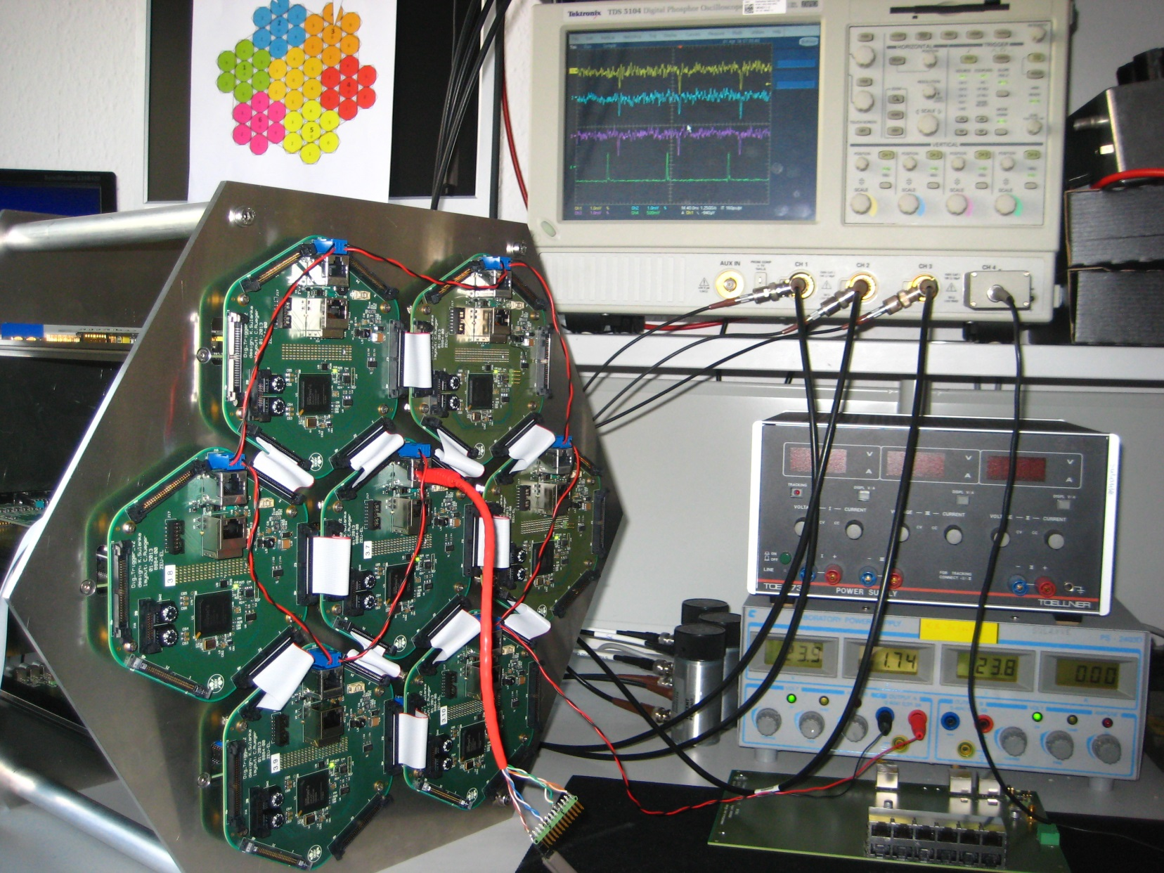
Digital Trigger Test Setup at DESY
3/2/2015
K.-H. Sulanke, DESY
22
Notes:
22

Slide 23
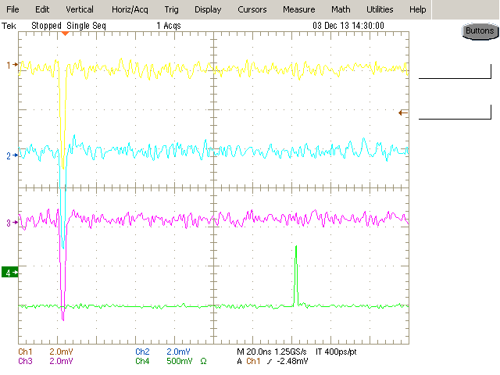
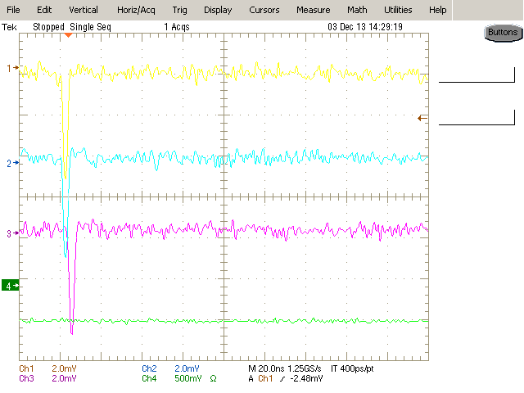
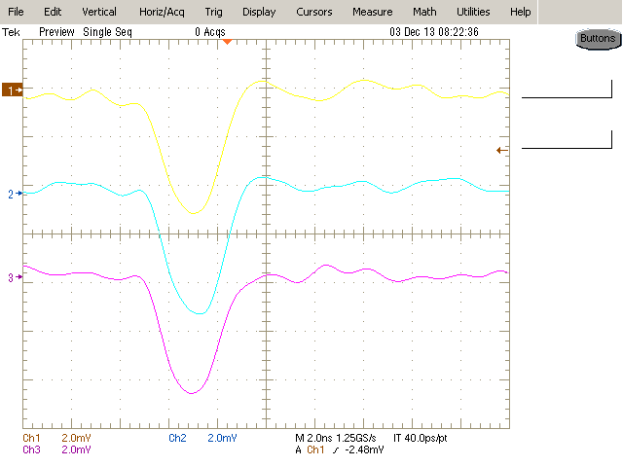
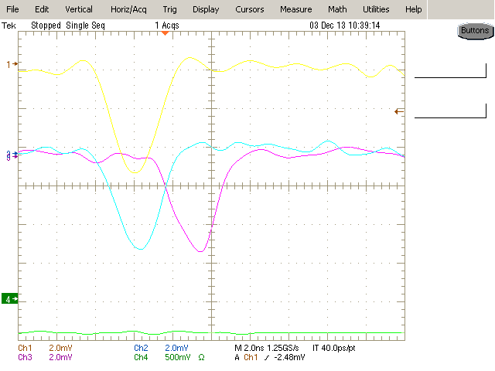
3NN Trigger Test Results
100% trigger and 0% trigger situation
5mV pk
2.5 ns FWHM
3ns shift
trigger
No trigger
Analog input signals, zoomed time scale
3/2/2015
K.-H. Sulanke, DESY
23
Notes:
23

Slide 24
L2
DTB
L0_neighbor
L2
24V
FEB
L1
CTDB
L2CB
PMT
7
L0
7
#01
Sector_trig
#01
GPS_clock
FPGA
ethernet
L1
L0_neighbor
…
…
FEB
FPGA
#18
FPGA
PMT
7
L0
7
#16
Camera_trig
FPGA
PMT = Photomultiplier Tube
FEB = Frontend Board
CTDB = Digital Trigger Backplane
CSB = Cluster Service Board
L2CB = L2 Controller Board
L2 still in the design phase
  will be a crate, ~ 50 x 20 x 20 cm, ~ 11 kg
    18 x CTDB (Clock & Trigger DistributionBoard)
    1 x L2CB (L2 Controller Board)
      Ethernet interface
      Optical / electrical camera trigger output
3/2/2015
K.-H. Sulanke, DESY
24
Notes:
24

Slide 25
The Clock & Trigger Distribution Board (CTDB)
15 x
Cat6
Cable
RJ45
RJ45
QOSC
RJ45
RJ45
CLK
PPS
Trigger
Sel_local
RJ45
PLD
RJ45
Clock
PPS
L1_T
Trigger
RJ45
Fanout
+
Repeater
RJ45
RJ45
RJ45
CLK
PPS
L1
Trigger
24V
RJ45
finger
edge
backplane
connector
RJ45
RJ45
RJ45
RJ45
vreg
Local mode, clk+pps+trigger by Altera PLD EPM3064, for test purposes
Schematic design done
Card size 160 x 233
3/2/2015
K.-H. Sulanke, DESY
25
Notes:
25

Slide 26
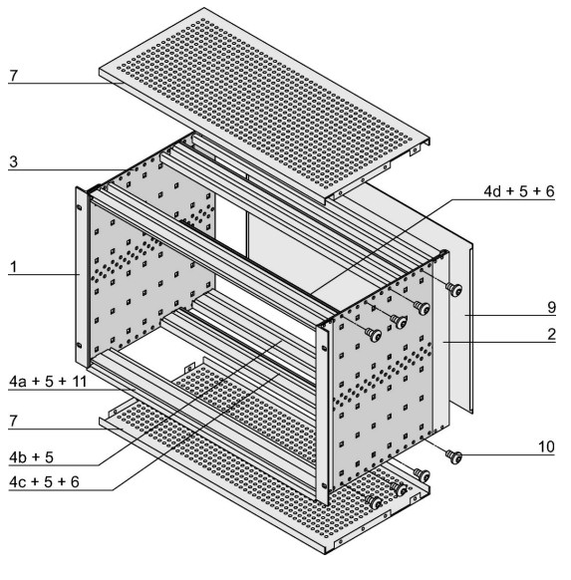
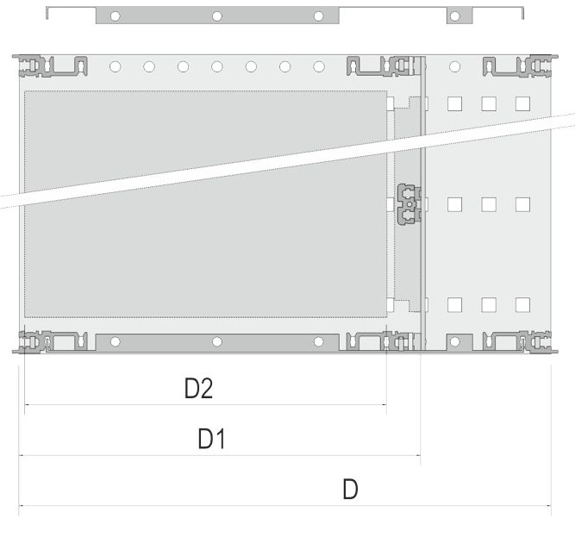
The L2-Crate
Schroff 24563-442
6 U, 84 HP (21 slots)
Card size : 233 x 160 mm
Preferred slot usage, see below
9x CTDB
L2CB
9x CTDB
D2 = 160 mm
D1 = 175 mm
D = 235 mm
3/2/2015
K.-H. Sulanke, DESY
26
Notes:
26

Slide 27
Summary
Main advantage of the digital trigger is its flexibility concerning the trigger algorithm and the simplicity of the overall scheme
The L0 stage performs very good (signals of 1mV are still detectable)
First results with the L1 stage, e.g. the 3NN trigger, are encouraging
  More sophisticated alghorithms will follow
  E.g. a time gradient trigger
The L2 stage will be designed and tested in 2015
  Intermediate solution (by Axel Kretzschmann) do exist
First camera integration tests in 2014 successful
Not yet clear who makes it finally, the analog or the digital trigger ?
3/2/2015
K.-H. Sulanke, DESY
27
Notes:
27

Slide 28
Outlook
19 cluster „Demonstrator“ test planned in Q4 2015
  NectarCam (MST, France)
    Nectar chip based (analog pipeline chip)
3/2/2015
K.-H. Sulanke, DESY
28
Notes:
28

Slide 29
Back Up Slides
3/2/2015
K.-H. Sulanke, DESY
29
Notes:
29

Slide 30
L2 Trigger Sectors, MST, Example
271 cluster shown (1897 pixel)
Each sector comprises 14..16 clusters and is connected to a certain CTDB board (L2 crate)
3/2/2015
K.-H. Sulanke, DESY
30
Notes:
30

Slide 31
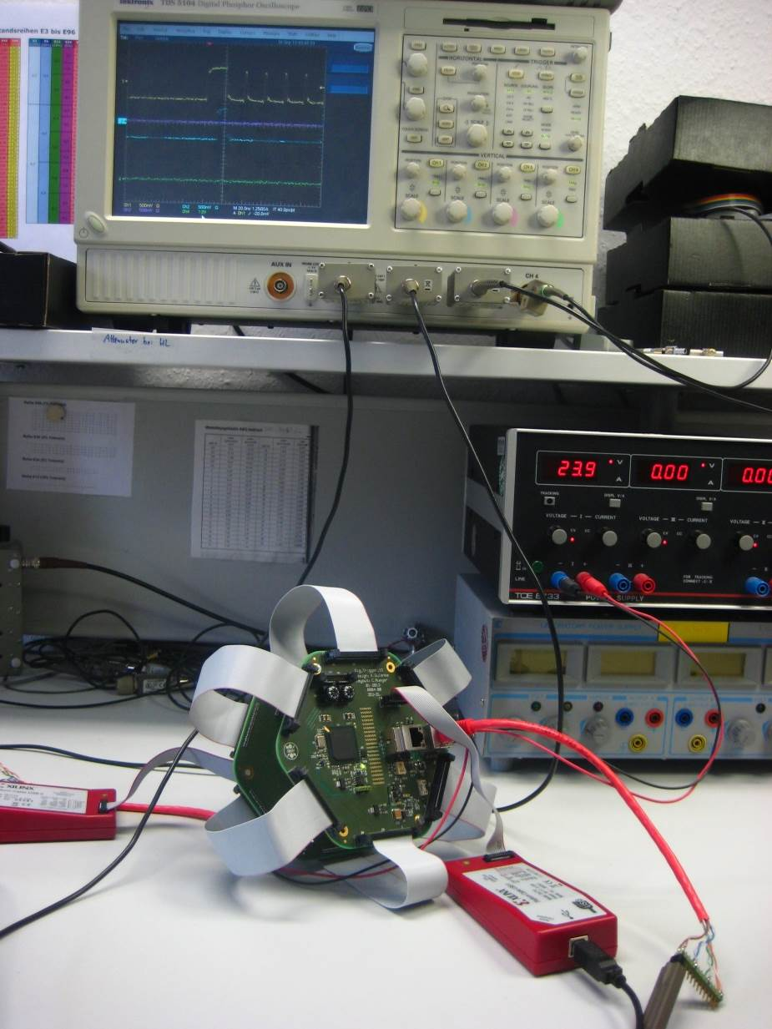
Test Setup w. Pattern Generator
expected
and
real trigger
DTB used as pattern generator board
e.g. for 3NN pattern
time resolution is 1.05 ns
trigger
board
pattern generator board
3/2/2015
K.-H. Sulanke, DESY
31
Notes:
31

Slide 32
Digital Trigger Test Board
Testing the L0 boards AND the FE-board interface of the Dig. Trigger Backplane
Xilinx with RS232 / RS485 interface, to set the discriminator thresholds etc.
Dig.Trigger-Bpl.
L0-Testboard
6x5 L0
by surr.
clusters
Single ended
to diff.
Digital L0 Mezzanine
PMT
or
Pulse-Gen.
Comp
FPGA
7
Opamp
Opamp
L0
LVDS
FPGA
DAC
RS 232
RS 485
FE-board
interface
3/2/2015
K.-H. Sulanke, DESY
32
Notes:
32

Slide 33
Digital Trigger Backplane, List of Key Hardware Features
Nominal power consumption: 1.5 W
Weight : 95 g + 10 g cabling to neighbor clusters -> 28 kg for MST
Automatic neighbor cluster recognition (border zone)
Synchronous DC-DC converter (24 V to 3.0 V …)
Local clock and external clock input (any diff. > 0.1V pk-pk)
FPGA load by JTAG cable or PROM or remote (by FE board)
6 x bidirectional L0 signal connection with neighbor cluster
Temperature sensor (allows automatic delay correction, if needed)
adjustable 8 bit cluster position ID (for unique, position-independant, firmware)
Gigabit ethernet pass through connection to FE-board
RJ 45 connector as combined power and clock input (single cat5e cable)

Slide 34
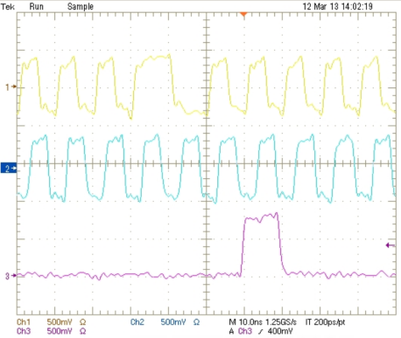
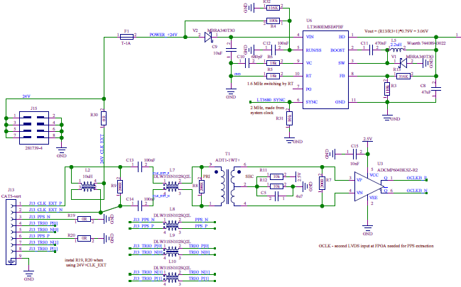
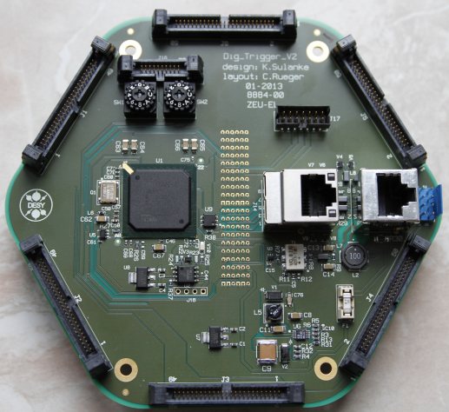
Combined Power and Clock Input
24V, clock, and PPS over a single wire pair
requires a single cat5e cable per cluster only (+ gigabit ethernet cable)
Current spikes of 0.8 A did not influence the (recovered) clock quality
Cat5e - Wire Pair | Standard mode | Combined mode
1 | Clock_in | Clock_in / PPS_in / 24V
2 | PPS_in | GND
3 | Trig_L1_out | Trig_L1_out
4 | Trig_L2_in | Trig_L2_in
Ext_Clock_PPS
Clock_recovered
PPS_recovered
24V
Alternative
Power conn.
Combined
Power and
Clock input
Clock+pps
FE-board
Gigabit port
3/2/2015
K.-H. Sulanke, DESY
34
Notes:
34

Slide 35
M12 Cat6 , Combined Power / Clock Input
Instead of RJ45, more robust
by Harting, Molex, ...
To be replaced by M12
3/2/2015
K.-H. Sulanke, DESY
35
Notes:
35

Slide 36

7-PMT-Cluster “DragonCam”

Slide 37
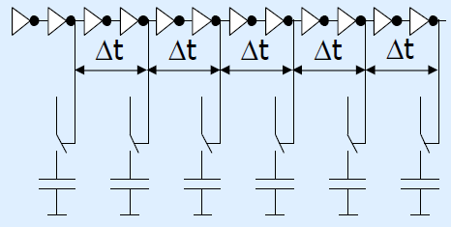
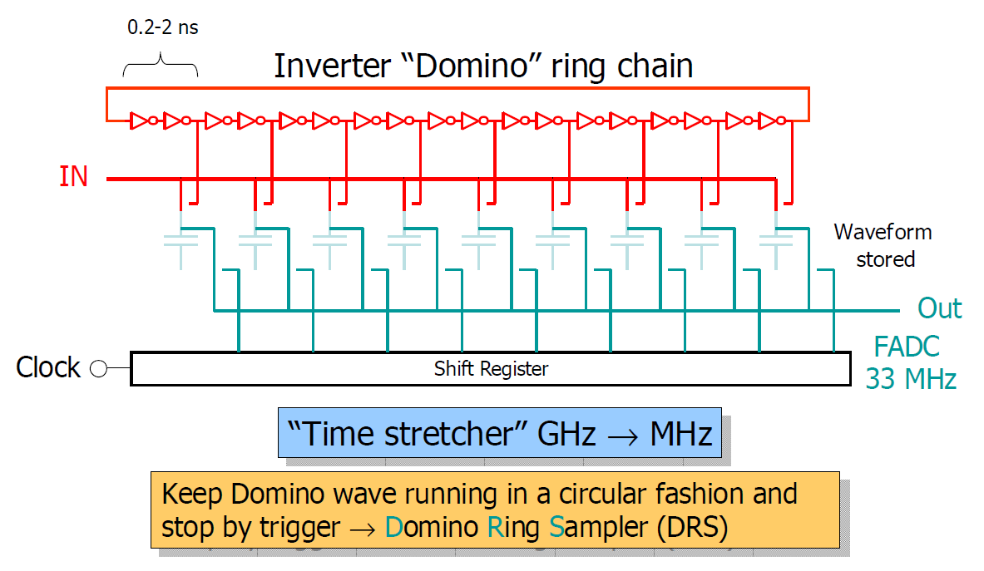
Analog Pipeline Chip
500 MHz ... 5 GHz sampling rate

