Slide 1
MTCA.4 Based Local Oscillator and Clock Generation Module for the European XFEL.
Uroš Mavrič on Behalf of the MSK Group / DESY and ISE / Technical University Warsaw,
Tony Rohlev (TSR Engineering)
DESY, Zeuthen, 03.03.2015

Slide 2
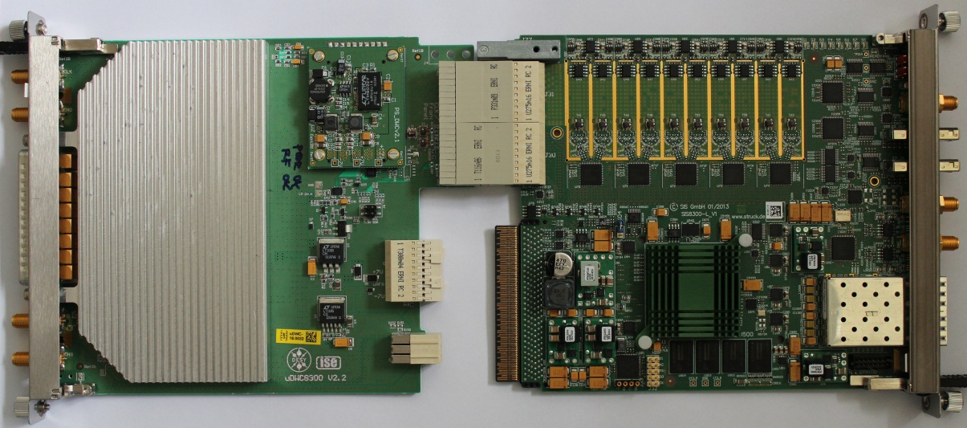
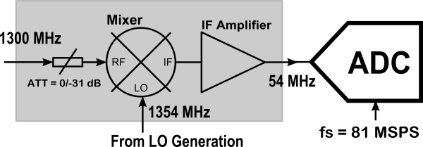
Motivation.
The RF field detection scheme for the XFEL low-level RF system uses the down-conversion of 1.3 GHz pulsed RF. The frequency translation is performed through a mixer which mixes the LO (1.354 GHz) and the RF (1.3 GHz) down to IF (54 MHz).
The IF (54 MHz) is sampled in a fast ADC with Fs = 81.25 MHZ.
RF
IF
Front-panel
LO
RF Backplane
25 RF stations
50 MTCA.4 Crates (master and slave)
9 LO and 9 CLK tap points per crate
450 LO tap-points and 450 CLK tap points

Slide 3
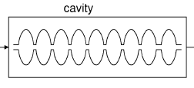
Specifications for LO and CLK Signals.
Specs for additive noise are derived from the noise contributions of other subsystems (RF front –end and ADC).
2 fs (1 mdeg at 1.3 GHz ) [10 Hz - 10 MHz]
Long term stability
0.2 ps_pp [forever – 10Hz]
Isolation on all ports
< -80 dBc
CLK additive noise
< -160 dBc/Hz floor for white noise
LO Output : 1 W at 1.354 GHz
Single Channel Receiver
AM
Front-End <-150dBc/Hz
ADC+ DDC -147dBc/Hz
BPF
DDC
CIC Filter
Calibration
LNA
ADC
Reference
CLK
Intermediate frequency [10MHz, 50MHz]:
PM
-150dBc/Hz
LO and CLK Generation
-150dBc/Hz – 10log10(8) = -160dBc/Hz
Mixer:
Vector sum processing gain
LO:

Slide 4
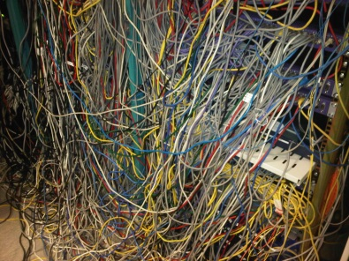
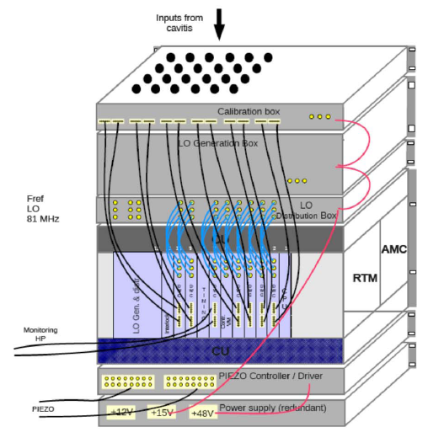
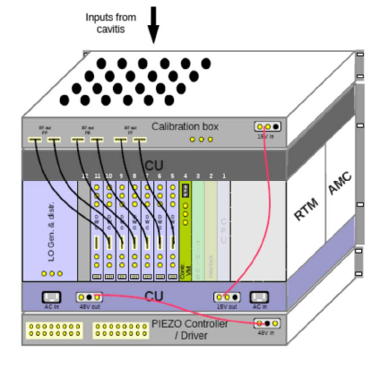
Cable vs. Backplane LO and CLK Distribution.
Introduction of the new concept of integrating the LO and CLK distribution into the MTCA.4 crate.
External LO and CLK modules allow for better performance of the generated signals.
Better Temperature and humidity control of the distribution system (cables).
No external cables needed
Compact system
Ext. LO and CLK
Integrated LO and CLK
generation

Slide 5
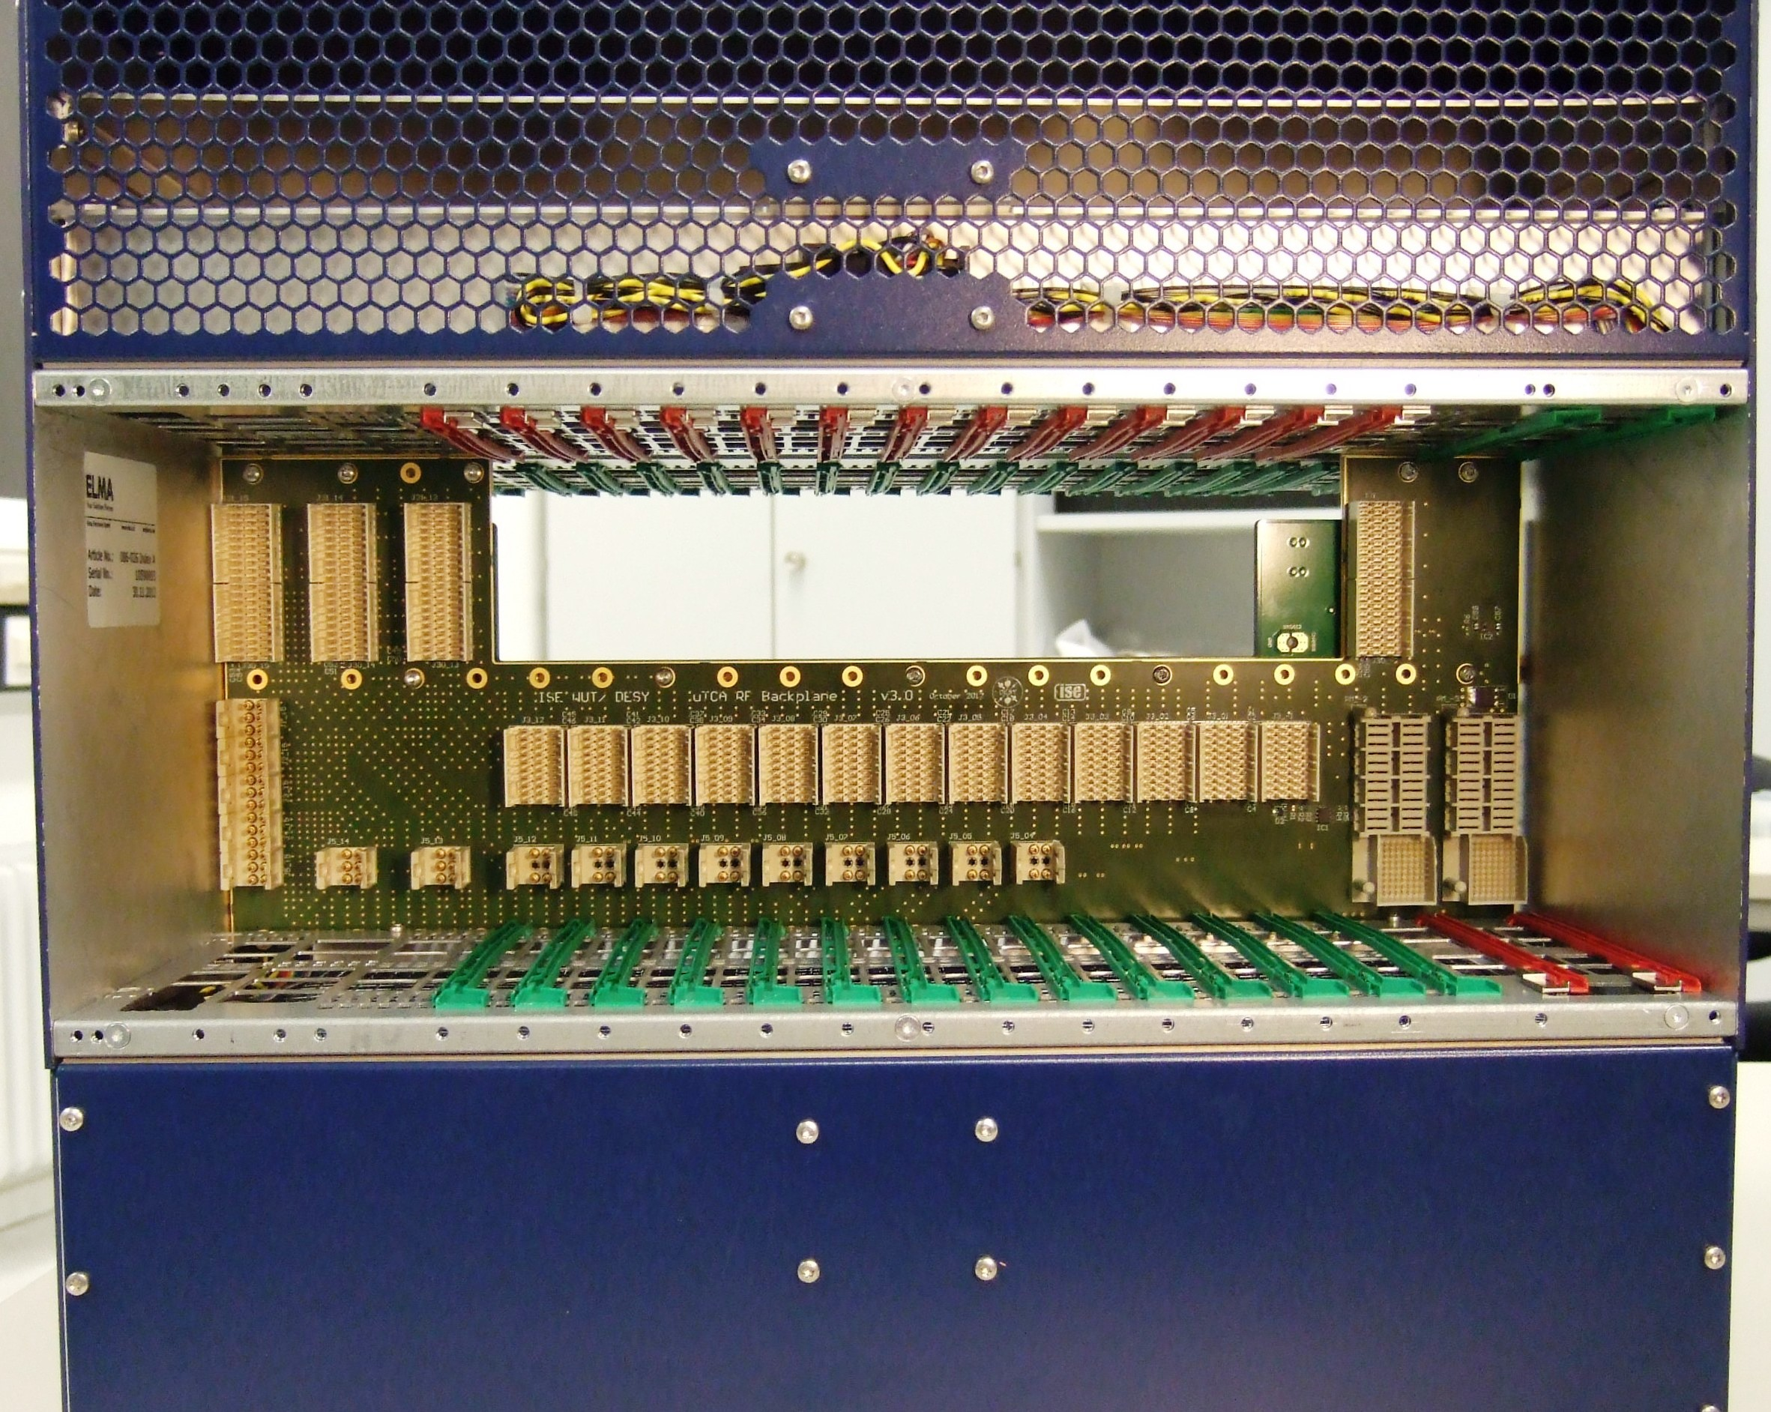
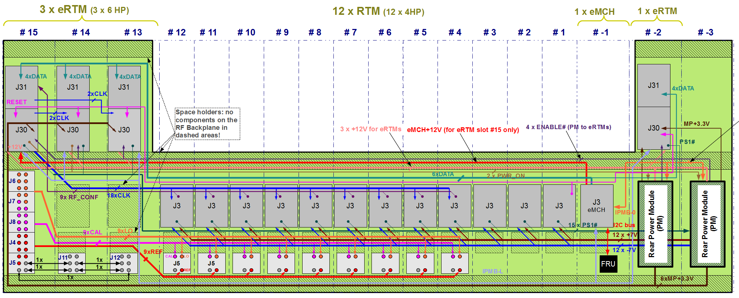
uRF-Backplane.
The uRF-backplane is used for the distribution of the LO, CLK and calibration signals.
The uRF-Backplane includes also other comm. signals such as I2C to modules, power lines, dedicated LVDS conn. etc.
From the point of view of MTCA.4 management it can be treated as an extension of the front AMC backplane.
It can accept 2 power modules that comply with MTCA.4 power specifications.
It can accept 4 eRTM modules.
DRTM-LOG1300 is an eRTM sitting in slot 15 in the rear.

Slide 6
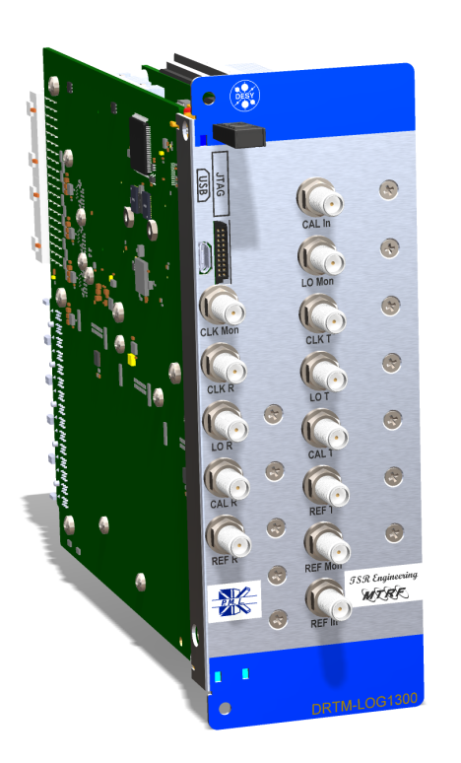
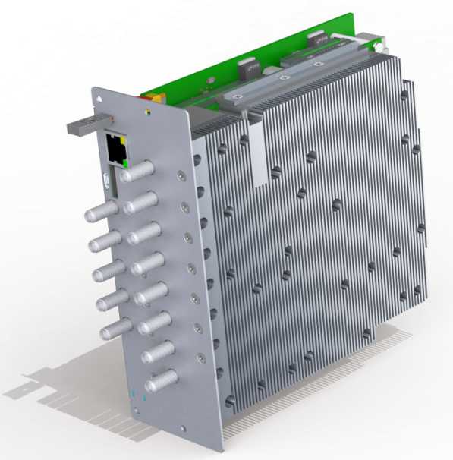
DeRTM-LOG1300.
Double-width, double full-size (12HP) module
Composed of several sub-modules
RF daughter card
Carrier mezz. + RF distribution mezz.
DC/DC mezz.
TEC mezz.

Slide 7
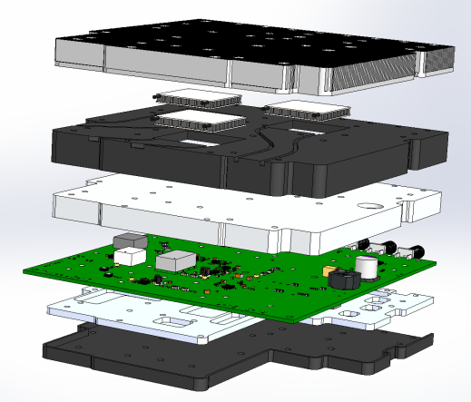
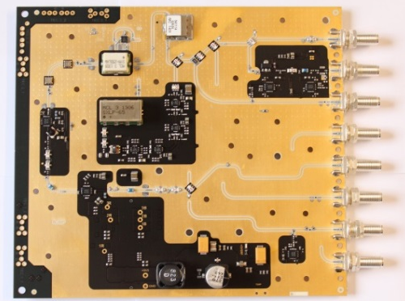
DeRTM-LOG1300 - RF.
Need to use small surface mount components because of compactness -> performance is deteriorated.
LO generated from REF via dividers
Features:
Variable LO output power by -3dB
High resolution temperature sensor (24 bit ADC with NTC Thermistor)
Dividers in the range from 1 to 64
2 variants (IF=54 MHz, IF=36 MHz) – assembly defined
Can cover RF/LO frequency range from 720 MHz To 3 GHz – assembly variant
3 Peltier modules for temperature regulation
All voltages on all chips are monitored
Heat-sink
Peltier Modules
Insulation - Top
RF Shield - Top
PCB
RF Shield - Bottom
Insulation - Bottom

Slide 8
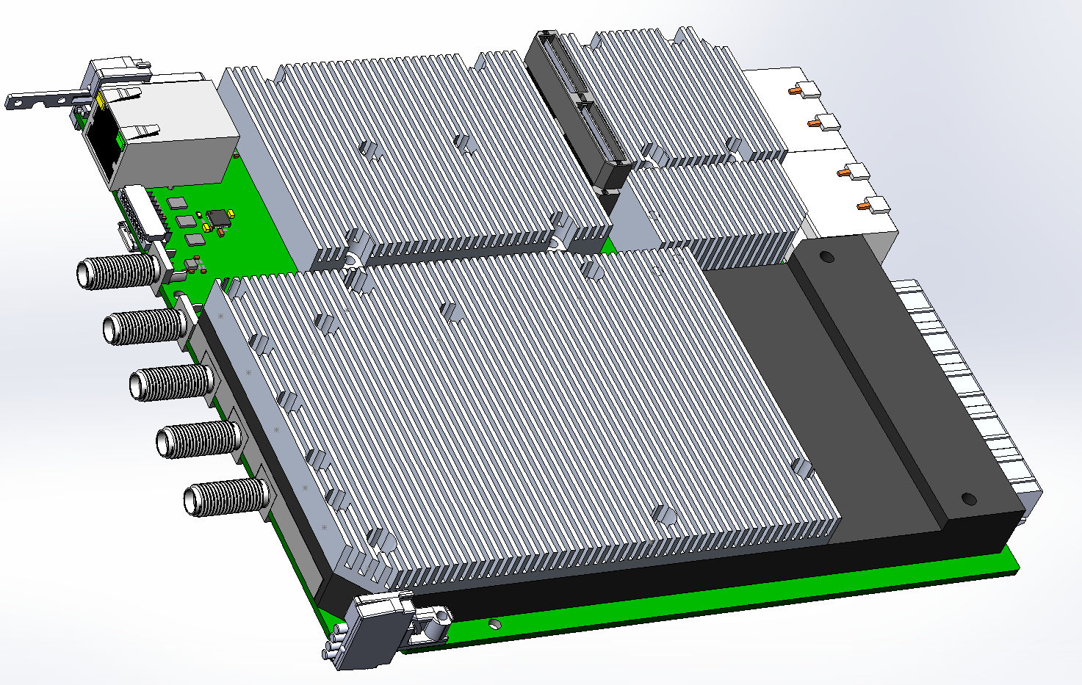
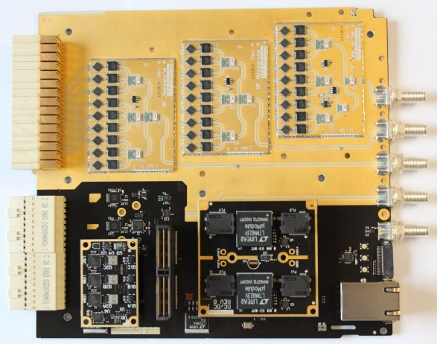
DeRTM-LOG1300 - Carrier.
Module that splits the RF, CLK signals and interconnects to the uRF-backplane.
Features:
9 x LO/REF/Pilot outputs on Radiall connectors
22 Diff. LVPECL CLK outputs on ERNI connectors
Switching OFF/ON each individual CLK, LO, REF and Pilot Output
Monitoring of the main voltages and currents
Temperature and humidity measurements
MMC 1.0 compliant
Application microcontroller
Connectivity to the ext. world
Heat-sink
Insulation - Top
PCB

Slide 9
Other Mezzanine Modules.
DC/DC power converter mezzanine
+12V into +5.9V and +5.4 V
RF splitting mezzanines
For splitting the REF, LO and calibration signal
Temperature controller mezzanine
Integrated 3 temperature controllers
DC/DC Converters
Temperature Controllers
9 x RF Outputs
RF Input
RF switches

Slide 10
Res. Phase Noise Analysis.
2 DUT measurements of residual phase noise of individual subsystems.
Test setup 1.3 fs [10 Hz – 10 MHz]
Main limitations:
Dividers – 3.2 fs
Pre-amp – 3.4 fs
Overall system res. jitter = 4.3 fs (2.7 fs with de-embedded setup)
[10 Hz – 10 MHz]
1.3 fs [10 Hz-10 MHz]
Overall Res. Phase Noise
4.3 fs [10 Hz-10 MHz]
Other spurs:
54 MHz - unshielded setup
1 kHz - unknown
Other spurs come from the test setup
3.2 fs [10 Hz-10 MHz]
3.4 fs [10 Hz-10 MHz]

Slide 11
Measurements I.
Return Loss
RF daughter board:
Isolation between channels
Return loss at connector
Harmonic content in output signals
Output power
The RF daughter card consumes 11 W
Reflection at [GHz]: | S11 [dB] – Measured-Shield
Ref In (1.3) | -24
Ref Aux Out (1.3) | -27
Ref Out (1.3) | -26
Cal Out (1.3) | -29
LO Out (1.354) | -26
CLK Out (1.3) | -23
LO Mon Out (1.354) | -32
CAL In (1.3) | -29
Output Power
Isolation between Ch.
Power out | Power [dBm] - Expected | Power [dBm] - Measured
Ref Aux Out (1.3) | 26.2 | 25.8
Ref Out (1.3) | 13 | 14.7
LO Out (1.354) | 31.0 | 30.2
CLK Out (1.3) | 9.2 | 10.0
LO Mon Out (1.354) | 14 | 16.5
Power out | Shielded [dBc]
Ref Aux Out (1.3) | < -80
Ref Out (1.3) | < -80
LO Out (1.354) | < -80
CLK Out (1.3) | < -80
LO Mon Out (1.354) | < -80
Pilot | < -80
Harmonic Content
Power out | 2nd [dBc] | 3rd [dBc]
Ref Aux Out (1.3) | <-80 | <-80
LO Out (1.354) | <-80 | <-80
CLK Out (1.3) | <-80 | <-80
REF (1.3) | <-80 | <-80

Slide 12
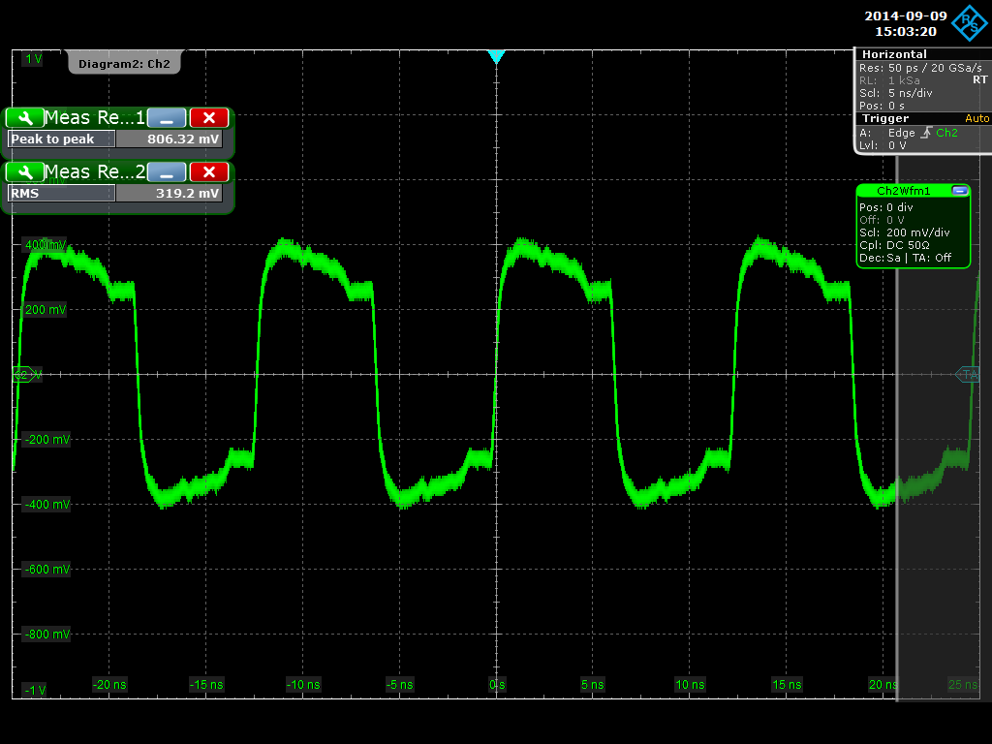
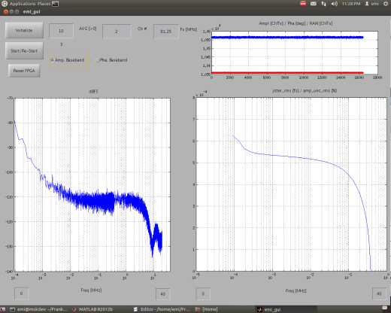
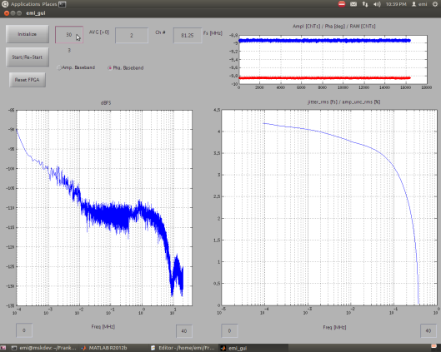
Measurements II.
S parameters of the splitting section:
S21 = LO -16 dB (spread = 0.4 dB), CAL -16 dB (spread = 0.5 dB)
S11 = < -22 dB
Isolation = mostly < -80 dB, some specific channels -65 dB
LO and CLK Distribution over the uRF-Backplane:
CLK distributed over the RF backplane
to slot 4 (long. distance).
Sampling of signals with CLKs that were distributed over the uRF-backplane. No additional spurs were visible.
Amp
Pha

Slide 13
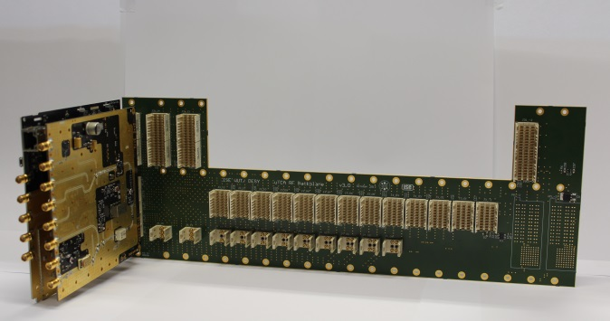
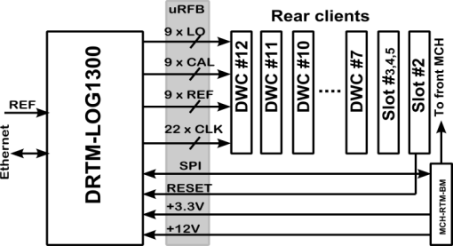
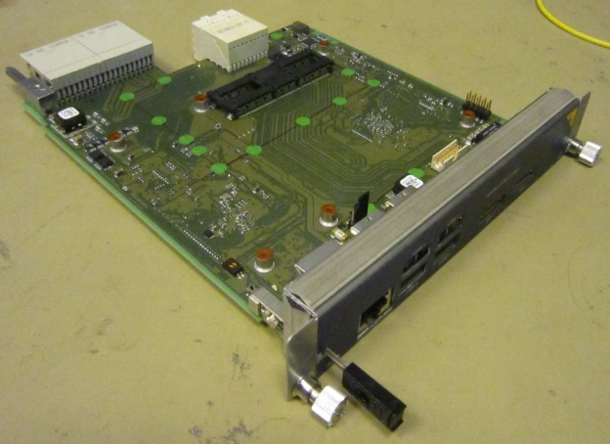
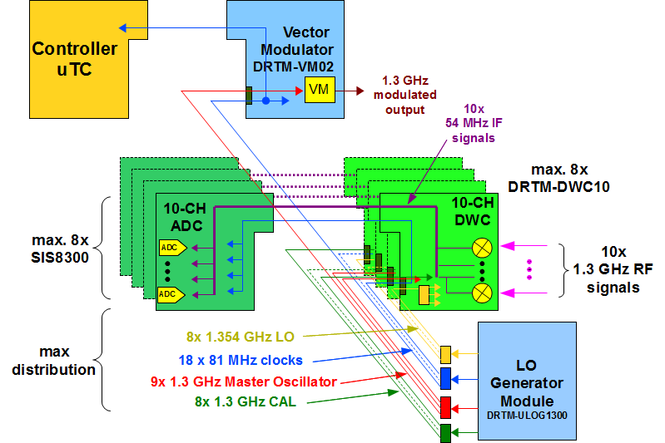
System Integration.
Subsystems Involved:
DRTM-LOG1300
uRF-Backplane
9U Chassis
NAT-MCH-BM or Rear Power module
End-Users (RTMs)

Slide 14
Thank you for your attention!

