Slide 1
Status of test kit
J. Dopke, T. Huffman, J. J. John

Slide 2
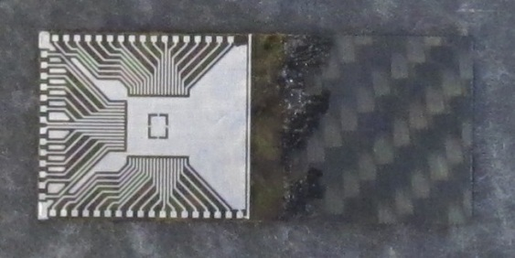
HVStripV1 daughterboards
Besides the initial 4 bonded daughterboards, we have in hand for bonding at RAL:
12 chips
20+ Al daughterboards
20 Cu/FR4 daughterboards with gold-plated pads
Jens will shortly organise more bonding

Slide 3
HVStripV1 motherboards
Ordered today, 30 September
See expected schedule on next slide.
See board overview after that.
Reviewed last week. Thank you all for your timely inputs.
All review recommendation implemented:
Board now 100 x 100mm to suit test beam equipment used by Pixels
Added 0.1” header probe points on LVDS clock pairs and LVDS data out pairs (every signal and bias has probe points now)
Added electrolytic capacitor for -60V
Added capacitors on LVDS-to-CMOS converter
as recommended by Ivan

Slide 4
Motherboard – expected schedule
Date | Task
30 Sept | Final quote received; order entered into RCUK Shared Service Centre
1 Oct | Day 1 for PCB manufacturer (of 5 working days) Order components in parallel
7 Oct | Boards should be complete at manufacturer (Day 5)
8 Oct | Boards should arrive in Oxford Write users’ guide to motherboard in parallel
9-10 Oct | Assembly in Oxford of first few boards
13 Oct | Meet with Matt and Peter P. for initial DAQ debugging – probably at Oxford Assembly continues in parallel
14 Oct (TBC) | Meet with Marcel, Kestutis and others for initial testing – at RAL

Slide 5
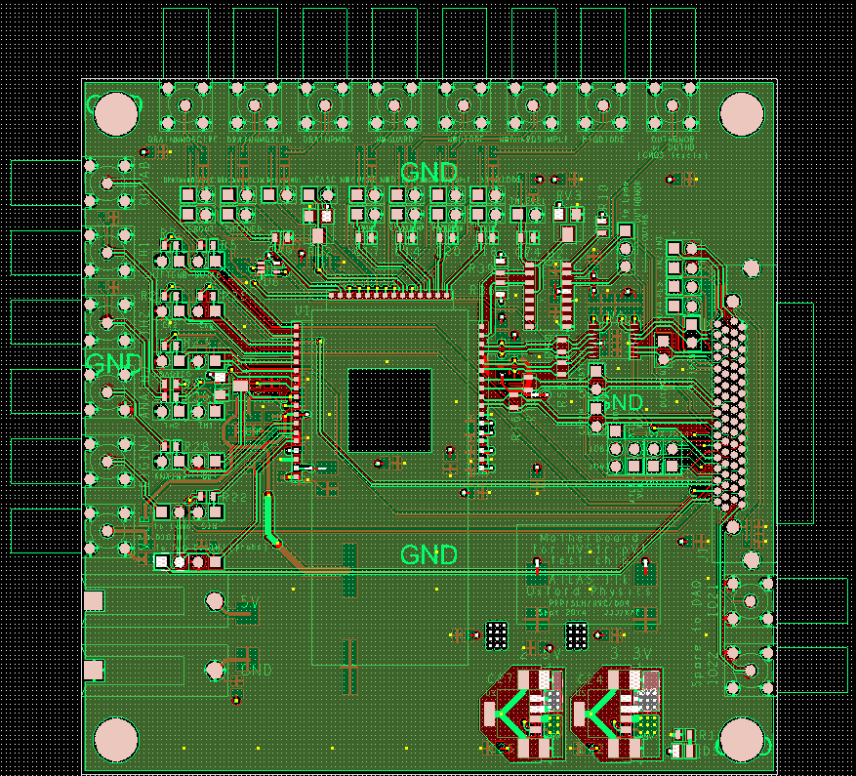
Motherboard overview
Lemos for analogue measurements
0.1” headers for probing
“VHDCI”
Connector to Atlys DAQ
- Serial data in
- LVDS clocks in
- LVDS data out
- HitBus out
more
Lemos
12x12mm
cutout
-60V in
daughterboard
Lemos, spare signals to/from DAQ
5V in
2.5V and 3.3V regulators, power LED

Slide 6
Assembly input needed
Could the groups who would like an HVStripV1 motherboard please let us know:
Would you like to first test it only using the 0.1” headers for probing, or will you initially use Lemo connectors?
This determines whether we install the 0Ω resistors which connect through to the Lemos, in the first instance.

Slide 7
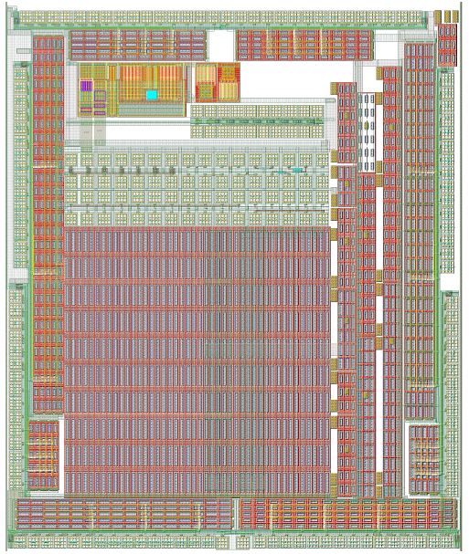
Towards HV CHESS test boards
We are now defining what test boards are needed for the first HV CHESS test chip – certainly a daughterboard, probably a motherboard?
First step = design daughterboard
Currently Hervé is working on the needed specifications and pad details for the daughterboard, thank you.
See next slides for initial thoughts on how different parts of the chip will be tested

Slide 8
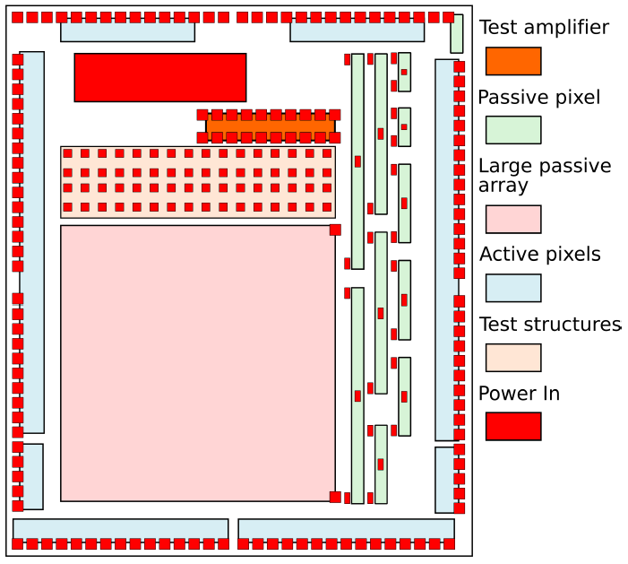
Reminder - HV CHESS overview
(from the CHESS spec v0.8)

Slide 9
HV CHESS – initial test thoughts
Device | How to test – this is for review by group
Test structures – array of R, C and transistors | Test using the existing CERN probe card
Passive pixels | “will be probed without need for wire bonding” (CHESS spec) However the passive TCT structure in the upper right corner should probably be bonded out to the daughterboard We have many questions about how to design the test boards so that edge TCT (charge injection by laser) is possible.
Test amplifiers | Bond out to daughterboard
Active pixels | Bond out to daughterboard Probably we will also want a motherboard with power/bias and Lemo connectors, as we are doing for the HVStripV1? This is what we’d like to discuss.
Power pads | Bond out to daughterboard. Pads are not at edge of chip.

