Slide 1
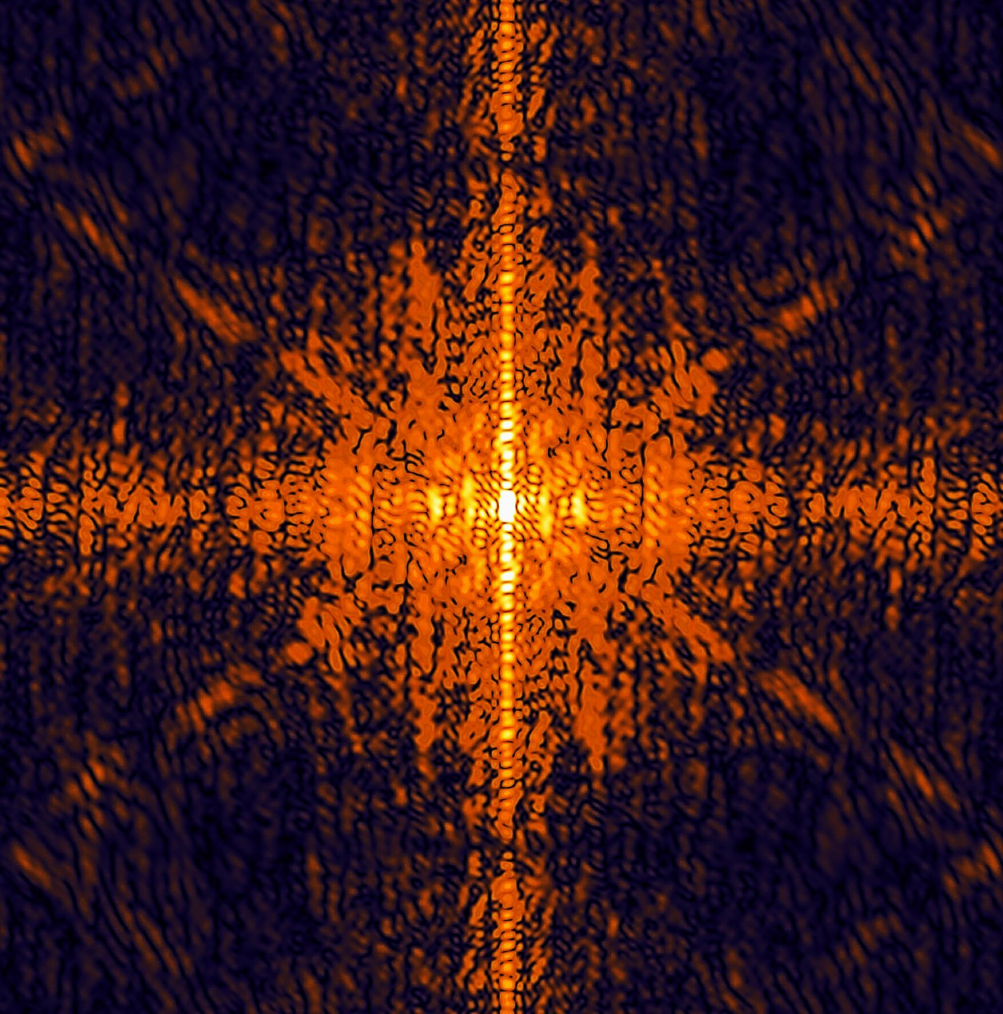
Calibration Infrastructure and
Calibration Working Group
Jola Sztuk-Dambietz (XFEL)
on behalf of
the European XFEL Calibration Group
December, 9th 2014
17th Meeting of the XFEL Detector Advisory Committee
European XFEL GmbH, Hamburg
Notes:
How to edit the title slide
Upper area: Title of your talk, max. 2 rows of the defined size (55 pt)
Lower area (subtitle): Conference/meeting/workshop, location, date,
your name and affiliation,
max. 4 rows of the defined size (32 pt)
Change the partner logos or add others in the last row.

Slide 2
Outline
Introduction
Infrastructure for detector calibration and tests at the XFEL – status and plans
    Little Amber (Ambient X-ray Test Setup for Small Prototype Detectors)
    Pheobe (Fe-55 Multi-Purpose Vacuum Test Setup)
    Big Amber (Ambient X-ray Test Setup for 1/4 Mpx detectors)
    PulXar (Pulsed Multi-Target X-ray Test Setup) and PANTER
    Reference SDD detector
Calibration schedule and plan - status
Summary

Slide 3
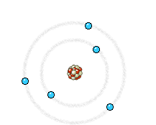

Status of Laboratory
Calibration Infrastructure

Slide 4
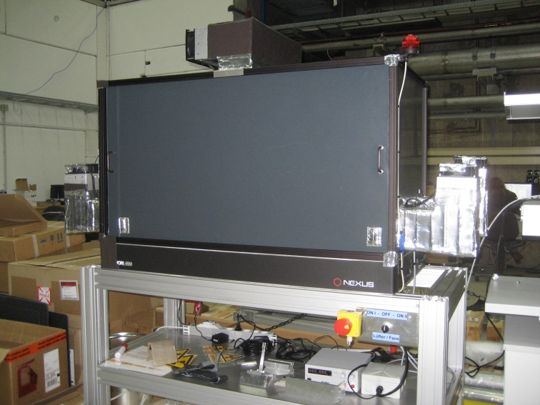
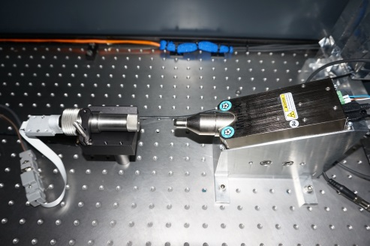
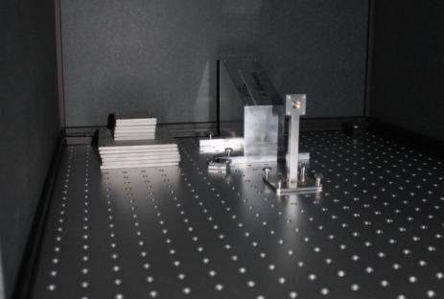
Portable Detector X-ray Test Stand – Little Amber
Movable ambient test stand for calibration and test of detector prototypes
Housing (3mm SS+ 1.5 mm Pb) was designed to be compliant to different types of X-ray source (rad. isotopes, portable low power X-ray tubes)
Little Amber
Mini-X -Amptek
X-ray sources:
Fe-55 (A = 1,85 GBq)
Low power X-ray tubes: Amptek Mini-X with Au and Rh targets (I< 80 μA, V< 50kV)
Source holder (Fe-55)

Slide 5
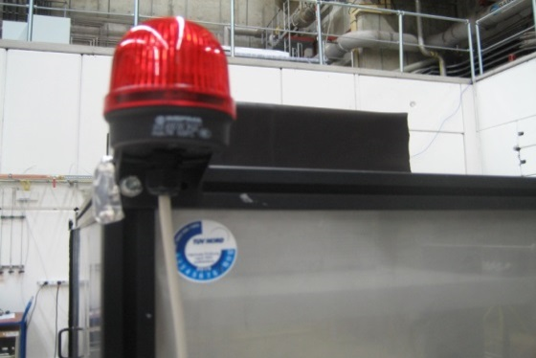
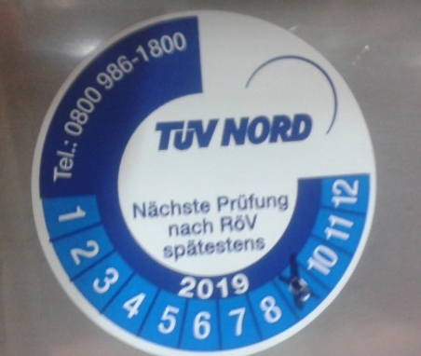
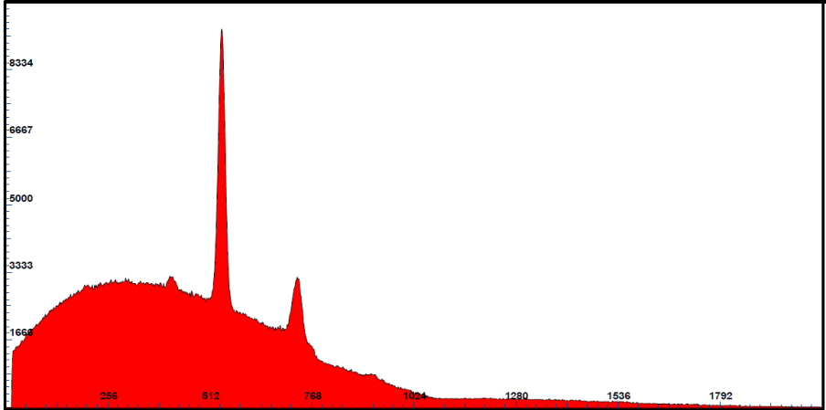
Portable ambient X-ray Setup - Little Amber
Status since the last XDAC:
Ventilators and interlocks installed
Approved by TÜV in September and HH authority in November for operation with low power X-ray tubes - Mini-X with Au and Rh target
Mini-X
SDD
Next Steps:
Temperature sensors to be
installed
X-ray spectrum of Mini-X (Amptek)
with SDD detector
Counts
Measurement conditions
Mini-X with Au target
Tube kV=15kV and
I = 50 µA
ADU

Slide 6
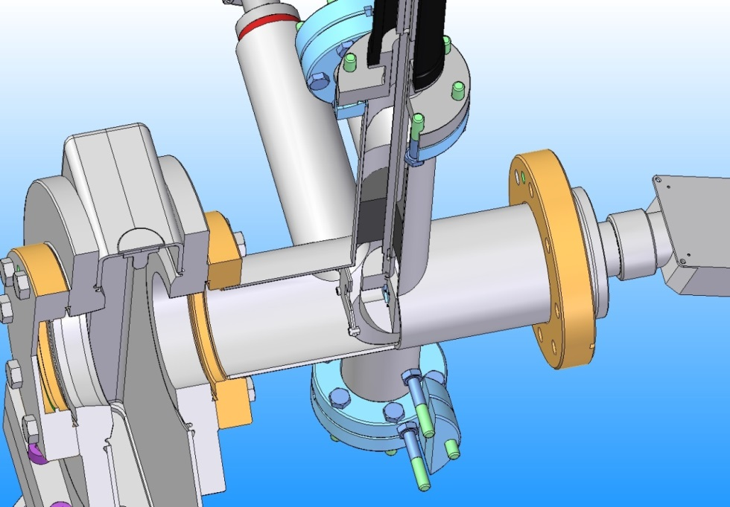
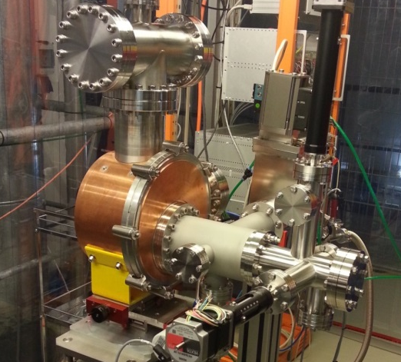
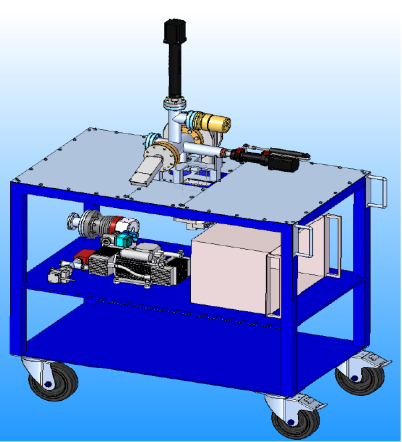
Vacuum compatible X-ray setup PHEOBE
Modular flexible device for multi-purpose usage (filters, pin-holes, collimator, etc..) with independent pumping system → can be separated from the tested detector via shutter
Manipulator
Source
chamber
Gate Valve
Mini-X
X-ray sources:
Fe-55 (A = 1,85 GBq)
Low power X-ray tubes: Amptek Mini-X with Au target (I< 80 μA, V< 15kV)
Filter holder
Source holder

Slide 7
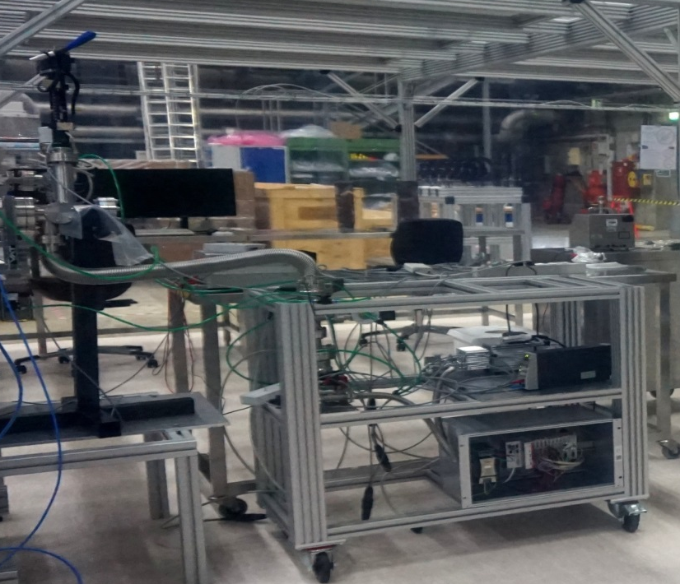
Vacuum compatible X-ray setup - PHEOBE
Status since the last XDAC:
Operational with radioactive source (Fe-55)
First measurements with pnCCD
Cart assembled
PLC: Firmware for control of valves, pumps and manipulators installed
Pheobe with Fe-55
Cart with pumps
and PLC system
Next steps:
Install filters
Test/commissioning control system
GUI for pump system
Commissioning of the setup with PLC , motor position calibration
Next use-cases: SDD detector and fastCCD
Extension of the system with portable X-ray tube → Q1/Q2 2015
Fe-55 spectra A = 1.85 GBq
pn CCD prototype

Slide 8
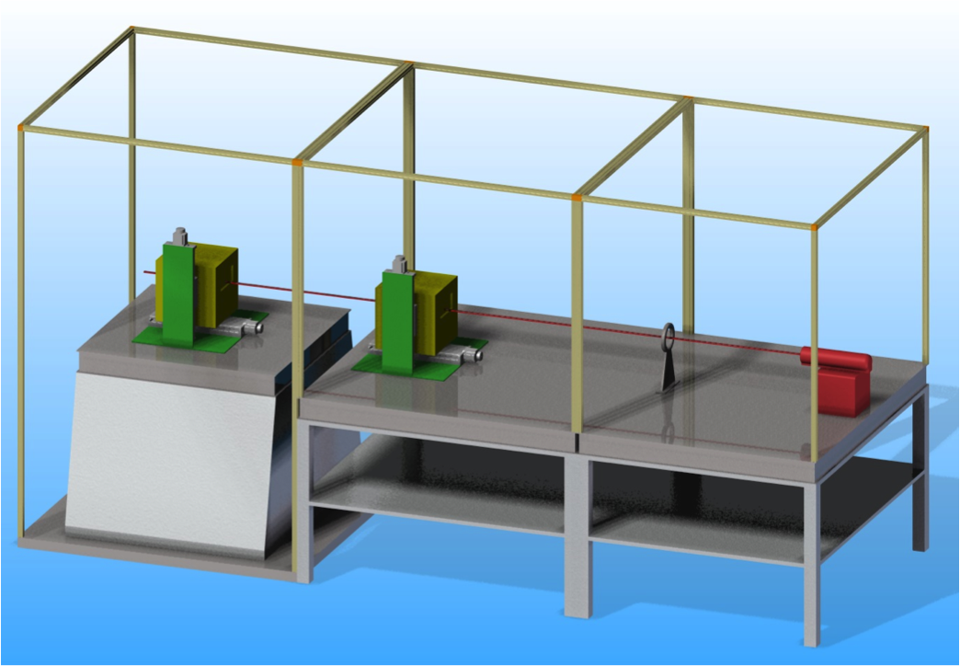
Permanent Ambient X-ray Test Setup – Big Amber
1,2 m
Modular setup for large area and small area detectors
Interlock system with safety sensors on the doors and between the modules
Detector System
Shielding and Enclosure
Pin Holes, Masks etc.
Bread Board
X-ray Tube
1,5 m
X-ray sources:
Commercial high power X-ray tubes: (V < 60 kV and P < 2 kW), anodes: Cu (8 keV) and Mo (17 keV) + Polycapillary focusing optics → estimated intensity for Cu target 10⁹ cps/50μm
PANTER source with exit window (V < 15kV, I < 5mA) multi-target anode
PulXar with exit window: pulsed mode (V< 50kV, I<20mA with pulse length > 25 ns and XFEL timing), DC mode (V<60kV, I<5mA), multi-target

Slide 9
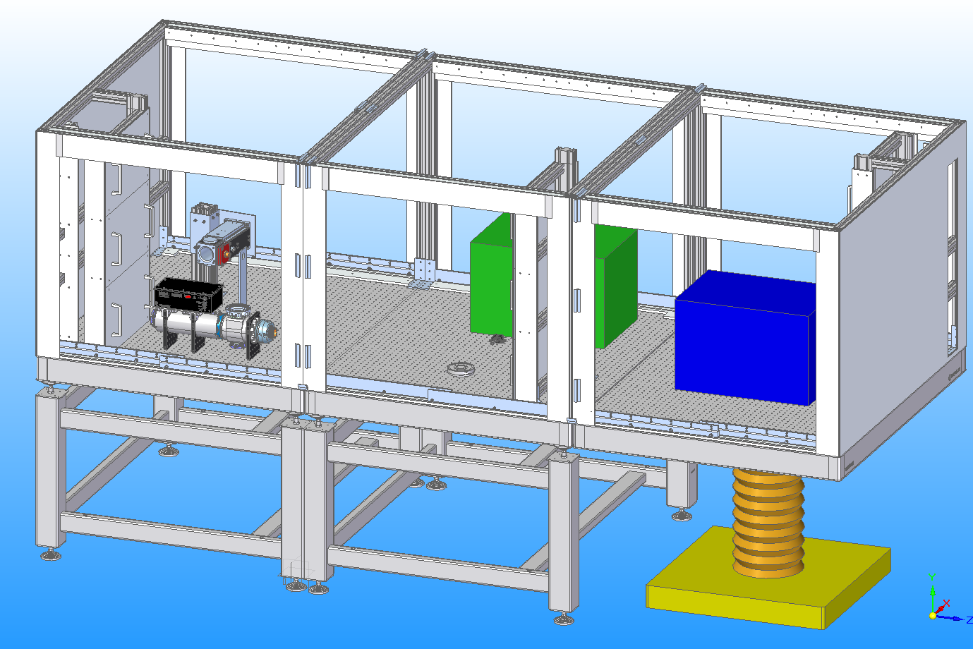
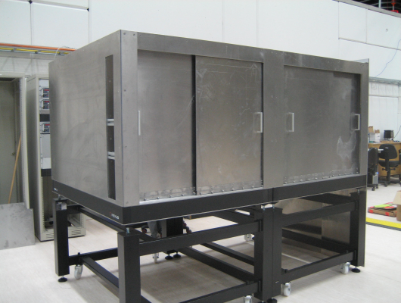
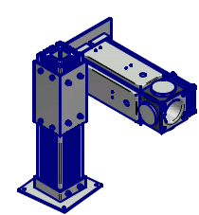
Permanent Ambient X-ray Test Setup – Big Amber
Preliminary setup with first two modules (big enough for ¼ LPD and AGIPD single module)
X-ray Tube
¼ Mpx
Detector
System
Status since the last XDAC:
Shielding assembled
Interlock system defined (extended for use with electron gun and PANTER) → installation ongoing
Documentation for TÜV approval exists → discussed with Safety group
X-ray tubes will be delivered in January including housing, collimator, HV - generator and cooling
Tube support exists
Offer for optics and optic holder exists
Requirements for the 3rd module are defined
→ Operational Q1 2015 for detector systems up to ¼ Mpx
Notes:
The concept is to built up infrastructure for XFEL in several steps.
Problem is …
→ go through right part of the slide
What are the specifications, requirements → next slide

Slide 10
Permanent Ambient X-ray Test Setup – Big Amber
10
Next steps (two modules):
Install moving stages for tube (200 mm travel, position resolution: 10 µm)
Install interlock system
TÜV approval
Preliminary cooling (ventilation) for the 2 module setup to be installed (heat dissipated to air of ¼ LPD ~2kW)
Housing for N₂ atmosphere for AGIPD single module
Commissioning of the X-ray tubes
x-y-z Translation Stage
and Support
Bread Board
Further steps – final (three-module) setup:
Finalize design of the third module
Focusing optics (focus sizes of <50 µm) from IFG with holders attached to the tube housing
Moving stage for detectors to be installed
Water cooling for the 3rd module necessary, ventilation not feasible in the clean room laboratory at XHQ
Notes:
The concept is to built up infrastructure for XFEL in several steps.
Problem is …
→ go through right part of the slide
What are the specifications, requirements → next slide

Slide 11
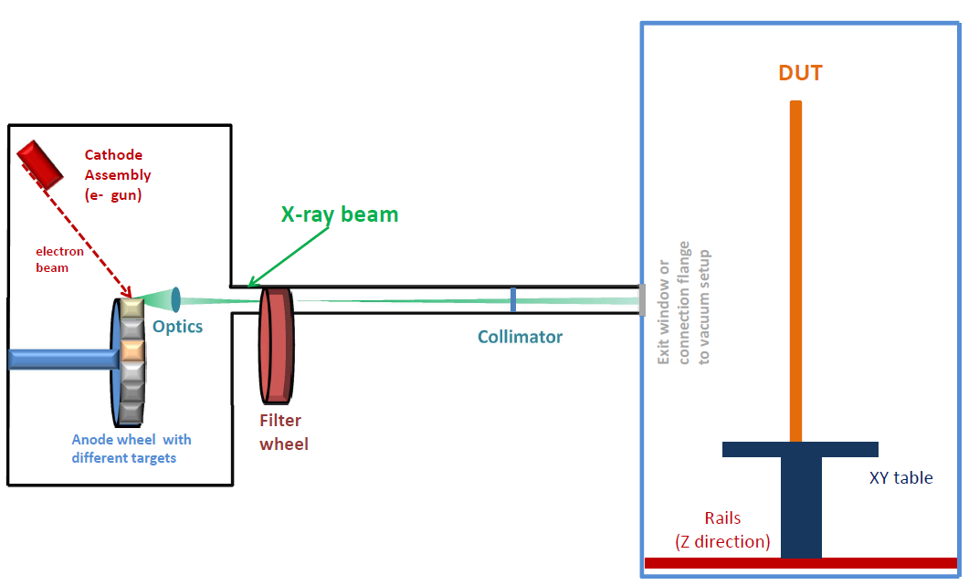
Multi-Target (Pulsed) X-ray Setup PulXar – reminder
Laboratory multi-purpose X-ray setup for up to 1MPix detector systems
Exchangeable
Pulsed X-ray /electron source
DC X-ray tubes /electron source
Radioactive isotopes
Modular beam pipe/filters
First step: Copy of PANTER X-ray source* assembled & operated at the XFEL as test bed
Detector Test Chamber
Vacuum and ambient operation
Next step: Replace the existing electron source with a customized pulsed electron source by Kimball
*Collaboration with PANTER X-ray test facility of the Max-Planck Inst. for extraterrestrial Physics

Slide 12
Pulsed Multi-target X-ray Test Setup - PulXar
PANTER X-ray source as a testbed towards a pulsed sources
Status since the last XDAC:
Complete PANTER system including tube, filter wheel, detector vessel, support structure and pumping system assembled and pumped (<1.0 x 10⁻⁶ mbar → sufficient for PANTER operation)
First bake-out of the filament was successful
Control system:
Power supplies for PANTER integrated and functionality was tested
PLC Control system (pumping system + manipulator for detector)
- Hardware ready
- Firmware was installed last week → to be tested
Interlock system for the tube installed → to be tested next week
Reference detector setup exists ( fast SDD + vacuum vessel + manipulator)
Documentation for TÜV exists → under discussion with Safety Group

Slide 13
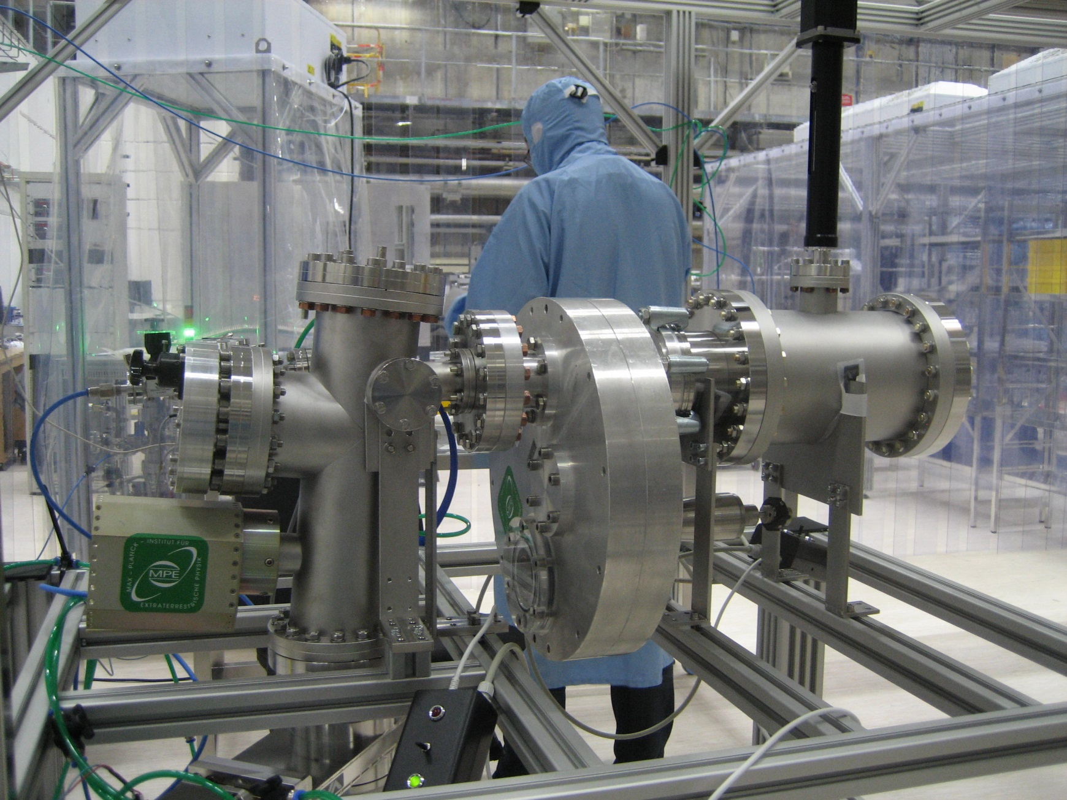
Pulsed Multi-target X-ray Test Setup - PulXar
PANTER X-ray source as a testbed towards a pulsed sources
(Collaboration with PANTER X-ray test facility of the Max-Planck Inst. for extraterrestrial Physics )
SDD detector Vessel
Status since the last XDAC:
Complete PANTER system including tube, filter wheel, detector vessel, support structure and pumping system assembled and pumped (1,2 x 10⁻⁶ mbar → sufficient for PANTER operation)
Power supplies for PANTER integrated in Karabo
PLC Control system
- Hardware ready
- Firmware was installed last week → to be tested
Interlock system for the tube installed → to be tested
Reference detector setup exists ( fast SDD + vacuum vessel + manipulator
Kimball pulsed e- source delivered
PANTER X-ray source
Filter wheel

Slide 14
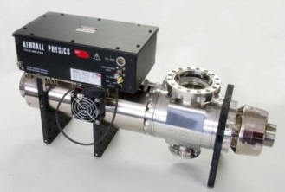
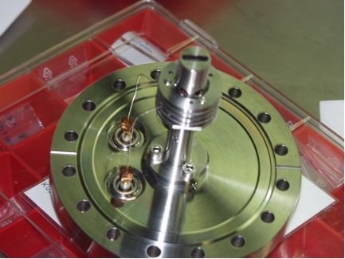
Pulsed Multi-target X-ray Test Setup - PulXar
Next steps - PANTER:
Commissioning of the PANTER tube system with HV < 5kV
TÜV approval
Commissioning for up to 15 kV
→ Operational Q1 2015
Next steps - PulXar :
Replace PANTER e- source with the Kimball e- gun → electron gun delivered to XFEL.EU
Synchronization of the electron gun with XFEL timing system
Commissioning of Kimball e- gun
→ Operational with PANTER mechanics Q2 2015

Slide 15
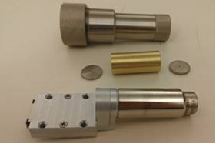
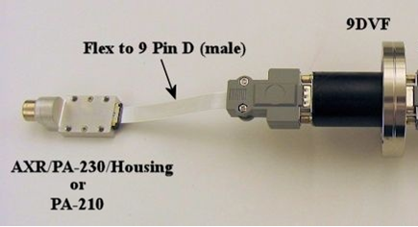
Reference detector for characterization of X-ray sources
Reference detector for characterization and measurement of spectral distribution of X-rays emitted by the X-ray sources
Status:
SDD detector including collimator with pinholes (25-2000 µm) delivered
Vacuum tests with detector collimator and feed through: 4 x 10⁻⁷ mbar
Movement system for vacuum operation
SDD detector operational
Amptek – Fast SDD
160 eV FWHM resolution @ 5.9 keV and 100ns peaking time
Peak-to-Background Ratio - 20,000:1
High Count Rate > 10⁶ cps
25 mm² X 500 µm
Next steps:
Detailed tests and calibration with X-rays (PHEOBE setup and/or Mini-X)
Synchronization of the detector with XFEL timing (needed for PulXar)

Slide 16
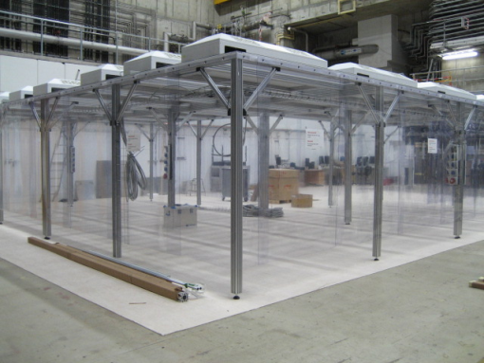
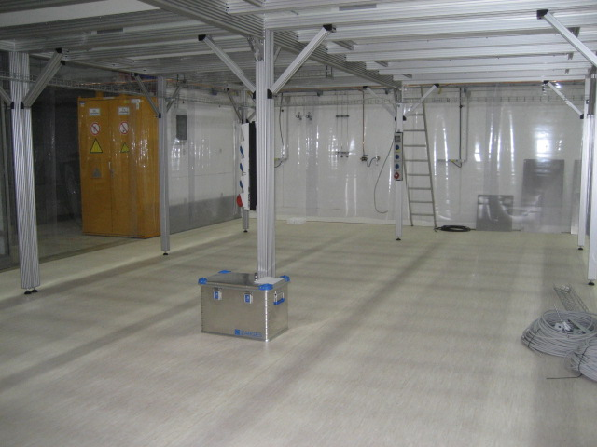
HERA South Detector Laboratory
May 2014
Clean room and Detector Lab Space at HERA South – 1st floor
Clean room ISO Class 6

Slide 17
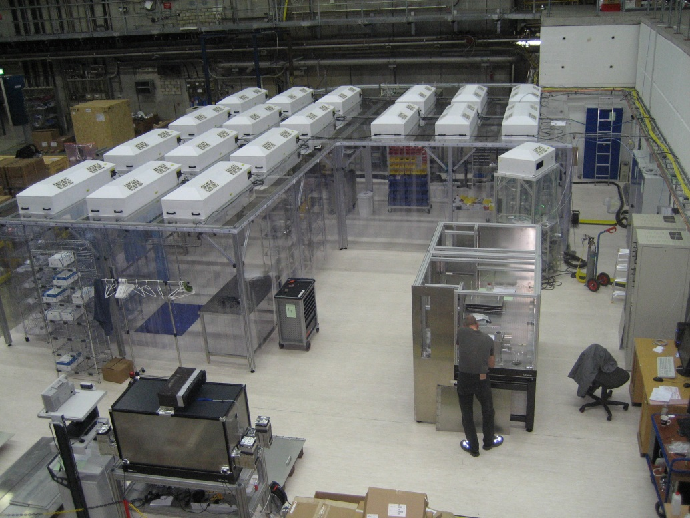

HERA South Detector Laboratory
November 2014
Clean room and Detector Lab Space at HERA South – 1st floor
Clean room ISO Class 6

Slide 18
Calibration Plan & Schedule for Lab. Infrastructure at XFEL.EU
First (preliminary) version of Calibration/Characterisation plan and schedule for the XFEL Laboratory Test Infrastructure exists → discussed with the Detector Consortia at the last Calibration Meeting
In general the Consortia are interested to use our infrastructure
Constant feedback from the Consortia is needed → What are their plans & schedule for calibration and testing of the full detector system in our Laboratory? → shall be worked out together with the corresponding XFEL contact persons

Slide 19
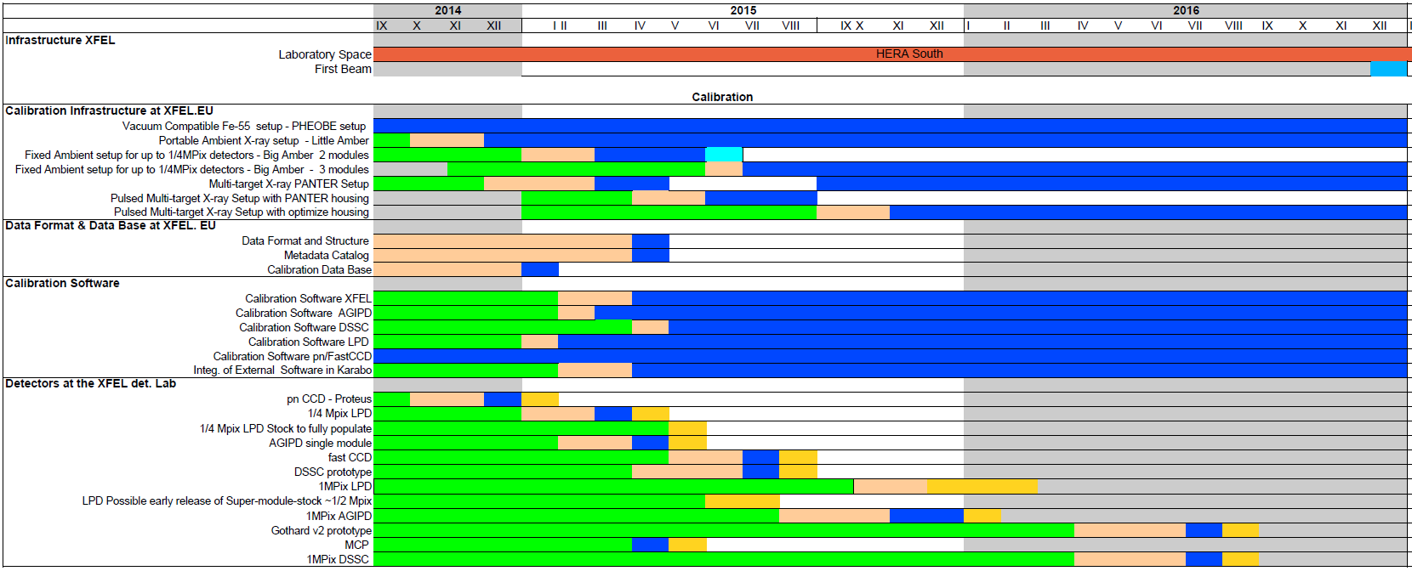


Calibration Schedule - General Plan

Slide 20
First X-ray tests in the Detector Lab – Q1 and Q2 2015
pnCCD detector prototype
→ X-ray test Setup: PHEOBE and later PANTER
¼ Mpix LPD
→ Cooling and DAQ infrastructure ready
→ X-ray test setup Big Amber with high-power X-ray tube
AGIPD single module prototype
→N₂ atmosphere setup and cooling is needed
→ X-ray test setup: Big Amber and later PulXar (with exit window)
Fast CCD detector
→ vacuum system and housing to be built
→ X-ray test setup: PHEOBE and PANTER

Slide 21
Procedures for Scheduling the WP-75 test facility usage
The procedures for scheduling the usage of the WP-75 test facility are under development → no show-stoppers were identified
Involved parties:
External users: test proposal including requirements for the test infrastructure, schedule and risk assessment
WP-75: evaluate the requirements, preparation and support before and during the tests as well as technical trainings
Safety Group: evaluate the risk assessment, safety trainings , access rights
The safety aspects which have to be taken into account (access of the external groups to our laboratory, required trainings etc.) are currently under discussion with the Safety Group
The first friendly users (DESY group) used our PHEOBE (vacuum Fe-55 test setup) system for testing their detector prototype. The organization of the work, safety training and access permission to the HERA South laboratory for the guests went all smooth and no show-stopper appeared.

Slide 22
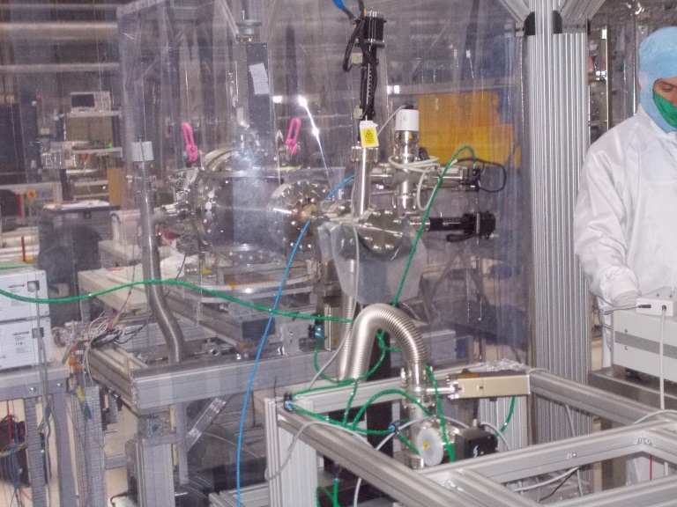
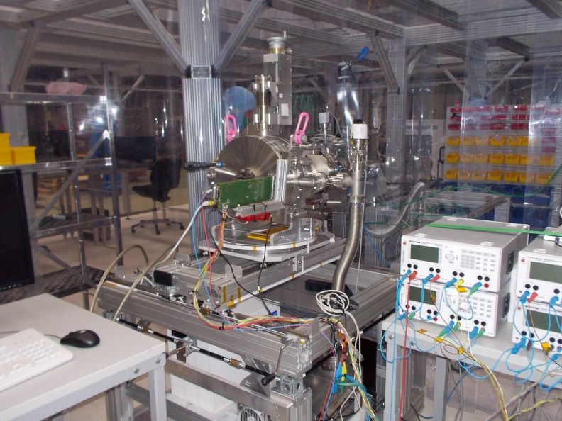
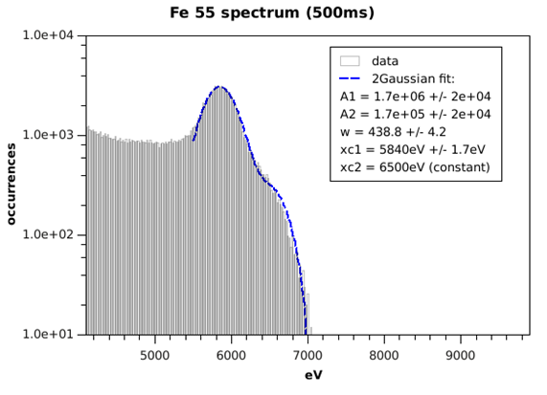
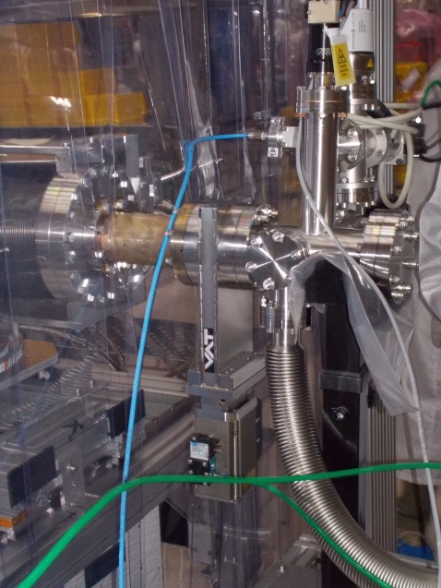
First Friendly Users at WP-75 Detector Laboratory
Percival prototype at HERA South (October 2014):
PHEOBE setup
PERCIVAL setup
PHEOBE
(vacuum compatible
Fe-55 source)
Percival setup
Courtesy DESY Percival team

Slide 23
Summary
Construction and commissioning of calibration infrastructure is progressing well
First X-ray setups are operational and can be used for tests
Procedures of scheduling and access of external groups to WP-75 infrastructure is in preparation and under discussion with Safety Group
Calibration Infrastructure – schedule:
First laboratory X-ray detector test setups Little Amber and PHEOBE operational (to be used for small prototypes or small detectors)
Ambient X-ray Test Setup for ¼ Mpix detectors operational (up to ¼ Mpix) Q1 2015
Pulsed Multi-Target X-ray Test Setup operational (up to 1 Mpix) Q3 2015
Preliminary plan for testing the first detectors at the detector Lab exists
Calibration software and alignment concept → see S. Hauf’s talk

Slide 24
Thank You

Slide 25
Additional information including introductory
&
Backup Slides

Slide 26
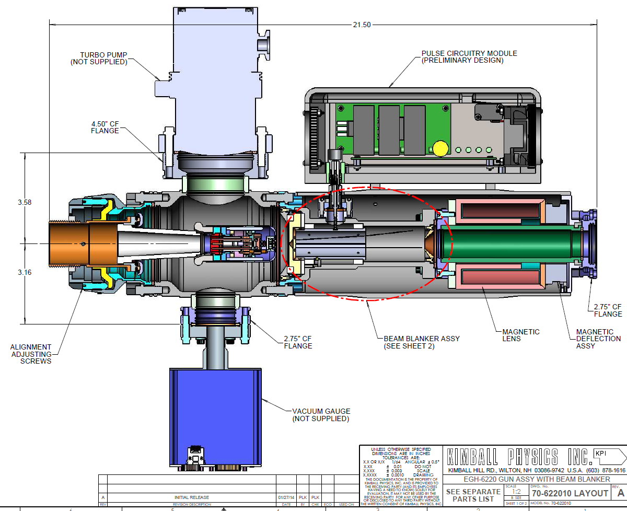
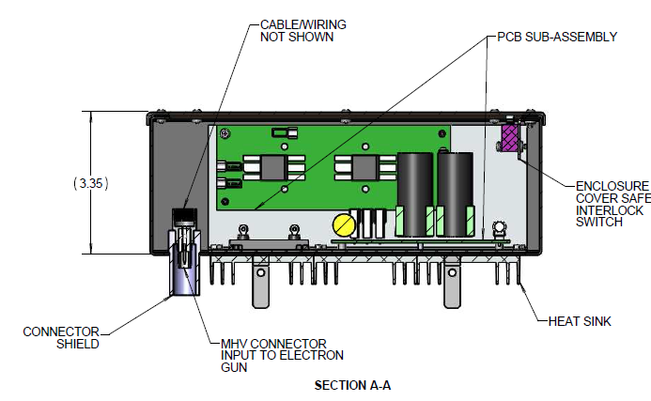
Kimball Physics Electron Gun for PulXar
Parameter | Pulsed mode | DC mode
Electron energy | 1 - 50 keV | 1- 60 keV
Electron beam current | 10μA - 20 mA | 10μA – 6mA
Beam diameter | 0.15 – 10 mm | 0.1-10 mm
Pulsed beam parameters | - Length: τ = 50 -150 ns rise: 2 ns / fall: 3-4 ns - XFEL burst mode | n.a.

Slide 27
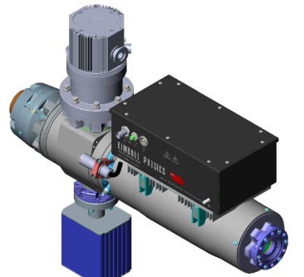
Kimball Physics Electron Gun for PulXar
Parameter | Pulsed mode | DC mode
Electron energy | 1 - 50 keV | 1- 60 keV
Electron beam current | 10μA - 20 mA | 10μA – 6mA
Beam diameter | 0.15 – 10 mm | 0.1-10 mm
Pulsed beam parameters | - Length: τ = 50 -150 ns rise: 2 ns / fall: 3-4 ns - XFEL burst mode | n.a.
Status since the last XDAC:
Custom beam blanker for high speed pulsing up to 5MHz designed and produced → 25 ns pulses are achievable
Custom pulse generator with burst operation designed and produced
Electron gun is in the testing phase → performance within the specification
Expected delivery date: June 2014 (on schedule)

Slide 28
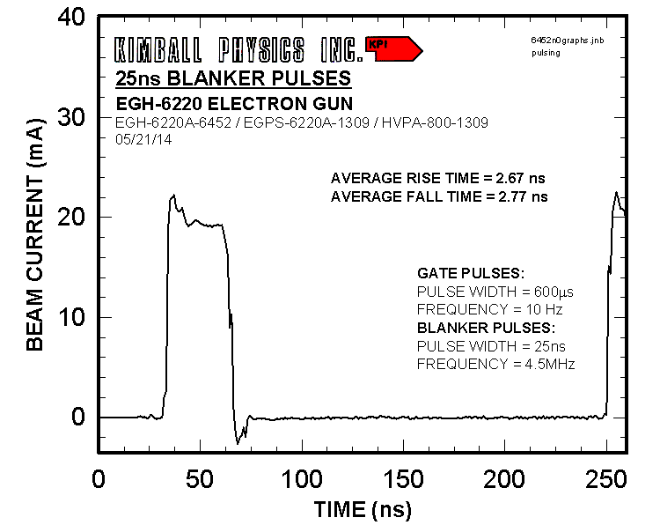
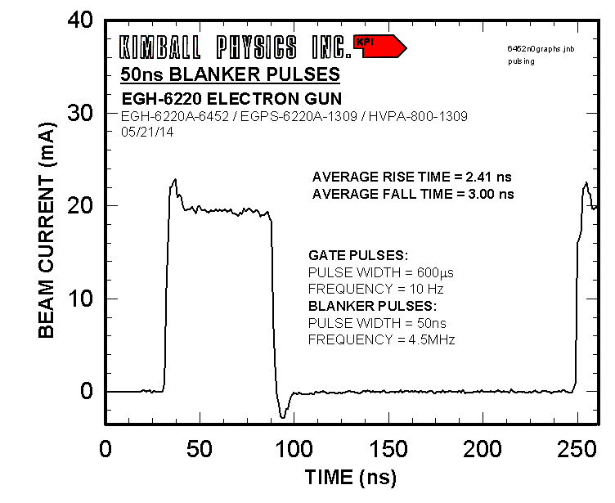
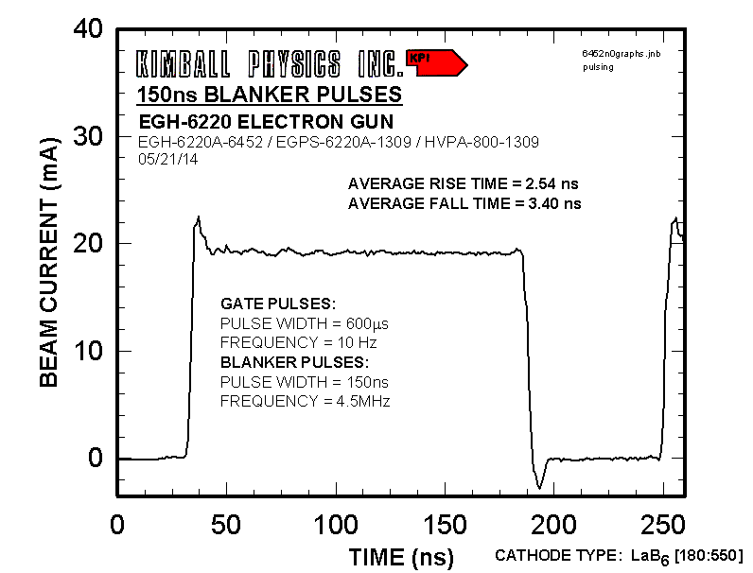
Electron Gun for PulXar – first test results
25 ns
50 ns
Oscilloscope measuring the electron beam into the lab Faraday cup
Blanker pulses 25, 50, 150 ns
Electron energy Ee=50 keV
Gun pressure p=2x10⁻⁸ mbar
Rise/fall time 2.5-3.5 ns
150 ns

Slide 29
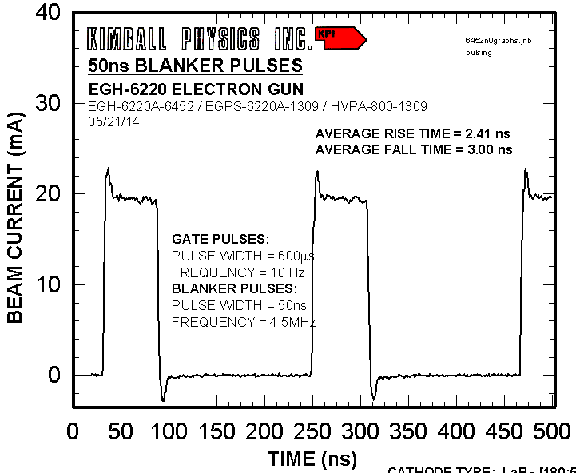
Electron Gun for PulXar – first test results
50 ns

Slide 30
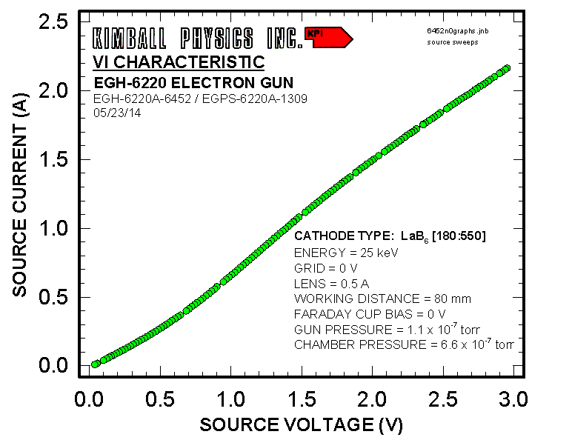
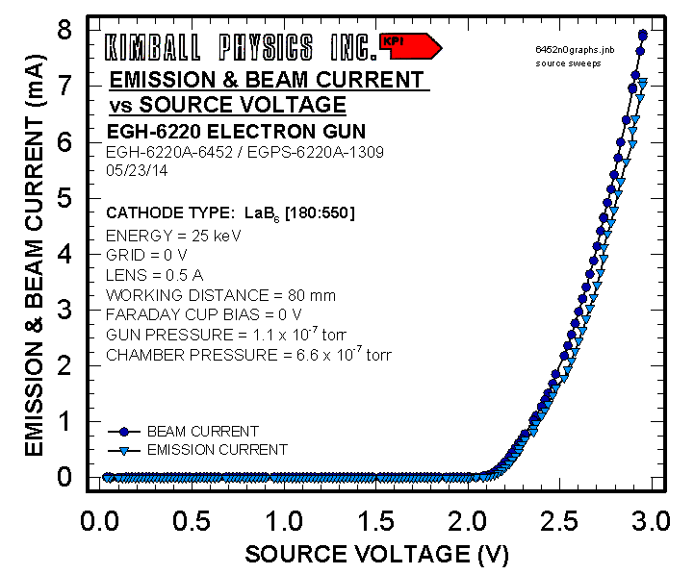
Electron Gun for PulXar – first test results

Slide 31
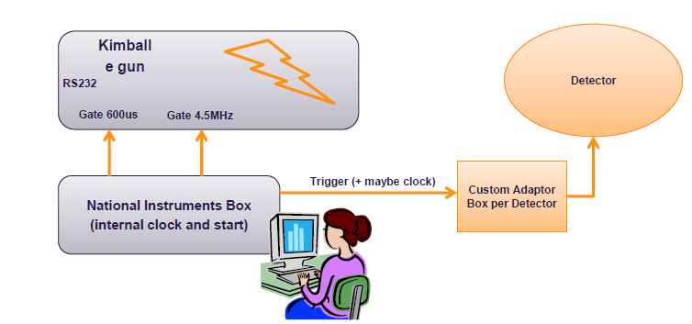
Multi-target Pulsed X-ray source
Clock and Control system (P. Gessler)
Day one solution – detector “triggered” by the source

Slide 32
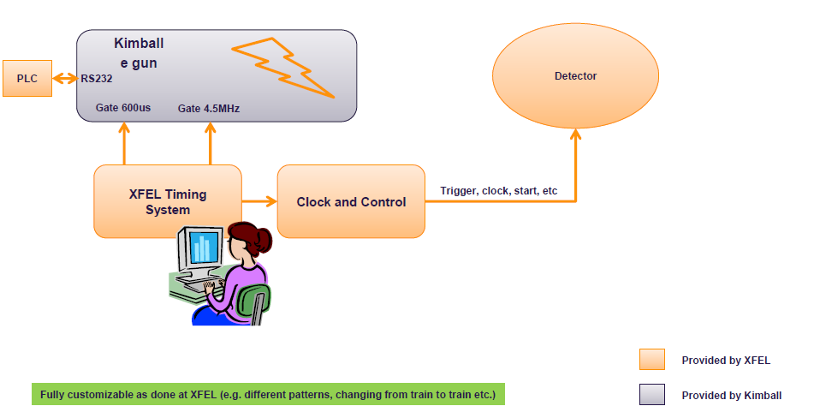
Multi-target Pulsed X-ray source
Clock and Control system (P. Gessler)
Final solution – XFEL Timing system

Slide 33
Calibration Strategy - what is needed to calibrate detectors
Infrastructure to run detector (DAQ, data storage, data base, cooling, cabling etc..)
Data analysis tools
Different kind of stimulus (X-rays, charged particles, etc..)
Required | Parameter | Comments
Internal charge injection | Gain conversion, Memory Charge Looses ( Droop) | Internal source needs to be cross calibrated with the real X-rays
Laboratory X-ray sources (isotopes, X-ray tubes) | Gain conversion, Detector Response Function, Flat-field, Charge Transfer Inefficiency, Quantum Efficiency Flat-field, Splitting Events – Crosstalk | Measurements which do not require high intensity and XFEL timing structure at the same time
Beam from FELs/Synchrotrons/ Particle Accelerators |  | All measurements which require high intensity and appropriated XFEL timing

Slide 34
Calibration Strategy – where calibration will be done
XFEL.EU Project Phase | Detector Laboratory | FELs/Synchrotrons/ Particle Accelerators
 |  | External Sources | XFEL. EU
 |  |  | Instr. Hutches | Dedicated beam
Start-up | Initial detailed calib. and characterization of det. prototypes, modules | Response of detector vs. either rep. rate or intensity
Commissio-ning | Initial detailed calib. and characterization of full systems | Calibration of 1MPix 2D cameras is NOT feasible due to the demanding infrastructure requirements | Cross-check lab. calibration Characterization of the detector response under real conditions (rep.rate and intensity)
User Operation | Calibration of the full system only if necessary (accident, detailed detector response investigation, etc..) |  | Scientific. exp: Part of regular exp. procedure (shall take a few mins) Maintainance time - Calibration/tests using in-hutch sources | Detailed detector response investigation under real conditions (rep.rate and intensity)

Slide 35
Detectors in Experimental Hutch
Work on definition of calibration procedure during operation
phase is ongoing
Discussion with instrument scientists
Required accuracy for calibration parameters
Specific online monitoring in addition to „standard“ detector performance monitors
Calibration data which can/should be taken as part of an experimental campaign/run
Detector alignment
X-ray calibration sources within the hutches → agreed with the instrument scientists

Slide 36
Detector Calibration & Characterization Priorities
Parameter | Priority | Target Accuracy
Conversion gain G(x,y) | High | < Poisson statistic
Dark signal O(cell nr,x,y) | High | < detector noise
Noise N(x,y) | High | < 1%
Bad pixel B(cell nr,x,y) | High
Quantum efficiency QE | High | 5-10 % (simulation uncertainty)
Dynamic range DR(x,y) | High | < Poisson statistic
Memory cell droop (signal losses) MD(cell nr, x,y) | High | < detector noise
Charge transfer inefficiency CTI(x,y) | High | < 1%
Point spread function PSF(x,y) | Low | to be defined
Line spread function LSF(x,y) | Low | to be defined
Spectral response | Medium | < 10%
Flat field corrections | High | < 10%
Common mode | High | to be defined
Event splitting | High | to be defined, for low rate applications
Alignment (position calibration) | High | < pixel size
Measurement
Simulation
Algorithm/ reconstruction
Required (motivated by science) accuracy for calibration parameters → input from scientific groups is needed

Slide 37
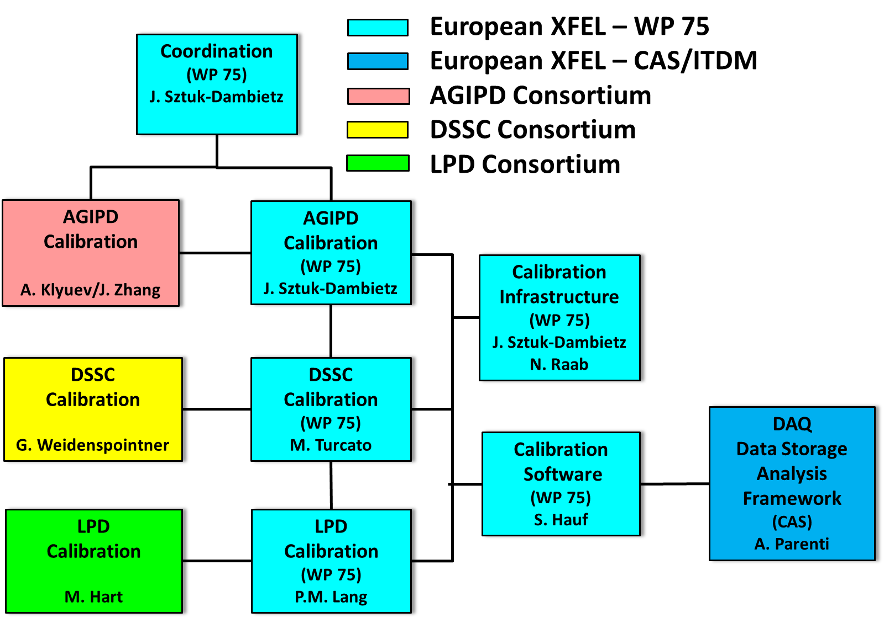
Calibration Working Group
Responsible contact persons of the group:
Work done by detector consortia, WP-75, CAS
Experts from consortia available beyond start-up phase of the project
Meetings: every 6 months → Last meeting November 2014
Exchange information and discuss progress and open issues, define next steps
Available documentation
Indico page with presentations and documents:
https://indico.desy.de/categoryDisplay.py?categId=278
Calibration Working Group site @ Alfresco - https://docs.xfel.eu/share/page/site/calibration/dashboard

