Slide 1
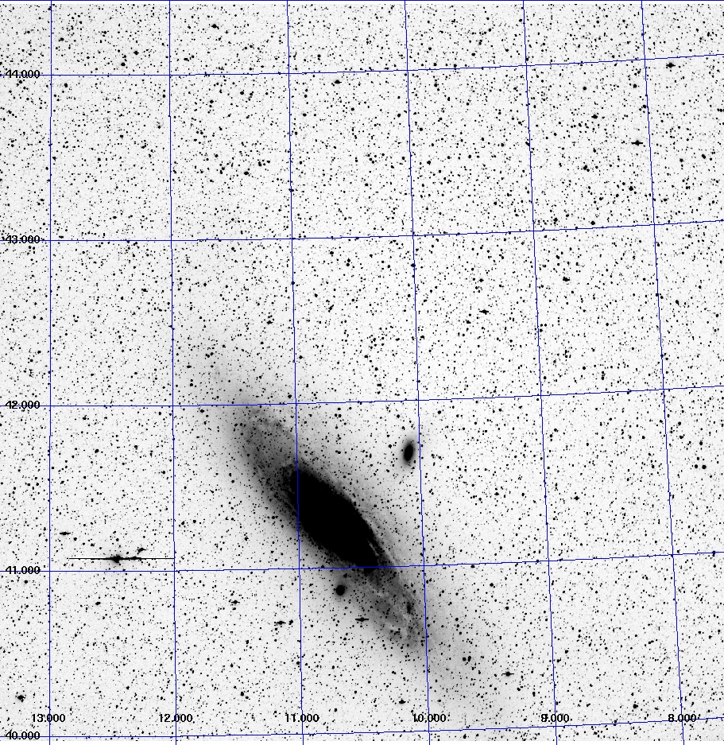
The All-Sky Automated Survey for SuperNovae ( or “Assassin” )
Krzysztof (Kris) Stanek
The Ohio State University
Notes:
Mention background is Pleiades

Slide 2
The Sky is Big!
How big?
$A=4π ×$steradian $= 41,250$deg²
$= 5 × {10}^{11}$arcsec²
500 Gigapixels → 1 Terabyte/epoch (1 arcsec pixels)
Notes:
Iran
Explanation: Snow-capped stratovolcano Mt. Damavand climbs to 5,670 meters (18,598 feet) near the left edge in this panoramic view of the world at night. In the sky to the left of Damavand's peak are the stars of the Big Dipper in Ursa Major. Pan to the right and your gaze will sweep across the arch of our Milky Way Galaxy above the Alborz Mountain Range bordering the Caspian Sea. Near the center of the panorama, recorded in the predawn hours of April 4th, bright stars Deneb and Altair lie close to the curve of the Milky Way, above the glow of the Haraz valley. Farther right, brilliant Jupiter dominates the sky near the stars, nebulae, and dark dust clouds toward the bulging galactic center. Finally, the horizon glow at the right edge, below bright yellowish giant star Antares, is from the city of Damavand, named for the legendary mountain peak.

Slide 3
C. Kochanek
K. Stanek
B. Shappee: OSU -> Hubble Fellow at Carnegie
B. Davis
T. Holoien
J. Beacom
J. Jencson: OSU -> Caltech
U. Basu (high school student)
J. Prieto: OSU -> Carnegie/Princeton -> Diego Portales
D. Bersier (LJMU)
D. Szczygiel, G. Pojmanski (Warsaw)
J. Brimacombe (Cairns)
+ W. Rosing + LCOGT staff
Notes:
Mention background is Pleiades

Slide 4
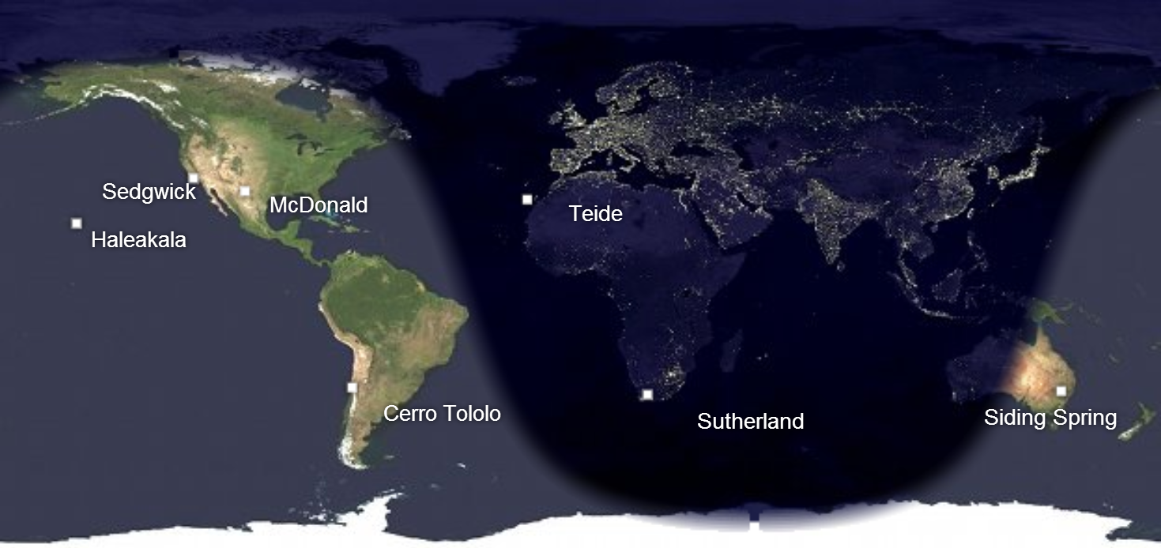
Notes:
The network will eventually be sited at roughly six locations in a northern and a southern global ring. Currently, the entire network is planned to contain up to 40 telescopes which will include 2 x 2-meter, approximately 12 x 1-meter, and 20 x 0.4-meter telescopes.^{[9]} Sites include Haleakala (Maui, USA), Siding Spring (New South Wales, Australia), Cerro Tololo (Chile), Sutherland (South Africa), Tenerife in the Canary Islands, and at the McDonald Observatory, Texas (USA). Negotiations are still taking place at some site locations, and the exact sites may change as the network evolves.

Slide 5
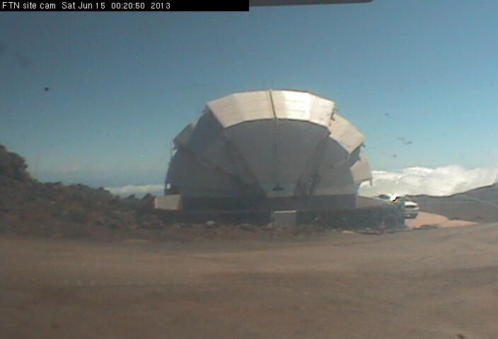
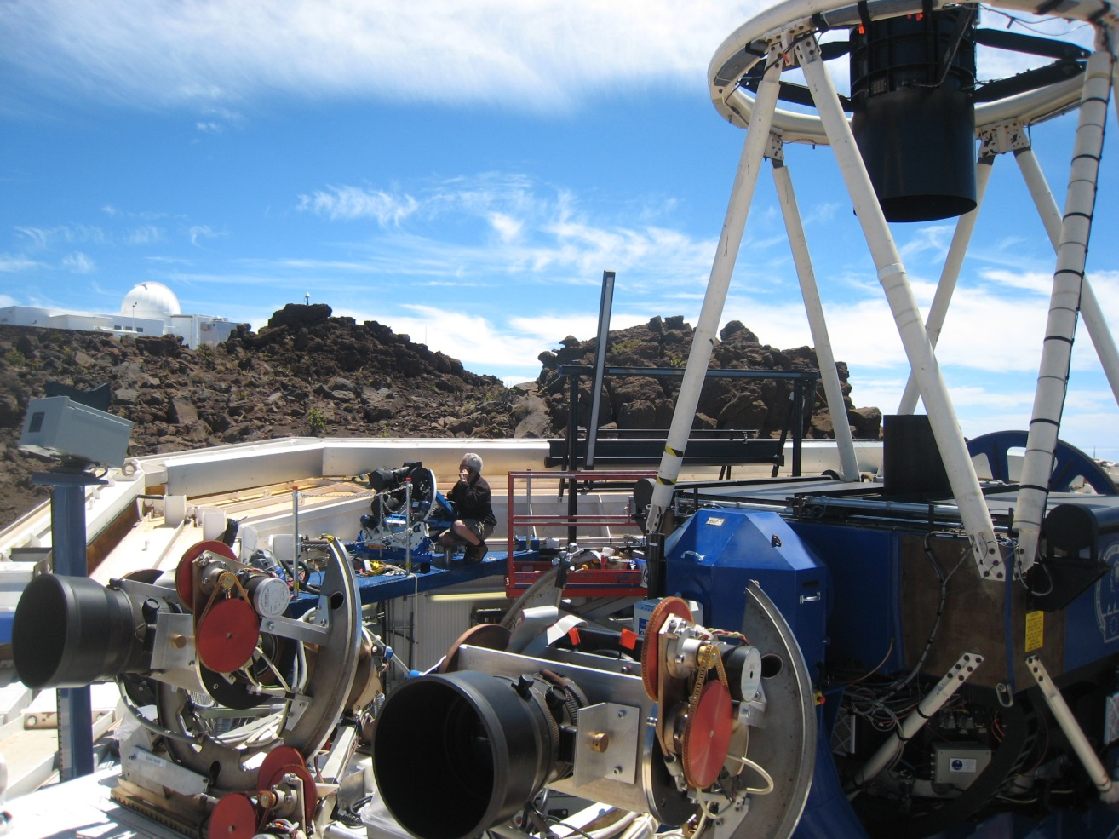
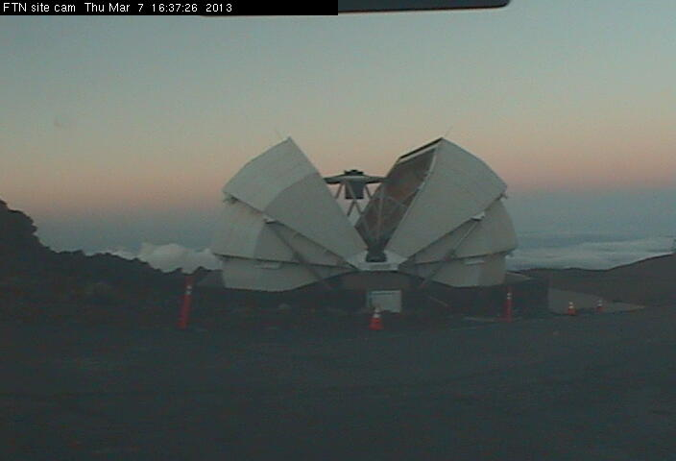
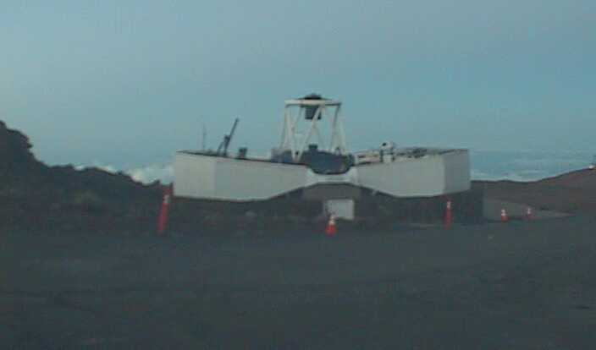
Faulkes Telescope North
Picture Courtesy of Mark Elphick

Slide 6
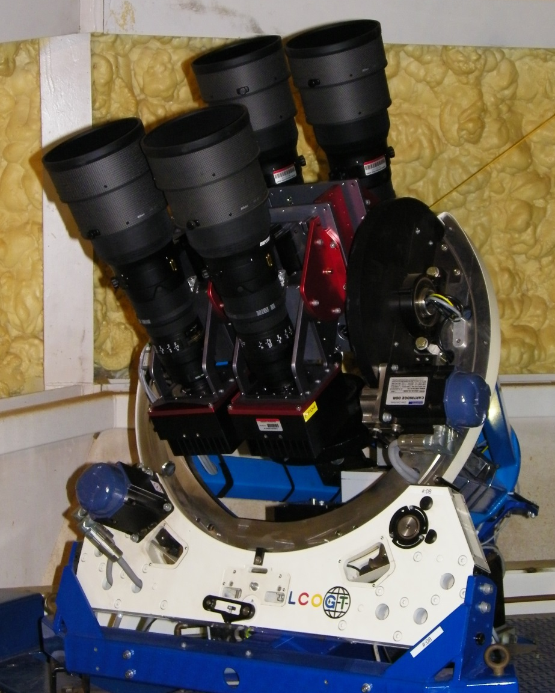
ASAS-SN North “Brutus”
Expanded in January 2014
4 telescopes on a common mount
4 x 14cm Nikon lenses
4 x FLI ProLine CCD cameras
4 x Fairchild Imaging 2k × 2k thinned CCD
4 x 4.47 × 4.47 degree field-of-view
7.8" pixel scale
V-band filters
limiting magnitude $V≈17$
10,000 square degrees per night
Picture Courtesy of Mark Elphick

Slide 7
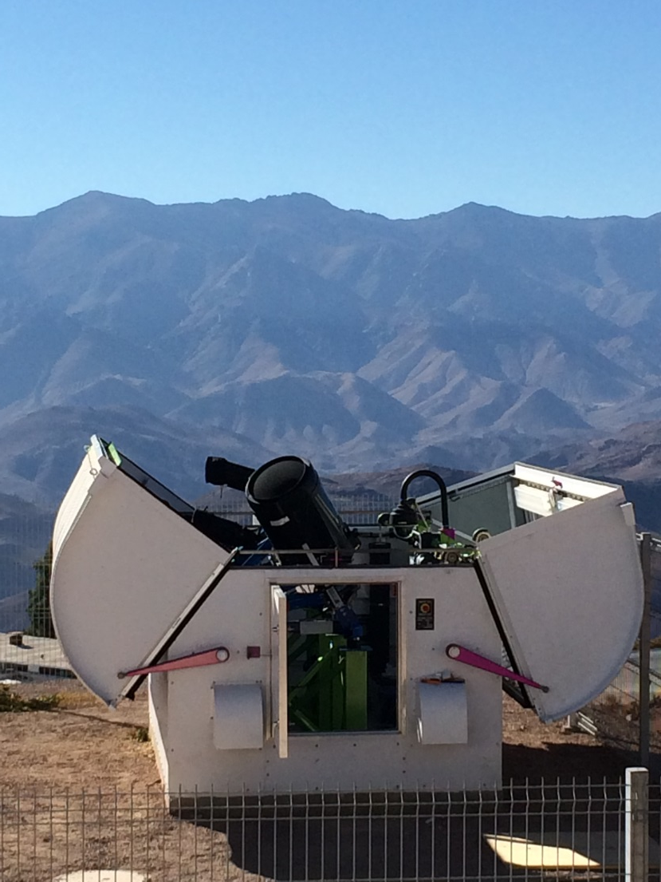
LCOGT Aqawan Enclosure at Cerro Tololo
Picture Courtesy of Wayne Rosing

Slide 8
ASAS-SN South “Cassius”
First light on April 25
2 telescopes on a common mount
2 x 14cm Nikon lenses
2 x FLI ProLine CCD cameras
2 x Fairchild Imaging 2k × 2k thinned CCD
2 x 4.47 × 4.47 degree field-of-view
7.8" pixel scale
V-band filters
limiting magnitude $V≈17$
5,000 square degrees per night
Picture Courtesy of Wayne Rosing

Slide 9
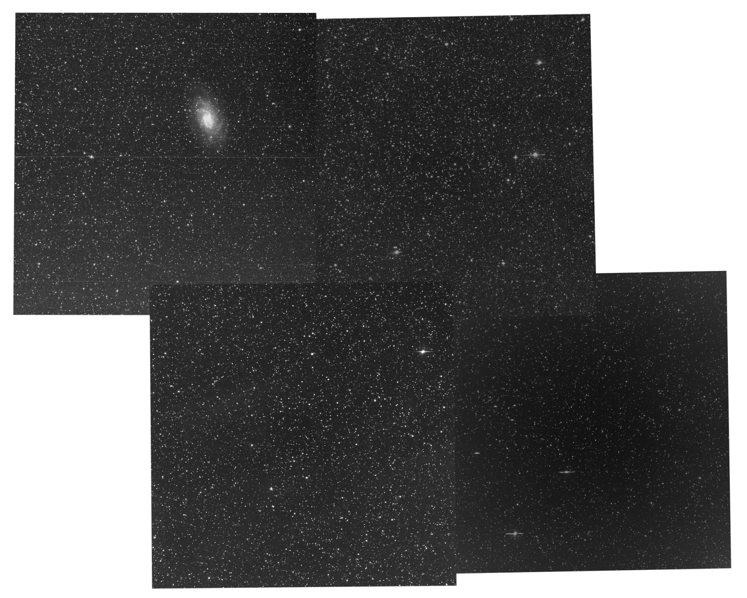
Brutus Data
Notes:
M33

Slide 10
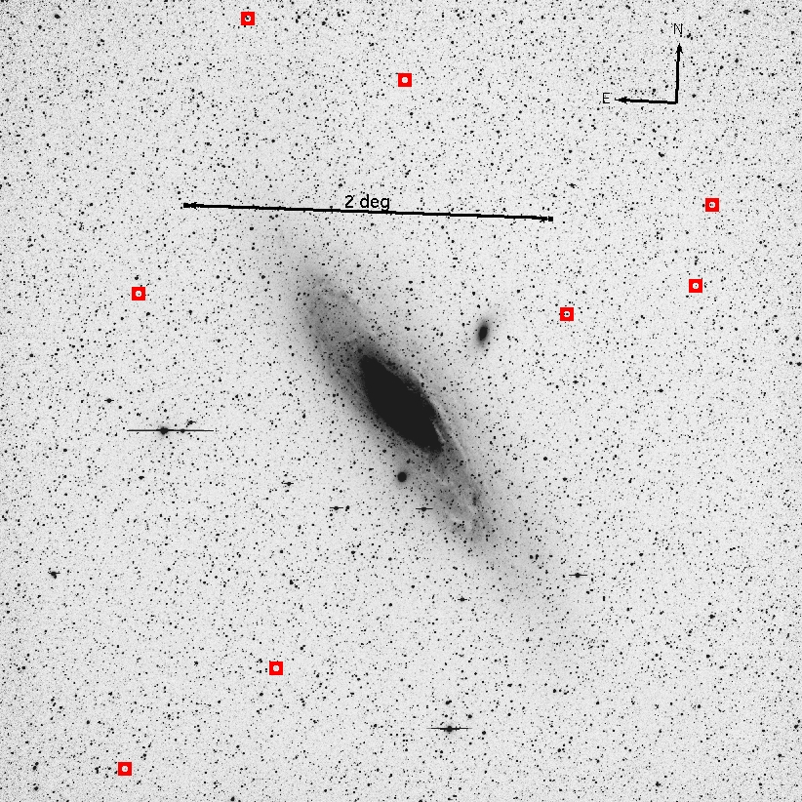
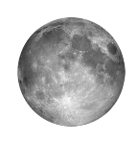
Data: M31

Slide 11
Data: M31

Slide 12
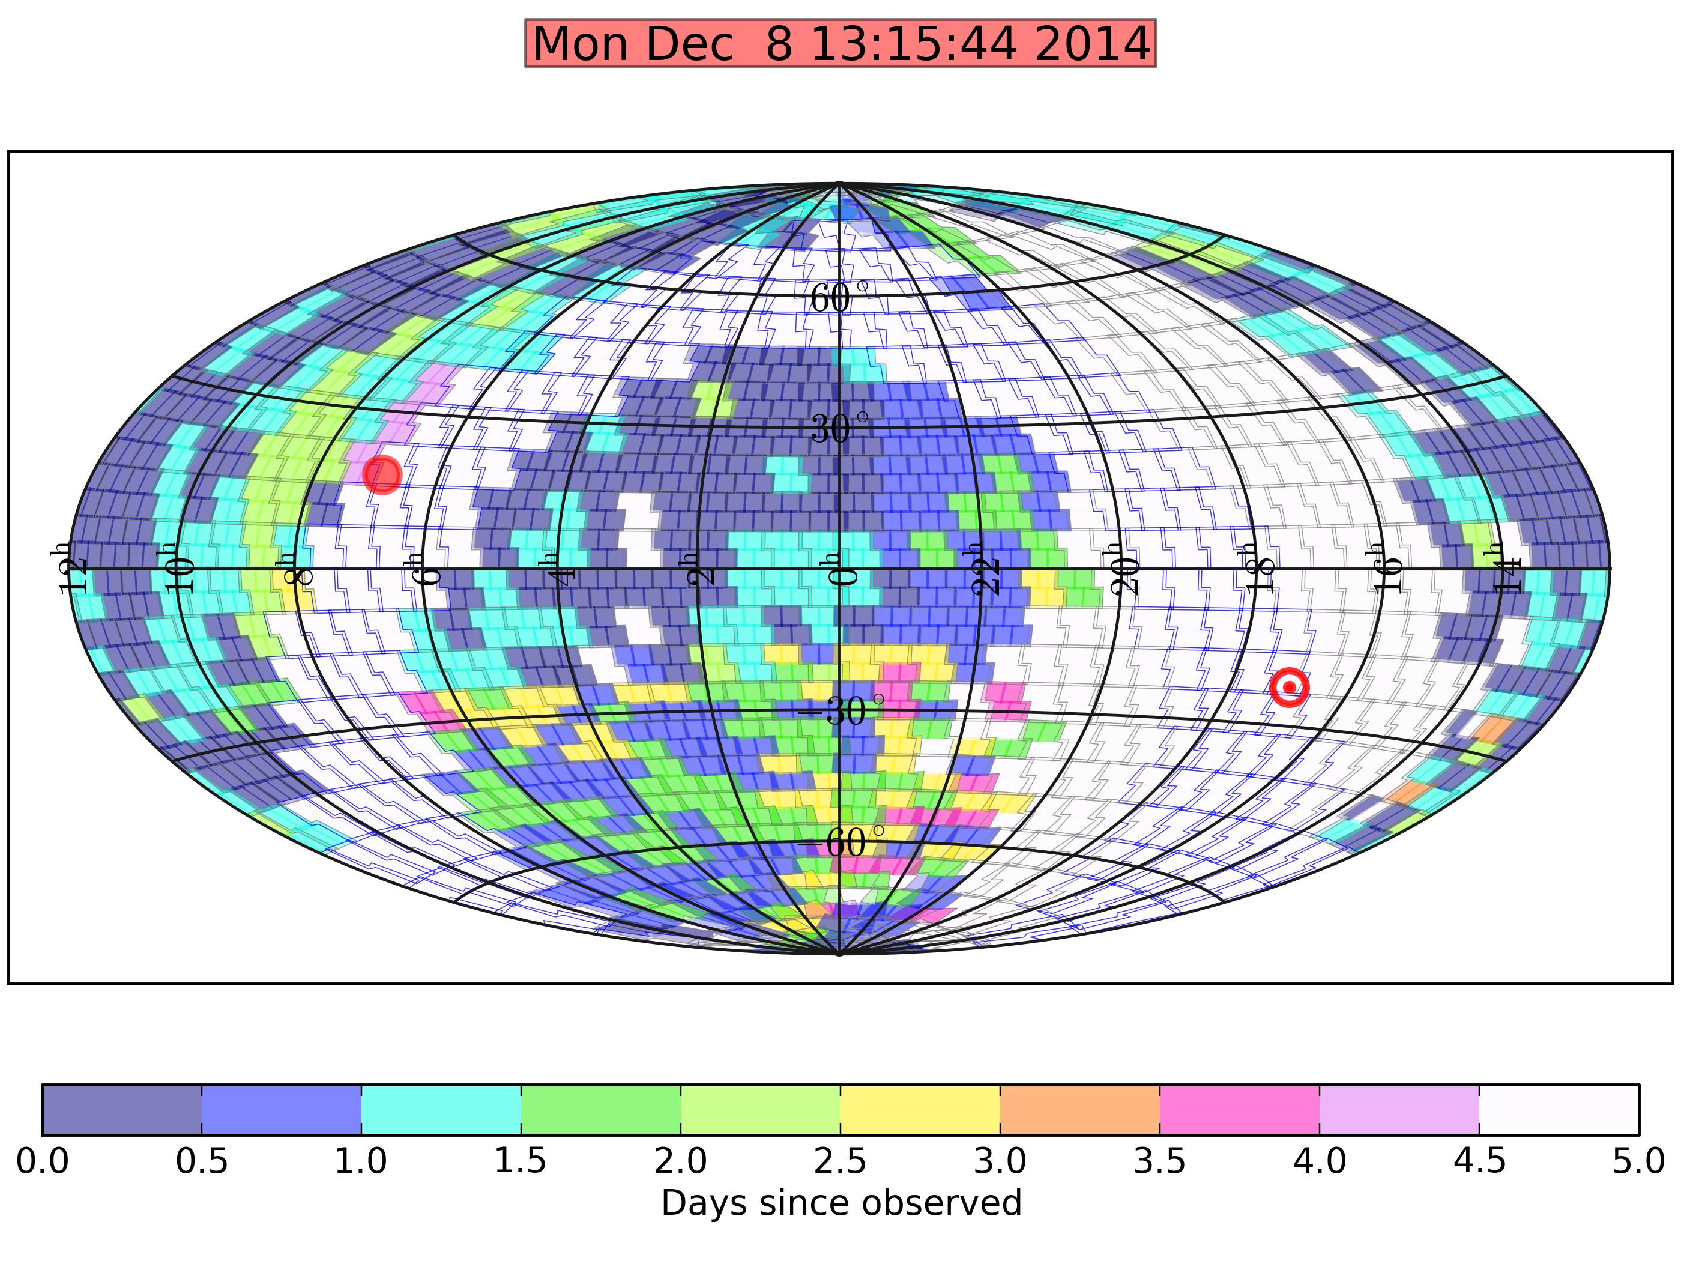
Scheduling
Notes:
~2500 fields

Slide 13
V < 17 mag: What Can You See?
$5×{10}^{7}$stars in our Galaxy, $\sim$1% are variable
250,000 LMC and 50,000 SMC stars
50 Type II, 200 Type Ia SNe, and 10 overluminous SNe per year discovered to distances 50, 150, and 400 Mpc
Many thousands of AGN, all variable
Thousands of asteroids

Slide 14
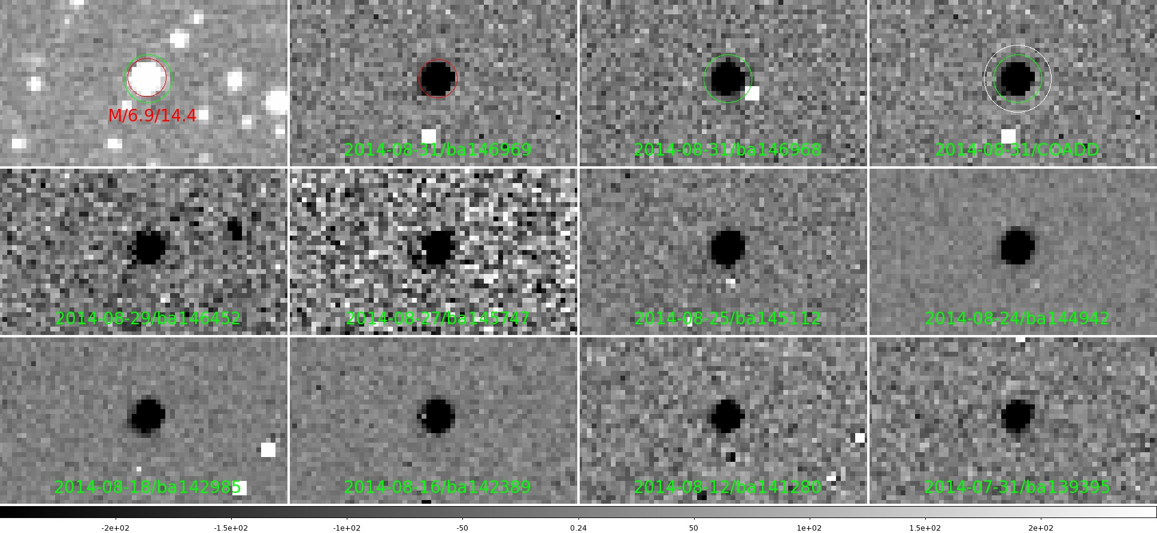
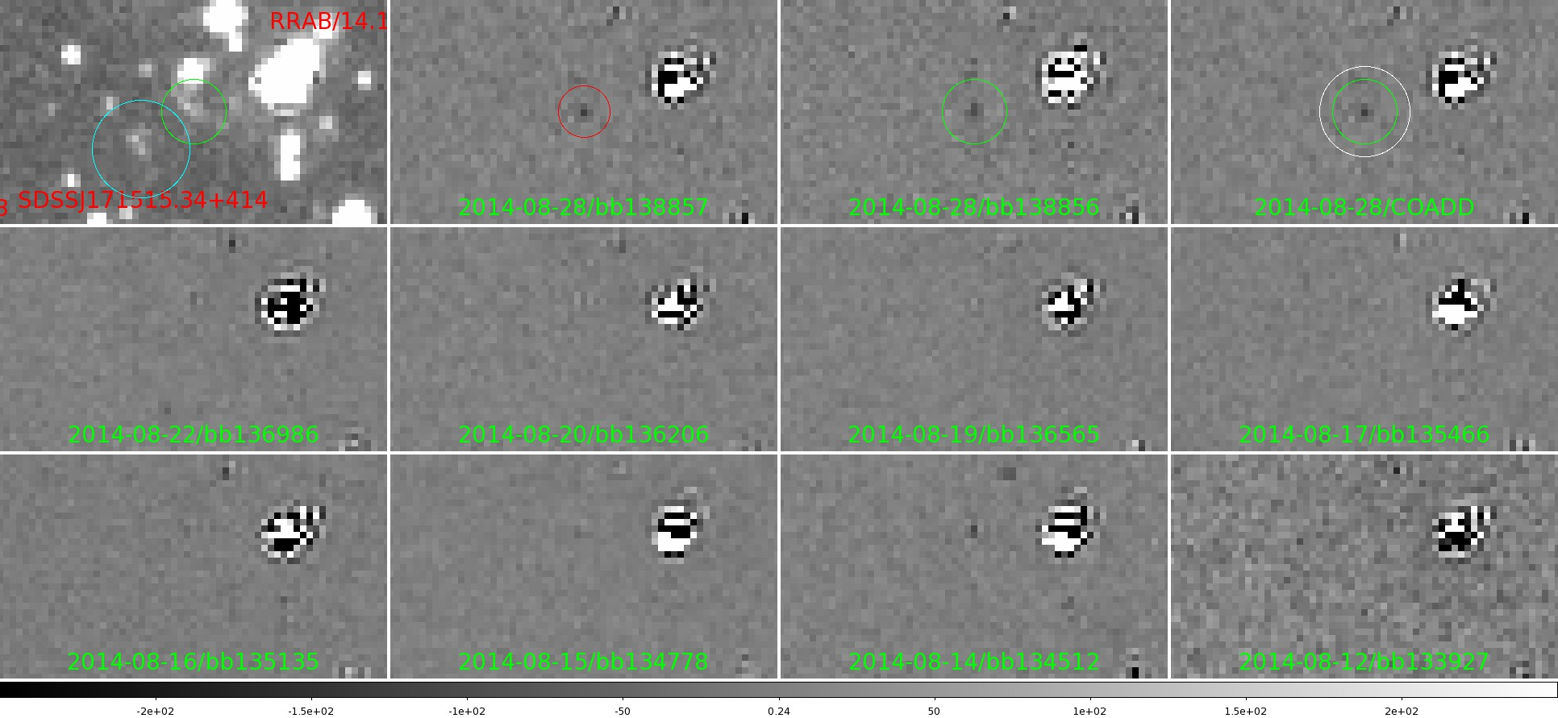
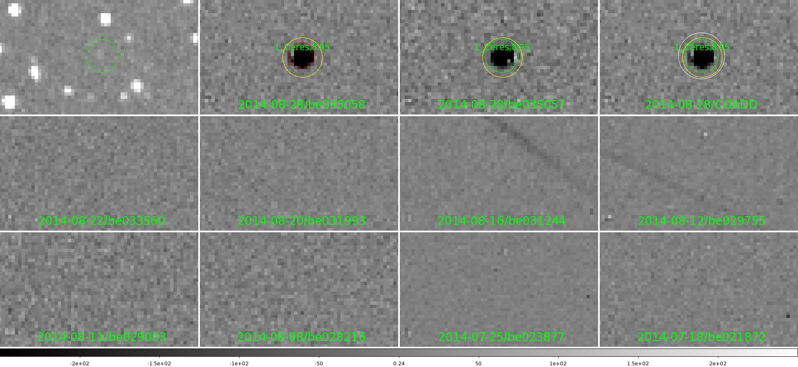
Pipeline
Real-time in April 2013
Scheduling, reduction, subtraction, and transient identification are fully automated
By-eye verification
Transients discovered and announced in hours
allows immediate ground- and space-based follow up.
Notes:
Because this is such a short talk I can’t go into the details of the pipeline, but if feel free to ask me afterwards.
Automated flux calibration against “The AAVSO Photometric All-Sky Survey”

Slide 15
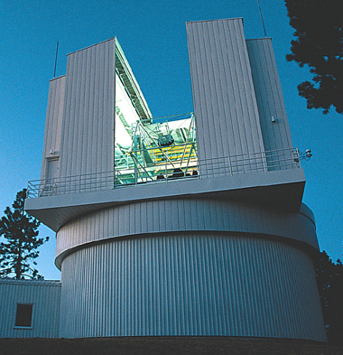
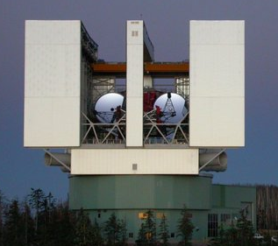
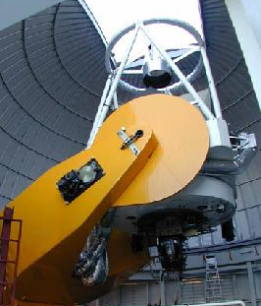
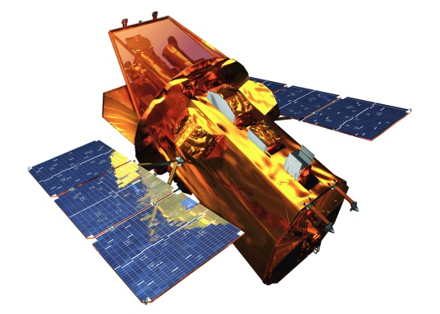
Follow-up Facilities
LCOGT 1 meters
APO 3.5 meter
LBT 2 x 8.4 meter
MDM 2.4 meter
Swift satellite
many others
Notes:
Because this is such a short talk I can’t go into the details of the pipeline, but if feel free to ask me afterwards.
Automated flux calibration against “The AAVSO Photometric All-Sky Survey”

Slide 16
Discoveries
120+ ATELs over 1.6 years of the real-time survey
6 publications with 5 more in preparation
200+ new CV discoveries
Low-mass Young Stellar Object (YSO) in a strong ($∆V>4$ mag) outburst
2 Tidal Disruption Events!
Many M dwarf flares
including two of the largest ever detected
75+ Supernovae (50+ SNe Ia)
Many AGN outbursts
Including a “Changing look” AGN

Slide 17
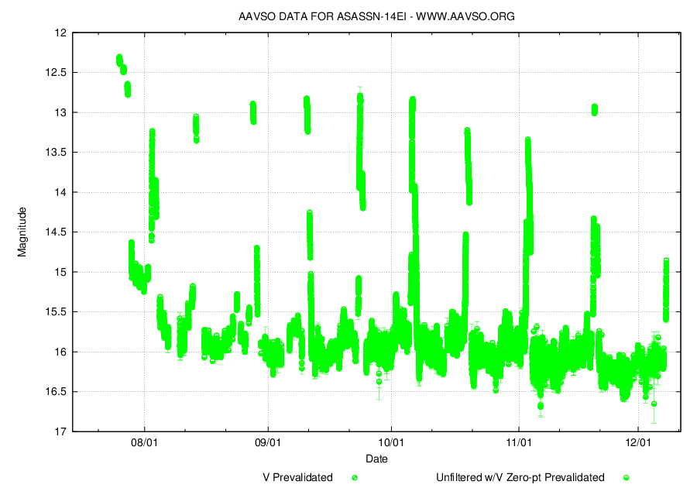
29,000 observations
Notes:
EVN (European VLBI Network)
V as a function of time. The three ASAS-SN detections
and associated uncertainties are shown (black points) with
five different lightcurves generated assuming a simple, classical flare
model (colored lines). The flare model assumes an impulsive phase
lasting until the magnitude of the flare decreases to a percentage of
the peak magnitude. It is likely that the actual flare morphology
was more complex, either with minor variations about the classic
shape or major substructure.

Slide 18
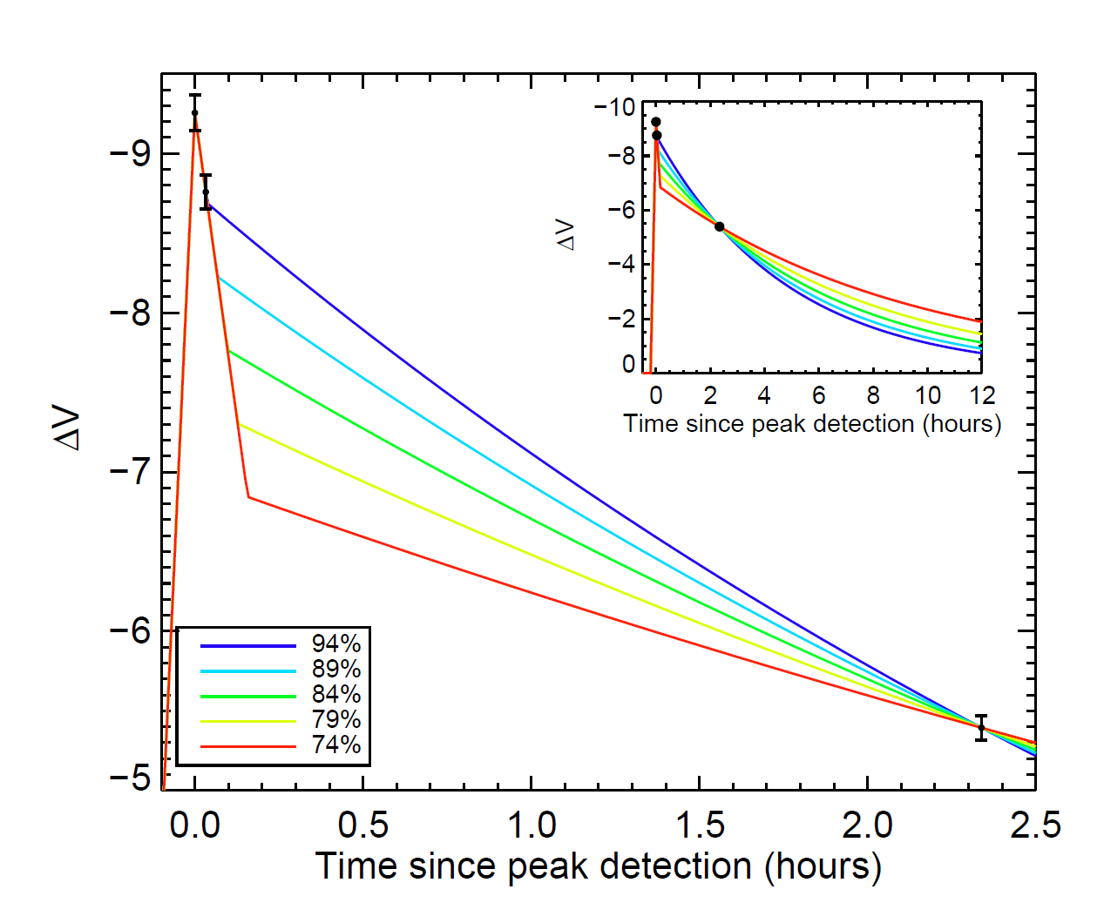
Dramatic Flare on an Ultracool Dwarf
M8 dwarf
$∆V≈9$ mag
$E_{V}=5.5 x {10}^{33}$ ergs
M$odeled E_{U}≈ {10}^{34}$ ergs
Among the largest M dwarf flares ever detected
Equivalent duration of flare 2–3.5 months
Schmidt et al. 2013
Notes:
So what can ASAS-SN do for you.
M dwarfs near M3-M4, where the stars are expected to transition to a fully convective interior.
the most frequent stars in the universe. They are therefore of large interest for our understanding of stars, their role as host stars of extrasolar planets and for a wide range of topics including the chemical composition and evolution of the universe. Unfortunately, many properties of the atmospheres of these small and faint stars are poorly known. It is still under debate whether a global dynamo in the interior or rather a local dynamo at the surface generates the magnetic fields observed in M-dwarfs. The resulting magnetic activity is observed in form of radiation emitted from the stellar chromospheres.

Slide 19
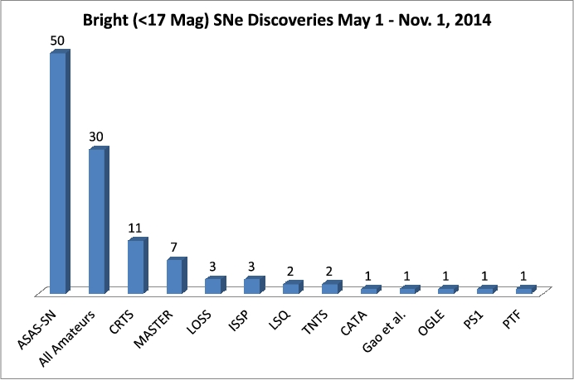
August 26th, 2014

Slide 20
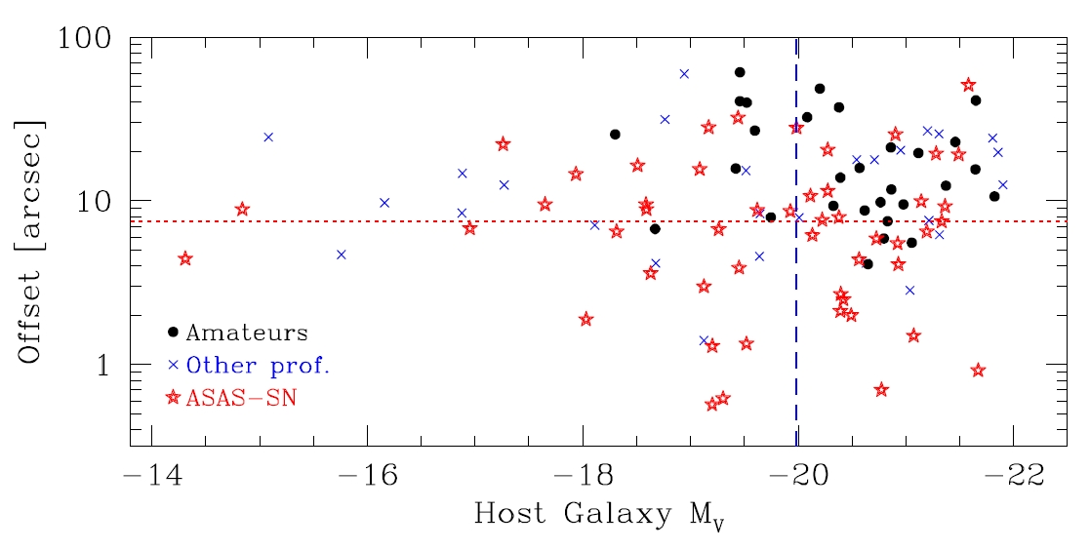
Unbiased Sample of Bright SNe
August 26th, 2014

Slide 21
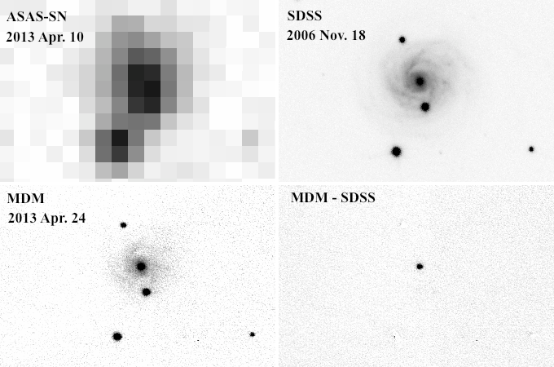
“Changing look” AGN: NGC 2617
ASAS-SN triggered on a 10% increase in flux from AGN + host
Follow-up imaging showed AGN continued to brighten by 1.3 mag
Shappee et al. 2014
Notes:
EVN (European VLBI Network)

Slide 22
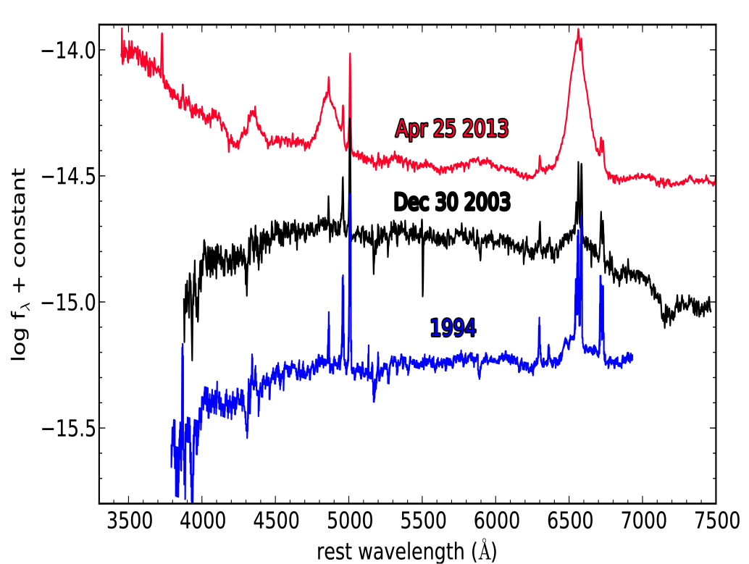
“Changing look” AGN: NGC 2617
Follow-up spectroscopy showed that the AGN changed from a Seyfert type 2 to 1.0
Applied for Swift TOO observations
Shappee et al. 2014

Slide 23
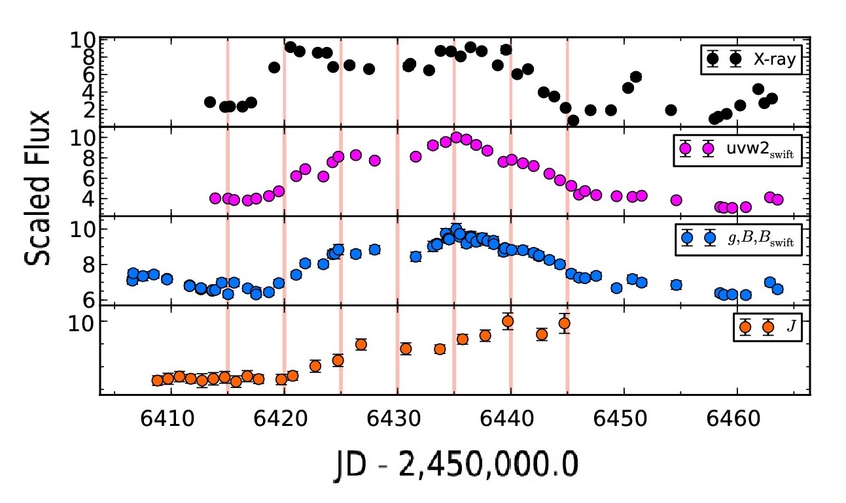
NGC 2617 X-ray–NIR light curves
Shappee et al. 2014

Slide 24
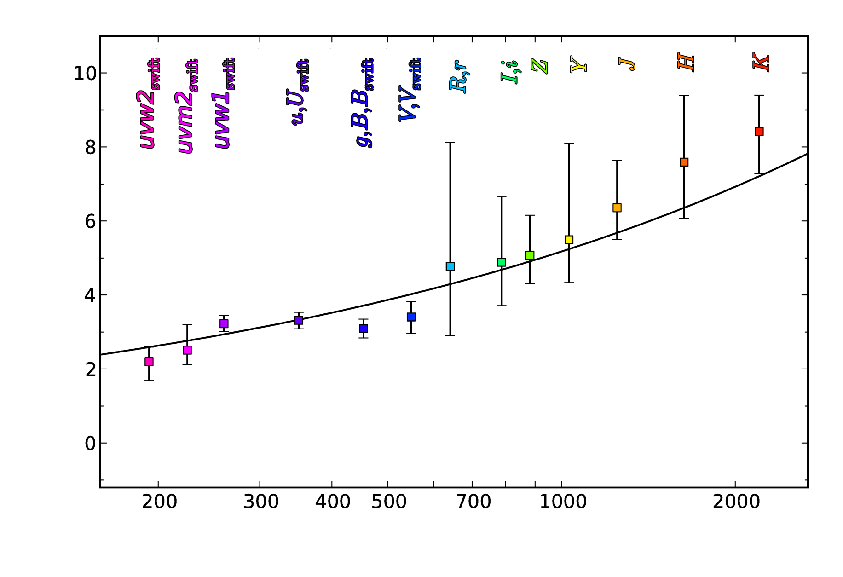
NGC 2617 Photometric Lags
Shappee et al. 2014

Slide 25
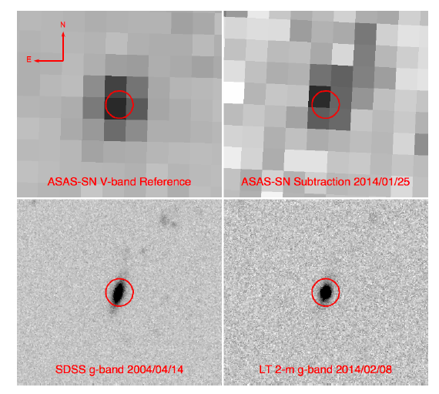
Tidal Disruption Event ASASSN-14ae
ASAS-SN triggered on a faint, V=17.1 event
Follow-up Swift imaging showed a very blue event
Holoien et al. 2014b
Notes:
EVN (European VLBI Network)

Slide 26
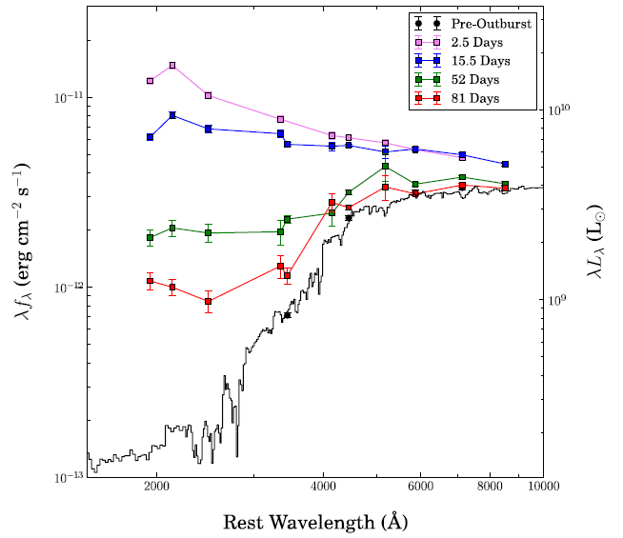
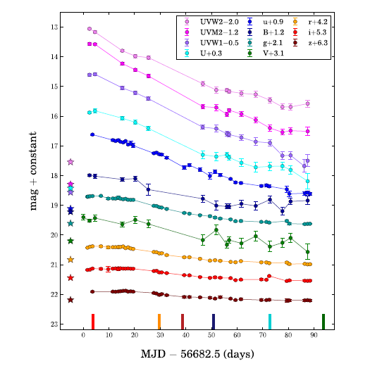
Notes:
EVN (European VLBI Network)

Slide 28
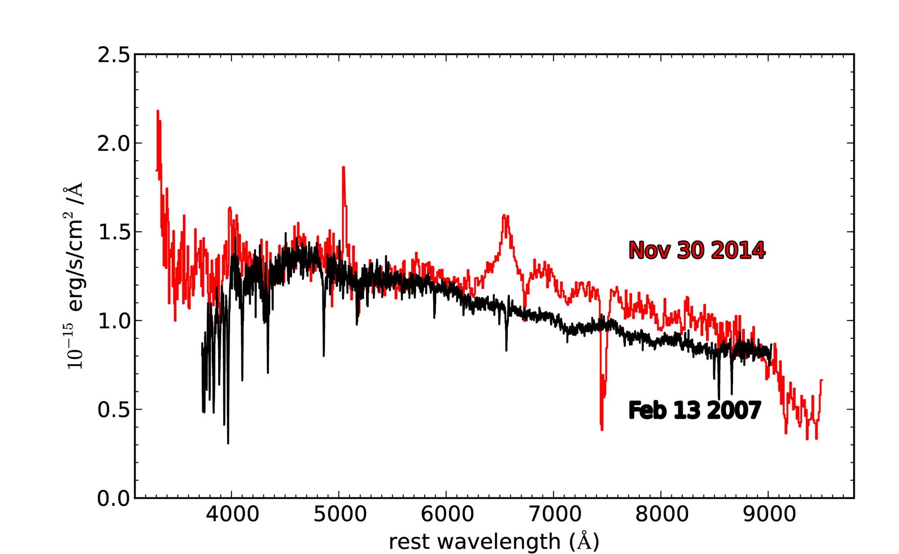
Tidal Disruption Event ASASSN-14li
Notes:
EVN (European VLBI Network)

Slide 29
ASAS: Looking Back
The original All-Sky Automated Survey (ASAS)
Low cost project to monitoring of the whole available sky
$8≤V≤14$ mag
${10}^{7}$ stars and 50,000 new variables
500+ publications with “ASAS” in their abstract (80 in 2013)
ASAS-SN
Faster cadence
Deeper ($V ≤17$ mag)
Reduce data in real-time

Slide 30
Planning the Future

Slide 31
ASAS-SN: Looking Forward
Finish commissioning ASAS-SN South, “Cassius” and its pipeline
June 2014 (Done!)
Improve cadence, sky coverage, and gaps in data
15,000 square degrees a night
Further Expansion
With 4 sites and 16 cameras
→ entire sky every night!
→ I-band in the Galactic plane?
All light curves public in real time
Long term goal
Notes:
I will leave a verbose summary and take your questions

Slide 33
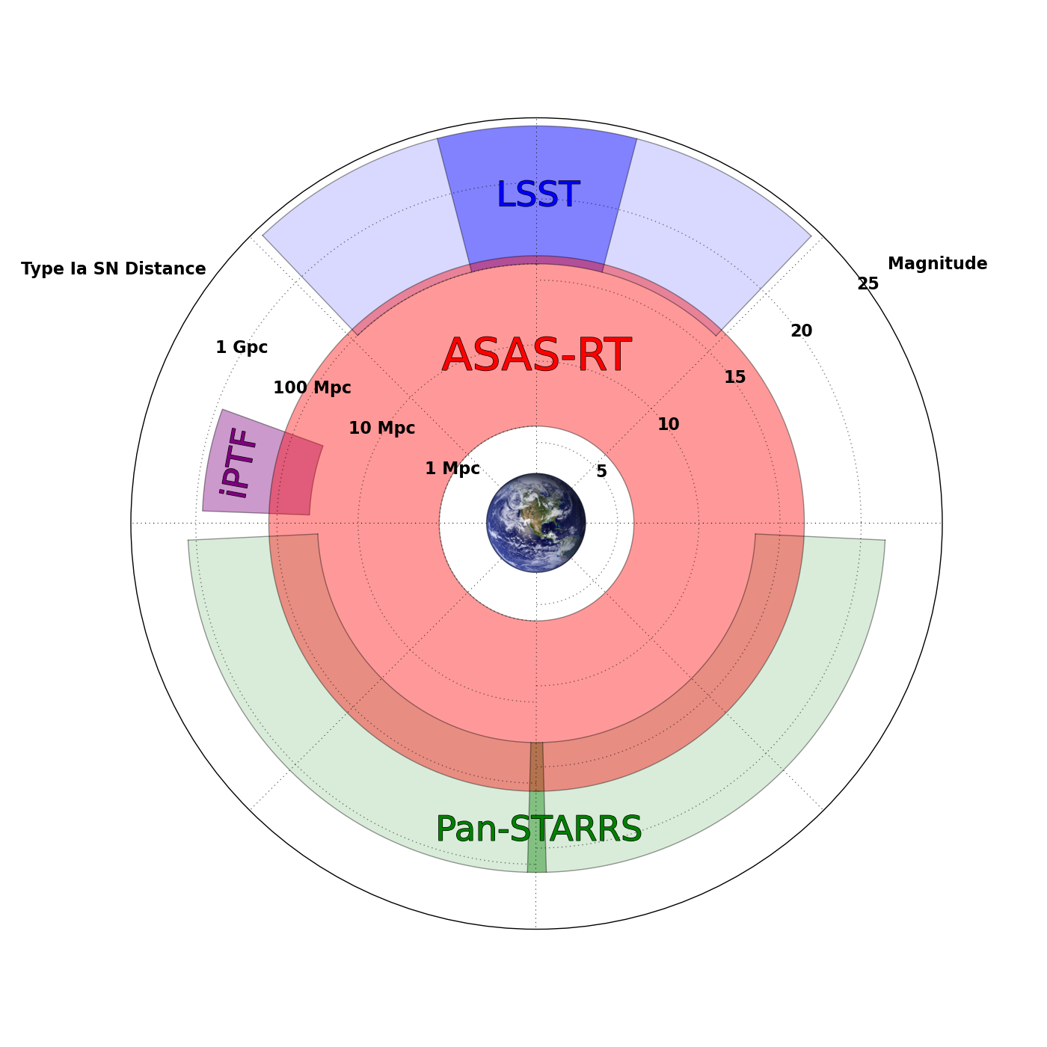

Slide 34
ASAS-SN Needs You!
FOR ASAS-SN!

