Slide 1
Status of test kit and update on HVStripV1 tests at RAL
J. Dopke, T. Huffman, J. J. John, K. Kanisauskas, M. Stanitzki, M. Warren

Slide 2
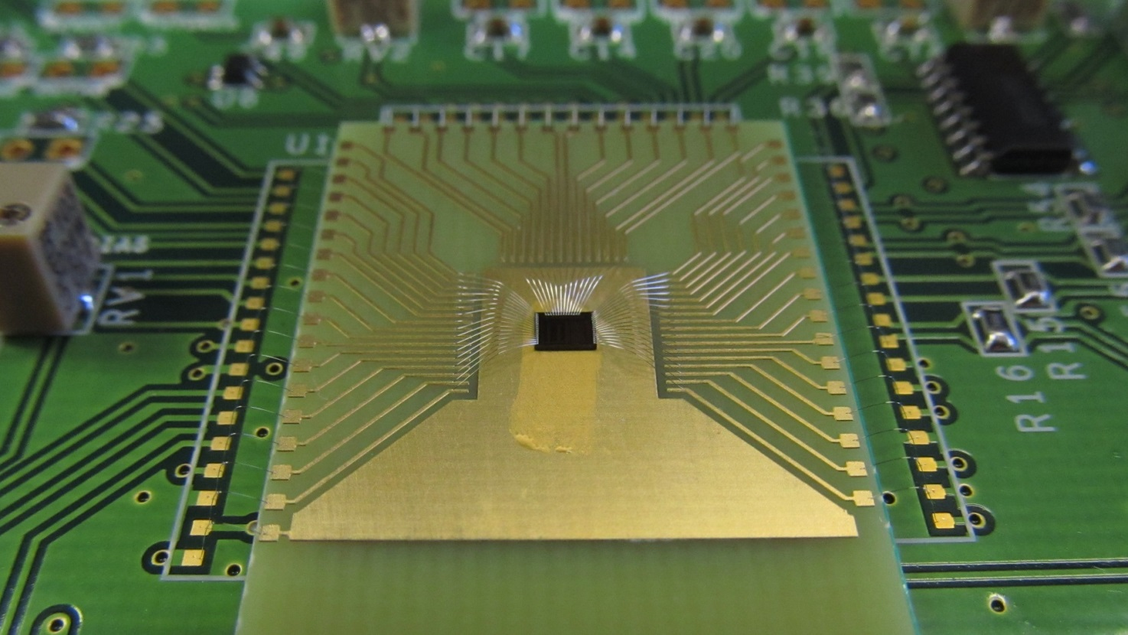
HVStripV1 hardware status
12 more daughterboards bonded at RAL
6 aluminium on kapton
6 copper on FR4, with nickel and gold plating
Half of each have chips glued with conductive glue and half with non-conductive glue
Of the copper boards, two have the wire bonds encapsulated (1 conductive glue , 1 non)

Slide 3
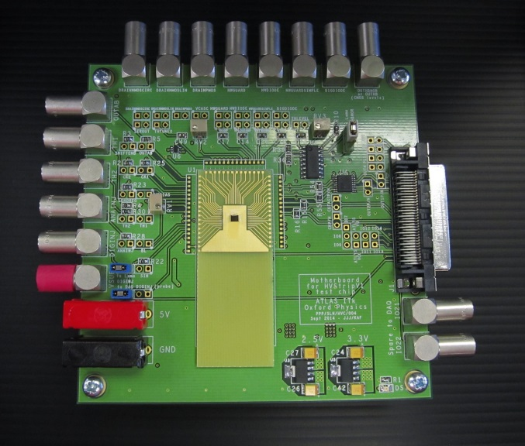
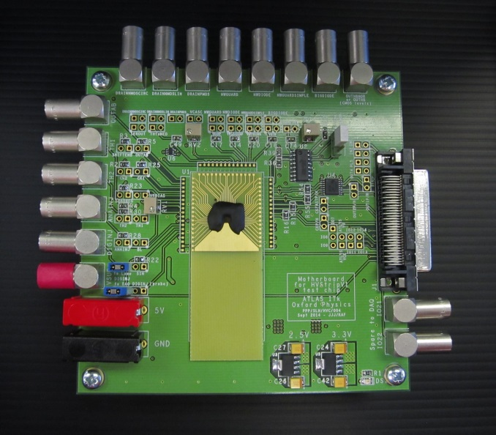
HVStripV1 hardware status
4 motherboards assembled so far
3 wire-bonded to daughterboards (copper) so far
Supplier delivered only 10 of 15 boards initially
Central cutout left out by supplier by mistake
Decided to assemble an initial 4 without the cutout, to maintain schedule
12 corrected boards delivered today
Thanks to Mark Jones and Paul Booker for expediting the motherboard assembly and the wire-bonding.

Slide 4
Motherboard – initial assignments
Number | Group
1 | DESY
1 | Glasgow
1 | Oxford
1 | RAL
let us know your needs | Other groups

Slide 5
Towards HV CHESS test boards
Daughterboard quick spec:
Similar to HVStripV1 daughterboard but include space for wire-bondable capacitors
Fanout pads:
Power, ground, substrate voltage
15 pads per array of active pixels, x 8 arrays
Pads for passive pixels for Edge TCT
Try for cutout for edge TCT, for passive pixels, plus adjacent active array if possible
Specs from Ljubljana: 2.5° beam angle, 8cm distance

Slide 6
Towards HV CHESS test boards
Motherboard quick spec:
Regulate power down from 5V
Have 6 bias supplies for active pixel arrays (6 connectors only - common to all 8 arrays)
Use jumpers to select one pixel at a time per array to connect to test connector
Consider SMA connectors instead of Lemos to reduce costs
We need precision current bias supplies for iN, iNBias, iPFB and iNSF. Are people happy to use 4 source meters for this? Do we want current DACs on board?
Pad number | Pad name | Value
1 | iN | 65µA
2 | Casc | 2.4V
3 | VPload | 1.85V
4 | iBias | 7nA
5 | iFB | 2nA
6 | iNSF | 20nA

Slide 7
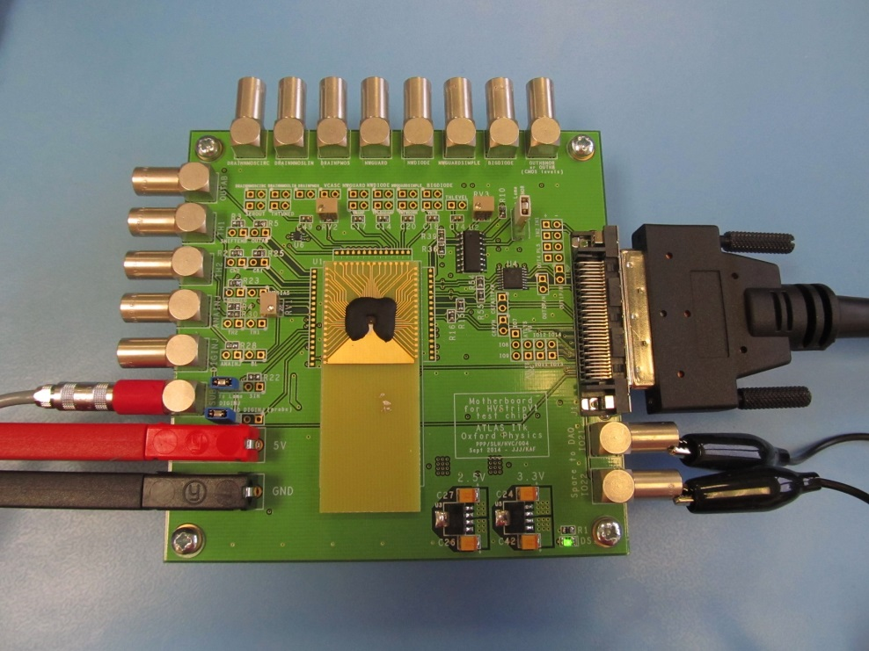
HVStripV1 test results
Tests so far:
Digital injection of one hit and digital readout to Atlys DAQ - working
Digital injection of two hits and digital readout to Atlys DAQ - working
Analogue injection of one hit and digital readout to Atlys DAQ – not working yet - OutAB pulse not seen

Slide 8
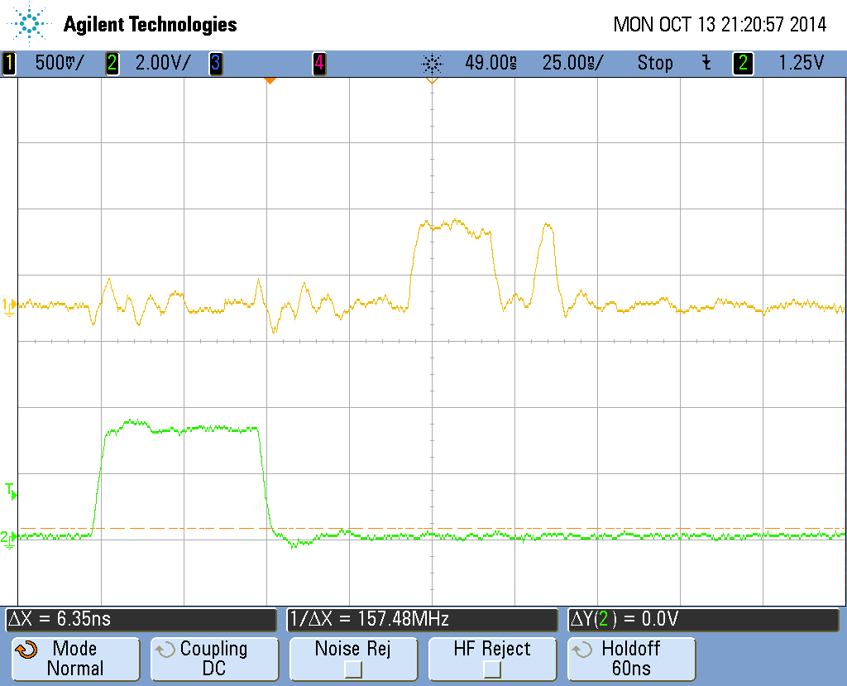
Digital Injection – One hit

Slide 9
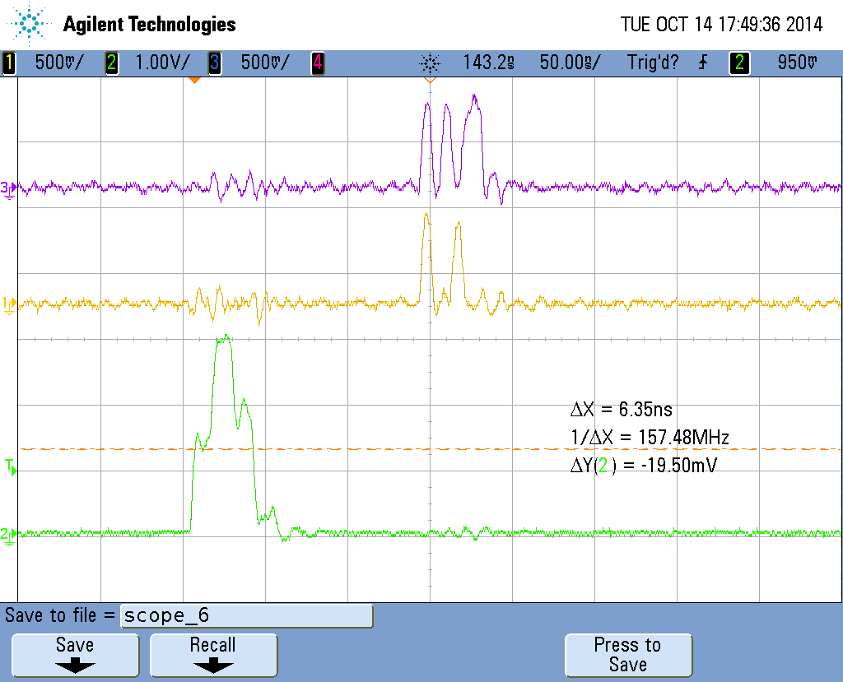
Digital Injection – Two hits

