Slide 1

FLASH2
Extension of the FLASH Facility
Elektronenstrahldiagnose in FLASH2
N. Baboi, MDI
für den Diagnose-Team
Beschleuniger-Betriebsseminar 2015
Grömitz, 24. März 2015

Slide 2
Inhalt
FLASH2
FLASH2 Standard-Diagnostik Überblick
  Allgemeine Eigenschaften
  Elektronik
  Inbetriebnahme (allgemein)
Diagnostik-Monitore in FLASH2
Zusammenfassung
  Ladungs-Monitore / toroide
  Toroid Protection System (TPS)
  Schirme
  Beam Position Monitors (BPM):
  Cavity, Button und Stripline BPMs
  Beam Loss Monitors (BLM)
  Beam Halo Monitors
  Ionizations-Kammern
  Cherenkov-Verlustmonitore

Slide 3
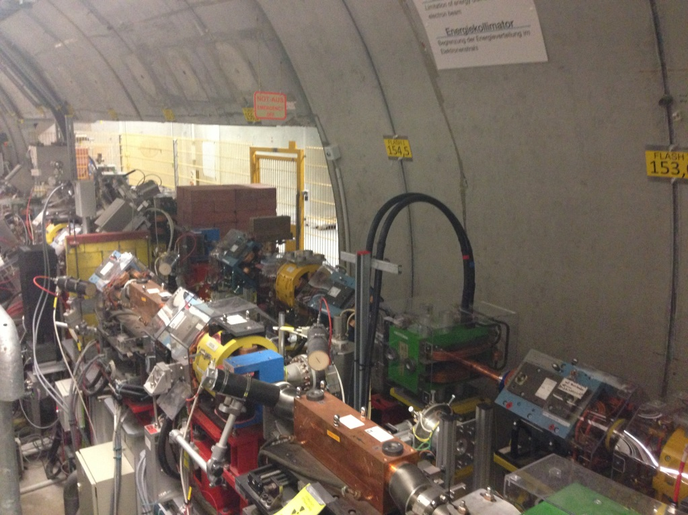
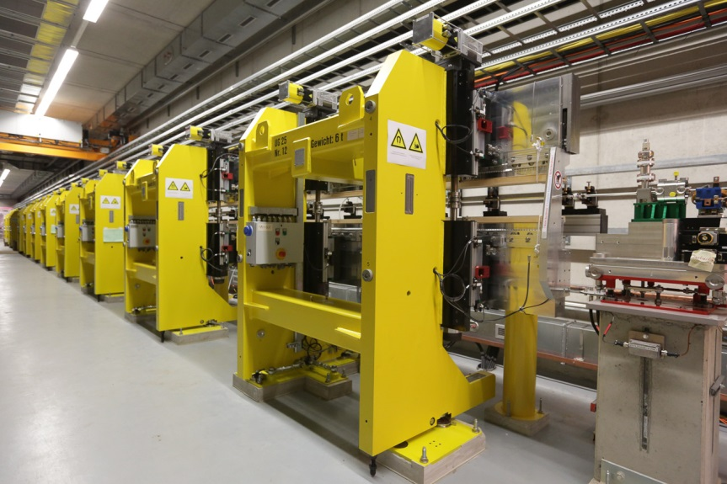
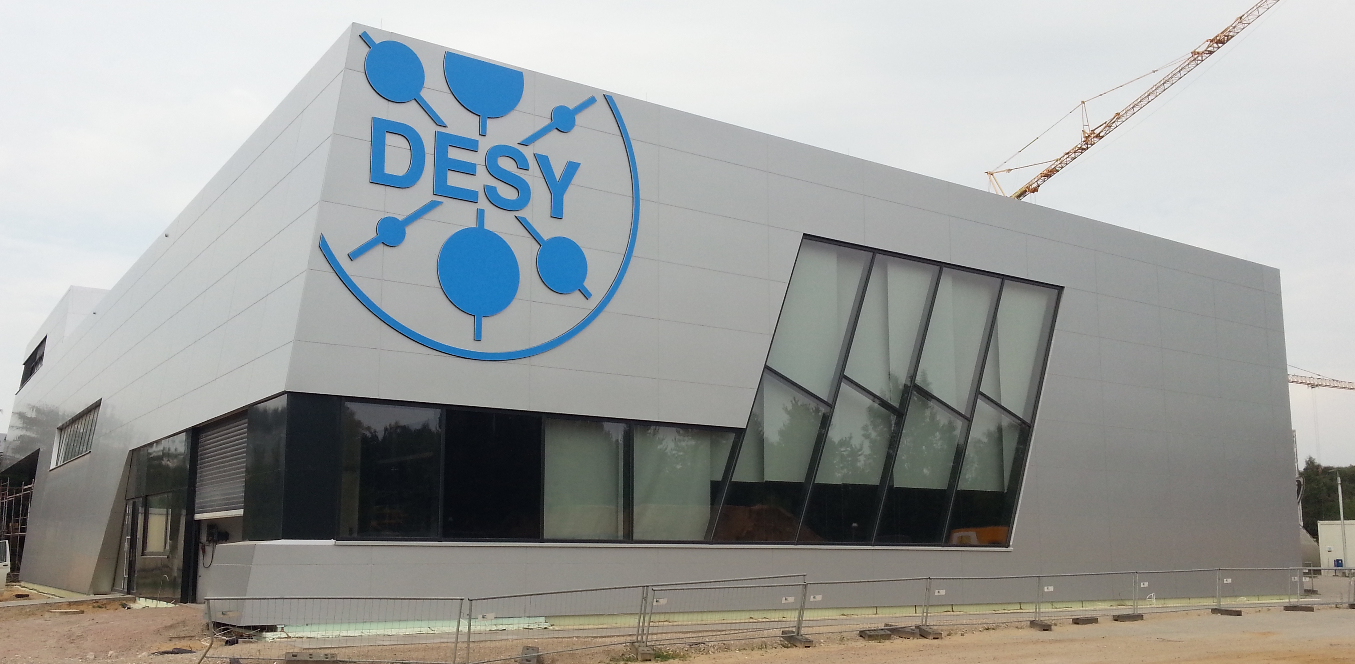
FLASH2
315 m
Soft X-ray Undulators
RF Stations
Accelerating Structures
sFLASH
Photon Diagnostics
FLASH1
THz
RF Gun
Bunch Compressors
FLASH2
Lasers
5 MeV
150 MeV
450 MeV
1250 MeV
Beam Dump
FEL Experiments
≥ 30 μs
gap
Extraction to FLASH2
FLASH2 variable gap undulators
FLASH2 Experimental Hall

Slide 4
Typische Parametern
 | FLASH(1) | FLASH2 | E-XFEL
Max. energy [GeV] | 1.25 | = | 17.5
Pulse repetition rate [Hz] | 10* | 1-10* | 10
Max. bunch frequency [MHz] | 1 | = | 4.5
Max. pulse duration [μm] | 800 | = | 600
Charge [nC] | <0.1 – 1 | = | 0.02 - 1
Photon wavelength [nm] | 4.2 – 45 | 4 – 60 | 0.05 - 6
* FLASH2 operates sometimes at 1 Hz to reduce activation

Slide 5
Inhalt
FLASH2
FLASH2 Standard-Diagnostik Überblick
  Allgemeine Eigenschaften
  Elektronik
  Inbetriebnahme (allgemein)
Diagnostik-Monitore in FLASH2
Zusammenfassung
  Ladungs-Monitore / toroide
  Toroid Protection System (TPS)
  Schirme
  Beam Position Monitors (BPM):
  Cavity, Button und Stripline BPMs
  Beam Loss Monitors (BLM)
  Beam Halo Monitors
  Ionizations-Kammern
  Cherenkov-Verlustmonitore

Slide 6
FLASH2 Standard-Diagnostik: Überblick
Most monitors were designed for the European XFEL
  Make use of synergies given by the similar time line
  Some have been designed specially for FLASH(2) or have a temporary solution
Deliver bunch by bunch measurements, with few exceptions
Generally based on MTCA-technology
  Modular architecture, high availability, redundant power, well defined management.
  9 MTCA crates for diagnostics installed at FLASH2
Challenges (not only for diagnostics)
  MTCA previously not fully developed
  x2timer, power supplies
  Low charge
  Different charge for FLASH1 and FLASH2 within the same pulse
  Different rep-rate of bunch trains FLASH1 and FLASH2 (10 vs 1 Hz)

Slide 7
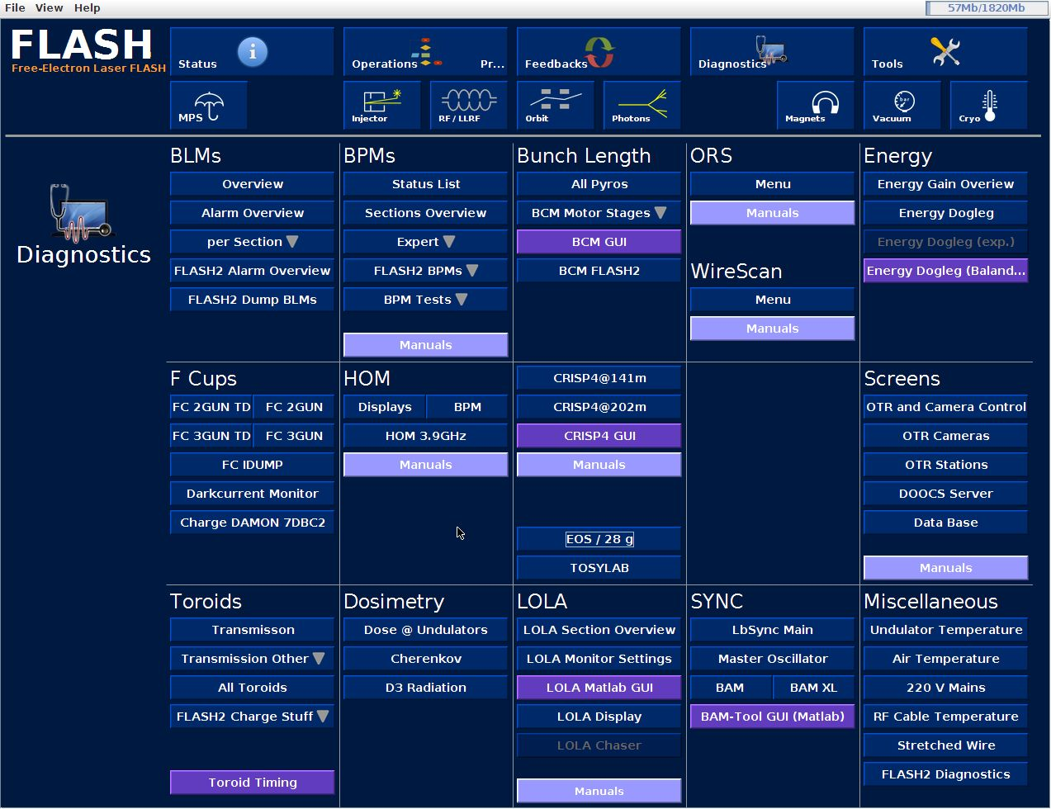
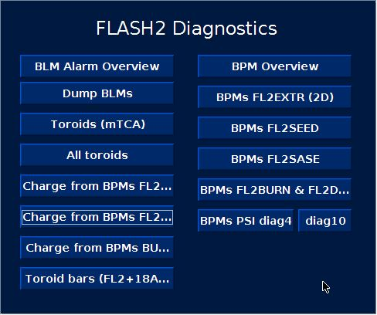
Diagnostik Panel

Slide 8
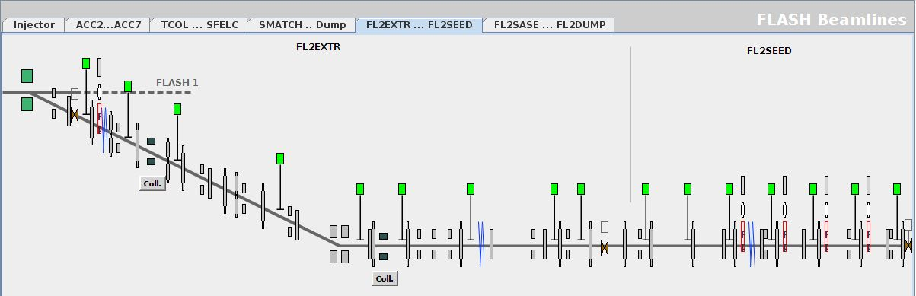
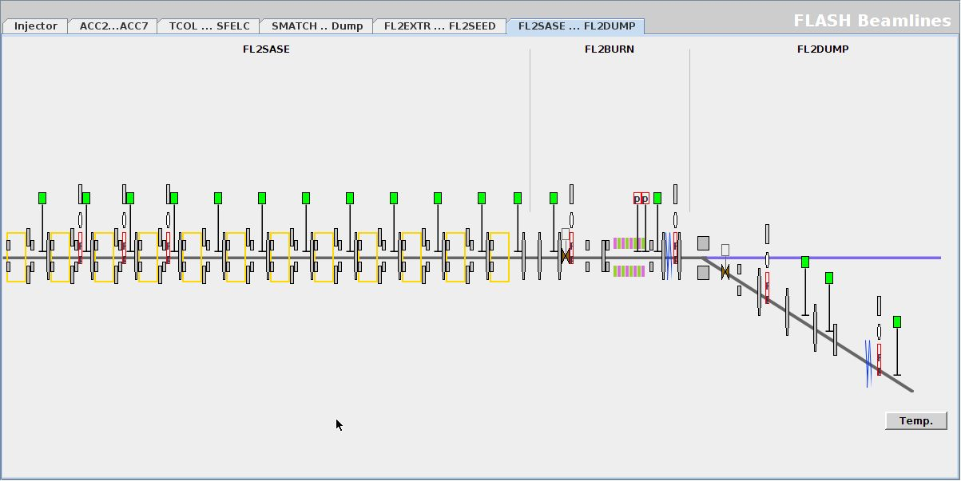
Orbit Panels

Slide 9
Neue Standard Diagnostik in FLASH
 | Pipe Ø (mm) | FLASH(1) | FLASH2% | XFEL&
Toroids | 40.5 & 100 |  | 5 | 36
Screens | 40.5 & 96 |  | 7 | 64
Screen on dump-window |  |  | 1 | 3
Cavity BPMs (10 mm) | 10 | 3 (for tests) | 17 | 101
Button BPMs | 10 - 96 | 4 | 12 | >300#
Stripline BPMs | 34 & 44 |  | 4 | -
BLMs | - |  | ~56 | >300
BHMs | 100 | 1 | 1 | 4
% Also other diagnostics, not XFEL-type: e.g. Ionization chambers, Cherenkov monitors
* With FLASH-electronics and with test-LCBPM-electronics
# Electronics: by PSI at XFEL, by DESY at FLASH2 (LCBPM)
& Also other diagnostics, not installed in FLASH2: e.g. Wire Scanners, Dosimetry monitors

Slide 10
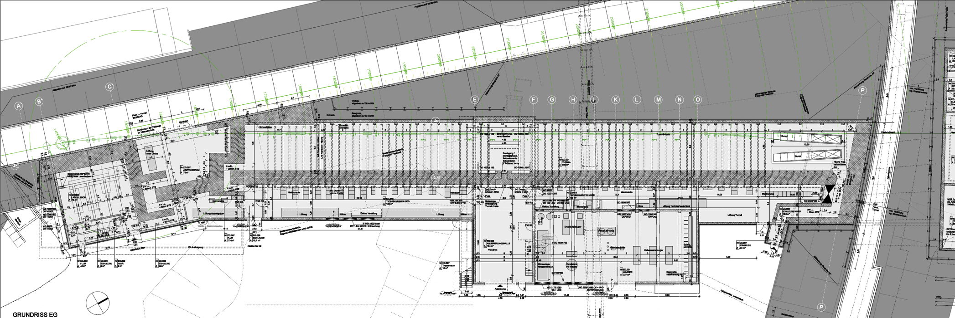
FLASH2 Tunnel und technische Abseite
SASE undulators
FLASH1 Tunnel
ACC7
FLASH2 Tunnel
Extraction
Electronics installed in technical corridor, parallel to tunnel
  At the XFEL: all diagnostics electronics installed in the tunnel

Slide 11
Diagnostik-Inbetriebnahme
“Cold” Commissioning
  Check monitors (mostly vacuum parts):
    e.g.: screens: motors, light; BPMs: short, symmetry
  Check cables
  Technical checks of electronics
    Check individual components (mostly MTCA-based) and how the parts work together
    Check availability and quality of signals needed: timing, IT
  Test servers
  Panels (!)
  Pre-calibration: either theoretical values or from lab measurements
Commissioning with beam
  Adjustment of trigger, clock
  Adjustment of electronics settings
  Calibration with beam

Slide 12
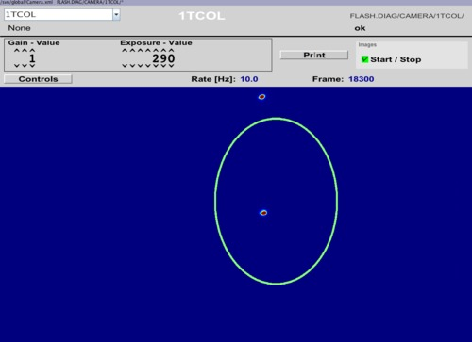
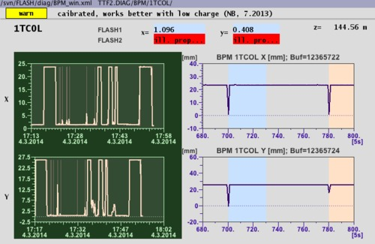
Erster Elektronen-Strahl in FLASH2
Beam separation seen on BPM and screen before septum
RF Stations
Soft X-ray Undulators
Accelerating Structures
sFLASH
Photon Diagnostics
FLASH1
THz
RF Gun
Bunch Compressors
FLASH2
Lasers
Beam Dump
FEL Experiments

Slide 13
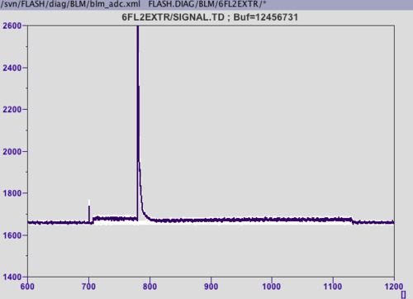
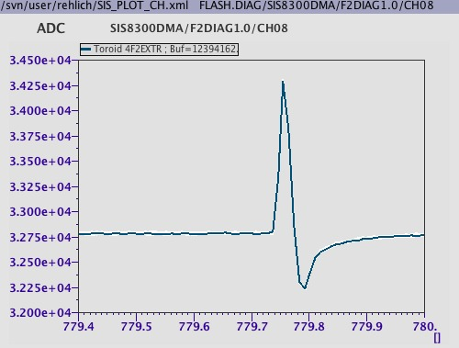
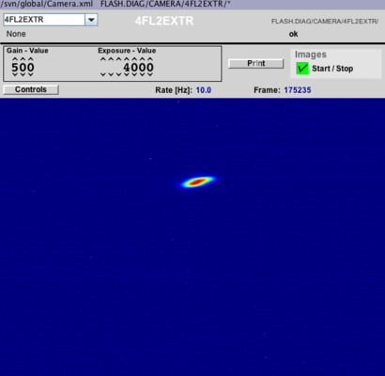
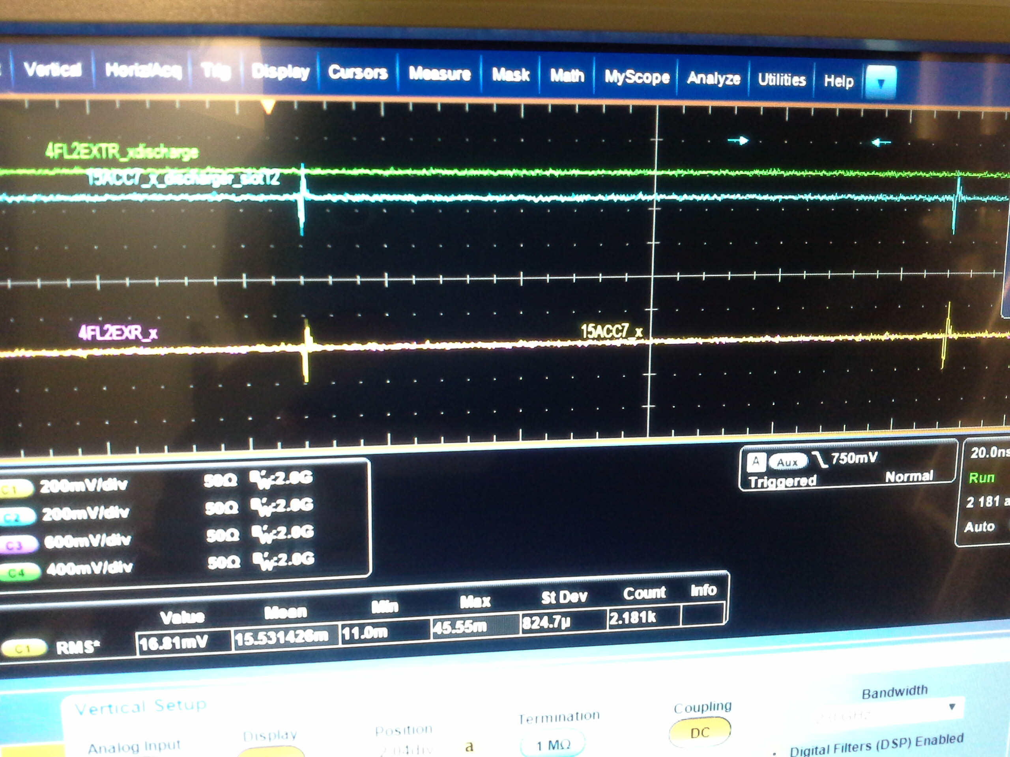
Erster Elektronen-Strahl in FLASH2 Extraktion
FLASH1
BLM
(raw)
Toroid
(raw)
FLASH2
BPM (Scope)
Screen

Slide 14
Inhalt
FLASH2
FLASH2 Standard-Diagnostik Überblick
  Allgemeine Eigenschaften
  Elektronik
  Inbetriebnahme (allgemein)
Diagnostik-Monitore in FLASH2
Zusammenfassung
  Ladungs-Monitore / toroide
  Toroid Protection System (TPS)
  Schirme
  Beam Position Monitors (BPM):
  Cavity, Button und Stripline BPMs
  Beam Loss Monitors (BLM)
  Beam Halo Monitors
  Ionizations-Kammern
  Cherenkov-Verlustmonitore

Slide 15
Diagnostik-Monitore in FLASH2
Charge monitors / toroids
Toroid Protection System (TPS)
Screens
Beam Position Monitors:
Cavity BPMs (CBPM)
Button and Stripline BPMs
(Low Charge BPMs)
Beam Loss Monitors (BLM)
Beam Halo Monitors
Ionization Chambers
Cherenkov Monitors
Beam Arrival Monitors
Bunch Compression Monitor etc.
XFEL-type

Slide 16
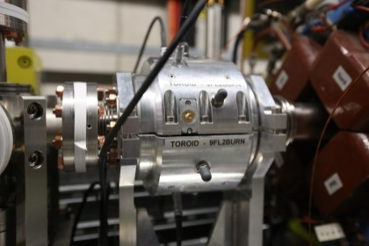
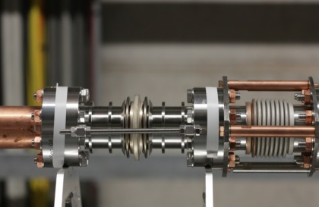
Ladungs-Monitore / Toroide
System for the XFEL under test
  Network of monitors to interlock on
  transmission and bunch pattern failure
  Noise < 1 pC
Temporary solution for FLASH2
  Put signal from front-end electronics on MTCA-ADC
  Differential signal sent over CAT cables
M. Werner, IBIC2014, WEPF02
W
+
Front-end
Adapter RTM
RTM SIS8900
W
W
+
W
+
AMC SIS8300

Slide 17
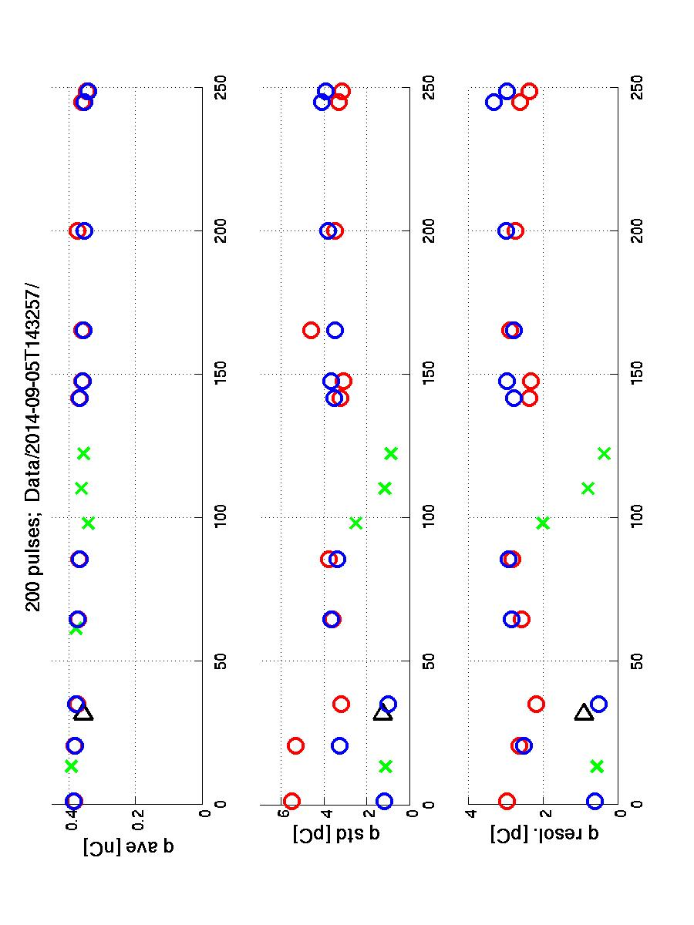
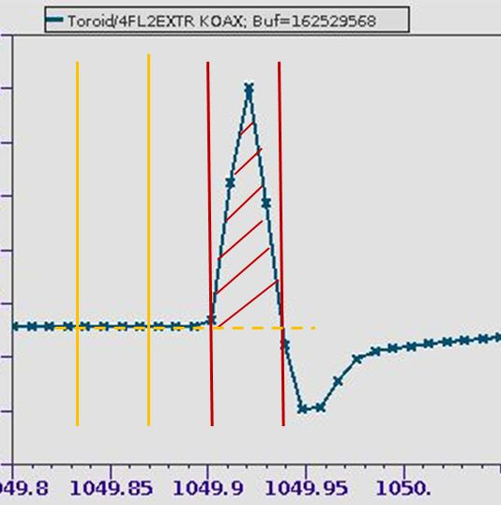
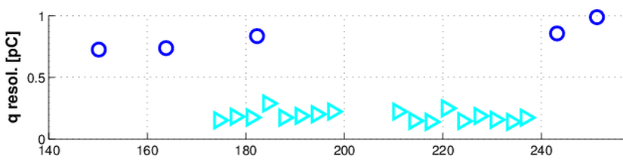
Ladungs-Monitore / Toroide
Resolution of charge monitors along FLASH(1) (~ 0.4 nC)
o FLASH-type (VME)
o FLASH2-type (MTCA)
O FLASH2 with new
amplifier
►
FLASH1 / 0.4nC
► Dark current monitor
Resolution measured with intermediate solution: < 1 pC rms
FLASH2 / 0.3nC
toroide
Cavity BPMs

Slide 18
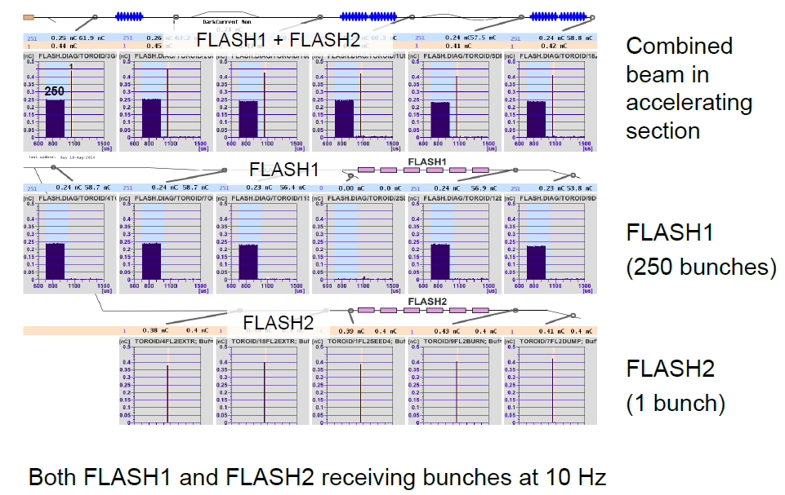
Toroide:
Strahl-Verteilung zu FLASH1 und FLASH2

Slide 19
Toroid Protection System (TPS)
At XFEL:
Temporary solution
using 3 TPS modules
designed for FLASH
M. Werner, WEPF02
TPS 0
TPS 1
RF Stations
Soft X-ray Undulators
Accelerating Structures
sFLASH
Photon Diagnostics
FLASH1
THz
RF Gun
Bunch Compressors
FLASH2
Lasers
5 MeV
150 MeV
450 MeV
1250 MeV
Beam Dump
FEL Experiments
A. Hamdi, DIPAC 2007, p. 349
TPS 2

Slide 20
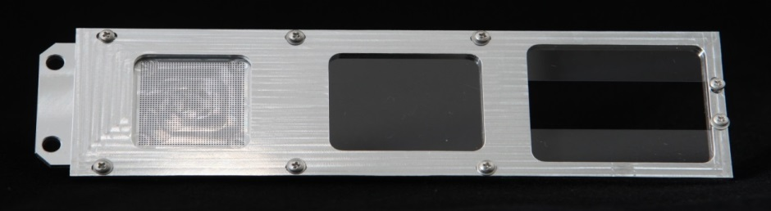
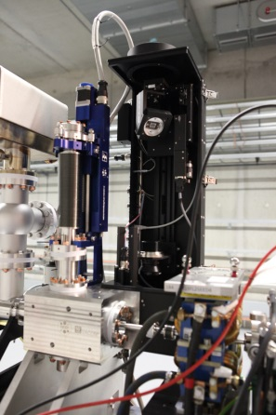
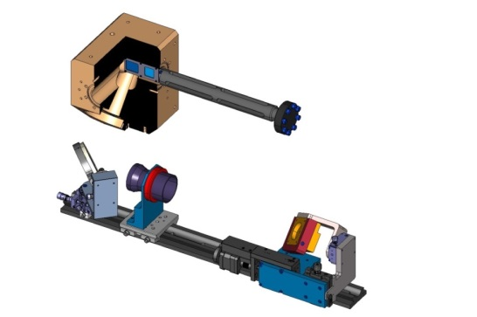
Schirme
Scintillator based
(LYSO:Ce), spatial
suppression of COTR
Optics:
  Look under 45 deg
  Uses “Scheimpflug´s” principle
  to extend depth of field
10 µm resolution required
  single bunch, streaked
Demonstrated at FLASH1
Dot Grid Target(spot Ø .50mm)
200µm thick LYSO Screen (ON-Axis)
2 half 200µm thick LYSO Screens (OFF-Axis)
Optics Axis
C. Wiebers, IBIC2013, WEPF03
BEAM

Slide 21
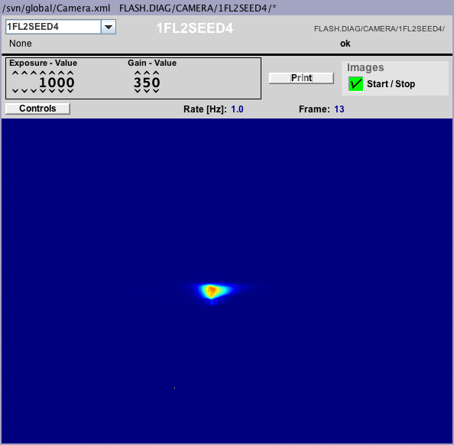
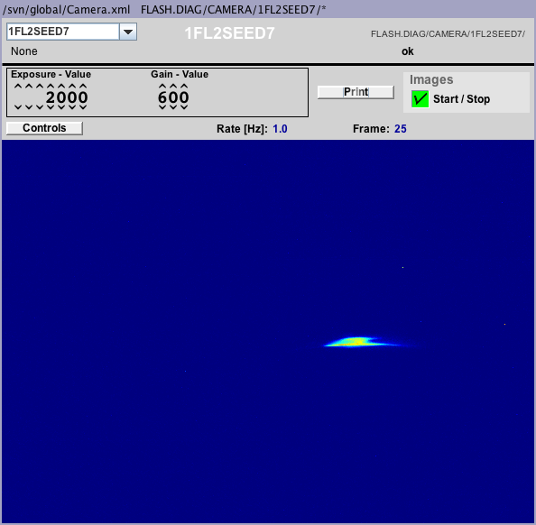
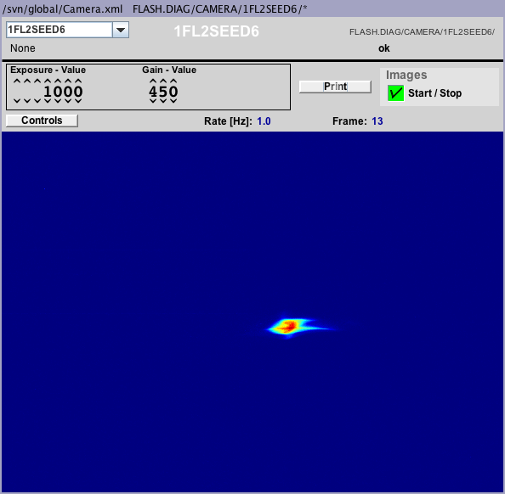
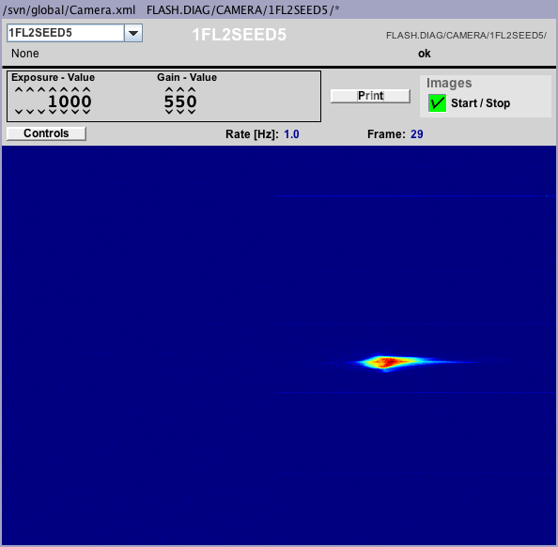
Schirme
1FL2SEED4
1FL2SEED5
FLASH1
1FL2SEED6
1FL2SEED7
FLASH2
Fully commissioned

Slide 22
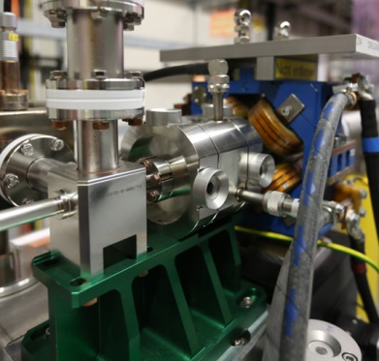
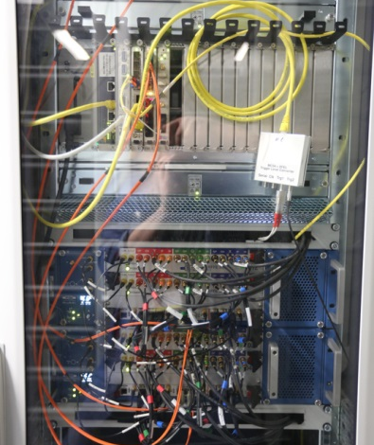
Cavity BPMs
Cavities
  Dipole + reference resonator
  3.3 GHz, low Q (about 70)
  17 installed between undulators –
  10 mm pipe
  No individual tuning
Readout (PSI)
  MBU (Modular BPM Unit) with 2 RFFE for 2 cavity BPMs
  Up to 4 MBUs connected to 1 DAMC2 interface board
  Timing: decoding timing protocol via fiber in MBU
Resolution requirement
  2 μm rms for 0.1-1 nC and within ± 0.5 mm
  (1 μm at XFEL, but longer cables at FLASH2)
M. Stadler, IBIC 2014, WEPD12

Slide 23
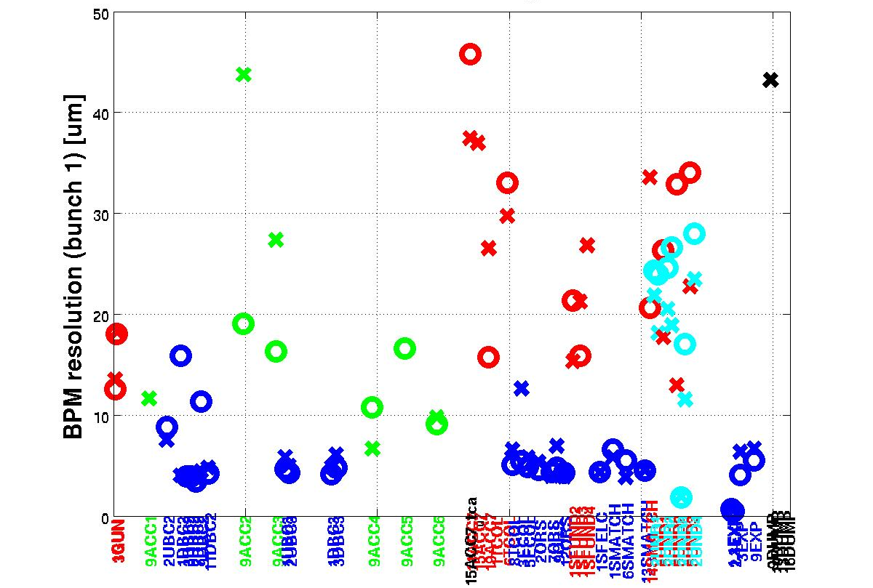
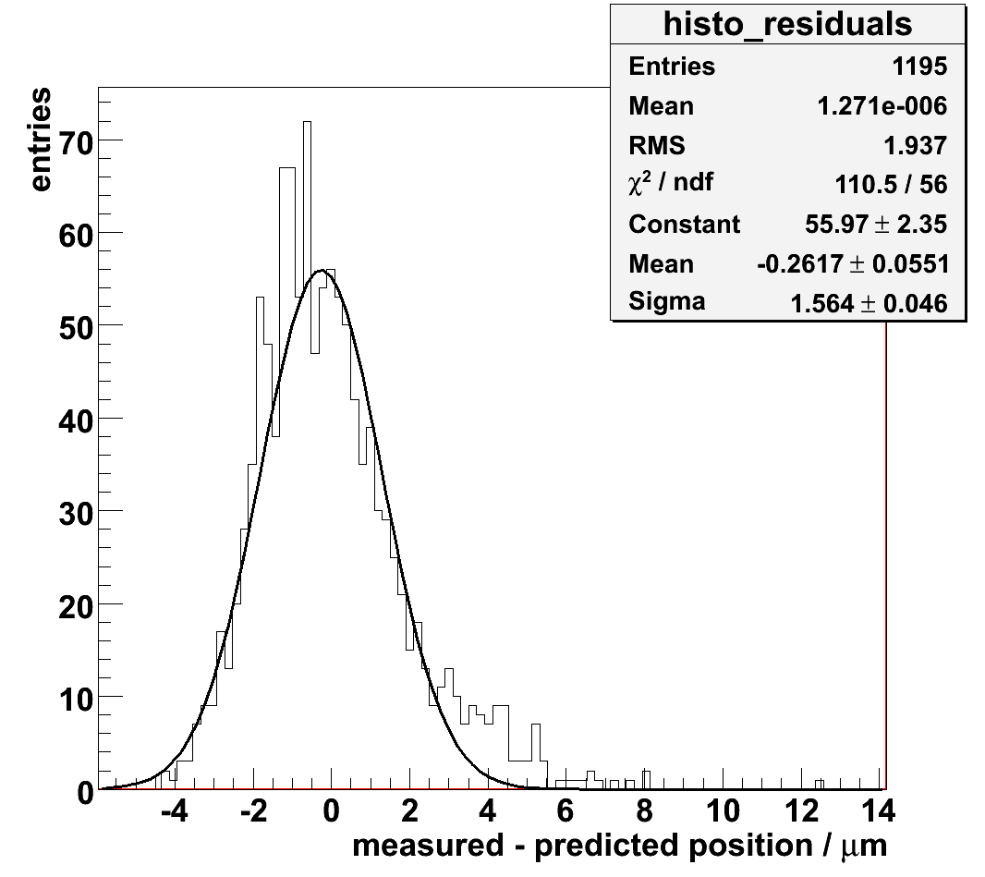
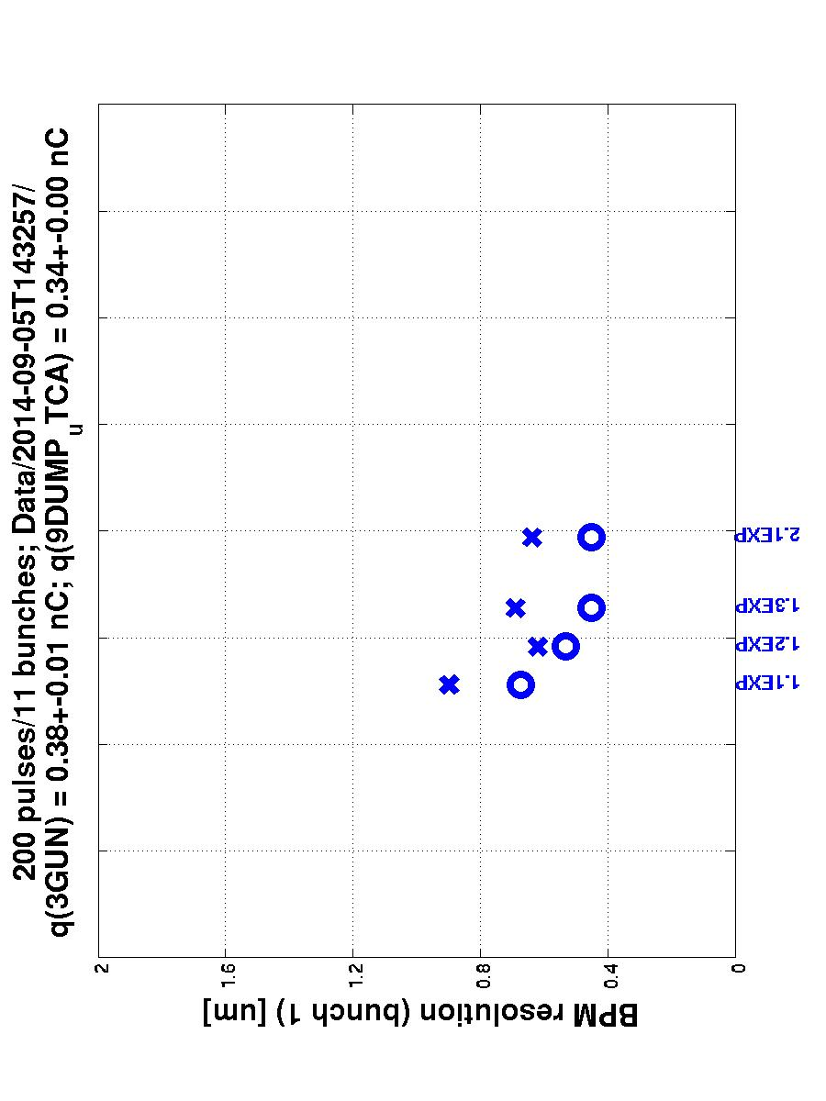
Cavity BPMs: Gemessene Auflösung
Test BPMs in FLASH1
  0.5 μm rms for 0.24 nC bunch charge
  and 0.5 mm bunch offset
BPMs in FLASH2
  Difference between expected and measured position with Gaussian fit
Resolution of various FLASH1-BPMs
(designed for 1 nC)
D. Lipka,
IBIC 2014,
TUPF07
~0.35 nC
preliminary

Slide 24
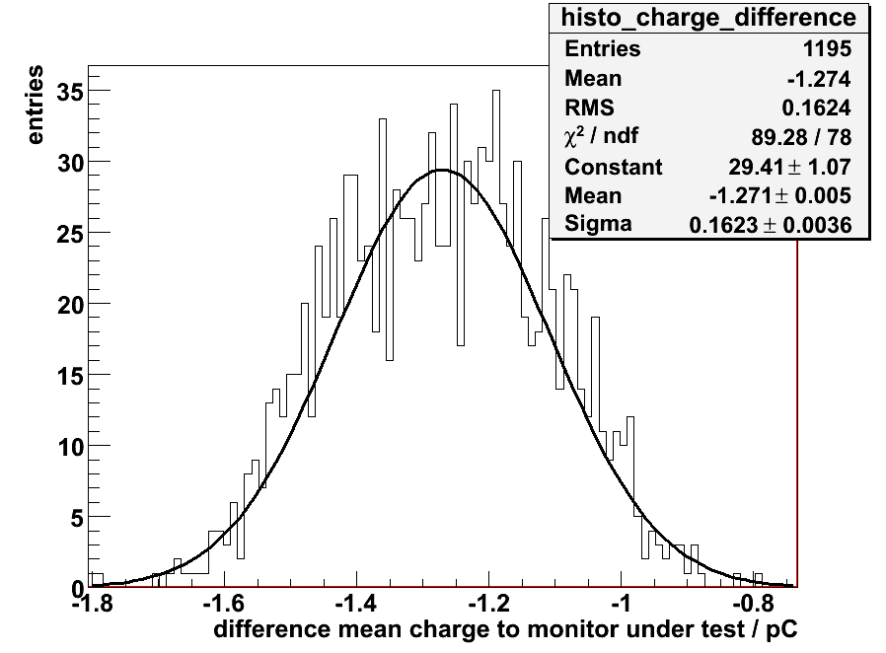
Cavity BPMs: Ladungs-Messung
Charge resolution for 100 pC bunch charge
< 0.2 pC rms
FLASH2 / 0.3nC
toroide
Cavity BPMs
D. Lipka, IBIC 2014, TUPF07

Slide 25
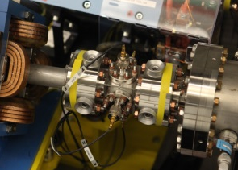
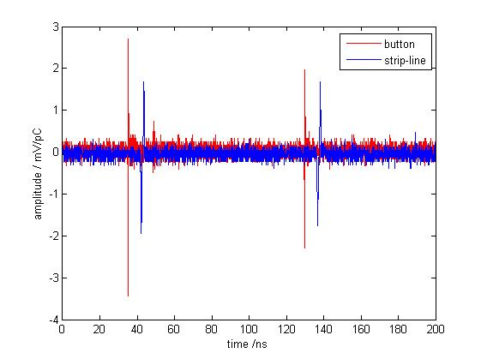
Button und Stripline BPMs: Überblick
Low Charge BPMs (LCBPM) electronics
  Name chosen in contrast to system designed for FLASH for charges of 1nC and higher
  Designed for FLASH2 (and to be installed in all FLASH)
Typical Signals from BUTTON/strip-line BPM
S. Vilcins, IBIC2014, TUPF11
Delay ~100ns
Signal of horizontal plane, delay line: ~100ns
B. Lorbeer, IBIC 2014, TUPF08
Button or
Strip-line BPM
Broadband
RF Combiner
RF cable 3/8“
Length < 80m

Slide 26
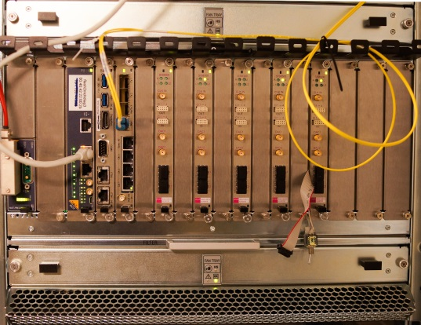
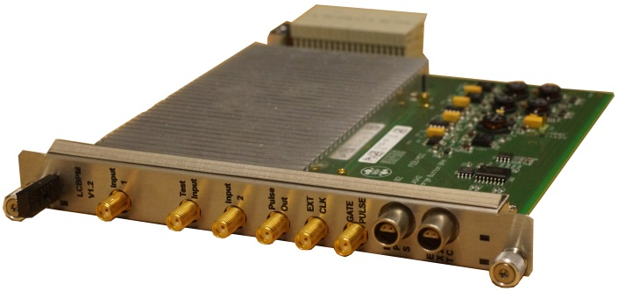
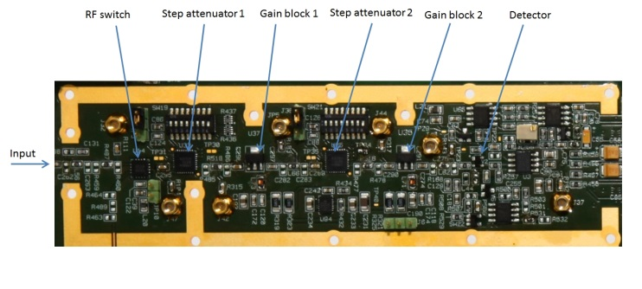
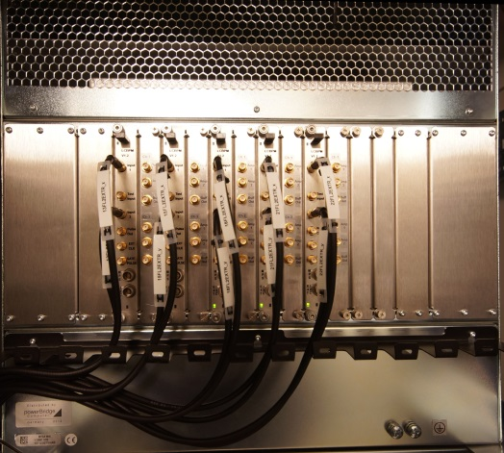
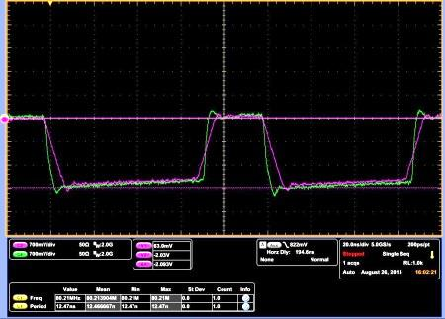
Button und Stripline BPMs: LCBPM
MicroTCA crate
RF Front-End
Rear Transition Module (RTM)
180mmx162mm
Compatible with the MTCA.4
for physics standard
Front
Side
5 BPMs/crate
G=38dB
Att.>60dB
Peak Detector
Back
Side
RTM Analog Output Signals
X-Channel
100ns
Y-Channel
Crate used for the tests includes:
management carrier hub (MCH)
hard disk (HD), processor (CPU)
Digitizer SIS8300
timing module x2timer

Slide 27
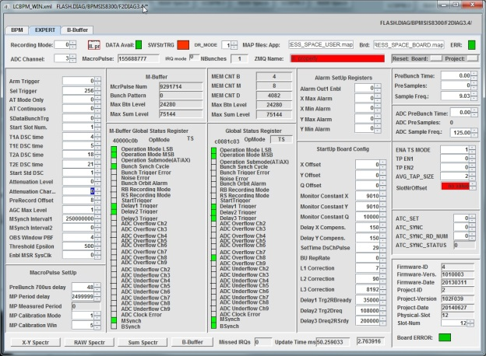
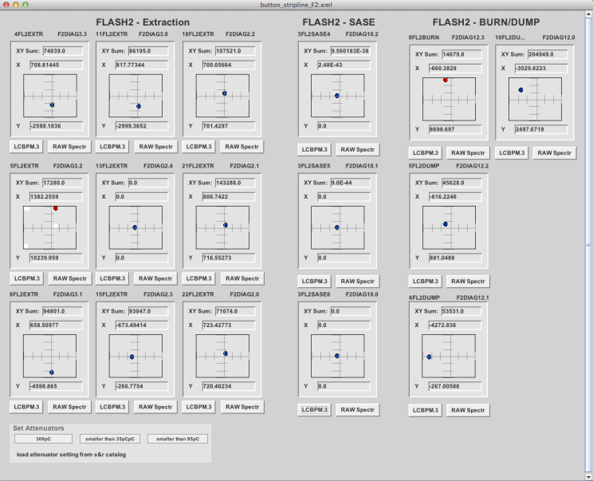
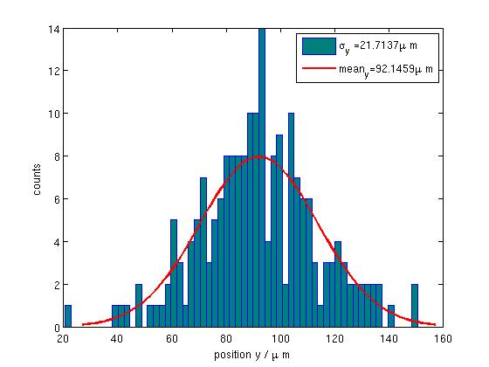
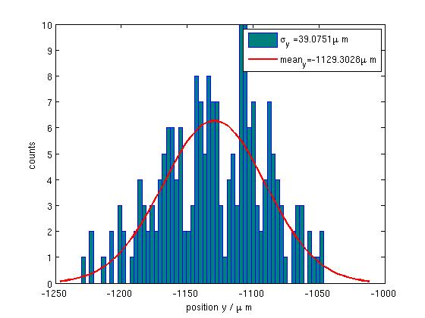
Button und Stripline BPMs: Betrieb
Server Panel for Firmware Adjustment
Requirements (from XFEL requirements)
bunch charge | 0.1-1 | nC
bunch spacing | ≥222 | ns
maximum macro-pulse repetition rate | 25 | Hz
beam pipe diameter | 40.5 | mm
single bunch resolution | 50 | μm
Averaged RMS resolution over 1000 bunches of identical train | 10 | μm
Range for max. resolution | +/- 3 | mm
Operation range with reasonable signal | +/-10 | mm
BPM Expert Panel
RMS at q=36 pC, 200 pulses (incl. beam jitter)
σ_{y} = 22 μm
σ_{y} = 39 μm
Strip-Line BPM
Button BPM

Slide 28
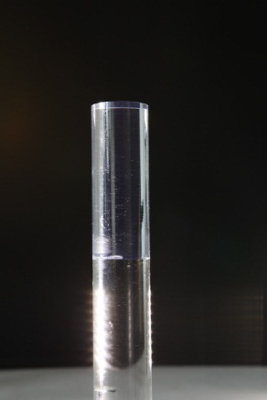
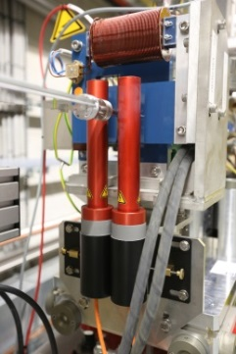
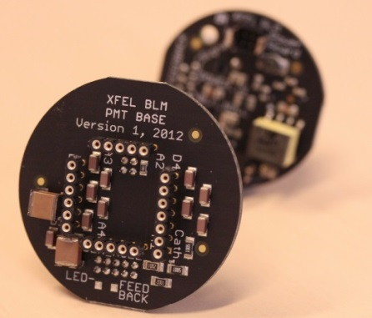
Beam Loss Monitors (BLMs)
Detector
  Scintillator or fused silica
  (rod or fiber)
  PMT: HV voltage (~500 V)
  generated by Cockcroft-Walton
  multiplier on board mounted at PMT
Electronics MTCA-based with
low latency interface with MPS
Alarms algorithms
  Single bunch
  Multi-bunch
  Integration
  OR of comparator and FPGA alarms
Beam Loss Monitor
Readout
Electronics
Scintillator
PMT
&
HV
Power control
Alarm
(to MPS)
e,γ,n⁰
A. Kaukher, BIW 2012, p. 35

Slide 29
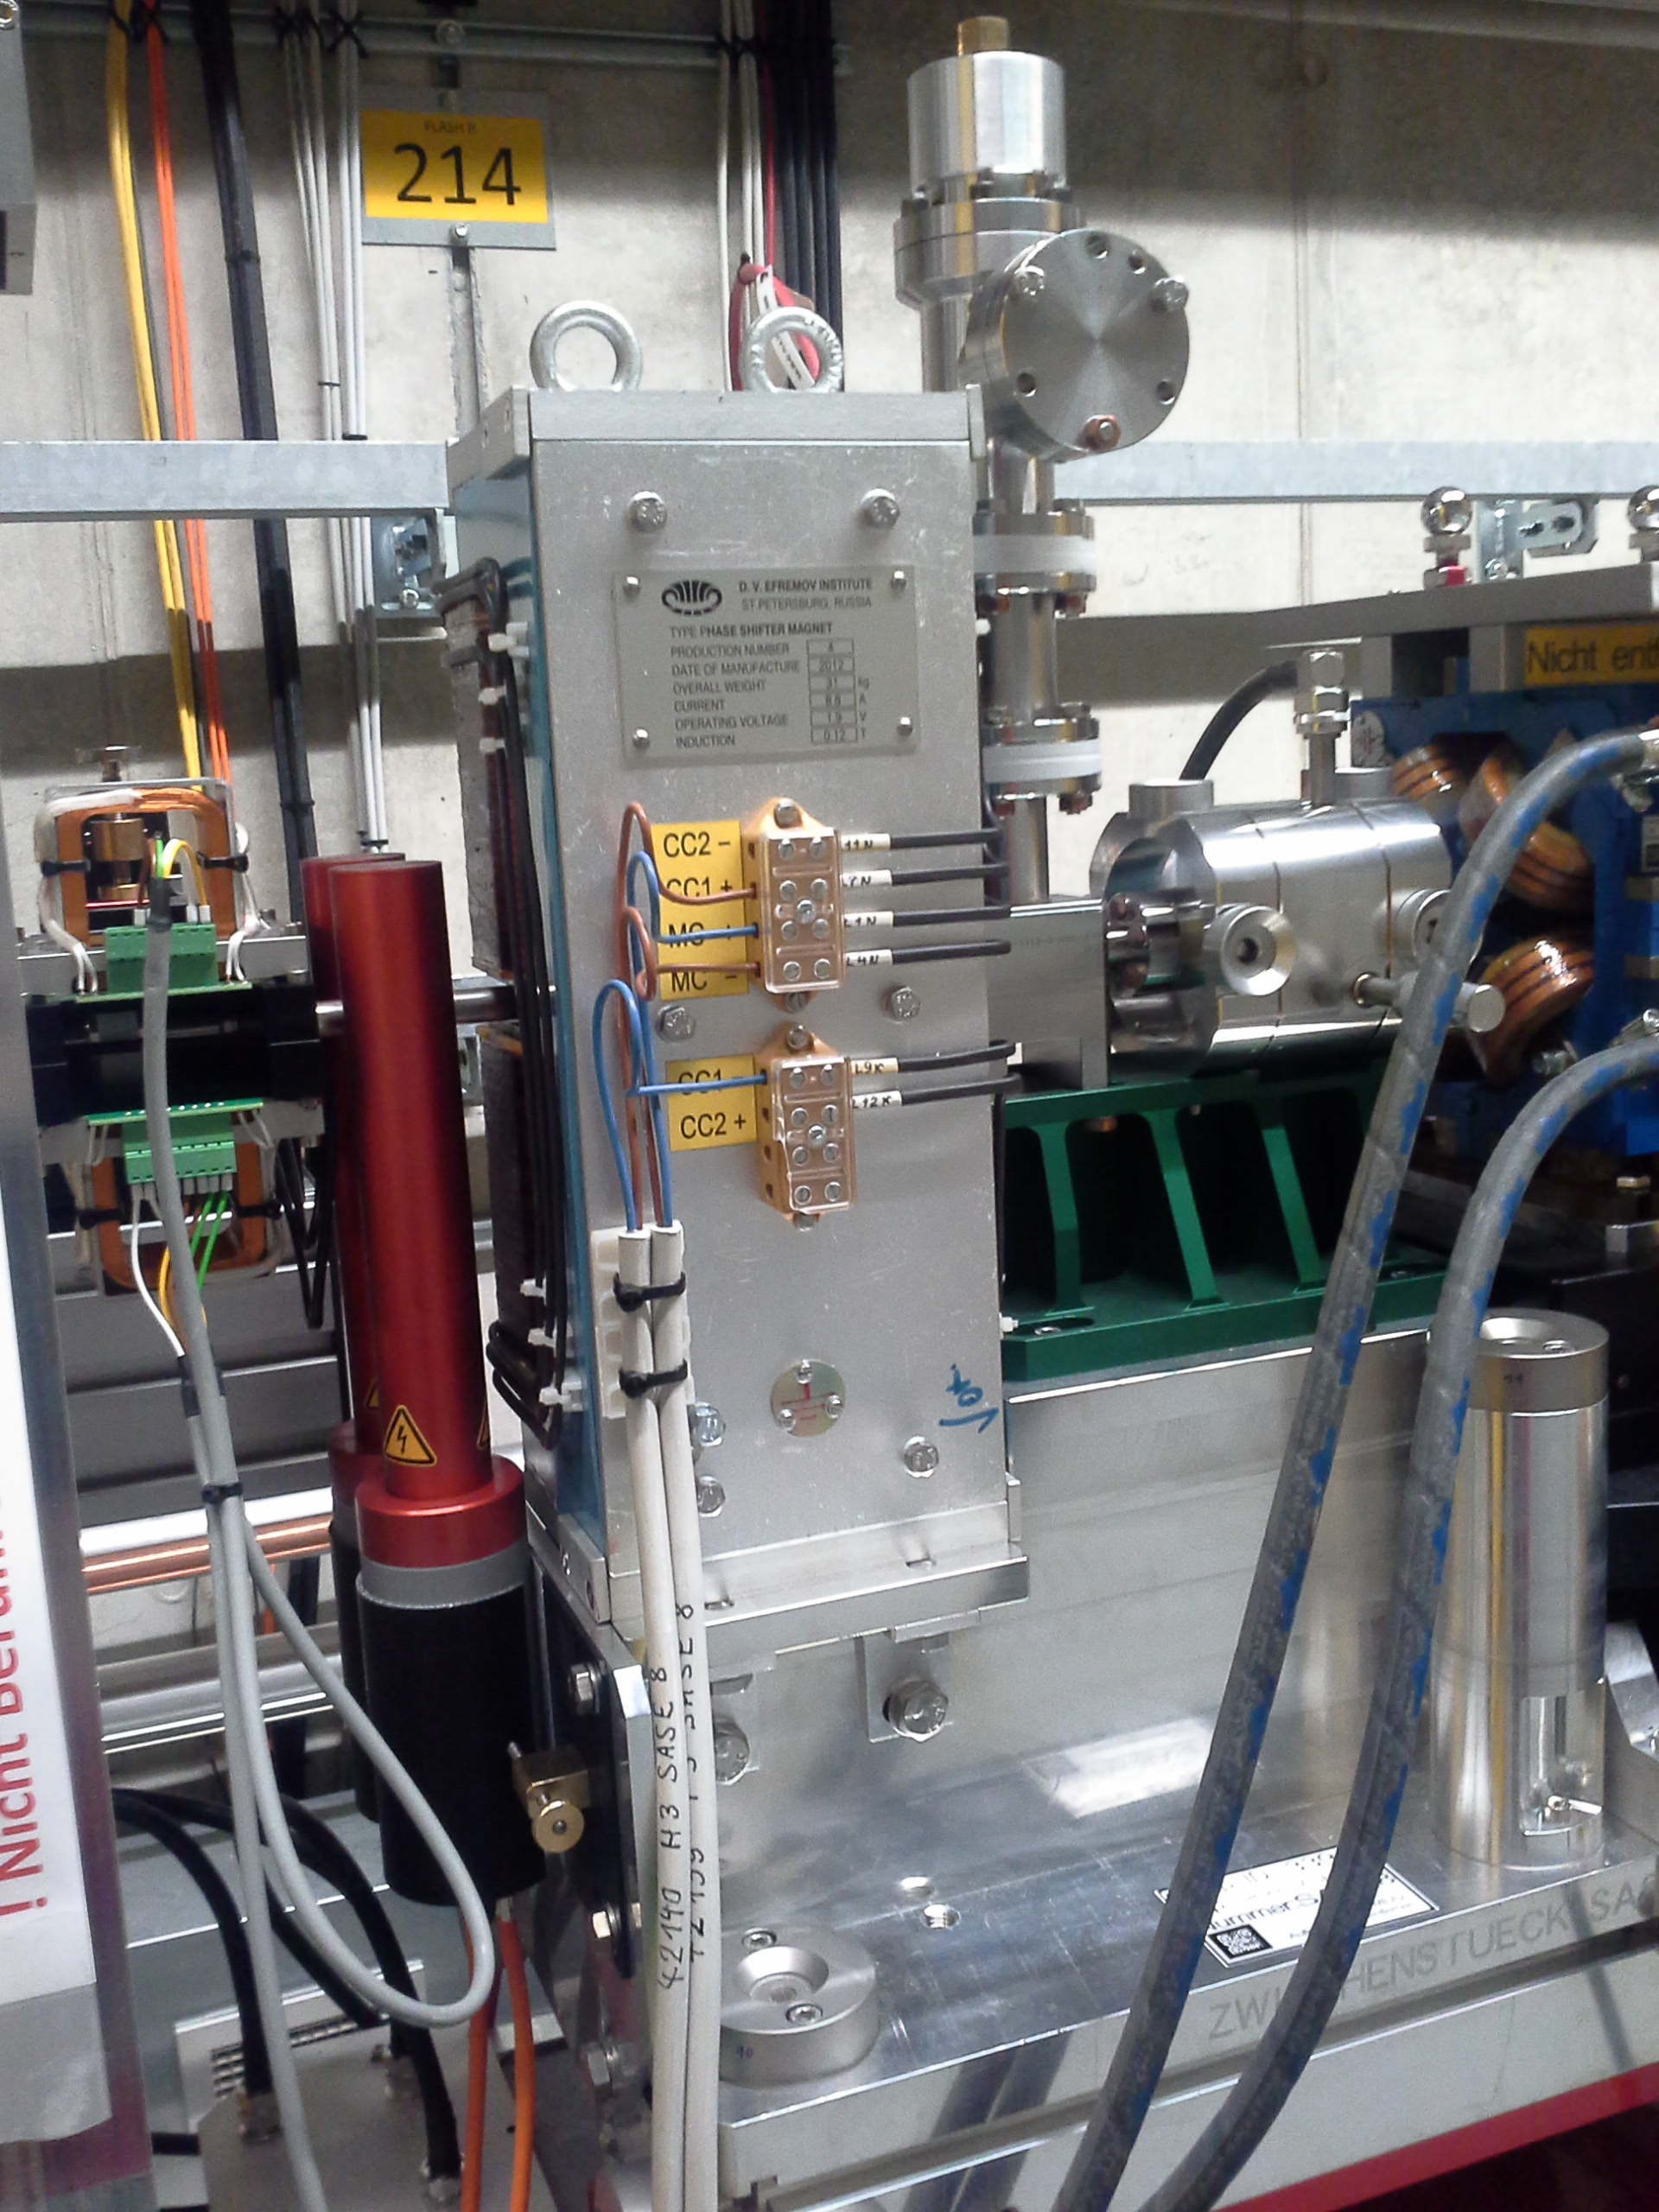
Beam Loss Monitors: Status
Calibrated single and multi-bunch alarm
Integration alarms to be calibrated

Slide 30
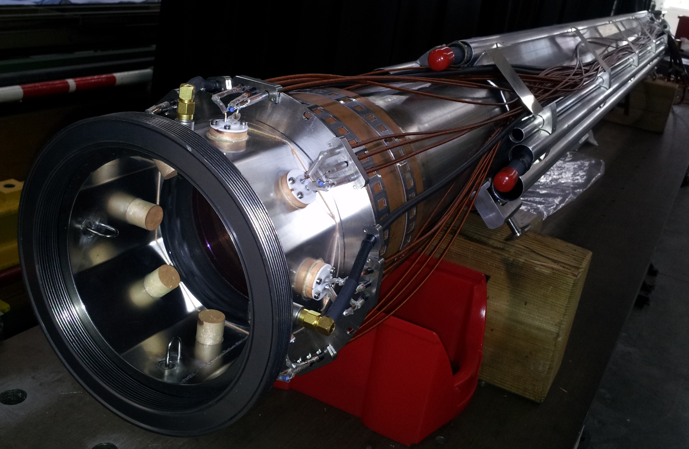
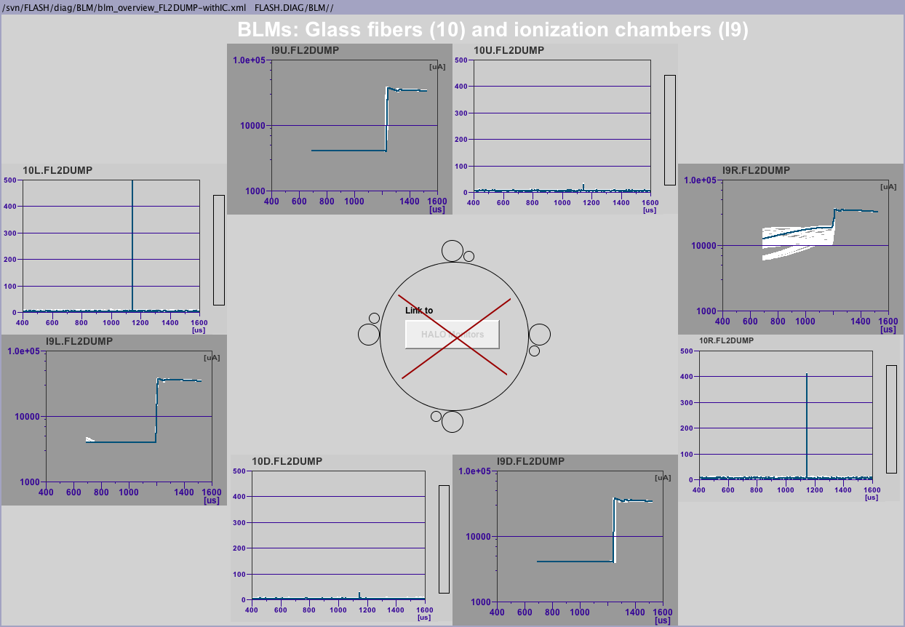
Verlustmonitore am Dump:
BLMs und Ionizations-Kammern
Similar to FLASH1: BLMs based on quarz-fiber + Ionization Chambers (air filled cables) along last 2m of beam line
beam
BHM
N. Baboi, BIW 2010, p. 420

Slide 31


Verlustmonitore am Dump:
Beam Halo Monitor
Similar to FLASH1
8 sensors:
4 Diamond + 4 Sapphire
mounted behind the dump
vacuum chambers
  At XFEL mounted
  outside chamber
FLASH1
A. Ignatenko, IPAC 2012, p. 816

Slide 32

Cherenkov Verlustmonitore entlang der Undulatoren
  Fibers installed along the undulator chamber (left and right)
  Similar to FLASH1
  Will be commissioned
  next
FLASH1
J. Schwarz

Slide 33
Andere Elektronen-Strahl-Monitore in FLASH2
Screen on dump-window
Beam Compression Monitors
Beam Arrival Monitors
Coherent Transition Radiation monitors
J. Good, IBIC’13, p. 814
C. Behrens, IPAC’10, p. 912
A. Angelowski, IBIC 2014, MOPD25
S. Wesch, BIW 2012, THAP01

Slide 34
Zusammenfassung
XFEL and FLASH-type of diagnostics
  Many leassons learned for the European XFEL
Some fully commissioned:
  Screens
Some in advanced commissioning state; still to do (e.g.):
  Integration alarm of BLMs
  Implement automatic gain control for LCBPMs
  BPM calibration
Some have temporary solution
  Toroid electronics and Toroid Protection System
Some to be commissioned
  Cherenkov loss monitors
  Screen at dump-window

Slide 35
Danksagung
Many people contributed to the work and this talk
  R. Neumann, N. Wentowski, Z. Pisarov, M. Werner, J. Lund-Nielsen, B. Lorbeer, A. Kaukher, T. Wamsat, A. Ignatenko, F. Schmidt-Föhre, K. Honkavaara, H. Tiessen, B. Michalek, R. Zahn, B. Keil, D. Nölle, O. Hensler, G. Marinkovic, K. Knaack, J. Schwarz, J. Liebing, H. Sokolinski, G. Kube, C. Wiebers, M. Felber, R. Zahn, S. Vilcins, J. Kruse, D. Renner, M. Felber, S. Schreiber, M. Holz, M. Pelzer, A. Ziegler, M. Hoeptner, H. Sokolinski, M. Stadler, I. Krouptchenkov
  and many others
Other Labs involved
  PSI: Cavity BPM electronics
Most photos by Dirk Nölle

Slide 36




1st Lasing at FLASH2
20:37
20:56
FLASH1: 250 pulses
FLASH1 lasing in parallel
with 250 pulses
Maximum
Energy (μJ)
Actual
Average
0 50 100 150 200 250
Bunch number
FLASH1
FLASH2: 1 pulse
FLASH2
S. Ackermann, MOPF22
K. Honkavaara, FEL2014, WEB05
S. Schreiber, FEL2014

Slide 37



Many Lessons Learned for the European XFEL
The commissioning of FLASH2 paves the way for an easy(ier) commissioning of the XFEL diagnostics
D. Nölle, IBIC 2014, WEPF15
M. Hüning, IPAC2013, WEZB101

