Slide 1
XFEL Injector Commissioning Plan
Bolko Beutner, MPY
Beschleuniger Betriebsseminar
26.3.2015
Notes:
How to edit the title slide
Upper area: Title of your talk, max. 2 rows of the defined size (55 pt)
Lower area (subtitle): Conference/meeting/workshop, location, date,
your name and affiliation, max. 4 rows of the defined size (32 pt)
Change the partner logos or add others in the last row.

Slide 2
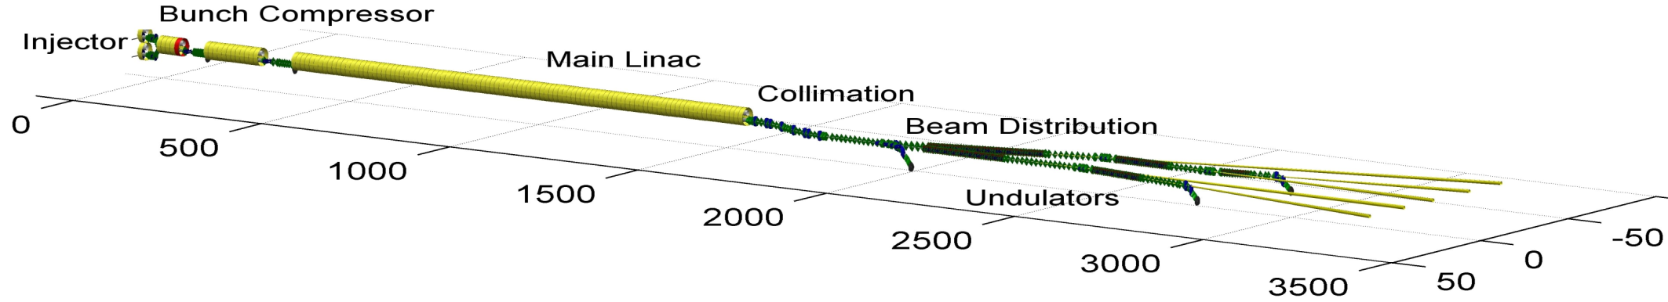
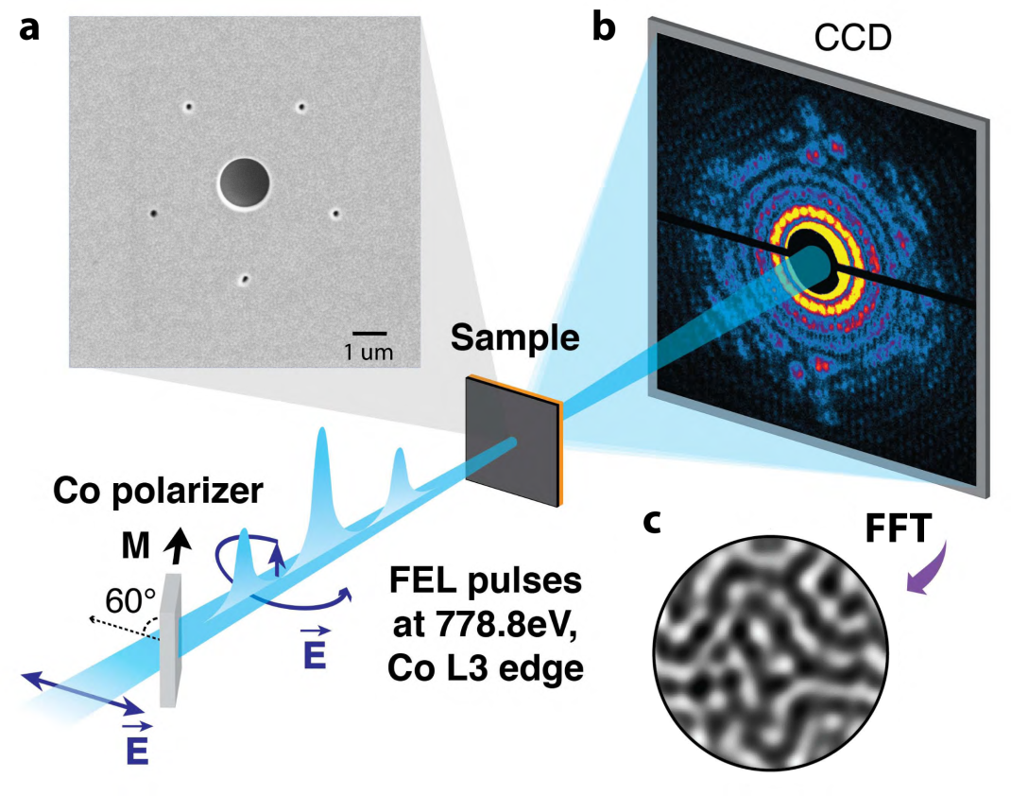
Global Timeline and Milestones (today)
2014
2015
2016
2017
2018
First e-beam out of RF gun installed at XFEL
Injector cooldown
Linac cooldown
SA1
SA3
SA2
Start user operation
Full TDR performance
1st lasing possible
e⁻
Gun and injector laser com.
Injector com. up to full XFEL performance (varying charges and bunch patterns, laser heater, slice diagnostics, intra-train feedbacks, automated procedures)
Initial linac com. with reduced performance
Continued accelerator com. to full performance (high beam power, bunch length flexibility, multiple bunch properties per rf-pulse, full wavelength tuneability, ….)
γ
Beam line and experiment com.
. First user operation

Slide 3
Global Timeline and Milestones (today)
2014
2015
2016
2017
2018
Injector cooldown
Linac cooldown
e⁻
Injector com. up to full XFEL performance (varying charges and bunch patterns, laser heater, slice diagnostics, intra-train feedbacks, automated procedures)
γ

Slide 4
Introduction
Commissioning goals:
Beam quality
  Emittance, …
Stability
  LLRF, beam-based feedbacks, ….
Bunch trains
  Losses, stability along train, …
Reliability
  Procedures, software, hardware, operator training…

Slide 5
Injector Commissioning
Commission sub-components
  LLRF, RF, ...
  standard and special diagnostics
  magnet systems, fast kickers, ...
Beam Dynamics
Establish routine operation with all necessary procedures, software, …
“Teambuilding”
Time available for tests, detours, „trial and error“, …

Slide 6
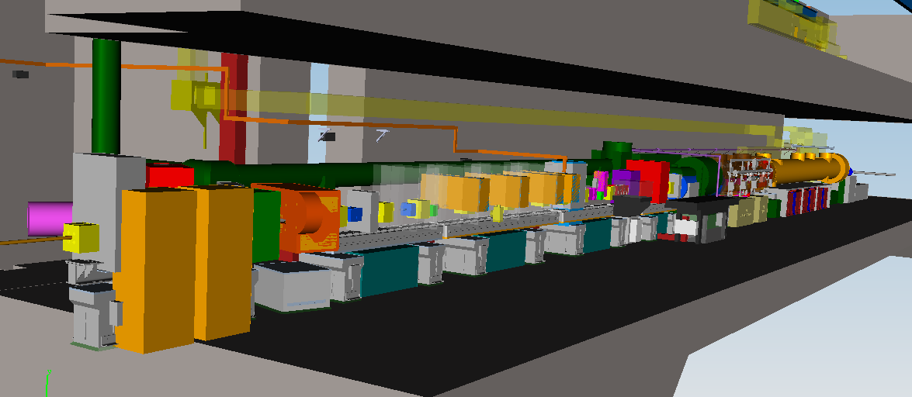
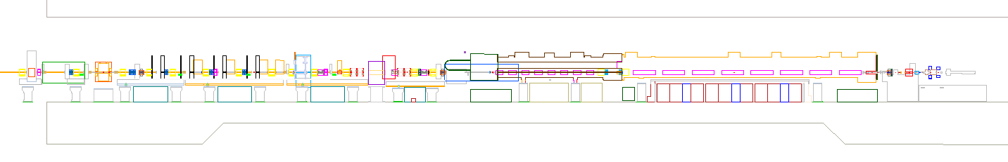
Injector Overview
Dump Transverse Deflecting Structure
Spectrometer Diagnostic Section Laser Heater 3.9 GHz Module 1.3 GHz Module Gun

Slide 7
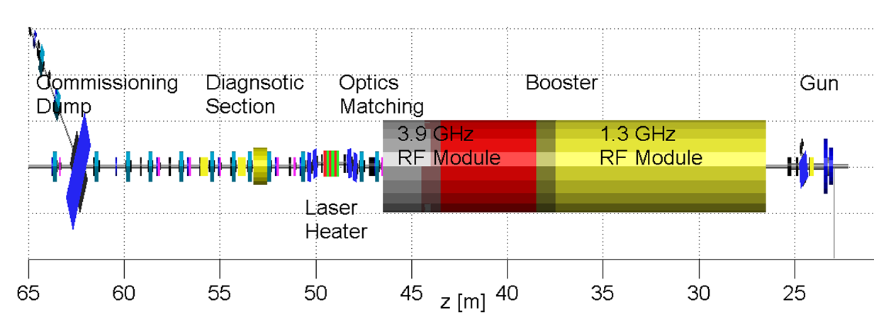
Injector Beam Line Components
Magnets | 6 Dipoles, 15 Quads, 20 Correctors, 2 Quad-Movers, 2 Solenoids
Modules | 1.3 GHz, 3.9 GHz
Diagnostics | 15 BPMs of 5 Types, 11 Screen Stations, 4 Toroids, 2 Dark Current Monitors, 1 Beam Arrival Monitor, 1 Beam Halo Monitor, 1 Electro-optical Detector, 3 Faraday Cups
Fast Devices | 5 Kicker Magnets, 1 Transverse Deflecting Structure
Undulator | 1 Laser Heater Undulator
Vacuum | About 50 m of cold & warm beam vacuum, Dark Current Collimator, Beam Stop

Slide 8
Injector Commissioning: Goal(s)
Achieve all XFEL parameters
Reduced/relaxed parameter set:
  beam charge around 0.5 nC good for diagnostics and LLRF
  Linac operation with several tens of bunches
    single bunch operation is useless for LLRF diagnostics and studies
    many bunch operation is more demanding for machine protection
Quantity | TDR goal | initial goal
macro pulse repetition rate | 10 Hz | 10 Hz
RF pulse length (useable flat top) | 600 μs | 600 μs
bunch repetition frequency within pulse | 4.5 MHz | 100 kHz
bunch charge | 0.02 – 1 nC | 0.5 nC
Slice emittance | 0.4 - 1.0 mm mrad | 1.0 mm mrad
Gun gradient | 60 MV/m | 50 MV/m

Slide 9
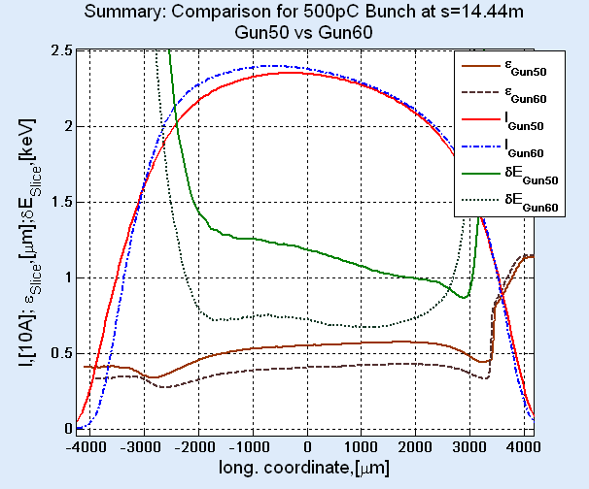
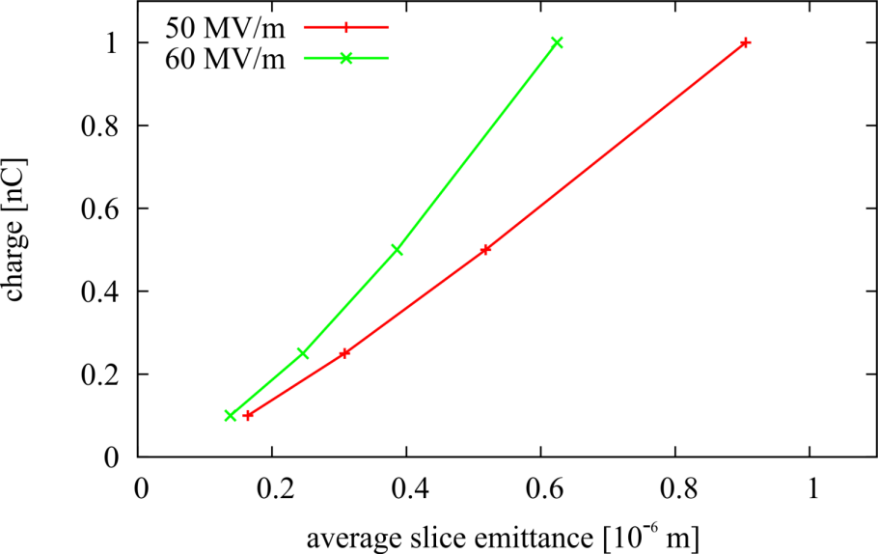
Gun Performance
Example: 0.5nC |  | Gun50 | Gun60
Working Point | MaxB [T] | 0.1892 | 0.2224
 | XY_{rms} [mm] | 0.360 | 0.285
projected Emittance | ε [10⁻⁶ m] | 0.544 | 0.439
averaged slice Emittance | ε_{Sl} [10⁻⁶ m] | 0.518 | 0.386
rms bunch length | σ_{z} [mm] | 1.98 | 1.94
0.5nC
Reasonable beam quality with reduced gun gradient confirmed in simulations
courtesy E. Kot

Slide 10
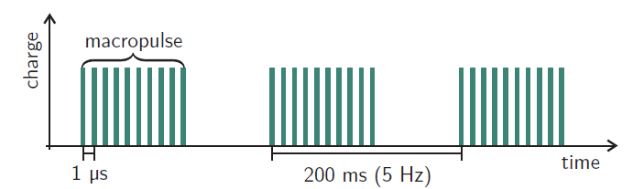



Bunch Trains
60 to 2700 bunches per train at a 10Hz repetition rate
78 to 3510 W beam power at 130MeV and 1nC (10-472kW at 17.5GeV)
Expected dark current of up to about 30 W at 130MeV and 600 μs
Variable pulse length, repetition rate, and beam-on-demand mode to reduce losses
Orbit/energy stability along train (intra-train feedbacks)
Enables semi-parasitic diagnostics (emittance, …)

Slide 11
Initial e-beam parameters – Bunch Repetition
Linac will be operated with several tens of bunches (not single bunch) as fast as possible
RF pulse length can be varied (gun performance and dark current losses might be limiting factors)
Initially possible repetition rates (injector laser)
Many bunches make European XFEL unique
Should be established as soon as possible
n | bunch repetition frequency [MHz] (=1.3GHz/(n*144) with n>=2 and even) | bunch spacing [ns] | max # of bunches in 600 μs train
2 | 4.514 | 222 | 2700
3 | 3.009 | 333 | 1800
8 | 1.128 | 886 | 670
90 | 0.1003 | 10000 | 60
- | - | - | 1

Slide 12
Commissioning Phases
Start | July 2015
Initial Commissioning Phase Goal: Reproducible and reliable beam transport for full bunch train length from the gun to the injector dump | 10 weeks
Intermediate Commissioning Phase (minimum goal) Goal: Slice emittance is reproducible below 1mm mrad | 20 weeks
Final Commissioning Phase Goal: Nominal performance for all charge options and full bunch train length | 19 weeks
Optional Beam Physics Studies / Contingency Beam physics studies and improvement of performance beyond TDR goals… | 6 weeks
End | June 2016
Initial
parameter set
Full TDR
parameter set
Operation consolidation at the end of each phase
  “Hot” tests (e.g. recovery after emergency shutdown)
  Stability runs (one week without interference…)
  Procedures, operator training, software
  Goal of each phase is only reached if it is reproducibly achieved

Slide 13
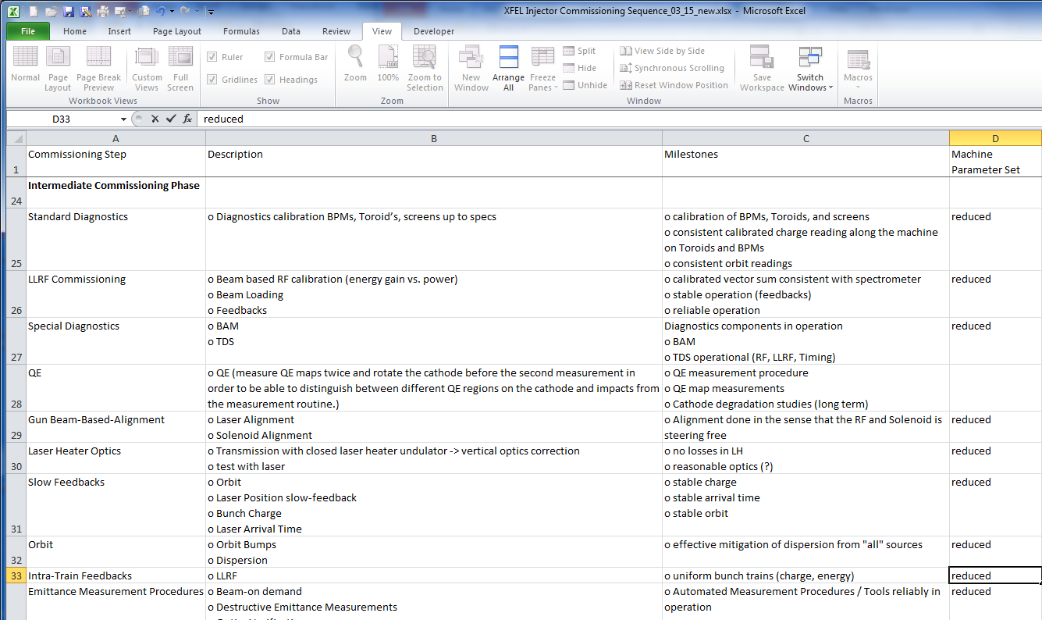
Example: Detailed Sequence

Slide 14
Initial Commissioning Phase
In the first beam phase we will focus on basic beam quality only (0.5nC, 60 bunches per train, no optimised emittance,…) but full transmission to allow for beam-based commissioning and calibration of all subsystems.
Goal: Full transmission is reproducible
Requirements: Stable and reliable operation of subsystems

Slide 15
Initial Commissioning Sequence
Gun setup
LLRF commissioning w/o beam
Initial operation of standard diagnostics
ACC1 acceleration setup
Laser heater dipoles for basic energy setup
Orbit control (automatic orbit steering)
Optics setup / Destructive emittance measurements
Machine protection system (MPS) for 600 μs trains (tests, threshold calibration)

Slide 16
Intermediate Commissioning Phase
After full transmission is reliably achieved beam-based methods for system commission are available. All subsystems, which require beam, are commissioned and calibrated in this phase.
Beam quality is optimised to initial beam performance parameters.
Goal: Slice Emittance reproducible below
1mm mrad at 0.5nC
Requirements: Transmission, stable, and reliable operation

Slide 17
Intermediate Commissioning Sequence
Beam based Commissioning (standard and special diagnostics / LLRF)
Gun beam based alignment (laser position, solenoid position)
ACC1/39 combined operation
Slow feedbacks (Orbit, RF, …)
(semi-parasitic-)emittance measurement and optics matching
Transverse deflecting structure (TDS)
Studies and optimisations of the transverse and longitudinal phase spaces
Laser heater undulator closed but without laser (optics distortions)

Slide 18
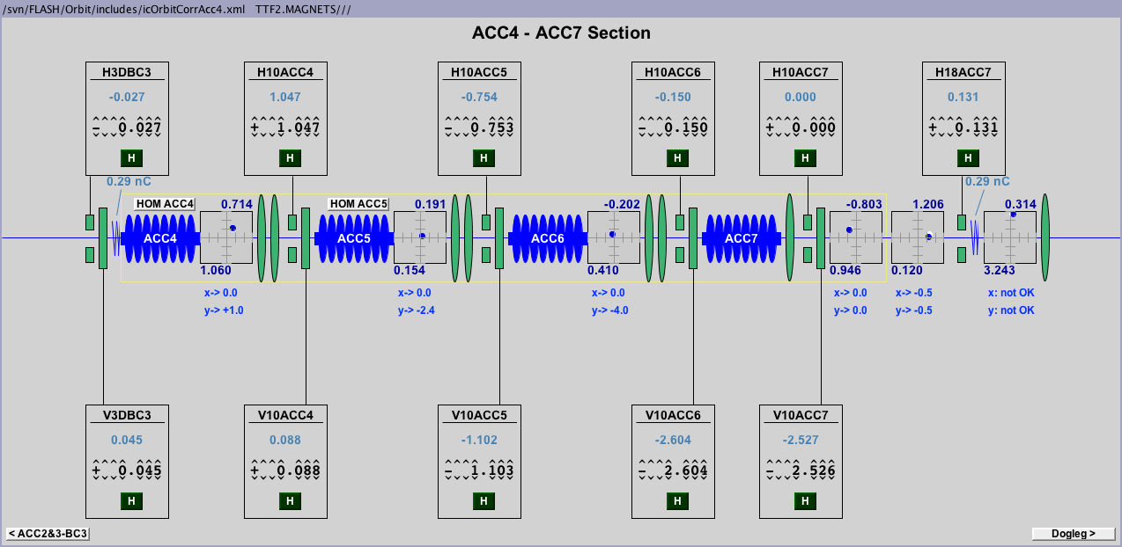
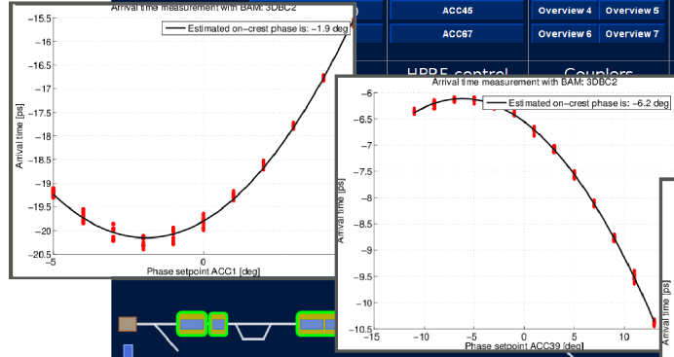
Operation Procedures and Tools
Automatic orbit steering
  Manual orbit correction
  does not scale to large
  XFEL
  Beam-on-demand mode
  to mitigate losses
Autophasing
  Set Linac Modules
  on-crest with LLRF
  and fine automated
  Spectrometer / BAM
  scans

Slide 19
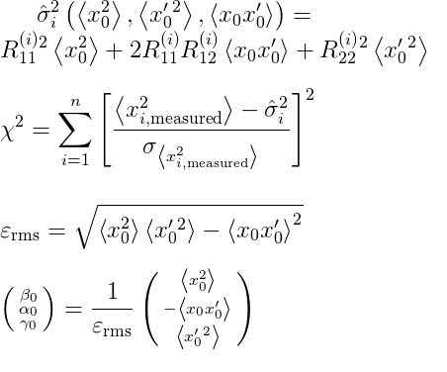
Phase Space Measurements
matching quads
reference point
screen
quadrupole
Beam moments are determined at a reference point using beam size measurements at different points in the machine or for different quadrupole settings
optics is adjusted to match the
design using upstream matching quads
Matching iterations
Reliable and efficient measurements
are essential for beam optics setup and
beam quality optimisation
Tomographic reconstruction of the
phase space is also possible
measured beam size
calculated beam size
Initial beam moments

Slide 20
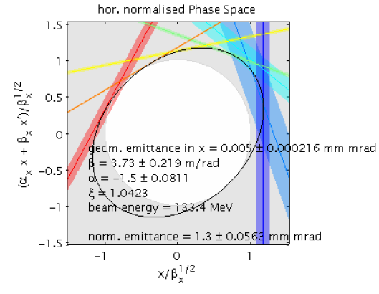
Phase Space Diagnostics
Christopher Gerth
WP-18 Special Diagnostics
Semi-parasitic due to fast kickers and off axis screens
Screen 2
Screen 4
Kicker
Kicker
Kicker
Kicker
Screen 1
OTR
OTR
Visualisation of beam moment fit
Beam size measurements represented by coloured lines

Slide 21
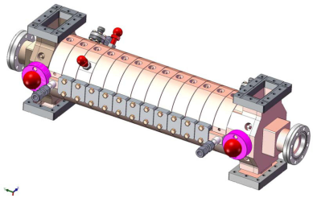
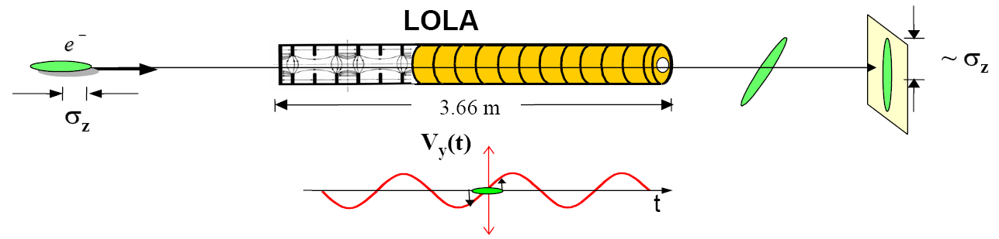
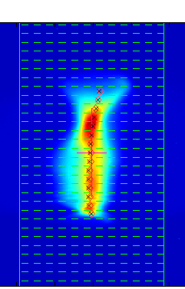
Phase Space Diagnostics
Christopher Gerth
WP-18 Special Diagnostics
Semi-parasitic due to fast kickers and off axis screens
Time resolved (slice-) emittance with a transverse deflecting structure
Requires commissioning of:
  Fast kickers
  Screen systems
  Orbit feedback systems
  TDS RF/LLRF systems
  Data processing and analysis
Screen 2
Screen 4
Kicker
Kicker
TDS
Kicker
Kicker
Screen 1
OTR

Slide 22
Summary
Sequential approach with intermediate milestones
Most milestones can be reached with reduced gun performance (but not with reduced gun availability)
Start with reduced repetition rate but full pulse length
Hardware component commissioning
Beam dynamics setup
Controls Software and operation procedures consolidation

Slide 23
  Thank You
  for Your Attention!

Slide 24
Injector Commissioning Schedule
24

Slide 25
Final Commissioning Phase
Extension of intermediate commissioning phase goals toward the full range of possible bunch charges and train configurations to full specified train length.
Full Injector Performance (all TDR working points)
Reliable procedures for working point change
Laser Heater characterization

Slide 26
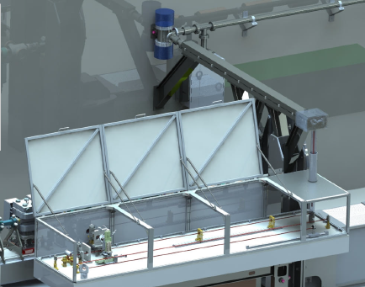
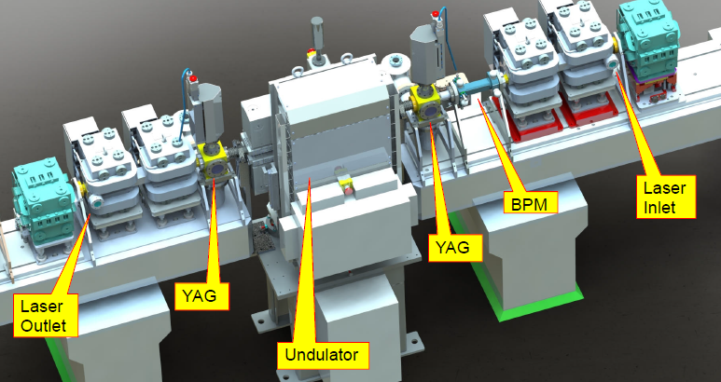
Laser Heater
Two commissioning stages:
  Undulator closed in intermediate
  commissioning phase
    Optics
    Magnet handling and control
  Laser operation in final phase
    trans. and long. overlap
    energy spread vs.
    laser power
    long. phase space TDS
Mathias Hamberg, Volker Ziemann, Uppsala University

Slide 27
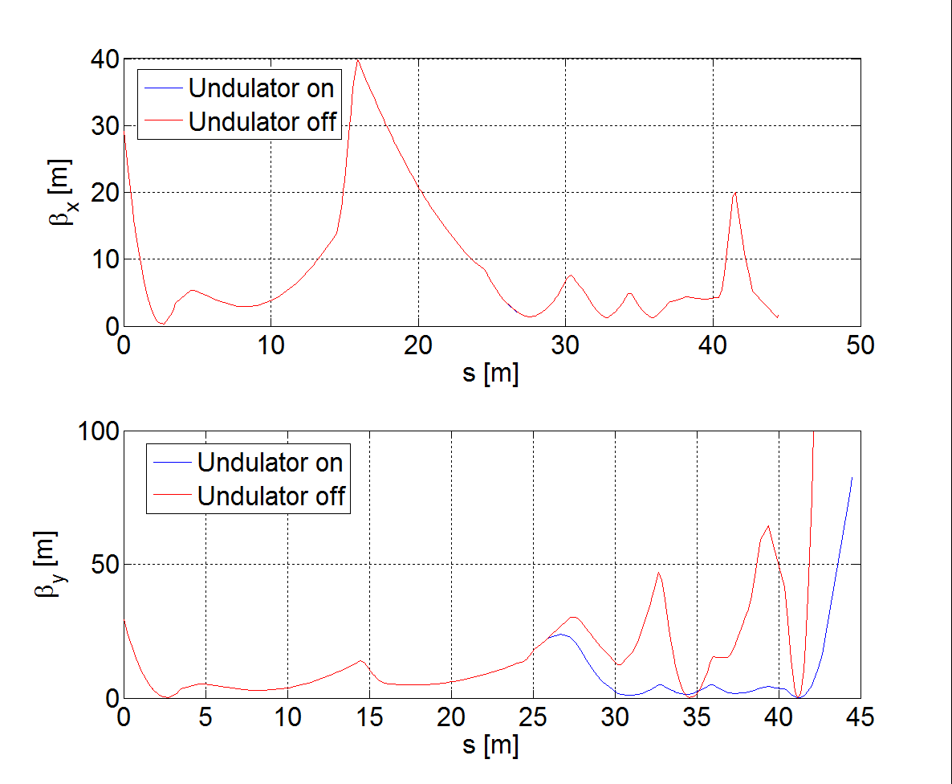
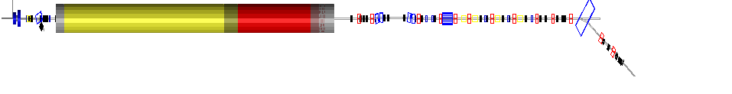
Laser Heater Optics

Slide 28
Laser Heater
Two commissioning stages:
  Undulator closed in intermediate
  commissioning phase
    Optics
    Magnet handling and control
  Laser operation in final phase
    trans. and long. overlap
    energy spread vs.
    laser power
    long. phase space TDS
Mathias Hamberg, Volker Ziemann, Uppsala University

Slide 29
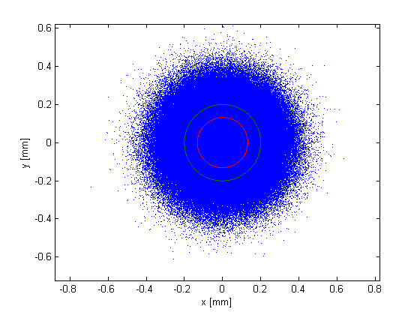
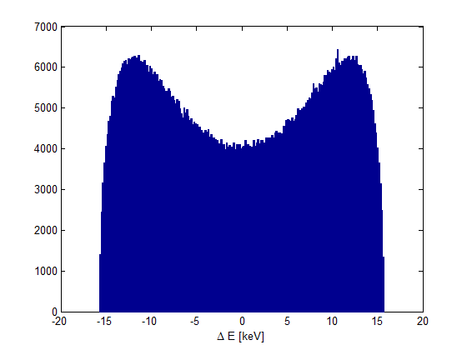
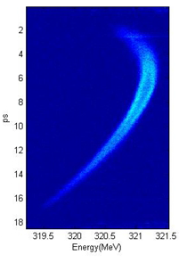
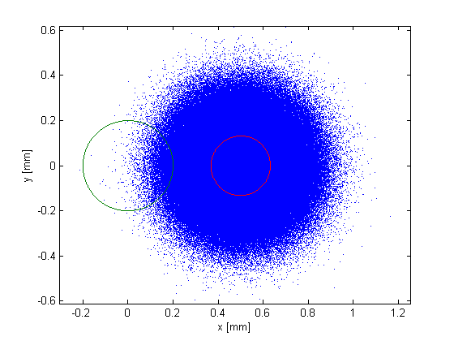
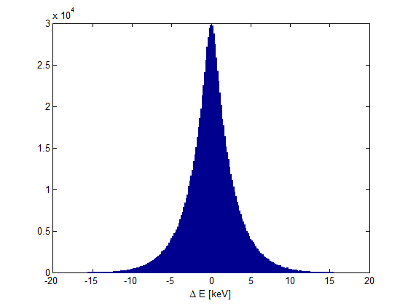
Laser Heater Spectrum
electrons (sigma)
laser beam
Simone Spampanati et. al.,
Proceedings of FEL2012,
Nara, Japan
LH simulations by Martin Dohlus

Slide 30
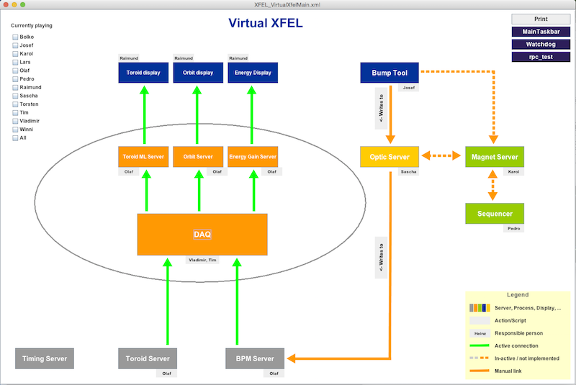
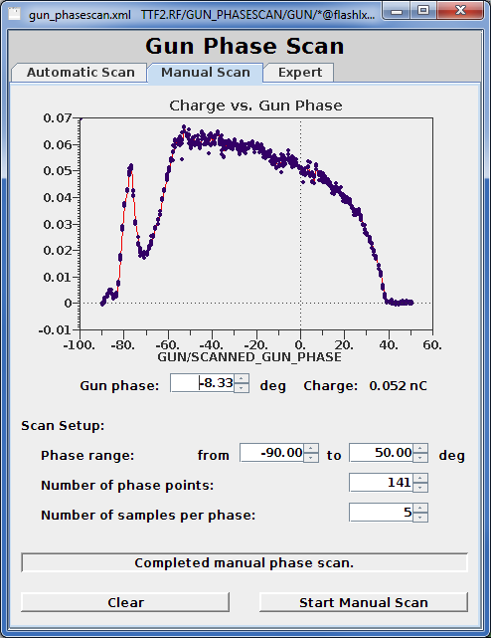
High Level Controls Software
Controls software is essential for reliable machine operation and commissioning
Preparation is work in progress in different groups
“VirtualXFEL” test environment with simulated data
  test of the foreseen architecture in it's whole (e.g. interfaces, scaleability, performance, …)
  test of physics applications
  (like e.g. Optics Server,
  Bump Tool, Orbit feedbacks, …)
Synergies with FLASH

Slide 31
Laser Heater
Two commissioning stages:
  Undulator closed in intermediate
  commissioning phase
    Optics
    Magnet handling and control
Mathias Hamberg, Volker Ziemann, Uppsala University

