Slide 1
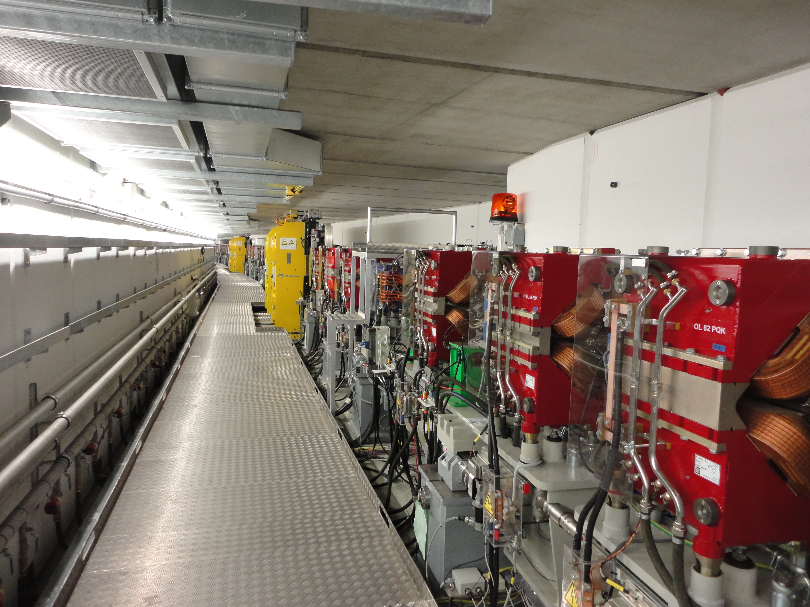
Optics View of Radiation Damage of Insertion Devices at PETRA III
OUTLOOK
Radiation damage of Undulators
Radiation Dose measurements in Tunnel
Tracking of particles in SixTrack
Theoretical Optics of PETRA III in MADx and correlation to beam losses
Tracking for p3x_v17 optics and preventive measures
Conclusion
Gajendra Kumar Sahoo
MPY

Slide 2
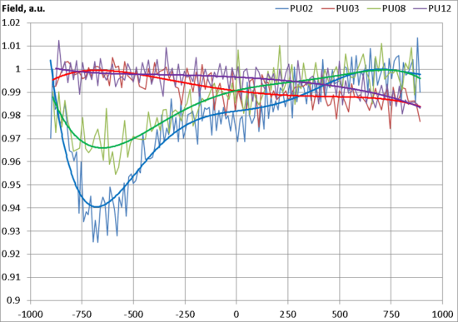
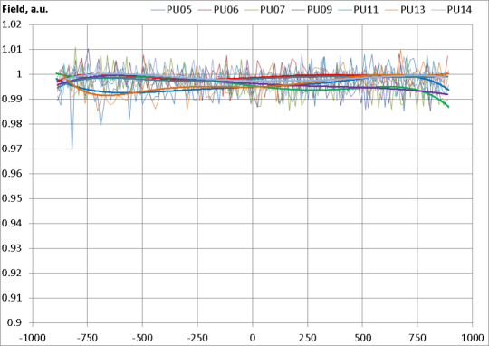
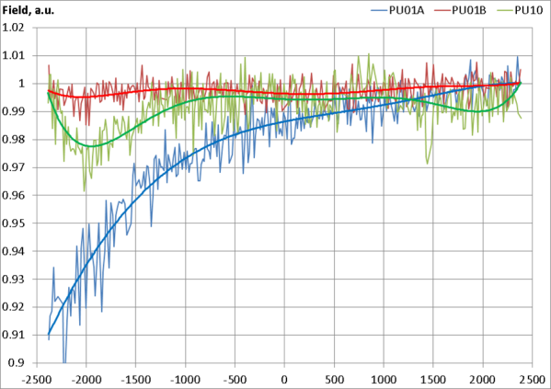
Radiation Damage in Undulators
Magnetic Field Measurements along Longitudinal positions
PU01a,b
PU02, 03
PU04
PU05, 06
PU07
PU08, 09
PU10
PU11, 12
PU13, 14
The characteristics of the magnetic damage follow the pattern of the 2m devices in the canted straights. The damage occurs at the entrance and the exit of the straight section and the damage of the upstream part are more severe than the damage of the downstream part.

Slide 3
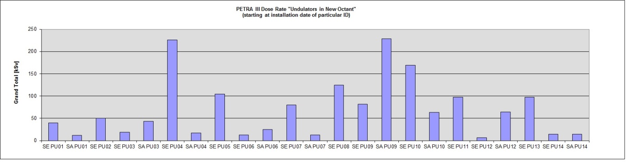
PETRA e-Logbook (22 January 2014)
Location | Rate [μSv] | Time of measurements | Particles Lost
NR_118 | 100 | 12:35 | 456
WR_118 | 17 | 12:45 | 49
NWR_83 | 20 | 12:40 | 2
OR_118 | 9 | 13:20
SOR_83 | 80 | 13:25 | 38
e-Loogbook
Entries
SixTrack
Tracking Results
Integrated radiation does accumulated at every insertion device from the first day of its installation as measured by TLDs.

Slide 4
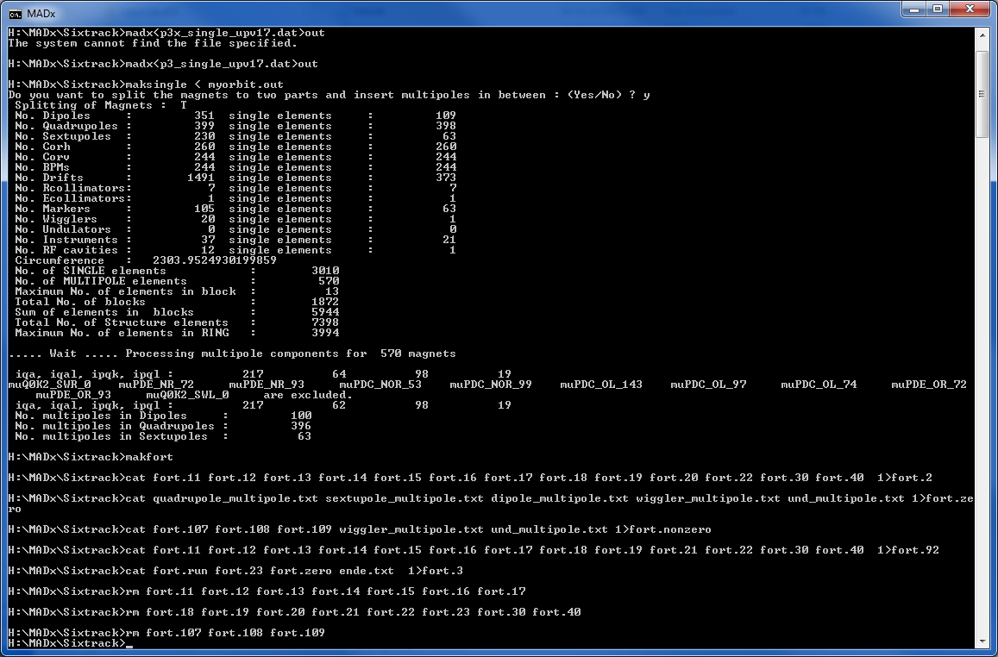
Preparation of input file for SixTrack formation of blocks of linear elements

Slide 5
P3_20wig optics Aperture limitations
Wiggler Section
Max von Laue Halle
BPM_NOR_11 EL 28.50 5.25 PU01a,b
BPM_NOR_23 EL 28.50 5.25
BPM_NOR_32 EL 40.00 20.00
ABSE EL 34.00 19.00
BPM_NOR_39 EL 39.00 19.00
BPM_NOR_40 EL 39.00 19.00
ABSA EL 35.00 19.00
BPM_NOR_44 EL 39.00 19.00
BPM_NOR_47 EL 39.00 19.00
ABSB EL 35.50 19.00
BPM_NOR_50 EL 30.00 3.50 PU02, 03
BPM_NOR_52 EL 30.00 3.50
BPM_NOR_55 EL 30.00 3.50
ABSC EL 34.50 19.00
BPM_NOR_58 EL 39.00 19.00
ABSD EL 39.50 19.00
BPM_NOR_62 EL 39.00 19.00
BPM_NOR_63 EL 39.00 19.00
ABSA1 EL 35.00 19.00
BPM_NOR_67 EL 39.00 19.00
BPM_NOR_70 EL 39.00 19.00
BPM_NOR_73 EL 30.00 3.50 PU04
BPM_NOR_78 EL 30.00 3.50
BPM_NOR_81 EL 39.00 19.00
BPM_NOR_85 EL 39.00 19.00
BPM_NOR_86 EL 39.00 19.00
BPM_NOR_90 EL 39.00 19.00
BPM_NOR_93 EL 39.00 19.00
BPM_NOR_96 EL 30.00 3.50 PU05, 06
BPM_NOR_98 EL 30.00 3.50
BPM_NOR_101 EL 30.00 3.50
BPM_NOR_104 EL 39.00 19.00
BPM_NOR_108 EL 39.00 19.00
BPM_NOR_109 EL 39.00 19.00
BPM_NOR_113 EL 39.00 19.00
BPM_NOR_116 EL 39.00 19.00
BPM_NOR_119 EL 30.00 3.50 PU07
BPM_NOR_124 EL 30.00 3.50
BPM_NOR_127 EL 39.00 19.00
BPM_NOR_131 EL 39.00 19.00
BPM_NOR_132 EL 39.00 19.00
BPM_OL_152 EL 39.00 19.00
BPM_OL_149 EL 39.00 19.00
BPM_OL_146 EL 30.00 3.50 PU08, 09
BPM_OL_144 EL 30.00 3.50
BPM_OL_141 EL 30.00 3.50
BPM_OL_138 EL 39.00 19.00
BPM_OL_134 EL 39.00 19.00
BPM_OL_133 EL 39.00 19.00
BPM_OL_129 EL 39.00 19.00
BPM_OL_126 EL 39.00 19.00
BPM_OL_123 EL 30.00 3.50 PU10
BPM_OL_118 EL 30.00 3.50
BPM_OL_115 EL 39.00 19.00
BPM_OL_111 EL 39.00 19.00
BPM_OL_110 EL 39.00 19.00
BPM_OL_106 EL 39.00 19.00
BPM_OL_103 EL 39.00 19.00
BPM_OL_100 EL 30.00 3.50 PU11, 12
BPM_OL_98 EL 30.00 3.50
BPM_OL_95 EL 30.00 3.50
BPM_OL_92 EL 39.00 19.00
BPM_OL_88 EL 39.00 19.00
BPM_OL_87 EL 39.00 19.00
BPM_OL_83 EL 39.00 19.00
BPM_OL_80 EL 39.00 19.00
BPM_OL_77 EL 30.00 3.50 PU13, 14
BPM_OL_75 EL 30.00 3.50
BPM_OL_72 EL 30.00 3.50
BPM_WL_30 EL 60.00 10.00
BPM_WL_24 EL 60.00 10.00
ABSW1 EL 30.00 4.50
BPM_WL_18 EL 60.00 10.00
ABSW2 EL 30.00 8.50
BPM_WL_12 EL 60.00 10.00
ABSW3 EL 31.50 4.50
BPM_WL_6 EL 60.00 10.00
ABSW4 EL 31.00 8.50
BPM_WR_0 EL 60.00 10.00
ABSW5 EL 39.50 4.50
BPM_WR_7 EL 60.00 10.00
ABSW6 EL 36.00 8.50
BPM_WR_13 EL 60.00 10.00
ABSW7 EL 50.00 4.50
BPM_WR_19 EL 60.00 10.00
ABSW8 EL 41.00 8.50
BPM_WR_25 EL 60.00 10.00
ABSW9 EL 30.00 4.50
BPM_WR_31 EL 60.00 10.00
ABSW10 EL 30.00 4.50
BPM_WR_37 EL 60.00 10.00

Slide 6
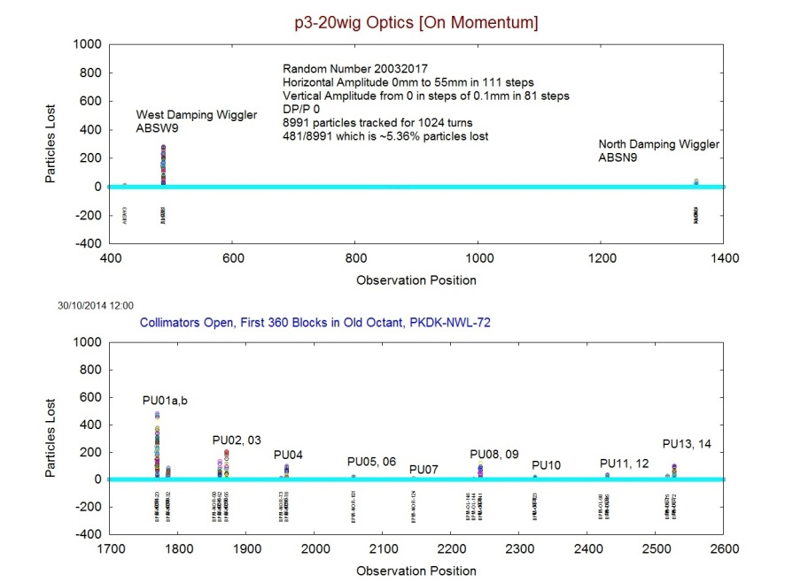
SixTrack : Tracking for p3_20wig optics
On Momentum Case
Tracking results for on momentum 8991 particles with magnetic field errors tracked at 360 different longitudinal positions starting from South West for a single random number [Collimators are open]. A maximum of 482 particles are lost out of 8991 near PU1a, b, which is 5.36%

Slide 7
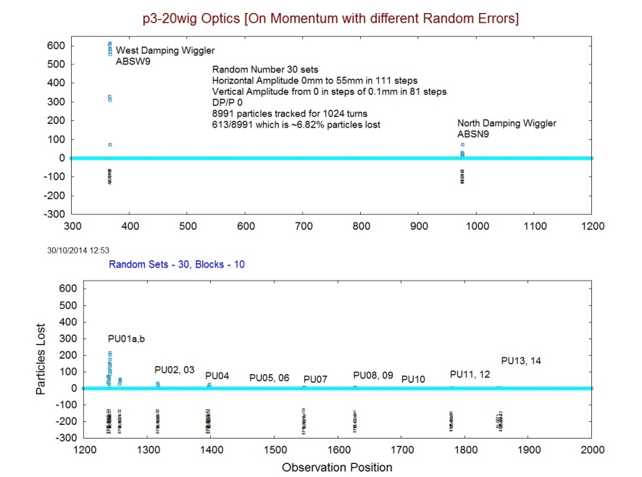
SixTrack : Tracking for p3_20wig optics
On Momentum with 20 Random Numbers
Tracking results for on momentum 8991 particles with magnetic field errors tracked at 10 different longitudinal positions starting from South West for 30 Random Numbers [Collimators are open]. A maximum of 613 particles are lost out of 8991 near ABSW9, 10, which is 6.82%.

Slide 8
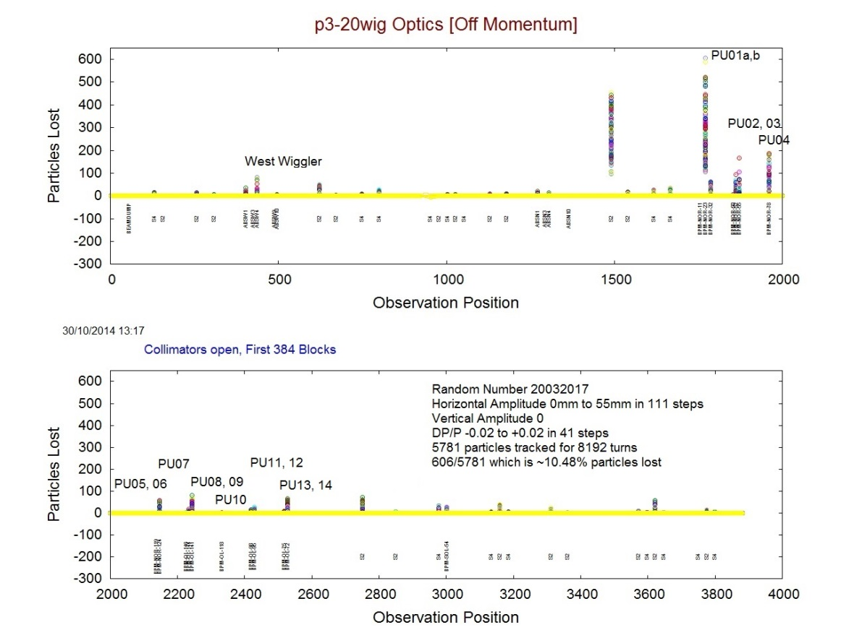
SixTrack : Tracking for p3_20wig optics
Off Momentum Case
e-LogBook
NR_118
WR_118
NWR_83
OR_118
SOR_83
PU01a,b
PU02, 03
PU04
PU05, 06
PU07
PU08, 09
PU10
PU11, 12
PU13, 14
Tracking results for off momentum (ΔP/P = -0.02 to 0.02) 5781 particles with magnetic field errors tracked at 384 different longitudinal positions starting from South West for a single random number [Collimators are open]. A maximum of 606 particles are lost out of 5781 near PU1a, b, which is 10.48%.

Slide 9
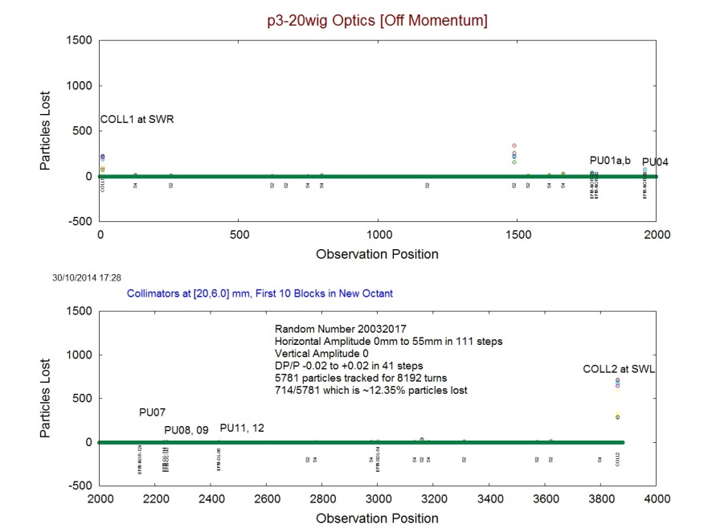
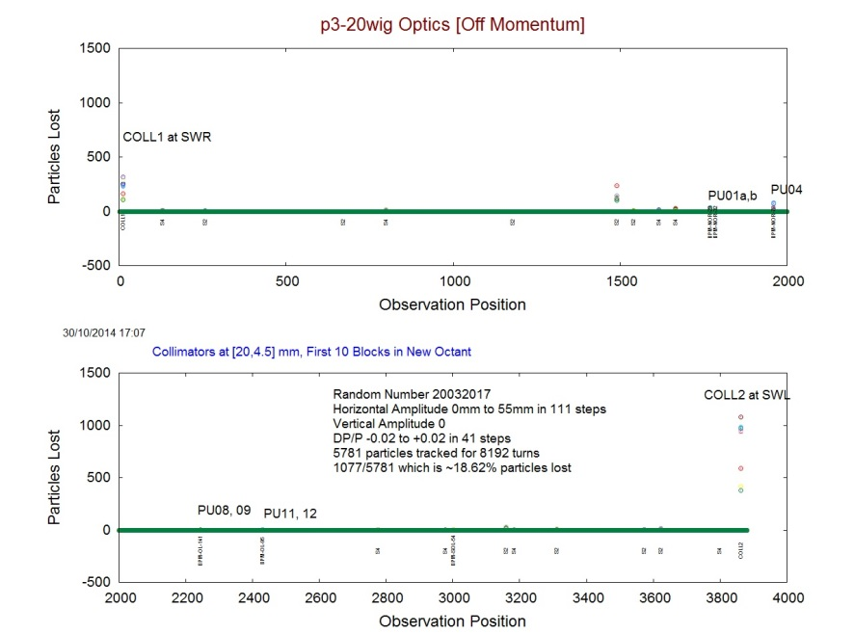
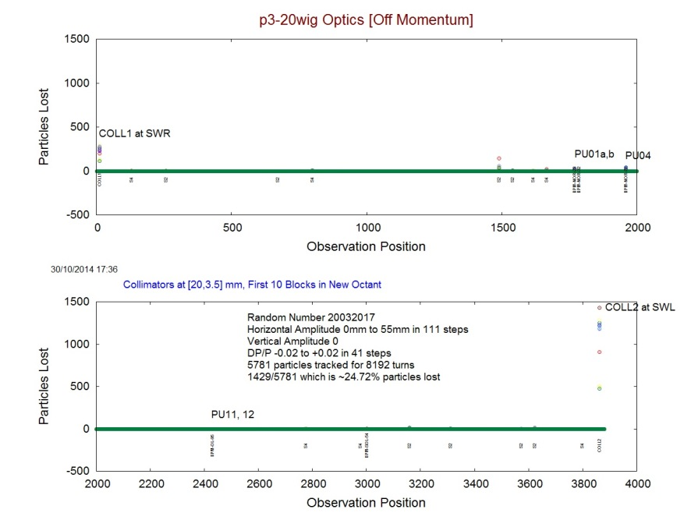
SixTrack : Tracking for p3_20wig optics
Off Momentum with Collimators closed
COLL1 & COLL2
[20, 6.0]mm
COLL1 & COLL2
[20, 4.5]mm
COLL1 & COLL2
[20, 3.5]mm
Tracking results for off momentum (ΔP/P = -0.02 to 0.02) 5781 particles with magnetic field errors tracked at 20 different longitudinal positions starting from New Octant for a single random number [Collimators are closed at 3.5mm, Maximum of 1429 particle lost at COLL2 which is 24.72%].

Slide 10
SixTrack : Tracking for p3_20wig optics

Slide 11
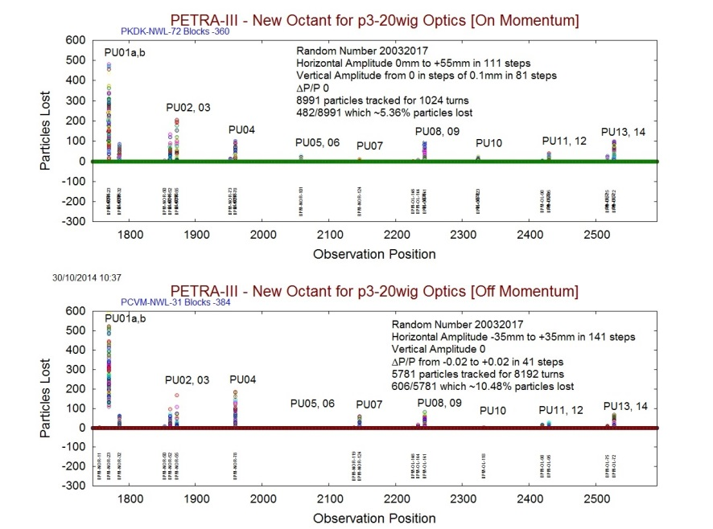
SixTrack : Tracking for p3_20wig optics
Tracking results shown in New Octant for on and off momentum (ΔP/P = -0.02 to 0.02) particles with magnetic field errors tracked at different longitudinal positions starting from South West for comparison.

Slide 12
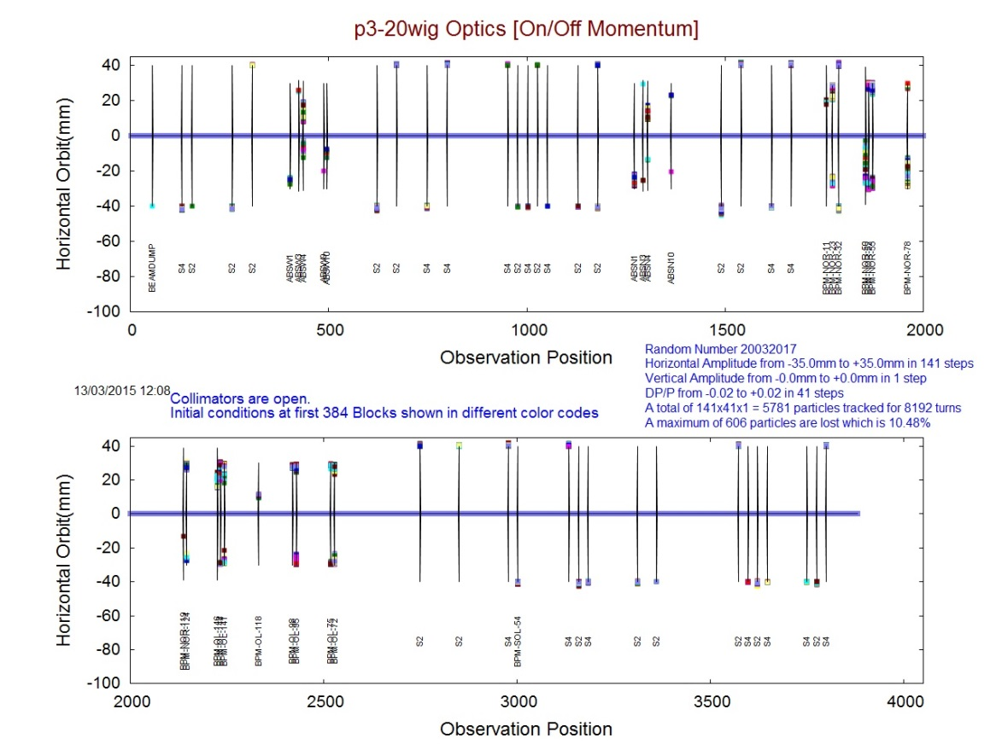
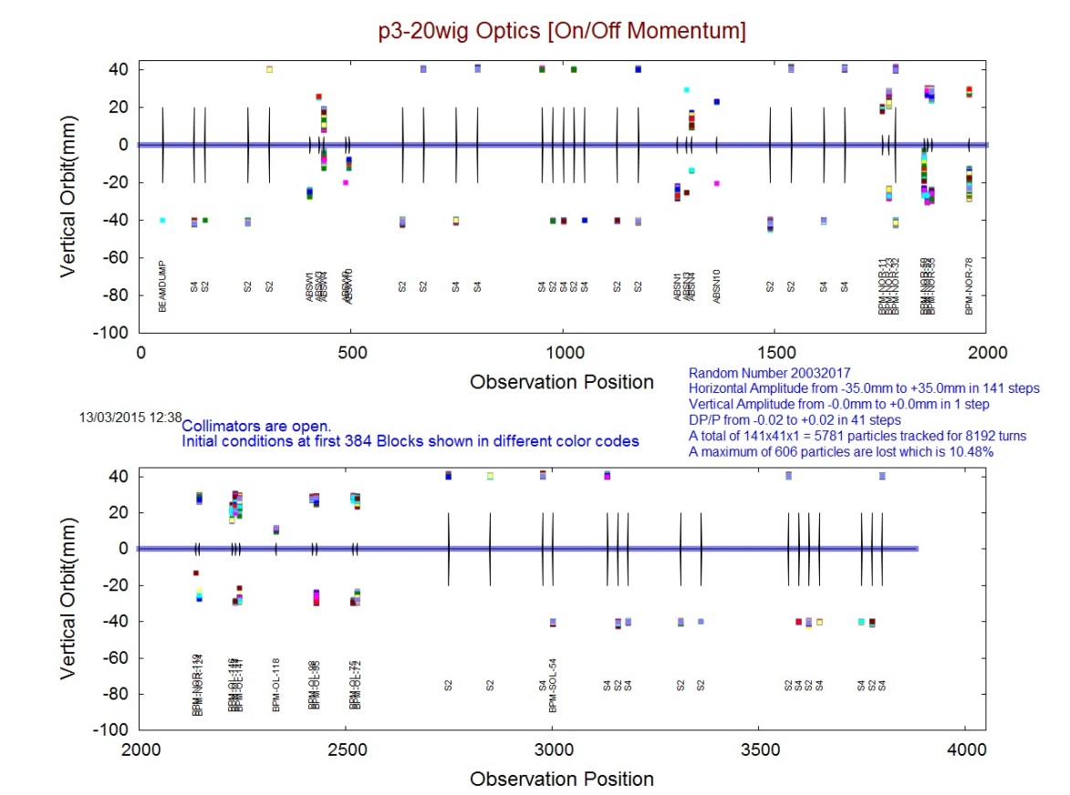
SixTrack : Tracking for p3_20wig optics
Loss of Particles along the Longitudinal Positions
Physical Aperture
Particles Lost in inner side of ring
Loss of particles for different initial conditions

Slide 13
P3_20wig optics : MADx output
Just after North Damping Wiggler Section
S2_NR_118
dDX: Chromatic derivative of dispersion D_{x}, [m]
dDX = 1/2 * (del²x / del PT²).
Particle losses are seen where Dx and Chromatic dDx are at Maxima

Slide 14
P3_20wig optics
Just after West Damping Wiggler Section
S2_WR_118
dDX: Chromatic derivative of dispersion D_{x}, [m]
dDX = 1/2 * (del²x / del PT²).
Particle losses are seen where Dx and Chromatic Dx are at Maxima

Slide 15
P3_20wig optics
DBA sections in North East
PU01a,b
PU02, 03
PU04
PU05, 06
PU07
PU08, 09
PU10
PU11, 12
PU13, 14
dDX: Chromatic derivative of dispersion D_{x}, [m]
dDX = 1/2 * (del²x / del PT²).

Slide 16
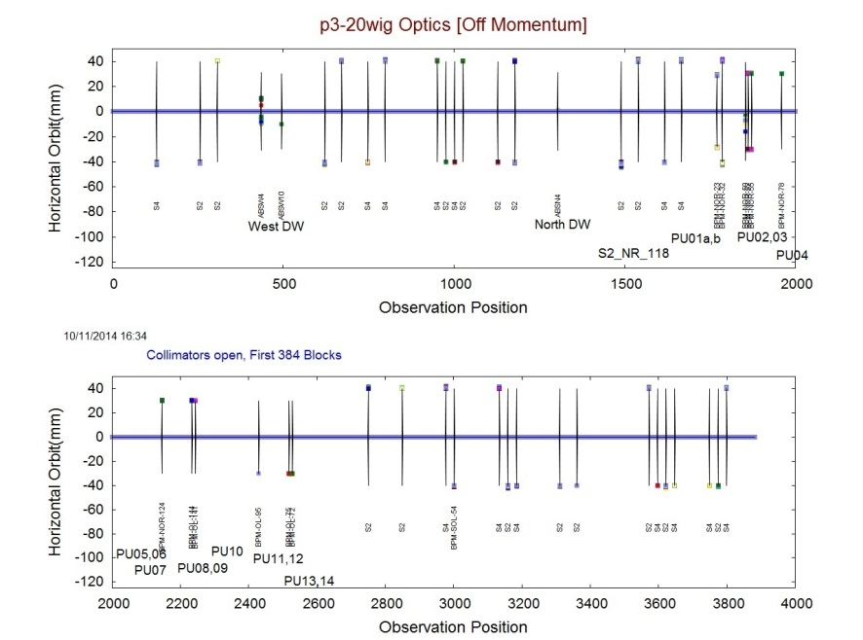
SixTrack : Tracking for p3_20wig optics
Tracking results for off momentum (ΔP/P = -0.02 to 0.02) 5781 particles with magnetic field errors tracked at 384 different longitudinal positions starting from south west for a single random number [Collimators are open]. Here the end horizontal orbits are shown at loss points to indicate in/out side of the ring. The solid lines indicate the available physical apertures.

Slide 17
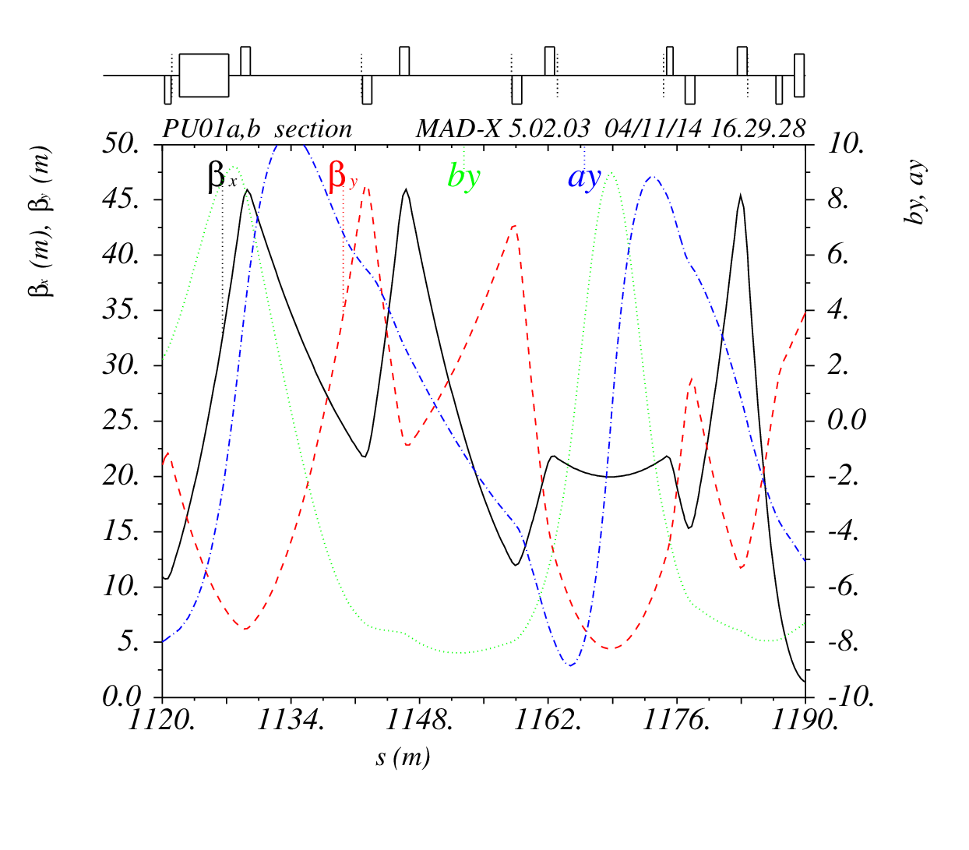
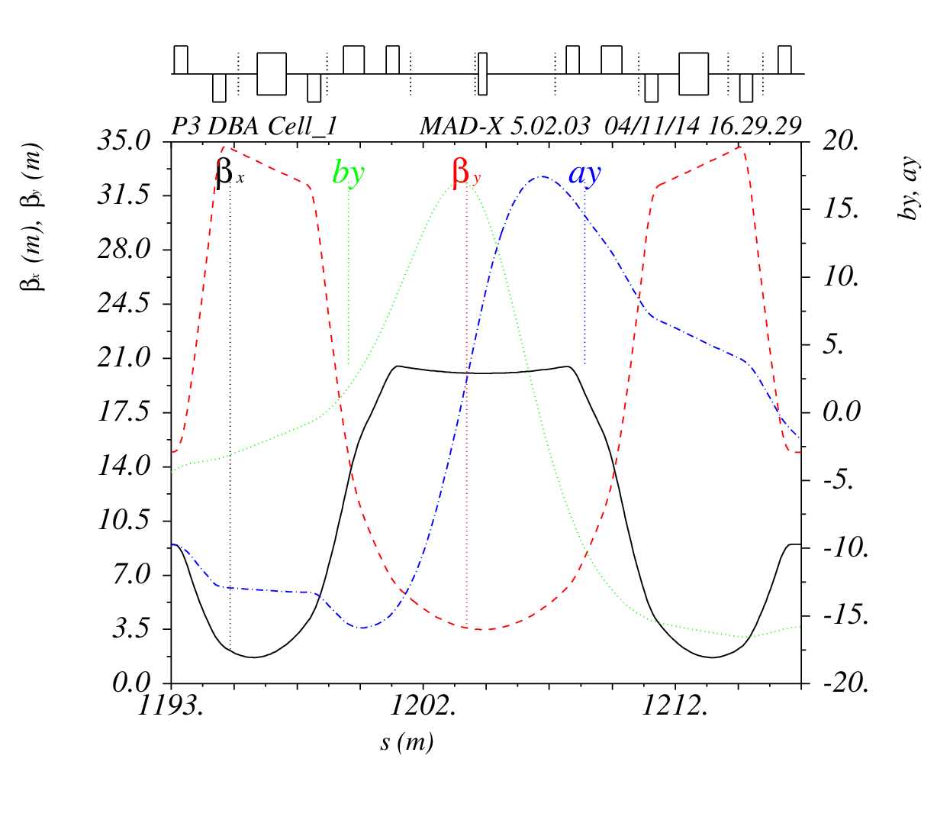
SixTrack : Tracking for p3_20wig optics
CERN MADx code
Trailing Edge with high β_{y} and a_{y}
Leading Edge with high β_{y} and a_{y}
PU01a,b
PU02
PU03

Slide 18
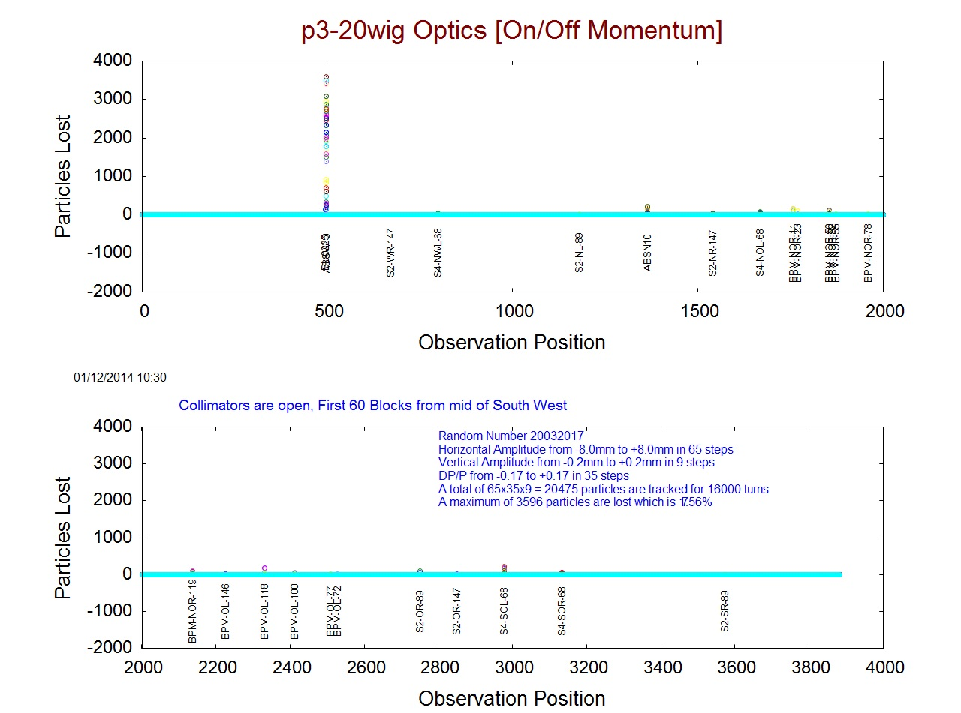
Recent Tracking Results

Slide 19
PETRA III Extension
Phase 1 and Phase 2
Precautionary measures to safeguard the Insertion Devices

Slide 20
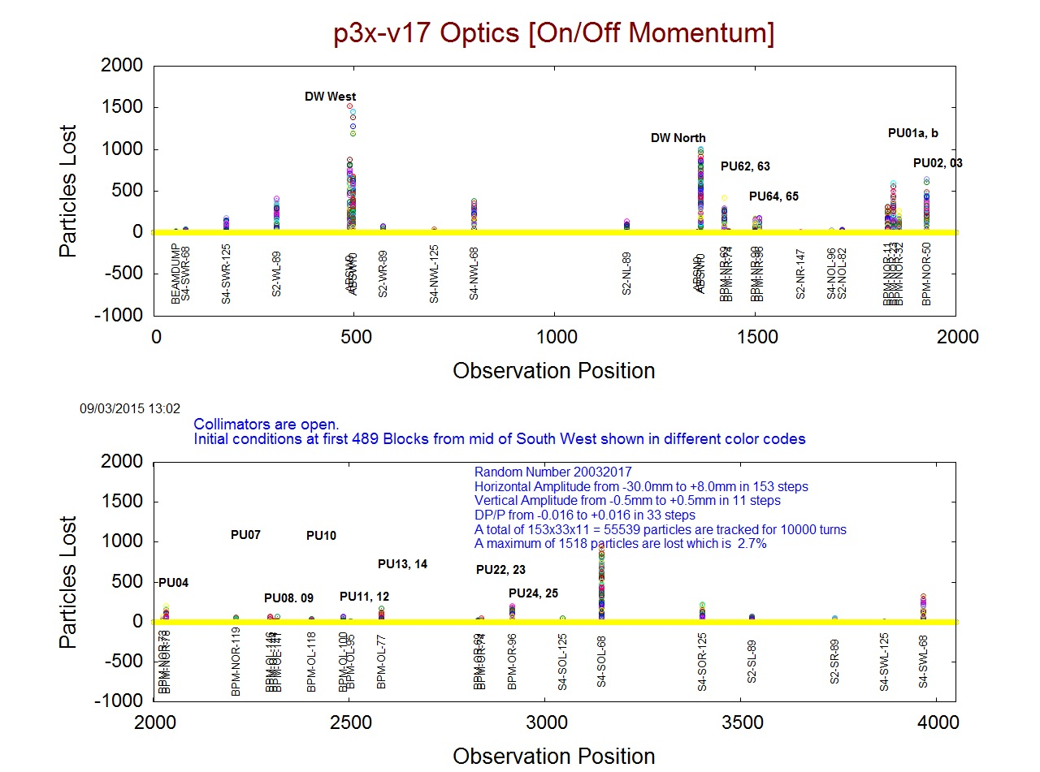
P3x_v17 Optics : PETRA III Extension

Slide 21
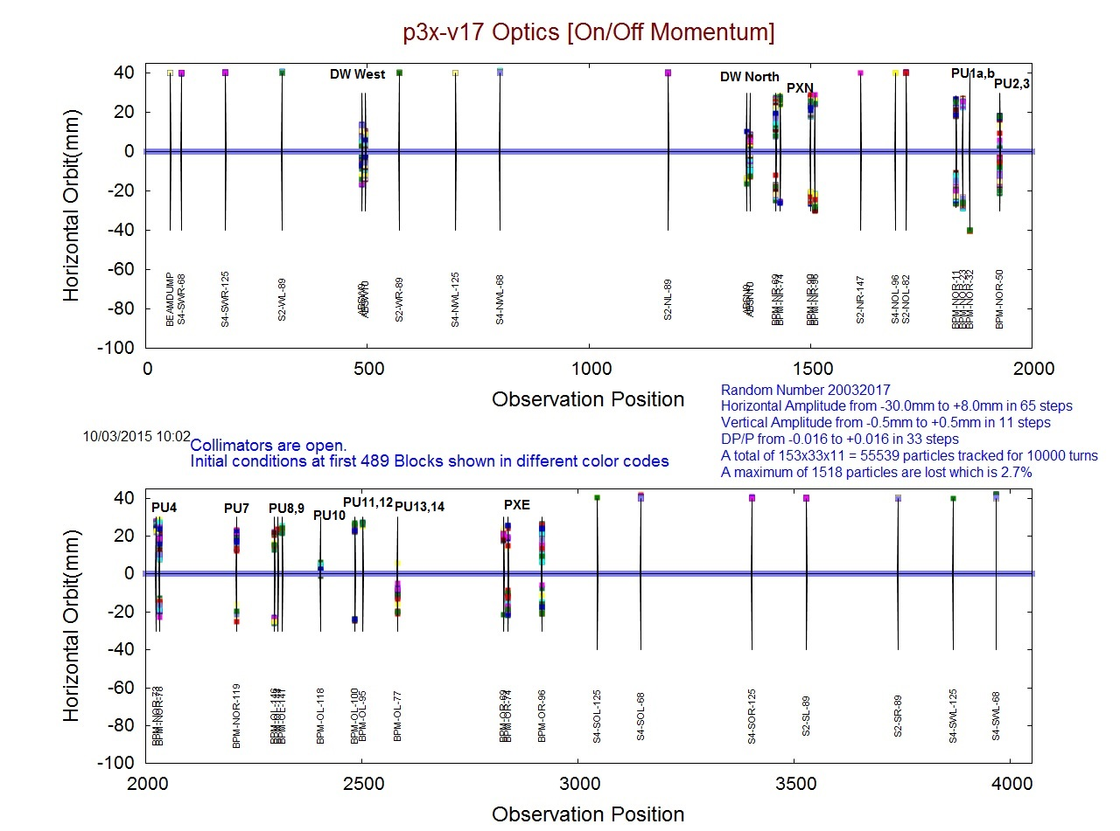
P3x_v17 Optics : PETRA III Extension

Slide 22
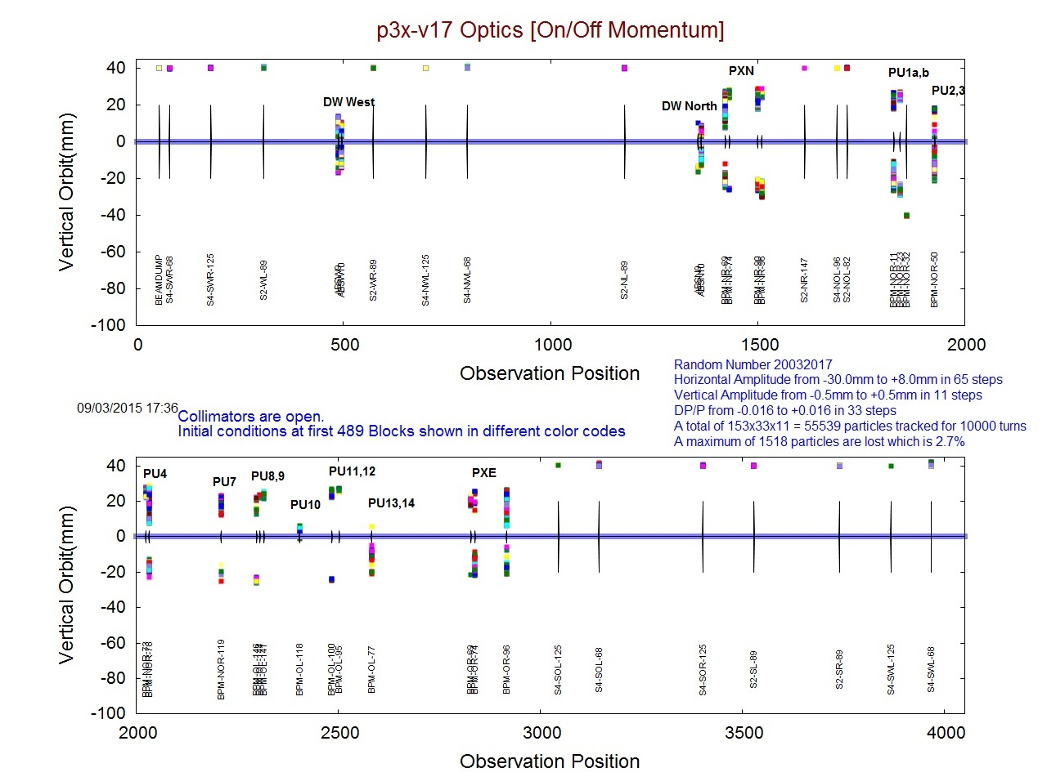
P3x_v17 Optics : PETRA III Extension

Slide 23
P3x_v17 Optics : PETRA III Extension Phase 2
Additional 2 Collimators in North East
COLL3
COLL4
PU01a,b

Slide 24
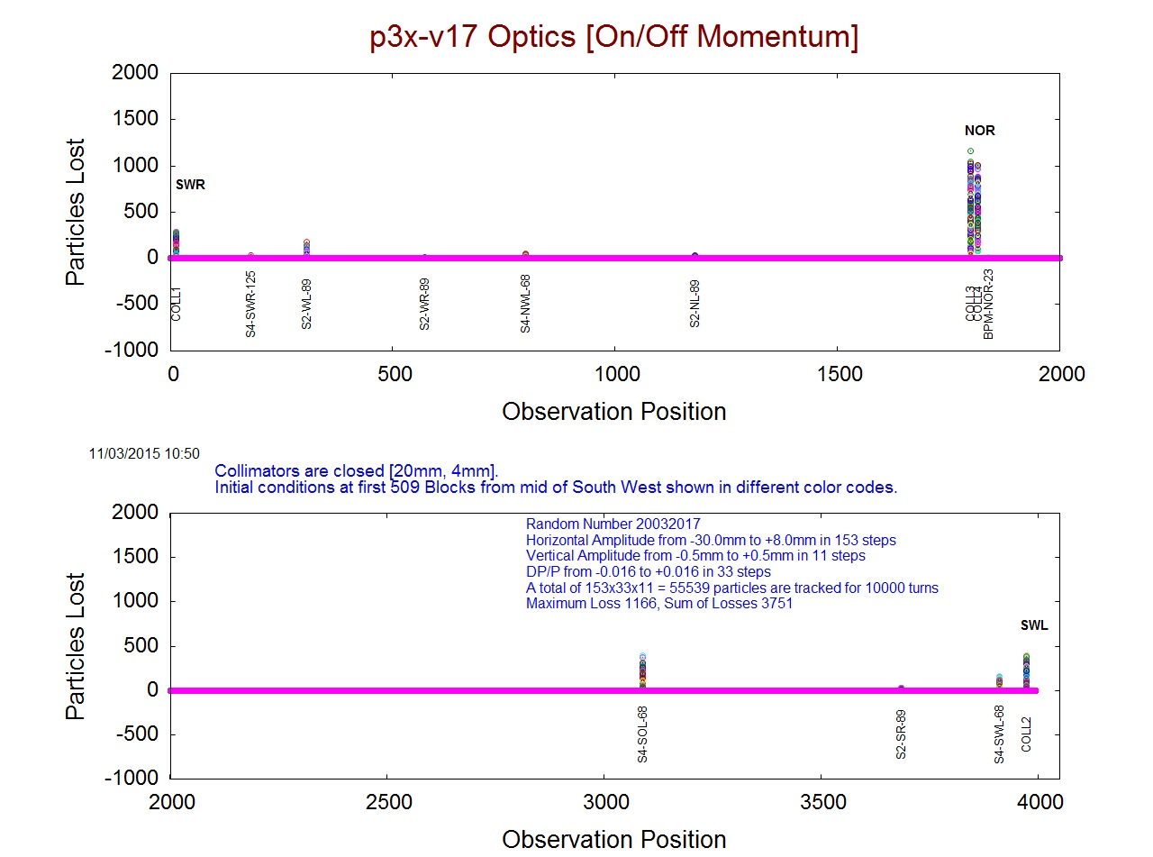
P3x_v17 Optics : PETRA III Extension

Slide 25
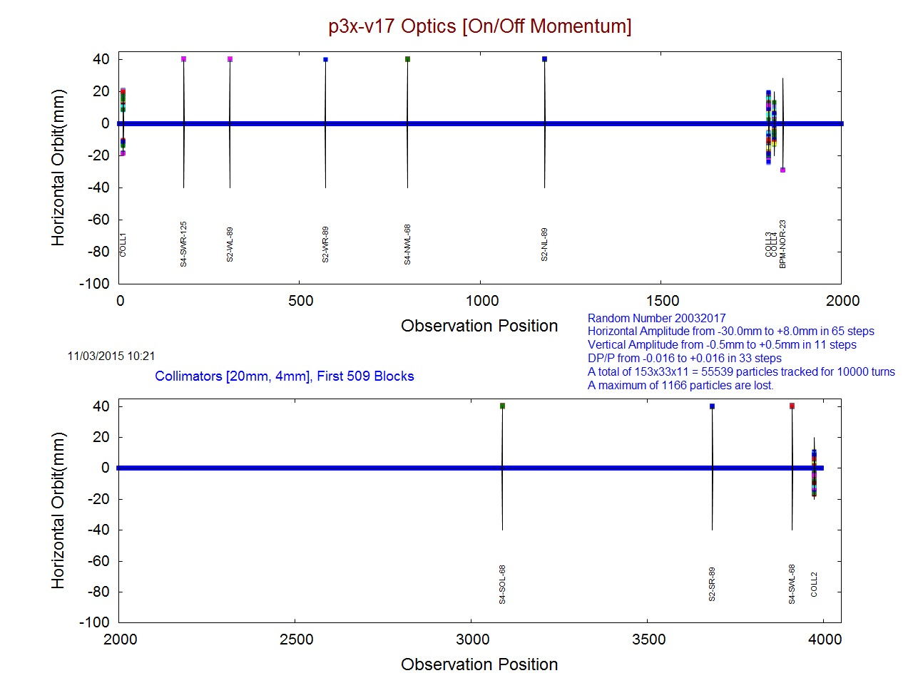
P3x_v17 Optics : PETRA III Extension

Slide 26
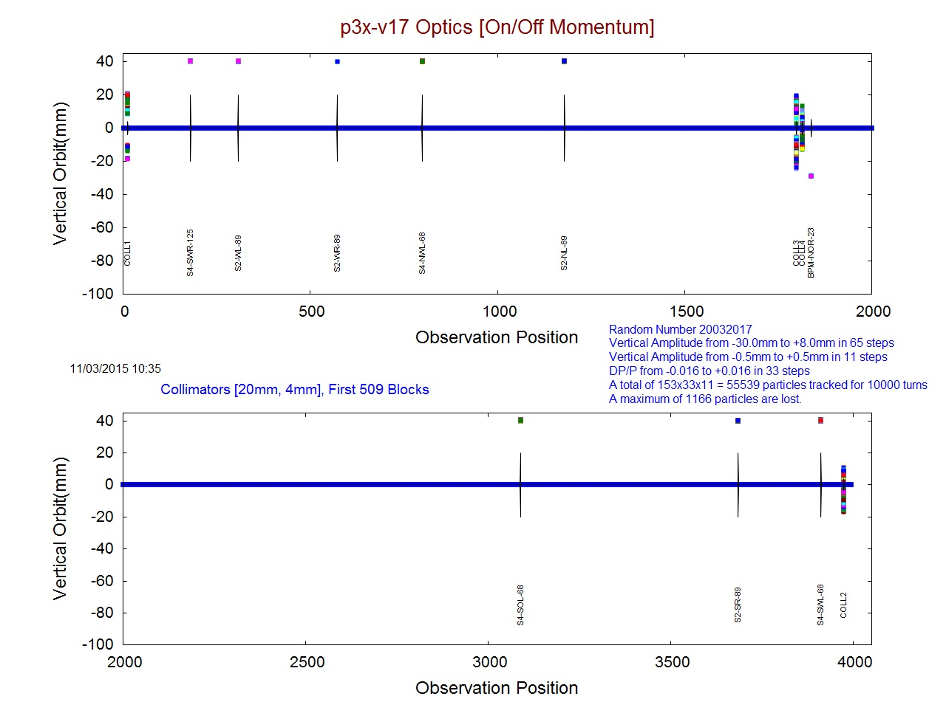
P3x_v17 Optics : PETRA III Extension

Slide 27
Conclusions
The radiation damage of insertion devices is observed in several places of the PETRA-III undulator sections. It follows a general pattern that devices located at the entrance of a straight section are damaged at the upstream part while undulators installed at the exit of a straight section show signs of demagnetization at the downstream part. This seems to indicate that particle losses occur in the vertical plane at locations where the beta functions become large while the physical aperture limits are still very small. If these particles losses occur during injection; or are mainly caused by off-momentum particles remains to be clarified. For these specific reasons, a question arises, is it associated with the optics of the lattice? We showed the tracking results of on and off momentum particles using the code SixTrack. It shows that the behavior of loss mechanism is independent of energy variation. When look to the plot of a_{y} we can see that the losses are at those locations where a_{y} are high. So, we may conclude that the loss of particles at beam lines P01, P02 and Damping wiggler sections are foreseen and are somehow connected to the property of the linear Optics. To safeguard the instruments we have to put collimators at high β_{x} and β_{y} values with proper phase advances which we are planning in the PETRA-III extension in phase 2.

