Slide 1
Trends in Design of
Low Emittance Light Source Lattices
Andreas Streun
Paul Scherrer Institut (PSI) Villigen, Schweiz
Synchrotronlichtquelle Schweiz / Swiss Light Source (SLS)
DESY Beschleuniger-Betriebsseminar
Grömitz, 23.-26.3.2015

Slide 2
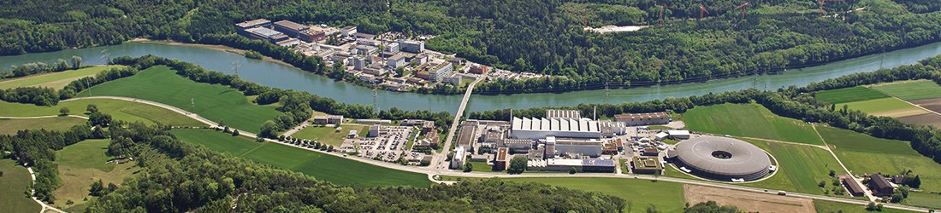
Paul Scherrer Institut (PSI)
1960 Eidgenössisches Institut für Reaktorforschung (EIR)
1968 Schweizer Institut für Nuklearphysik (SIN)
1988 EIR + SIN = PSI ⇨ research with photons, neutrons, muons
PSI Accelerators:
590 MeV proton cyloctron: 1.3 MW beam power
⇨ spallation neutron source SINQ & muon source SμS
5.8 GeV / 1 Å free electron laser SwissFEL: operation 2017
2.4 GeV synchrotron light source SLS

Slide 3
Contents
Trends in Design of Low Emittance Light Source Lattices
■   Intro
■    Brightness & coherence
■         How to get low emittance
■          The new generation of storage rings
■   The Swiss Light Source SLS
■       A compact low emittance lattice
■         SLS upgrade studies
■ Conclusion
general
information
for beam
physicists

Slide 4
Emittance ε
Brightness & coherence
ε = size × divergence − correlation
ε ≅ phase space area
ε unit = m·rad, nm·rad, pm·rad
ε as 2-D quantity presumes decoupling
horizontal ↔ vertical ↔ longitudinal
ε is an invariant of motion
ε_{γx/y} of photon beam is convolution of
  electron-ε_{x/y} : property of storage ring
  diffraction-ε_{r} ≈ λ/4π (λ = wavelength)
angle
position
area is invariant
x ⋅ δ ∼ λ/2

Slide 5
Photon beam emittance 1
Brightness & coherence
(same for y)
ε_{x/y} electron beam emittances (at dispersion free locations)
  SLS emittances: ε_{x/y} = 5500 / 5 pm
ε_{r} = λ/4π diffraction emittance → 8 pm for λ =1 Å (≅ 12.4 keV)
β ∼ beam size / beam divergence → phase space orientation
β_{x/y} electron beam beta functions
  SLS short straights: β_{x/y} = 1.4 / 1.0 m; superbends: β_{x/y} = 0.45 / 14.0 m
β_{r} approximations for diffraction
  Undulator: β_{r} ≈ L / 2π → ≈ 0.3 m for L = 2 m
  Superbend: β_{r} ≈ 0.014 m / B [T] → ≈ 0.0045 m for B = 3 T
Convoluted photon beam emittances
  Undulator @ SLS: ε_{γx/y} = 5520 / 15 pm
  Superbend @ SLS: ε_{γx/y} = 5900 / 350 pm
 W. Joho
SLS-Note 3/93

Slide 6
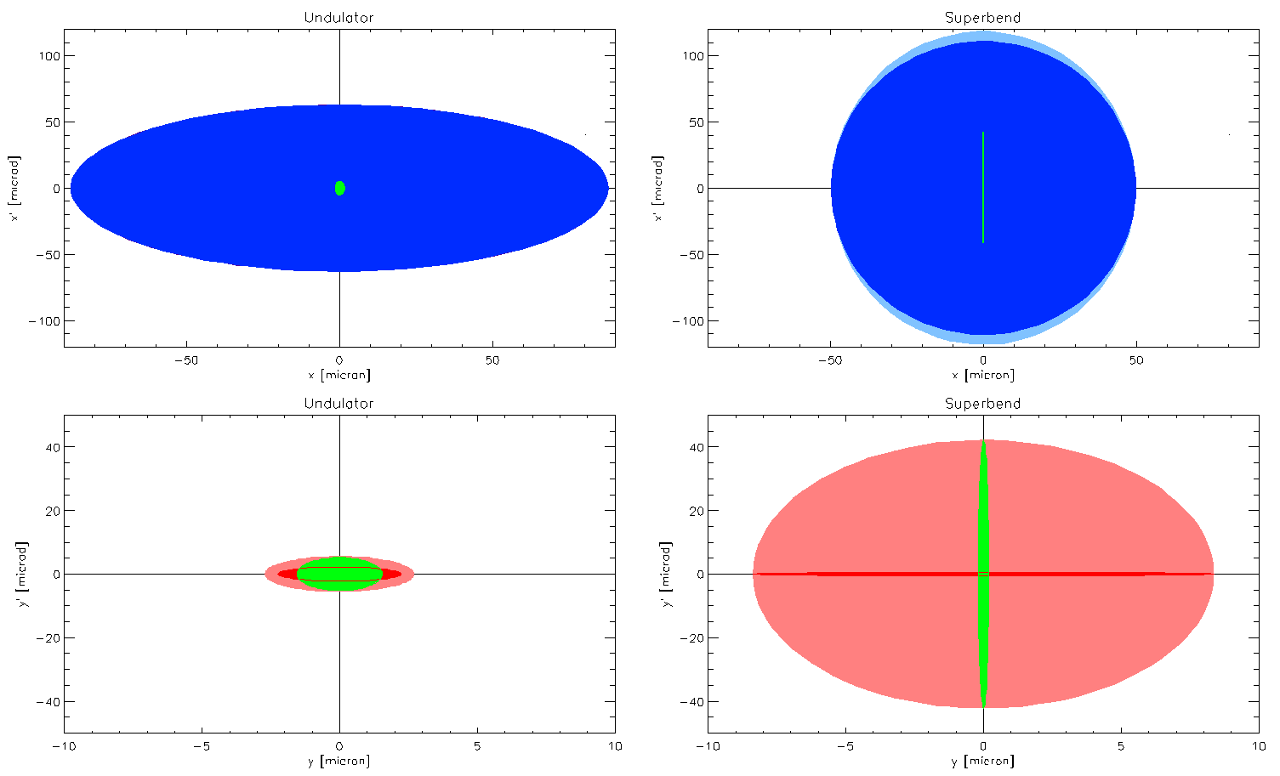
Photon beam emittance 2
Brightness & coherence
Diffraction (1Å → ε_{r} = 8 pm)
Electron beam horizontal/vertical (ε_{x/y} = 5500/5 pm)
Photon beam convoluted horizontal / vertical
for SLS undulator () and superbend ()
(same for y)
ε_{γx} = 5520 pm
ε_{γx} = 5900 pm
ε_{γy} = 15 pm
ε_{γy} = 350 pm

Slide 7
Brightness and coherent fraction
Brightness & coherence
•
N(λ) spectral photon flux
Δλ/λ bandwidth of experiment
Brightness B ⇨ focusing photons on small spot:
RIXS (resonant inelastic X-ray scattering)
EXAFS (extended X-ray absorption fine structure)
spectro- and microscopy, crystallography – any experiment
Coherent flux = CF⋅ N ⇨ focusing on diffraction limited spot
Coherent diffraction imaging, ptychography
X-ray photon correlation spectroscopy
Diffraction limited source ⇨ invisible electron source size: CF = 1
⋅

Slide 8
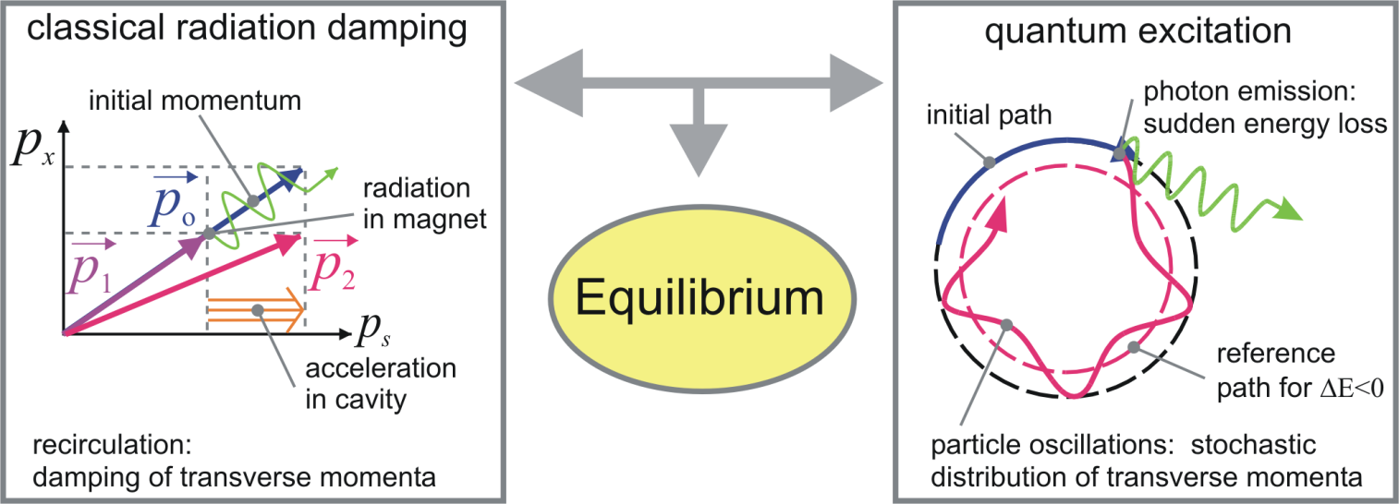
Electron beam emittance 1
Low emittance
Horizontal emittance in electron storage ring:
↓radiation damping↓ ⇒ equilibrium ⇐ ↑quantum excitation↑
independent from initial conditions !
⇩
how to
⇧ maximize this -- and -- minimize this 
?

Slide 9
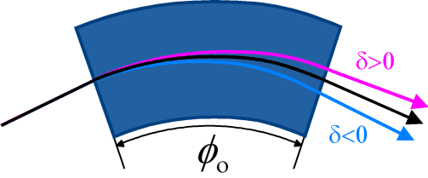
Electron beam emittance 2
Low emittance
Maximum radiation damping
  increase radiated power ⇨ pay with RF-power
    High field bending magnets
    Damping Wigglers (DW): Σ |deflection angles| > 360°
Minimum quantum excitation
  keep off-momentum orbit close to nominal orbit
  minimize dispersion at locations of radiation (bends)
    Horizontal Focusing into bends to suppress dispersion.
    Multi-Bend Achromat lattice (MBA)
    many short (= small deflection angle) bends to limit dispersion growth.
    Longitudinal Gradient Bend (LGB)
    highest radiation at region of lowest dispersion and v.v.
δ =Δp/p

Slide 10
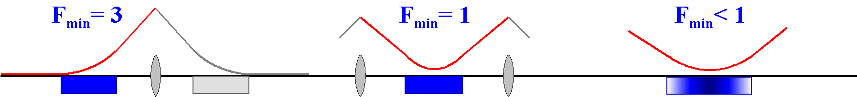
Electron beam emittance 3
Low emittance
Beam energy
Deflection angle per dipole
Beam optics...
Horizontal emittance
(for a flat iso-magnetic lattice
without damping wigglers)
ε_{x} ≈ 1/6 pm (E [GeV])² (φ [°] )³ F
  many (n) small dipoles: φ = 360°/n
  focus to magnet center: F ≈ 3...6 × F_{min}
SLS: 5500 pm
dispersion
end bend center bend longitudinal gradient
Vertical emittance (of a flat lattice)
equilibrium emittance small by nature SLS : 0.2 pm
determined by lattice imperfections SLS : 1...10 pm

Slide 11
Paths to low emittance
Low emittance
Equilibrium beam parameters of a flat lattice
ε_{xo} natural horizontal emittance
σ_{δ} rms relative momentum spread, δ = Δp/p
ΔE energy loss per turn
I₂ I₃ I₄ I₅ synchrotron radiation integrals...
constants
to do:
I₅ 
I₃ 
I₂ 
I₄ ≈ −I₂

Slide 12
The beam optics path
Low emittance
H = dispersion invariant
η, η’ dispersion and slope,
β hor. beta function, α = −β’/2
H δ ² = betatron amplitude of particle
after momentum change δ
h = orbit curvature, h = 1/ρ = B/(p/e)
⇨ keep dispersion (η, η’) small in dipoles (h ≠ 0) !
⇨ horizontal focus in each dipole
⇨ MBA: small bend angle φ = hL , so η can’t grow (η’’ = h)
⇨ LGB: longitudinal field variation B (s): compensate H (s) growth by h (s)
x’
ηδ
x
η’δ

Slide 13
The power path
Low emittance
h = orbit curvature, h = 1/ρ = B/(p/e)
⇨ increase radiation loss ΔE ~ I₂ ⇨ expensive for high energy rings !
⇨ high dipole field ⇨ large momentum spread σ_{δ}² ~ h
⇨ Damping Wigglers: length L_{w}, period λ_{w}, peak field B_{w} = (p/e) h_{w}
wiggler: long, short period, weak field, horizontal focus
PETRA 3 : Power 1.1→ 4.9 MW ⇨ ε_{xo} 4.4 → 1.0 nm

Slide 14
The damping partitioning path
Low emittance
h = 1/ρ = B/(p/e) curvature, b₂ = B’/(p/e) focusing strength
damping partitioning numbers
J_{x} = 1 − I₄/I₂ J_{δ} = 2 + I₄/I₂ → J_{x} + J_{δ} = 3
separate functions ( b₂ = 0 in bending magnets ): |I₄| << I₂ ⇨ J_{x} ≈ 1, J_{δ} ≈ 2
⇨ get ≈½ emittance on expense
of ≈√2 larger momentum spread:
⇨ vertical focusing (b₂ < 0, |b₂| >> h²) in bends (h > 0, η > 0)
e.g. MAX IV J_{x} = 1.85
⇨ horizontal focusing (b₂ > 0) in anti-bends (h < 0, η > 0)

Slide 15
The TME cell
Low emittance
what is the lowest possible emittance of a lattice cell ?
  homogenous (constant h), short (φ =hL << 1) bending magnet
  set α_{o} = η_{o}’ = 0 at bend center (symmetry); find minimum H ( β_{o}, η_{o} ) :
⇨ Theoretical Minimum Emittance (TME) for
periodic symmetric cell:
α = η’ = 0 at ends
matching problem
TME phase advance
μ ^{min} =284.5°
  2nd focus, useless
  long cell
  overstrained optics
independent of bending magnet field !
β_{x} β_{y} η
φ, L, h

Slide 16
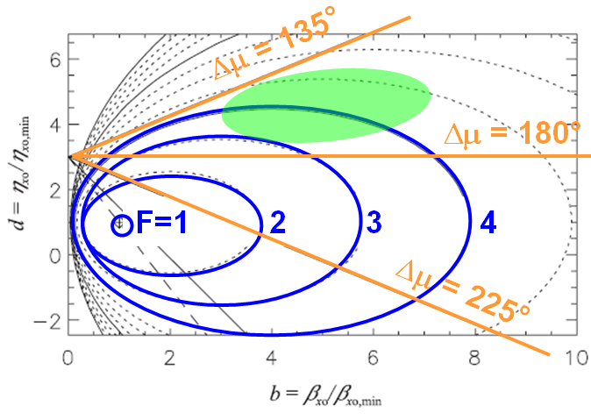
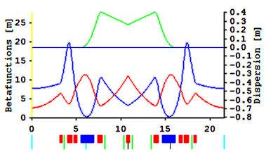
Relaxed TME cells
Low emittance
Deviations from
TME conditions
Ellipse equations
for emittance
Cell phase advance
real cells: μ < 180° ⇨ F ~ 3...6
( this is for a periodic cell, the dispersion suppressor cell is different, with F_{min} = 3 )
  ELETTRA: F = 4.1

Slide 17
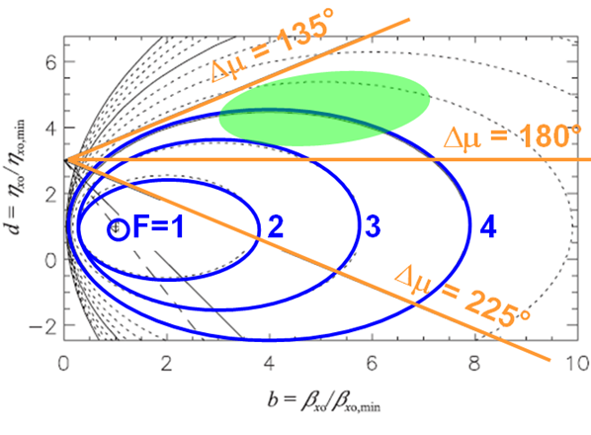
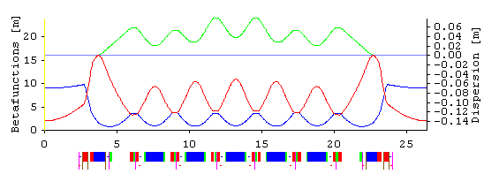
The MBA concept
Low emittance
 D. Einfeld & M. Plesko,
NIM A 335 (1993), 402-416
move
here!
relax optics: allow large F
  low phase advance μ
exploit ε ∼ φ ³ dependence
  many small angle bending magnets, many lattice cells
  MAX IV: μ ~ 78°, b ~ 6, d ~ 10, F ~ 15, φ = 3° → ε = 328 pm
Lattice Miniaturization
  small bend angle φ
  ⇨ small dispersion η
  minimum aperture for
  momentum acceptance
  (with regard to Touschek lifetime)
MAX IV: 20 × 7BA arcs

Slide 18
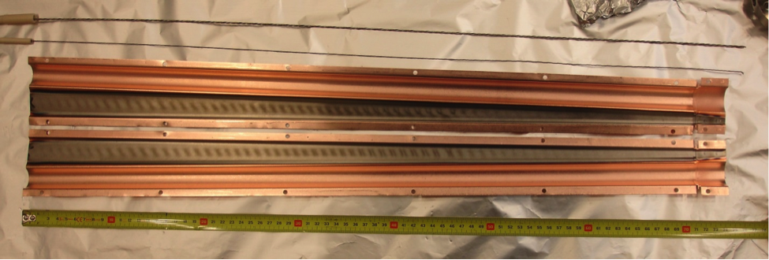
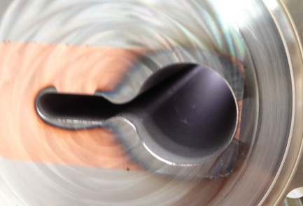
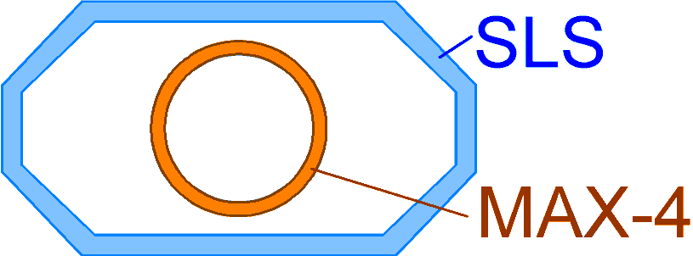
Vacuum technology: NEG coating
New generation
Ultra high vacuum requirements: ∼10⁻¹² bar
  Coulomb scattering lifetime
  Bremsstrahlung background to experiments
3rd generation light source vacuum systems
  pumping cross section: wide vacuum chamber
NEG* coating of small vacuum chambers.
  *Non Evaporable Getter: ≈ 1 μm Ti-Zr-V layer
  beam pipe = getter pump
  basically no lower size limit
  5 mm full height MAX IV antechamber ⇨
  low radiation desorption
⇨ factor ≈3 smaller beam pipe
⇨ small magnet bore.
⇨ high magnet gradient.
⇨ lattice miniaturization.
 S. Dos Santos, LER-4, Frascati

Slide 19
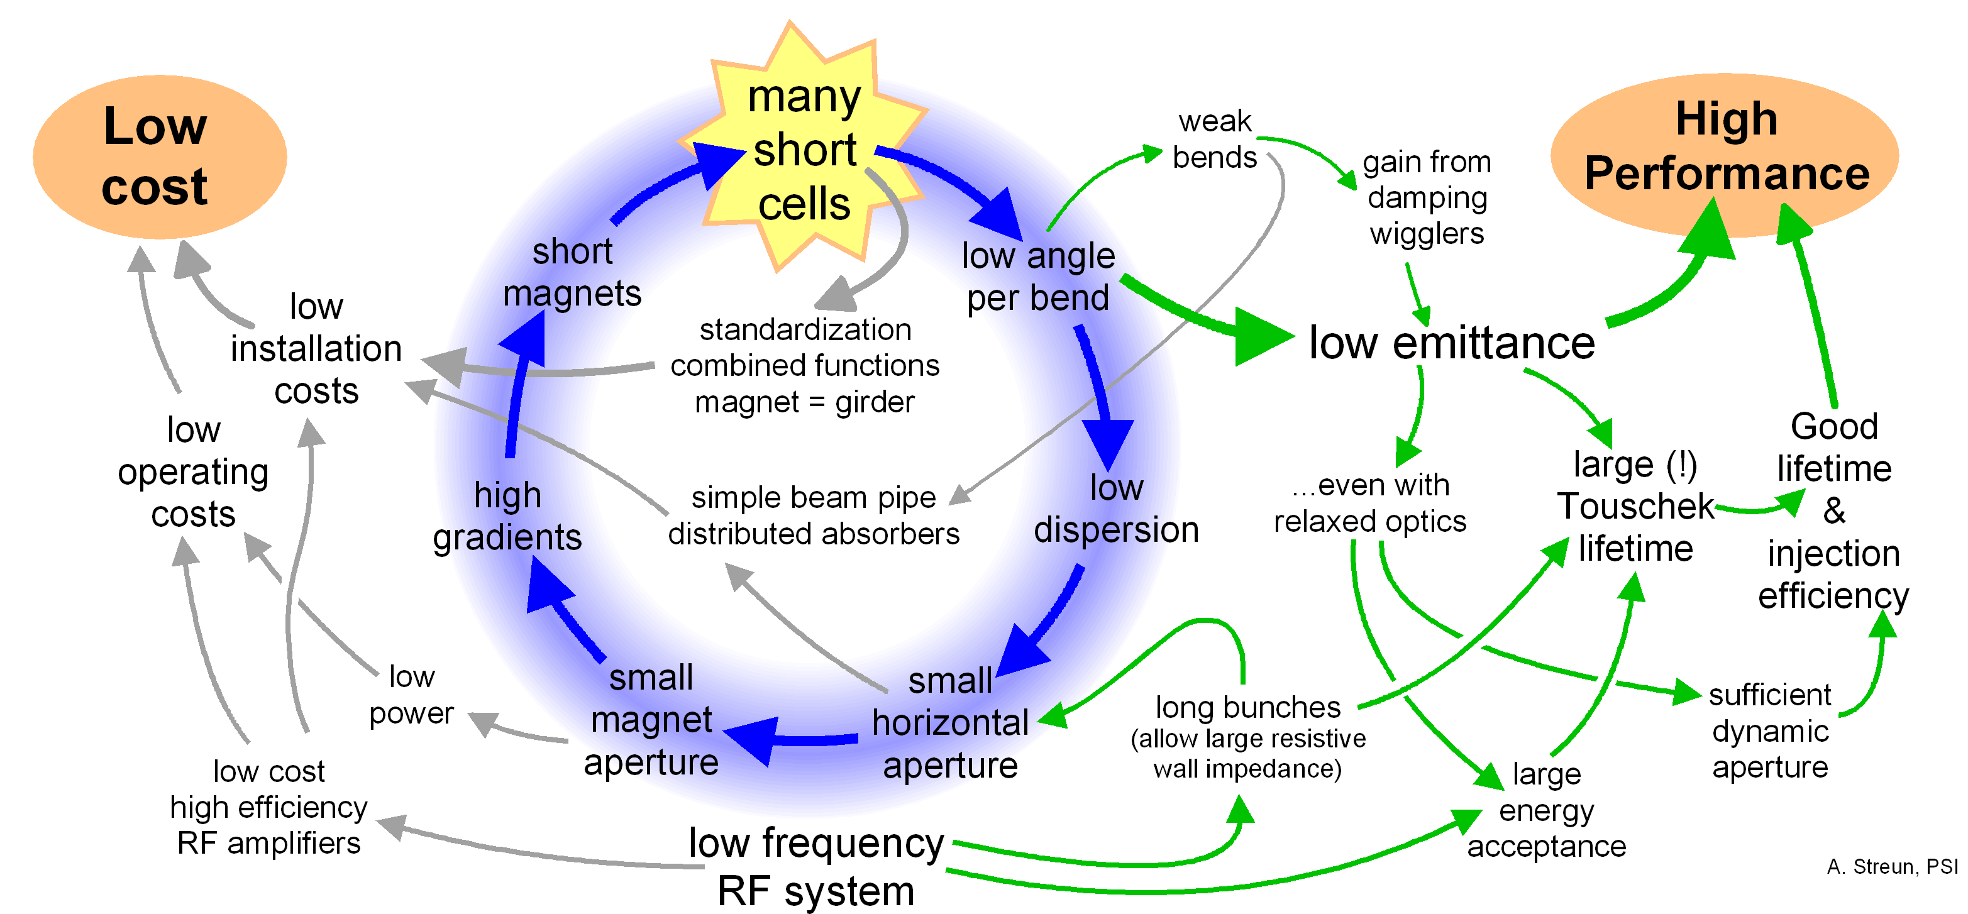
The multi-bend achromat optimization cycle
New generation

Slide 20
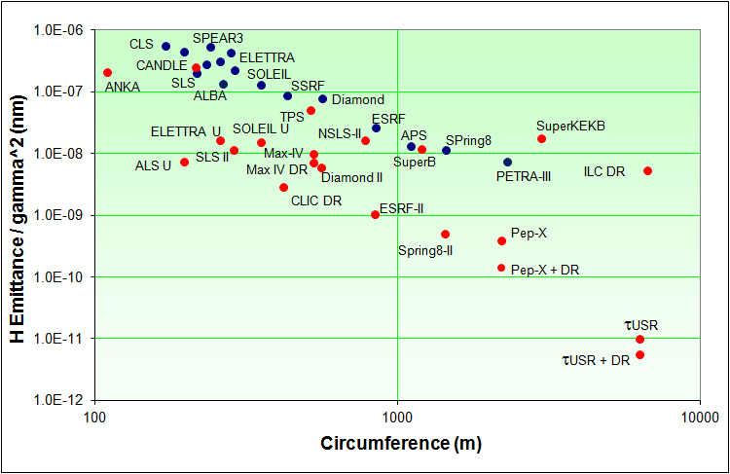
The storage ring generational change
New generation
Horizontal emittance normalized to beam energy
Riccardo Bartolini (Oxford University)
4th low emittance rings workshop, Frascati , Sep. 17-19, 2014
Storage rings in operation (•) and planned (•).
The old (—) and the new (—) generation.

Slide 21
New storage rings and upgrade plans
New generation
Name | Energy [GeV] | Circumf. [m] | Emittance* [pm] | Status
PETRA-III | 6.0 3.0 | 2304 | 4400 → 1000 85 (round beam) | operational
MAX-IV | 3.0 | 528 | 328 → 200 | 2015
SIRIUS | 3.0 | 518 | 280 | 2016
ESRF upgrade | 6.0 | 844 | 147 | 2020
DIAMOND upgrade | 3.0 | 562 | 275 | started
APS upgrade | 6.0 | 1104 | 65 | study
SPRING 8 upgrade | 6.0 | 1436 | 68 | study
PEP-X | 4.5 | 2200 | 29 → 10 | study
ALS upgrade | 2.0 | 200 | 100 | study
ELETTRA upgrade | 2.0 | 260 | 250 | study
SLS now | 2.4 | 288 | 5500 | operational
SLS-2 | 2.4 (?) | 288 | 100-200 ? | 2024 ?
*Emittance without → with damping wigglers

Slide 22
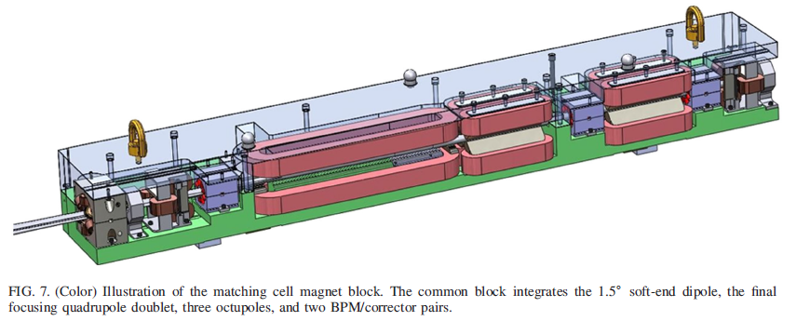
MAX IV
New generation
Magnets
  integrated yokes
  bore diameter 25 mm
  minimum magnet
  distance: 25 mm
Vacuum chamber
  NEG coated
  copper pipe ∅ 22/20 mm (outer/inner) as distributed absorber
RF system: low frequency (100 MHz) + passive 3rd harmonic
  long bunch: avoid instabilities due to resistive wall impedance
  short pulse users → go to FEL !
Beam dynamics performance
  bare lattice emittance 330 pm @ 3 GeV, 200 pm with DW
  5% energy acceptance, Touschek lifetime 30 h (with Landau cavity)
Start of operation: summer 2015
20 × 7BA
 S. C. Leemann at al., PRST AB 12, 120701

Slide 23
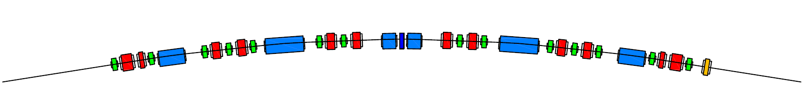
SIRIUS
New generation
20 × H5BA lattice, 518 m, 3 GeV, 280 pm
HMBA = hybrid MBA
(different bend types)
20 × H5BA
L. Liu, LER-3, Oxford, 2013
L. Liu et al., JSR (2014) 21, 904-911
2T super bends for hard X-rays
- permanent magnet design
- 10% emittance reduction from longitudinal field profile

Slide 24
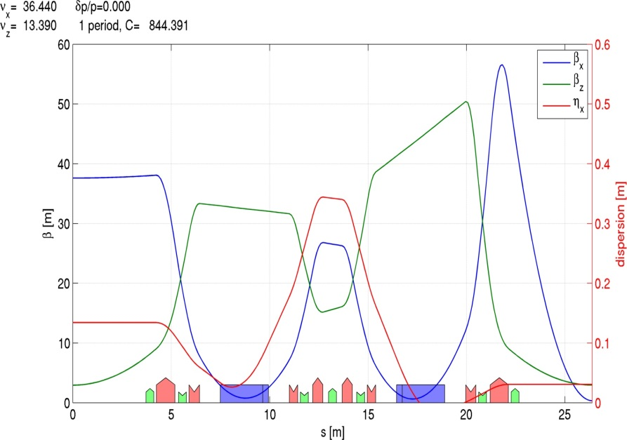
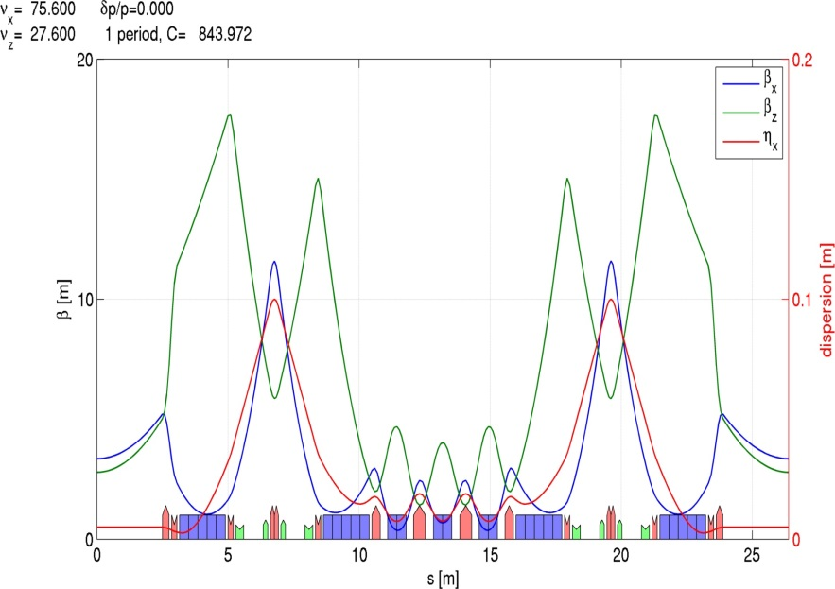
ESRF upgrade
New generation
Upgrade program 2015-20
Emittance 4 nm → 160 pm @ 6 GeV
Keep tunnel and injector complex
Maintain ID beam lines and bending magnet beam lines
Reduce radiated power 5 MW → 3 MW
1 year downtime for installation
32 × DBA
old
new →
lattice
32 × H7BA
Dispersion bumps for efficient chromaticity correction
maintain bending magnet positions
max. quad gradient up to 100 T/m, 26 mm bore diam.
A. Franchi, USR Bejing 2012
J.-L. Revol et al, IPAC 2014, p.209

Slide 25
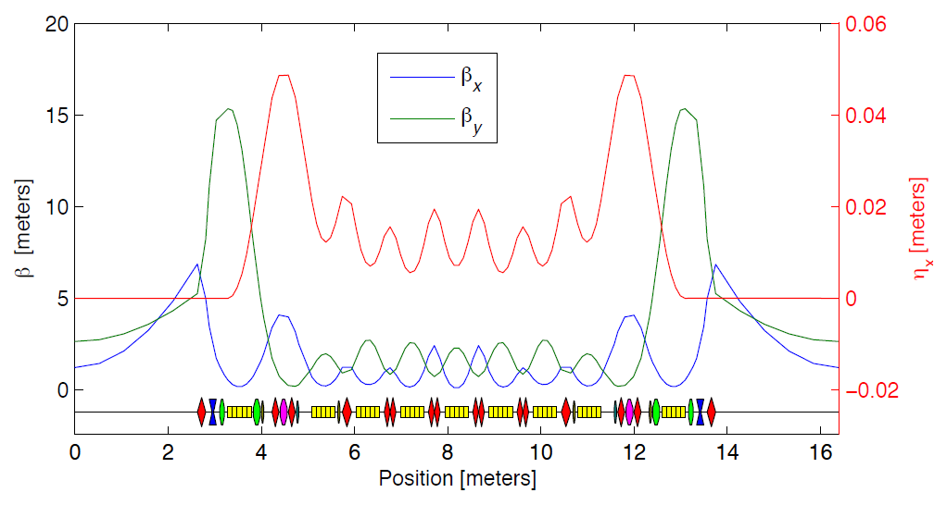
ALS upgrade
New generation
emittance 2 nm → ~50 pm @ 2 GeV in ~200 m circumference
  fully coupled beam,
  i.e. ε_{x} = ε_{y} (ε_{xo} ~100 pm)
Lattice: 12×TBA → 12×9BA
small dynamic aperture
⇨ on-axis swap-out injection
  additional accumulator ring
12 × 9BA
 C. Steier et al., IPAC 2014, p.567
injector
top-up
top-up
fill
fill
top up
swap
accumulator
swap
swap
accu
ring
storage ring

Slide 26
PEP-X
New generation
PEP: HEP collider. PEP-II: B-factory 1999-2008
PEP-X: 2.2 km ring @ 4.5 GeV, 11 pm emittance !
MAX-IV type7-bend achromat: 6 x 8 arcs
long straights from HEP times: places for damping wigglers
large β_{x} ≈ 200 m for off-axis injection
emittance 29 pm, with damping wigglers: 11 pm
48 × 7BA
Y. Cai et al., PRST AB 15, 054002 (2012)
Lattice courtesy Y. Cai, SLAC

Slide 27
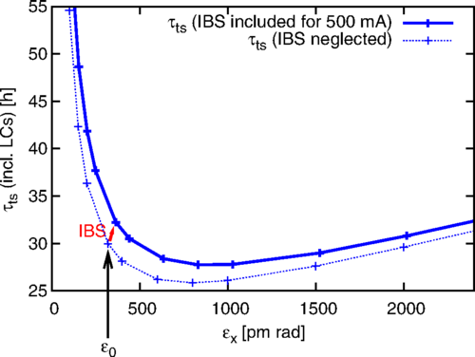
Summary of main features [and options]
New generation
Magnet miniaturization
  NEG coated vacuum chambers, ∅ 20..25 mm
  MBA & HMBA lattices with many cells
Dynamic aperture challenge
  new tools (e.g. MOGA) for optimization
  installation of octupoles
Harmonic RF systems [& low fundamental RF]
  bunch lengthening to increase Touschek lifetime
  low frequency bunch spectrum to avoid excitation of instabilities
  Landau damping to prevent instabilities
Intra-beam scattering effects (IBS)
  significant contribution to emittance
  inverse scaling of
  Touschek lifetime with emittance ⇨
[ Round beam ]
  optimization of coherent flux
  mitigation of IBS emittance increase
[ On-axis injection ]
  cope with limited dynamic aperture
S. Leemann, PRST AB 17, 050705 (2014)

Slide 28
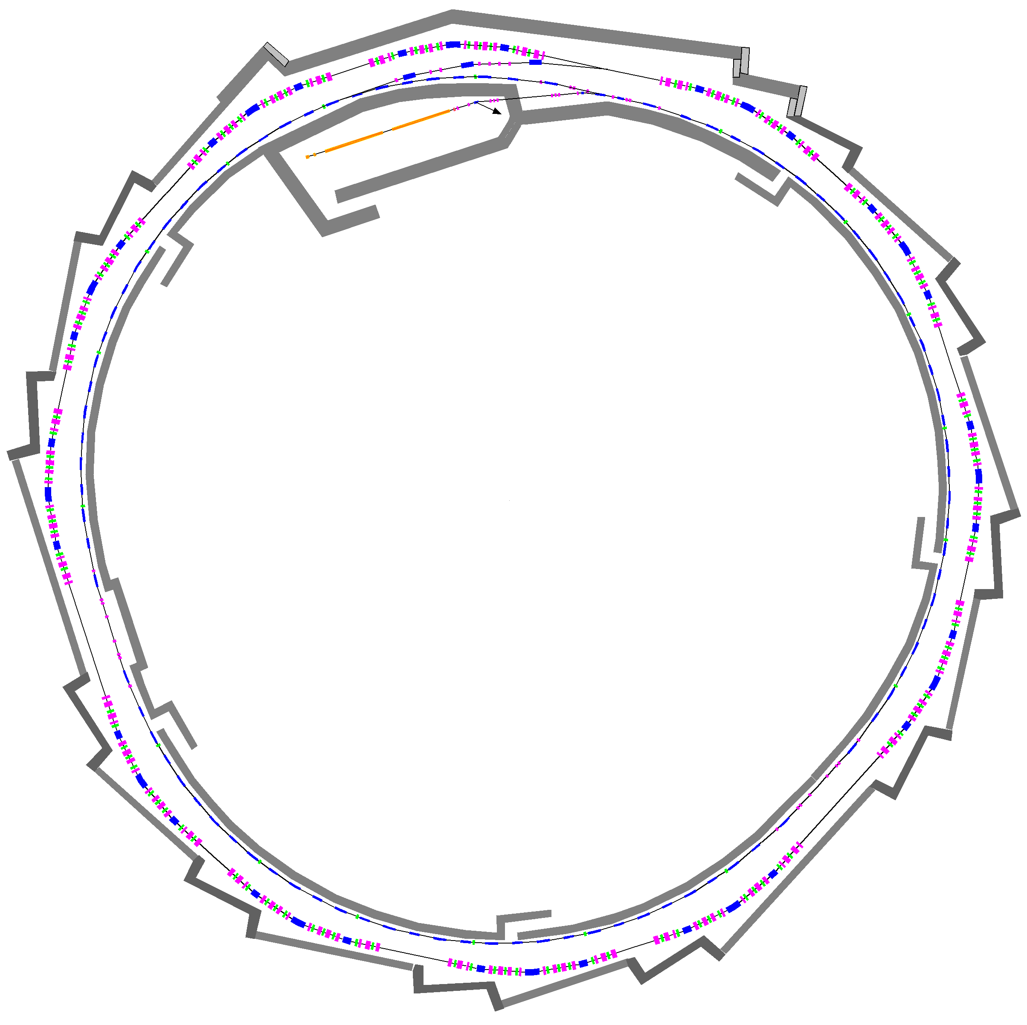
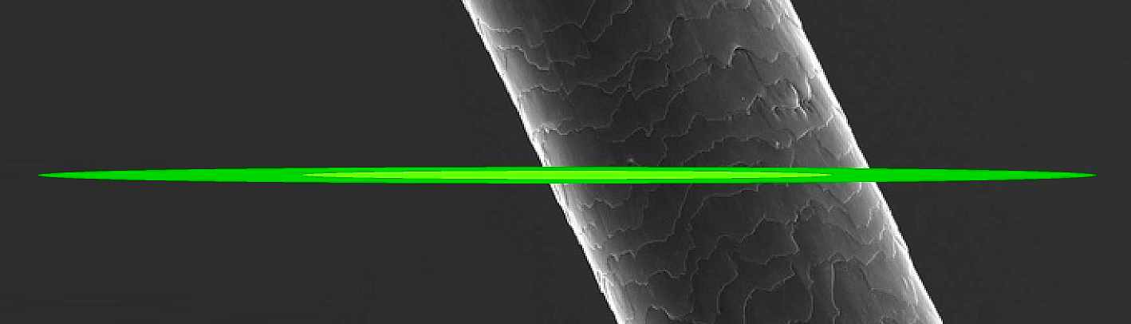
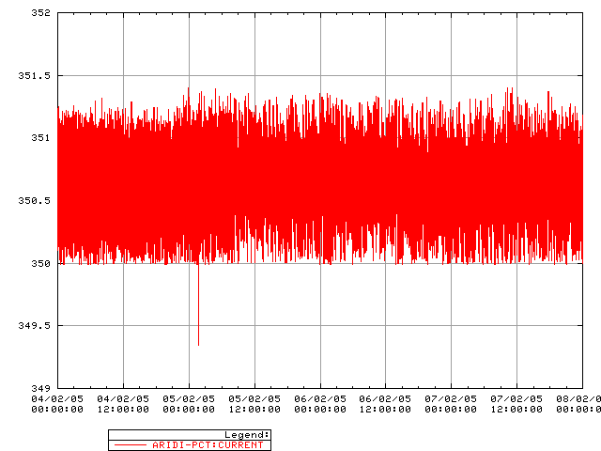
SLS Layout
Swiss Light Source
Electron beam cross section in comparison to human hair
transfer lines
90 keV
pulsed (3 Hz)
thermionic
electron gun
100 MeV
pulsed linac
Synchrotron (“booster”)
100 MeV → 2.4 [2.7] GeV
within 146 ms (~160’000 turns)
Current vs. time
2.4 GeV storage ring
ε_{x} = 5.0..6.8 nm, ε_{y} = 1..10 pm
400±1 mA beam current
top-up operation
1 mA
4 days
shielding
walls

Slide 29
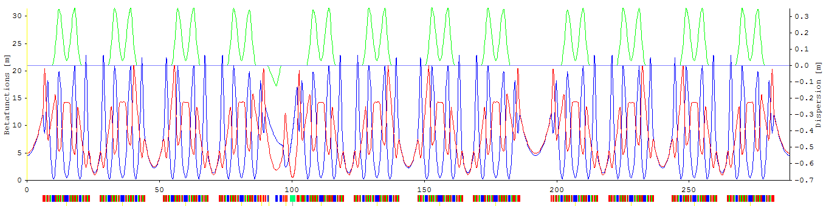
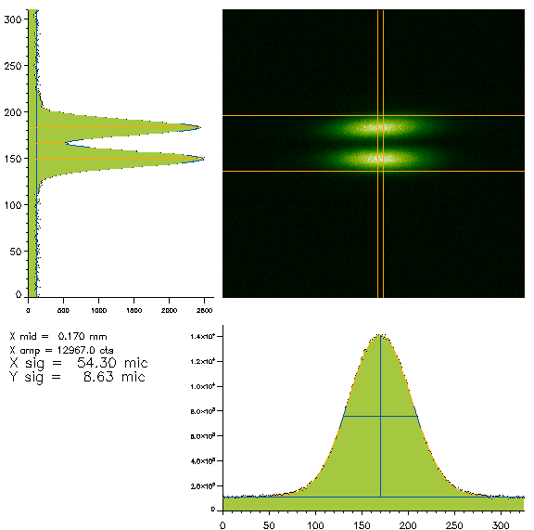
SLS lattice and history
Swiss Light Source
β_{x} β_{y} η
288 m circumference
12 × TBA (triple bend achromat) lattice
straight: 6 × 4 m, 3 × 7 m, 3 × 11.5 m
FEMTO chicane for laser beam slicing
3 normalconducting 3T superbends
Horizontal emittance 5.5 nm
Vertical emittance ≈ 5 pm
User operation since June 2001
18 beam lines in operation
Beam size monitor
X09DA
vertically polarized
synchrotron light

Slide 30
SLS upgrade constraints and challenges
Swiss Light Source
Constraints
  get factor 20...50 lower emittance !
  keep circumference & footprint: hall & tunnel.
  re-use injector: booster & linac.
  keep beam lines: avoid shift of source points.
  “dark period” for upgrade 6...9 months
Main challenge: small circumference
  Multi bend achromat: ε ∝ (number of bends)^{─3}
  Damping wigglers (DW): ε ∝ radiated power
  Low emittance from MBA and/or DW requires space !
  Scaling MAX IV to SLS size and energy gives ε ≈ 1 nm,
  improvement by factor 5 only ✗
ring
ring + DW

Slide 31

Compact low emittance lattice concept
The LGBAB cell
Longitudinal gradient bends (LGB):
field variation B_{y} = B_{y} (s)
  ε ∝ ∫ (dispersion²...) × (B-field)³ ds
  → high field at low dispersion and v.v.
Anti-bends (AB): B_{y} < 0
  matching of dispersion to LGB
  (disentangle horizontal focusing
  from dispersion matching)
Factor ≈ 5 lower emittance
compared to a conventional lattice
MBA + LGB/AB : factor ≈ 25!
Disp.
 AS & A. Wrulich, NIM A770 (2015) 98–112
 AS, NIM A737 (2014) 148–154

Slide 32
Longitudinal gradient bends
The LGBAB cell
orbit curvature
h(s) = B(s)/(p/e)
Longitudinal field variation h(s) to compensate H (s) variation
Beam dynamics in bending magnet
  Curvature is source of dispersion:
  Horizontal optics ~ like drift space:
  Assumptions: no transverse gradient (k = 0); rectangular geometry
Variational problem: find extremal of η(s) for
  too complicated to solve
    mixed products up to η’’’’ in Euler-Poisson equation...
special functions h(s), simple (few parameters):
variational problem → minimization problem
numerical optimization

Slide 33
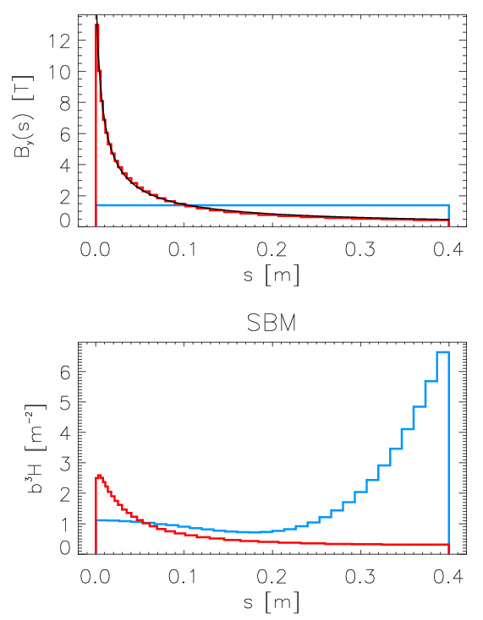
Numerical optimization
The LGBAB cell
Results for half symmetric bend
( L = 0.8 m, Φ = 8°, 2.4 GeV )
Half bend in N slices:
curvature h_{i} , length Δs_{i}
Knobs for minimizer:
{h_{i}}, β₀, η₀
Objective: I₅
Constraints:
  length: ΣΔs_{i} = L/2
  angle: Σh_{i}Δs_{i} = Φ/2
  [ field: h_{i} < h_{max} ]
  [ optics: β₀ , η₀ ]
Results:
  hyperbolic field variation
  (for symmetric bend, dispersion suppressor bend is different)
  Trend: h₀ → ∞ , β₀ → 0 , η₀ → 0
optimized
hyperbola fit
homogeneous
I₅ contributions

Slide 34
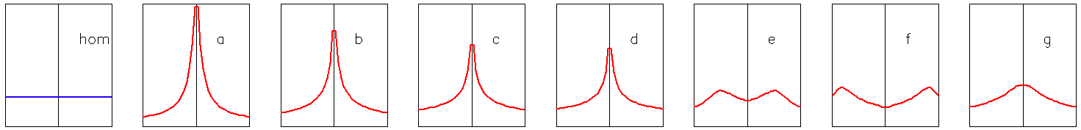
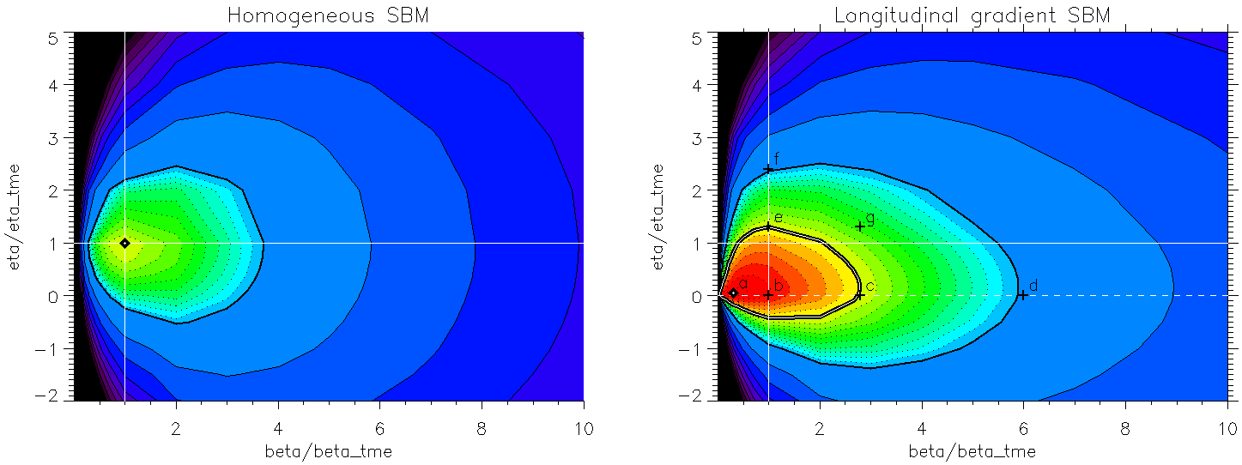
Optimization with optics constraints
The LGBAB cell
Numerical optimization of field profile for fixed β₀, η₀
  Emittance (F) vs. β₀, η₀ normalized to data for TME of hom. bend
F = 3
F = 3
F = 2
F = 2
F = 1
F ≈ 0.3
F = 1
small (~0) dispersion at centre required, but tolerant to large beta function

Slide 35
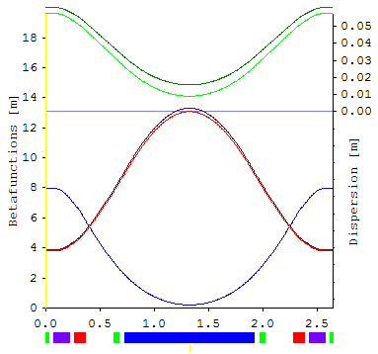
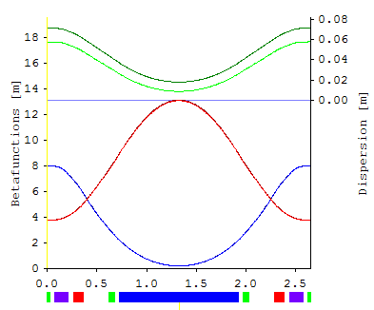
Anti-bends
The LGBAB cell
General problem of dispersion matching:
  dispersion is a horizontal trajectory
  dispersion production in dipoles → “defocusing”: η’’ > 0
Quadrupoles in conventional cell:
  over-focusing of horizontal beta function β_{x}
  insufficient focusing of dispersion η
⇨ disentangle η and β_{x} !
use negative dipole: anti-bend
  kick Δη’ = ψ , angle ψ < 0
  out of phase with main dipole
  negligible effect on β_{x} , β_{y}
Side effects on emittance:
  main bend angle to be increased by 2|ψ |
  anti-bend located at large H
  → in total, still lower emittance
dispersion:
anti-bend off / on
β_{x} β_{y}
relaxed TME cell, 5°, 2.4 GeV, J_{x} ≈ 2
Emittance: 500 pm / 200 pm

Slide 36
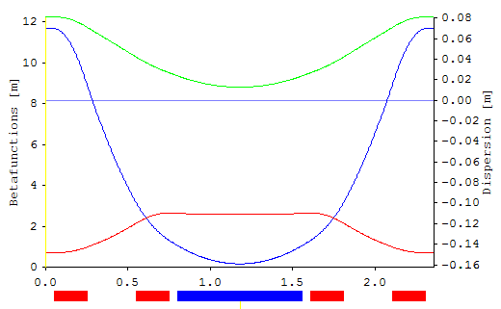
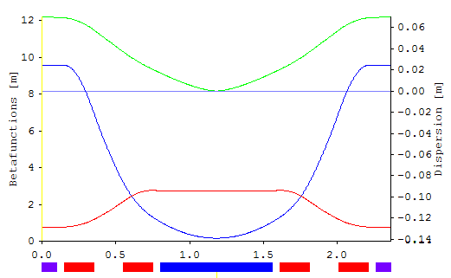
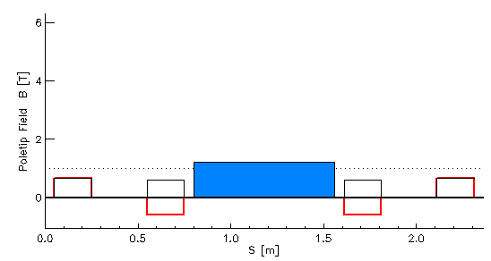
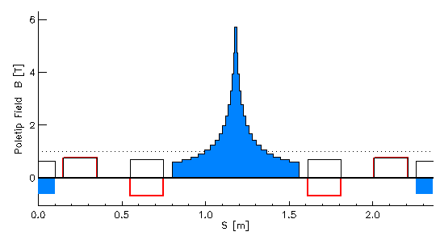
The LGB/AB cell for low emittance
The LGBAB cell
Conventional cell vs. longitudinal-gradient bend/anti-bend cell
  both: angle 6.7°, E = 2.4 GeV, L = 2.36 m, Δμ_{x} = 160°, Δμ_{y} = 90°, J_{x} ≈ 1
conventional: ε = 990 pm LGB/AB: ε = 200 pm
Disp. η
Disp. η
β_{x} β_{y}
β_{x} β_{y}
dipole field
quad field
total |field|
longitudinal
gradient
bend
} at R = 13 mm
anti-bend

Slide 37
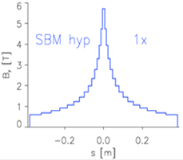
Additional benefits of the LGB/AB cell
The LGBAB cell
Hard X-rays (≈ 80 keV) from high B-field peak (4..6 Tesla)
at moderate beam energy (2.4 GeV):
ε-reduction due to increased radiated power from high field and from Σ|deflection angle| > 360° (“wiggler lattice”).
Beam dynamics: potentials for ease of chromaticity correction
  rather relaxed optics for a low emittance lattice.
  negative momentum compaction (“below transition”) : suppression of head-tail instability at negative chromaticity.
SLS normal bend
SLS superbend
SLS-2 LG superbend
Photon energy [keV]

Slide 38
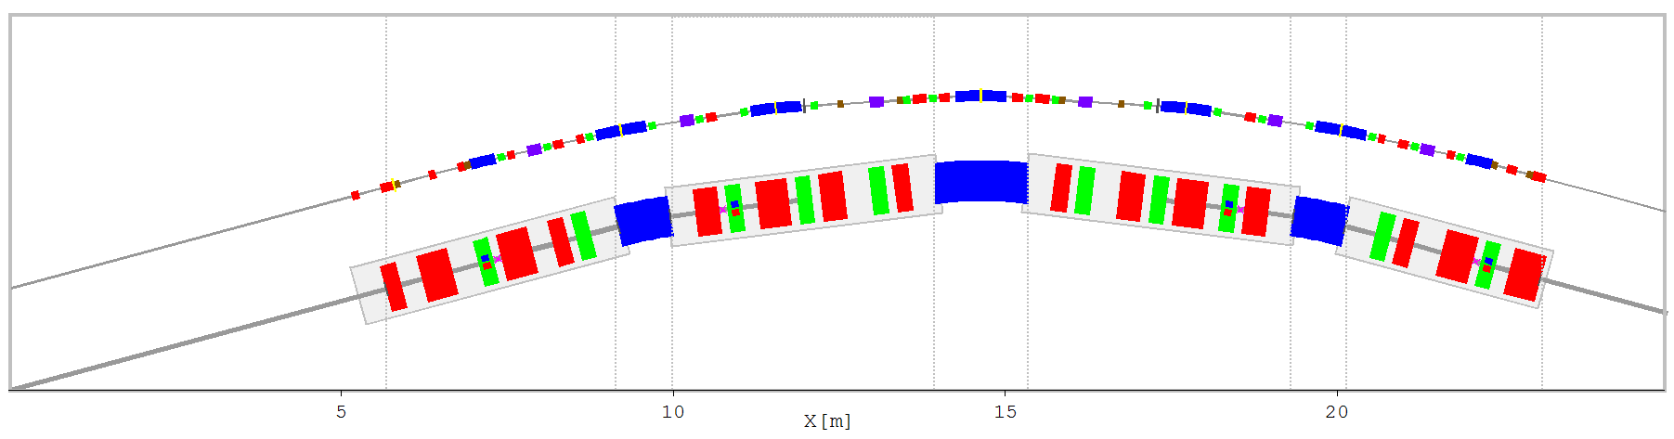
SLS-2 lattice design status
SLS upgrade
SLS-2 arc
SLS arc
Various concept lattice designs for 100-200 pm
(factor 25...50 compared to SLS-1)
  based on a 7-bend achromat arc.
  longitudinal gradient superbends of 4-6 T peak field.
  anti-bends for dispersion matching.
  beam pipe / magnet bore ∅ 20 / 26 mm.

Slide 39

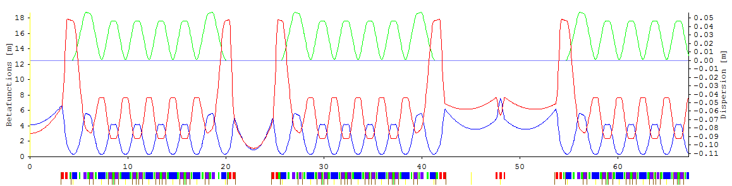
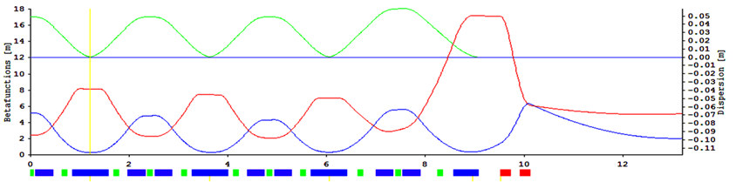
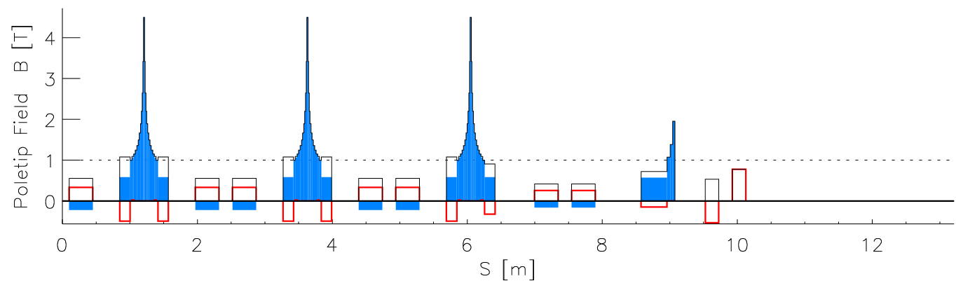
SLS upgrade
Draft design (example)
2½ of 12 arcs  ½ arc 
β_{x}
β_{y} η
(beam size)²
emittance
dispersion
Emittance 126 pm
Straight sections 6 × 3.6 m
3 × 6.2 m
split long straights → 3 × (5 + 5) m
Radiation loss 735 keV
Energy spread 1.24 ⋅10⁻⁴
Working point 37.7 / 10.8
Chromaticities −61 / −49
MCF α −10⁻⁴
hyperbolic
superbends
strong
anti-bends
Σ|Φ| = 504°
ca06b

Slide 40
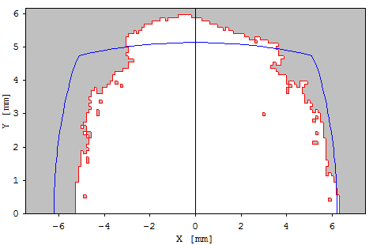
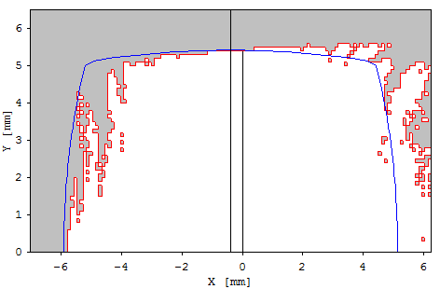
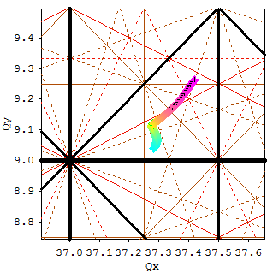
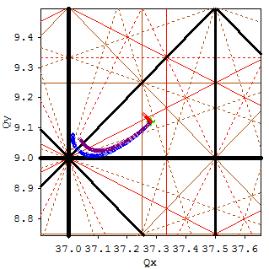
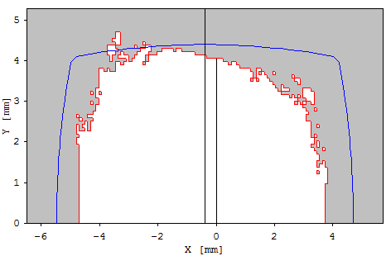
Dynamic aperture optimization
SLS upgrade
M. Ehrlichman, PSI
MOGA optimization (one arc only)
Objectives: dynamic apertures at Δp/p = 0, ±3%
Parameters: 6 sextupole and 4 octupole families
Constraints: - maintain zero chromaticities
- tune footprint in half-integer box
- limited multipole strengths
Δp/p = 0
Tune shifts
⇦
with amplitude
x, y, coupled
⇦ ⇦
with momentum
+/− 4%
Δp/p = +3%
Δp/p = −3%
physical aperture from R=10 mm beampipe
dynamic aperture (500 turns, loss check only at sext.& oct.)


Slide 41
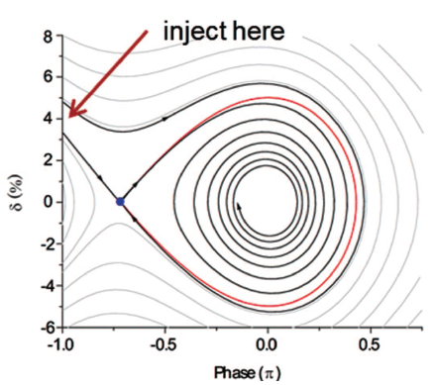
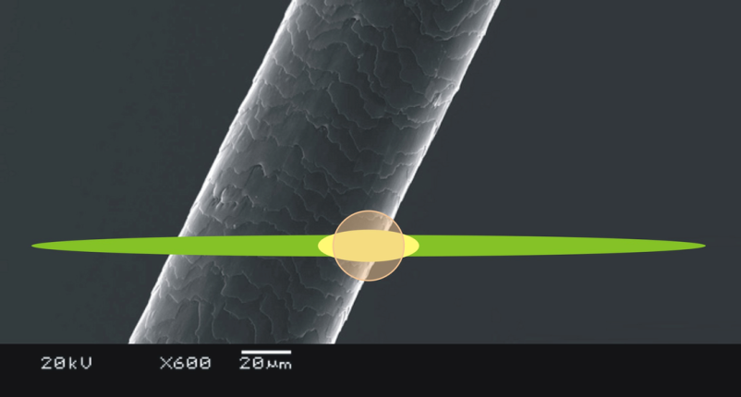
Advanced options
SLS upgrade
A new on-axis injection scheme
  cope with reduced aperture
  (physical or dynamic)
  use interplay of radiation damping and synchrotron oscillation in longitudinal phase space to inject off-energy,
  off-phase but on-axis.
Figure taken from R. Hettel, JSR 21 (2014) p.843
 M. Aiba, M. Böge, Á. Saá Hernández, F. Marcellini & AS, PRST AB 18, 020701 (2015)
Round beam scheme
  Wish from users (round samples...)
  Maximum brightness & coherence
  Mitigation of intrabeam scattering blow-up
  “Möbius accelerator”:
  beam rotation on each turn to exchange transverse planes
SLS
SLS-2
SLS-2 RB
 R. Talman (Cornell Univ.), PRL 74.9 (1995) 1590

Slide 42
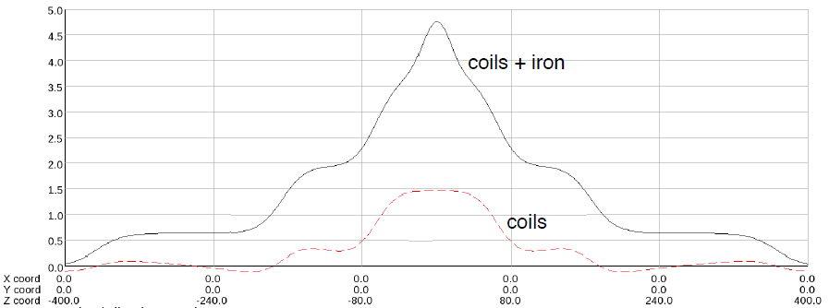
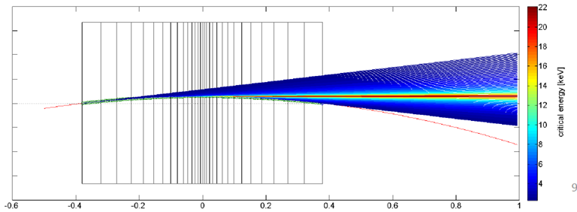
Longitudinal gradient superbend
SLS upgrade
Hyperbolic field shape
  rough approximation
  is sufficient.
Narrow peak of high field:
  emittance minimization.
  limitation of heat load
  and radiated power.
Benefits of high field:
  Hard X-rays available
  at a 2.4 GeV ring.
  Photon BPMs for
  orbit correction.
  X-ray pinholes for beam size measurements.
V. Vrankovic, PSI
A. Saa Hernandez, PSI
SLS normal bend
SLS superbend
SLS-2 LG superbend
Photon energy [keV]

Slide 43
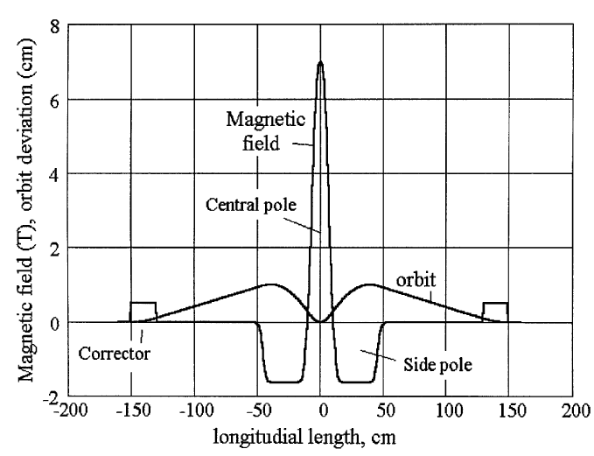
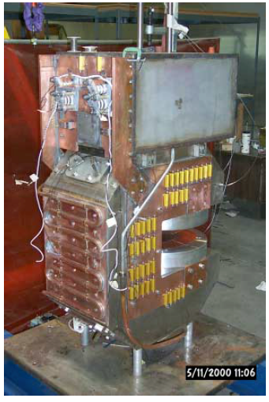


LGSB predecessors
SLS upgrade
V. Shkaruba et al., Superconducting high field three pole wigglers at Budker INP,
NIM A448 (2000) 51–58 ⇨
K. Zolotarev et al., 9 Tesla superbend for Bessy II, APAC-2004 
D. Robin et al., Superbend project at the Advanced Light Source, PAC-2001  

Slide 44


Anti-bend
SLS upgrade
Anti-Bend: inverse field, B < 0
Low field, long magnet
  emittance contribution ∝ |B|³ H L
  H is large and ≈constant at anti-bend.
Strong horizontal focusing, dB/dx > 0
  needed for optics at location
  out of phase with main bend.
  manipulation of damping partition
  to get lower emittance:
    vertical focusing in normal bend.
    horizontal focusing in anti-bend.
anti-bend = off-centered quadrupole.
most convenient magnet design = half quadrupole.
Disp. η
β_{x} β_{y}

Slide 45
R & D top priorities
SLS upgrade
Dynamic apertures
  Chromaticity correction and non-linear optics optimization to provide sufficient lifetime and injection efficiency.
  Sensitivity to misalignments and multipolar errors
  tools: multi-objective genetic algorithms
Impedances and instabilities
  Interaction beam ↔ narrow vacuum chamber
  measures: low RF (100 MHz), harmonic RF, feedback system...
  predicition of current thresholds
Baseline lattice
  Meet all constraints (geometry, source points...)
  Fulfill all user wishes (emittance, photon energies... )
  Demonstrate the performance (lifetime, injection efficiency, emittance...)
  Respect technical feasibilities (magnet strengths, spaces...)

Slide 46
Time schedule
SLS upgrade
  Jan. 2014 Letter of Intent submitted to SERI
  (SERI = State secretariat for Education, Research and Innovation)
  schedule and budget
    2017-20 studies & prototypes 2 MCHF
    2021-24 new storage ring 63 MCHF
    beamline upgrades 20 MCHF
  Oct. 2014 positive evaluation by SERI
Going on now
  communication of project inside PSI
  specification of upgrade in discussion with users
  project preparation: manpower, time schedules, priorities, milestones...
Concept decisions fall 2015.
Conceptual design report end 2016.

Slide 47
Conclusion
Magnet miniaturization enables multi-bend achromat lattices providing emittance in the 10..100 pm range.
Miniaturization is based on NEG coated vacuum chambers.
Progress forces existing light sources to consider upgrades.
Upgrade of the Swiss Light Source SLS has to cope with a
rather compact lattice footprint.
The longitudinal gradient bend / anti-bend cell provides
a solution for compact low emittance lattices.
Draft designs for an SLS upgrade promise a
factor 25...50 improvement in brightness and coherence.
THE END

Slide 48
Bonus tracks
■      The dynamic aperture problem

Slide 49
The dynamic aperture problem
Dynamic Aperture
Local aperture = beam pipe
Physical aperture = “shadow” of local apertures
  linear projection of local apertures to track point
Dynamic aperture = area of stable particle motion
  obtained from tracking
  including local aperture limits
  result depends on model parameters.
y
x
Consequences of bad dynamic aperture
bad or impossible off-axis injection & accumulation
  [ ⇨ on-axis injection ⇨ complicated injector, kicker, timing ✗ ]
bad lattice momentum acceptance (= off momentum dynamic apertures)
⇨ low Touschek lifetime
  [ ⇨ top-up injection / frequent refill ⇨ high radiation background ✗ ]
⇨ Dynamic aperture optimization = main design challenge
  iterate with linear lattice design

Slide 50



The challenge of chaos
Dynamic Aperture
Low emittance lattice
strong (horizontal) focusing
chromatic quadrupole errors
correction by sextupole
in dispersive regions
small dispersion in MBA lattice
very strong sextupoles !
nonlinear sextupole field B ~ x²
deterministic chaos:
particle losses beyond some
amplitude: dynamic aperture
non-linear dynamics in transverse phase space ( y, p_{y} )

Slide 51

Sextupole optimization strategy
Dynamic Aperture
to do: find optimum sextupole scheme
amplification of wanted effects (chromaticity correction)
cancellation of unwanted effects (tune shifts & resonance driving)
1. Minimize strength of chromatic sextupoles
  decoupling horizontal vertical: β_{x}$ $β_{y}↓ and v.v.
  find/create locations of high dispersion
2. Suppression of 1st order resonance drive terms (RDT)
by betatron phase advance between sextupoles
  add “harmonic” sextupoles in dispersion free regions
  cancellation by periodic repetition in MBA cells
  (−Ι ) transformer: sextupole pairs separated by 180° in phase
3. Suppression of ≥2nd order effects:
amplitude dependent tune shifts and nonlinear chromaticities
  RDT suppression is prerequisite
  add higher multipoles for 1st order correction
  numerical minimization...

Slide 52











MBA resonance cancellation
Dynamic Aperture
N full cells: (N+2) bend achromat
Sextupole and octupole Hamiltonian modes
j = 2,3,1,1,1,2,0, 4,2,2,3,0
k = 1,0,0,0,0,0,0, 0,0,0,1,0
l = 0,0,1,0,2,0,2, 0,2,0,0,3
m = 0,0,1,2,0,0,0, 0,0,2,0,1
Light source cell
Q_{x} high (≈ 0.4)
Q_{y} low (≈ 0.1)
N = 5, Q_{x} = 2/5 = 0.40, Q_{y} = 1/10 = 0.10
N = 7, Q_{x} = 3/7 = 0.43, Q_{y} = 1/7 = 0.14
N = 8, Q_{x} = 3/8 = 0.38, Q_{y} = 1/16 = 0.06
N = 9, Q_{x} = 4/9 = 0.44, Q_{y} = 1/9 = 0.11

Slide 53

Dynamic Aperture
Higher multipoles
Multipole strength, bore radius R
n = 2,3,4 quadru-, sextu-, octupole
Aperture reduction ⇨ octupoles and decapoles usable
⇨ control in 1st order higher sextupole terms
Octupole ⇨ 2nd order sextupole:
  amplitude dependent tune shifts
  ⇨ 3 octupole families in MAX IV
  quadratic chromaticities: ∂²Q_{x}/∂δ², ∂²Q_{y}/∂δ²
Decapole ⇨ 3rd order sextupole:
  cubic chromaticities: ∂³Q_{x}/∂δ³, ∂³Q_{y}/∂δ³
Minimization of beam footprint in tune space
  provide sufficient horizontal dynamic aperture for injection.
  provide sufficient momentum acceptance for Touschek lifetime.
Provide knobs for control room (linear systems).
 S. C. Leemann & AS, PRST AB 14, 030701

Slide 54

Optimization tools
Dynamic Aperture
Perturbation theory try
Hamiltonian modes, Lie algebra,
resonance driving terms, maps, etc.
   fast; straightforward minimization
   understanding of problem (!)
   bad prediction of performance (→ B)
Tracking test
   sound prediction of performance
   fractal result space, difficult to handle for (conventional) minimizers
Multi-objective genetic algorithms (MOGA)
[and related]
simulation of evolutionary process to handle tracking results
   combination of several (conflicting) objectives and constraints
   returns many solutions with different individual profiles
  ... often counter-intuitive and unreachable for perturbation theory
   computationally intensive – but well suited for parallel computing
 Y. Li, LER-2014
Dynamic aperture
Sextupole Hamiltonian
try
test

Slide 55
Conclusion
Magnet miniaturization enables multi-bend achromat lattices providing emittance in the 10..100 pm range.
Miniaturization is based on NEG coated vacuum chambers.
Low emittance rings are challenged by the problems of
dynamic aperture optimization (and by beam instabilities).
Non-linear optics uses octupoles and tracking-based methods like MOGA for doptimization.
Progress forces existing light sources to consider upgrades.
Upgrade of the Swiss Light Source SLS has to cope with a
rather compact lattice footprint.
The longitudinal gradient bend / anti-bend cell provides
a solution for compact low emittance lattices.
Draft designs for an SLS upgrade promise a
factor 25...50 improvement in brightness and coherence.

