Slide 1
Timing
&
Machine Protection System
FLASH and XFEL
Kay Rehlich
MCS4
25. March 2013

Slide 2
Die Motivation
Synchronisation der Subsysteme
Schutz des Beschleunigers
bunches in experiment A
FLASH1
FLASH2
bunches in main linac
0.8 ms
bunches in experiment B
100 ms

Slide 3
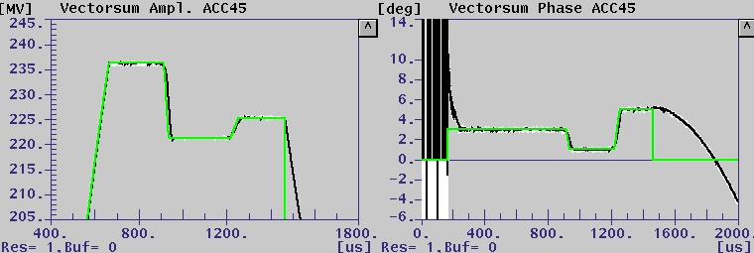
LLRF with different Settings FLASH 1 / 2 / 3
FLASH1
FLASH2
FLASH3
FLASH1
FLASH2
FLASH3
RF response
Requested RF Pulse shape

Slide 4
FLASH2 -- XFEL
Gun
ACC1 ACC39
ACC23
ACC45 ACC67
sFLASH
SASE
~4.1 – 44 nm
EXP. Hall
1st BC
2nd BC
FLASH1
SASE
~4 – 60 nm
FLASH2
Keeping Hardware and
Software Compatible …
SASE 5
I1
SASE 2
SASE 4
BC 0
BC 1
BC 2
SASE 1
SASE 3
L1
L2
L3
I2
XFEL

Slide 5

Timing and Machine Protection: FLASH
Timing Master
nC
MPS defines the allowed pattern:
➔ Sections with permissions
Allowed charges
number of bunches / section
Request
bunches
Set
Parameters
Timing Rcv.
Timing Rcv.
Timing Rcv.
Laser 1
Controller
Laser 2
Controller
Old FLASH system
FLASH1
BIS
BIC
FLASH2
MPS
MPS
MPS

Slide 6
Timing and Machine Protection: XFEL
Timing Master
nC
MPS defines the allowed pattern:
➔ Sections with permissions
Allowed charges
number of bunches / section
Request
bunches
Set
Parameters
Timing Rcv.
Timing Rcv.
Timing Rcv.
Laser
Controller
SASE 4
SASE 5
Laser
I1
SASE 2
BC 0
BC 1
BC 2
SASE 1
SASE 3
L1
L2
L3
Dump
Kicker
I2
MPS
MPS
MPS
MPS

Slide 7
32 Bit Bunch Pattern Defines Every Bunch
XFEL:
TDS Inj
TDS BC1
TDS BC2
Wire Scanner
‘Distortions’ to ignore
Max. Charge:
No bunch
0.02 nC
0.03 nC
0.04 nC
0.06 nC
0.09 nC
0.13 nC
0.18 nC
0.25 nC
0.36 nC
0.50 nC
0.71 nC
1.00 nC
1.42 nC
2.00 nC
infinite
FLASH:
-
-
LOLA
Wire Scanner
Photon line deflection
Laser:
FLASH
PP3
PP2
PP1
Seed3
Seed2
Seed1
Laser4
Laser3
Laser2
Laser1
XFEL
Seed5
Seed4
Seed3
Seed2
Seed1
I2.Laser2
I2.Laser1
I1.Laser3
I1.Laser2
I1.Laser1
31
30
29
28
27
26
25
24
23
22
21
20
19
18
17
16
15
14
13
12
11
10
9
8
7
6
5
4
3
2
1
0
FLASH:
-
-
FLASH 3 e-
FLASH 2 e-
FLASH 1 e-
-
XFEL:
SASE 5 special mode
SASE 4 special mode
SASE 3 special mode
SASE 2 e-
SASE 1 e-
Main dump

Slide 8
Example: 4 Bunches in FLASH1, 2 in FLASH2
FLASH1
Kicker gap
FLASH2
700 µs
1 MHz
1364.6 µs
0.5 MHz
Length of
pattern table = 7222
= 800µs*1300MHz/144
Dest.
Beam line
…
…
…
…
…
…
Laser
Charge
Bunch
200 pC
8 *
No bunch
5972 *
No bunch
Bunch
50 pC
17 *
No bunch
1223 *
No bunch

Slide 9
Beam Modes: max. # of Bunches in Section, 32 bit Word (MPS)
FLASH1
FLASH2
1 | Single
S | <= 30
M | <= 300 / 500
F | Full
1 | S | M | F | 1 | S | M | F | 1 | S | M | F | 1 | S | M | F | 1 | S | M | F | 1 | S | M | F | - | - | - | - | - | - | - | -
31
30
29
28
27
26
25
24
23
22
21
20
19
18
17
16
15
14
13
12
11
10
9
8
7
6
5
4
3
2
1
0
SASE 5
I1
SASE 2
SASE 4
BC 0
BC 1
BC 2
SASE 1
SASE 3
L1
L2
L3
I2
XFEL

Slide 10
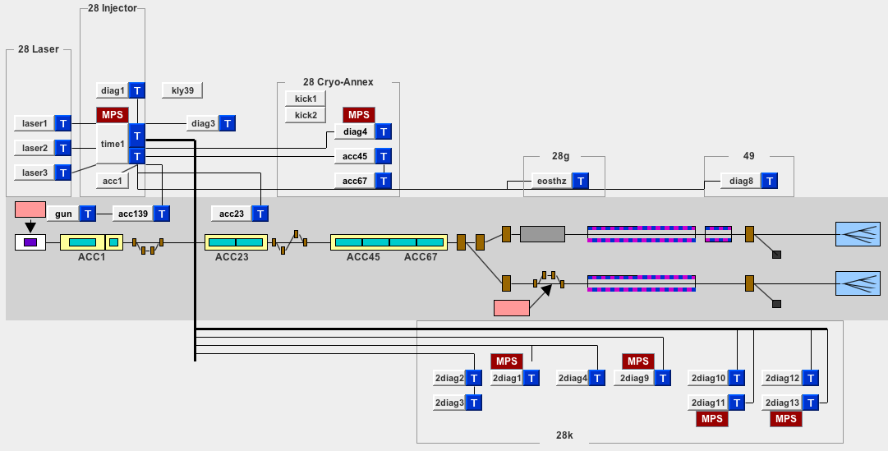
MicroTCA Crates with Timing and MPS
25 MicroTCA Crates are used in standard FLASH operation 24/7
LLRF, Timing, MPS, Laser, Kicker, Diagnostics

Slide 11
Timing System for XFEL and FLASH
Transmitter
L = const.
Receiver
MO
1.3GHz
Trigger
Sender
Event & Pattern
Receiver
delay
Divider
delay
Bunch
Pattern
÷ 26 000 000
÷ 12 960
Sync.
50 Hz
100.3kHz
Clocks
Timing Events &
Pattern Table
Divider
50 Hz
mains
(÷12) 108.333 MHz
(÷288) 4.514 MHz
(÷144) 9.028 MHz
...
MPS
FLASH
9.028 MHZ as the base frequency:
Bunch spacing >= 1 / 4.5MHz
1 or 3 MHz bunch spacing are possible
FLASH compatibility
XFEL
f_{max} = 4.5MHz
1 MHz

Slide 12
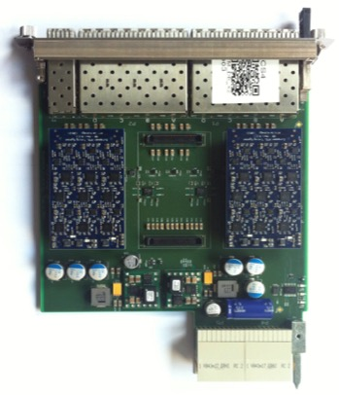

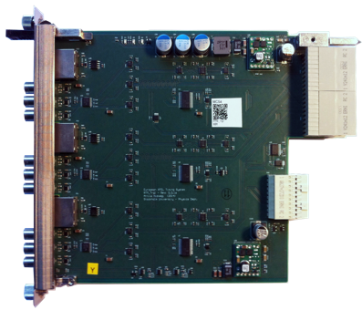
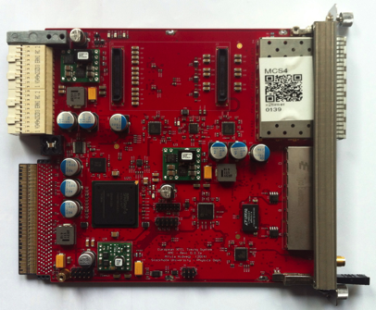
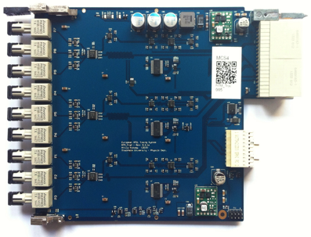
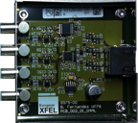
Timing Hardware
RTM:
9 channel
1.3GHz out
9 channel
trigger out
9 channel
trigger for klystron/modulator
Transmitter
Piggyback
OUT
IN
Fiber optics
> 100m Cable

Slide 13
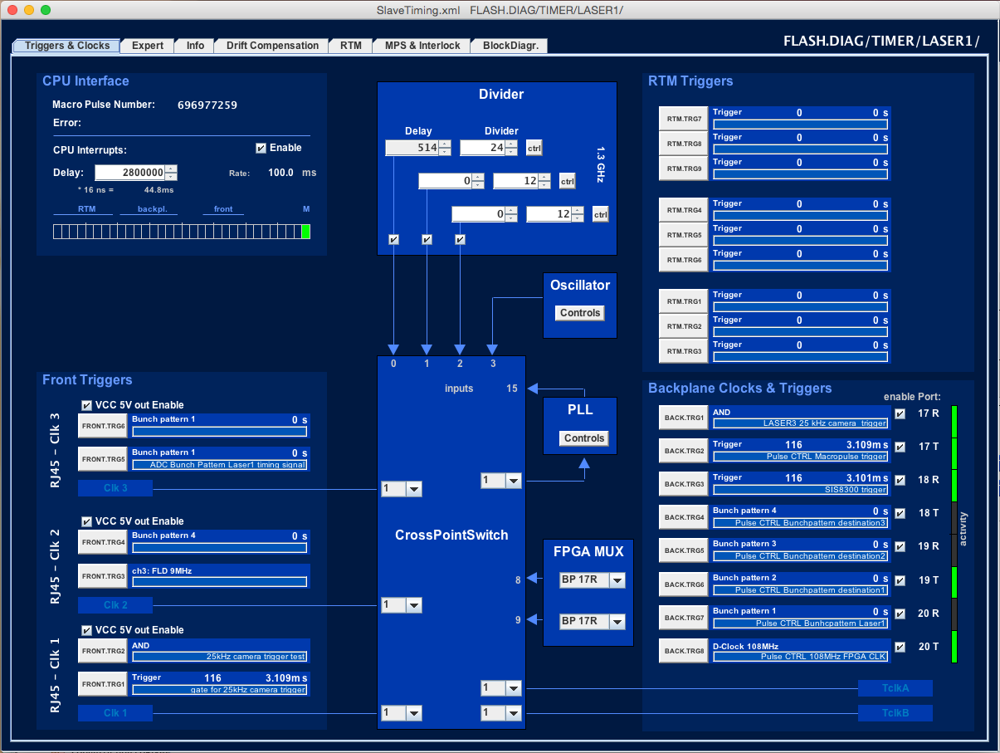
Timing: Main Expert Configuration Panel
23 trigger channels
Clock
channels

Slide 14
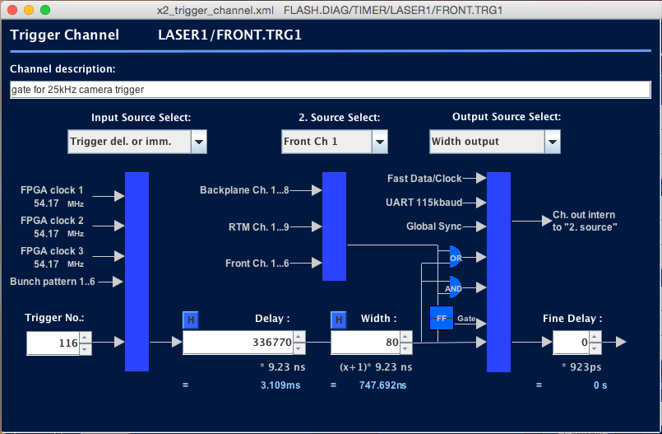
One out of 23 Trigger Channels

Slide 15
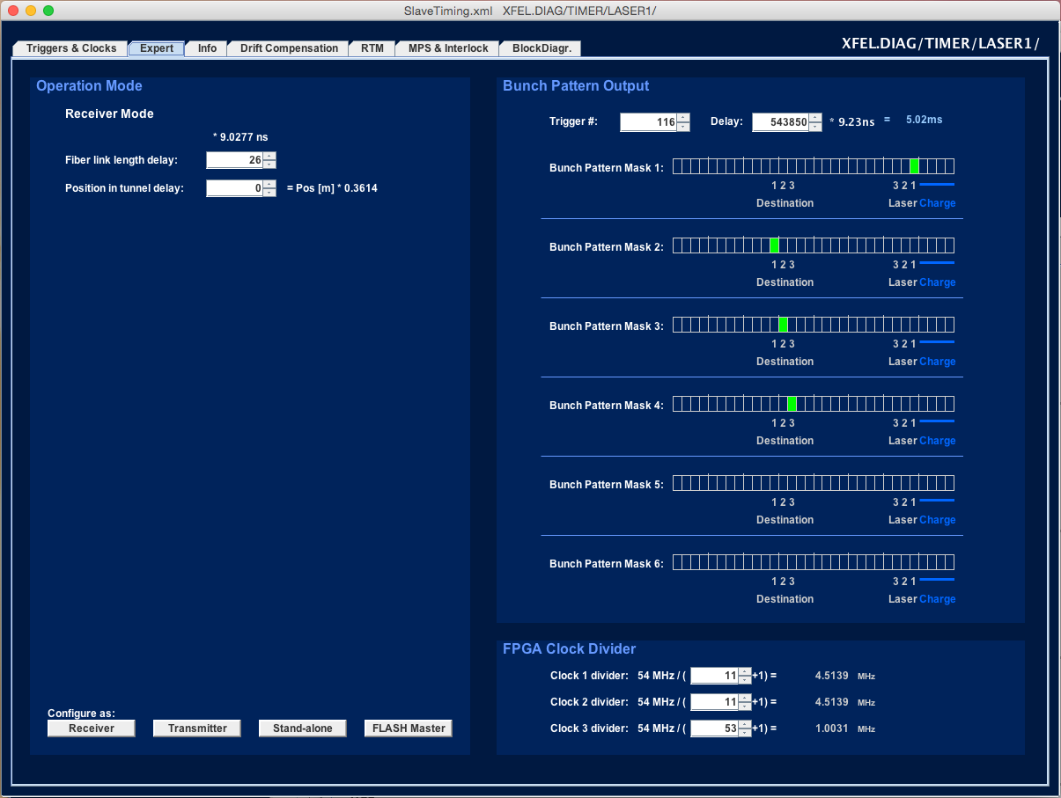
Configuration: Pattern & Slow Clock outputs
6 patterns
selectable
Delay output is corrected by fiber link delay and position in tunnel
Module can be receiver or transmitter
3 slow
clocks

Slide 16
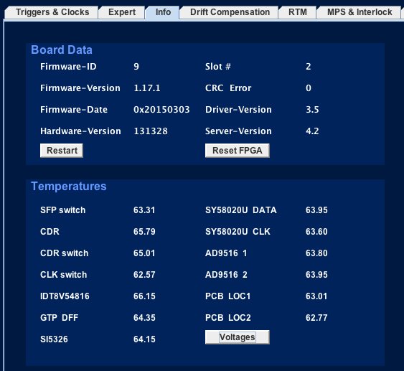
Maintenance Information

Slide 17
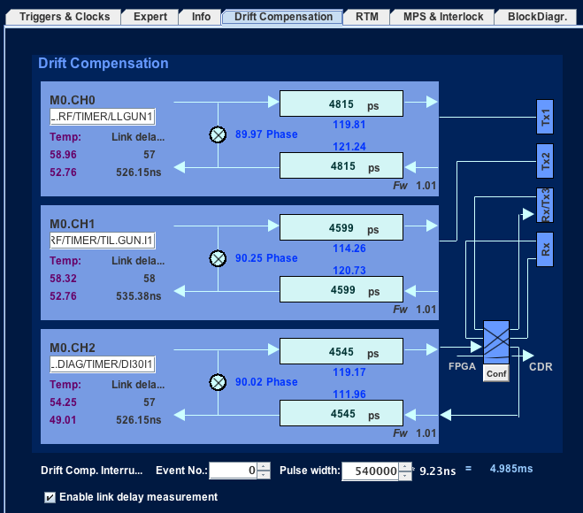
3 Channel Transmitter w/ Drift Compensation
Connected to
Out
Out
Measured
Link delay
In or Out
In

Slide 18
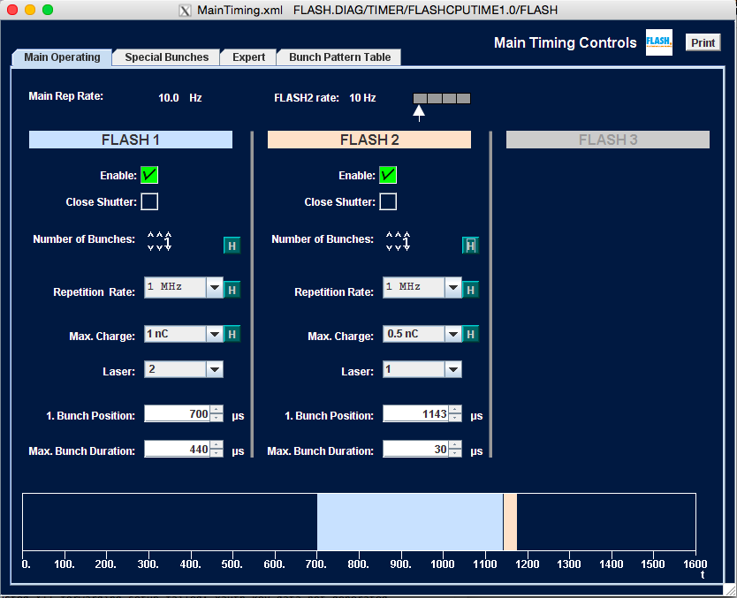
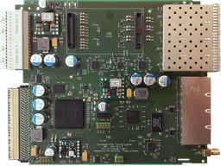
Main Operator Panel and Timing Server
Front-end Server erhalten ihre Konfiguration vom Timing System
Main Timing Server
Conf.
Calc table from properties
DAQ
DAQ erhält:
Bunch Pattern, MacroPulseNumber, ShotID, Time, …

Slide 19
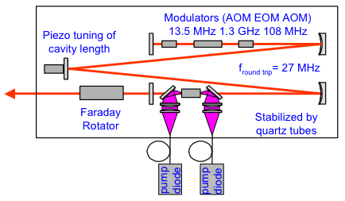
Controlling the Injector Laser
µTCA
MPS
New Timing Receiver
Timing
Master
MO
1.3 GHz
Inhibit FLASH 1
FLASH 2
Shutter
13.542 MHz
108.33 MHz
Reset
Bunch Pattern
Trigger
Divider
FPGA: Laser Output Controller
Triggers
φ
fast FB
Shutter
Example layout
of a laser
Pockels cell,
AOM

Slide 20
Timing & MPS Connections within a MicroTCA Crate
Ethernet
CPU
CPU
Ethernet
Subsystem
FPGA
ADC
PCIe
Pre-Amp
RTM
DAMC 2
MPS
MCH
Interlocks
Device status
FPGA
Clock
RTM
DAMC 2
Trigger & Gates
Clock & Data
Interlocks
MPS link
Timing
FPGA
Central Timing
1.3GHz
Timing
Receiver
MicroTCA Crate
Backplane

Slide 21

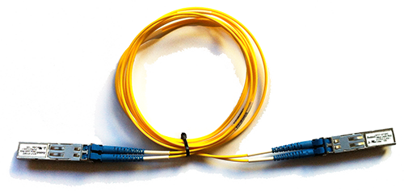
Machine Protection System
Reads status of Accelerator
  NO request from operator required
Based on combinational logic functions in FPGAs
  Logic is configurable
All MPS modules are communicating on a dedicated fiber net
Software and Ethernet is for configuration and status information only

Slide 22
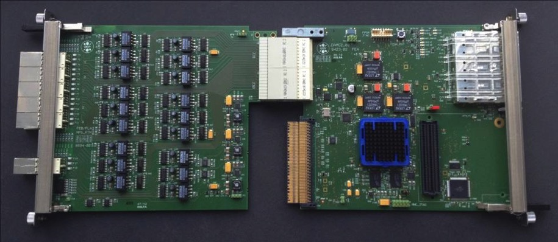
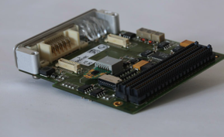
MPS Hardware
RTM
DAMC2
XILINX Virtex-5 FPGA
MMC support
onboard flash-memory
1 Gbit SDRAM
optional dosimetry FMC-card
FMC-card
Dosi-Mon
DAMC2 has been developed at FE
  Besides MPS, other groups have developed firmware for their projects, e.g. BLM-controller
  25 MPS-boards in use, 100 ordered for the beginning of 2015, further will follow
Interface RTM has been developed at FLA and FEB
  Besides MPS, it also used by other systems, e.g. laser controller
  18 MPS-RTMs in use, 100 delivered and under final assembly, further will follow
Radiation dosimetry monitoring FMC-card is currently under development at MDI
© J. Jäger

Slide 23
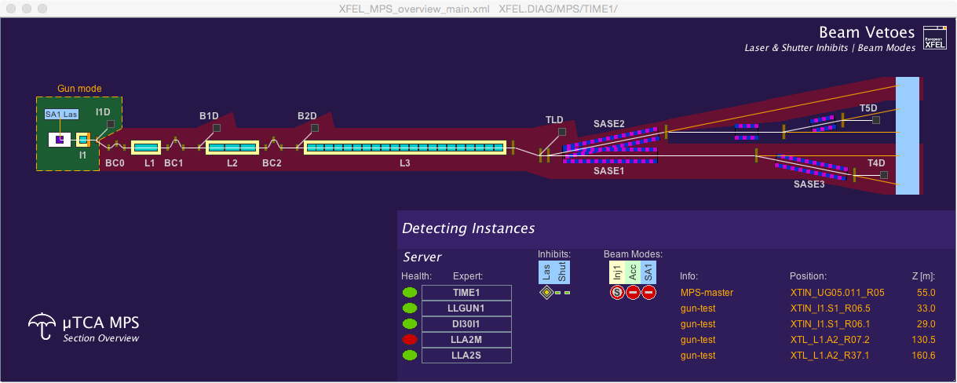
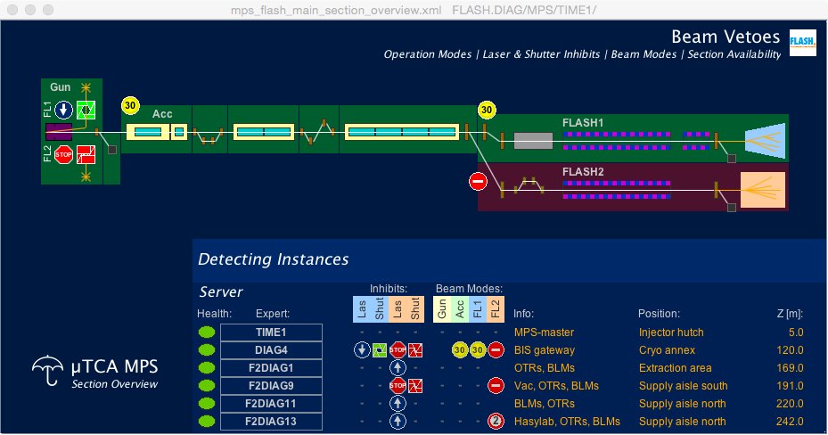
Operator’s GUI: Overview
Wird noch vereinfacht
  ‘give way’-signs for current state of laser inhibits, shutter states and linac dump kicker
  ‘speed limit’-signs for current beam limits
  ‘red-green’-background for current availability of the different accelerator subsections
  ‘white boxes’ for current operation modes
  list of MPS-servers with their current health state and their contributions to the beam limitation
© J. Jäger

Slide 24
ToDo: MPS
Correct handling of a module that is switched off (FW)
Middle layer server to summarize alarms
Include new toroid protection when ready
FLASH2 “slow protection” for BLMs → Chr. Grün

Slide 25
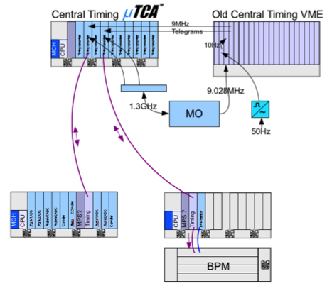
ToDo: Timing System
Upgrade FW and server in May
New timing has old protocol output → slow transition possible
New system will be the master.
Status:
Old system is master.
Old VME Crate
Second step:
VME connected to new system

Slide 26
Vielen Dank!
Das Timing Team:
  Attila Hidvégi, Uni Stockholm
  Christian Bohm, Uni Stockholm
  Pattrick Gessler, XFEL
  Holger Kay, MSK
  Arthur Aghababyan, MCS4
  Gevorg Petrosyan, MCS4
  Ludvig Petrosyan, MCS4
  Vahan Petrosyan, MCS4
  Kay Rehlich, MCS4
  Christoph Stechmann, MCS4
Das MPS Team:
  Jürgen Jäger, MCS4
  Sven Karstensen, FLA
  Robert Kunze, MCS4
  Martin Staack, MCS4

