Slide 1
Status of test kit
J. Dopke, T. Huffman, J. J. John
with help from many others

Slide 2
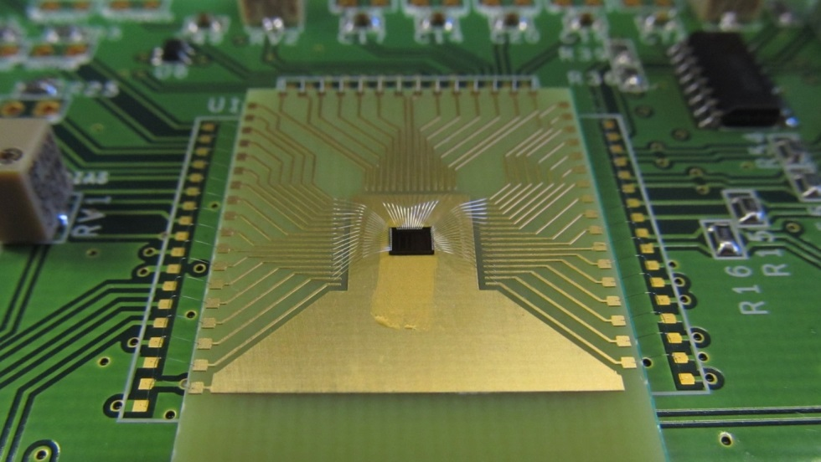
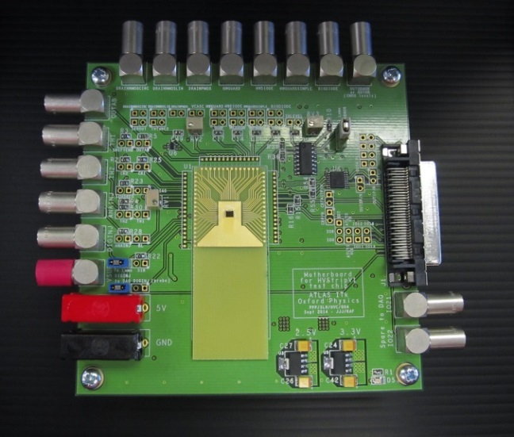
HVStripV1 hardware status
4 motherboards now tested to a reasonable extent
  Digital readout + analogue readout with OUTAB – see other talks
  Still to be tested: working with the passive devices via the motherboard
4 more motherboards are nearing completion in Oxford
  To be bonded this week at RAL and brought to ATLAS Upgrade Week
  1 is for SCIPP; would any other groups like one?
  Otherwise I propose the other 3 new motherboards as stock for irradiation campaigns

Slide 3
Motherboard – initial assignments
Number | Group
1 | DESY
1 | Glasgow
1 | Oxford
1 | RAL
1 | SCIPP
let us know your needs | Other groups and/or motherboards for irradiation campaigns

Slide 4
Towards HV CHESS test boards
Motherboard – updated spec:
  Regulate power down from 5V; could also generate -60V onboard
  For the 6 bias supplies needed, decided on having onboard current and voltage DACs in last meeting, to reduce test equipment requirements
  Proposing to use up current Lemo stock, then switch to SMA connectors, to manage costs
  Proposing one output Lemo/SMA for each of the 8 arrays of active pixels, with a software-controlled mux to select the pixel
  Proposing to add a VHDCI connector so that software via the Atlys DAQ can configure bias DACs and mux

Slide 5
HV CHESS Motherboard – proposed schedule
Date | Task
 | Being away this week and at AUW next week, I propose this schedule:
~12 Nov | Daughterboard design complete
~21 Nov | Motherboard design complete In parallel: review daughterboards
Week of 24 Nov | Review motherboard design and update as needed In parallel: manufacture daughterboards
Week of 1 Dec | Manufacture motherboards (bare PCBs)
Week of 8 Dec | Assemble motherboards
Week of 15 Dec | Bonding and begin testing

