Slide 1
Readout Status
Peter, Matt, Jens
(with input from Bruce)

Slide 2
Firmware
Matt refining the ATLYS firmware to allow unblocked readout of injected hits
  Currently suffers from noise, filling buffers on ATLYS
Close to stable, allows readout of both HVStripV1 streams into SCTDAQ

Slide 3
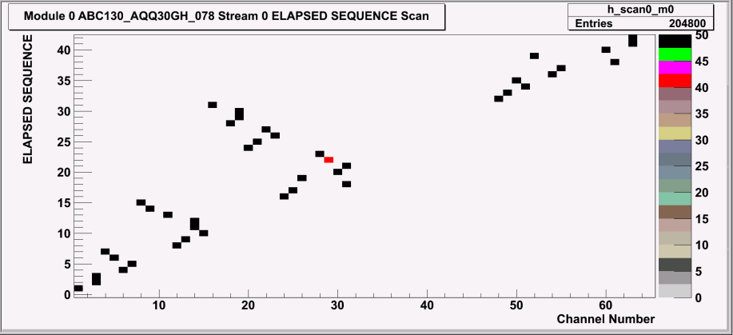
Software
Peter wrote a decoder to allow using the returned data from ATLYS
Partially shows errors in the returned addresses
  Seems to be a feature, can change from one scan to another
  Stable during a scan, i.e. over multiple injections – configuration related?

Slide 4
More testing
Peter working on a setup at Oxford to get controlled external analog injection to work – should soon allow for doing threshold scans/noise measurements
  Thinking of a small PMOD board to plug into ATLYS, allowing us the external injection without a large Pulse generator, as well as trigger interaction with ATLYS and ABC130
Kestutis started looking at some DACs to identify behaviour
  Different Pixels show different speed, can that be changed?
  Need to understand what TDACs do before the next TB
Possibly a testbeam end of November at SPS, can we make it?

