Slide 1
EO Bunch Length Monitoring
Collaborative Effort on a Reliable EO Bunch Length Monitoring in Accelerators
Peter Peier
Hamburg, 24. Februar 2015

Slide 2
Facilities using YFLAD (Ytterbium Fiber Laser for Accelerator Diagnostic)
SwissFEL
SLS

Slide 3
Contents
History of electro-optic bunch length measurements
Principle of electro-optic bunch length measurement
Development of a robust and customizable system
Current activities at different locations

Slide 4
(Incomplete) History of E-O Bunch Length Measurement
Facility | Setup | Laser | Crystal | Method
FELIX 1999: G. M. H. Knippels et al., PRL Vol. 83 p. 1578 | farfield | Ti:Sa | ZnTe | sampling
SLS 2003: A. Winter, DESY-Thesis-2004-027 | farfield | Ti:Sa | ZnTe | sampling
FLASH 2005: B.Steffen, DESY-THESIS-2007-020 | farfield/nearfield | Ti:Sa | ZnTe/GaP | sampling/ single-shot
SLS 2010: F. Müller, PhD thesis, University of Bern | farfield/nearfield | Yb fiber | ZnTe/GaP | sampling/ single-shot
ANKA 2013: N. Hiller, PhD thesis, KIT | nearfield | Yb fiber | GaP | sampling/ single-shot
SwissFEL Injector Test Facility 2013 / 2014: P. Peier, Y. Ivanisenko, FEL2014 | nearfield | Yb fiber | GaP | single-shot
XFEL, FLUTE, DELTA starting from 2015 | farfield/nearfield | Yb fiber | GaP | sampling/ single-shot

Slide 5
Principle of Electro-Optic Bunch Length Measurement
λ
λ
λ
t
t
t

Slide 6
Scheme - Electro-Optic Bunch Length Measurement
reference
laser
oscillator
synchronization
timing signal
timing
AOM
laser
amplifier
detector
compact
beamline station
Synchronized Ytterbium fiber laser is modulated by Coulomb field of the electrons (E_{THz}) in EO crystal (GaP)

Slide 7
Performance Requirements
(Non invasive) monitoring of bunch length and longitudinal bunch shape
(20fs) 200fs – 20ps temporal range
Bunch resolved measurement
24/7 operation
Remote control of all subsystems for XFEL installation
All components must fit in limited number of HUs of 19” rack
Operator friendly operation
Automated calibration and measurement

Slide 8
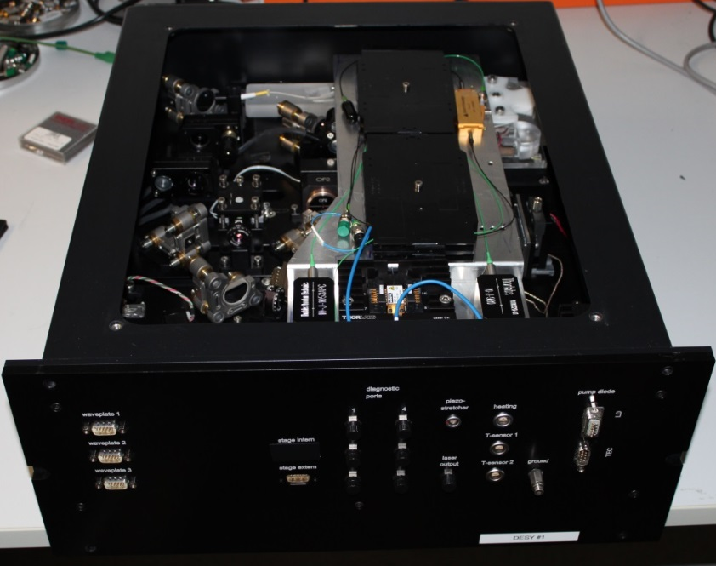
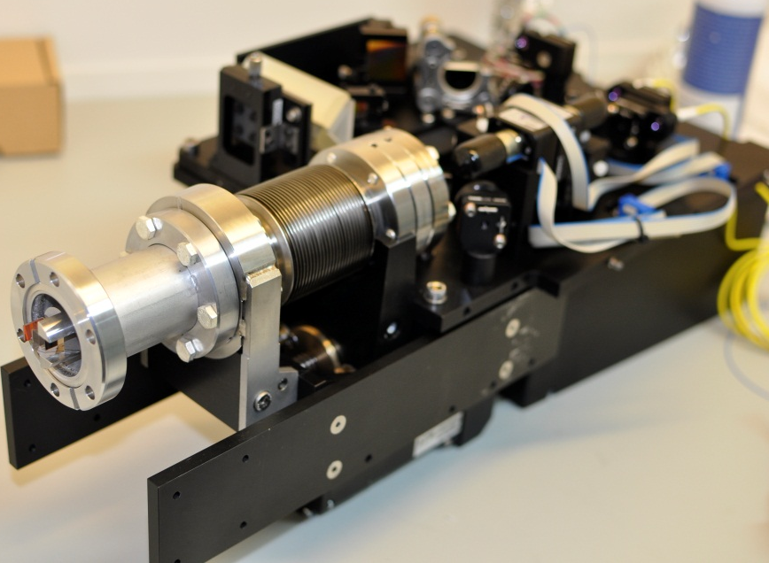
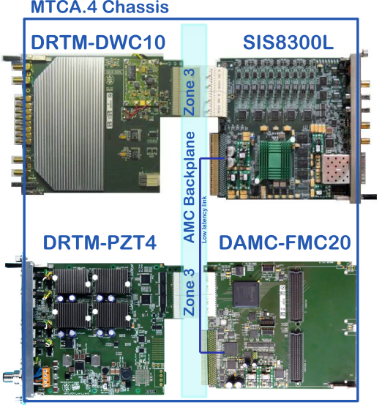
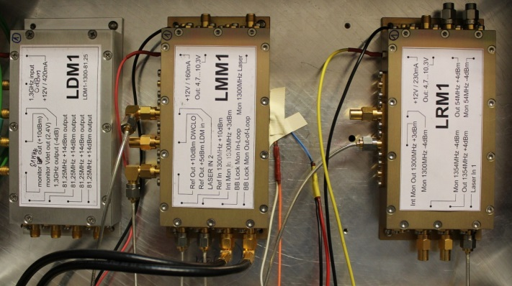
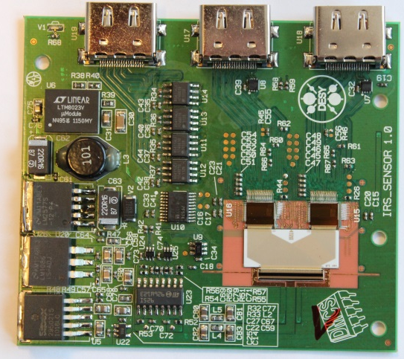
Developed / Used Hardware
Laser and Amplifier
DESY
KIT
PSI
TU D.
Beamline Station and Opticbox
e⁻
DESY
KIT
PSI
MTCA.4
RF Electronic
MHz 1D Detector
DESY
DMCS
KIT
PSI
DESY
KIT
DESY

Slide 9
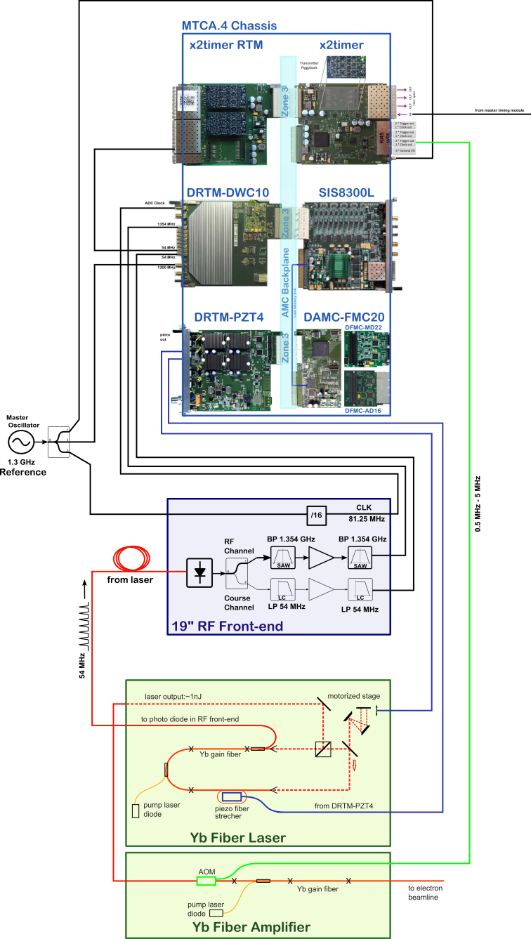
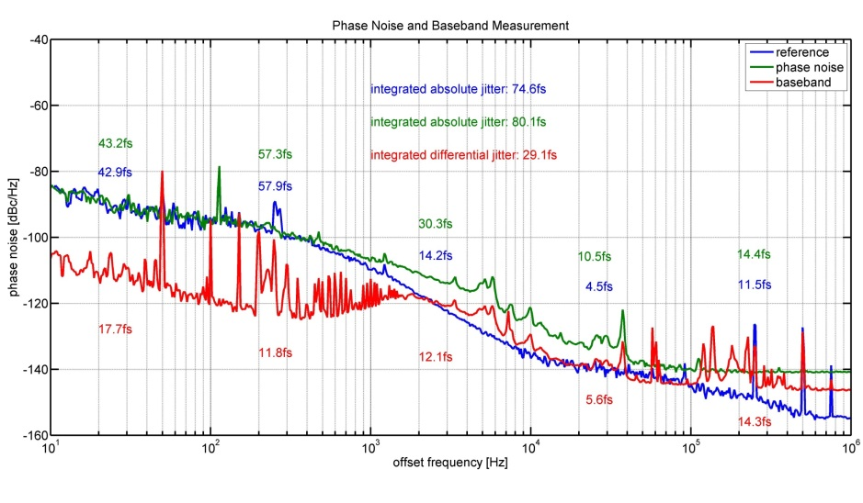
E-O System Activities at DESY
Phase noise of synchronized laser
Synchronization of YFLAD with MTCA.4 components
Long term locking test

Slide 10
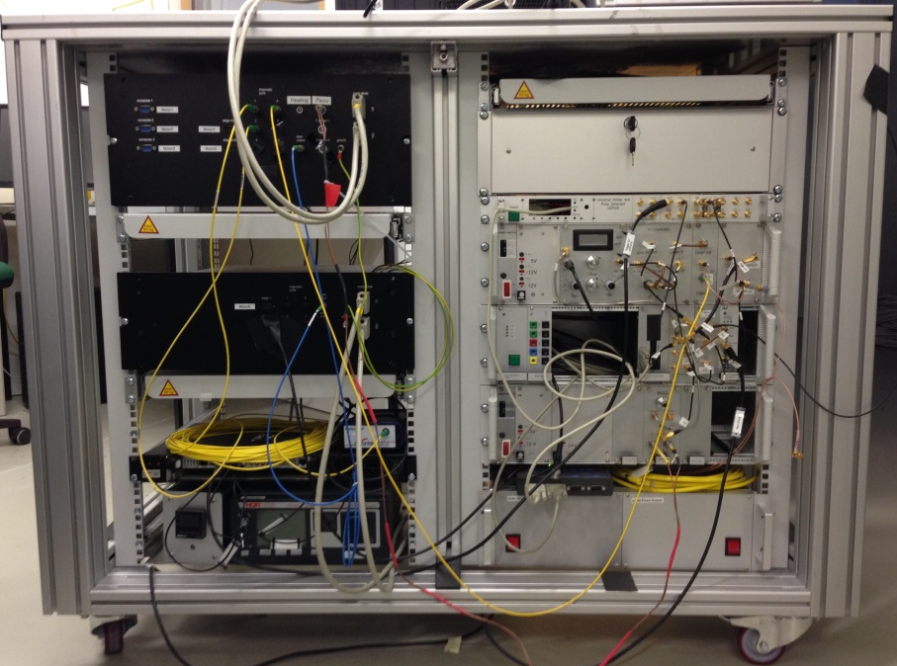
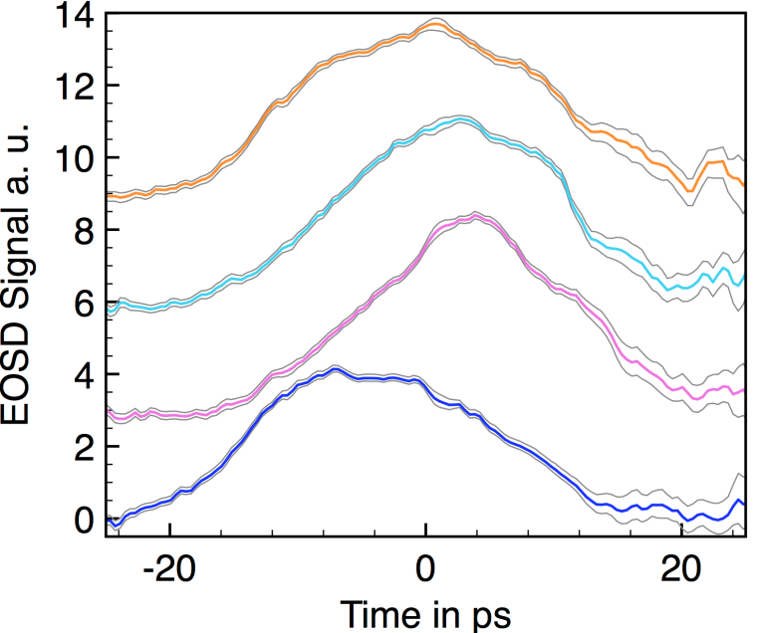
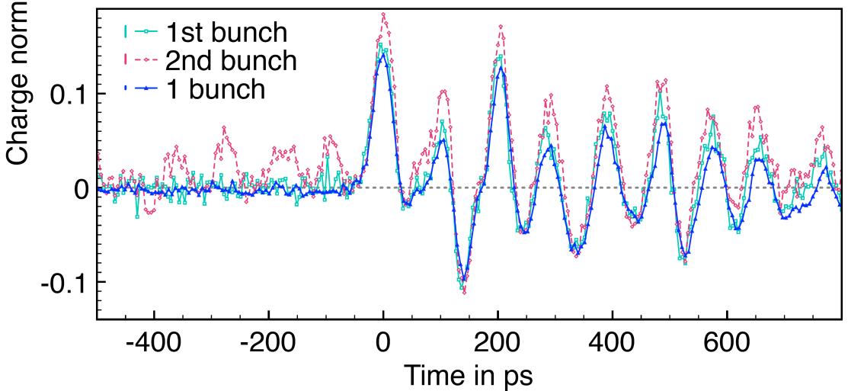
E-O System Activities at KIT
E-O system installed at ANKA
Single-shot measurements at ANKA
Multi-shot measurement at
ANKA: wakefield study
Courtesy of N. Hiller and A. Borysenko

Slide 11
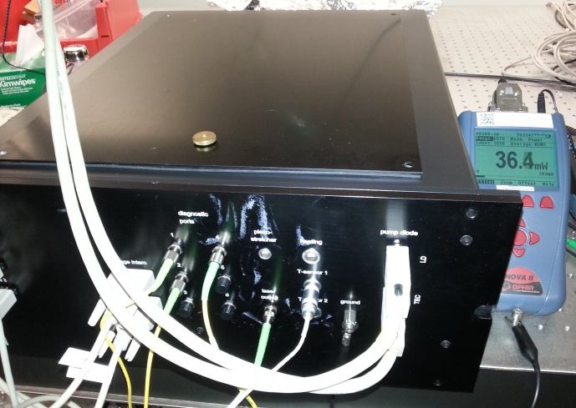
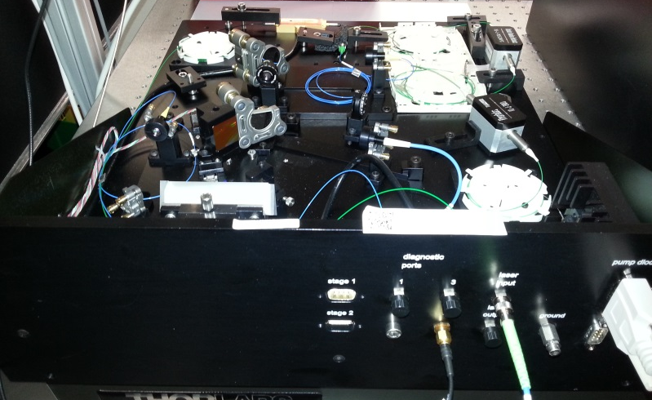
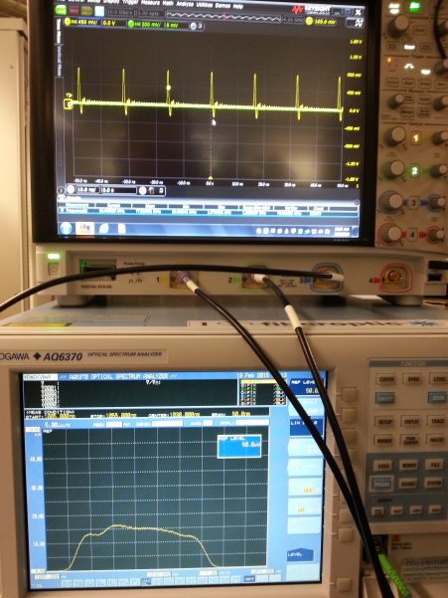
E-O System Activities at TU Dortmund
Coherent harmonic generation at DELTA
Courtesy of P. Ungelenk
Modifications of laser needed for operation at DELTA

Slide 12
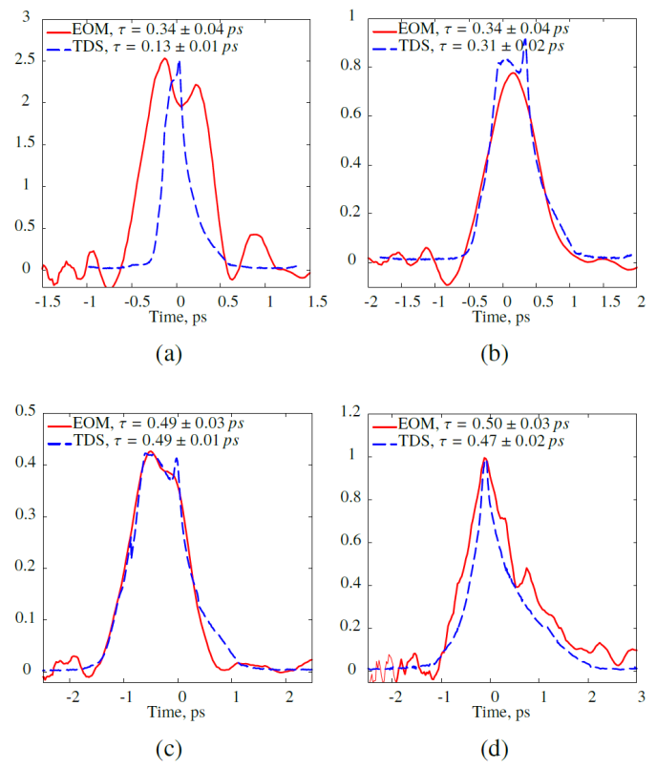
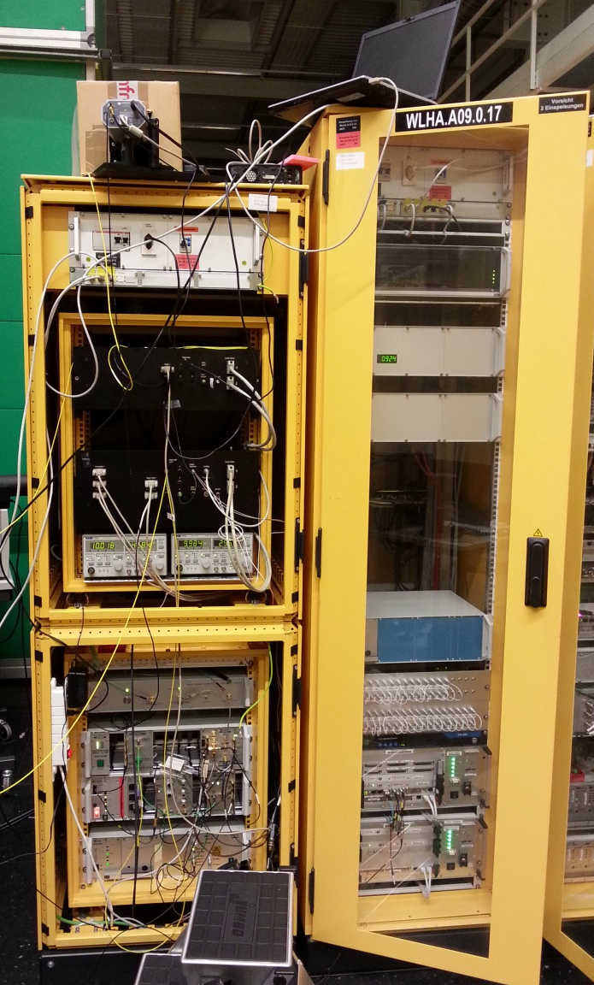
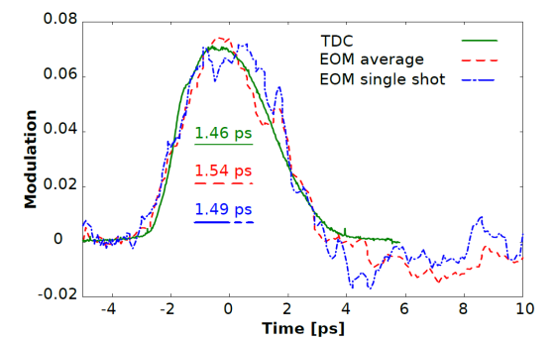
E-O System Activities at PSI
E-O system at SwissFEL
Injector Test Facility (SITF)
Compression study with BC1
at SITF of 100pC bunch
Uncompressed bunch
with 50pC
Wakefields in SITF (and reflections of THz field)
Courtesy of Y. Ivanisenko

Slide 13
Joint Activities
Workshop on Longitudinal Instrumentation for Future Accelerators
takes place every nine months
electro-optic bunch length measurements is a major topic
measurements, reliability issues and new concepts are discussed
detector development for high repetition rate measurements
Laser assembly at DESY and PSI
Hands on demonstration of E-O system
On-site commissioning of systems by experts
Planned 2015:
Installation of E-O system at XFEL Injector
Installation of E-O system at FLUTE
Installation of E-O system at DELTA

Slide 14
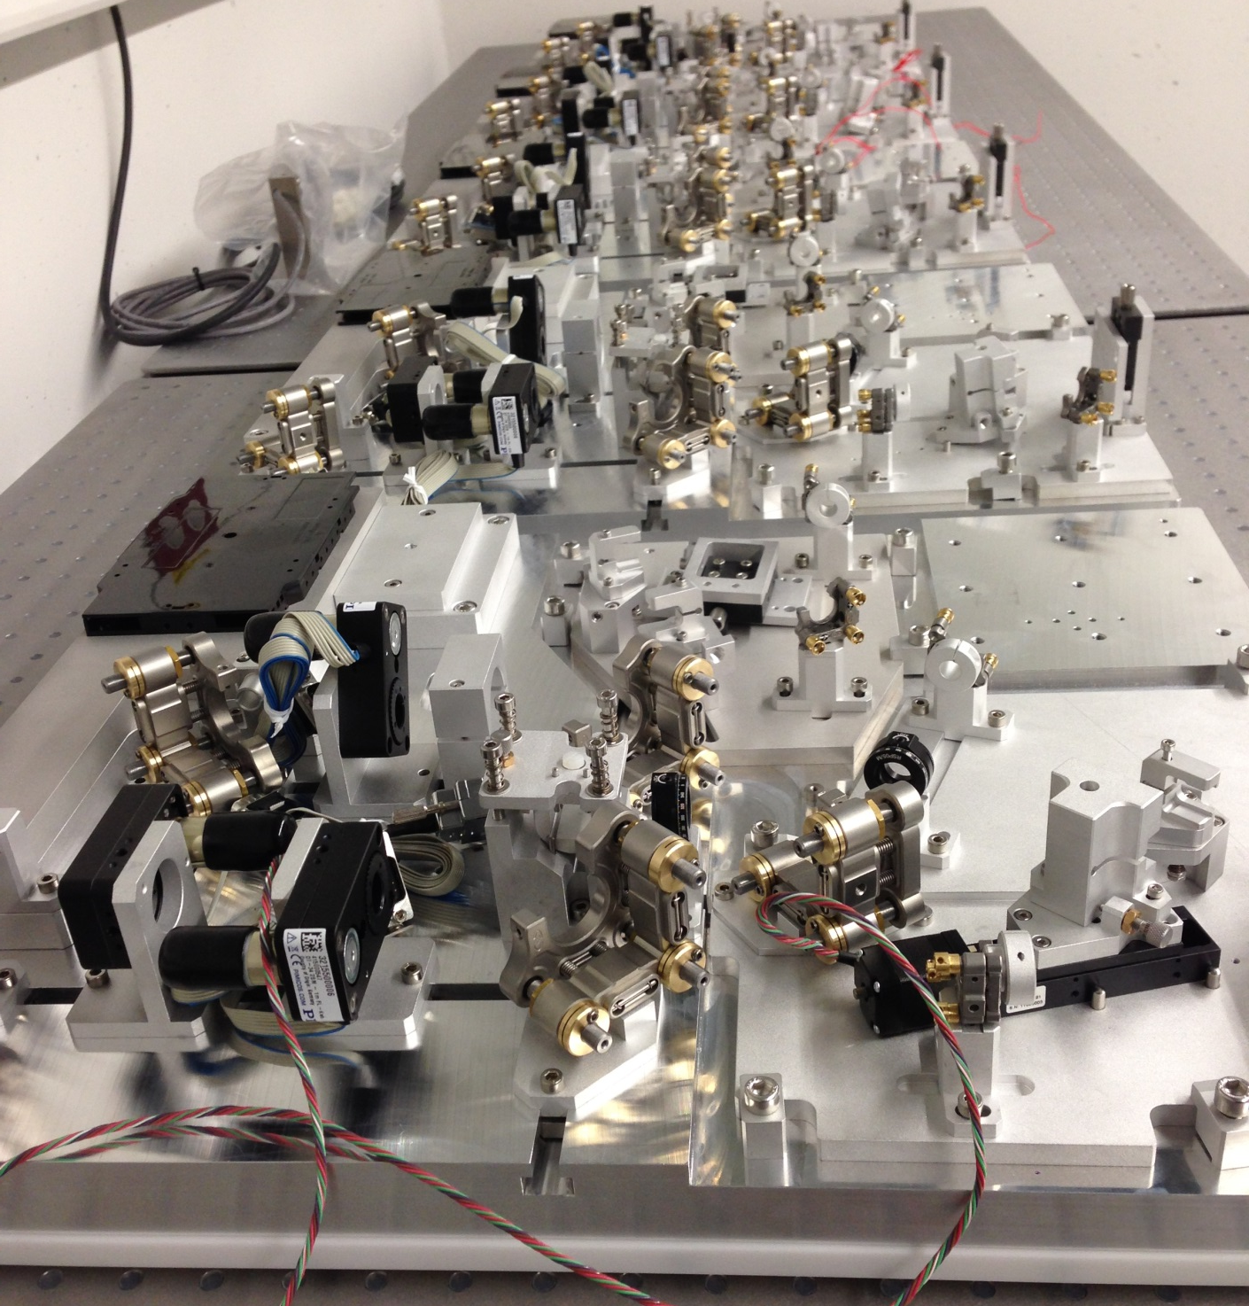
Thank you for your attention!
Laser assembly during this week in XFEL injector building

