Slide 1
From Optical Undulators to Optical FELs with
Traveling-Wave Thomson-Scattering
K. Steiniger, M. Bussmann, A. Debus, A. Irman, A. Jochmann, R. Pausch, F. Röser, U. Schramm, R. Sauerbrey

Slide 2
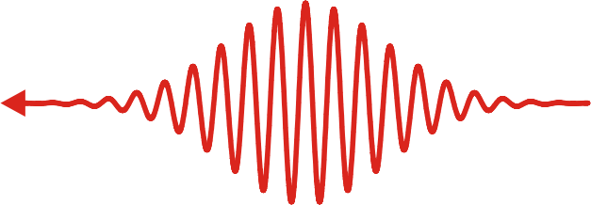
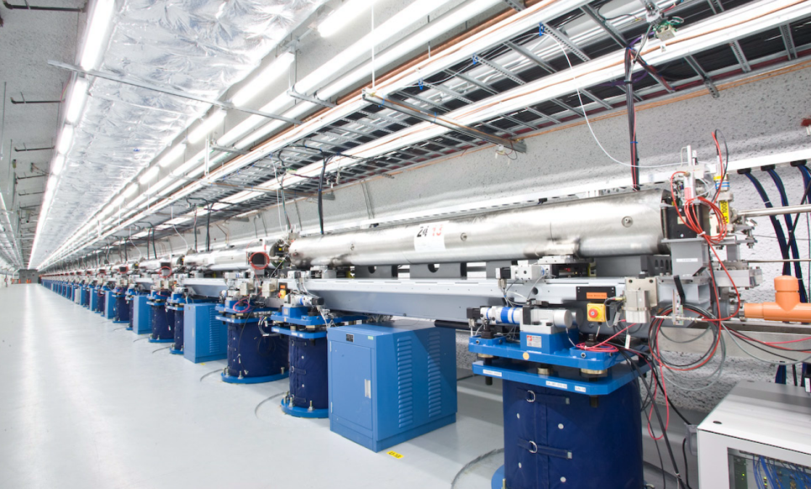
Reduce size and cost for a free-electron laser with laser undulators
laser pulse (amplitude a)
electron pulse
(energy γ)
scattered radiation
lasers allow for undulator periods not possible with conventional undulators
cm→µm
$$λ_{FEL}=\frac{λ_{laser}(1+a^{2}/2)}{2γ^{2}(1−cosφ) }$$
$$φ$$
Short interaction distances from µm
scale undulator wavelength
100m→1m
Small accelerators from small
electron energies
km→m
~100m
The 0.1nm FEL at SLAC (http://lcls.slac.stanford.edu)

Slide 3
Optical FELs have not yet been realized
incoherent sources using optical undulators:
PHOENIX@HZDR
MEGa-ray@LLNL
Show stoppers for optical FELs in head-on scattering setups:
Required electron beam emittance for transverse coherence is not available.
The photon emission recoil greatly reduces the gain.
Laser systems providing the required interaction distances are not available.

Slide 4
Realizing Optical FELs with
Traveling-Wave Thomson-Scattering

Slide 5
Traveling-Wave Thomson-Scattering (TWTS)
Using pulse-front tilted petawatt lasers in side scattering geometries for arbitrarily long interaction distances
1) Reduce the local intensity
of a high power laser
by making the pulse wider
2) Increase interaction
duration by tilting the
laser pulse front
$$e^{−}$$
$$L_{int}$$
Interaction distance is determined by laser beam spatial spread
and not pulse duration.
Interaction distance is limited by laser power and available optics.
laser pulse

Slide 6
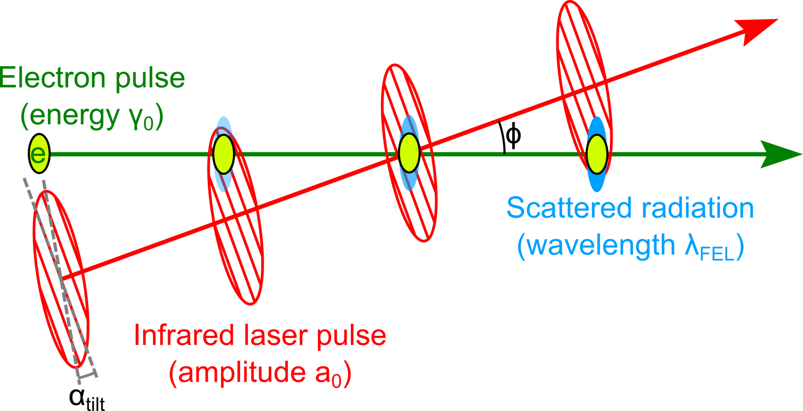
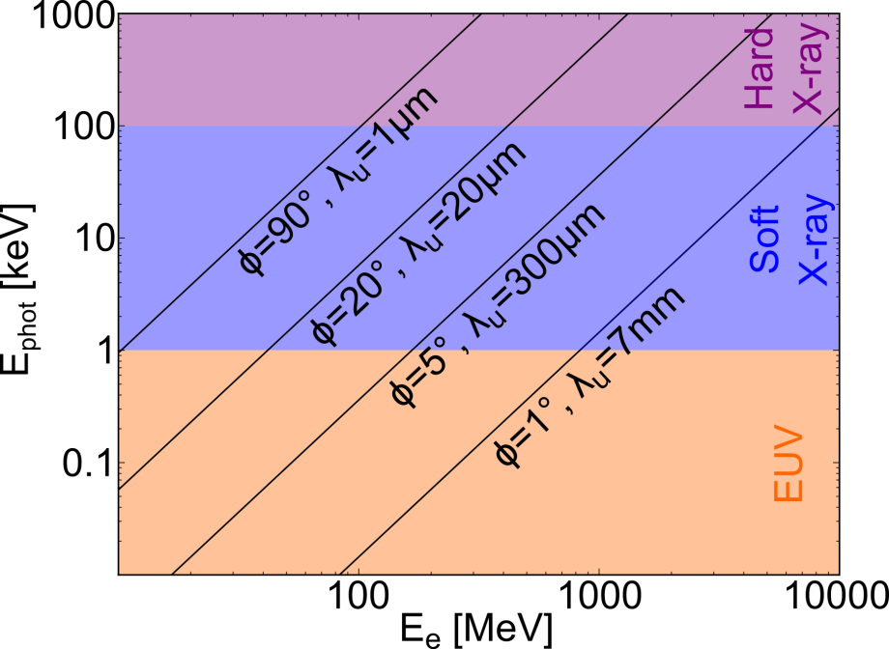
Traveling-Wave Thomson-Scattering is scalable in photon energy
Pulse front tilt of half the interaction angle ensures continuous overlap independent of interaction angle.
1keV≈1nm
$$α_{tilt}=φ/2$$
Variability in interaction angle allows to overcome the disadvantages of head-on OFEL concepts.
MeV - GeV

Slide 7
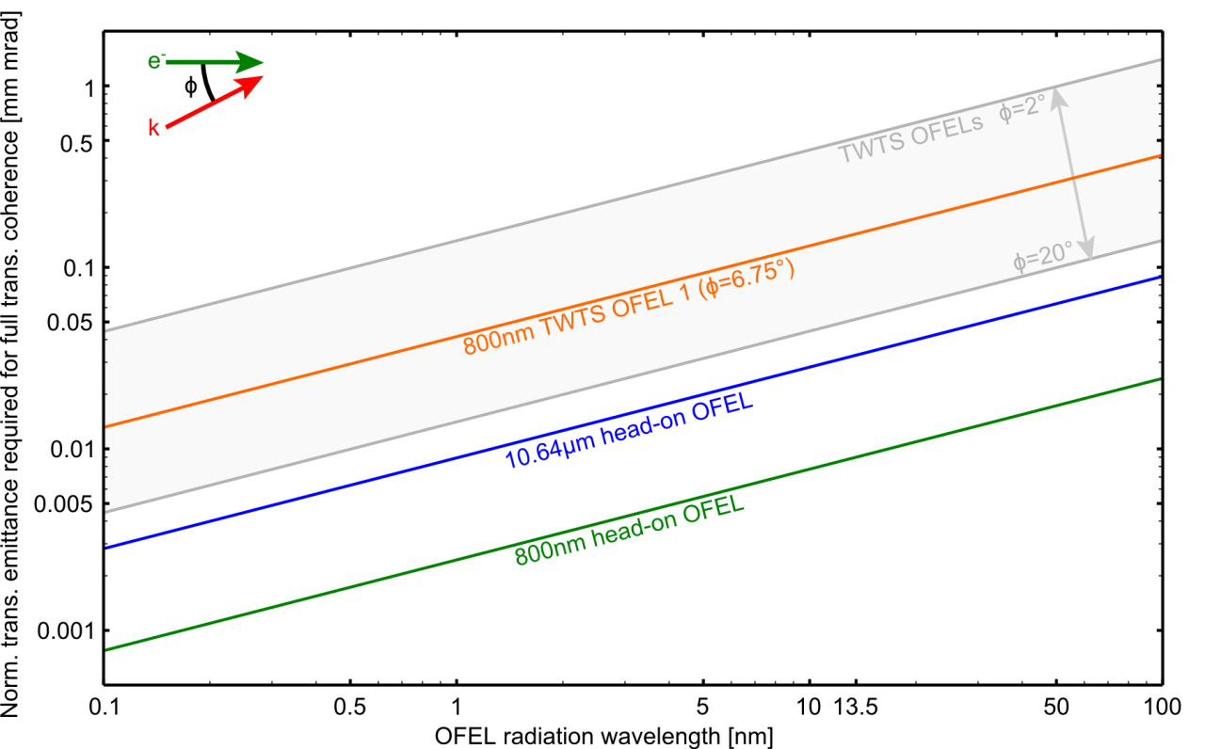
1. With TWTS transverse coherent radiation is accessible
Matching electron beam and radiation divergence for transverse coherence.
β* = γσ_{e}²/ε_{n}
Make use of the variability of TWTS with respect to interaction angle.
$\sqrt{2}$w₀
$\sqrt{2}$*2σ_{e}
$$e^{−}$$
w₀ = 2σ_{e}
z_{Rayleigh} = πw₀² / λ
$$e^{−}$$
radiation
$$e^{−}$$
radiation
Still useable transverse coherence with 5-10 times larger emittance.

Slide 8
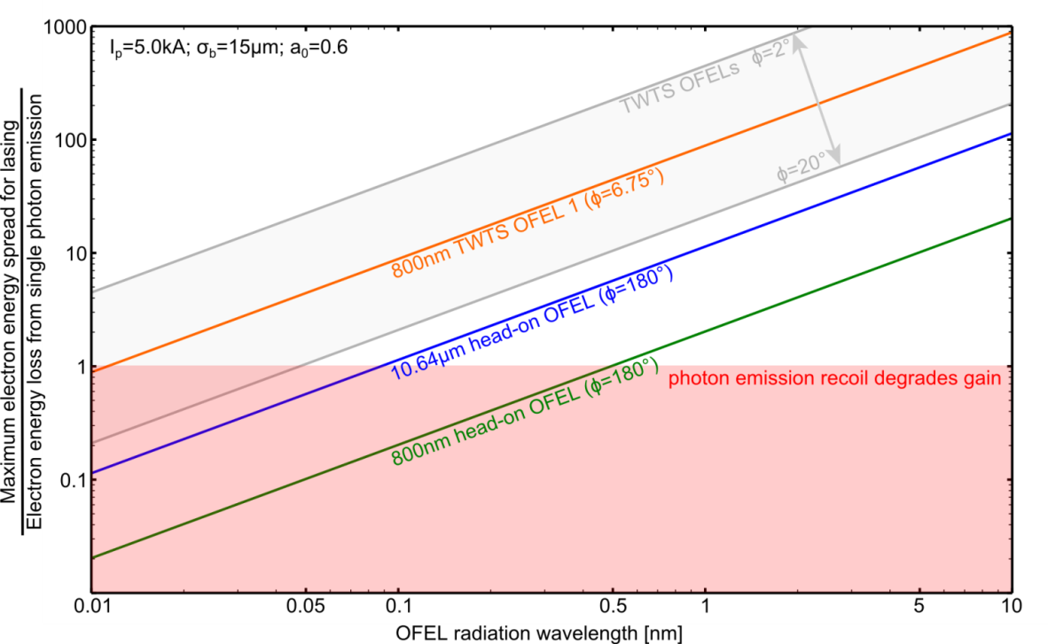
2. With TWTS the impact of photon emission recoil is small
Photon emission recoil pushes electrons out of momentum acceptence interval.
Small angle TWTS increases electron beam radiation coupling.
accepted electron momentum spread for lasing
electron momentum p
$$p_{γ}$$

Slide 9
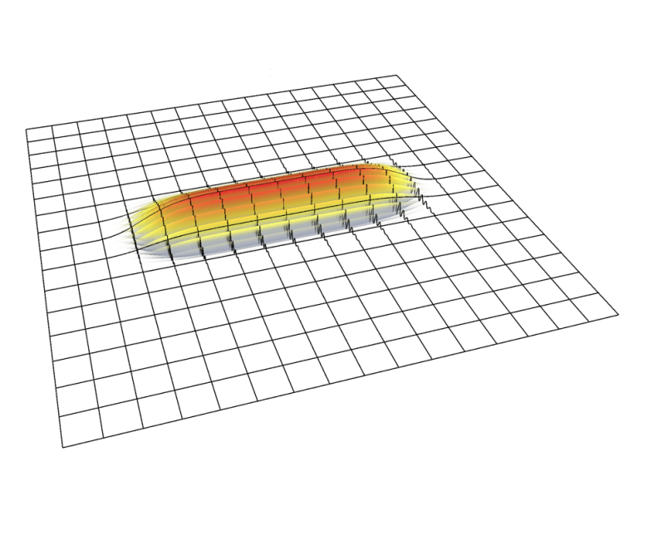
3. With TWTS required laser system are available
TWTS uses provided laser energy more efficient
Variations in laser intensity increase scattered bandwidth and inhibit microbunching.
laser amplitude a
$$ω_{sc}=\frac{{2γ^{2}(1−cosφ)ω}_{Laser}}{(1+a^{2}/2)}$$
k
10kJ, 10ns lasers in head-on geometries
Larger intensity variations with TWTS from larger radiation-electron beam coupling
‰ (head-on) → % (TWTS)
Examples for required laser systems at the end.

Slide 10
What challenges to expect when realizing
Traveling-Wave Thomson-Scattering OFELs?

Slide 11
Challenges of TWTS realization
Dispersion control of TWTS laser pulses
Synchronization of TWTS pulses to electron source
Diagnostics development for TWTS pulse analysis

Slide 12
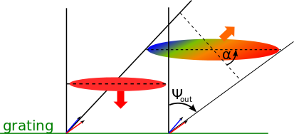
1. Dispersion control of TWTS Pulses
Optical gratings generating the pulse-front tilt also introduce dispersion.
Angular dispersion introduced with puls-front tilt increases pulse duration
(reduction of interaction length, increase in scattered bandwidth)
grating

Slide 13
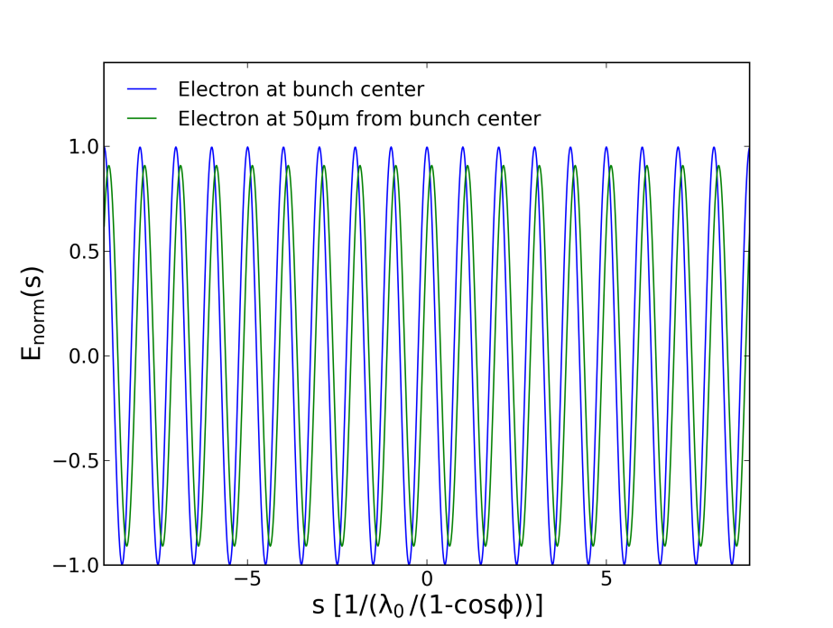
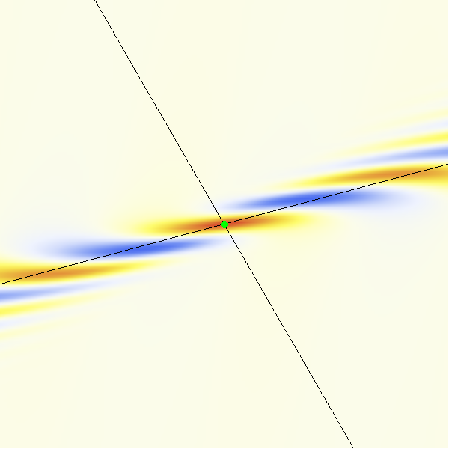
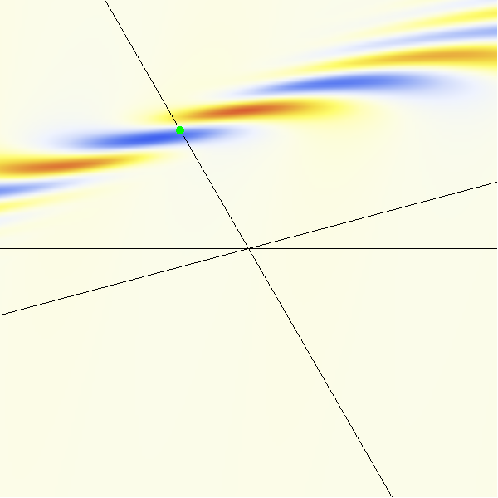
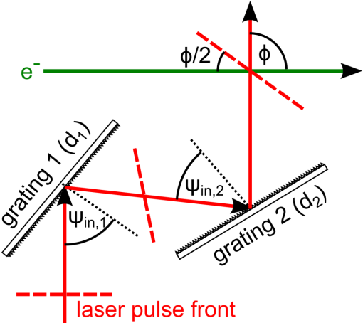
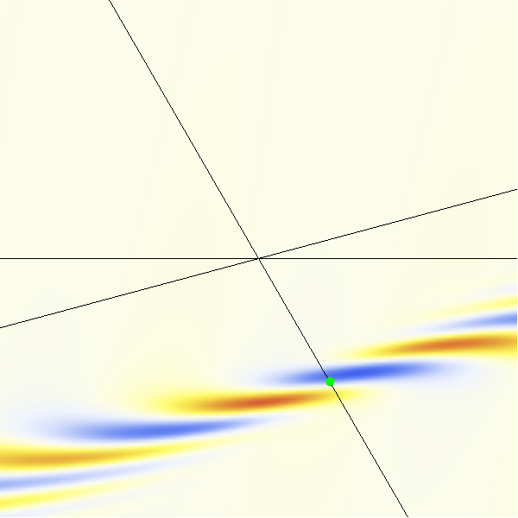
1. Dispersion control of TWTS Pulses requires two-grating setup
Optimum pulse duration along electron trajectory with well chosen angles
(ψ_{in,1}, ψ_{in,2}) and gratings (d₁,d₂)
Two-grating setup allows for local control of pulse-duration and higher order dispersion
$$ϕ$$
$$\vec{k}$$
$$e^{−}$$
Electric field amplitude along electron trajectory.
1µm, 120fs laser pulse at 25° interaction angle

Slide 14
1. Dispersion control of TWTS Pulses is technically equivalent to Petawatt laser compressors
Grating angular stability: Δε <10μrad
(PEnELOPE compressor: Δε <1μrad )
Δε

Slide 15
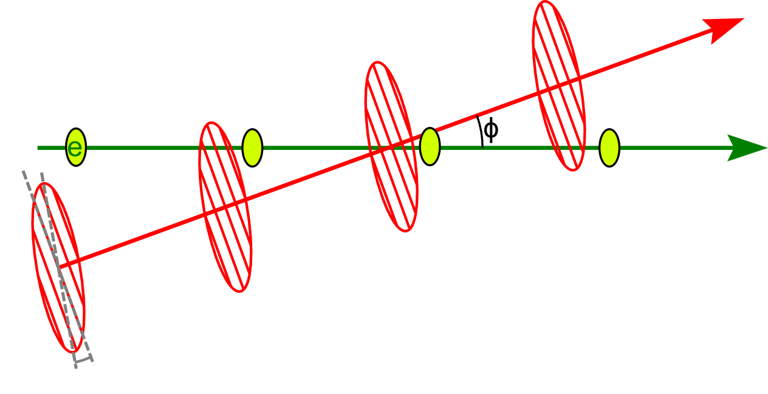
2. Synchronization of TWTS pulses to electron source
Synchronization accuracy needs to be a fraction of the laser pulse duration (<100fs)
Technically equivalent problem in pump-probe experiments or external seeding of X-ray FELs
Facility-wide, all-optical system has been implemented at FLASH@DESY

Slide 16
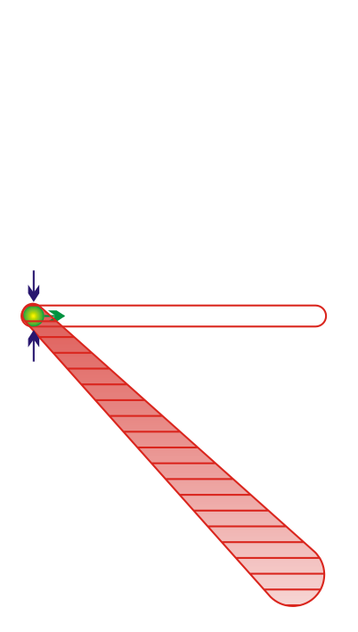
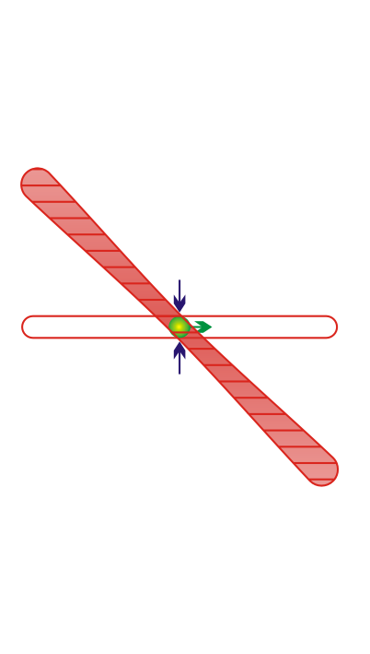
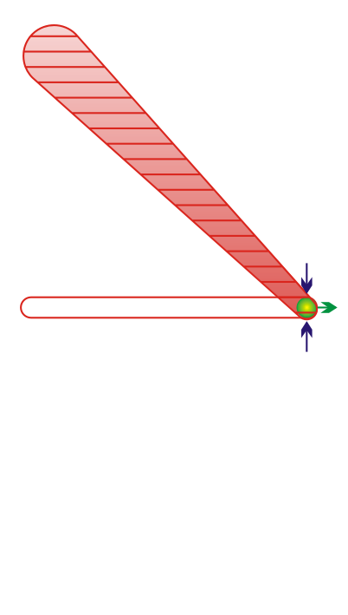
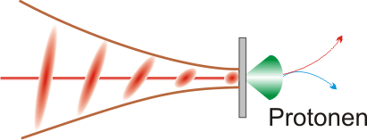
3. Diagnostics development for TWTS pulse analysis
How to measure the pulse duration and pulse dispersion in the plane of optimum laser compression?
τ₀
τ₀
τ₀
Equivalent problem in experiments using high power laser pulses as a pump (e.g. ion acceleration from foils)
Find measurement methods that provide laser pulse information in focus
Ions

Slide 17
Building a
Traveling-Wave Thomson-Scattering OFEL

Slide 18
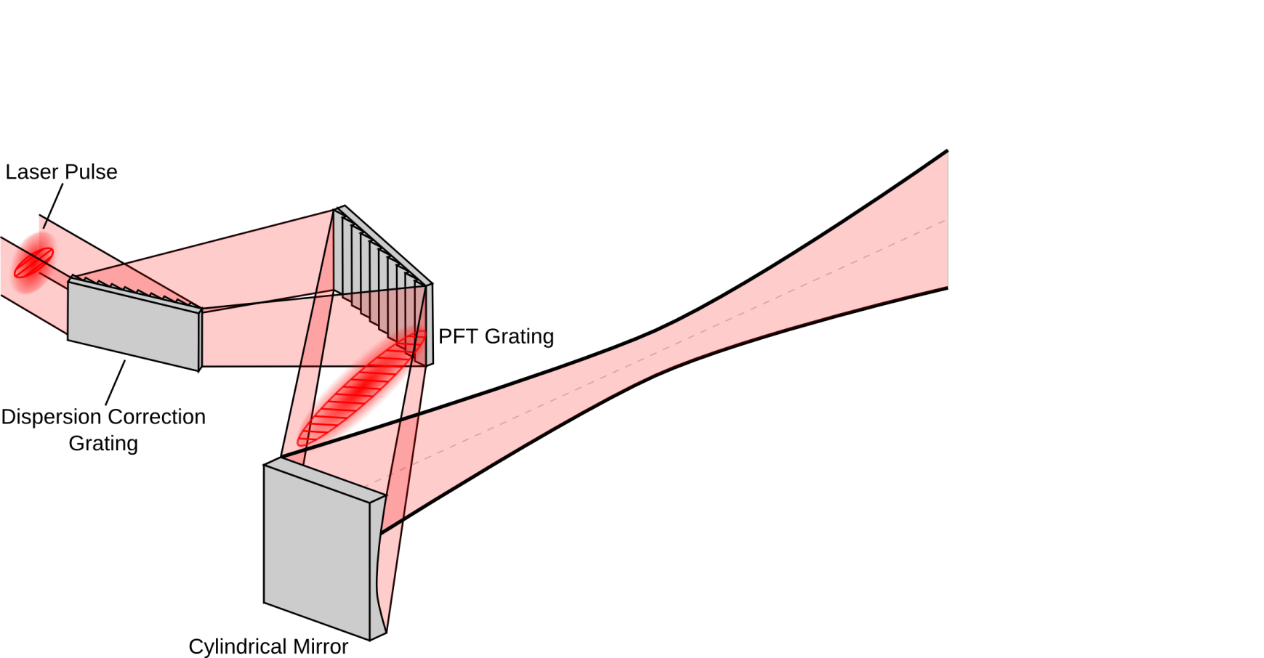
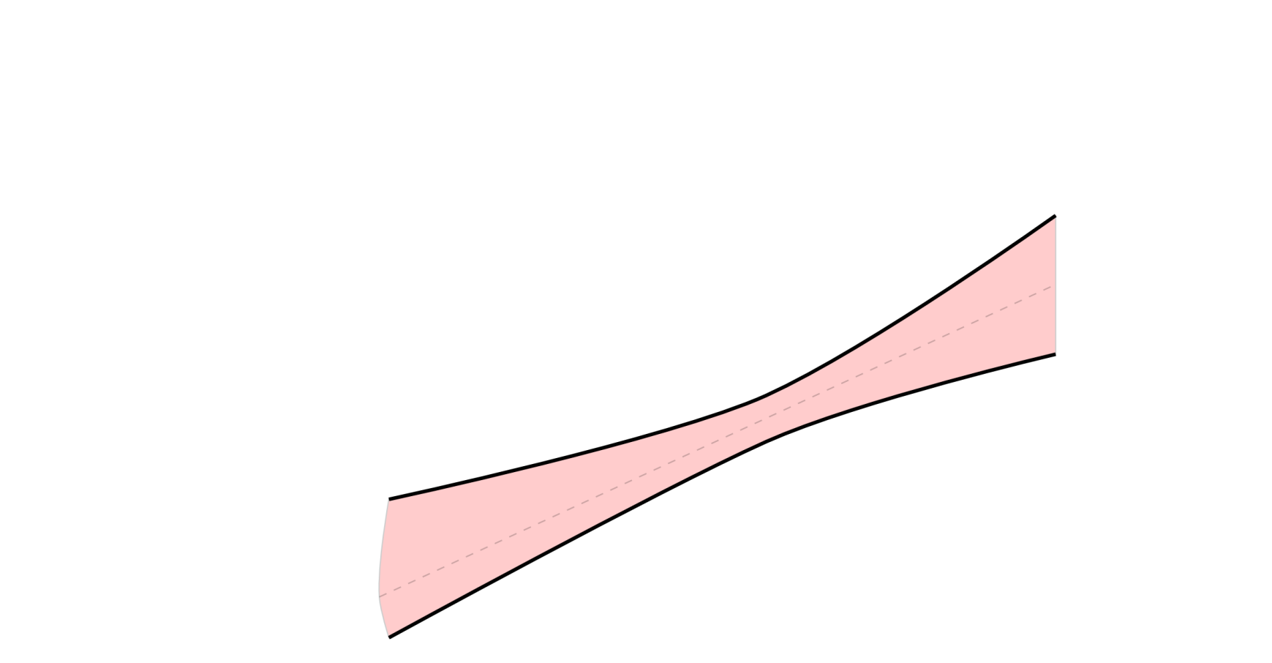
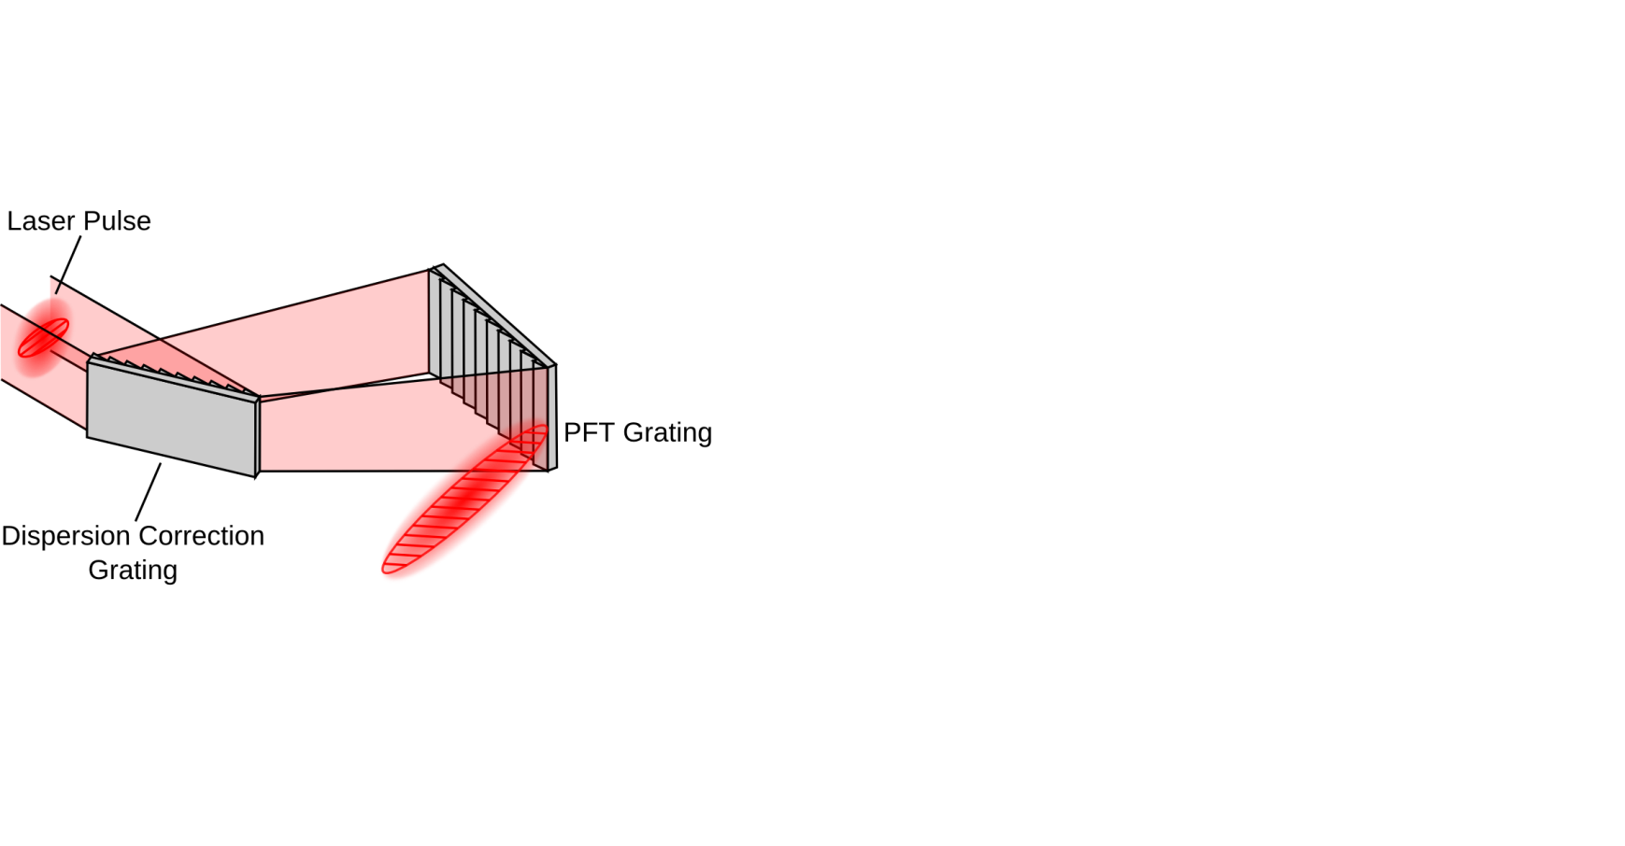
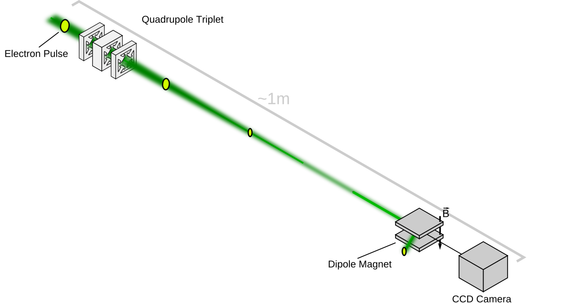
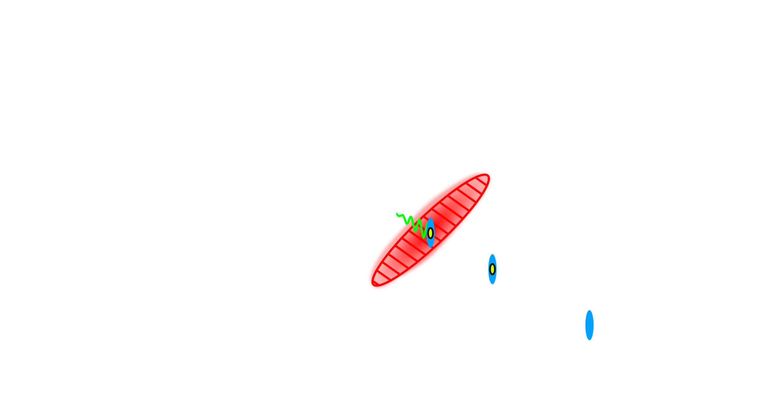
A basic setup of a Traveling Wave-Thomson Scattering OFEL

Slide 19
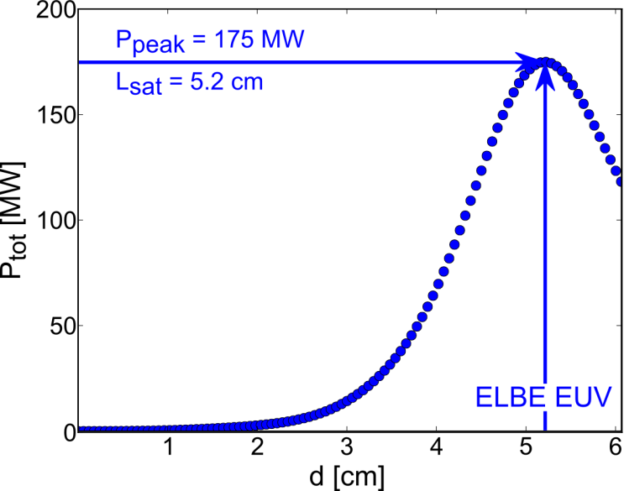
How would a 13.5nm FLASH-type TWTS OFEL at ELBE energy look like?
Parameter | EUV TWTS OFEL ELBE@HZDR | FLASH conventional FEL
Scattered wavelength [nm] | 13.5 | 13.5
Interaction angle [deg] | 6.6 | -
Undulator period [mm] | 0.15 | 27.3
Electron energy [MeV] | 40 | 700
Peak current [kA] | 2.5 | 2.5
Norm. emittance [mm mrad] | 1.0 | 1.45
Rel. energy spread | 0.2% | 0.2%
Undulator parameter $a_{0}/K$ | 0.5 | 1.2
Laser power [TW] | 995 | -
Gain length [cm] | 0.35 | 250
Interaction distance [m] | 0.052 | 27
Peak X-ray power [MW] | 175 | 10000
Simulation of ELBE EUV
TWTS OFEL based on
analytic 1.5D TWTS OFEL
equations
TWTS can be realized with state-of-the-art accelerators and lasers

Slide 20
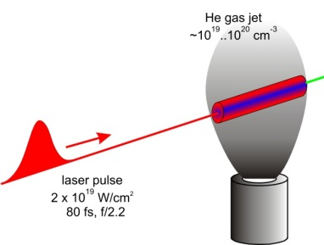
Ultra compact TWTS OFEL using laser wakefield accelerated electrons
Parameter | EUV TWTS OFEL LWFA
Scattered wavelength [nm] | 13.5
Interaction angle [deg] | 3.0
Undulator period [mm] | 0.578
Electron energy [MeV] | 98
Peak current [kA] | 5 (50pC/10fs)
Norm. emittance [mm mrad] | 0.2
Rel. energy spread | 1%
Undulator parameter $a_{0}/K$ | 1.2
Laser power [TW] | 865
Gain length [cm] | 0.27
Interaction distance [m] | 0.043
Peak EUV power [MW] | 4888
Use ultra-low emittance of LWFA
electrons for tight focusing to 5μm (rms).
This maximizes radiation-electron coupling for LWFA electrons with 1% level energy spread
e⁻
MeV-GeV
$${\text{ε}}_{n}\sim 0.1mm mrad$$
$${\text{σ}}_{E}\sim 1\%$$
gas nozzle
TWTS+LWFA offers inherent synchronization of laser and electrons

Slide 21
All of this has been published and more will follow…
Fully analytic theory of TWTS OFELs including TWTS laser field
Optical Free-Electron Lasers with Traveling-Wave Thomson-Scattering
Journal of Physics B 47(2014)23, 234011
Taming transverse coherence and photon recoil with TWTS for high brightness TWTS OFELs
Brilliant and efficient optical free-electron lasers with
Traveling-Wave Thomson-Scattering
AAC 2014 Proceedings
We can build TWTS OFELs with state-of-the-art technology
to be submitted
Simulating TWTS OFELs using the Particle In Cell algorithm
the next step

Slide 22
Conclusion
TWTS is the most promising OFEL scheme that can be realized with state-of-the-art electron sources and laser systems
TWTS is scalable, provides transverse coherence and does not suffer from photon emission recoil in contrast to head-on OFEL schemes
The technical challenges are equivalent to those in the construction and application of Petawatt laser systems
Thank you for your attention!

