Slide 1
CMOS technology, for HEP and PS

Slide 2
CMOS sensors

Slide 3
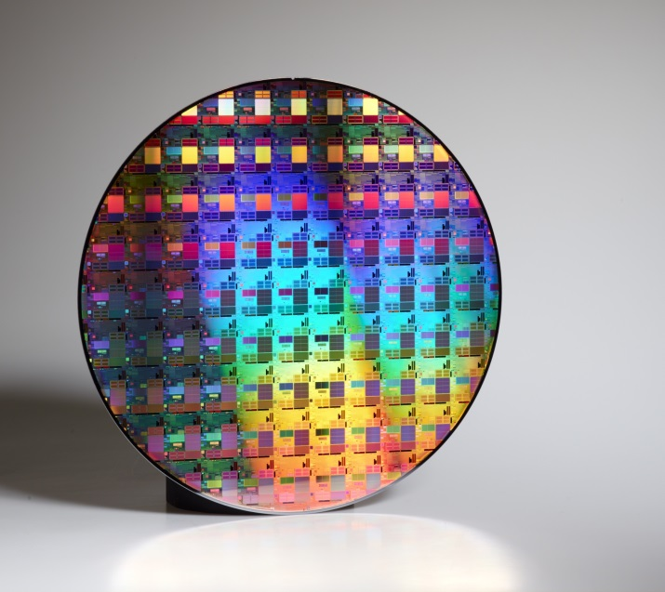
(C)MOS technology
MOS Technology – Integrated circuit technology based on Metal Oxide Semiconductor field effect transistors
Field effect transistor principle invented in 1925 by Julius Lilienfeld
Finally realized in 1960s
„Metal“ Electrode
Insulator
n type region “diffusion”
Silicon p type
Samsung 32nm process

Slide 4
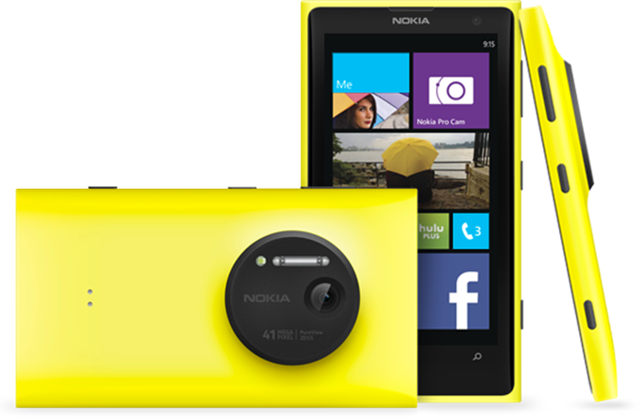
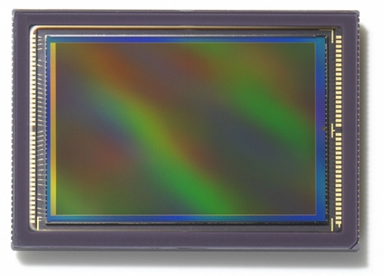
CMOS sensors
CMOS sensors are now the technology of choice for digital cameras in the consumer applications
41.3-megapixel BSI CMOS image sensor, 1/1.5-inch
29 mm
Canon 120 M pixels, 2um pixel size

Slide 5
CMOS pixel
N in P diode acts as sensor element – signal collection electrode
Sensor-junction
N-type region
Diffusion (shallow)
Or well (deep)
MOS FET
Gate
MOS FET
Sensor-junction

Slide 6
CMOS pixel
Charge generated by ionization is collected by the N-diffusion
This leads to the potential change of the N-diffusion
The potential change is transferred to transistor gate – it modulates the transistor current
Sensor-junction
N-type region
Diffusion (shallow)
Or well (deep)
MOS FET
Gate
MOS FET
Sensor-junction

Slide 7
CMOS sensors
CMOS pixel usually worse signal to noise ratio than a CCD
Possible to implement electronics on the chip which makes it faster and allows signal processing
Examples: averaging of signals from many pixels, many frames or double correlating sampling
Thanks of this signal proccessing, the image quality is now as good as with CCDs

Slide 8
CMOS sensors
CMOS sensors in their original form are, mostly, not suitable for the scientific applications, such as particle detection in high energy physics, photon science, electron microscopy
One problem is that the standard CMOS sensors do not have 100% fill factor- this means not the whole area is sensitive. This is so because the readout electronics is placed near the sensor diode. The area covered by the electronics is blind.

Slide 9
Fill-factor
Partial signal collection in the regions without E-field

Slide 10
Fill-factor
Partial signal collection in the regions without E-field
Recombination

Slide 11
Partial signal collection in the regions without E-field
Recombination

Slide 12
Partial signal collection in the regions without E-field
Charge collection by diffusion

Slide 13
Fill-factor
Partial signal collection in the regions without E-field
Charge collection by diffusion

Slide 14
MAPS sensors

Slide 15
CMOS sensors
Some decade ago, an improved version of CMOS sensors have been developed that is sensitive over entire area. These sensors are called MAPS.
However these sensors have other drawbacks, line the limited readout electronics and slow signal collection by diffusion.

Slide 16
MOS pixel sensor with 100% fill factor
MOS sensor with 100% fill-factor
Based on epi-layer
Monolithic active pixel sensor - “MAPS”
MOS FET
NMOS
N-diffusion or N-well
Heavily p-doped P-well
Lightly p-doped epi-layer

Slide 17
MOS pixel sensor with 100% fill factor
Ionization in the epi-layer
Charge collection by diffusion
Particle
N-diffusion or N-well

Slide 18
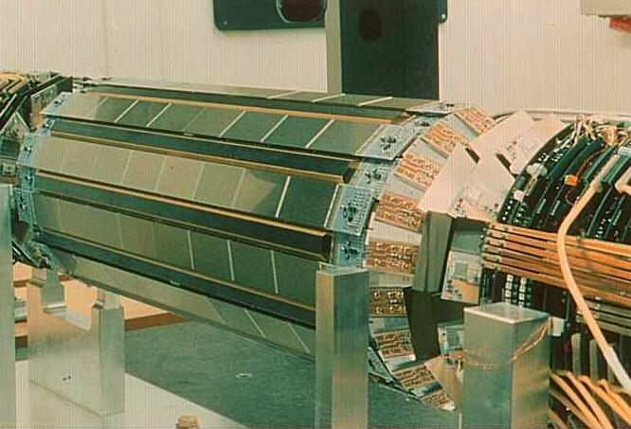
MAPS
Many institutes are developing MAPS, for instance: IPHC Strasbourg (PICSEL group)
Family of MIMOSA chips
Applications:, STAR-detector (RHIC Brookhaven), Eudet beam-telescope and ALICE inner tracker upgrade
http://www.iphc.cnrs.fr/Monolithic-Active-Pixel-Sensors.html

Slide 19
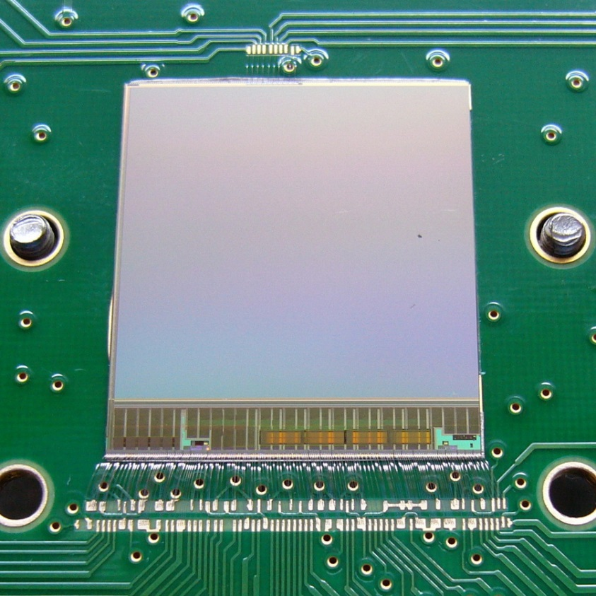
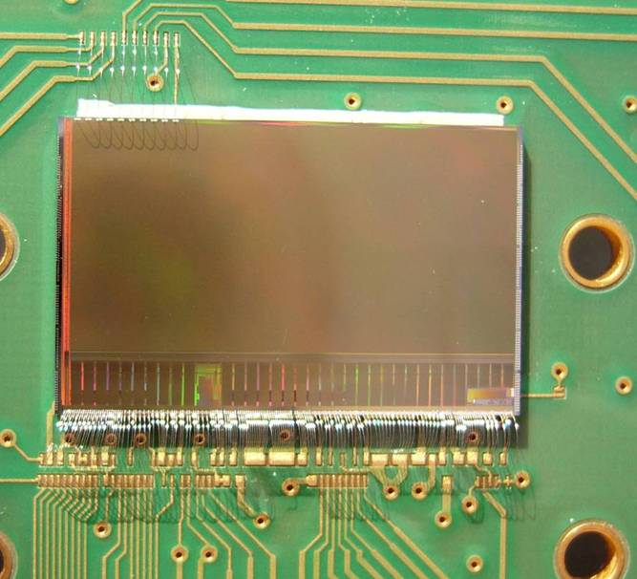
MAPS
Although based on simple MAPS principle – epi layer and NMOS electronics – MIMOSA chips use more complex pixel electronics
Continuous reset and double correlated sampling
Ultimate chip for STAR
MIMOSA 26 for Eudet telescope
http://www.iphc.cnrs.fr/Monolithic-Active-Pixel-Sensors.html

Slide 20
HVCMOS sensors

Slide 21
HVCMOS sensors
One possibility to overcome these limitations - high voltage CMOS sensors.
The main idea is here to use a high voltage on a CMOS chip and in this way produce a large depletion region.
This depletion region is necessary for particle detection.
Problem – the CMOS transistors are sensitive and cannot withstand high voltage.
We have solved this by putting all the transistors into an n-well structure.
The high voltage is limited to the regions outside the n-well.
The n-well to p-substrate is used as a sensor.

Slide 22
One possibility to overcome these limitations - high voltage CMOS sensors.
The main idea is here to use a high voltage on a CMOS chip and in this way produce a large depletion region.
This depletion region is necessary for particle detection.
Problem – the CMOS transistors are sensitive and cannot withstand high voltage.
We have solved this by putting all the transistors into an n-well structure.
The high voltage is limited to the regions outside the n-well.
The n-well to p-substrate is used as a sensor.
PMOS
NMOS
deep n-well
>15µm
Depletion zone

Slide 23
HVCMOS structure.
The sensor element is the deep n-well in p-substrate diode.
The pixel electronics, usually based in charge sensitive amplifier, is placed inside the n-well.
The diodes can be depleted by applying of negative high voltage bias to p-substrate.
The charge signal collection is mainly by drift.
PMOS
NMOS
deep n-well
>15µm
Depletion zone

Slide 24
Intelligent pixel
3.3 V
CR-RC
Comparator
CSA
AC coupling
-50 V
N-well
P-substrate

Slide 25
Intelligent pixel
3.3 V
CR-RC
Comparator
CSA
AC coupling
-50 V
N-well
P-substrate

Slide 26
Intelligent pixel
3.3 V
CR-RC
Comparator
CSA
AC coupling
-50 V
N-well
P-substrate

Slide 27
Intelligent pixel
3.3 V
CR-RC
Comparator
CSA
AC coupling
-50 V
N-well
P-substrate

Slide 28
Intelligent pixel
3.3 V
CR-RC
Comparator
CSA
AC coupling
-50 V
N-well
P-substrate

Slide 29
Intelligent pixel
3.3 V
CR-RC
Comparator
CSA
AC coupling
-50 V
N-well
P-substrate

Slide 30
Intelligent pixel
3.3 V
CR-RC
Comparator
CSA
AC coupling
-50 V
N-well
P-substrate

Slide 31
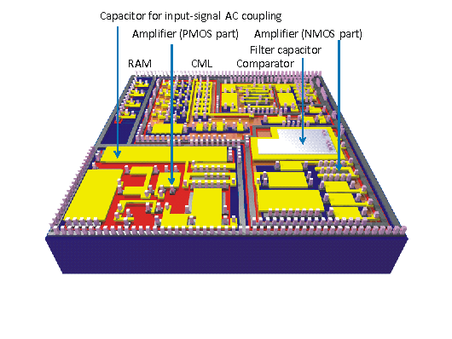
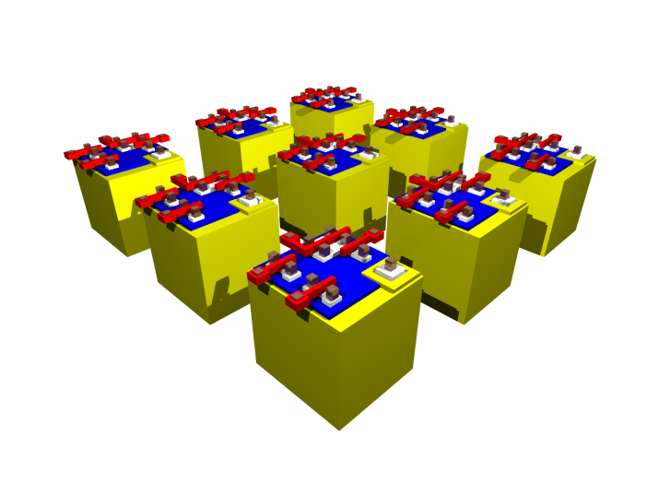
HVCMOS sensors
HVCMOS layouts
2.5um pixels in UMC 65nm technology
55um pixels in AMS 350nm technology

Slide 32
The HVCMOS sensors have the following nice properties:
Signal collection is based on drift – signals are fast
It is possible to implement complex readout electronics in pixels and on the chip periphery
HVCMOS sensors can be produced in standard CMOS technologies
They are intrinsically very radiation hard

Slide 33
HVCMOS applications

Slide 34
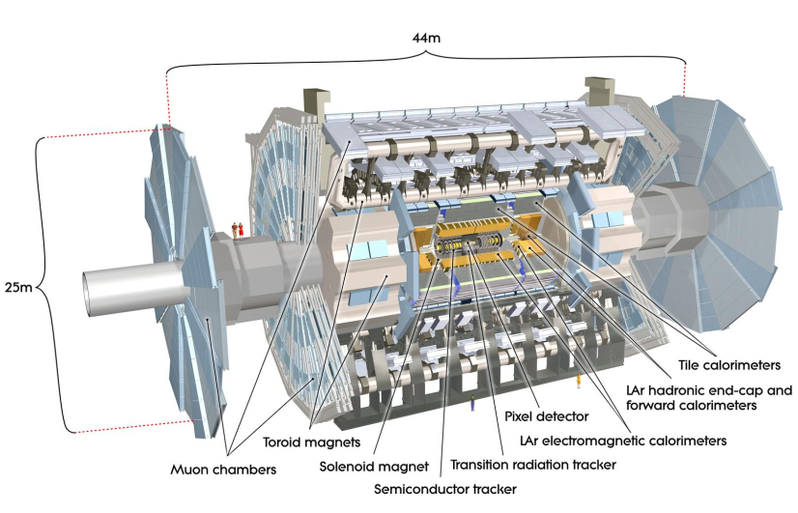
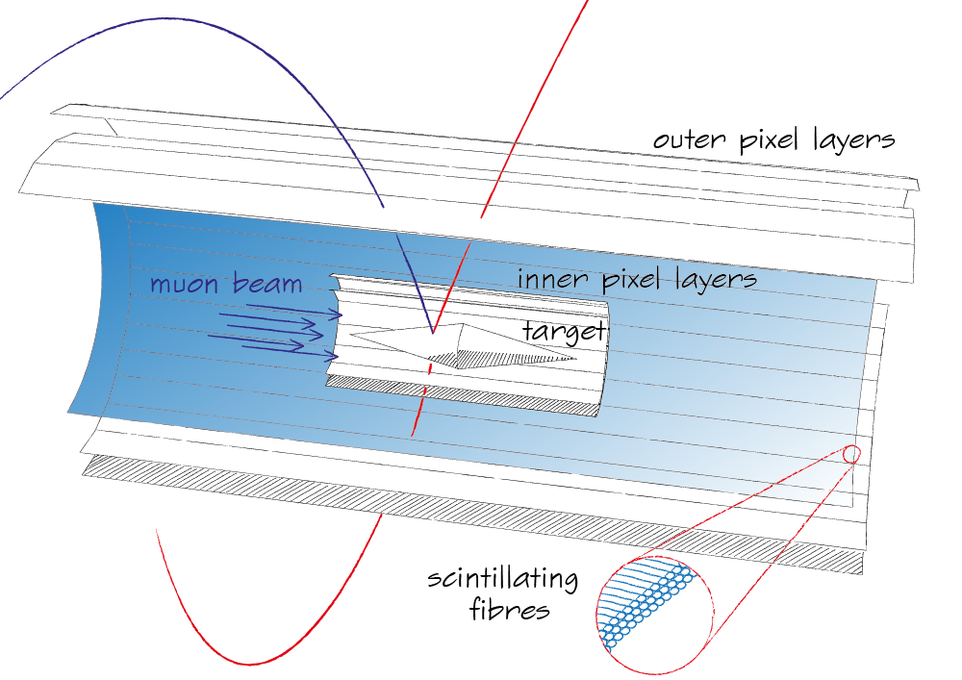
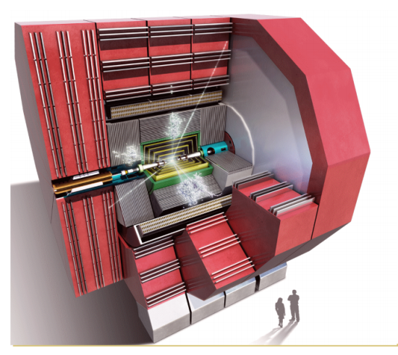
The development of HVCMOS sensors started as a small project.
Now they are developed within several collaborations:
Mu3e collaboration (Heidelberg, PSI, KIT, University ETH Zuerich)
ATLAS pixel HVCMOS collaboration
ATLAS Strip CMOS collaboration
CLIC detector R&D group.

Slide 35
Mu3e
The Mu3e is a proposed experiment at PSI.
The goal is to look for a muon decay to three electrons. The observation of this decay would be a sign of new physics.
The Mu3e detector should consist of three pixel layers with a total area of 2m². Due to low electron momentum, very thin detectors are required.
Time resolution of at least 100ns is required in the pixels.
HVCMOS sensors, since they can be thinned and have a fast signal collection.

Slide 36
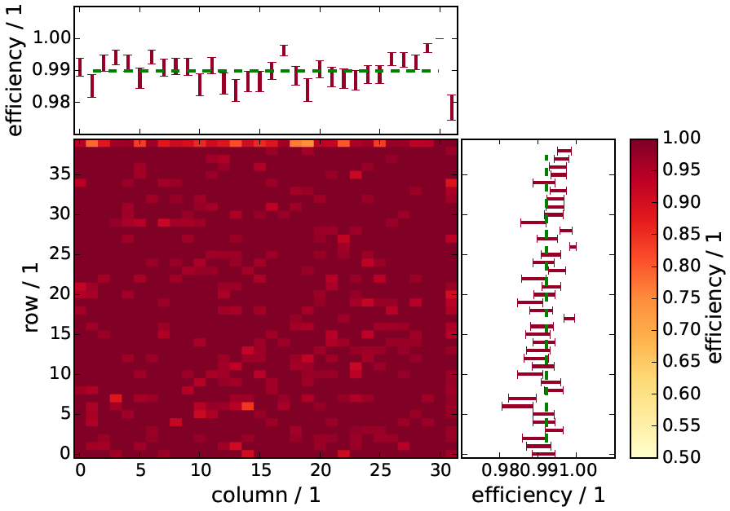
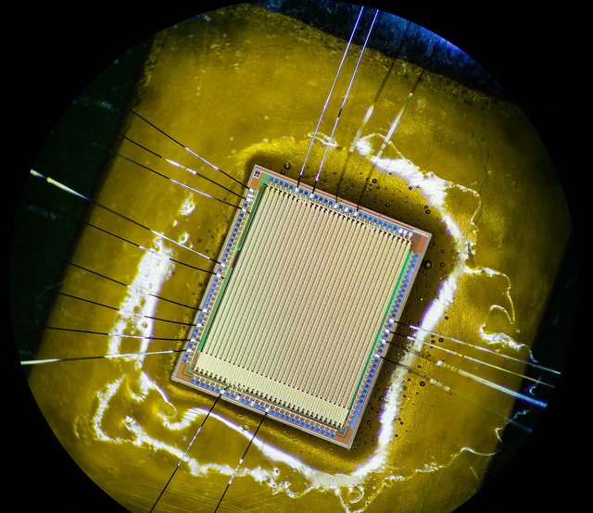
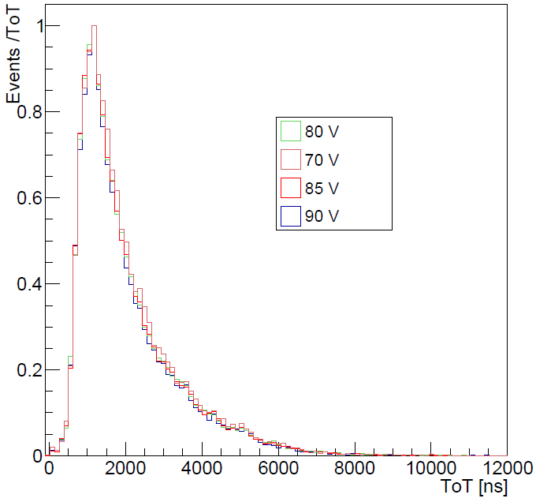
Mu3e
We have developed within several iterations a monolithic pixel sensor.
System on a chip - the readout electronics is placed on the same chip as the sensors.
The signals are directly sent to FPGAs via GBit links.
We measure 99% efficiency in beam tests.
Chips have been thinned and work as the thick ones

Slide 37
ATLAS upgrade
HVCMOS is also investigated for ATLAS upgrade, both for pixel and strip layers.
We have here two concepts.
New concept – monolithic sensors
The more conservative concept is to keep the existing readout chips
And to replace the existing planar pixel or strip sensors with smart HVCMOS sensors.

Slide 38
ATLAS upgrade
What are the benefits?
In the case of pixels we can have several smaller pixels connected to one readout cells of the pixel readout chip.
In this way we can increase the spatial resolution.
Signals of several pixels are position to amplitude modulated and multiplexed.
Moreover, the signals can be then capacitively transmitted from the sensor to the readout chip.
In this case we do not need bump bonding and the construction of the whole detector can be much cheaper since the bumping costs are making the largest portion of the costs.
Readout pixel
Size: 50 µm x 250 µm
TOT = sub pixel address
Different pulse shapes
+
Size: 33 µm x 125 µm

Slide 39
Strips
In the case of strips, we would send the hit data in digital format to the external digital chip that does the triggering.
HVCMOS replacement for the strip sensor is a pixel sensor with long pixels.
The advantages over the present concept are
z-resolution with one layer
less number of wire bonds between the sensor and the digital readout chip
simplified readout chip which is only digital
Present detector
ABCN chip
1
1
1
1
HVCMOS detector
Digital chip
0
1
2
3
2
0
0
1
2
3
0
1
2
3
1
0
1
2
3
3

Slide 40
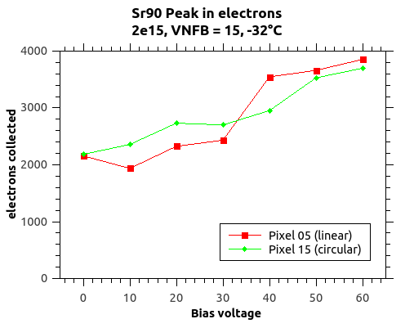
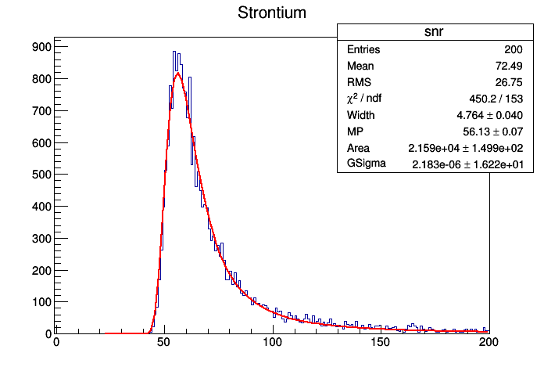
Strips
In the case of strips, we would send the hit data in digital format to the external digital chip that does the triggering.
HVCMOS replacement for the strip sensor is a pixel sensor with long pixels.
The advantages over the present concept are
z-resolution with one layer
less number of wire bonds between the sensor and the digital readout chip
simplified readout chip which is only digital
Strontium-90 illumination – spectrum
irradiated
128mV
A/D units

Slide 41
Large area sensors
…
2.5cm

Slide 42
Large area sensors
…
10cm
2.5cm
80um
Reticle ring
Reticle ring

Slide 43
Large area sensors
…
10cm
2.5cm
80um
Redistribution layer
Reticle ring
Reticle ring

Slide 44
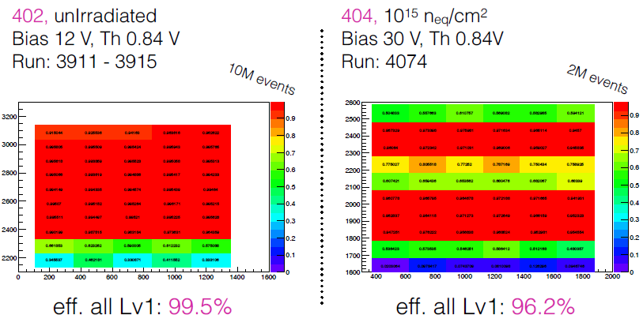
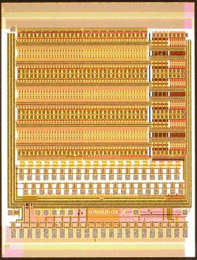
ATLAS pixels
We have developed small HVCMOS prototypes for the pixel layers.
There chip are just glued onto FEI4 readout chip without bumps.
We measure 99% detection efficiency.
ATLAS application is especially difficult since a high radiation tolerance is required. After irradiation to 1e15 neq we still have 95% efficiency.
This is a good result, but we need and will improve it with our next prototypes.

Slide 45
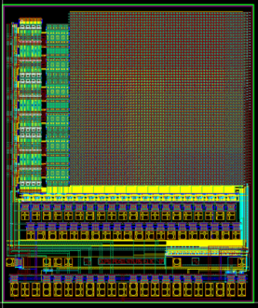
CLIC
HVCMOS is also proposed for CLIC.
CLIC detector:
Hybrid detector based on HVCMOS active senor and a CLICPIX chip.
The pixel size is only 25um x 25um.
Size: 25 µm x 25 µm
Readout pixel
Size: 25 µm x 25 µm

Slide 46
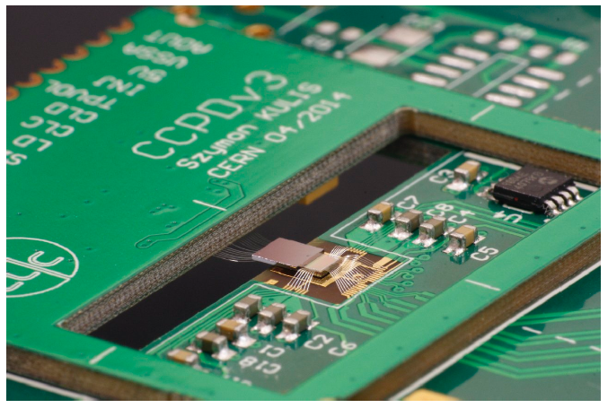
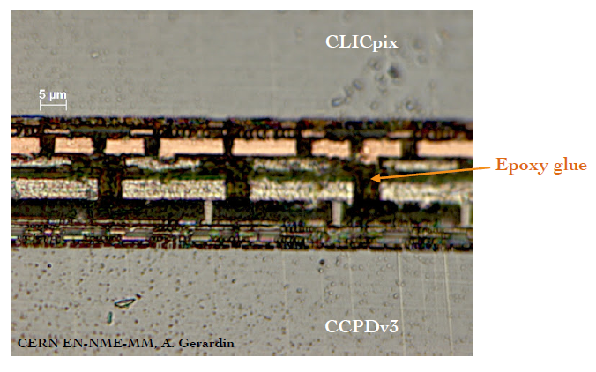
CLIC
HVCMOS is also proposed for CLIC.
CLIC detector:
Hybrid detector based on HVCMOS active senor and a CLICPIX chip.
The pixel size is only 25um x 25um.
Possible due to capacitive signal transmission.
Although very small, the pixels in this sensor have sophisticated signal processing – amplitude and time measurements are possible. Such a processing was possible so far only with much larger pixels.
CCPD Sensor for CLIC

Slide 47
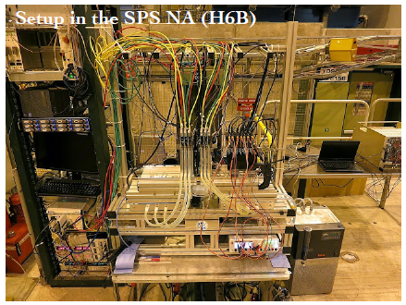
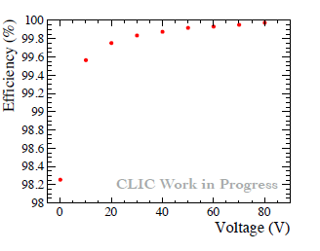
CLIC
Also here we measure excellent detection efficiency.

Slide 48
FEL
HVCMOS sensor can be used for FEL applications too.
The depletion layer size can be adapted by choosing of high resistive substrates.
Several produces are ready to produce sensors on the substrates we choose.
Backside illumination is possible. Radiation tolerance of the electronics is very good. There can be several advantages over the existing hybrid detectors.

Slide 49
…
250um
HV~100V
Radiation

Slide 50
For instance we can keep two chips a HVCMOS chip and a readout chip. The HVCMOS chip can contain the sensor, the amplifier and ADC. The readout chip (digital processing chip) can contain only the storage cells or only the fast digital circuits to transfer the large amount of data from the pixels to periphery. In this way the readout chip is purely digital, and can be done in a technology optimal for digital circuits.
Another possibility is to implement the HVCMOS sensor in GF BCD process, By doing this we could use the 3D integration to connect the HVCMOS tier with the digital tier. Smaller pixel sizes are possible.
In both cases only standard components are used.
Development in Global Foundry process
3D integration possible
Back Side Metal
TSV
Tier 1
(thinned wafer)
M1
M2
M3
M4
M5
M1
M2
M3
M4
M5
M5
M4
M3
M2
M1
M5
M4
M3
M2
M1
HVCMOS
Tier 2

Slide 51
For instance we can keep two chips a HVCMOS chip and a readout chip. The HVCMOS chip can contain the sensor, the amplifier and ADC. The readout chip (digital processing chip) can contain only the storage cells or only the fast digital circuits to transfer the large amount of data from the pixels to periphery. In this way the readout chip is purely digital, and can be done in a technology optimal for digital circuits.
Another possibility is to implement the HVCMOS sensor in GF BCD process, By doing this we could use the 3D integration to connect the HVCMOS tier with the digital tier. Smaller pixel sizes are possible.
In both cases only standard components are used.
Development in Global Foundry process
3D integration possible
High dynamic range ADC with linear response (measurementtime 1us)

Slide 52
Detection of low energy electrons/photons
HVCMOS sensors can be also used for the detection of low energy x-ray photons or low energy electrons.
AMS, for instance, offers the possibility to remove the insulation layers down to the silicon. In this way a dead (insensitive) region of only ~ 100ns is there over the sensor volume.
Such sensor would be suitable for UV detection as well.
In some CMOS processes (LFoundry) the backside electrodes should be possible.
Low energy radiation
200nm

Slide 53
Pixel readout ASICs

Slide 54
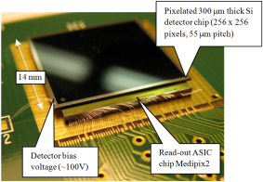
CMOS sensors
Planned development: Detector readout chips – e.g. pixel readout chips
The existing readout chips are not always suitable for the readout of new sensor types.
One example of such a new sensor would be a hybrid pixel detector based on CdZnTe or GaAs sensor. Such sensors are good for the detection of high energy x-rays.
The new readout chip could for instance allow simultaneous energy measurement and counting of the photons.
It could contain a high dynamic range ADCs.
Novel feedback circuits can be used to allow fast counting with a rate of < 20MCounts.
New: capacitive signal transmission instead of bump bonding.
This can be especially important for CdZnTe sensors with Al Shottky/In contacts. These contacts are very sensitive and if bumping could be avoid, this would simplify the construction of the detector. For this, the existing readout chips are not suitable.

Slide 55
CCPD
….
Readout chip
Shottky diode
CdZnTe sensor
Bias grid

Slide 56
ADC with high dynamic range
….
Integration time 2.5ms.
I.Peric: „Advanced Pixel Detectors for Scientific- and Medical
Applications“.

Slide 57
CMOS SiPMs for various applications

Slide 58
CMOS sensors
New szintillator/SiPM detectors for PET
The present PET systems have the trade-off between the time and spatial resolution and the quantum efficiency.
If high quantum efficiency is needed, the crystals should be long. However, in the case of long crystals the time the scintillating light needs to come to the sensor is not negligible. If absorption of gamma occurs far away the lime is longer than in the absorption is occurs closer.

Slide 59
CMOS sensors
Instead of one layer of long crystals, we would have many layers of short crystals.
SiPMs CMOS chips – so called digital SiPMs would be used to detect the scintillating light. Since the path for the light is short we can expect faster signals and better time resolution.
Parallax error would be much smaller.
Necessary for this development – large area SiPM – CMOS chips

