Slide 1
Integrating Detectors at First Instrument
M. Kuster
for WP75
April 23rd 2015
Notes:
How to edit the title slide
Upper area: Title of your talk, max. 2 rows of the defined size (55 pt)
Lower area (subtitle): Conference/meeting/workshop, location, date, your name and affiliation, max. 4 rows of the defined size (32 pt)

Slide 2
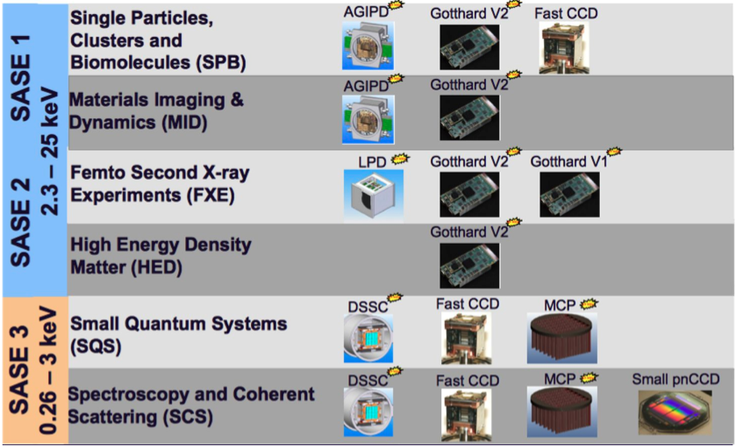
Detectors for XFEL Instruments
Notes:
Before you start editing the slides of your talk change to the Master Slide view: Menu button “View”, Master, Slide Master:
Edit the following 2 items in the 1st slide: 1) 1st row in the violet header: Delete the existent text and write the title of your talk into this text field 2) The 2 rows in the footer area: Delete the text and write the information regarding your talk (same as on the Title Slide) into this text field.
If you want to use more partner logos position them left beside the DESY logo in the footer area Close Master View

Slide 3
End-to-End Test of Detectors
Goal of the Test
Demonstrate the functionality of the detector system including all subcomponents and identify potential problems before system acceptance and integration at beam line.
What will be Tested?
Vacuum, cooling and movement system
Detector control system
C&C and veto system
DAQ and data management system including calibration data base
Data processing pipeline and calibration pipeline
All detector operation modes for first day operation
Data and calibration data quality checks
Where and How will be Tested?
HERA South: BigAmber and PulXar depending on tests to be performed
Data taking with and without X-rays
Sequentially all four quadrants of a detector at full speed 4.5 MHz
Notes:
Before you start editing the slides of your talk change to the Master Slide view: Menu button “View”, Master, Slide Master:
Edit the following 2 items in the 1st slide: 1) 1st row in the violet header: Delete the existent text and write the title of your talk into this text field 2) The 2 rows in the footer area: Delete the text and write the information regarding your talk (same as on the Title Slide) into this text field.
If you want to use more partner logos position them left beside the DESY logo in the footer area Close Master View

Slide 4
Hutch, DAQ/Control System and Detector Ready for Installation at Experiment
Requirements
All dirty work in hutch completed, hutch is cleaned and is accessible
Hutch and rack room is accessible for installation
Crane and/or transport equipment available for detector installation
Racks installed and rack components are tested
Initial alignment of detector on tile level finalized
Detector successfully passed end-to-end test in HERA South
Tasks and Responsibilities
Installation of cabling in the hutch [CIE (to be confirmed), Instrument Team, WP75]
Installation and testing of detector control system [CAS, WP75, Consortium]
Installation and testing of detector DAQ system [ITDM, WP75, Consortium]
End-to-end test of detector system at HERA South [WP75, ITDM, CAS, AE, Consortium]
Installation of calibration source in experiment chamber and test movement system [Instrument Team, WP75]
Preparation and installation of mechanical interface between detector and detector support [Instrument Team, WP75]

Slide 5
M1: Planning of Planning for Detector Installation Finished
Tasks and Responsibilities
Preparation of installation schedule and documents [WP75, Instrument Team, CAS, ITDM, AE, Consortium]
Cabling specifications [WP75, Instrument Team, AE, Consortium]
Rack planning for detector, DAQ and control system [AE, Instrument Team, AE, Consortium]
Define responsibility for rack installation at experiment [CIE (to be confirmed), AE]
Transport installation of crates and PLC CPU [CIE (to be confirmed), AE]
Install cables for equipment to first patch panel [CIE (to be confirmed), Instrument group]
Definition of mechanical detector interface [Instrument group, WP75, Consortium]

Slide 6
M2: Preparation of Detector Beam Line Integration Finished
Requirements
Rackspace at beam line accessible and ready for installation
Hutch and rack room accessible and ready for installation
more … ??
Tasks and Responsibilities
Rack installation at experiment [CIE (to be confirmed), Instrument Team]
Preparation of mounting for the detector [Instrument Team, WP75, Consortium]
Implementation of motor control for detector movement (xyz-direction and quadrant motion) [CAS, Instrument Team, WP75, Consortium] , result of End-to-End test
Initial alignment of detector on tile level [WP75, Consortium], result of End-to-End test
Initial calibration of detector [Consortium, WP75], result of End-to-End test

Slide 7
M3: Cooling System Operational
Requirements
All dirty work in hutch completed, hutch is cleaned and is accessible
Hutch and/or rack room accessible for installation
Crane and/or transport equipment available for installation
Chiller integrated in control system and chiller operation successfully tested in HERA South before installation
Tasks and Responsibilities
Install chiller at its final location and cooling pipes to and from hutch [CIE (to be confirmed)]
Fill cooling circuit with cooling liquid if necessary [WP75, Instrument Team]
Connect chiller in control system and test control system functionality [CAS, Instrument Team]
Test run of cooling system with control system and leak check without detector [WP75, Instrument Team]

Slide 8
M4: Detector System Installed at Beam Line
Requirements
Hutch and rack room is accessible for installation
Cooling system installed, operational and tested
All detector relevant cabling installed and tested
Crane and transport equipment available for hutch installation
N₂ available in hutch to vent/open detector vessel
Experiment chamber installed and vacuum leak tested according to specifications
Safety interlocks for detector are operational and tested (beam attenuators, no direct beam on detector possible)
Tasks and Responsibilities
Transport of detector from HERA South to the hutch [WP75]
Inspect all systems of the detector for damage after transport [WP75]
Mechanically install detector system at beam line [WP75, Instrument Team, Consortium?]
Wire system up to patch panel (control, DAQ, vacuum system, power and cooling pipes) [WP75, Instrument Team, Consortium?]
Functional tests of control system of detector [CAS, WP75, Consortium]

Slide 9
M5: Detector Vacuum System Operational
Requirements
Cooling system installed, operational and tested
All detector relevant cabling installed and tested
N₂ available in hutch to vent/open detector vessel
Experiment chamber installed and vacuum leak tested according to specifications
Detector chamber vacuum leak tested according to specifications
Tasks and Responsibilities
Vacuum system and temperature control system tests (pump down, cool, warm up) [WP75, Consortium, Instrument Team]
Warm detector up to room temperature and vent system [WP75, Consortium, Instrument Team]

Slide 10
M6: Test of Safety System and Procedures Completed
Requirements
Cooling system installed, operational and tested
All detector relevant cabling installed and tested
N₂ available in hutch to vent/open detector vessel
Detector vented and at ambient pressure
Tasks and Responsibilities
Functional tests of detector shutdown procedures [WP75, Consortium]
Functional tests of gate valve and its mechanical locking system [Instrument Team, WP75, Consortium]
Functional tests of beam attenuators and other safety related equipment etc. [Instrument Team, WP75]
Test of SIB and/or other safety procedures implemented in the detector front-end (vacuum, temperature etc.) [WP75, Consortium]

Slide 11
M7: Detector Motion System Operational
Requirements
Cooling system installed, operational and tested
Control system ready
All detector relevant cabling installed and tested
N₂ available in hutch to vent/open detector vessel
Experiment chamber installed
Tasks and Responsibilities
Motion system and limit switch tests with open chamber [WP75, Consortium, Instrument Team]

Slide 12
M8: Timing System Tests Successfully Completed
Requirements
Access to control room and hutch
Control system ready and C&C signals available and tested
Control room and control hardware ready and operational (e.g. control PCs)
N₂ available in hutch to vent/open detector vessel
Tasks and Responsibilities
Install and check C&C system and C&C signals [AE, WP75, Consortium]

Slide 13
M9: Initial Alignement Finalized
Requirements
Detector vented and sensor plane accessible
Alignment lasers or other alignment system in hutch available and tested
N₂ available in hutch to vent/open detector vessel
Detector modules aligned up to quadrant level
Tasks and Responsibilities
Align detector to beam line coordinate system [Instrument Team, WP75]
Installation of alignment system (e.g. laser?) [Instrument Team, WP75]

Slide 14
M10: Detector Commissioning without X-Ray Beam Finalized
Requirements
Access to hutch and control room
Detector and safety interlocks fully operational
Calibration source installed and operational
Detector evacuated and at nominal operation temperature
No direct and not attenuated beam can hit the detector
Tasks and Responsibilities
Detector performance verification measurements of all three first day operating modes with and without calibration source under nominal operation conditions [WP75, Consortium]
Analysis of performance data and update of CalDB [WP75, Consortium]

Slide 15
M11: Detector Commissioning with X-Ray Beam Finalized
Requirements
Access to hutch and control room
X-ray beam available in hutch
Detector and safety interlocks fully operational
Detector evacuated and at nominal operation temperature
No direct and not attenuated beam can hit the detector
Tasks and Responsibilities
Alignment measurements with diffraction sample [Instrument Team, WP75, Consortium]
Injection of initial alignment data into CalDB [WP75]
Detector performance verification measurements of all base line operating modes with FEL beam [WP75, Consortium, Instrument Team]
Analysis of performance data and update of CalDB [WP75]
Final operation tests with up-to-date CalDB and alignment data [WP75]
Training of beam line scientists in detector operation [WP75, Instrument Team]

Slide 16
M12: Detector Ready for User Operation
Requirements
All previous tests haven been finished successfully
Beam line scientists have been trained in operating the detector
Tasks and Responsibilities
None, we are set
Open Issues
None

Slide 17
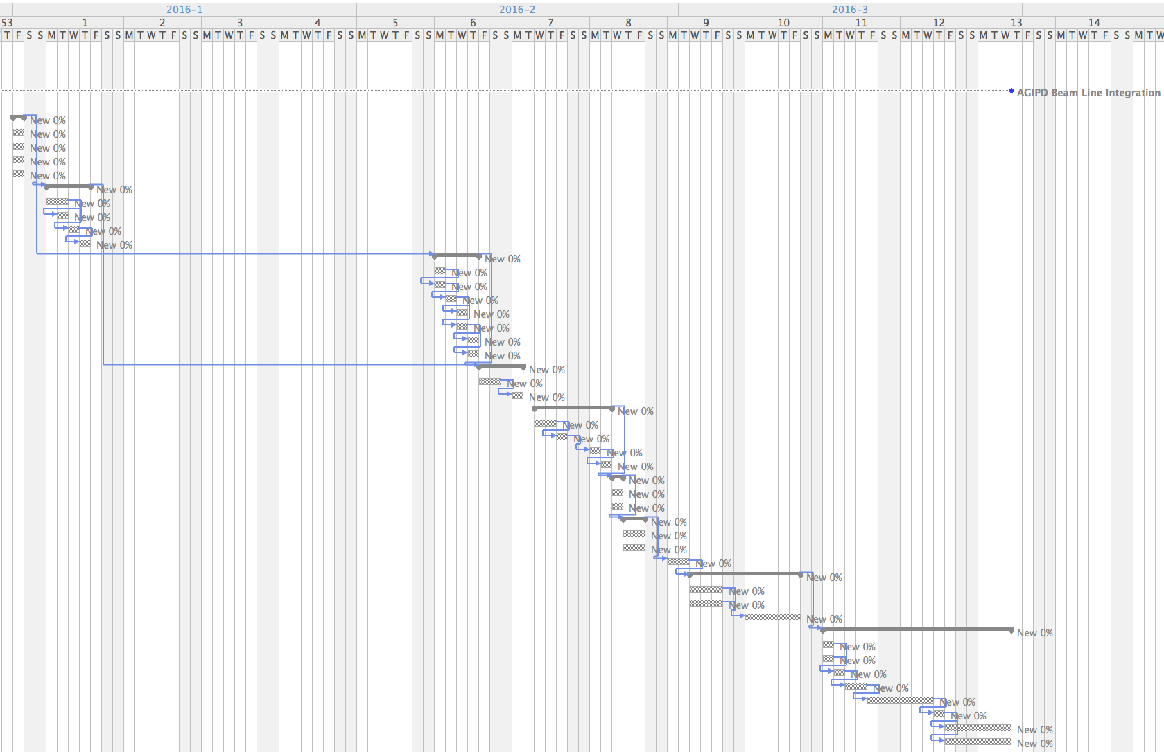
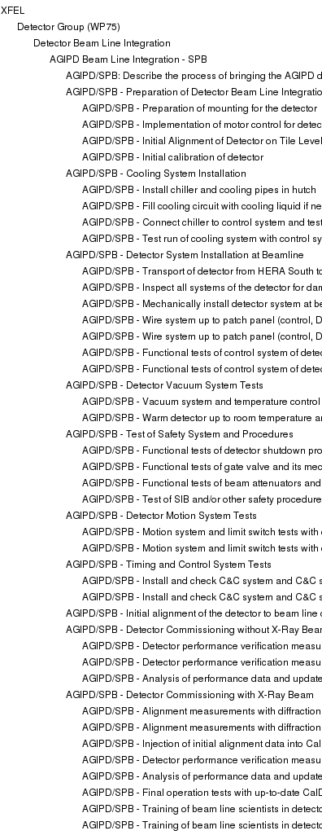
Example: AGIPD 1 Mpx Integration at SPB
Total Duration 8 Weeks

Slide 18
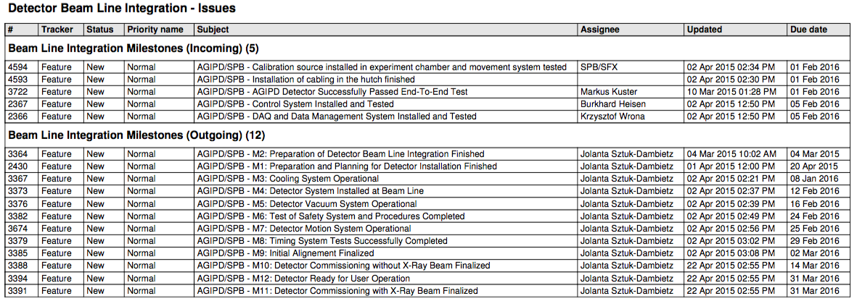
Example: AGIPD 1 Mpx Integration at SPB
Status of Planning
Template resource loaded detector integration schedule exists for vacuum and non-vacuum detectors.
Detailed schedule and approach has been discussed with FXE, SPB and MID.
Milestones have partially been synchronized with scientific groups up to the level presently known.
Responsibilities are agreed with FXE, SPB, MID, CAS, ITDM and AE.
Definition of planning interface to PSPO and TC.

Slide 19
Example: AGIPD 1 Mpx Integration at SPB
Open Issues
Agreement on responsibilities with CIE.
Establish planning interface to PSPO and TC.
Integration of the detector installation schedule into the XFEL “master plan” and resolve collisions.
Fix dates for incoming milestones with instrument groups, AE, ITDM and CAS.
Prepare planning for SQS, SCS, and HED and synchronize milestones.
So far no contingency is foreseen to be consistent with the global XFEL “master plan”.

Slide 20
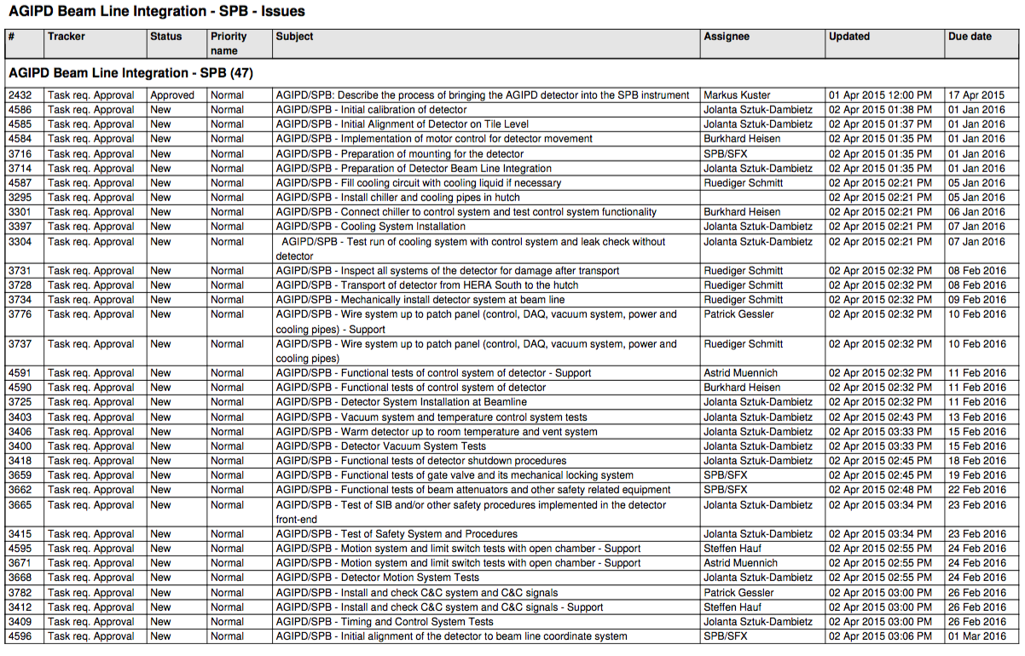
AGIPD 1 Mpx Integration at SPB – Tasks

Slide 21
AGIPD 1 Mpx Integration at SPB – Tasks

