Slide 1
Controls during installation and technical commissioning
Burkhard Heisen
for WP90, WP91 and WP92
Collaboration Meeting
Hamburg, April 24, 2015
Notes:
How to edit the title slide
Upper area: Title of your talk, max. 2 rows of the defined size (55 pt)
Lower area (subtitle): Conference/meeting/workshop, location, date,
your name and affiliation,
max. 4 rows of the defined size (32 pt)
Change the partner logos or add others in the last row.

Slide 2
Agenda
What will be controlled, monitored and processed
  Beckhoff
  COTS devices (heaters, cameras, power supplies, etc.)
  MicroTCA (digitizers, timing, read out, health management)
  Detectors
  Servers (online computing and health management)
Where is what and how is it connected
  Tunnels, balcony rooms, rack hutches, control hutches, experiment hutches
  Network infrastructure and data flow
How is it technically realized
  Hardware, firmware, software interaction
  Broker interface, Point2Point interface, Middle-Layer devices/macros
User interfaces
  Interactive graphical and command line interface
  Macro execution
Project Management
  PSPO / CIE / CAS / AE / ITDM

Slide 3


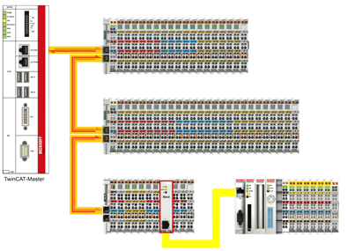

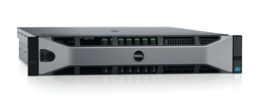
Motors, pumps, valves… and real-time control
Karabo itself does not directly provide real-time processes/communications -> uses Beckhoff layer
Beckhoff PLC-firmware blocks are mapped to Karabo devices and can be auto-generated from PLC self-description
Integrated devices (now extending to different vendors):
  Turbo-, ion-, and scroll-pumps
  Valves, gauges, temperature sensors
  Stepper-, piezo- and servo-motors
Motor1
Motor2
Pump1
Beck
Com
Gather/Scatter
TCP (own protocol)
PLC-CPU
EtherCAT
Motor1
Motor2
Pump1
Courtesy of P. Geßler

Slide 4
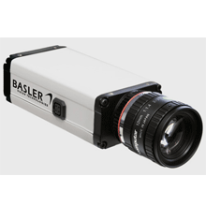
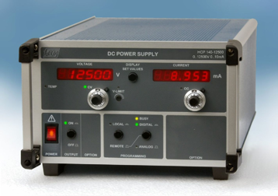
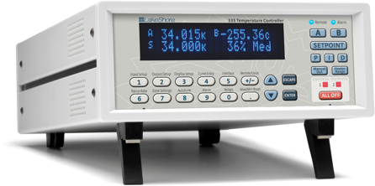
Cameras, power supplies, heaters…
Supported standards
  GenICam (generic interface for cameras) - industry standard
  Lima (library for image acquisition) – ESRF project
  SPCI (Standard Commands for Programmable Instruments)
Cameras
  Basler (all GigE), Photonic Science (sCMOS)
  IMPERX (Bobcat B4020), Andor (Neo)
  AVT (all Prosilica), Axis (all)
Other devices
  FUG, Heinziger (power supplies), TEM (beam lock)
  Amphos (laser power stage)
  EnergyMax (laser sensors)
  Lakeshore (heater), STS (spectrometer)

Slide 5
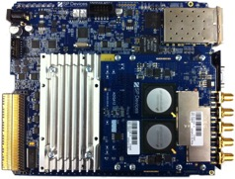
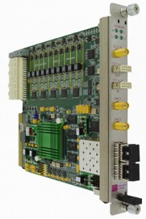

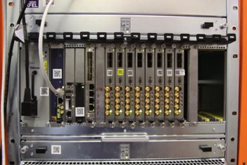
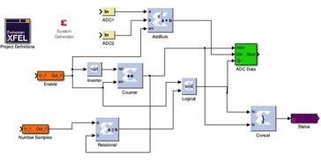


Digitizers, ADCs, Timing interfaces…
Digitizers (used in XGMs, PESs)
Fast ADCs (analog to digital converters)
Timing interfaces (in progress)
Simulink/Matlab based FPGA programming framework with Karabo integration
ADQ 412 (SP-Devices)
SIS8300 – ADC AMC
(Struck Innovative Systems)
MicroTCA crate
XML FILE
  User Registers and Memories Description
Software
(Karabo)
Source Files
  with script
Final Design
  Bus protocol logic generated automatically
Courtesy of P. Geßler
FPGA compiler/tool

Slide 6
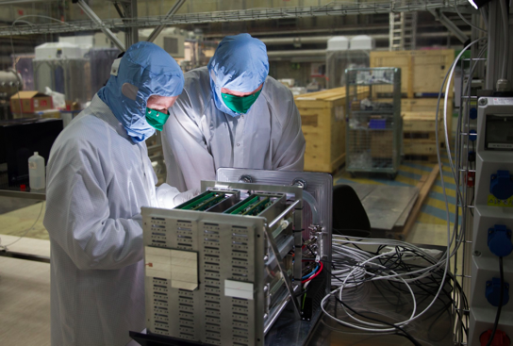
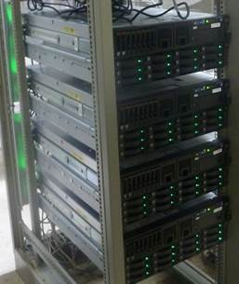
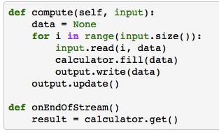

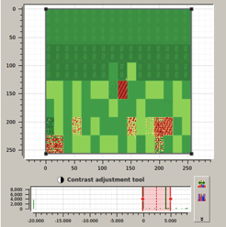


Detectors, control and read out…
Large Pixel Detector (LPD) prototype testing
  Detector control (Python based)
  Data acquisition and storage (HDF5) (C++)
  Online calibration processing, analysis and correction (Python and CUDA based)
  Interaction with calibration database (Oracle)
  Full integrated run control expected in summer
LPD quadrant prototype
Server setup necessary to harvest the data
Visualization of a LPD quadrant in Karabo
Courtesy of S. Hauf

Slide 7
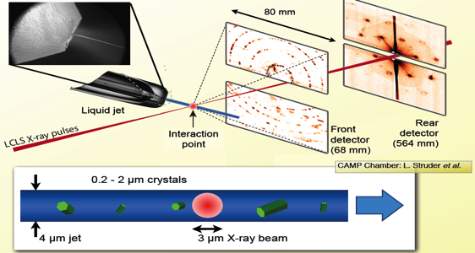
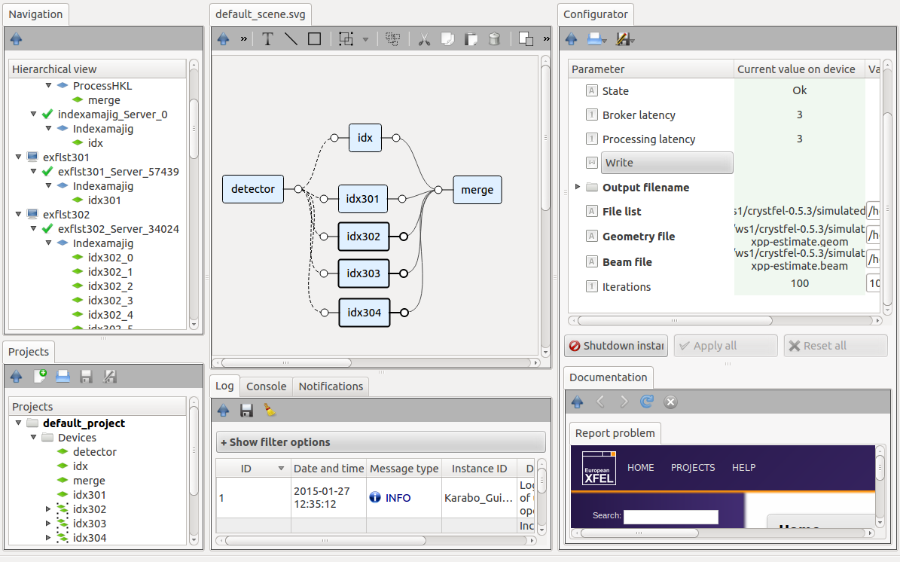
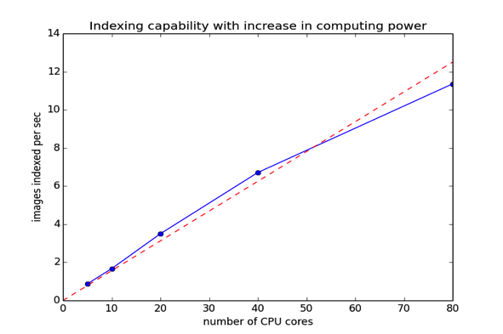
Online computing, data analysis…
Serial femtosecond crystallography
  Aim is to build an SFX data processing pipeline to match the high repetition rate offered at the European XFEL
  5000 images/sec
  @ 2.3 sec per image
  30% hit rate
  3500 cores needed
Linear speed up with number of cores!
Courtesy of C. Yoon

Slide 8
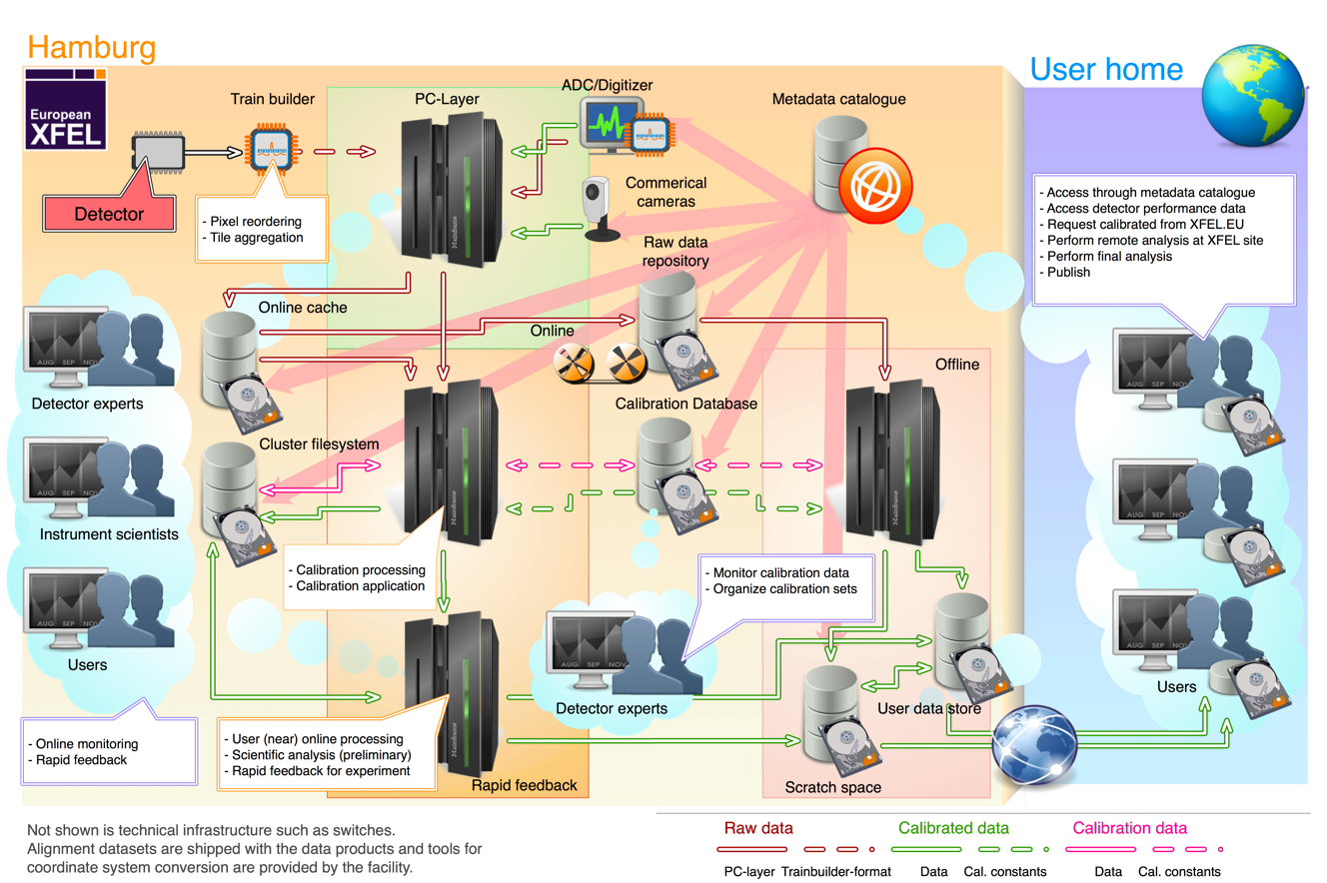
Logical (data) infrastructure
Courtesy of S. Hauf

Slide 9
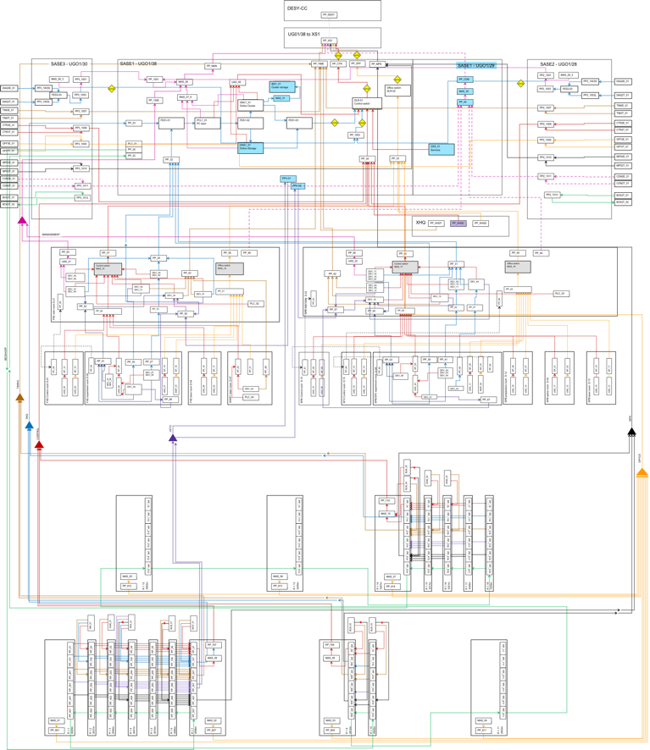
Physical (network) infrastructure (i.e. SASE1)
DESY Computer Center / XS1
Balcony Rooms
Rack Rooms
Experiment/Control/Laser Hutches
Tunnels
Courtesy of C. Youngman

Slide 10
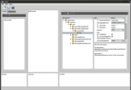



Technical realization (Karabo)
DAQ
Equipment
Equipment
Control
DAQ
Equipment
User interface(s)
Service
Device
e.g. 2D-detectors (AGIPD, LPD, DSSC)
e.g. motor, pump, valve, sensor
DAQ
Control
e.g. commercial camera
e.g. calibrationManager, configurationManager
Data Storage
Node
DM
DA
Message Broker
Composite
Device
Analysis
Node
e.g. storage of data from runs
e.g. calibrationManager, projectManager, GUI server
e.g. complex detector motion control

Slide 11
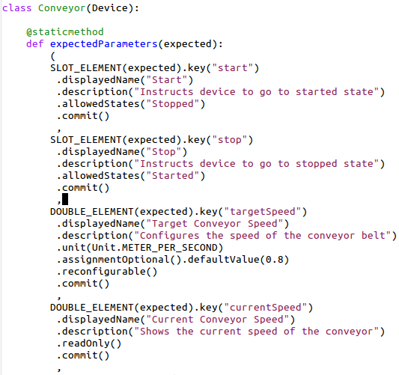
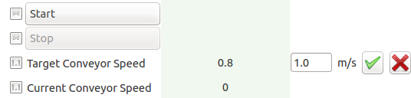
Device – As controllable object
  Device classes can be loaded at runtime (plugin technology)
  Can be written in C++ or Python
  Devices completely describe themselves. Allows automatic GUI creation
  Runtime-extension of properties, commands and attributes is possible
  Hierarchical groupings of parameters are possible
  Any property setting or command execution can be restricted to a set of allowed states
  The GUI reflects state limitations by enabling/disabling buttons and properties dynamically
Command
Attribute
Property
auto generated

Slide 12
Device – As pipeline module
Devices can act as modules of a streaming data pipeline
  Configurable generic input/output channels on devices
  Developers just need to code the onData and (optionally) the onEndOfStream method
  IO system is decoupled from processing system (process whilst transferring data)
  Input channels configure whether they share the sent data amongst all input channels or whether they receive a copy of each data token
  Broker-based communication transparently establishes a point-to-point connection
  Any pipeline device has full access to the live control-system (feedbacks easily possible)
Memory
Multi-threaded processing
TCP
Distributed processing

Slide 13
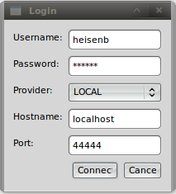
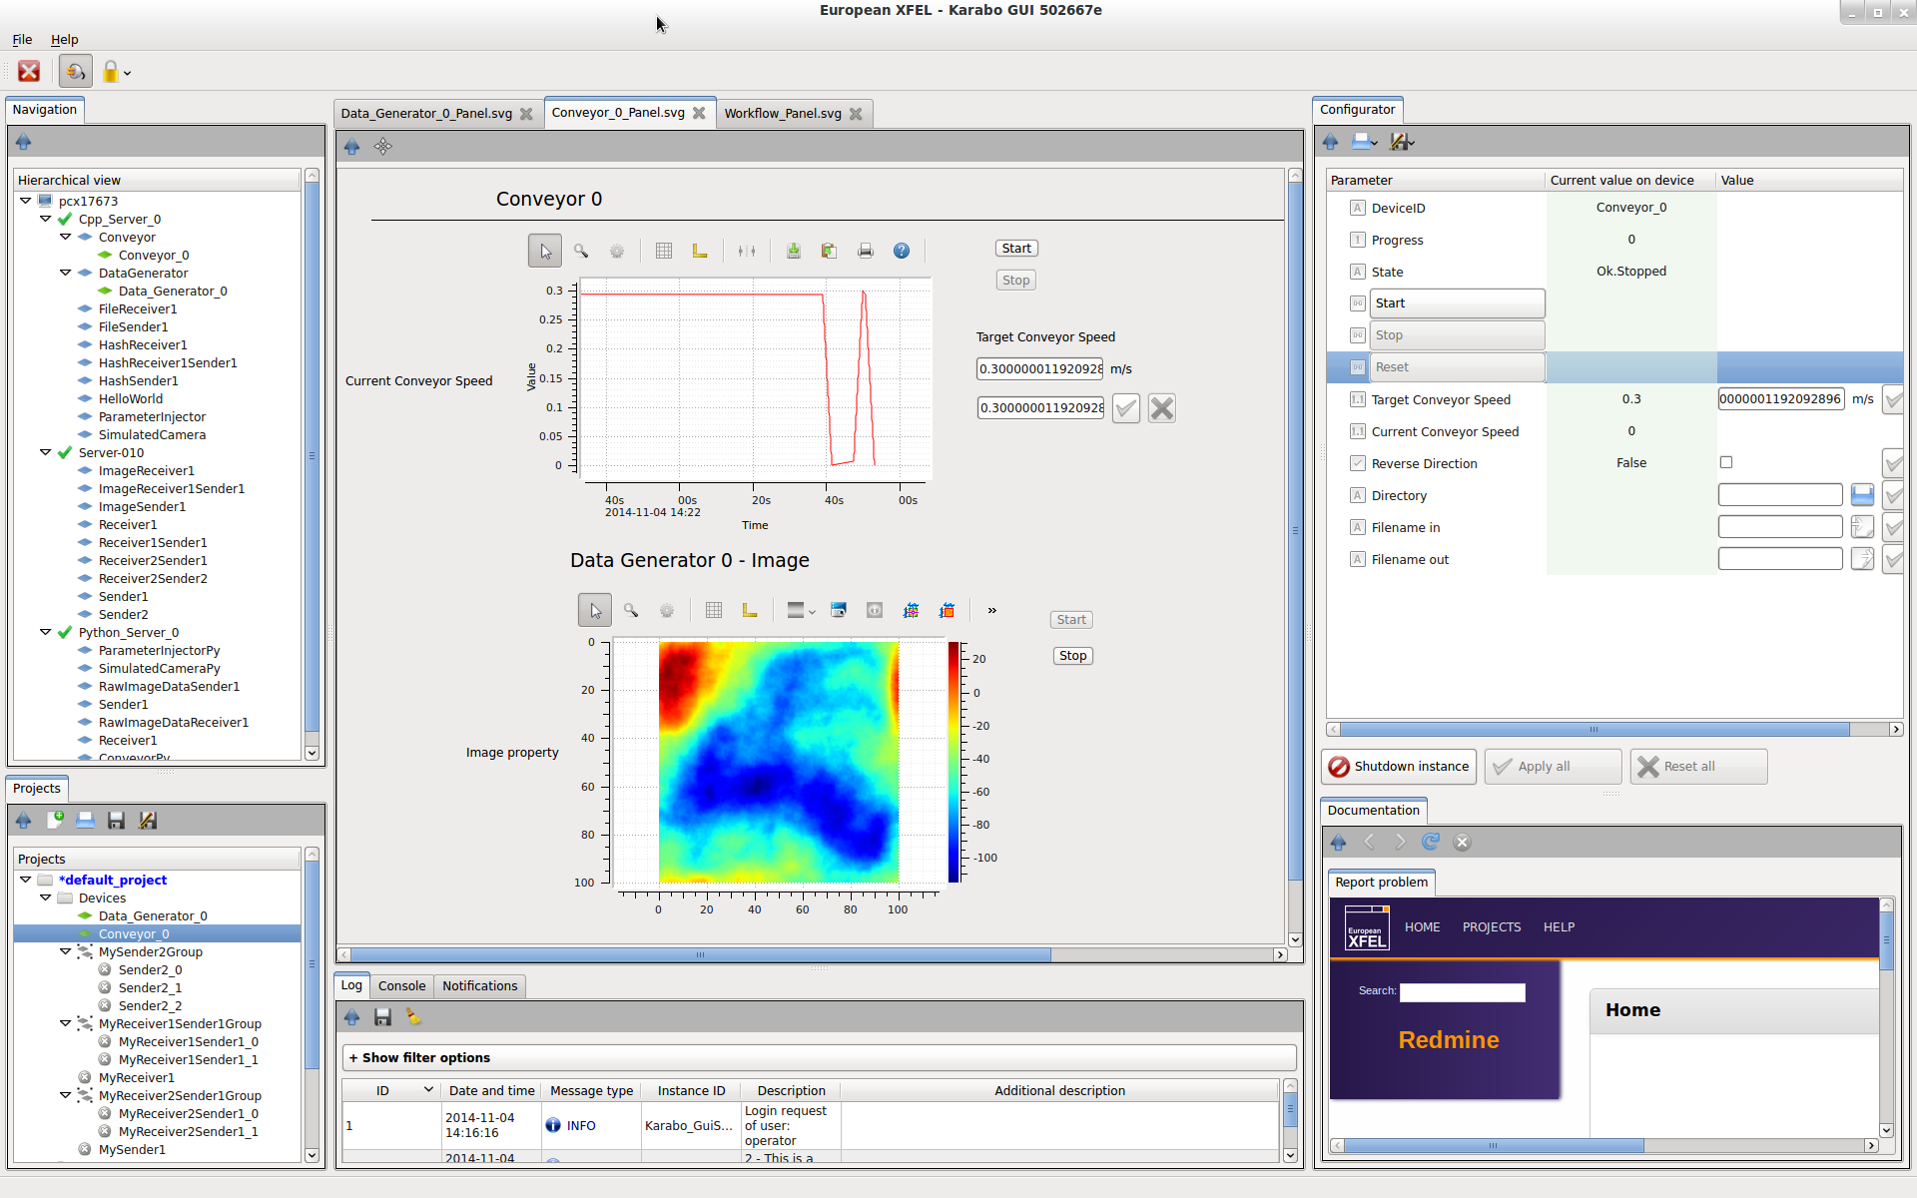
Graphical interface - Overview
Live Navigation
drag & drop
Configuration
Custom Scene
User centric and access-controlled setup (login at startup)
Dock-able and resizable multi-panel, all-in-one user interface
Live navigation showing all device-servers, plugins, and device instances
Automatically generated configuration panel, allowing to read/write/execute
PowerPoint like, drag & droppable, tabbed custom scene
Project panel for persisting configurations, macros, scenes, resources, etc.
Centralized logging information, notification handling, documentation, etc.
Log Messages
Interactive Command Line
Documentation
Bug Reporting
Project

Slide 14
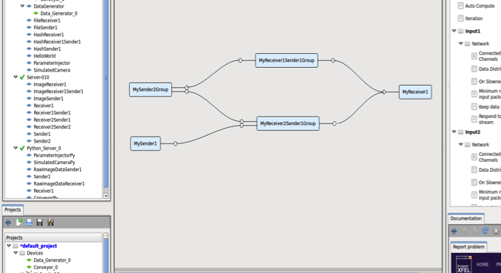
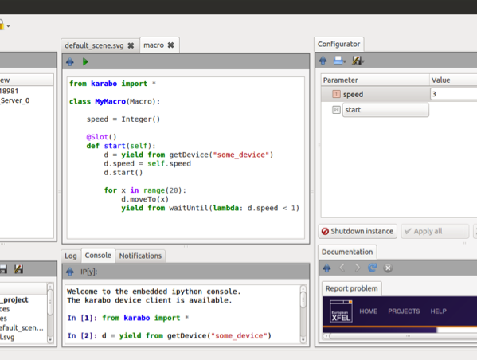
Graphical interface – Pipelines and Macros
Pipeline configuration
  Whole devices can be dragged (from left side) as pipeline nodes
  Dragging individual parameters from right is still possible (e.g. control parameters)
  Devices can be grouped and edited as group (connections and configurations)
Macro editing
  Editing and execution from within GUI or using regular terminal
  Macro parameters and functions integrate automatically into configuration panel
  Macro API can be interactively executed in embedded IPython interpreter
  Macro writing is something we hope our users can easily do themselves
drag & drop
Courtesy of K. Weger
Courtesy of M. Teichmann

Slide 15
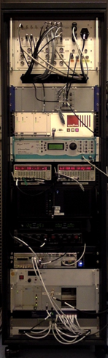
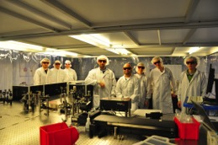
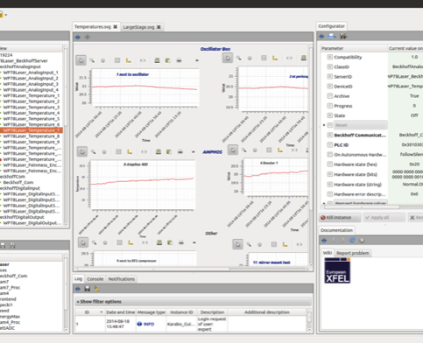
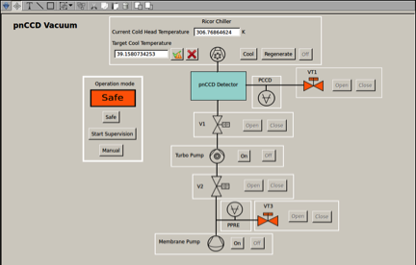
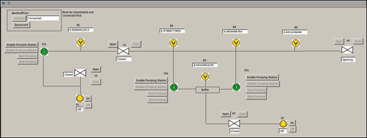
Karabo in use – Control systems
Pump probe laser setup (laser group)
  Runs burst mode according to XFEL (4.5 MHz intra burst)
  Control of motors, cameras, MicroTCA based ADCs, image processing devices
  Controls pulse arrival time in a closed loop (motor position correction depending on ADC signal)
Vacuum setups
  Control of e.g. differential pumping sections
  Typically includes several valves, pumps, and PLC-interlocks for safety
  Pressure monitoring and history trend line plotting
Courtesy of L. Wissmann

Slide 16
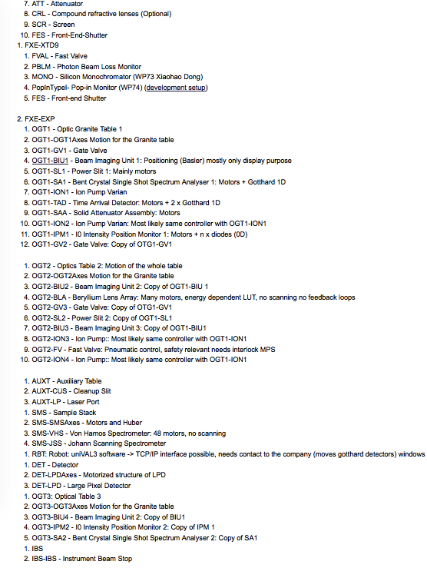
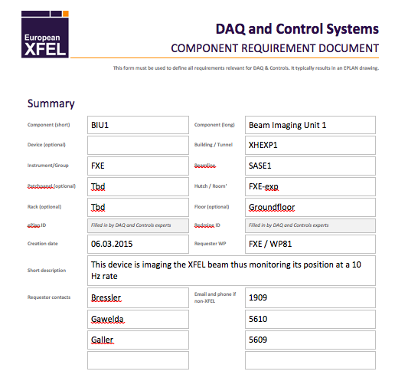
Project Management
Centralized DAQ & Control Alfresco page
  Names and conventions (95%)
  Overview about all components (80%)
  Collection of exact requirements (10%)
  DAQ & Control tasks are integrated into PSPO plans
  Execution is component wise, we start now

Slide 17
Conclusions
Software layer (Karabo) will be ready and usable for control during installation and commissioning
Beckhoff firmware is currently under extensive testing and stabilization and will be ready for installation and commissioning
Infrastructure is planned and fits the control and DAQ needs
Many Beckhoff crates need to be built, but can only after exact requirements are collected
Project management strategy is fixed and will now be executed

Slide 18

Thank you for your kind attention.
Contact details: burkhard.heisen@xfel.eu

