Slide 1
Status of injector vacuum components (WP19)
presented by S. Lederer
Notes:
How to edit the title slide
Upper area: Title of your talk, max. 2 rows of the defined size (55 pt)
Lower area (subtitle): Conference/meeting/workshop, location, date, your name and affiliation, max. 4 rows of the defined size (32 pt)
Change the partner logos or add others in the last row.

Slide 2
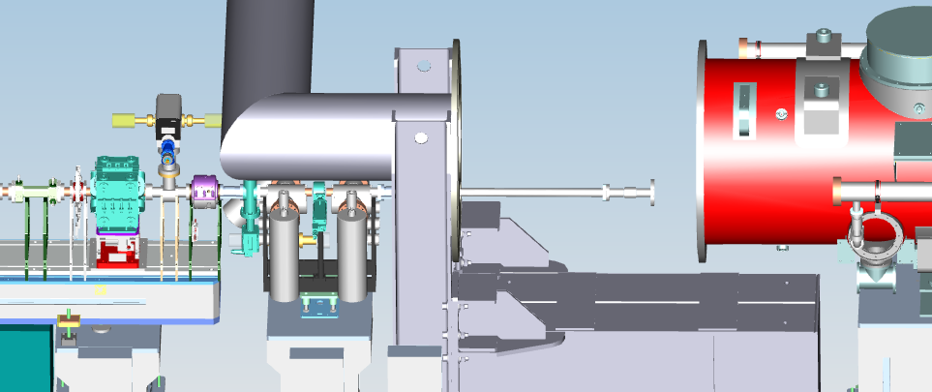
Vacuum works around modules
Installation of warm-cold transition at end-cap of 1.3 GHz module – parts RFI
Installation of warm-cold transition at feed-cap of 3.9 GHz module – parts RFI
Installation of pressure stage (high pumping speed in short length) in-between 3.9 GHz module and INJ-girder-#1 – parts RFI

Slide 3
Laser-heater vacuum

Slide 4
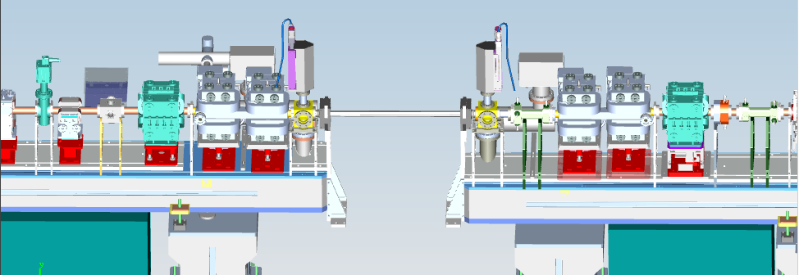
Laser-heater vacuum
Installation of laser-heater in- and out-coupling mirrors and view ports – all parts available
Installation of laser-heater vacuum chamber – chamber undergoes final preparation (oxide layer reduction and final leak check + RGA)
Girder #2
Girder #1

Slide 5
Vacuum work Girder #2-4

Slide 6
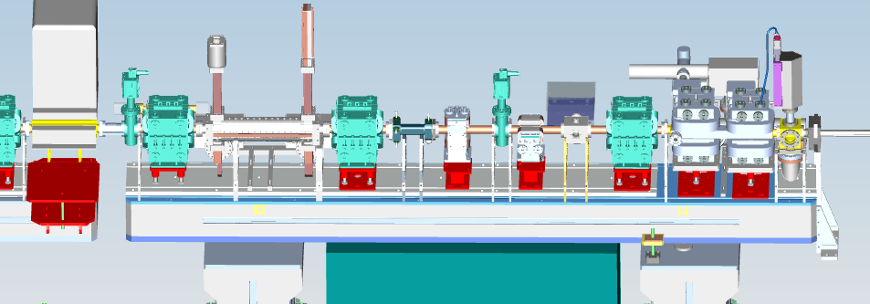
Vacuum work Girder #2-4
Installation of view ports on EOD – parts available
Installation auxiliary TDS UHV-parts – availability see talk from INR in this session
Girder #2
Girder #3

Slide 7
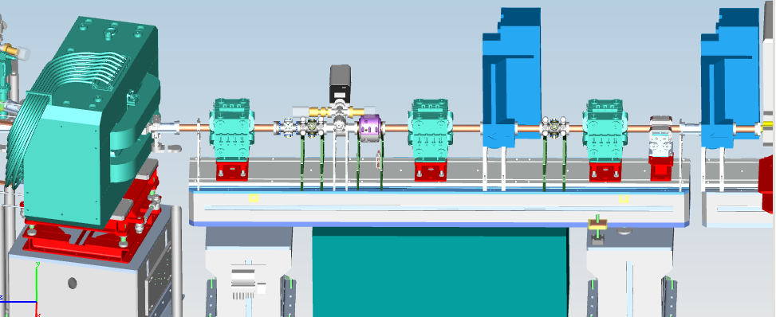
Vacuum work Girder #2-4
Connection of girder #3 and #4 – all parts available
Girder #4
Girder #3

Slide 8
Vacuum work down-stream Girder #4

Slide 9
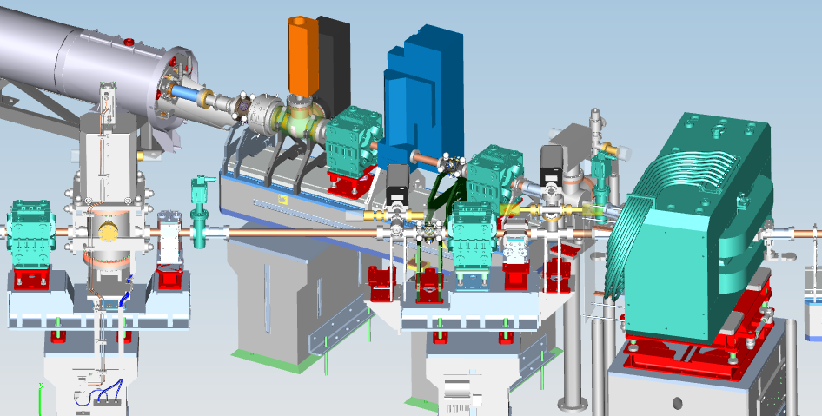
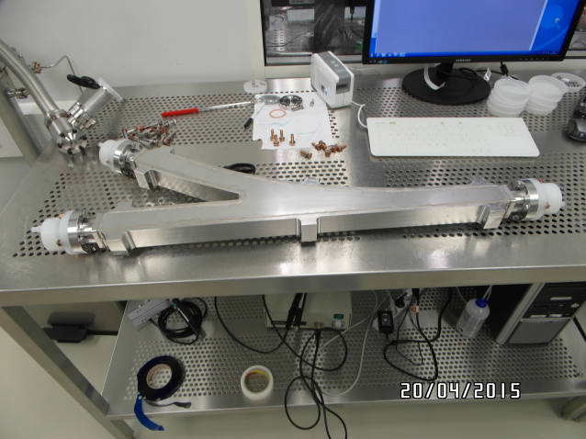
Vacuum work down-stream Girder #4
Installation of dipole chamber – undergoes final preparation (oxide layer reduction and final leak check + RGA)
Closure of INJ-dump-line – all parts available
Installation of beam-shutter (personal safety device) – RFI
Installation of parts between dipole and beam-shutter – all parts available

Slide 10
And…
Installation (cables) and commissioning of vacuum electronics
Installation of beam pipe to XSE
Leak check of TDS wage-guide distribution

