Slide 1


L1 tunnel installation: cryogenics
S. Barbanotti on behalf of K. Jensch
4th XFEL Collaboration Meeting
DESY – 24th April 2015
Notes:
How to edit the title slide
Upper area: Title of your talk, max. 2 rows of the defined size (55 pt)
Lower area (subtitle): Conference/meeting/workshop, location, date,
your name and affiliation, max. 4 rows of the defined size (32 pt)

Slide 2
Summary
Module connection: what does it mean?
Developments during L1 installation
Time schedule:
  what didn‘t last as expected?
  why do we expect to be faster in L3?

Slide 3
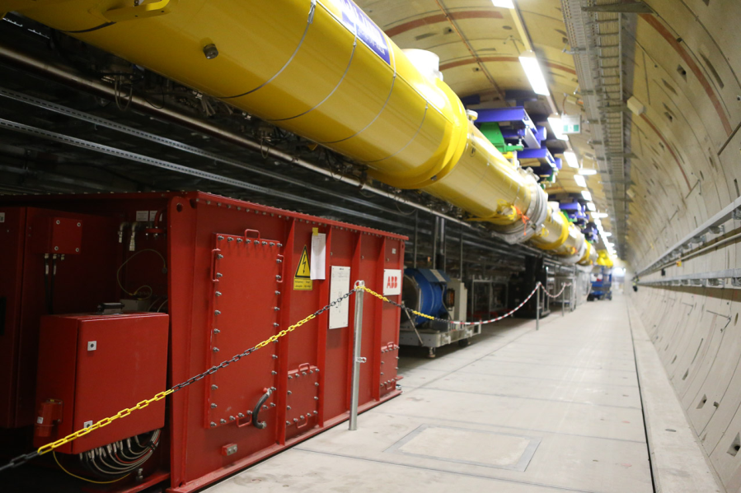
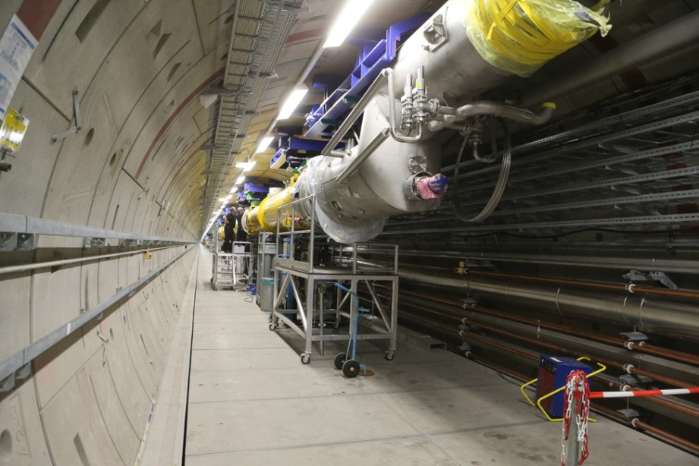
L1 string
4 cryomodules + 2 boxes -> 5 module connections

Slide 4
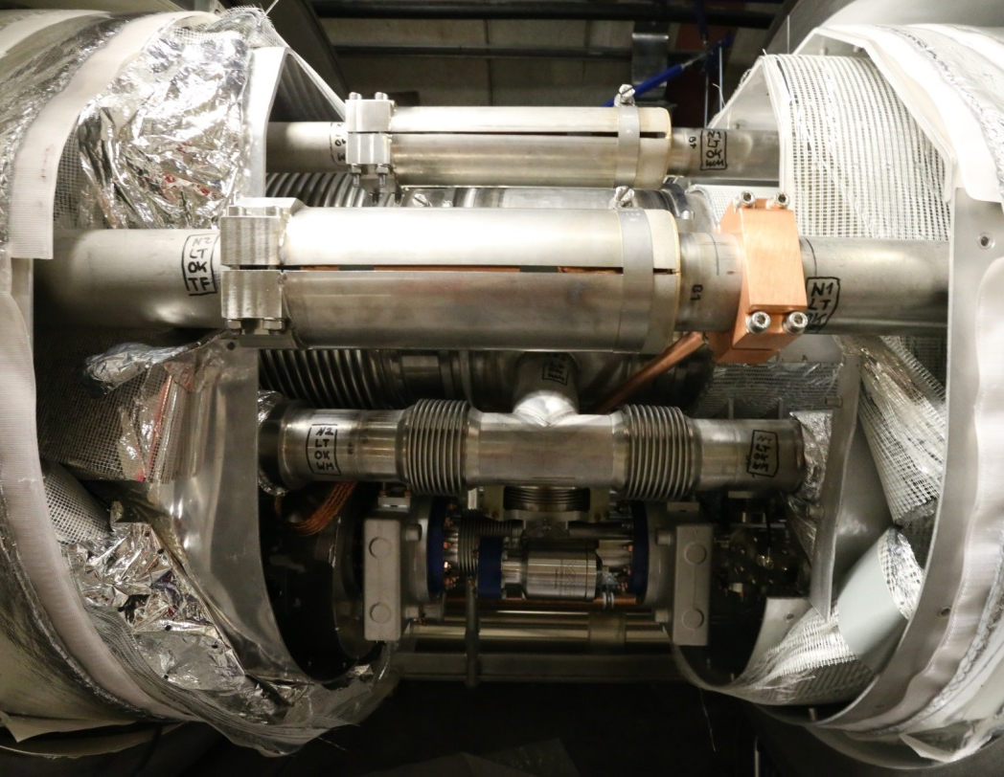
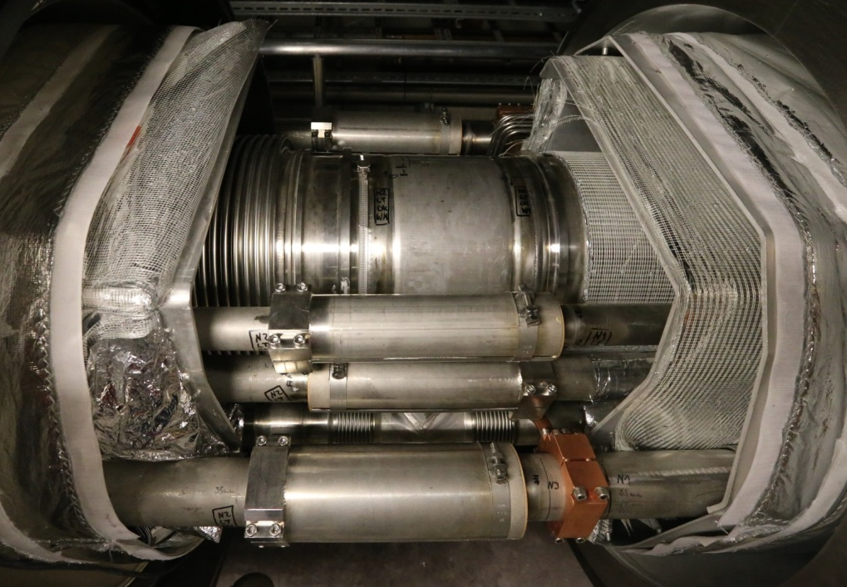
Module connections - cryo
One MC (Module/Module- or Module/Box-connection) consists of:
  8 cryo-pipe connections -> 17 welds
  2 thermal shield connection -> 10 layers MLI for 8K and 30 layer for 80K
  1 DN1100 sliding bellows

Slide 5
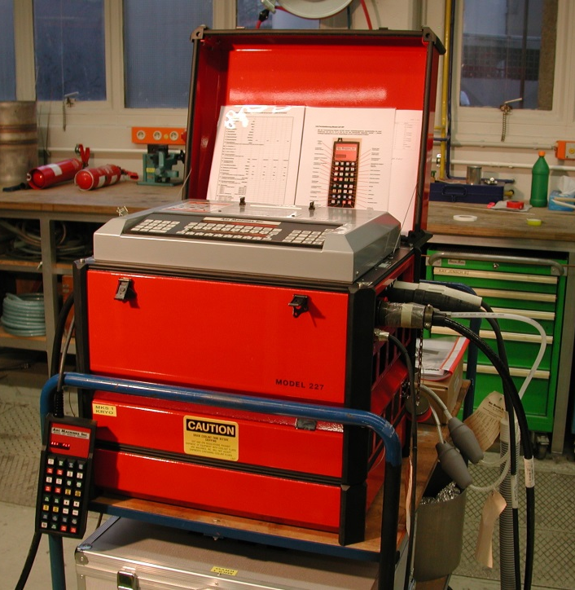
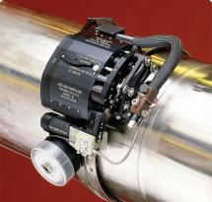
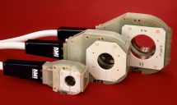
Welding technique
All welds are done semi automatically -> orbital welds
  GRP and 8K-return -> tractor welding head
    90% standard parts
    10% custom-made parts (in-house development)
    Welding with filler material (automatic welding filler supply)
  Other pipes -> closed welding head
    100% standard parts
    welding without filler material

Slide 6
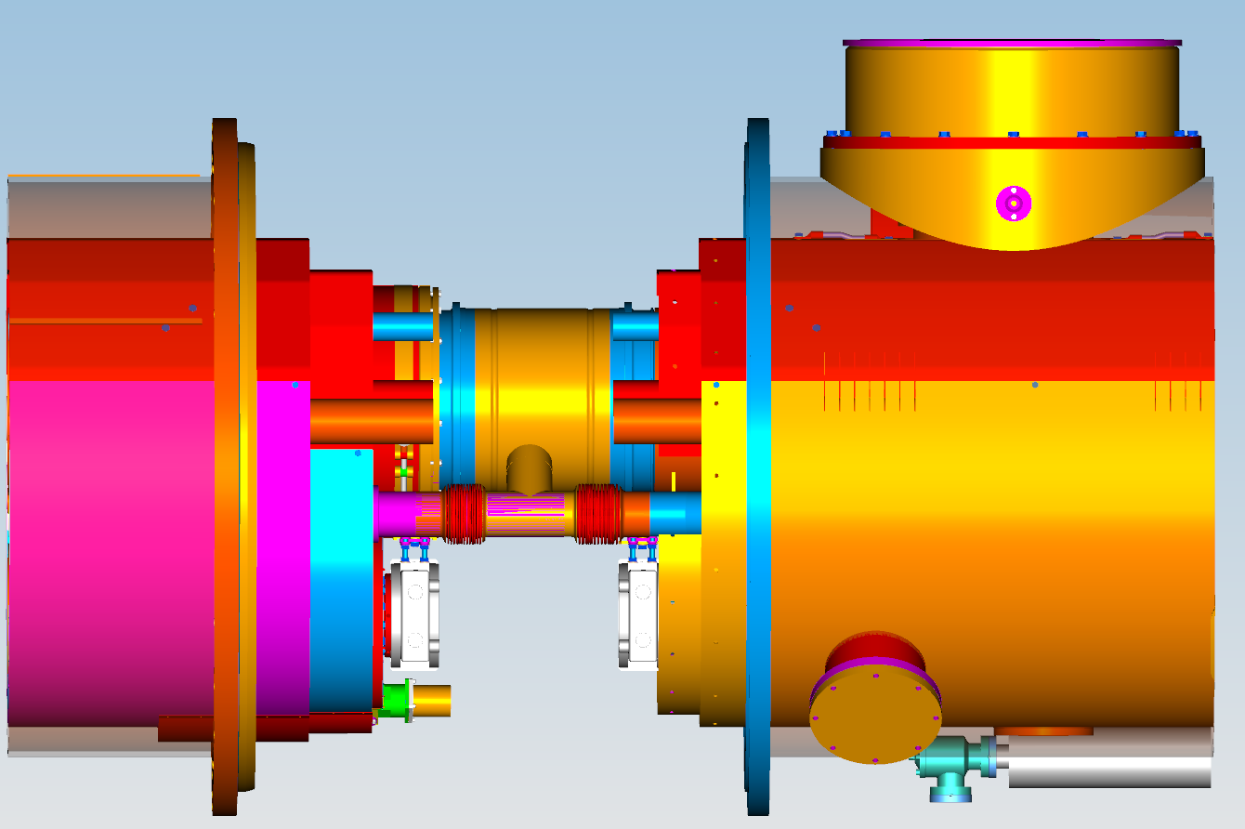
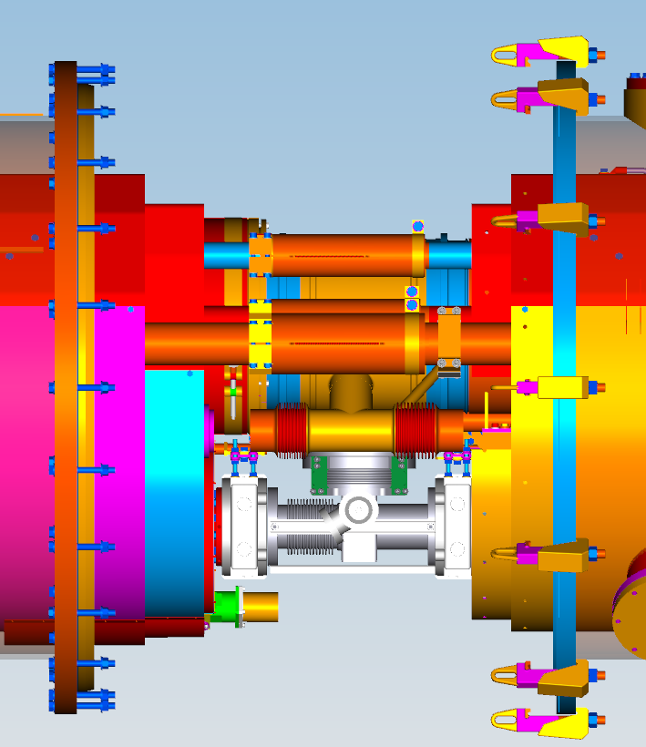
Welding sequence
Part 1: Welding of the GRP, 2 phase and the 8 K return pipe
Part 2: Welding of all other pipes
In-between: assembly of the Beam Line Absorber
Warm up / cool down
2.2 K forward
5 K forward
70 K forward
80 K return
GRP
2phase T-part
8K-return (back side)

Slide 7
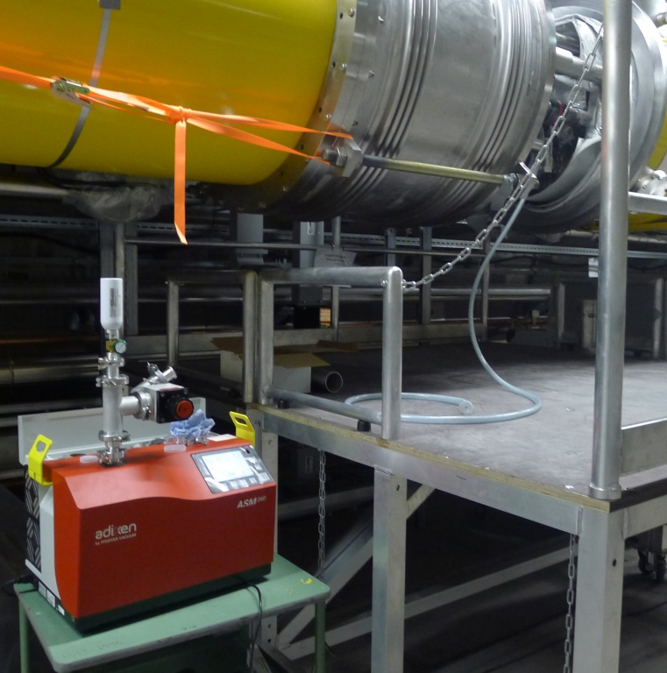
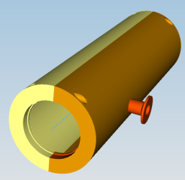
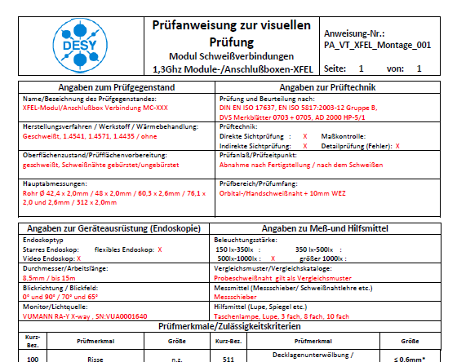
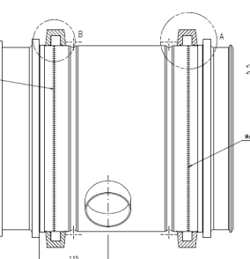
Non-destructive tests
In agreement with the notified body (TÜV Nord), the following NDTs
have to be performed on 100% of the welds:
  - visual test (VT)
  - radiographic test (RT)
  - leak test (LT)

Slide 8
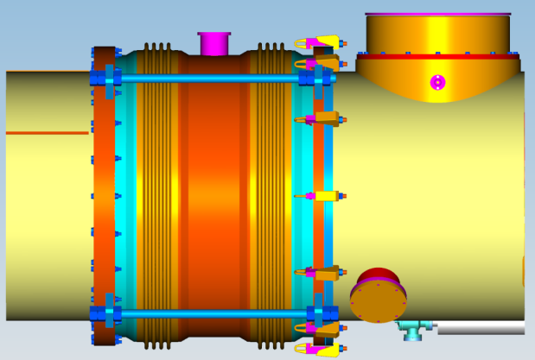
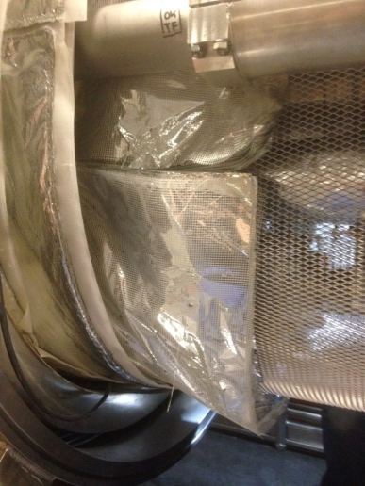
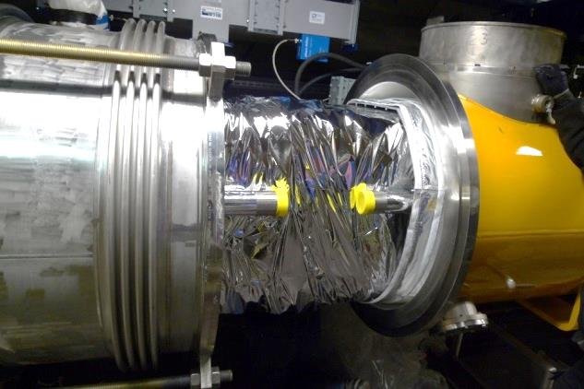
Final installation
Check list before closing the DN1100 bellows:
Connection Vacuum
Installation of BLA / vacuum bellows
Installation of BLA support
Final steps
Installation BLA thermische Anbindung
Bälge auf Beschädigungen kontrollieren
Balge mit Kupferfolie ummanteln, Balghülsen montieren
2 Ph-Leitung isolieren
Halterung HOM-Adsorber kontrollieren
Trockenbeutel und Feuchtigkeitssensoren entfernen
Schutzfolie MVS von den Strahlrohrkomponenten entfernen
Thermische Schilde installieren (Aufgebogene 4K-Schilder zurückbiegen)
MLI installieren
Beam vacuum valves öffnen
Staub entfernen , Schmutz entfernen , Welle des Tuningsystems prüfen
Schiebemüffe Schließen

Slide 9
Development work during L1 work
Welding
  Finalization of welding procedures (L1 first real string to be welded in final conditions), i.e. add a weld at 70 K pipe because of space problems
  Welders need to make practice on the real thing
Radiographic test
  Foreseen with X-ray (due to pipe thickness)
  After first essays with BIS → not enough space for the X-ray tube
    Change to gamma-ray source (Selenium)
    New test procedure and tooling developed
    Special agreement between BIS - TÜV – DESY needed
Assembly of thermal shields
  First time with final configuration → many adjustments needed
Interaction with other teams
  For installation of BLA
  For transport in the tunnel

Slide 10
What didn‘t last as expected?
Feed and end boxes were not installed on time
    work flow interrupted and not optimal
Welding sequence not consequently followed (jumping between MC)
    Lot of unnecessary moving of tools and equipment
    Sub-optimal gas distribution
First real exercise
    ~10-11 repair welds needed → time consuming
    not all work steps 100% defined
Coordination of work in the tunnel not yet well organised
    Lot of interruptions for transport or other works in the tunnel

Slide 11
  Why do we expect to be faster in L3?
Module and boxes are installed on time
    MC can be welded and ND tested following the optimal sequence
No more mayor developments needed
    minor optimization still ongoing
Further optimization of the connection sequence under investigation
    start BLA installation after finishing all welding operations
Welder and NDT teams already trained
    Total number of repairs already decreased
Tunnel coordination in development
    Welding gas bottles already in place
    Transports on fixed date, less interruptions

Slide 12
Thank you for your attention!
And thanks to all the colleagues who actually did the job:
T. Feldmann H. Hintz
C. Langner W. Maschmann
O. Paschold T. Toedten
J. Wanders
and to the colleagues who provided material for this talk.

