Slide 1
Sample Environment Integration
Joachim Schulz
WP-79
Notes:
How to edit the title slide
Upper area: Title of your talk, max. 2 rows of the defined size (55 pt)
Lower area (subtitle): Conference/meeting/workshop, location, date, your name and affiliation, max. 4 rows of the defined size (32 pt)

Slide 2
WP-79 Sample Environment for Six Instruments
Biology
Biology labs with XBI UC
Liquids & Gases
Fixed Targets
Fast sample scanner
Magnets & Cryogenics
Compact pulsed magnet
Liquid jets
COMO UC
HIBEF UC
Cryogenics
Temperature control
Load-lock sample exchange
Aerodynamic lens in-kind contribution
Biological sample preparation
Mass spectrometry

Slide 3
WP-79 mission
Provide state of the art sample environment
Biological samples for SPB/SFX and others
Fast sample scanner for SCS, MID, SPB, HED
Aerosol injector (via in-kind contribution)
Compact pulsed magnets for MID, SCS, HED
Assist users bringing samples into the instruments
Provide user laboratories
Integrate sample environments into the instruments
Special user equipment
Pool of equipment in Sample Environment Group

Slide 4
Plans for day-one sample delivery
Prototypes will be designed in close collaboration with instruments
SCS: Fast sample scanner
SCS: Constant field magnet
MID and SCS: Compact pulsed magnets
SPB/SFX: Biological sample preparation and delivery
Participation in safety concepts for
Magnets (together with HIBEF UC)
Biological samples (XBI UC)

Slide 5
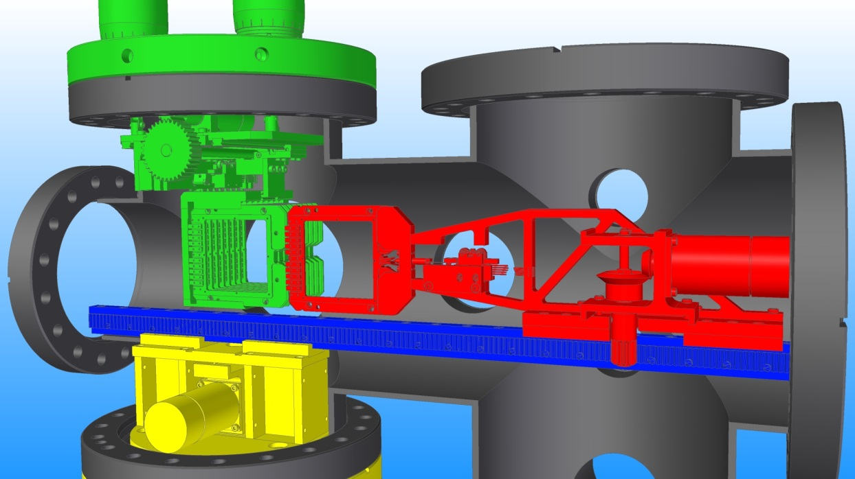
Fixed targets: Fast sample scanner
Design in close cooperation with the SCS team
Electronics
Uses Beckhoff PLCs wherever possible
Coordinated with WPs 90 and 91
Setup and testing in Sample Environment laboratory
Contact points with instrument and machine:
Vacuum interlock with sample chamber
Synchronization with X-rays

Slide 6
Fast sample scanner: Proceeding from prototype
Prototype for SCS will be day-one instrumentation
Target area 50x50mm², µm precision, 10⁻⁹ mbar
Available: 1Q 2017
Modifications for MID and SPB/SFX
Larger area 100x100mm², reduced vacuum demands
Available: 3Q 2017
Additional requirements for HED
Electromagnetic pulse protection
Debris shielding
Coordination with HIBEF user consortium

Slide 7
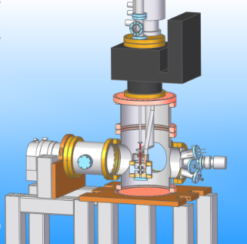
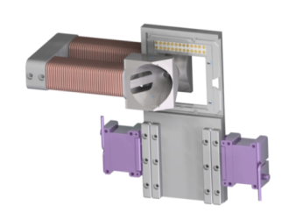
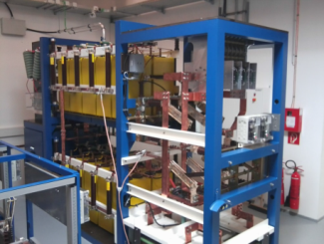
Deliverables – magnetic environments
Miniature pulsed coil
3Q 2017 instrument for SCS and MID
1Q 2016 – 1st prototype built
From 1Q 2016 – DAQ & Control needed (Draft definition 10.2014)
DC electromagnet
Day-1 instrument for SCS and MID
4Q 2015 – prototype built and tested
HIBEF 60T pulsed coil
HIBEF contribution for HED – lead time 18 months
WP79 responsible for XFEL integration – ongoing 2015-17

Slide 8
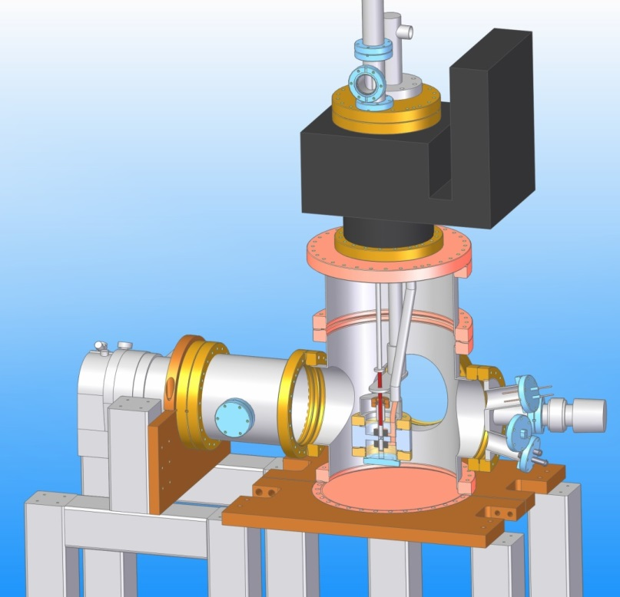
Magnetism: miniature coils for pulsed fields
Agreed concept and specifications with MID and SCS
Design support by ESRF
2015 – prototype being built at Hera-Süd:
Inserts on chamber top-flange, 15-20T split-pair coil, L-He cryostat,
Will be tested for beamline conditions
DAQ & Control
Testing in LabVIEW by WP79
Later in Beckhoff/Karabo by DAQ&Control
Aim for one instrument that can be adapted to fit SCS or MID chambers

Slide 9
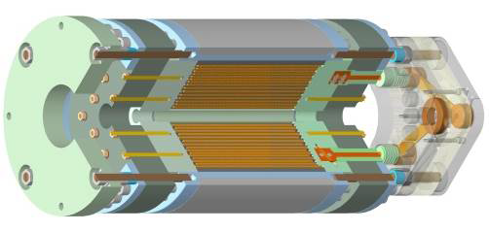
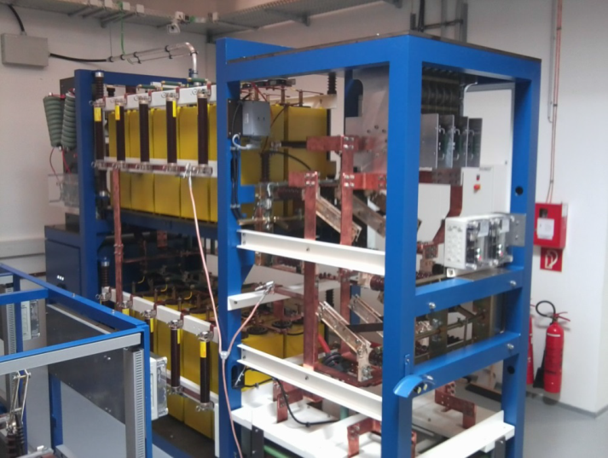
Magnetism: HIBEF 60 T pulsed coil for HED
HIBEF program (High Intensity Beamline for Extreme Fields)
HLD (HZDR) will deliver 1MJ pulser and 60T coil to the HED instrument
WP79 role: Interface for pulse magnet issues and integration
Workflow items together with HLD:
Safety assessment for pulser/coil needed for HED hutch planning
Technical infrastructure – cable routing

Slide 10
Bringing biology into X-rays
Instruments
SPB/SFX is specialized for this research
MID/FXE for imaging
SCS for soft X-rays
Biology users
Need preparation laboratories
Sample delivery
Data analysis
Typical samples
Micro to nano sized protein crystals
Single living cells, viruses, organelles
Proteins and complexes
Safety aspects
Genetically modified organisms
Contamination protection
Samples
Outside world
Methods
Liquid jets
Aerosols of neutral and charged particles
Fixed targets (solid sample scanner)

Slide 11
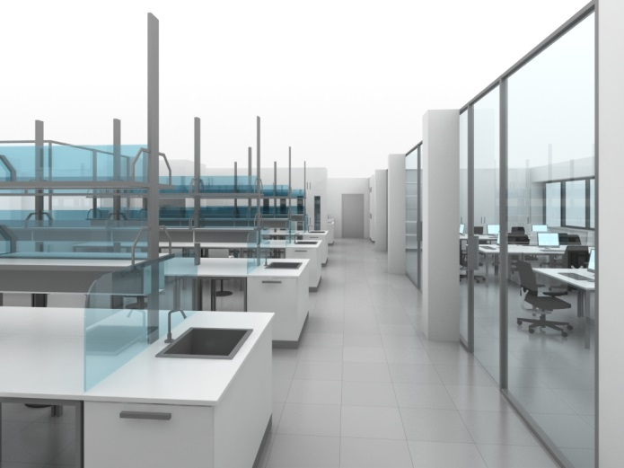
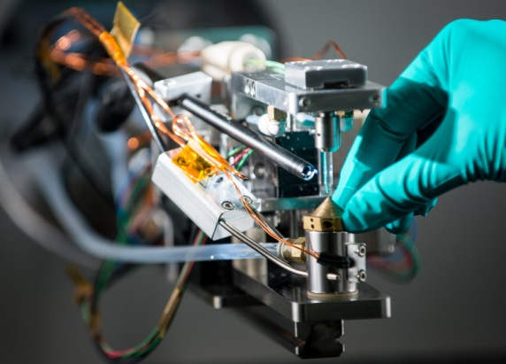
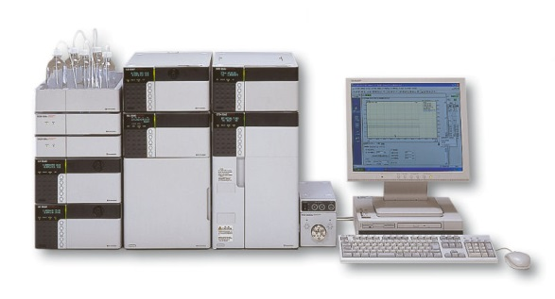
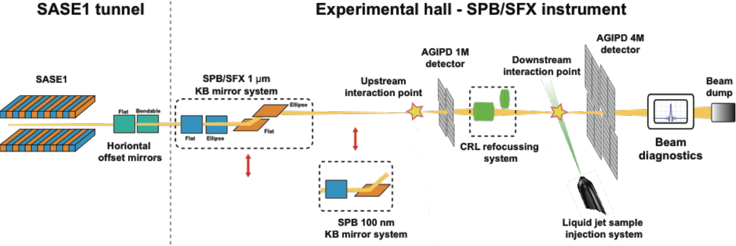
Integrated sample delivery scheme
Laboratories
Sample injection
Liquid Jet
Delivery system
HPLC pumps

Slide 12
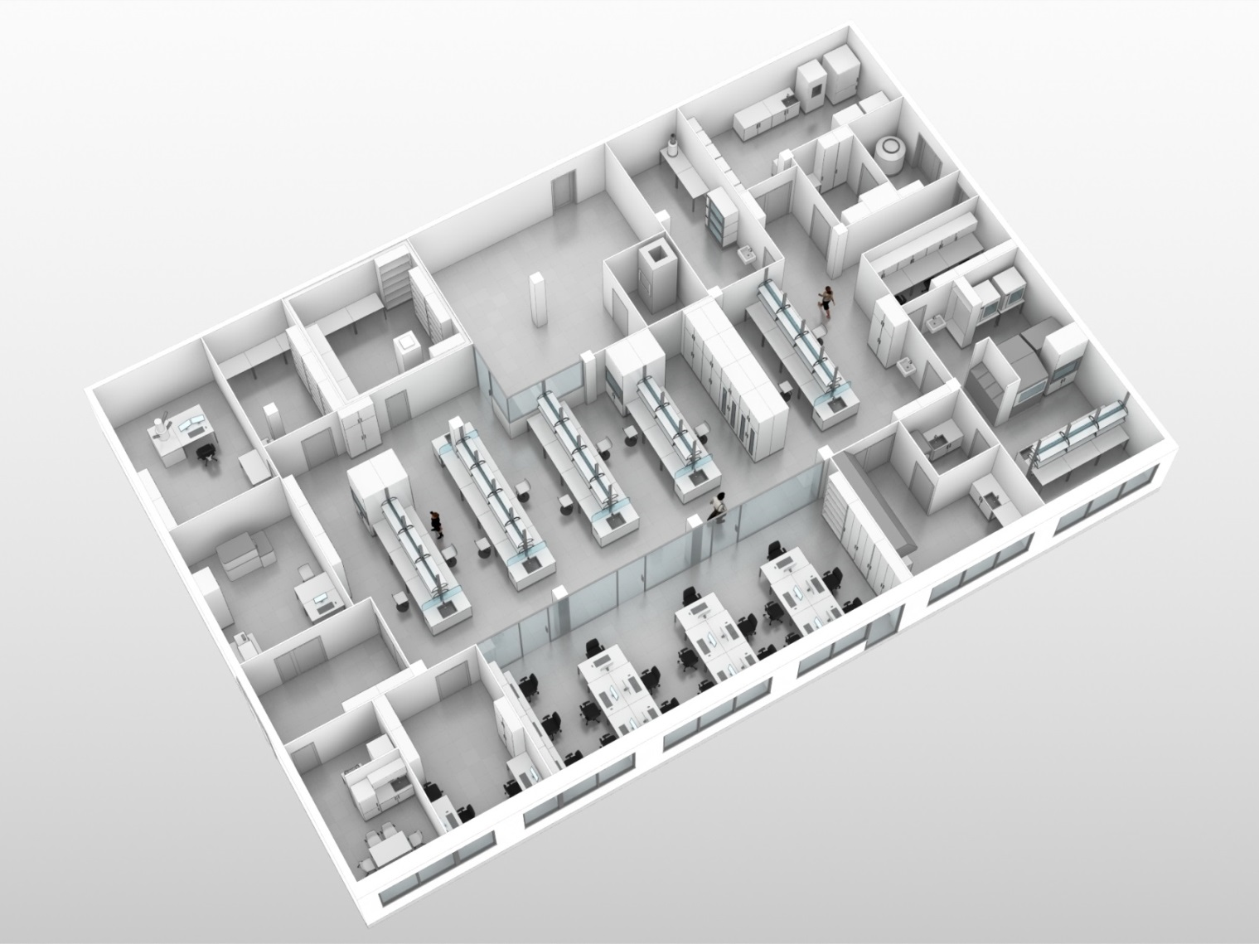
XBI and SPB biology laboratories
SPB/SFX
Preparation room
Sample lift
Preparation hutch
XBI user consortium
Laboratory
User support
Computation
Equipped for
Cell expression
Crystallization
Sample preparation
Quality control
WP-79
Operates laboratories for SPB/SFX
Coordinates XBI UC
Takes responsibility in
Laboratory safety
User support

Slide 13
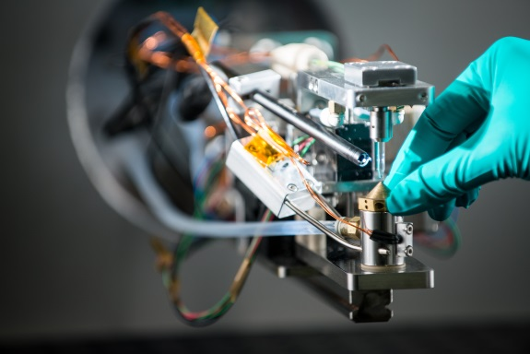
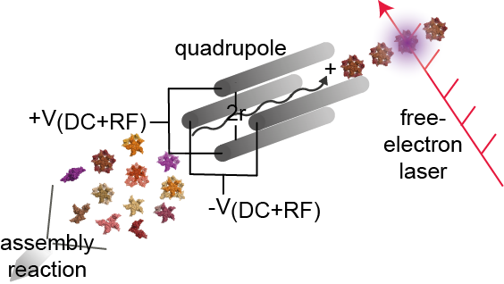
Delivery of biological samples
Integration
With Karabo for
Control
Safety
Aerosol injector
Sample
Delivery system
HPLC pumps
Liquid jets
Standardizes tubing to sample systems
Electrospray ionization

Slide 14
SPB/SFX sample environment integration
Upstream focus
Versatile setup for single particle imaging and crystallography
WP-79
Coordinates both sample environments
Interfaces between SPB/SFX and XBI
Gives user support
Downstream focus
Reuses the beam for high throughput serial femtosecond crystallography (SFX)

Slide 15
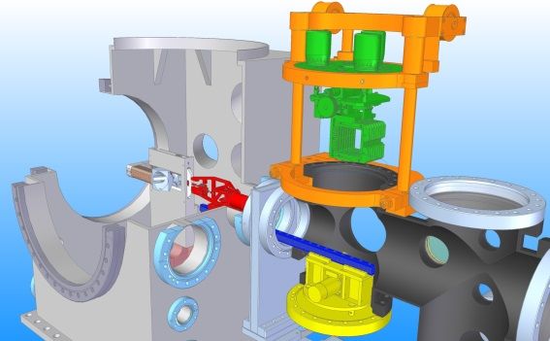
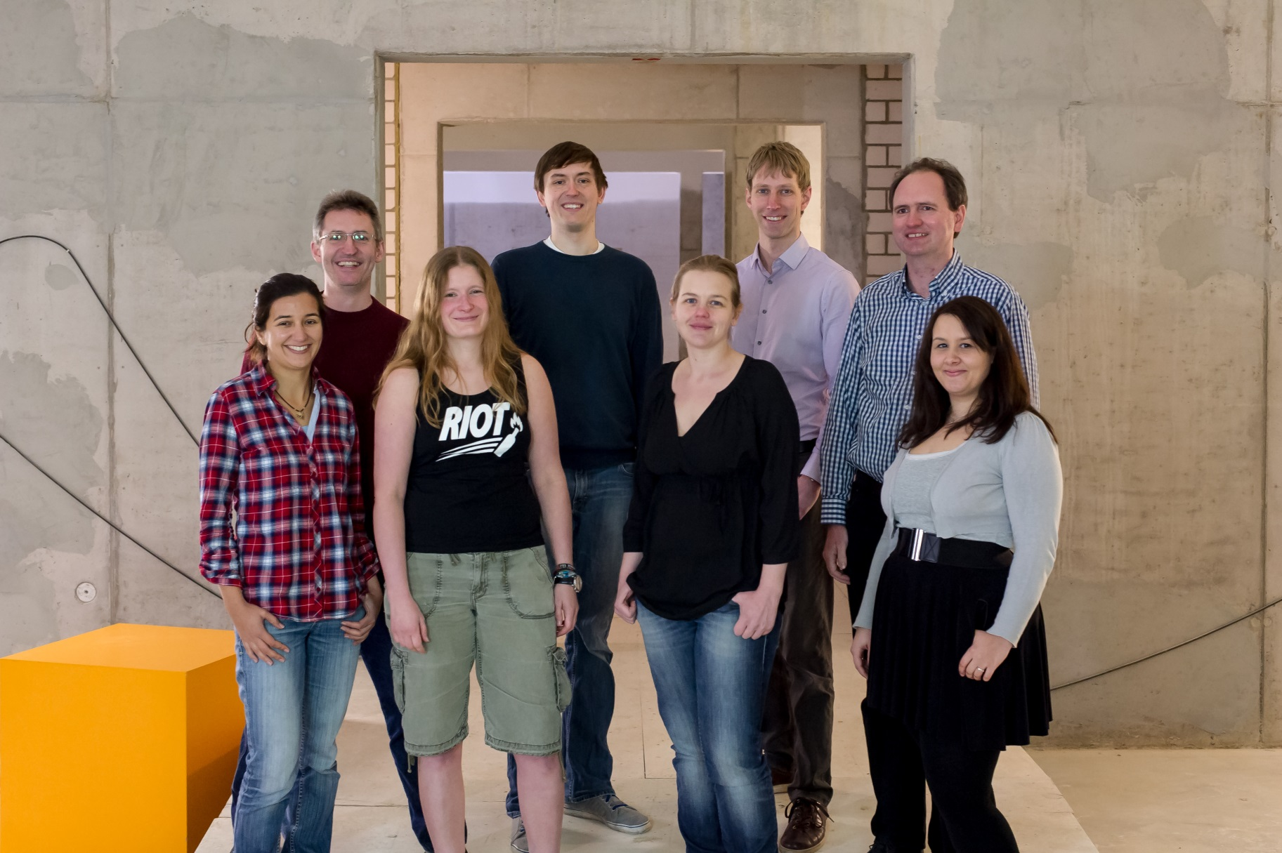
WP-79: Sample Environment Group

