Slide 1
Installation Status
Markus Hüning
Notes:
How to edit the title slide
Upper area: Title of your talk, max. 2 rows of the defined size (55 pt)
Lower area (subtitle): Conference/meeting/workshop, location, date, your name and affiliation, max. 4 rows of the defined size (32 pt)
Change the partner logos or add others in the last row.

Slide 2
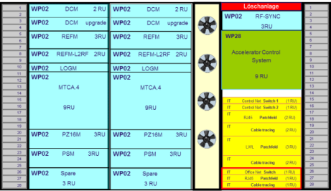
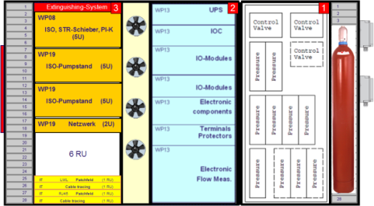
Linac Section Installation
XFEL ACB – April 22, 2015
Hans Weise, DESY

Slide 3
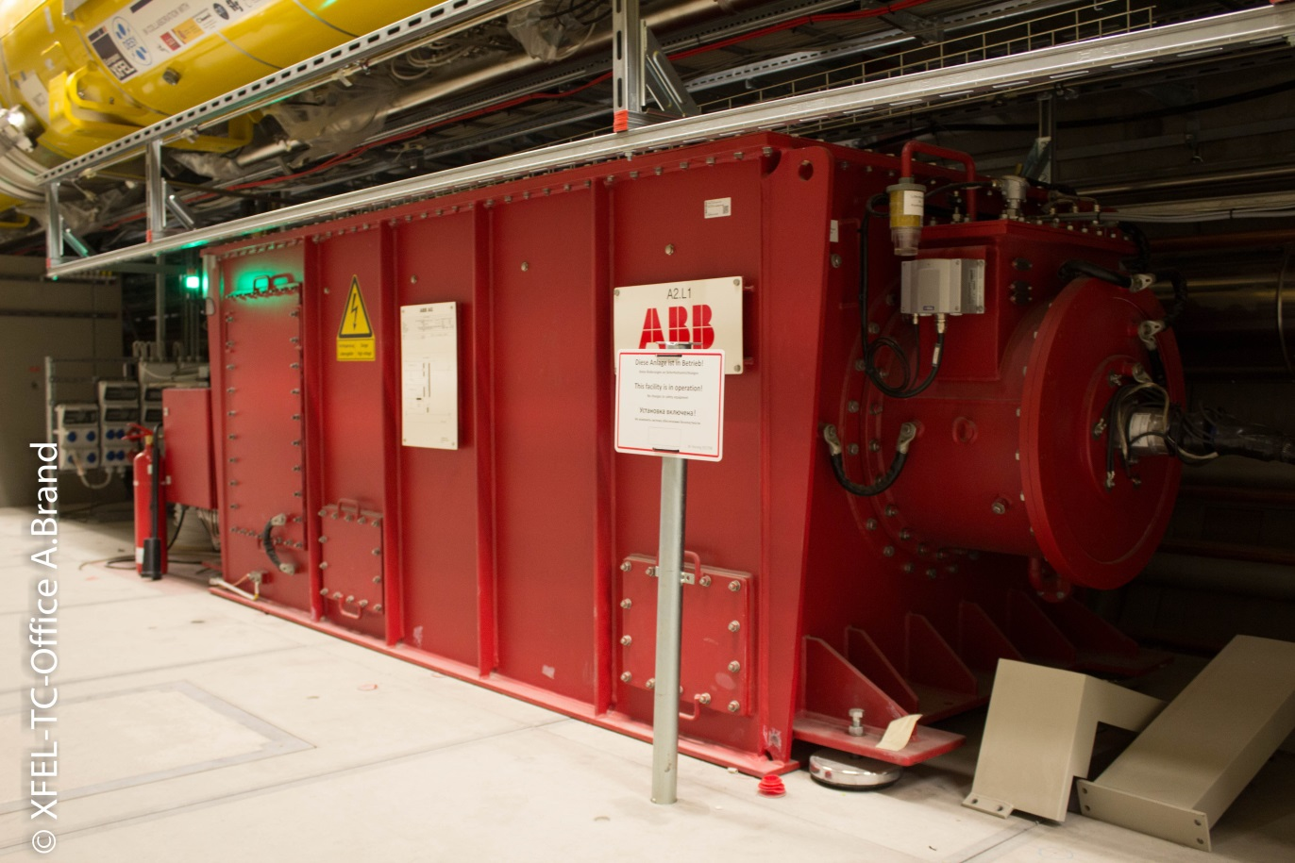
L1 in Operation

Slide 4
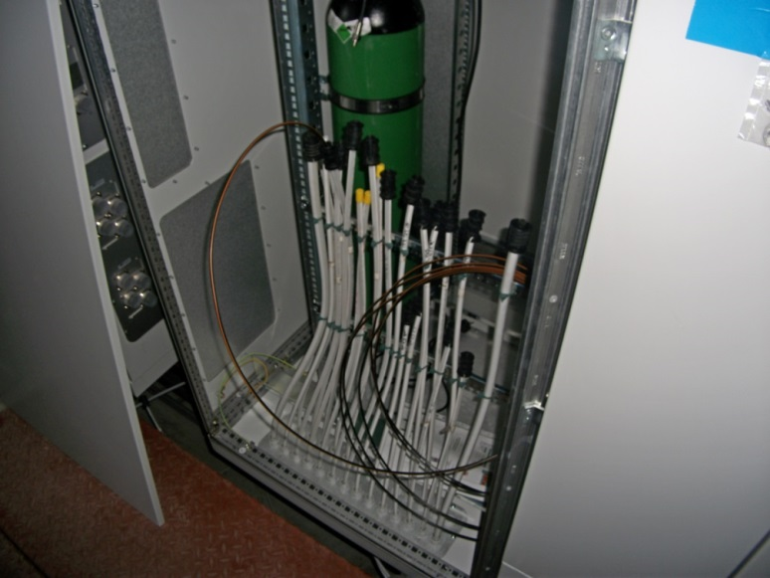
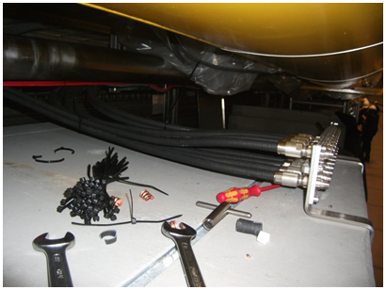
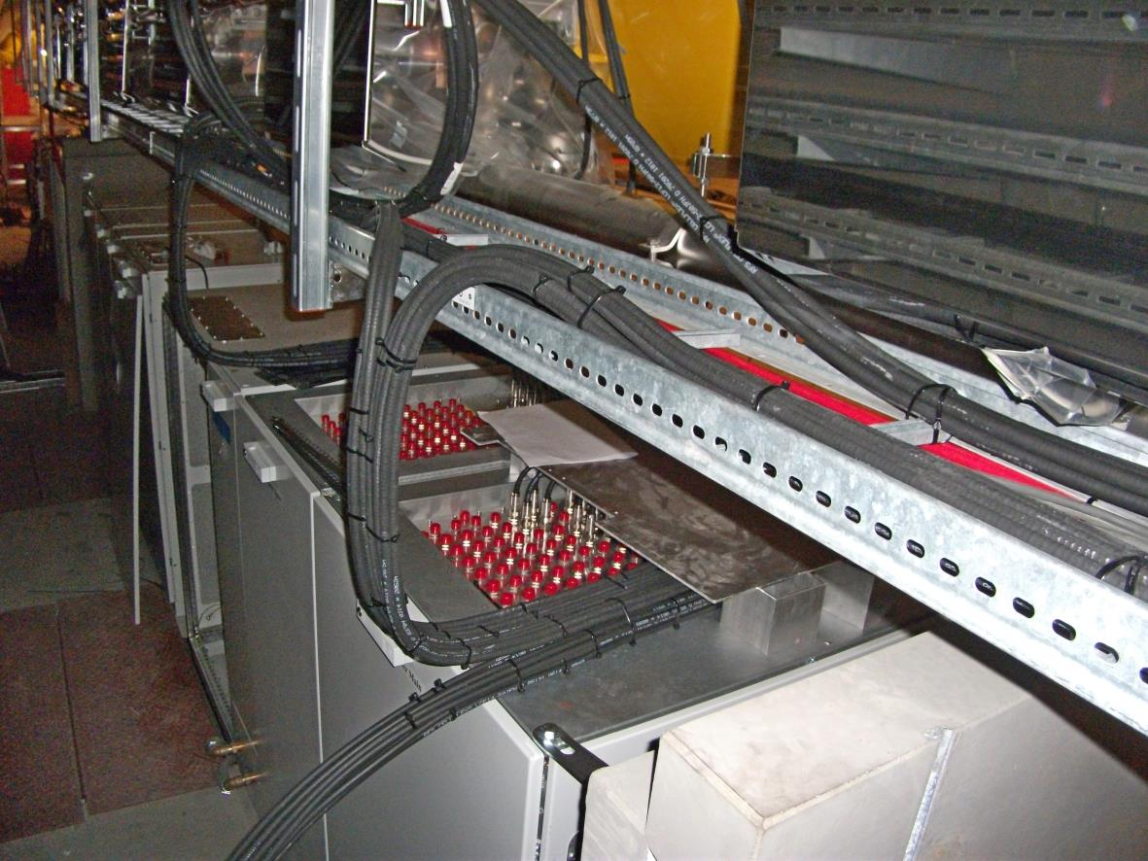
Cabling of the L1 Linac Section

Slide 5
L1 in Operation
Since Monday, April 20th L1 can officially be operated
New access rules had to be implemented (XTL is now accelerator)
Finalize installation of electronis
Need to share time between installation and commissioning
This week: cabling; next week: RF operation

Slide 6
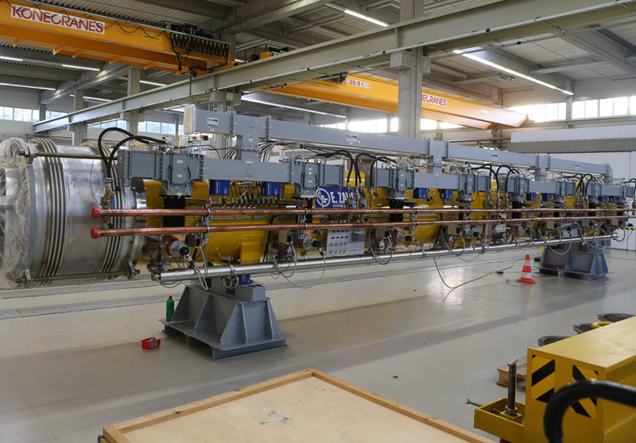
Schritt 5: Betrieb der Module

Slide 7
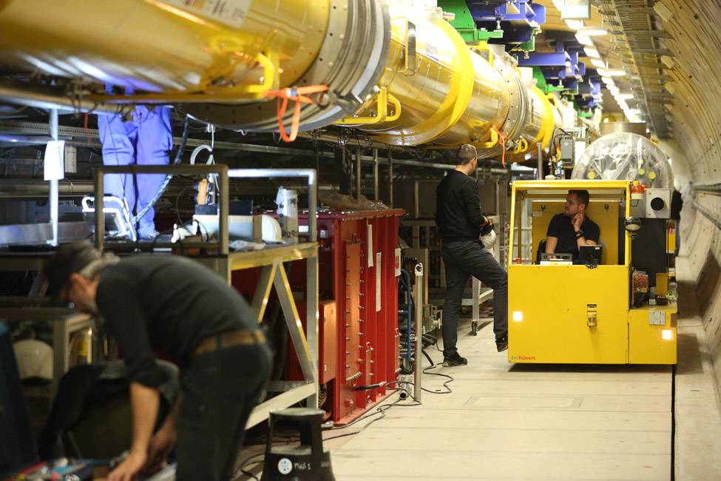
Constricted Room

Slide 8
L3 Installation

Slide 9
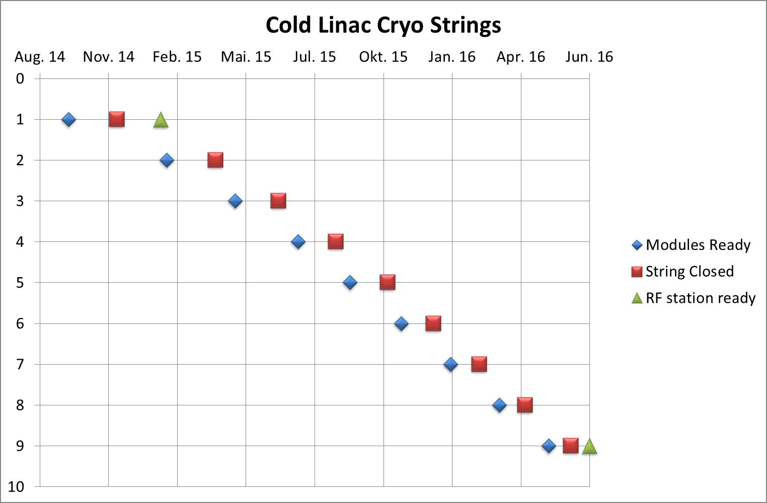
Installation Sequence
8 Wochen / Kryostring
1 Woche / Modul

Slide 10
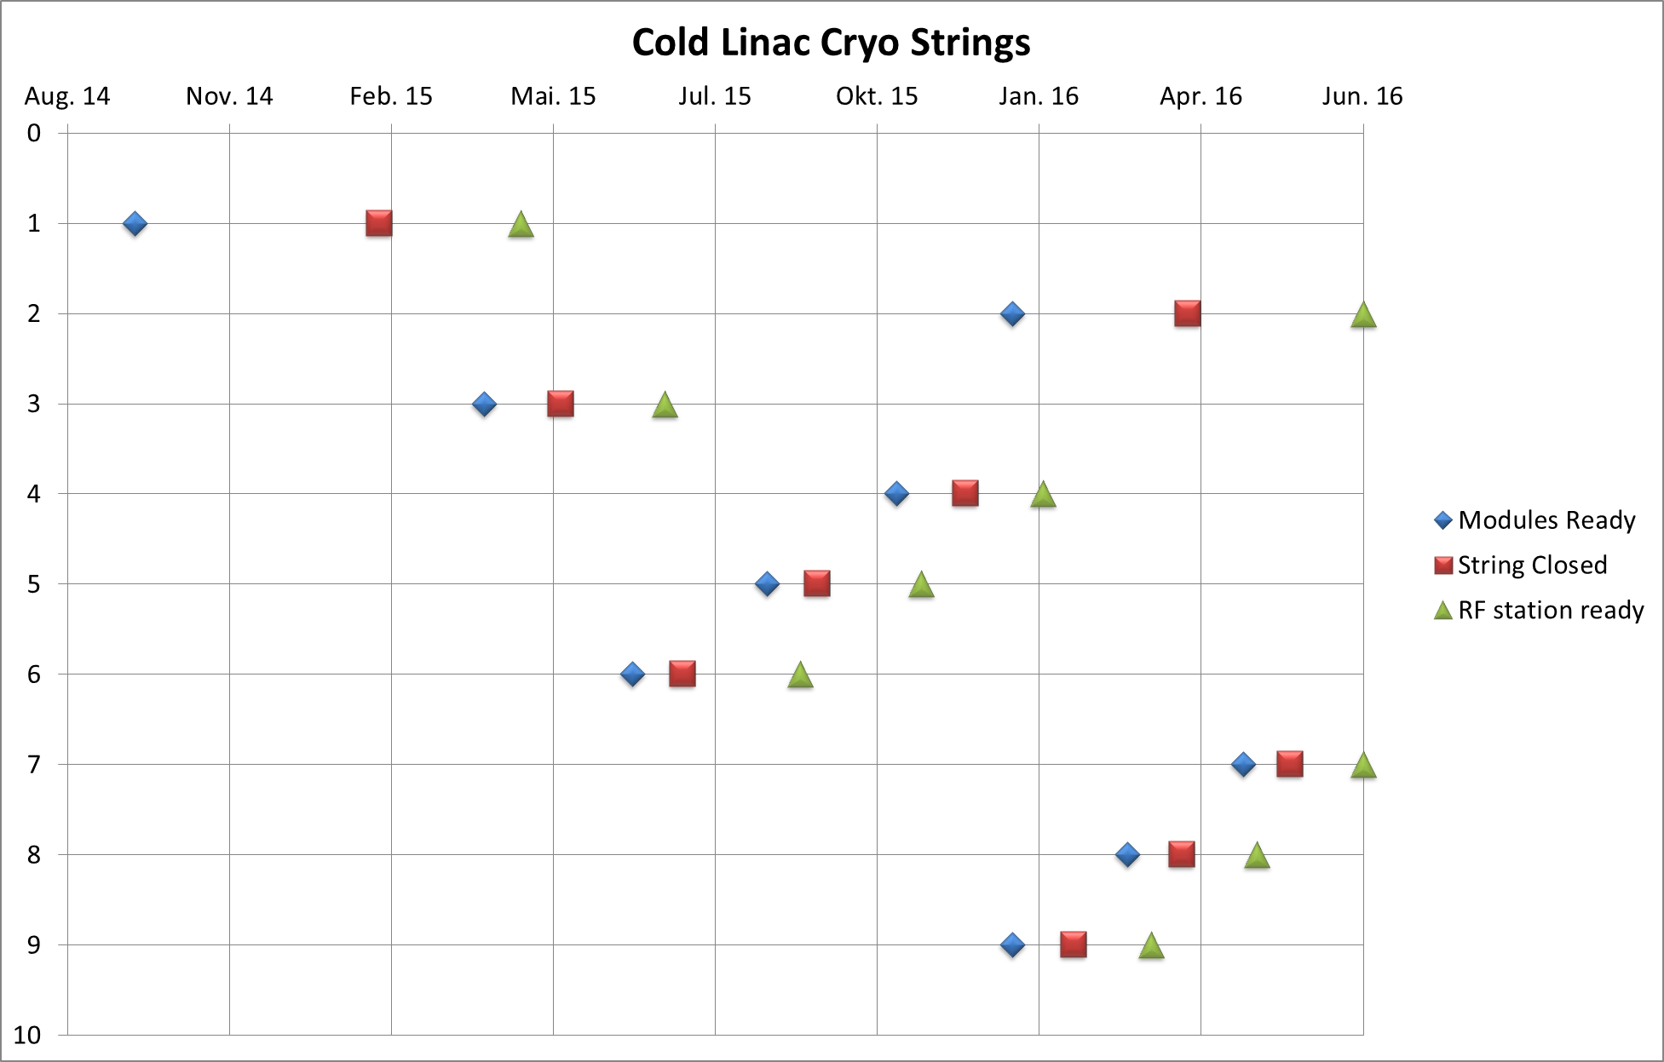
Less Crossings between Welding and Transport
Last String, that can be operated up to now

Slide 11
Sub-Distribution for L3 awaiting Installation

Slide 12
Cabling work
Magnet cables pulled whenever injector schedule and L1 commissioning allows
RF reference lines for L3

Slide 13
String Connection Boxes
Statics of suspension frames finally OK
Due to manufacturing error frames need to be straightened
Acceptance test of first SCB starting next week, then two more bi-weekly

Slide 14
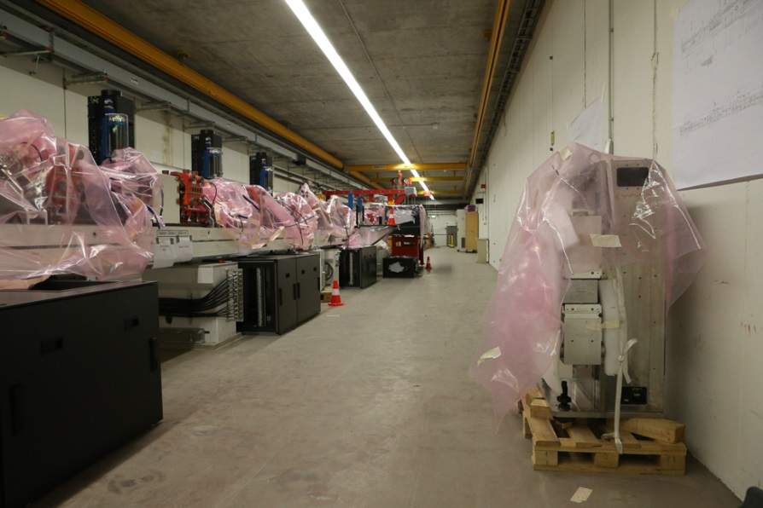
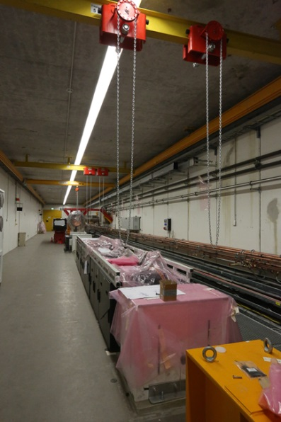
Injector Installation

Slide 15
Injector Installation
Currently Gun in Operation
First Beam!
Starting May 11th shutdown to install module A1 and finish warm section of injector
Short operation period starting June 30th
As soon as AH1 (3.9 GHz module) is ready interrupt for completion of injector linac

Slide 16
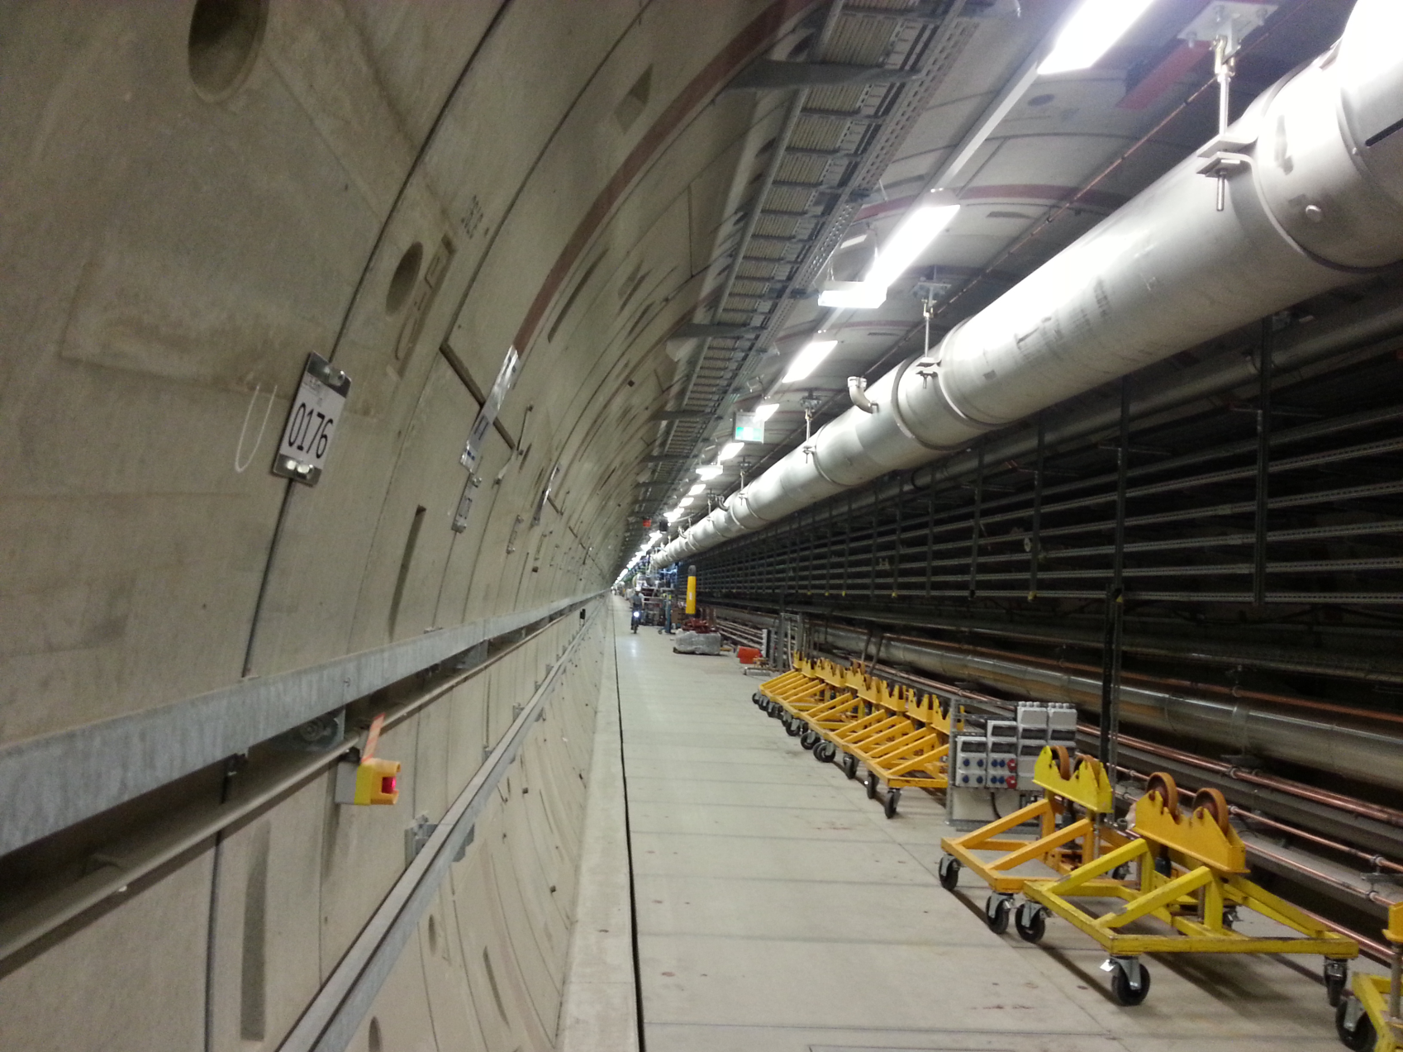
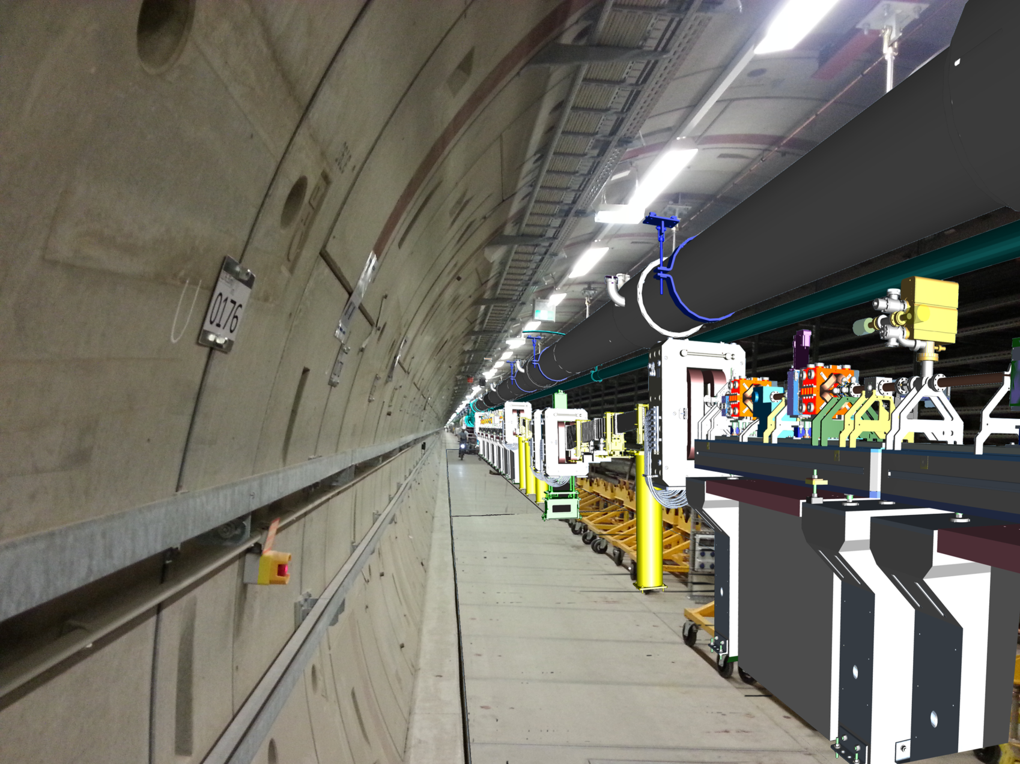
BC1

Slide 18
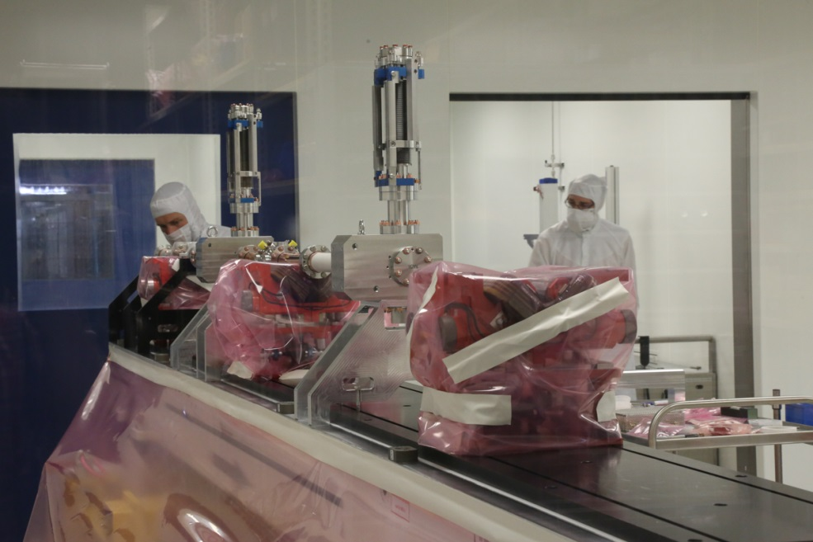
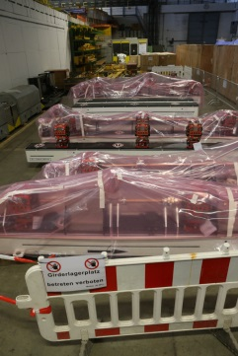
Girder Production

Slide 19
Bunch Compressors
21 girders in BC1 and BC2
7 finished so far
50 concrete columns
24 racks and 2 modulators/klystrons

Slide 20
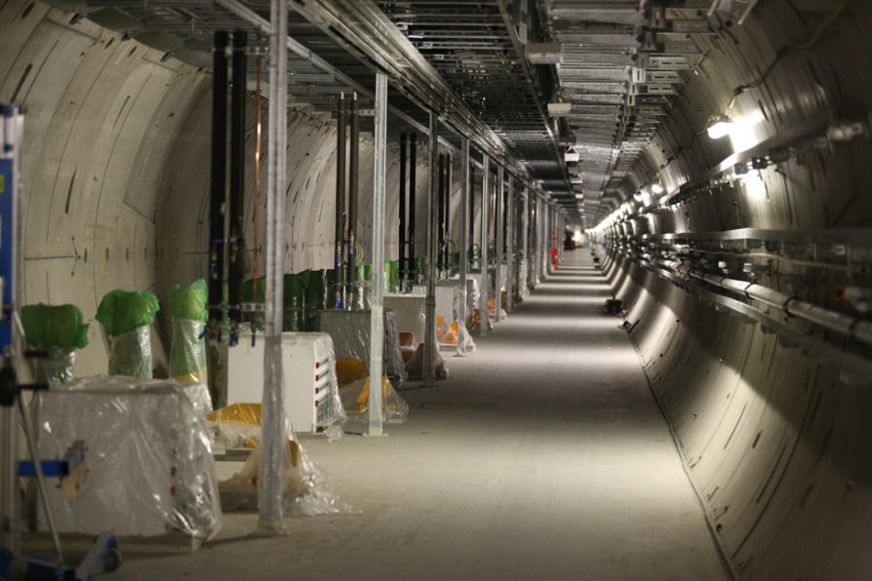
XTD2

Slide 21
XTD2 Installation
Undulator Supports and Iinfrastructure ready
Photon Beamlines well advanced (see A. Schwarz)
Electron Beamline supports ready
Waiting for Support Beams for Undulator Vacuum Chamber

Slide 22
Beam Line Suspension

Slide 23
End of L3, CL, TL
70 magnet suspension frames, 66 to be manufactured, 4 in house
Very massive to reduce vibrations
~400 m of vacuum line + vacuum suspension
At the end of XTL 3 beamlines above or besides each other

Slide 24
„Base“ of Vacuum Suspension

Slide 25
Welded Fixtures for Suspension Frames

Slide 26
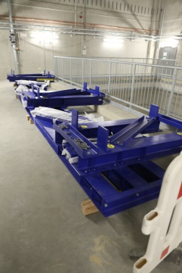
Frames already in house

Slide 27
General Remarks
Like in the cold linac so far everything is driven by availability of components
Installation schedules kept shifting
Variety of reasons, some within WPs some outside
This resulted in a period of very little activity in XTL (and XTD2 to a lesser extend)
This must come to an end if we are to keep the project schedule goal

