Slide 1
XFEL Cavity Testing
Detlef Reschke (+Nick Walker) – DESY
for the Cavity Testing Team
4th Collaboration Meeting of the European XFEL

Slide 2
General remarks
Vertical test work-flow is well-established. Vertical testing of cavities can be finished in time until end of 2015 (assuming “normal“ operation conditions).
Work flow organisation is based on EDMS, IFJ-PAN data base, spread-sheets and lots of communication
Analysis is fully based on XFEL cavity data base + Mathematica tool (some spreadsheets still alive …) Missing: - Post-documentation of Retreatments - Some useful data base GUI (e.g. “Summary form”)

Slide 3
Vertical test procedure
3
Incoming Inspection (mechanical, electrical, vacuum) incl. NCR handling (vendors + home-made)
Survey check of “3D-transfer data” (all RI; 10% random sample EZ)
HOM rejection filter tuning
Vertical test at 2K
HOM check at 2K (all RI; special EZ)
if necessary: Retreatment at DESY
2-phase (service) pipe repair (~650 cavities)
Outgoing inspection (mechanical, electrical, vacuum)
Preparation for transport to Saclay

Slide 4
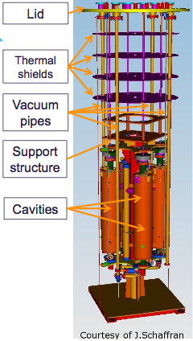
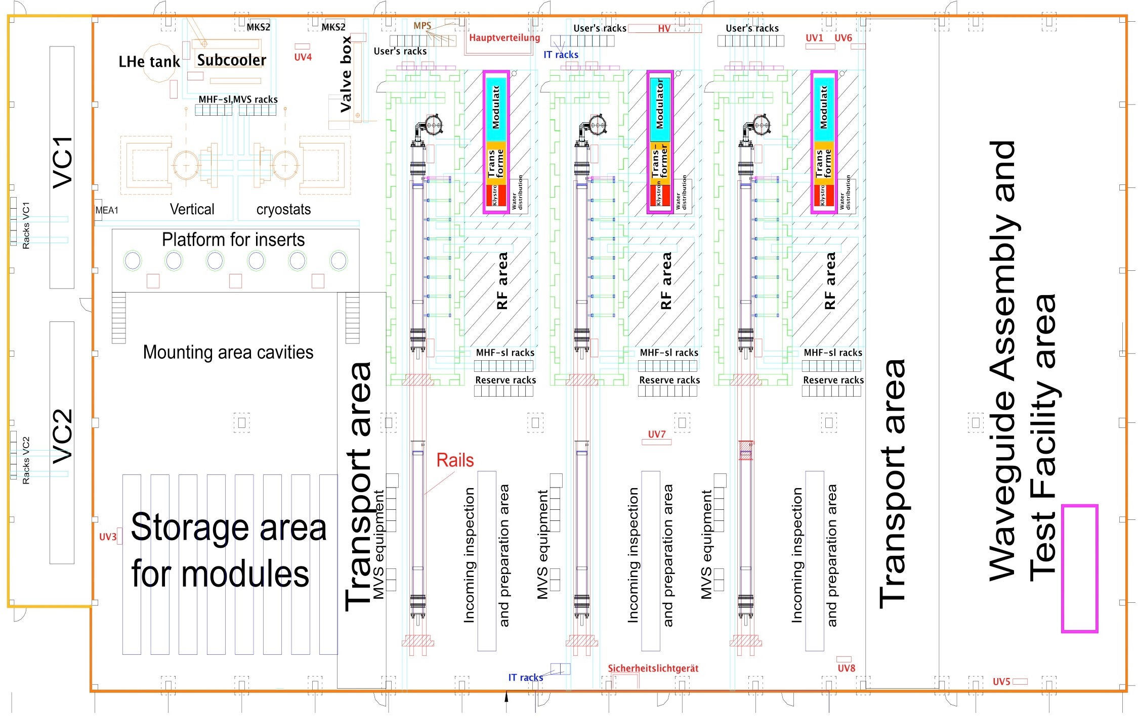
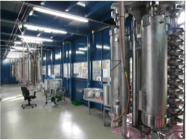
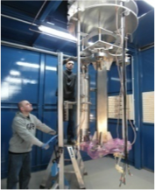
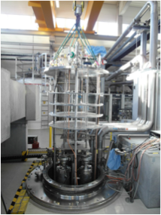
AMTF @ DESY - cavity testing

Slide 5
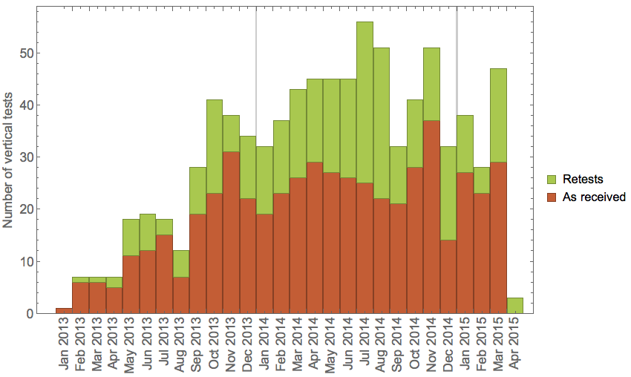
Cavity test rates in AMTF
Average: ~ 40 tests / month
Test date (≠ delivery date)

Slide 6
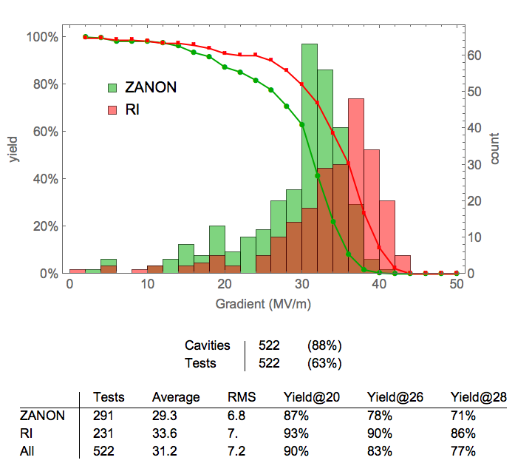
Test results: MAX GRADIENT
“As received” test Cavities with re-treatment before first test are not included

Slide 7
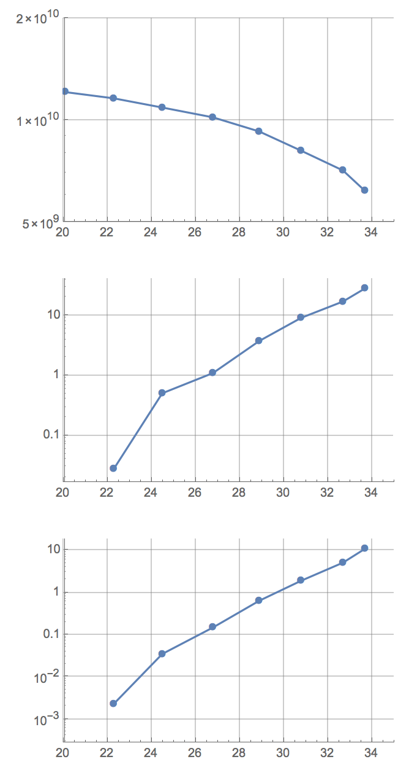
Definition of “Usable Gradient” in VT
Q0
GQ0
Minimum of the following gradient values:
MAX (i.e. quench)
Q0 = 10¹⁰
X-ray 1 (top) threshold
X-ray 2 (bottom) threshold
Gmax
X-ray1
Gx-ray1
- In this example, usable gradient is limited by FE (X-ray1) to ~27 MV/m - max gradient is ~34 MV/m
X-ray2
Gx-ray2
Gradient (MV/m)

Slide 8
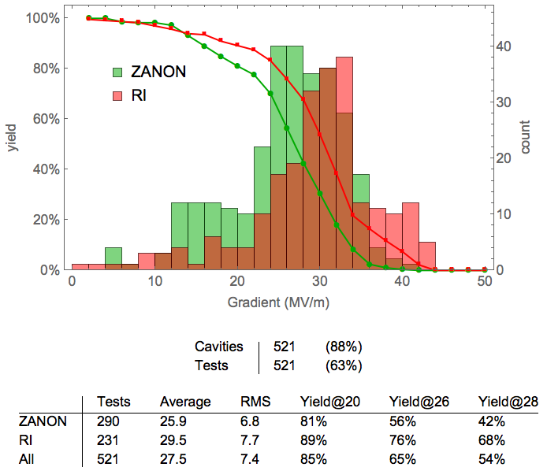
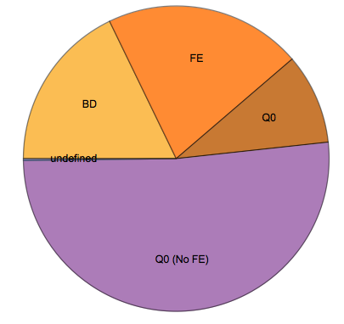
Test results: USABLE GRADIENT
“As received” test
FE
BD
Q0
Q0 (no FE)
limiting criterion
Average loss: ~4 MV/m

Slide 9
Test results: Re-treatment @ DESY
accept for module
“As received” test
⟨Gu⟩≈30 MV/m
In general, first re-treatment is a standard High-Pressure Rinse (HPR)
Several cavities with
< 20 MV/m accepted, if a) limitation = “bd“ +
b) no FE
⟨Gu,op⟩≈28.5 MV/m
re-treat & retest

Slide 10
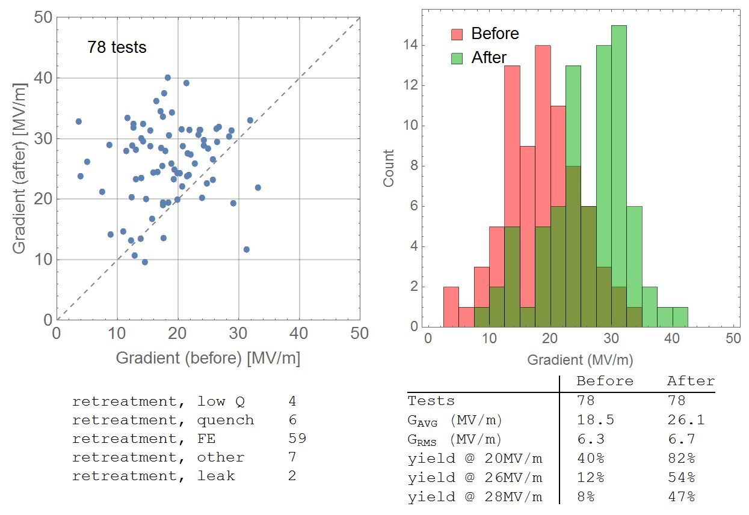
Impact of HPR (pairs before /after only)
Before = as received
-
-
-
Total: ~150 retreatments

Slide 11
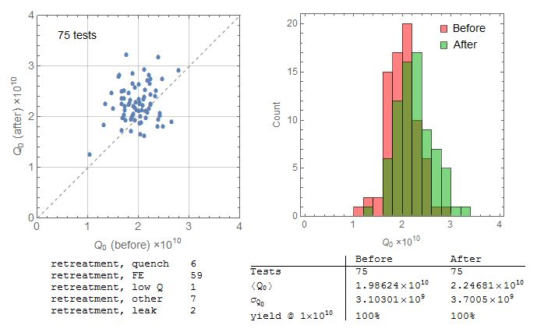
Impact of HPR on Q_{o} (pairs before /after only)
“before”: “as received” only
-
-
-
Total: ~150 retreatments

Slide 12
Outlook until end of 2015
12
652 (RI: 292; EZ: 360) series cavities delivered to DESY
~ 630 series cavities tested
=> ~ 170 cavities to be tested
Test rate: 1.4 tests / cavity - retreatment due to bad performance - retreatment due to leaks, assembly problems at Saclay, … - retest due to vacuum, RF problems, … - preliminary acceptance
Average of 40 tests per month
Estimate: ~ 240 “new” tests + ~ 25 add. “special cavity” tests
=> Vertical tests can be finished well in-time until end of 2015

Slide 13
Thanks to all colleagues of:
IFJ-PAN
INFN Milano
E. Zanon
Research Instruments
Daher Transkem
DESY

