Slide 1
Agenda of XFEL Collaboration Meeting
Short status on module assembly O. Napoly
Cavity performance degradation ON + discussions
Cavity degradation during string assembly S. Berry + discussions
Enhanced Quality Control on module assembly T. Trublet + discussions
Non-conformities of incoming components ON-TT + discussions
Integration problems for CPI couplers discussions
Issue on BQU A. Matheisen
Missing parts until XM100 discussions

Slide 2
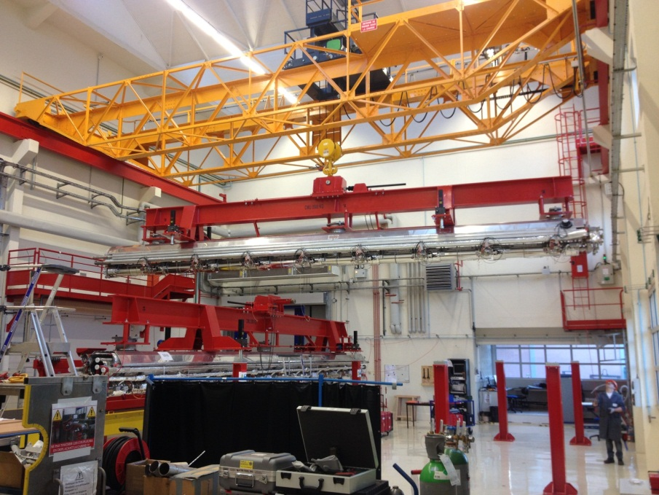
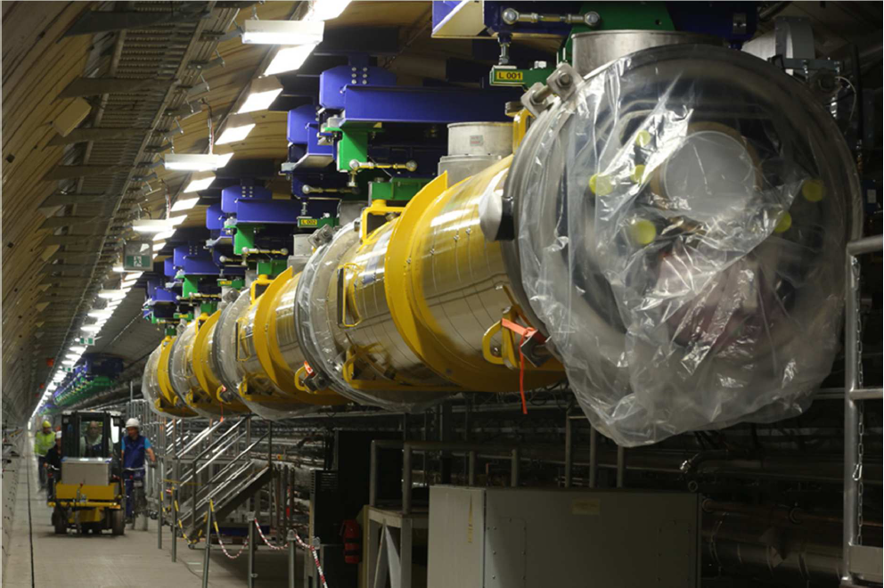
Status of String and Module Assembly
XFEL cryomodule integration at CEA/Saclay

Slide 3
Outline
Achievements:
  Recent developments
  Production and schedule
  Challenges
  Module performance
  Module repair
  Risks

Slide 4
Organisation of Work Stations
The breakdown of the assembly work of 7 Work Stations aims at:
balancing almost equally the time occupancy of each WS,
bringing the largest occupancy below 5 days
Clean Room Cold Coupler Area (IS04-CC-WS1)
  Cold coupler assembly (x8)
  Leak check of caity-coupler connection (+RGA)
Clean Room String Assembly Area (ISO4-SA-WS1, ISO4-SA-WS2)
  String connections (1 gate valve + 8 cavities + 1 Qpole unit)
  Leak check of string and N₂ venting (+RGA)
Roll-out Area (RO-WS1, RO-WS2)
  HOM adjustment, magnetic shielding, T-sensors (x6)
  Tuner assembly (x8), coupler 4K and 80 K shields
  2 Ph-tube welding, NCT (LT, PT, RT)
  Cold-mass/string connection
Alignment Area (AL-WS1, AL-WS2)
  Cavity and quadrupole fine alignment (~100 µm)
  Welding of 8 mm LHe filling line (x9)
  Tuner and piezo electric tests
Cantilever Area (CA-WS1)
  Welding of 4K and 70 K shields, 4K and 79 K super insulation
  Cable routing and insulation, Quad current lead
  Insertion into vacuum vessel and cold mass alignment
Coupler Area (CO-WS1, CO-WS2)
  Warm couplers + coupler pumping line + leak checks (8 connections + coupler vacuum)
  Cabling of flanges A (x8) and flange D
  Quadrupole current lead connections and welding
  Final leak check of cavity vacuum + final pumping
Shipment Area (SH-WS1, SH-WS2)
  Control operations (RF frequency)
  End-caps closing, N2-insulation
  CEA-Alsyom “acceptance test”
  Loading

Slide 5
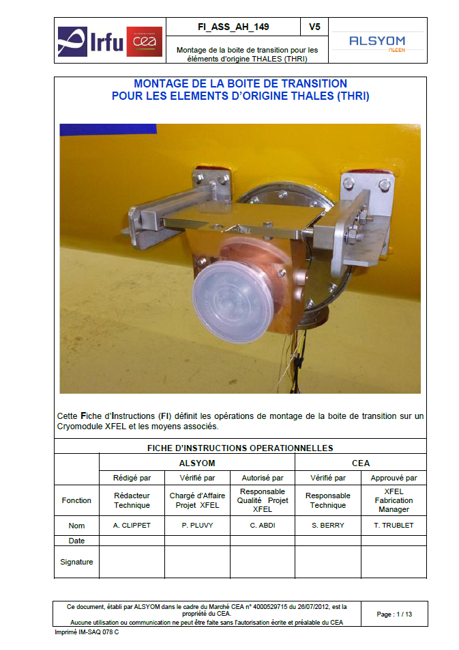
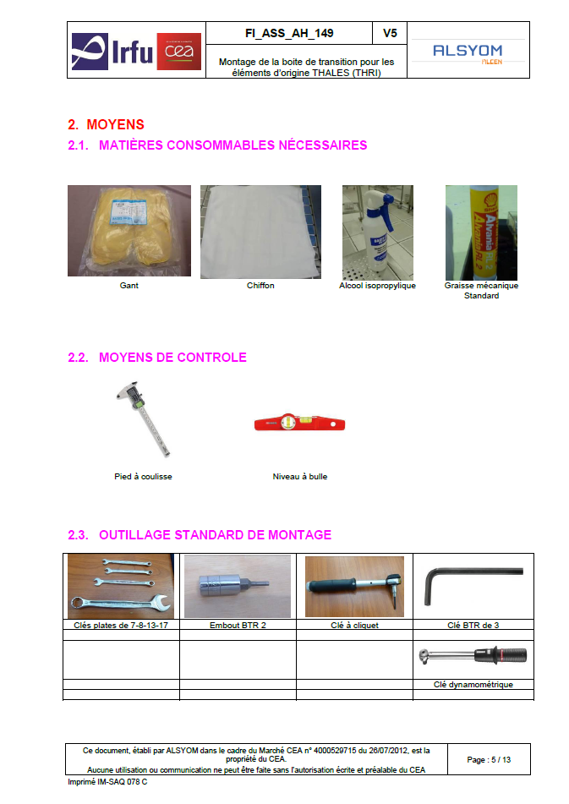
Assembly Procedures

Slide 6
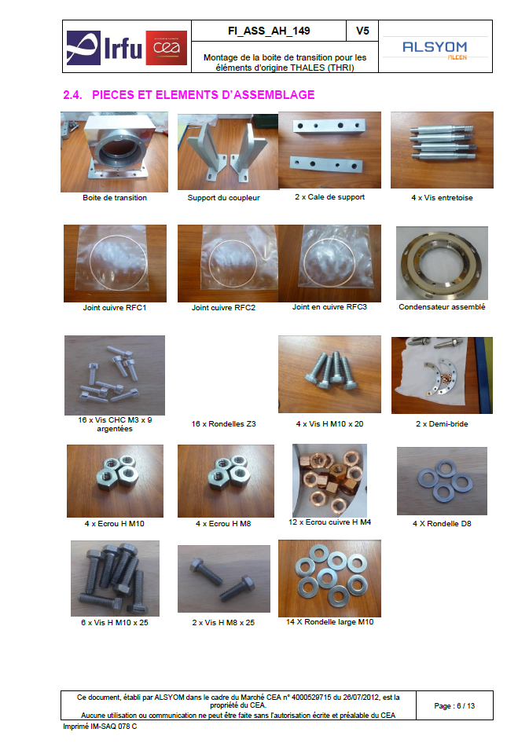
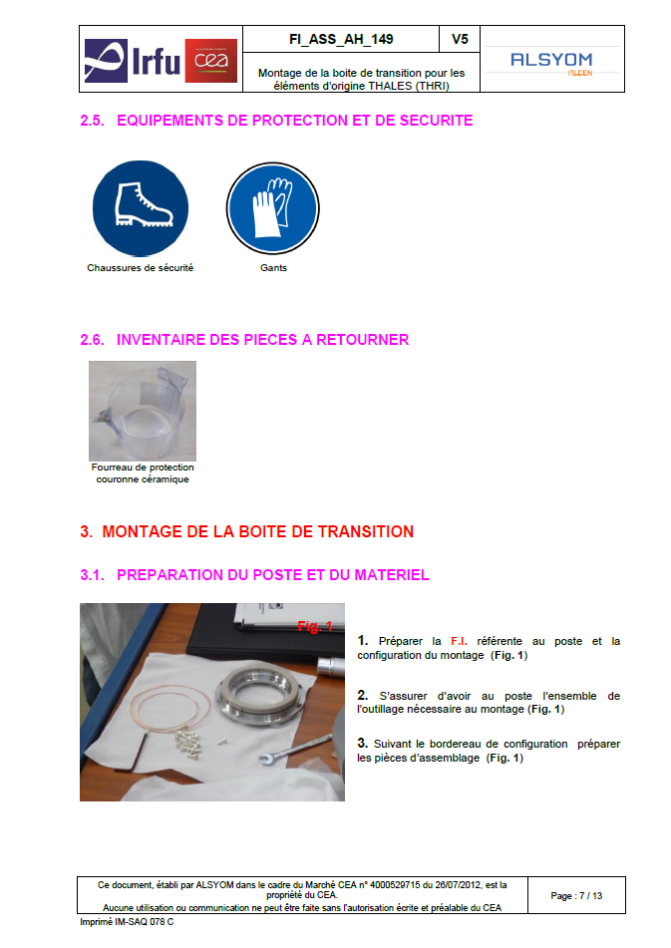
Assembly Procedures

Slide 7
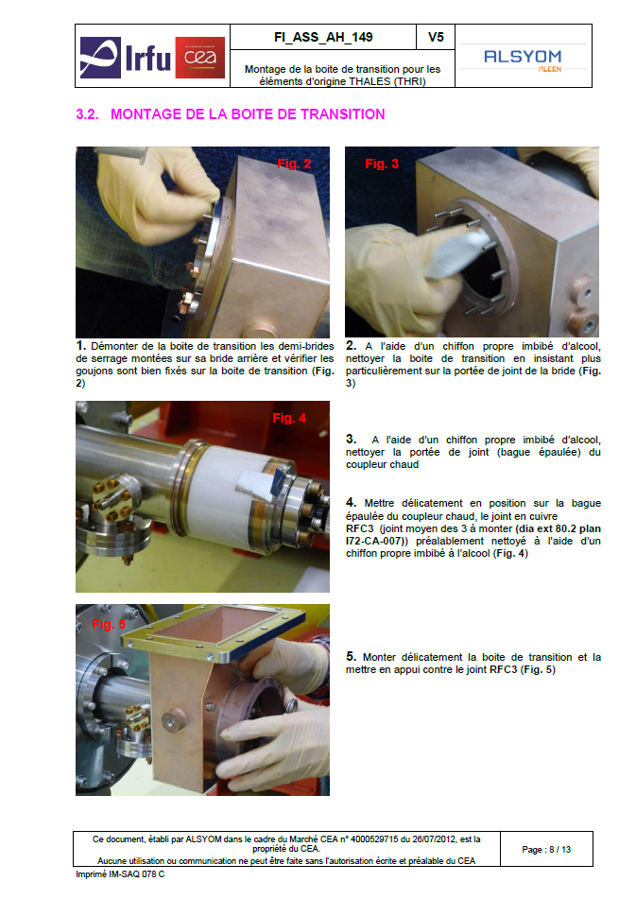
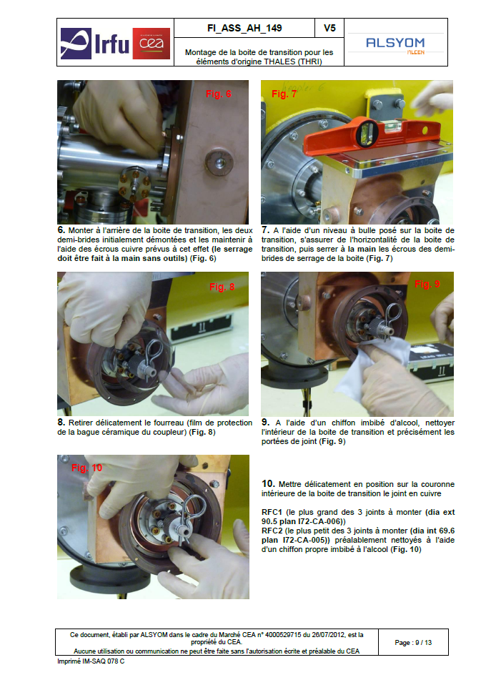
Assembly Procedures

Slide 8
Assembly Procedures
The preparation, assembly and control work are described in 179 procedures, ‘Fiches d’Instruction’, ‘used’ by the operators.
The first set of draft procedures was written by CEA, during the Prototyping phase at DESY and Saclay, in English and appended to the Call for Tender Specifications for Industrial Operator selection
Alsyom, the selected Industrial Operator, was in charge of updating these procedures during the Pre-Series phase (3 modules) and to translate them in French for their usage during the Series production phase.
This took much (much) longer than expected ! 166 are final.

Slide 9
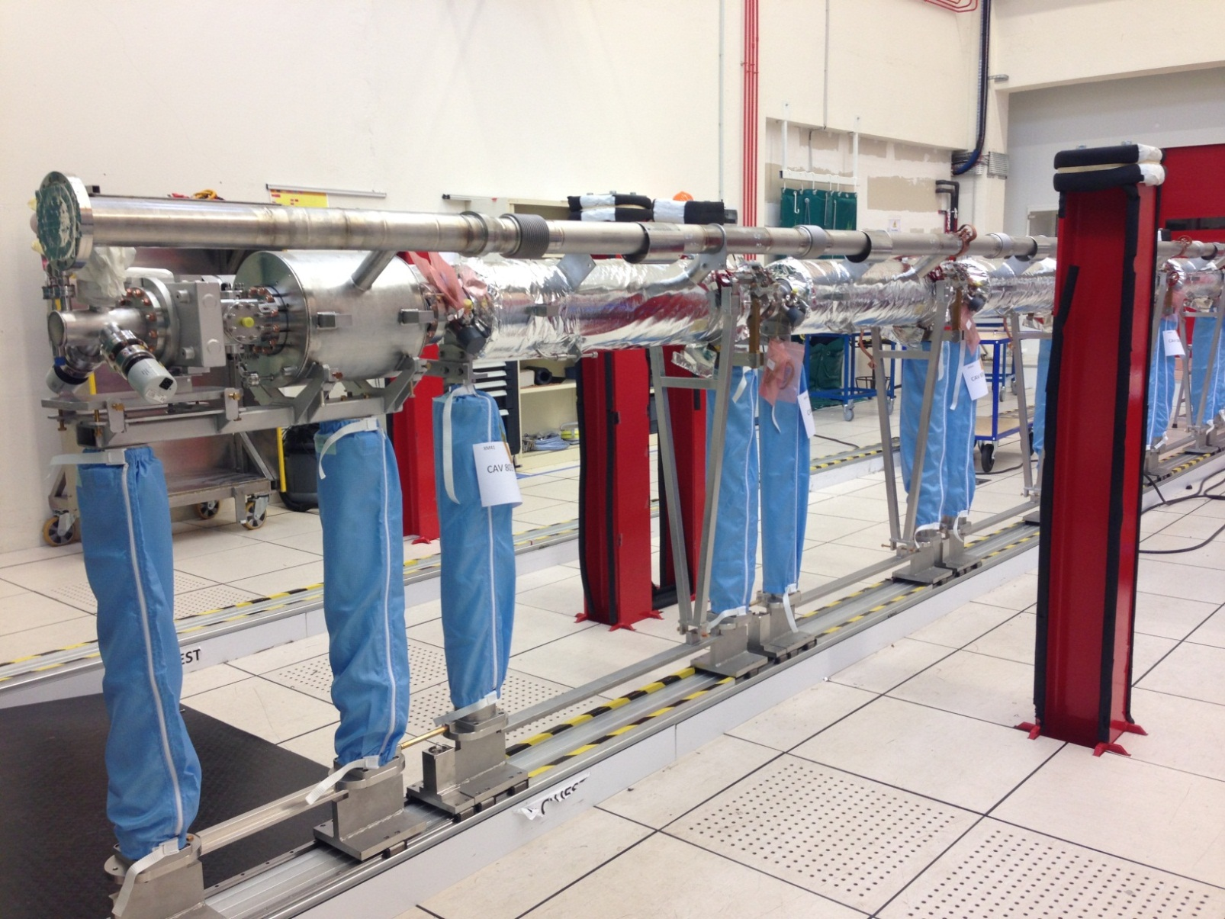
Integration Tools
Productivity may still gain from improvement of small tools
Socks used to transfer cavity string from Clean Room to Roll-out Area, suppress time-consuming cleaning of cavity posts

Slide 10
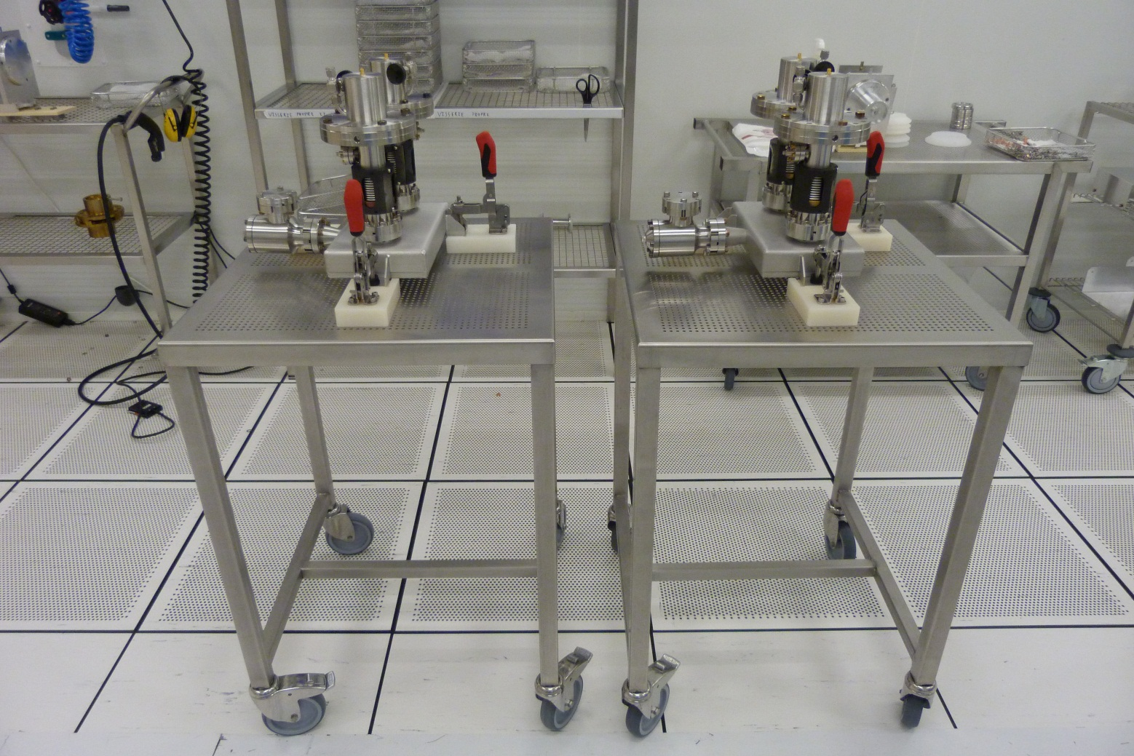
Integration Tools
Productivity may still gain from improvement of small tools
Transfer carriages for cold coupler pairs and coupling box

Slide 11
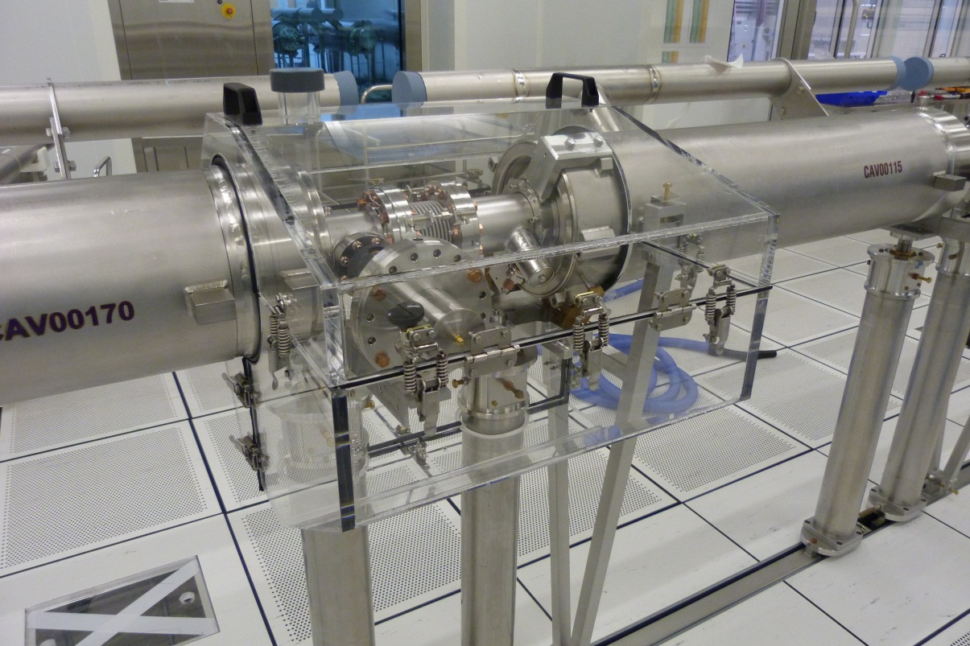
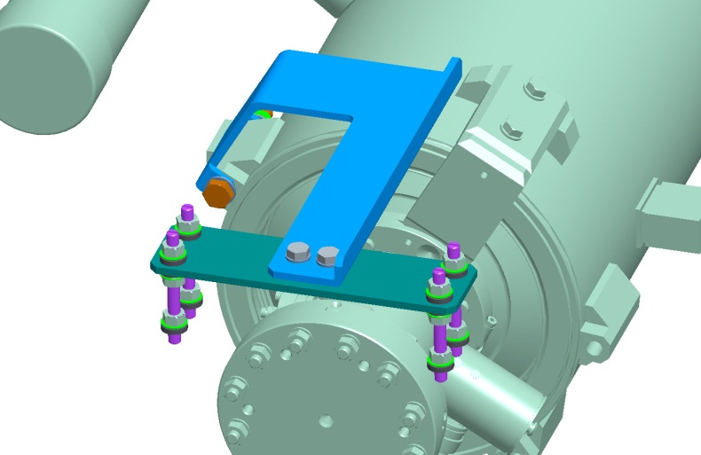
Integration Tools
Two more examples, in use:
1) Pre-fabricated et reusable devices for the leak-check of
the cavity string connections → 3 units fabricated and in use.
2) Realization of gate valve support for its assembly on Cold-Coupler workstation:
Design and fabrication taken over by Alsyom, used for XM22.
Inter-cavity connection leak-check box, including cold coupler connection, and pre-existing HOM flanges

Slide 12
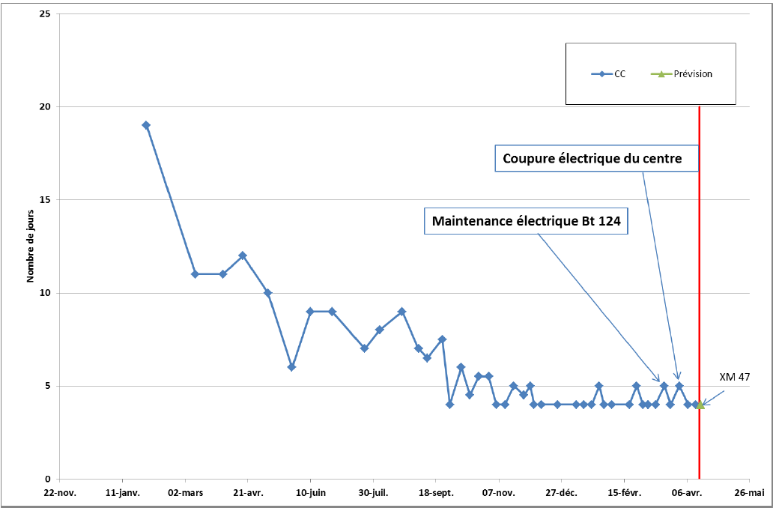
Throughput at Cold Coupler WS
12

Slide 13
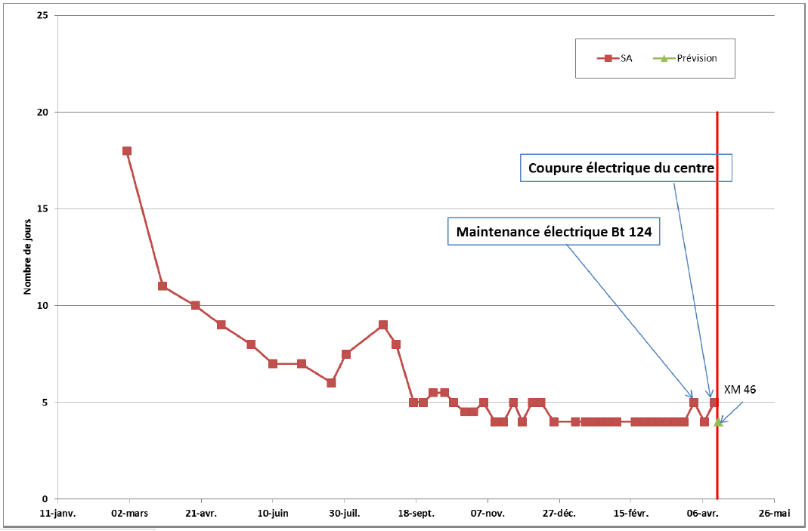
Throughput at String Assembly WS
13

Slide 14
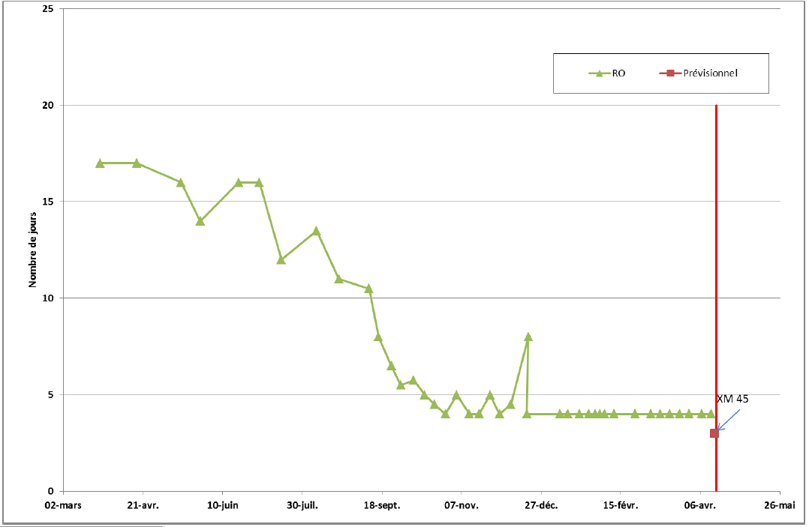
Throughput at Roll-out WS
14

Slide 15
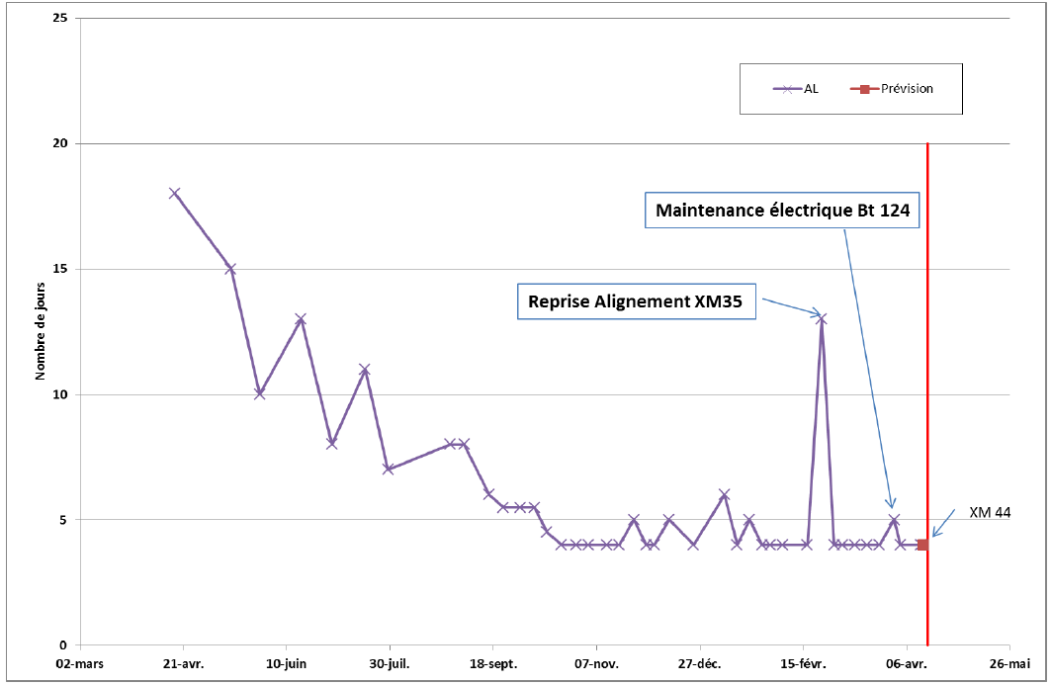
Throughput at Alignment WS
15

Slide 16
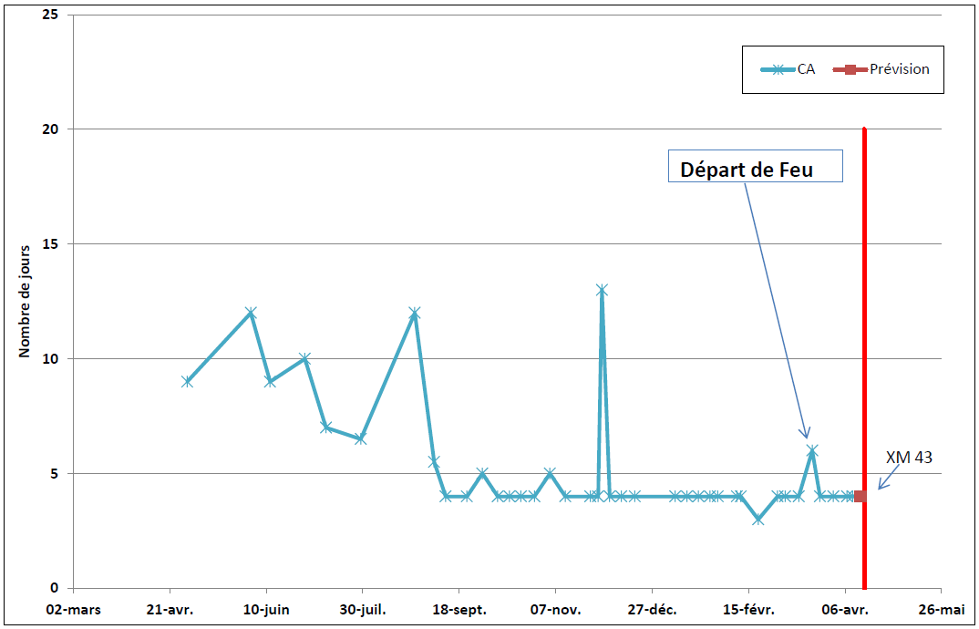
Throughput at Cantilever WS
16

Slide 17
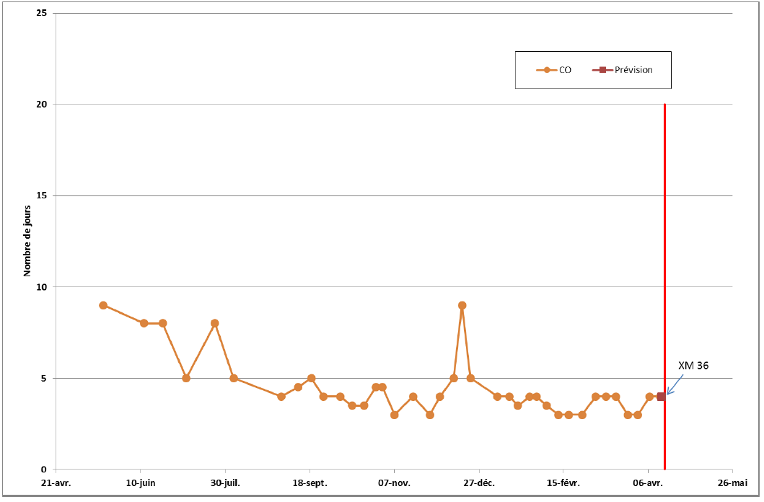
Throughput at Warm Coupler WS
17

Slide 18
Cryomodule Asssembly Time
7 weeks = 7 x 5 working days was reached mid-October 2014 with XM15
⇒ the design of the Assembly Infrastructure was sound
7 x 4 working days was reached on 5 January 2015 with XM25
This accelerated production is needed to close the XFEL tunnel mid-2016
18

Slide 19
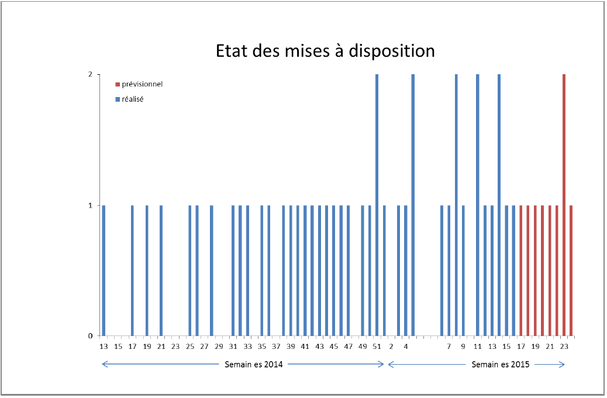
Alsyom to CEA Cryomodule Delivery
19

Slide 20
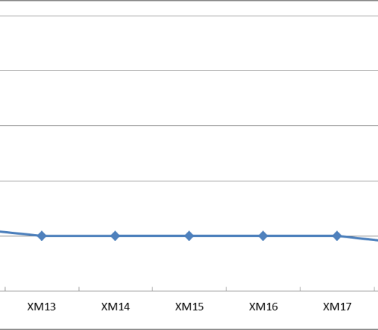
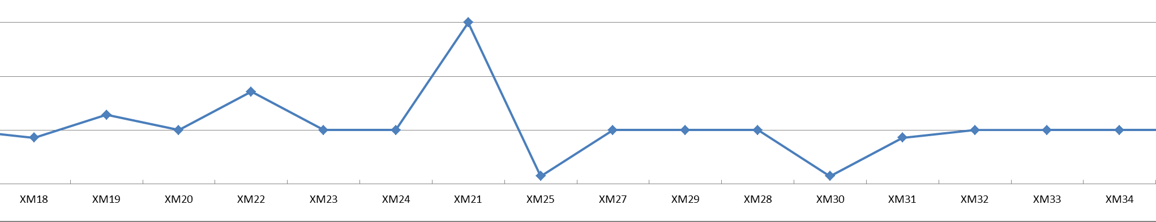
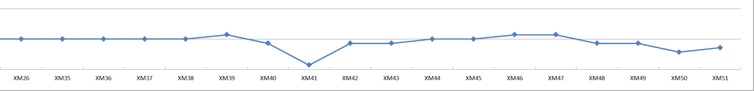
CEA to DESY Cryomodule Delivery
As of April 22, 2015: 45 out of 103 modules shipped to DESY.
Throughput of 4 days started in 2015 : from January 5 till April 21, CEA delivered 18 cryomodules (XM25 to XM42) in 69 working days (69/4=17,25).
If we maintain the 4 day throughput (so-called acceleration of production) XM100 will be delivered around 20 April 2016.
The accelerated scheme is robust: it has already absorbed major incidents.
4
mid-October 2014
3
2
1
Shipment Rate to DESY / week
January 2015
21 April 2015
20

Slide 21
Quality Control
Quality Control consists in:
Inspecting the incoming components
Controling the assembly work in person
Documenting the controls and non-conformities
Until end of 2014, the quality control group of Alsyom was too small (3 people) in such a way that Documenting and Incoming Inspection was performed in priority. CEA took the major part of the Assembly Work Controling, essentially during pre-defined ‘Hold Points’.
The ‘every day’ or ‘random’ controls were too few and this led to many mal-fabrication, most of them recorded at DESY before or during cryomodule cold test !
In November 2014, the quality control group of Alsyom was increased to 5 people which, together with the better organisation, covers the need of QC.

Slide 22
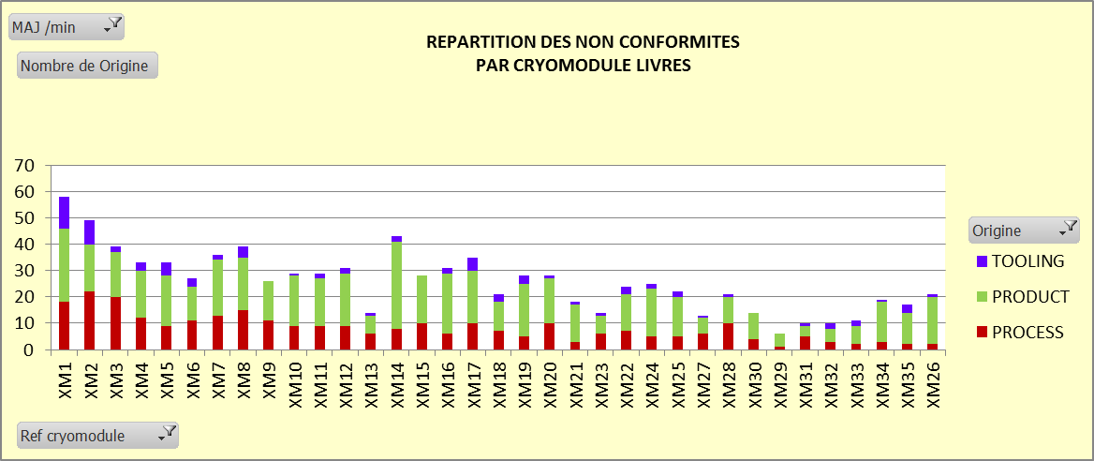
Quality Control: Non Conformities
Non Conformities recorded by Alsyom fall into 3 categories:
Tooling and assembly equipment, from CEA and DESY (pump stations) (TOOLING)
Accelerator components (PRODUCT)
Assembly operation (PROCESS)

Slide 23
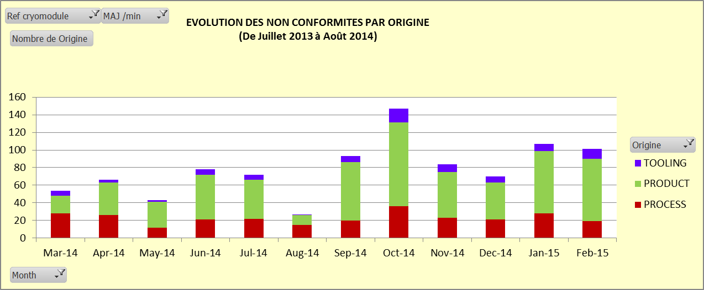
Quality Control: Non Conformities
The number of Non Conformities is NOT going down.
But, with better and more efficient detection at Incoming Inspection, the impact of PRODUCT NC on the module assembly has considerably decreased, compared to when many NC were discovered ‘on the fly’.

Slide 24
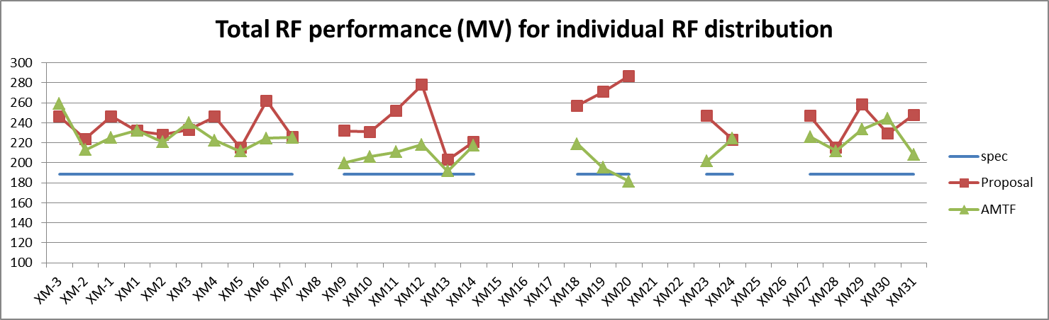
Cryomodule Performance
All tested modules are on XFEL specs (188 MV per module), on average 15 % above specs (27.2 MV/m).
Some very important cavity gradient degradation have been recorded: XM-3 and XM30 are the two exceptions.
Individual cavities are power limited to 31 MV/m, i.e. cryomodules to 250 MV.

Slide 25
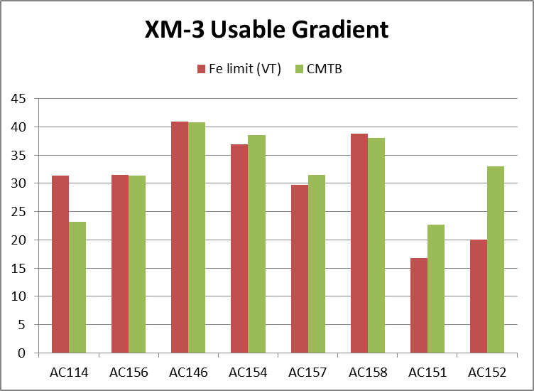
Cryomodule Performance : XM-3

Slide 26
Cryomodule Performance : XM19

Slide 27
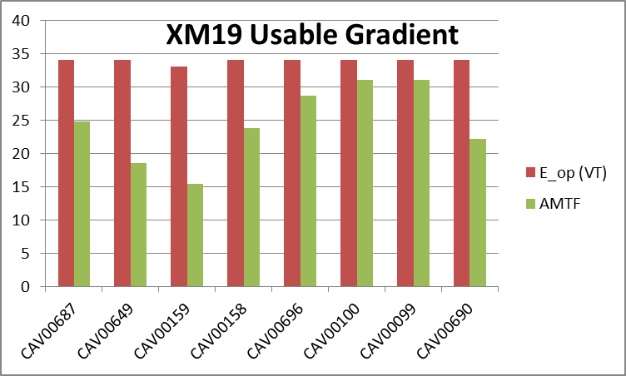
Cryomodule Performance : XM19

Slide 28
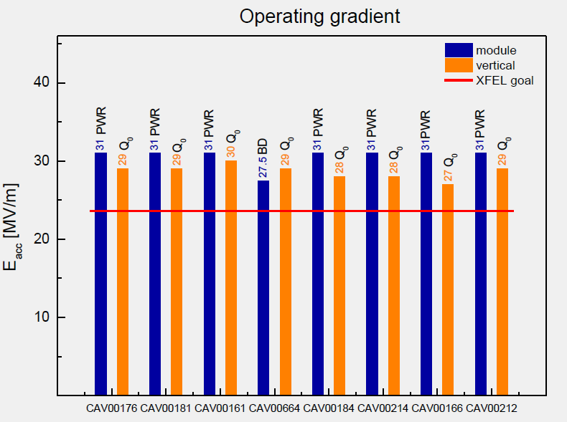
Cryomodule Performance : XM30

Slide 29
About Cavity Degradation
CEA and DESY are working on understanding the causes of cavity degradation after module assembly.
1st remark: one module is worth > 1 M€ and 200 MV. We lost about ¼ M€ on XM12 and ½ M€ on XM20. This cost is worth investing in in-situ (AMTF) diagnostic and in-situ repair (better conditioning).
2nd remark: about 80% of cavities are reproducing or improving their VT performances: module integration is based on a sound process. Causes ?
3rd remark: a smaller but significant number of cavities improve their gradient after module integration.
Individual cavities are power limited to 31 MV/m, i.e. cryomodules to 250 MV.

Slide 30
About Cavity Degradation
The gradient degradation is presumably du to contamination of the cavity RF surfaces. Contamination can occur by two processes:
External contamination of cavity volume
Internal contamination of cavity volume
1st process: External contamination may have 3 causes:
a) Clean room air: idle ISO5-ISO4 clean rooms are worth ‘ISO0’: permanent counting at nights monitors cleanliness
b) Operator behavior : hands-on cavity connections and bad preparation work is a highly probable cause of contamination. DESY and CEA performed two audits of clean room assembly. No major faults were detected but some procedures needed a reminder. Also, the connection of the gate valve to cavity is difficult, particularly on the CC workstation.
c) N2 Flushing (10 l/mn) and N2 venting (3 l/mn): venting systems release 10k particulates / mn in open air, but in-cavity tests measured less than 10 particulates / mn on realistic conditions of cavity venting. Systematics ??

Slide 31
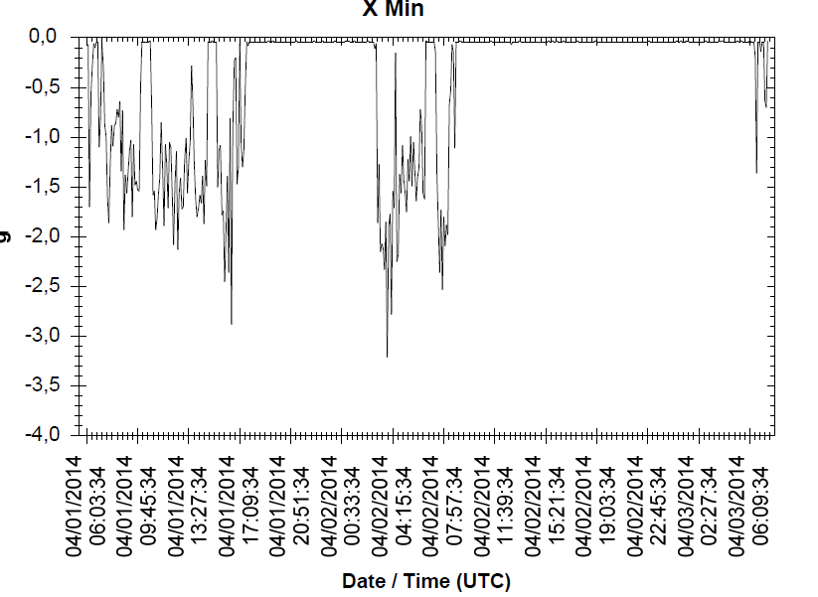
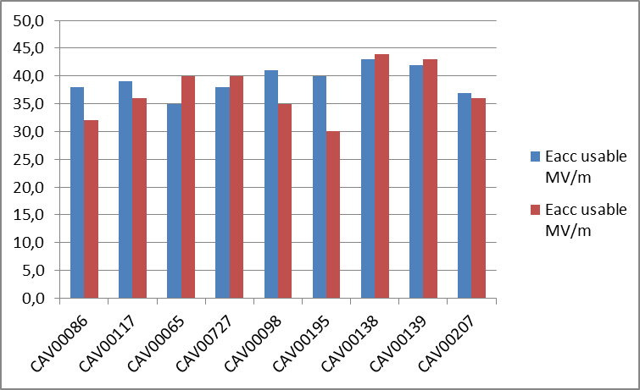
About Cavity Degradation
2nd process: Internal contamination may have 3 causes:
Particulates migration: metallic particulates are inevitably present or produced in the RF-free volumes around flanges. The ‘art’ is not to move them using controled slow venting and slow pumping, and avoiding vibration. Flushing with clean N2 is questionable from this point of view.
Vibrations: ‘Sticking’ theory predicts that particulates stick to the surface when cavity is under vacuum ⇒ cavity and cryomodule transports are done under vacuum. Vibrations are recorded: the case of XM19 and XM26 cavities (not an isolated case)
XM26 cavities have been shipped back to DESY and tested a second time in VTC
XM19 cavity transport > 3g
after 2nd transport

Slide 32
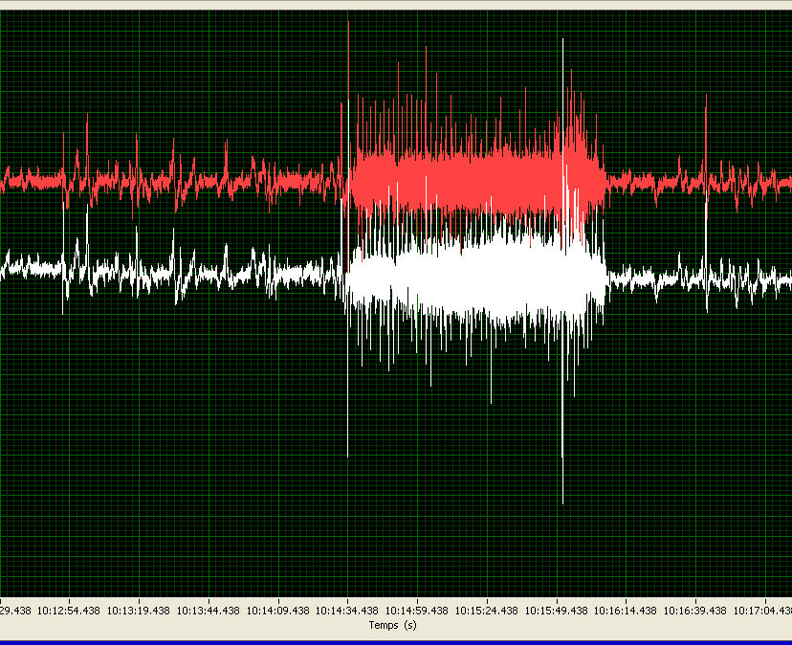
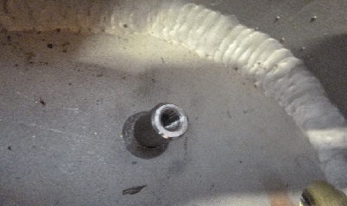
About Cavity Degradation
2nd process: Internal contamination may have 3 causes:
Vibrations: vibrations occurs alos during the ‘5 assembly weeks’ outside of the clean room when the string is vented.
e.g vibrations during cut-out of Ti tubes e.g hammering of 6 pins
of the 2K 2-phase line along cavities on cold mass
The maximum acceptable acceleration
levels remains unknown to us.
XM35: 0.7 g during cutting for 2 mn, up to 4g shocks
during cutting tool positioning.

Slide 33
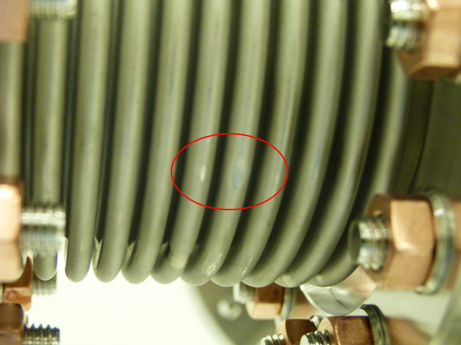
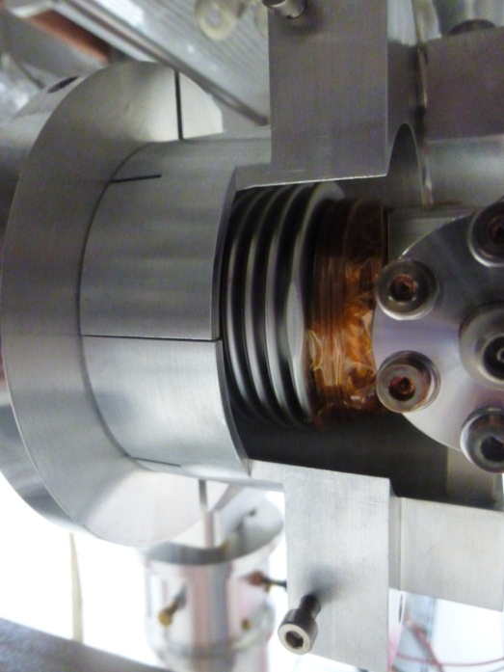
About Cavity Degradation
2nd process: Internal contamination may have 2 causes:
b) Particulates creation and migration: copper coating flakes on intercavity bellows and coupler Cold External Conductor are particularly suspected.
Conclusions:
several suspects were interrogated but the culprit is still loose ☺ ☹
ILC could help in conducting some assembly and RF tests.

