Slide 1
Cavity degradation during string assembly
Stéphane BERRY
CEA/irfu/SACM

Slide 2
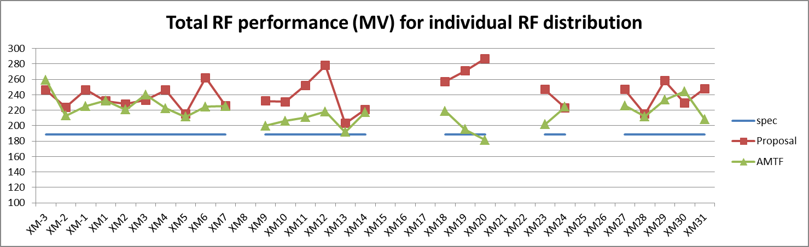
About Cavity Degradation (cf. Nick’s talk)
CEA and DESY are working on understanding the causes of cavity degradation after module assembly.
1st remark: one module is worth > 1 M€ and 200 MV. We lost about ¼ M€ on XM12 and ½ M€ on XM20. This cost is worth investing in in-situ (AMTF) diagnostic and in-situ repair (better conditioning).
2nd remark: about 80% of cavities are reproducing or improving their VT performances: module integration is based on a sound process. Causes ?
3rd remark: a smaller but significant number of cavities improve their gradient after module integration.
Individual cavities are power limited to 31 MV/m, i.e. cryomodules to 250 MV.

Slide 3
About Cavity Degradation
The gradient degradation is presumably du to contamination of the cavity RF surfaces. Contamination can occur by two processes:
External contamination of cavity volume
Internal contamination of cavity volume
1st process: External contamination may have 3 causes:
a) Clean room air: idle ISO5-ISO4 clean rooms are worth ‘ISO0’: permanent counting at nights monitors cleanliness
b) Operator behavior : hands-on cavity connections and bad preparation work is a highly probable cause of contamination. DESY and CEA performed two audits of clean room assembly. No major faults were detected but some procedures needed a reminder. Also, the connection of the gate valve to cavity is difficult, particularly on the CC workstation.
c) N2 Flushing (10 l/mn) and N2 venting (3 l/mn): venting systems release 10k particulates / mn in open air, but in-cavity tests measured less than 10 particulates / mn on realistic conditions of cavity venting. Systematics ??

Slide 4
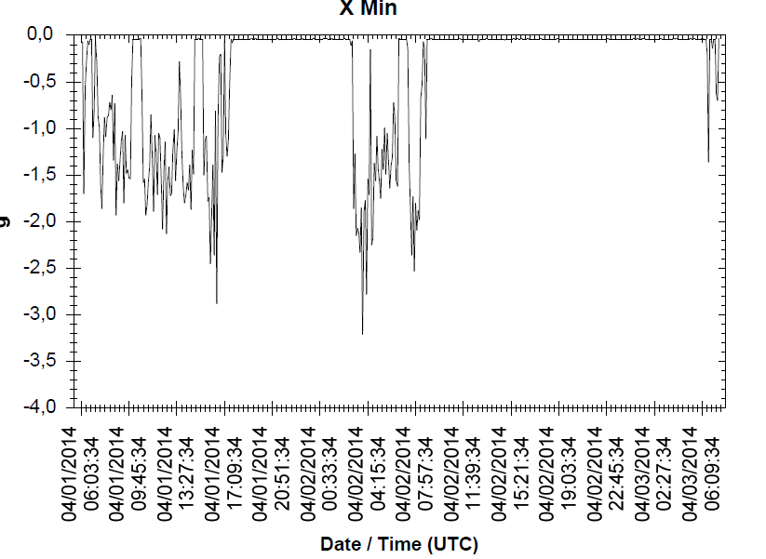
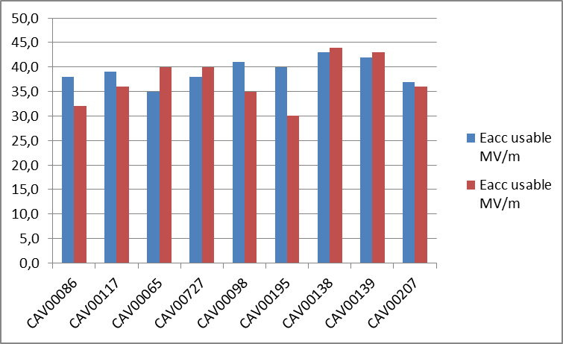
About Cavity Degradation
2nd process: Internal contamination may have 3 causes:
Particulates migration: metallic particulates are inevitably present or produced in the RF-free volumes around flanges. The ‘art’ is not to move them using controled slow venting and slow pumping, and avoiding vibration. Flushing with clean N2 is questionable from this point of view.
Vibrations: ‘Sticking’ theory predicts that particulates stick to the surface when cavity is under vacuum ⇒ cavity and cryomodule transports are done under vacuum. Vibrations are recorded: the case of XM19 and XM26 cavities (not an isolated case)
XM26 cavities have been shipped back to DESY and tested a second time in VTC
XM19 cavity transport > 3g
after 2nd transport

Slide 5
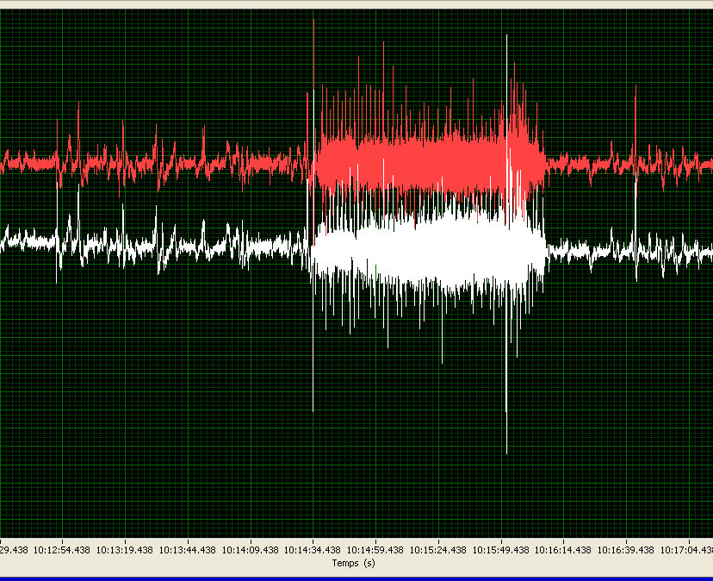
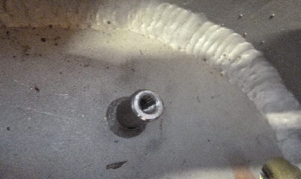
About Cavity Degradation
2nd process: Internal contamination may have 3 causes:
Vibrations: vibrations occurs alos during the ‘5 assembly weeks’ outside of the clean room when the string is vented.
e.g vibrations during cut-out of Ti tubes e.g hammering of 6 pins
of the 2K 2-phase line along cavities on cold mass
The maximum acceptable acceleration
levels remains unknown to us.
XM35: 0.7 g during cutting for 2 mn, up to 4g shocks
during cutting tool positioning.

Slide 6
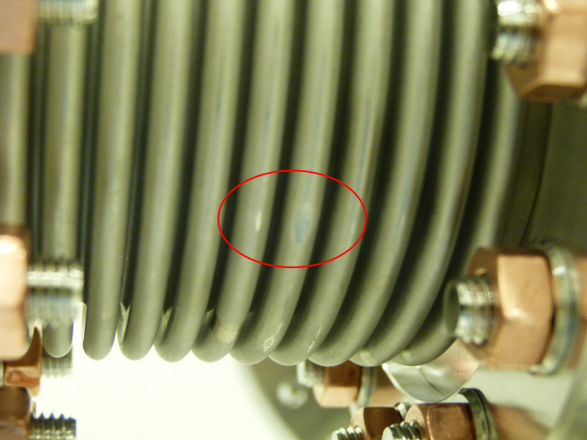
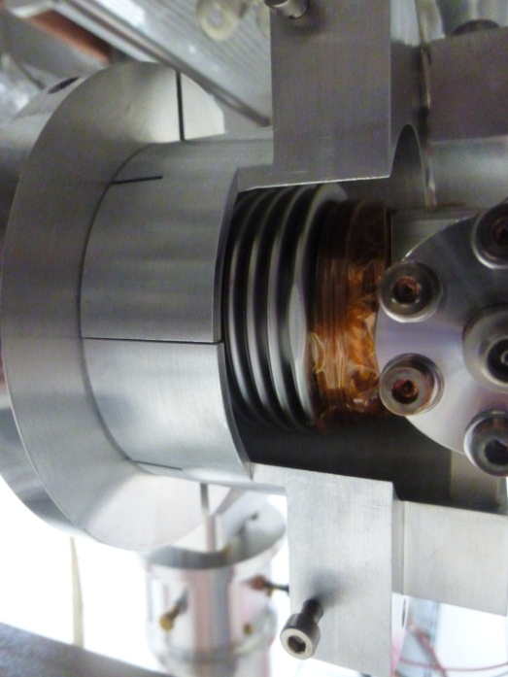
About Cavity Degradation
2nd process: Internal contamination may have 2 causes:
b) Particulates creation and migration: copper coating flakes on intercavity bellows and coupler Cold External Conductor are particularly suspected.
Conclusions:
several suspects were interrogated but the culprit is still loose ☺ ☹
ILC could help in conducting some assembly and RF tests.

Slide 7
Additional Cavity Degradations on string believed conform
Contamination can occur on a string which is believed to be conform against assembly procedures :
1st process: External contamination:
contamination du to a pumping through a leak which is later on close by tightening the fasteners (2 10-8mbarl/s) (exemple CAV_FE00668 With GV on : pumping over night)
2nd process: Internal contamination
Particulates creation: metallic dust due to opening and closing angle valve : solution optimize the assembly process to withdraw unnecessary close-open cycles (example solution3)

Slide 8
Particle-free Venting and Pumping of Cavities and Modules
Tests with particles counters were made in the CEA clean room for module string assembly.
standard operations on the slow venting and pumping system and the CEA pumping system do not cause particle transport.
In contrast, non-standard manipulations do generate particle transport. Especially, the flushing mode of the SVPS must not be used.
In flushing mode the initial conditions are less well defined. External sources of vibrations on the pump station and the pump lines behind the particle filter can cause particles being dislodged and transported.
A general problem that remains - even when the system are operation g normally - is that a vented vacuum system can support particle movement much better than a pumped system. Vibrations on vented systems need to be avoided as much as possible.

Slide 9
XM26 AUDIT
General observations
No major deviations to initial procedures (but one deviation can destroy 10 working days)
Operators walk to fast in the clean room
Difficulties to assemble pumping systems (pipes or pumps) with very smooth approach
Operators position versus critical RF surfaces not always perfect

Slide 10
Cold Coupler Workstation
Observations
Alignement of cavity not carefully performed: make coupler assembly more difficult
Gate valve procedure has been reviewed recently :
Open with nitrogen overpressure
no leak check in advance of the blowing connector flange
Action/improvement
Cleaning of gate valve will be more efficient
Gate valve procedure has been reviewed recently the

Slide 11
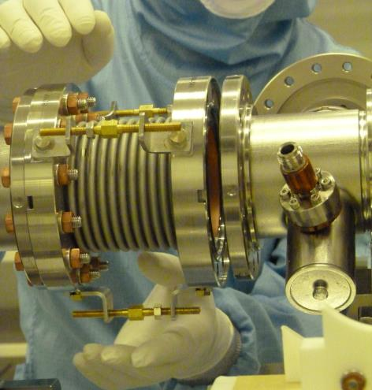
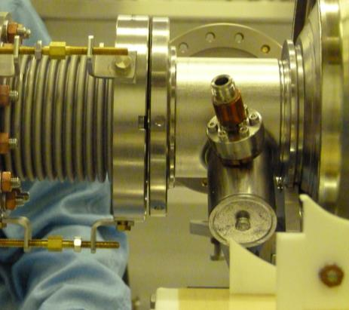
String assembly Workstation
observations
For production optimization the pre-alignement of the rotating flange of the bellow is not perform but minimum impact due to the use of spacer on the bellow
Action/improvement
  Optimization the way to introduce threaded rod and nut in the flange hole

Slide 12
XM26 AUDIT
ACTIONS
Written procedures available at workstation
Record the value of the cleanness level reached to the angle valve before the pump connection to the cavity
Two people requested to assemble pump to the cavity
Pre-alignment of parts has to be taken with care (easy assembly)
Improvement of operator position versus critical surfaces
Better teach two new operators

Slide 13
Cavity return to DESY for HPR
XM32/CAV00733/CEA-XFEL-RNC-15-523
operator forgot to clean angle valve before the connection to the pumping unit
preventive action: information to operator how crucial is this step!
XM41/CAV00668/CEA-XFEL-RNC-15-627
one leaky connection on the Blowing Connector then pump over night against cavity coupler and VGV
preventive action: VGV and blowing connector are leak check elsewhere before been used.
XM41/CAV00610/CEA-XFEL-RNC-15-633
accidental turn of the nitrogen valve : cavity vented quickly
preventive action: protection cap to prevent from non intentional turn of the valve
unexpected 10 min electrical shutdown of the cleanroom while cavity with coupler was open.
preventive action: none
wrong use of the CEA pumping unit by less experienced operator: cavity pumped quickly while vented already and its flange was ready to be unbolt :
preventive action: information to two recent operators

