Slide 1
Status of the Module BPMs
Dirk Nölle et al.
European XFEL Collaboration Meeting
DESY, 23.4.2015
Notes:
How to edit the title slide
Upper area: Title of your talk, max. 2 rows of the defined size (55 pt)
Lower area (subtitle): Conference/meeting/workshop, location, date, your name and affiliation, max. 4 rows of the defined size (32 pt)
Change the partner logos or add others in the last row.

Slide 2
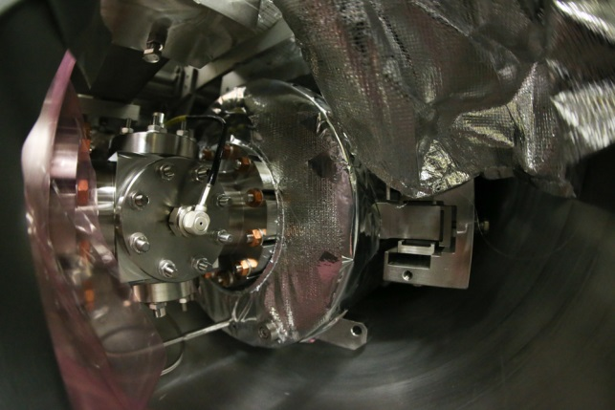
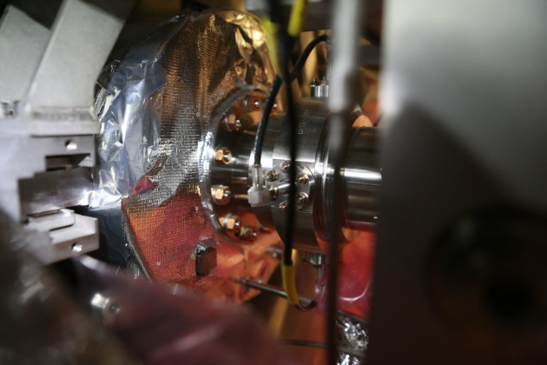
Availability of Cold BPMs
Material for cold BPMs -> 109 BPMs
BPMC:
77 bodies with feedthroughs
75 cable sets for inner module cabling
BPMR:
32 bodies with feedthroughs
35 cable sets for inner module cabling
Need to cover 100 series modules, plus 3 XM-, plus 2 3.9 GHz Modules -> 105 BPMs
About 30% of the BPMR and 60% of BPMC are already integrated into or assigned to a BPM Quadrupole Unit (BQU)

Slide 3
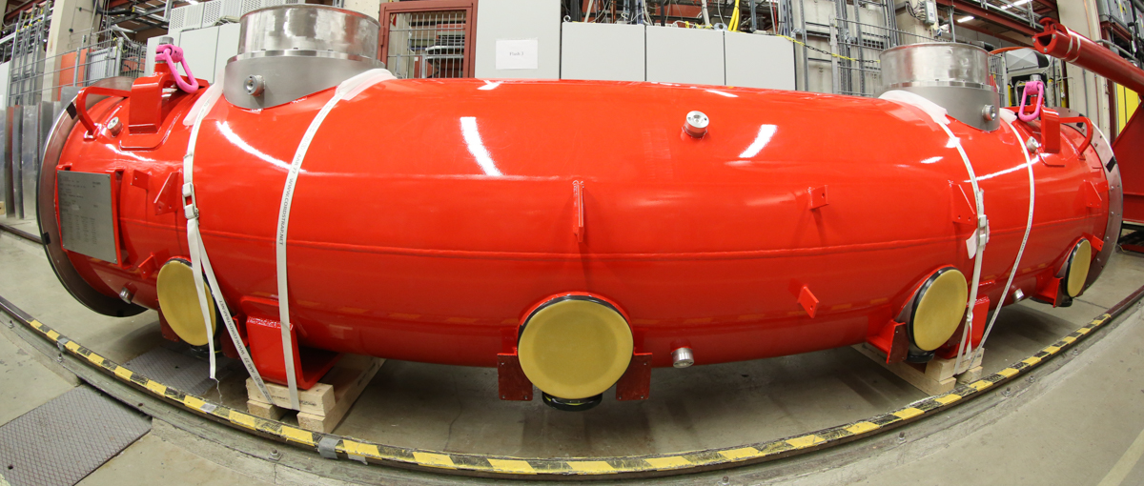
3.9 GHz Module
Both 3.9 GHz and Spare Module will be equipped with a Reentrant Cavity BPM
-> Injector 1.3 GHz Modules must have Button BPM
This allows to commission all BPM Types (except Undulator Cavity BPM) in the Injector
BPM and Module Cabling available at DESY for 3.9 GHz Assembly
Start of BPM Commissioning Late Summer 2015

Slide 4
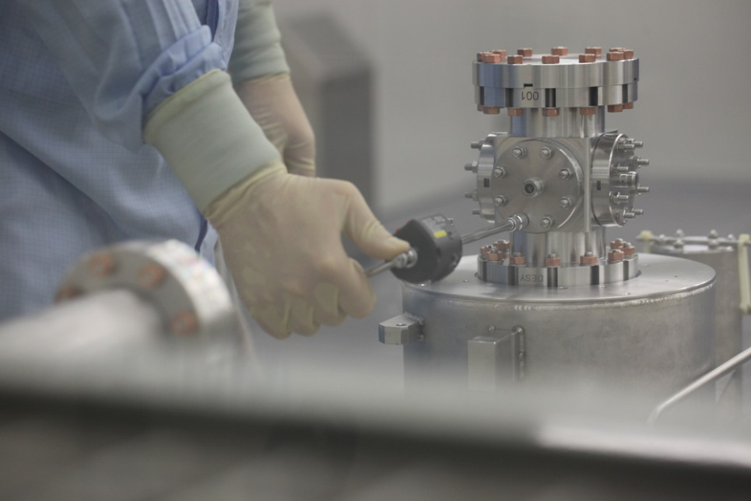
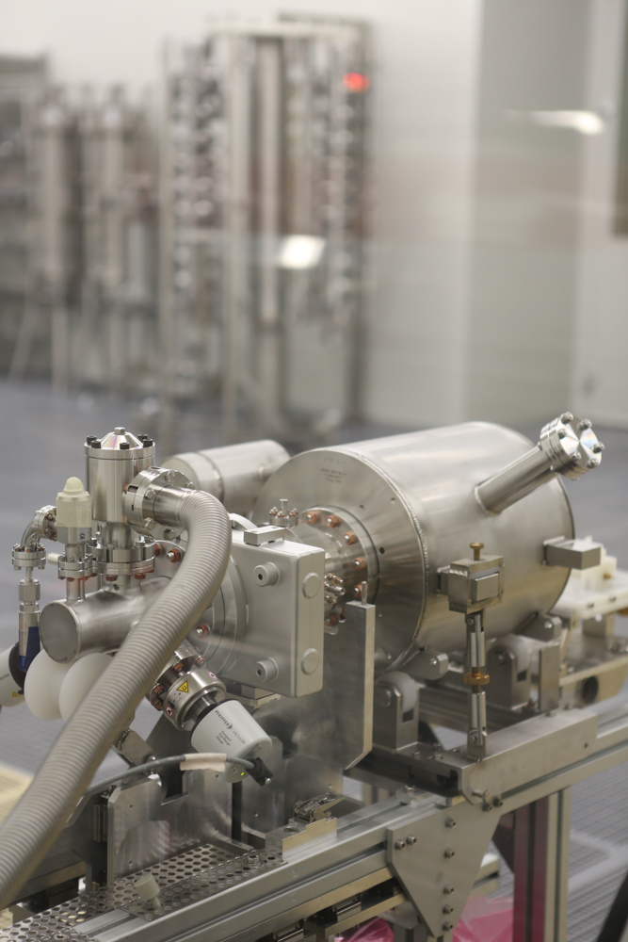
Current Status of the Assembly
Assembled BQU
with BPMR: 13 (31)
with BPMC: 49 (73)
Assembly Rate 1-2 BQU/week alternating BPMR/C
WP-17 takes care to have a buffer of 4-6 BPMs of each type

Slide 5
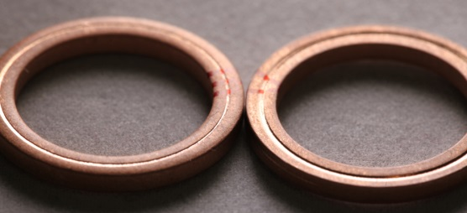
Discussions and Problems
BPMR Mechanics
Pre assembly tests at MDI show “fluctuations” in the contact of the feedthrough tip to the body and even no contact. CEA tests: no problem
-> Try to find out the difference in a common test assembly
Some feedthrough get dark carbon layers during the cleaning process. Need special extensive cleaning.
-> Cleaning Steps at CEA planned to reduce the effort
BPMR Electronics
Development of the RFFE of the BPR not finished up to now.
PRR in summer 2015 required to be ready for first beam in summer 2016.
-> strict reporting and milestone control established.

