Slide 1
Status Cold Magnet Production
H. Brueck
DESY, Hamburg, Germany
XFEL Project working group WP 11

Slide 2
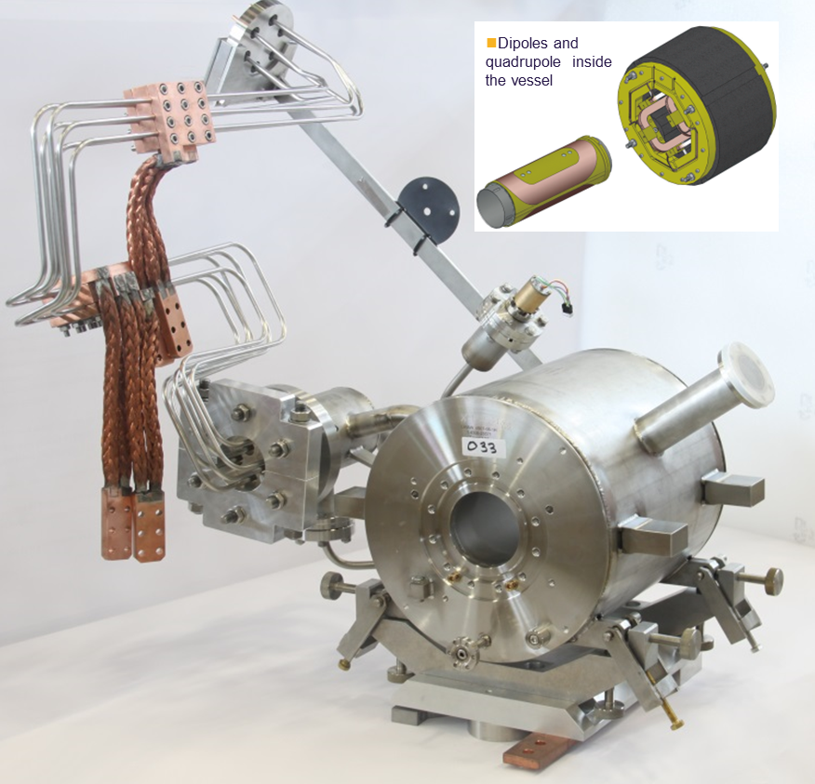
Magnet Production
Magnet production in Spain has finished
Thanks a lot to colleagues at CIEMAT for their work during the last years
Magnets at DESY
99(100) series
Last 2 magnets(one is a spare) passed all tests at the manufacturer and will be shipped next week
2 (2) for the 3.9 GHz module

Slide 3
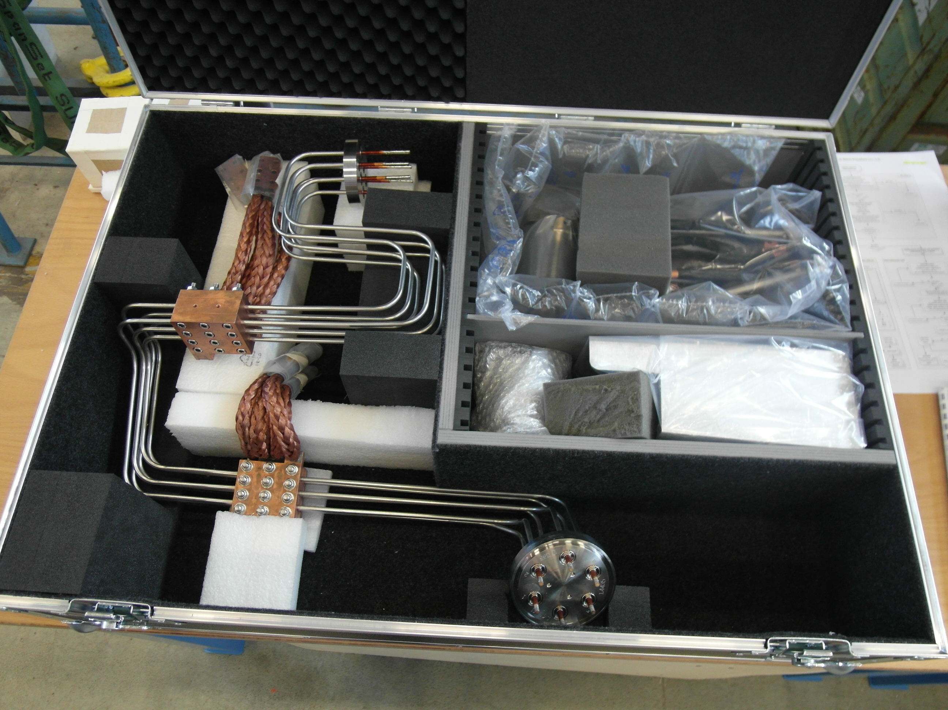
Lead Production and Test Status (this week)
97 (100) current leads are at DESY, the remaining 3 are expected until mid Mai
10 spare leads were ordered
All leads tested warm and cold and are ready for shipment
Leak check, high voltage check, geometry check, performance check cold
57 shipped to Saclay

Slide 4
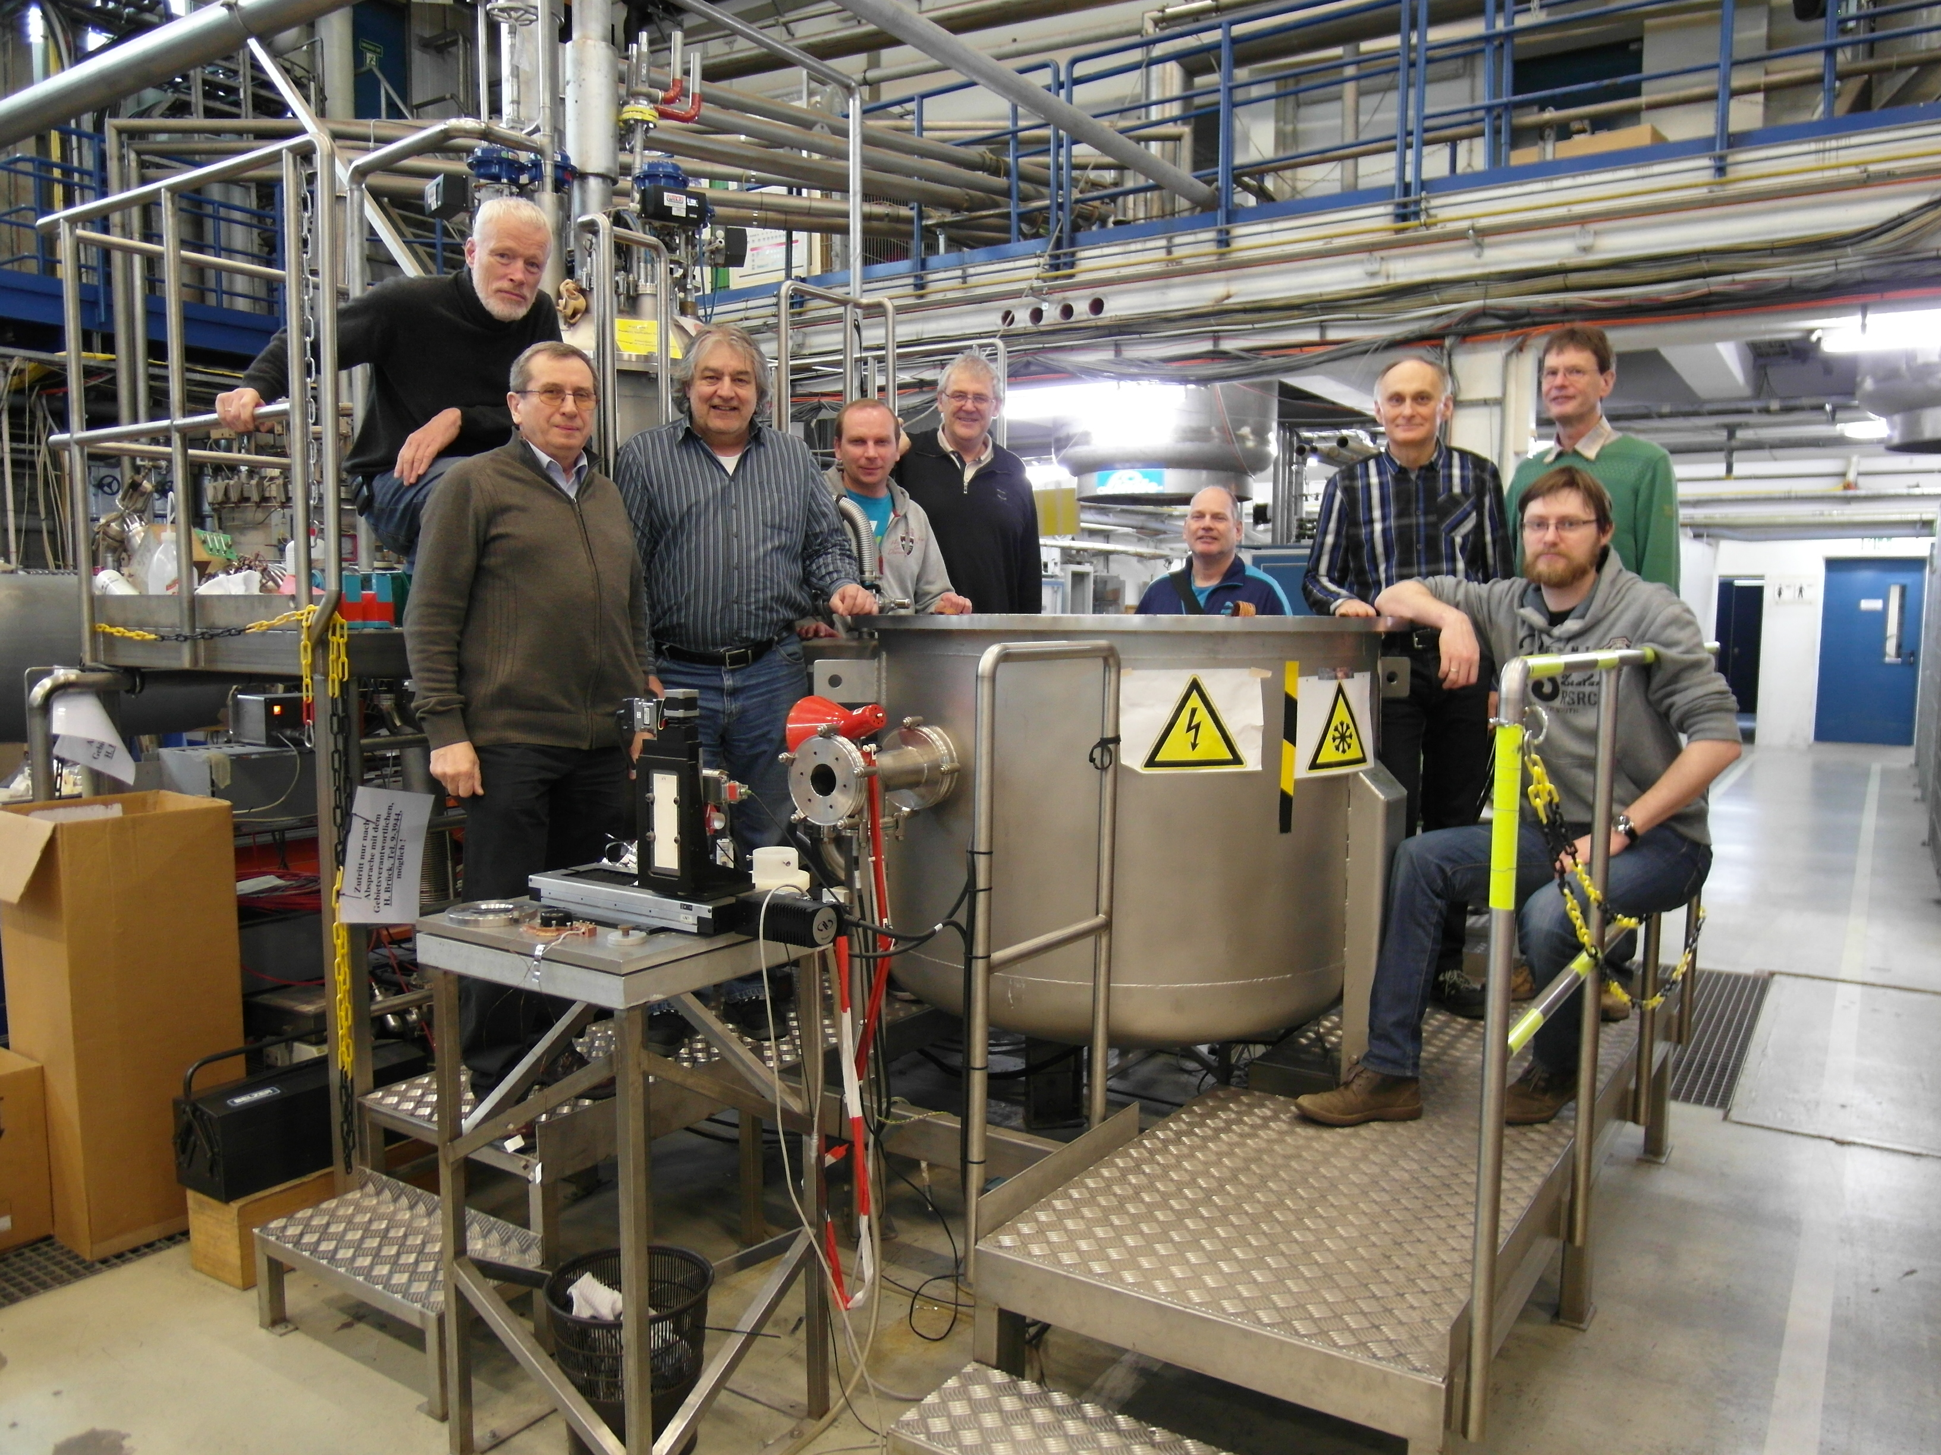
Magnet Test Status
All magnets in house were tested
the remaining 2 will follow in Mai
95 copper plated
46 BQU assembled
End of March the last milestone of the IFJ-PAN contribution to WP11 was fulfilled.
Thanks a lot to the colleagues from IFJ-PAN for their help over the last years.

Slide 5
Future Work
Continue tests at XMTS
mainly leads tests
Special measurements (unipolar cycling of magnets)
Preparing magnets for cleaning and leads for shipping
Continue tests at AMTF
Polarity checks of magnets in modules (so far one magnet showed inverse polarity)
every module needs power supply commissioning before magnet stability test
Still small problems with the new generation of XFEL type power supplies
Preparation of data tracking model

