Slide 1
WP-06: HOMs and Pickups XFEL Collaboration Meeting 2015-04-23
J. Sekutowicz
Notes:
How to edit the title slide
Upper area: Title of your talk, max. 2 rows of the defined size (55 pt)
Lower area (subtitle): Conference/meeting/workshop, location, date, your name and affiliation, max. 4 rows of the defined size (32 pt)
Change the partner logos or add others in the last row.

Slide 2
Beam Line Absorber – status of the production.
BLAs are the only components not yet fully delivered in frame of the NCBJ in-kind contribution.
BLAs produced till 31.03.2015; Status
 | Currently at DESY | Sent (or will be sent) back to vendor after inspection at DESY | New production, still with vendor
# | 49 | 25 | 11+
Status / Reason | Cu-layer and µ_{r} okay Spectrum test Cleaning Installed in tunnel (6) Ready for install. (3) | Re-coating (20), Cu peels off Welds had µ_{r} too high (2) Mechanical issues (3) | Inspection Re-coating
Notes:
Before you start editing the slides of your talk change to the Master Slide view: Menu button “View”, Master, Slide Master:
Edit the following 2 items in the 1st slide: 1) 1st row in the violet header: Delete the existent text and write the title of your talk into this text field 2) The 2 rows in the footer area: Delete the text and write the information regarding your talk (same as on the Title Slide) into this text field.
If you want to use more partner logos position them left beside the DESY logo in the footer area Close Master View

Slide 3
Cu-coating issue vs. permeability
Good adhesion of the Cu-coating requires an interlayer of Nickel.
The 1st delivery had this layer of the order of 3+µm, adhesion was good but the thick Ni layer caused that permeability, µ_{r} , was significantly ≥ 1.05 for several BLAs. All with µ_{r} > 1.16 have been sent back for re-coating.
DESY requested to keep µ_{r} ≤ 1.16 (much less conservative value).
For the next produced BLAs the thickness of Ni layer was reduced to 1-3µm.
These BLAs had still good adhesion and µ_{r} ≤ 1.12.
Then the thickness of Ni layer has been reduced second time to 0.3-0.7µm(??)
µ_{r} dropped below 1.04, but
Adhesion was poor in convolutions of bellows, peeling off was observed in many BLAs.
….and one may expect that some of BLAs, which need very long pumping time, have virtual leaks (blisters, not proven yet hypothesis).
All these BLAs have been sent back to vendor for the re-coating.

Slide 4
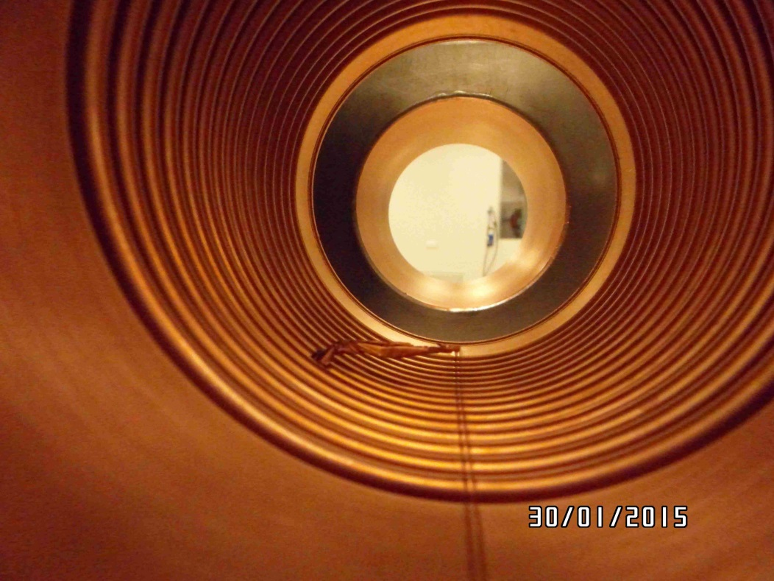
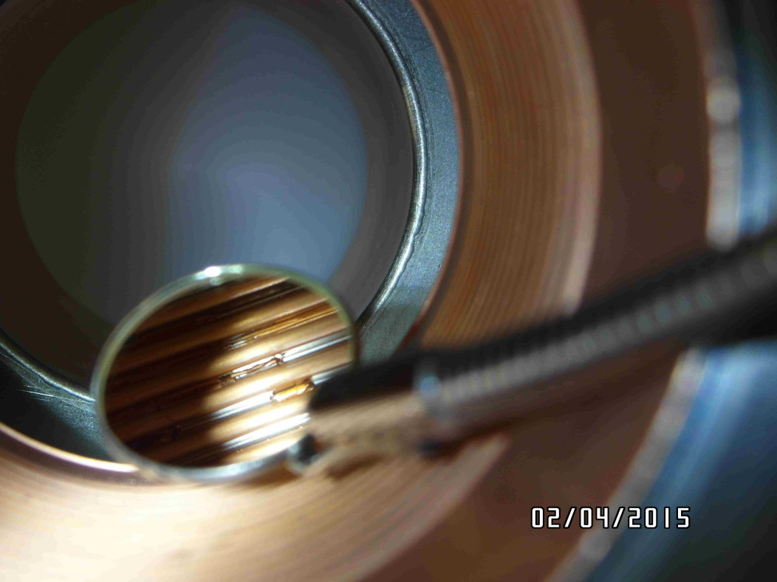
Cu-coating issue vs. permeability
Poor adhesion observed at DESY, on January 30th and on April 2nd, 2015

Slide 5
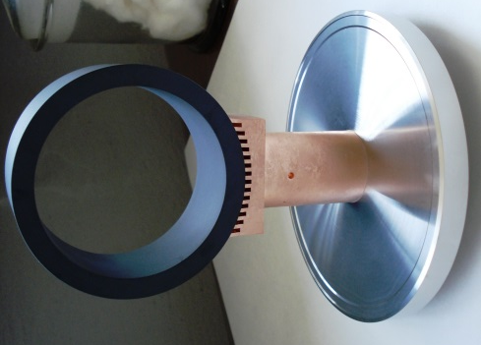
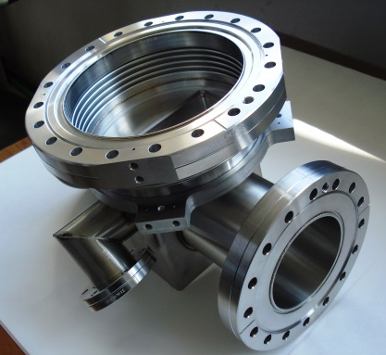
Cleaning and mass spectrum issues
All BLAs undergo leak test (as specified in the contract) performed by the vendor. 84 of 85 produced BLAs have passed this acceptance test.
During the production:
Ceramic ring with Cu-stub brazing and Cu-stub with Stainless Steel brazing is done in the vacuum oven at 950 C and 1050 C respectively.
Every housing, after the coating, is heat treated in 450C (1h) to test quality of the Cu layer

Slide 6
Cleaning and mass spectrum issues, cont.
One would expect that after these treatments BLA should be very clean. This was not the case for the 1st delivery. Decision was made to have much more advance incoming inspection and additional cleaning at DESY for all BLAs.
The procedure is unavoidable and time consuming (work performed mainly by MVS).
Disassembly +Visual, Mechanical and Cu-layer inspection
Permeability test of the housing
Cleaning of the housing:
Cleaning in ultrasonic bath
Rinse with ultrapure water
Rinse with isopropanol
Drying in 55 C
Cleaning of rings:
Cleaning in an ultrasonic bath (containing organic surfactants ?)
Rinsing with ultrapure water.
Drying in 55 C.
Baking in vacuum, T= 300 – 600 C.
Installation of the ring in the housing
…………………...
Mass spectrometer test.

Slide 7
Cleaning and mass spectrum issues, cont.
The cleaning procedure, even though it is done very carefully:
Does not result always in the specified RG spectrum.
Pumping time of the an assembled BLA varies from 4h to 100h.
We do not have a clear picture why it is so. The investigation is in progress!
Final remarks:
It seems to be understood why the Cu-coating peels-off. The vendor undertook measures to avoid it.
We need more time to find explanation why the cleaning is not always successful. It has the highest priority to us, because the BLA ready-to-install rate is to low at the moment.
More support for the MVS-group from the NCBJ is possible, if needed.

