Slide 1
Optical Laser Installation at SASE 1
Hamburg, 24th April, 2015
Max Lederer, Laser Group, WP78, European XFEL
max.lederer@xfel.eu
Notes:
How to edit the title slide
Upper area: Title of your talk, max. 2 rows of the defined size (55 pt)
Lower area (subtitle): Conference/meeting/workshop, location, date, your name and affiliation, max. 4 rows of the defined size (32 pt)
Change the partner logos or add others in the last row.

Slide 2
Overview
Laser Group WP78
Pump-probe laser R&D status
SASE 1 pump-probe laser installation
Conclusion

Slide 3
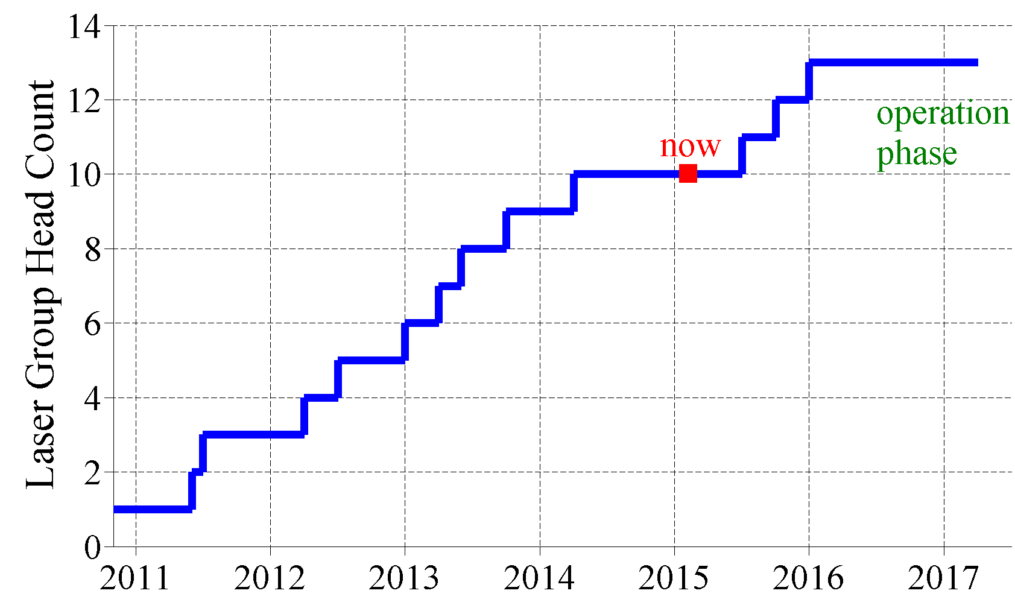
Laser group at European XFEL GmbH
Foundation: project WP-78, November 2010
Mission:
Provide and operate laser equipment for the x-ray beam line experiments
In-house developments
Industrial and academic collaborations
Personnel:
Construction
phase: 10
Installation,
commissioning,
operation: 13+

Slide 4
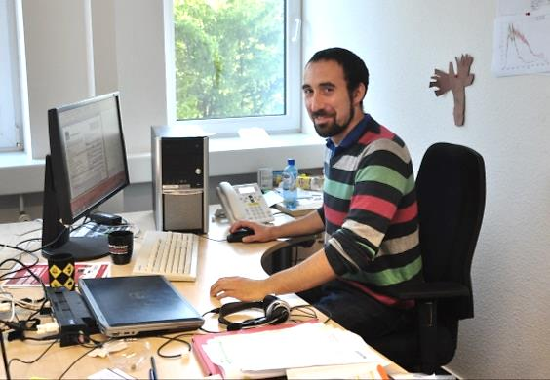
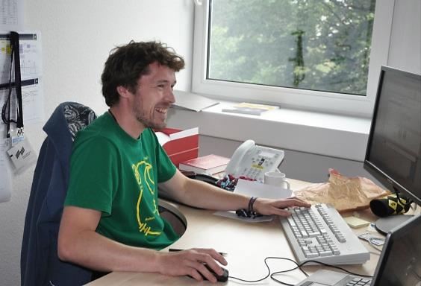
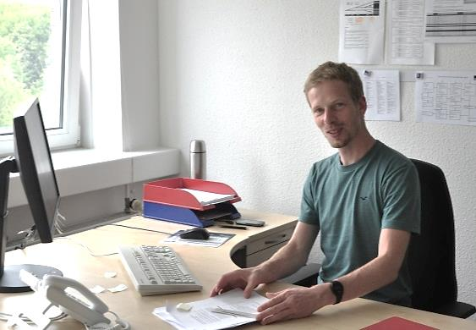
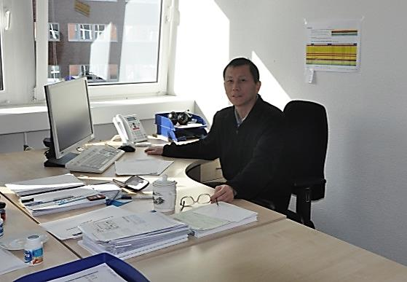
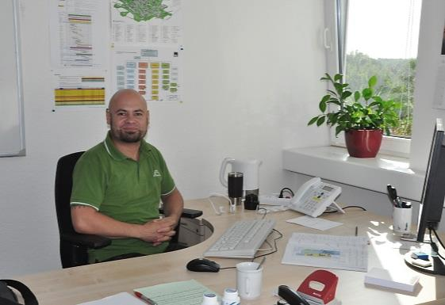
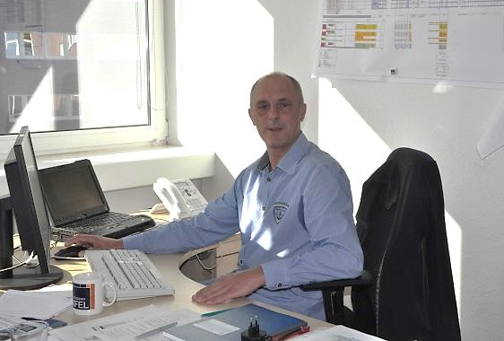
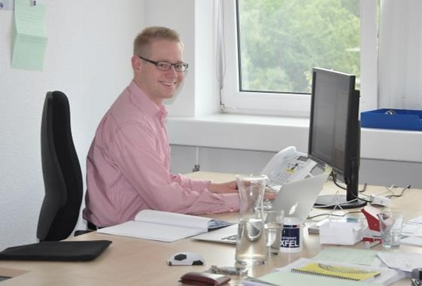
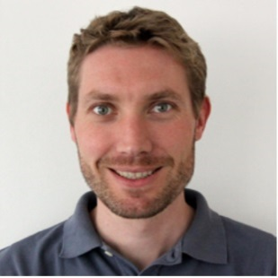
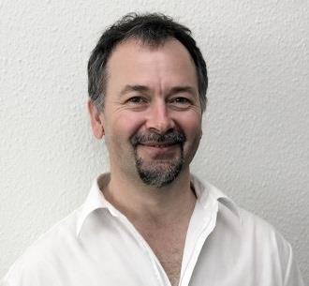
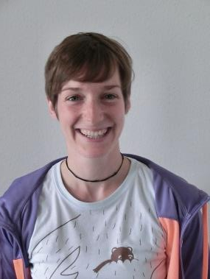
Laser group at European XFEL GmbH
Misha Pergament (pp-laser)
Martin Kellert (pp-laser)
Kai Kruse (pp-laser)
Jin Wang (pp-laser)
Guido Palmer (pp-laser and instruments interface)
Gerd Priebe (HED-lasers, HIBEF)
Moritz Emons
(pp-laser and instruments interface)
Max Lederer
(group leader)
Laurens Wißmann (mon. and contr.)
Ulrike Wegner (pp-laser)

Slide 5
Laser Advisory Committee (LAC)
Joint European XFEL and DESY LAC:
Review, evaluate and expertly advise laser groups on all developments, installations and operations of facility related lasers
Provide strategic advice to management and report to SAC
Members
Uwe Morgner (LZH, Uni Hannover), Chair
Giulio Cerullo (Politechnico di Milano)
Patrick Georges (Institut d’Optique, Paris)
Alfred Leitensdorfer (Uni Konstanz)
Robert Schoenlein (LBNL, Berkeley)
William White (SLAC)
Mike Dunne (LCLS)
LAC convened the 4th time in September 2014, endorsing our efforts and progress.

Slide 6
PP-Laser R&D status

Slide 7
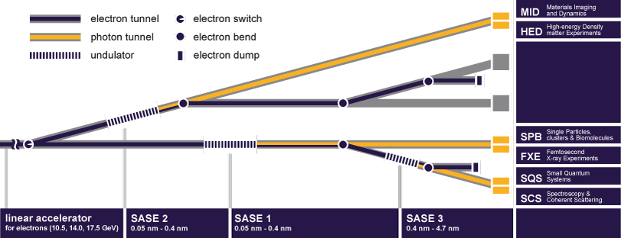
European X-ray Free Electron Laser Facility
3 underground experimental areas with 3 X-ray beams
6 experiment stations
Up to 60% of experiments require optical lasers.

Slide 8
European XFEL experimental laser plans
Experiment Hall
Types of experimental lasers:
PP (pump-probe):
sub-15…100fs, 0.2mJ, 10Hz burst, 0…4.5MHz, 800nm
MAL (molecular alignment):
sub-20fs, 3…10mJ, 10Hz burst, 800nm („kick“)
or
1J-class, 10Hz or burst, ns („adiabatic“)
TUNE (tuning, freq. conversion):
UV…mid-IR, THz
TW (Terawatt):
<30fs, >1Hz, 100 Terawatt–class laser, Ti:sapphire
SHOCK (high energy):
100J … kJ-class ns-laser, exponential ramp
MID
HED
SASE 2
TW
PP
TUNE
PP
SHOCK
U1
PP-type
high rep-rate
U2
HE/HI-type
FXE
SPB
SASE 1
PP
MAL
TUNE
PP
MAL
TUNE
SCS
SQS
Baseline
HiBEF User Consortium
SASE 3
PP
MAL
TUNE
PP
MAL
TUNE
Notes:
Before you start editing the slides of your talk change to the Master Slide view: Menu button “View”, Master, Slide Master:
Edit the following 2 items in the 1st slide: 1) 1st row in the violet header: Delete the existent text and write the title of your talk into this text field 2) The 2 rows in the footer area: Delete the text and write the information regarding your talk (same as on the Title Slide) into this text field.
If you want to use more partner logos position them left beside the DESY logo in the footer area Close Master View

Slide 9
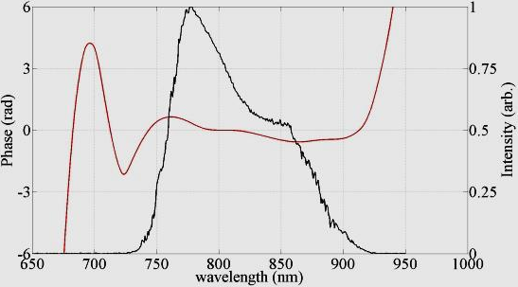
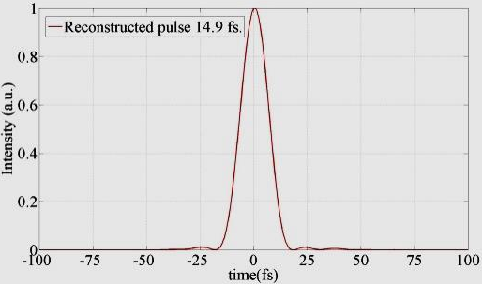
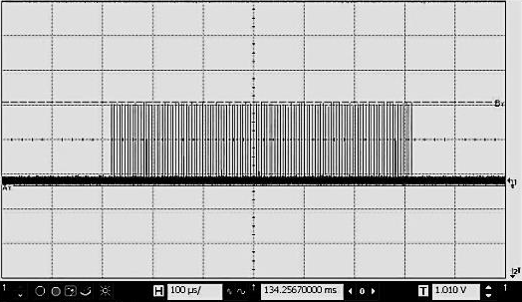
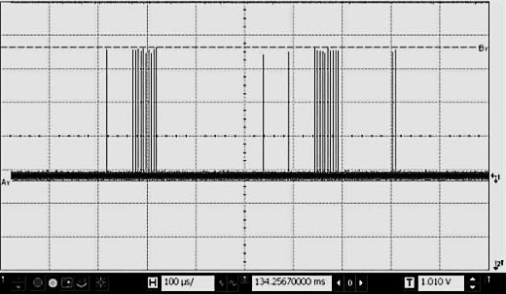
Status of pump-probe laser NOPA R&D
diff. lim.
15fs
600µs burst
Some features:
180µJ per pulse, 34W average power during burst
Nearly transform limited pulses: 15fs … 75fs
100nm tuning for longer pulses
200kHz and 4.5MHz intra-burst operation
Identical performance from BBO and LBO
Arb. sequence
High power burst-mode optical parametric amplifier with arbitrary pulse selection
Optics Express, Vol. 22, Issue 18, pp. 22202-22210 (2014)

Slide 10
What‘s left to do?
Finalize till Q1 2016:
5kW-pumped NOPA-stages
Control and monitoring integration of PP-laser (Karabo etc.)
PP-laser layout and CAD-integration
Some opto-mechaical desings, environmental stability
Procurement
Evaluation of 20kW pump
All efforts are currently on track.

Slide 11
SASE 1 Pump-Probe Laser Installation

Slide 12
Status November 2014
WBS-document for SASE 1 completed
Identified stake holders and their function as: „coordinator“, „executor“, „customer“
Identified 5 phases with associated tasks:
Before installation of laser tables (Start hutch construction -> Mar. 2016)
Installation of laser tables and additional (under-table) infrastructure (Apr. -> June 2016)
Installation and commissioning of laser components in PP-Hutch (Jul. 2016 -> Apr. 2017)
Final Commissioning of AC (Dec. 2016)
Beam delivery to ILH and experiment (Jul. 2016 -> Apr. 2017)
Handed over to PSPO

Slide 13
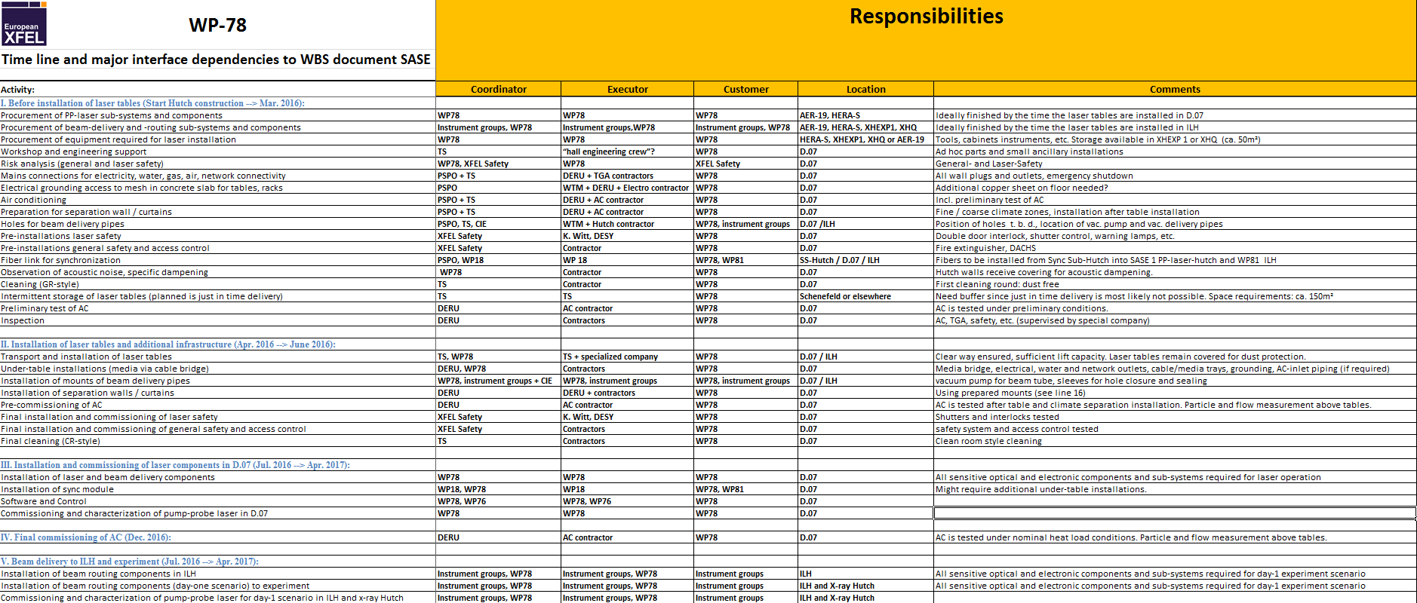
WBS SASE 1: major tasks and responsibilities

Slide 14
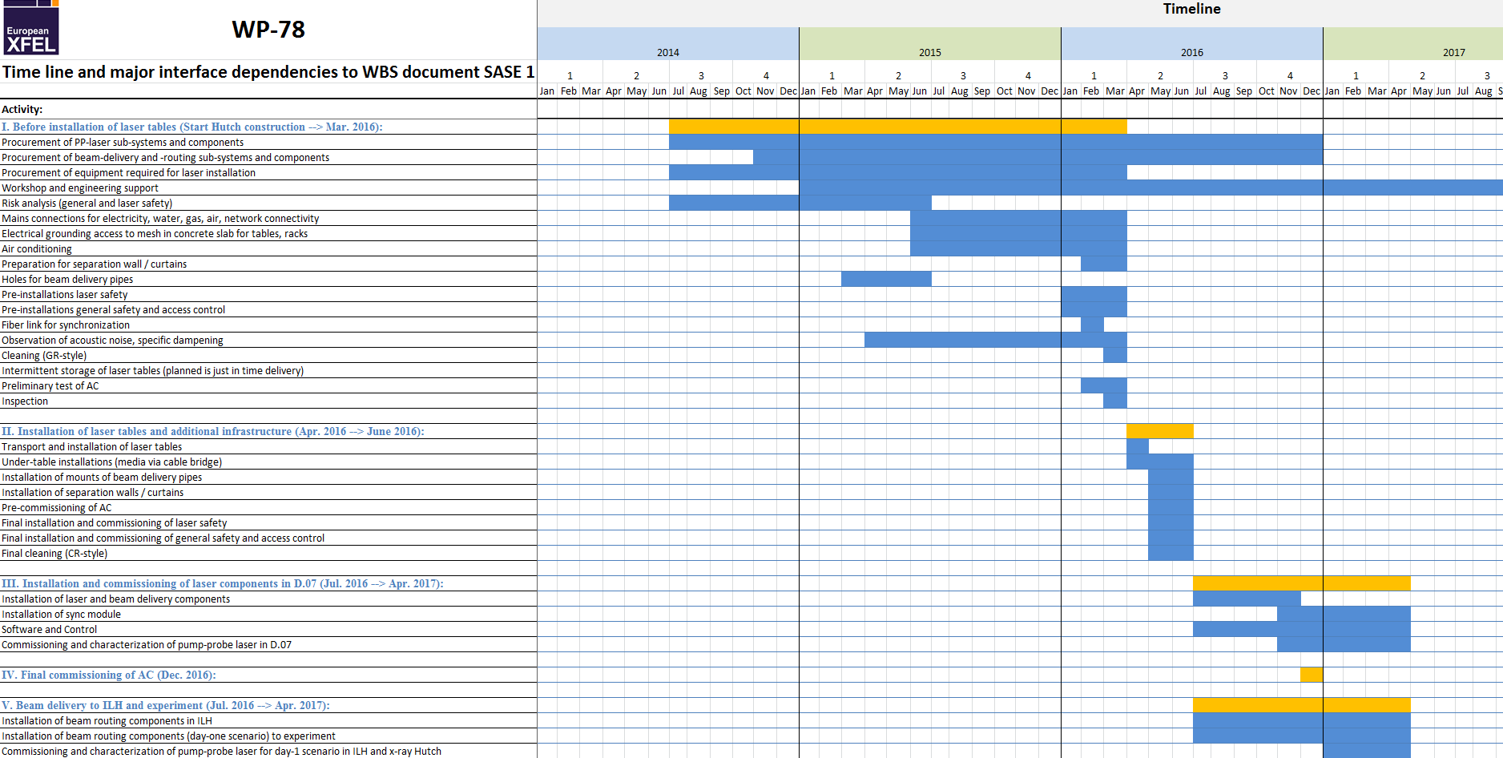
WBS SASE 1: major tasks and time line
NOW
Detailed planning of phase III is currently being drafted

Slide 15
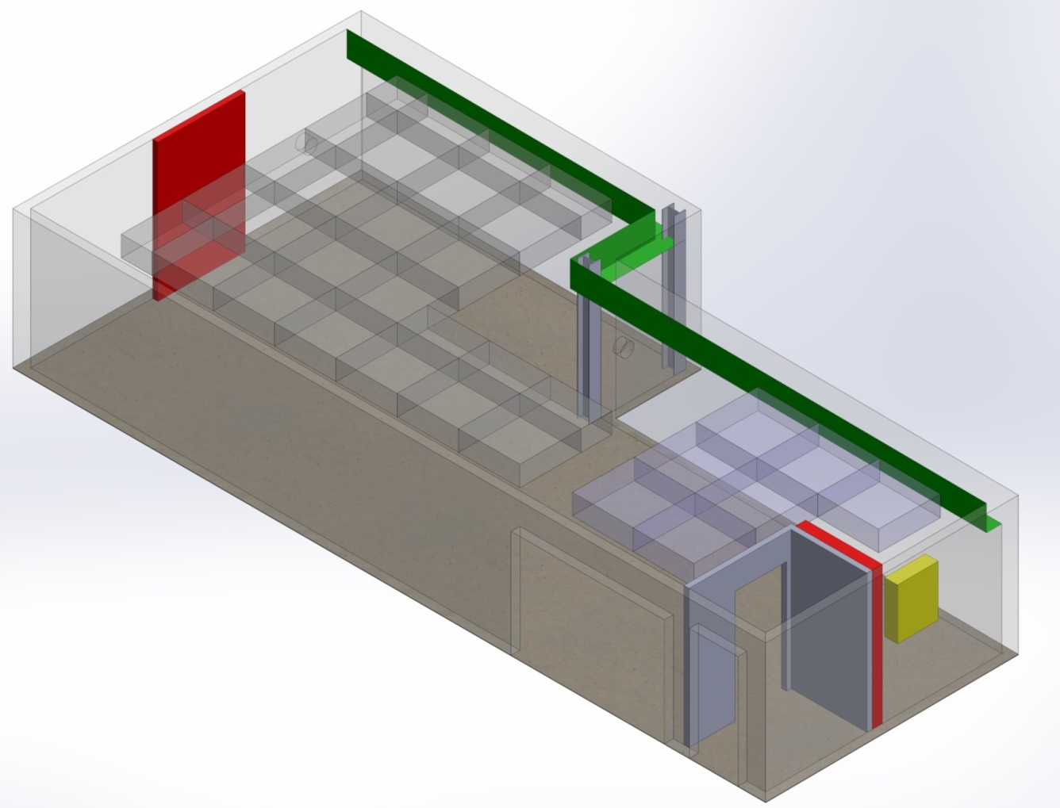
I: Before installation of laser tables (-> Mar. 2016)
At the end of phase I we have:
Electricity, network, water, gas as specified at walls
Electricity, network, water at access point for under-table installation
AC and GR condition
Ideally:
Hutch access control
Safety (general and laser)
Sync-cable (WP-18)
Access point for
under-table installation

Slide 16
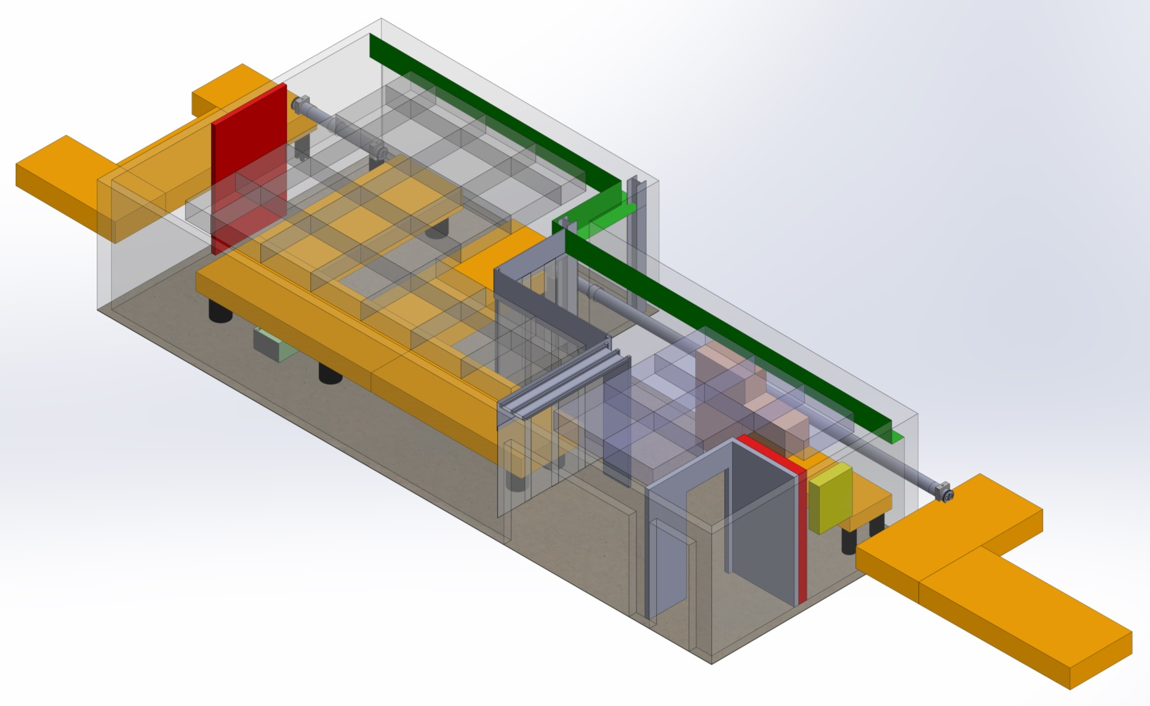
II: Installation of laser tables and additional (under-table) infrastructure (Apr. -> Jun. 2016)
At the end of phase II we have:
Laser tables and furniture installed
Under-table installation complete as specified
Beam delivery pipes installed
Climate separation
Hutch access control
Safety (general and laser)
Sync-cable (WP-18)
AC initial comm. and CR conds.
Furniture
ΔT=21+/-0.1°C
ΔT=21+/-1°C
Access point for
under-table installation

Slide 17
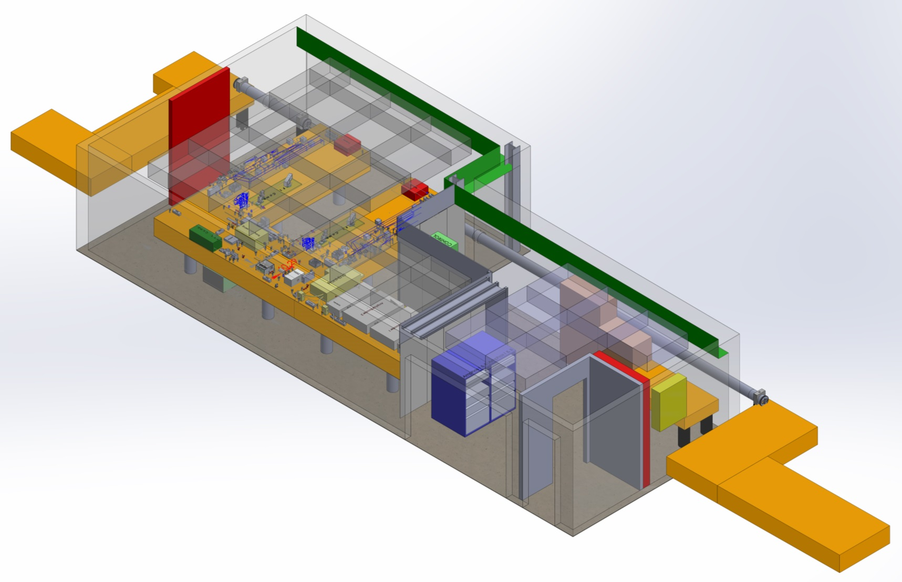
III and IV: Installation and commissioning of laser components in PP-Hutch (Jul. 2016 -> Apr. 2017)
At the end of phase III we have:
Operative PP-laser with synchronization and Karabo-control
Beam delivered to ILH
Exclusive WP-78 effort
Phase IV:
Fully commissioned AC
Access point for
under-table installation

Slide 18
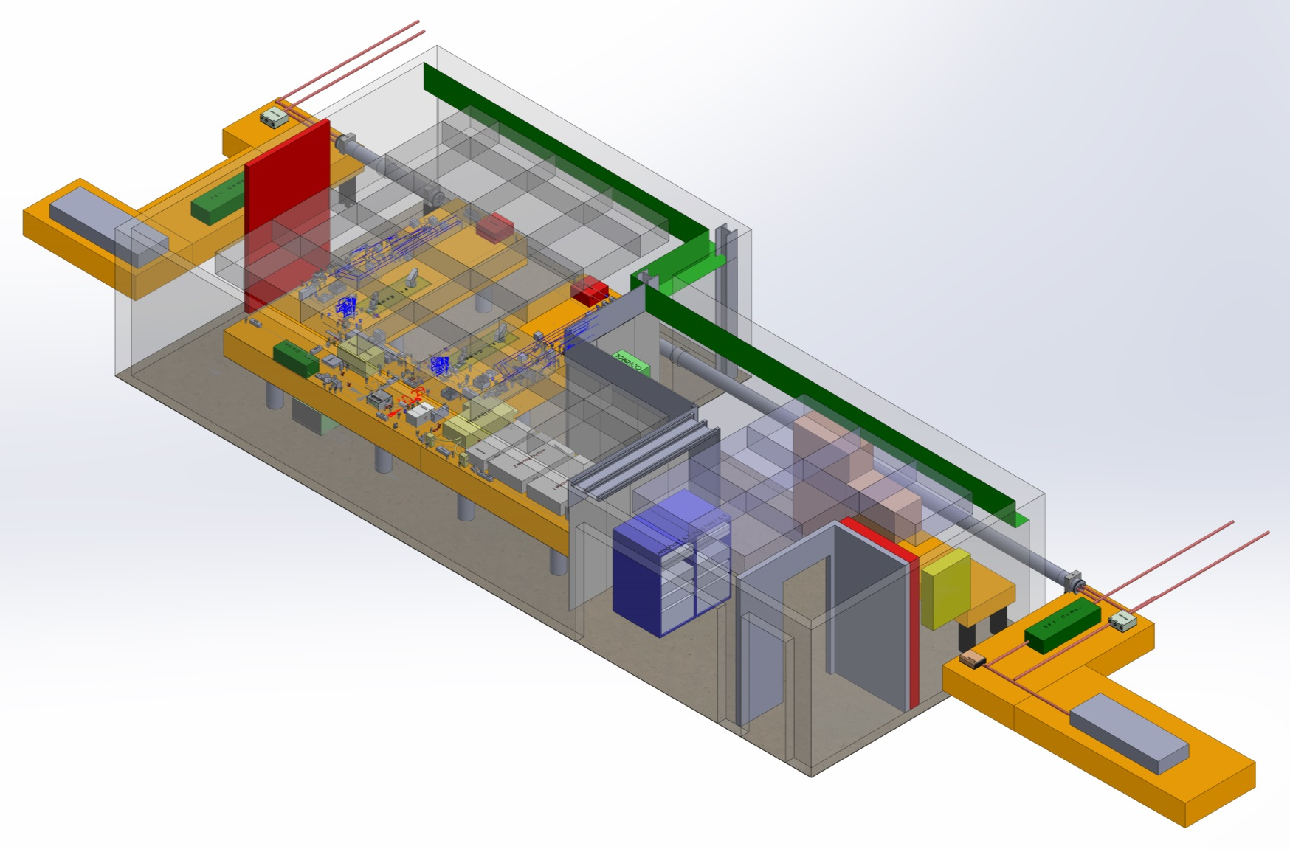
V: Beam delivery to ILH and experiment (Jul. 2016 -> Apr. 2017)
At the end of phase V we have:
Beam delivered to first experiment
Combined effort WP-81/84 and WP-78

Slide 19
Conclusion
Laser installation at SASE 1
PP-laser development status: on schedule
PP-laser procurement started mid 2014: ongoing
Installation planning: WBS with time line
PP-laser hutch planning: finalized
Hutch construction: masonry started

Slide 20
Thank you!!

Slide 21
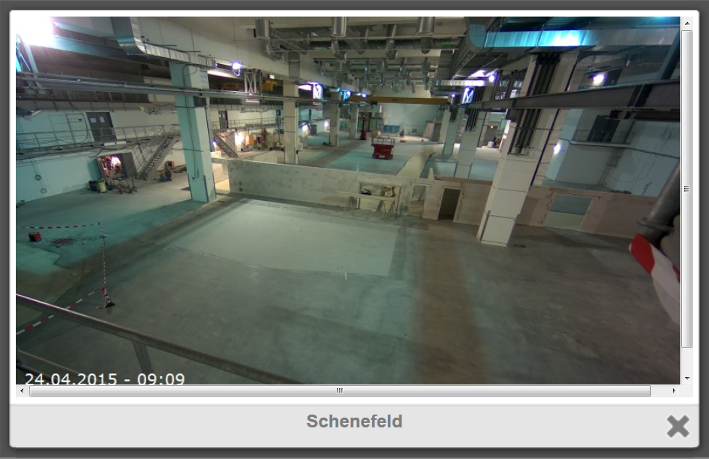
SASE 1 laser hutch constr. status

