Slide 1
BC1/BC2 girder integration
presented by S. Lederer
Notes:
How to edit the title slide
Upper area: Title of your talk, max. 2 rows of the defined size (55 pt)
Lower area (subtitle): Conference/meeting/workshop, location, date, your name and affiliation, max. 4 rows of the defined size (32 pt)
Change the partner logos or add others in the last row.

Slide 2
Girder integration procedure
Installation drawings for each girder prepared by WP33/WP19
Check of availability of components
Based on the availably decision of which girder to be mounted next
WP19
WP12/33
WP17
WP18
WP19

Slide 3
Girder integration procedure
WP17 and WP18 components handed over to WP19
Magnet installation on girder (WP12/WP32/WP33)
WP33 delivers the girder with pre-mounted magnets to WP19
Opening of magnets (WP33/WP19)
Clean room installation of vacuum parts (WP19)
Including leak check and mass spectrum
Venting with dry nitrogen
Closing of magnets (WP33/WP19)
Transport of girder to „storage area“ (WP33)
Installation of girder in tunnel (WP33/WP32)
Closing of vacuum system by means of bellow units (WP19)

Slide 4
Girder status
BC1
Girder 1: ready for tunnel installation
Girder 2: availability check of components – scheduling phase
Girder 3: depends on completeness of UHV part of TDS
Girder 4: availability check of components – scheduling phase
Girder 5: ready for tunnel installation
Girder 6: ready for tunnel installation
Girder 7: ready for tunnel installation
Girder 8: availability check of components – scheduling phase
Girder 9 (special steel girder):

Slide 5
Girder status
BC2
Girder 1: ready for tunnel installation
Girder 2: availability check of components – scheduling phase
Girder 3: depends on completeness of UHV part of TDS
Girder 4: availability check of components – scheduling phase
Girder 5: availability check of components – scheduling phase
Girder 6: ready for tunnel installation
Girder 7: ready for tunnel installation
Girder 8: in clean room for vacuum system installation
Girder 9: scheduled CR installation week 18
Girder 10: scheduled CR installation week 19
Girder 11: scheduled CR installation week 20
Girder 12: availability check of components – scheduling phase

Slide 6
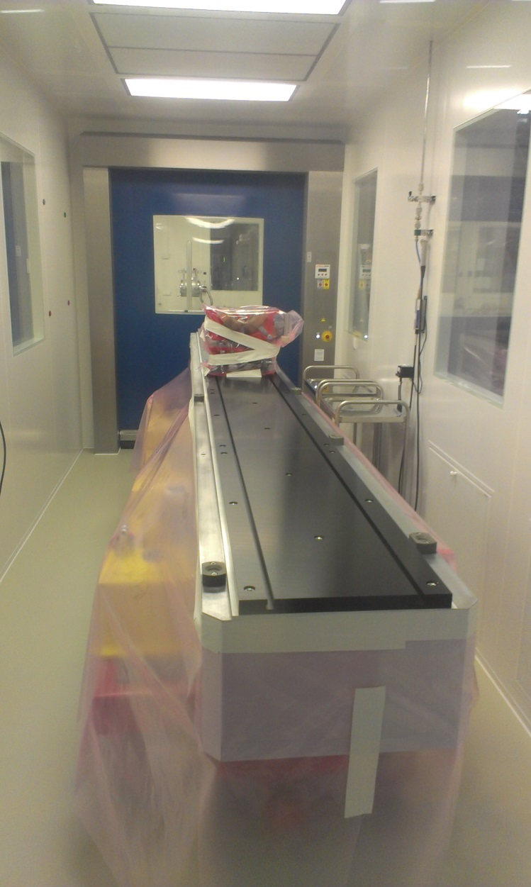
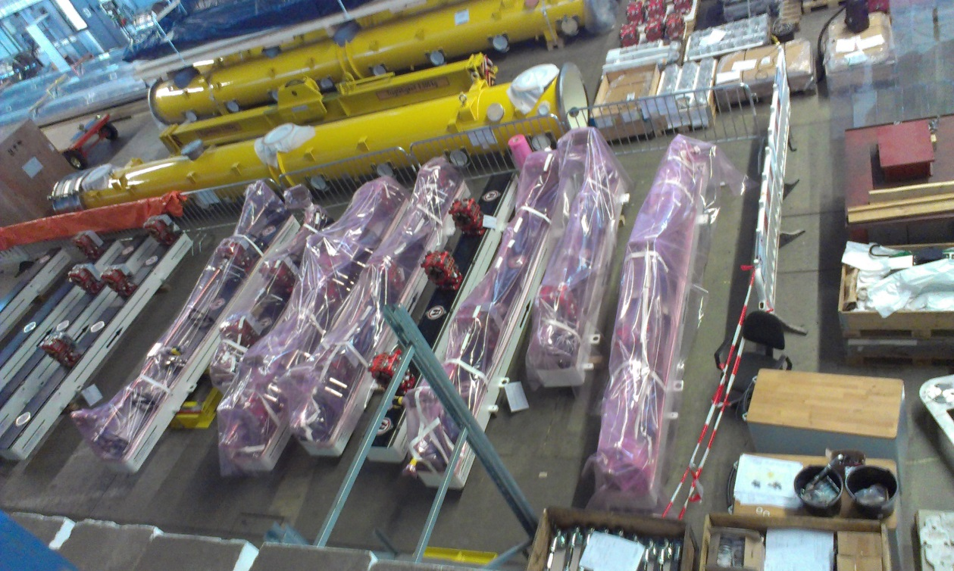
Girder status
BC2 girder 8 clean room roll-in
BC girder storage

Slide 7
Plan for girder tunnel installation
Connection of two girders will take a day
If sufficient man power is available two connections per day will be possible – two clean rooms available
Final pump down and leak check – one week
Detailed scheduling required since best would be the complete check of the BC vacuums systems, including
Chicanes
and dump lines
Electronic installation for vacuum components and check two weeks – if all cables, racks and μTCA components are available

Slide 8
Final remarks
Up to now the girder installation worked quite fine
Good collaboration and short way agreements between involved WPs
Girder installation in clean room takes one week as scheduled
Two girders per week are possible if
Sufficient manpower is available – depends on module schedule (preparation of parts and module connections)
Equipment is not blocked by unpredicted work for BLAs
The whole girder integration is done without the missing section coordination
Documentation of the machine is not defined at all up to now
EDMS business of the sections or even girders unclear
Pending issue of installation drawings – has to be solved centrally and not on the shoulders of WPs in principle not responsible for CAD integration

