Slide 1
Installation Schedule
Markus Hüning
Notes:
How to edit the title slide
Upper area: Title of your talk, max. 2 rows of the defined size (55 pt)
Lower area (subtitle): Conference/meeting/workshop, location, date, your name and affiliation, max. 4 rows of the defined size (32 pt)
Change the partner logos or add others in the last row.

Slide 2
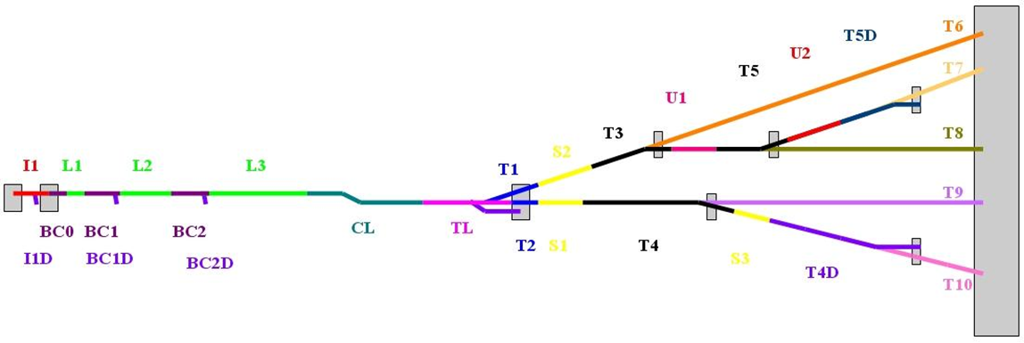
Warm Beamlines in XTL
900 lattice elements
385 magnets, 234 main magnets, 98 on girders
Approx. 1100m of beam line
Partly (B0, B1, B2) to be installed under clean room conditions
The downstream parts to be suspended from the ceiling

Slide 3
General Remarks
Like in the cold linac so far everything is driven by availability of components
Installation schedules kept shifting
Variety of reasons, some within WPs some outside
This resulted in a period of very little activity in XTL
This must come to an end if we are to keep the project schedule goal

Slide 4
Scheduling
Installation of bunch compressor bypass lines progresses
completion expected before summer
Large scale production of components just started
Very soon – or in this meeting respectively – will have a clearer picture of delivery times
It is now time to reestablish the schedule
In this talk I can give only a rough outline

Slide 5
Bunch Compressors
21 girders in BC1 and BC2
7 finished so far
50 concrete columns
24 racks and 2 modulators/klystrons

Slide 6
BC1

Slide 8
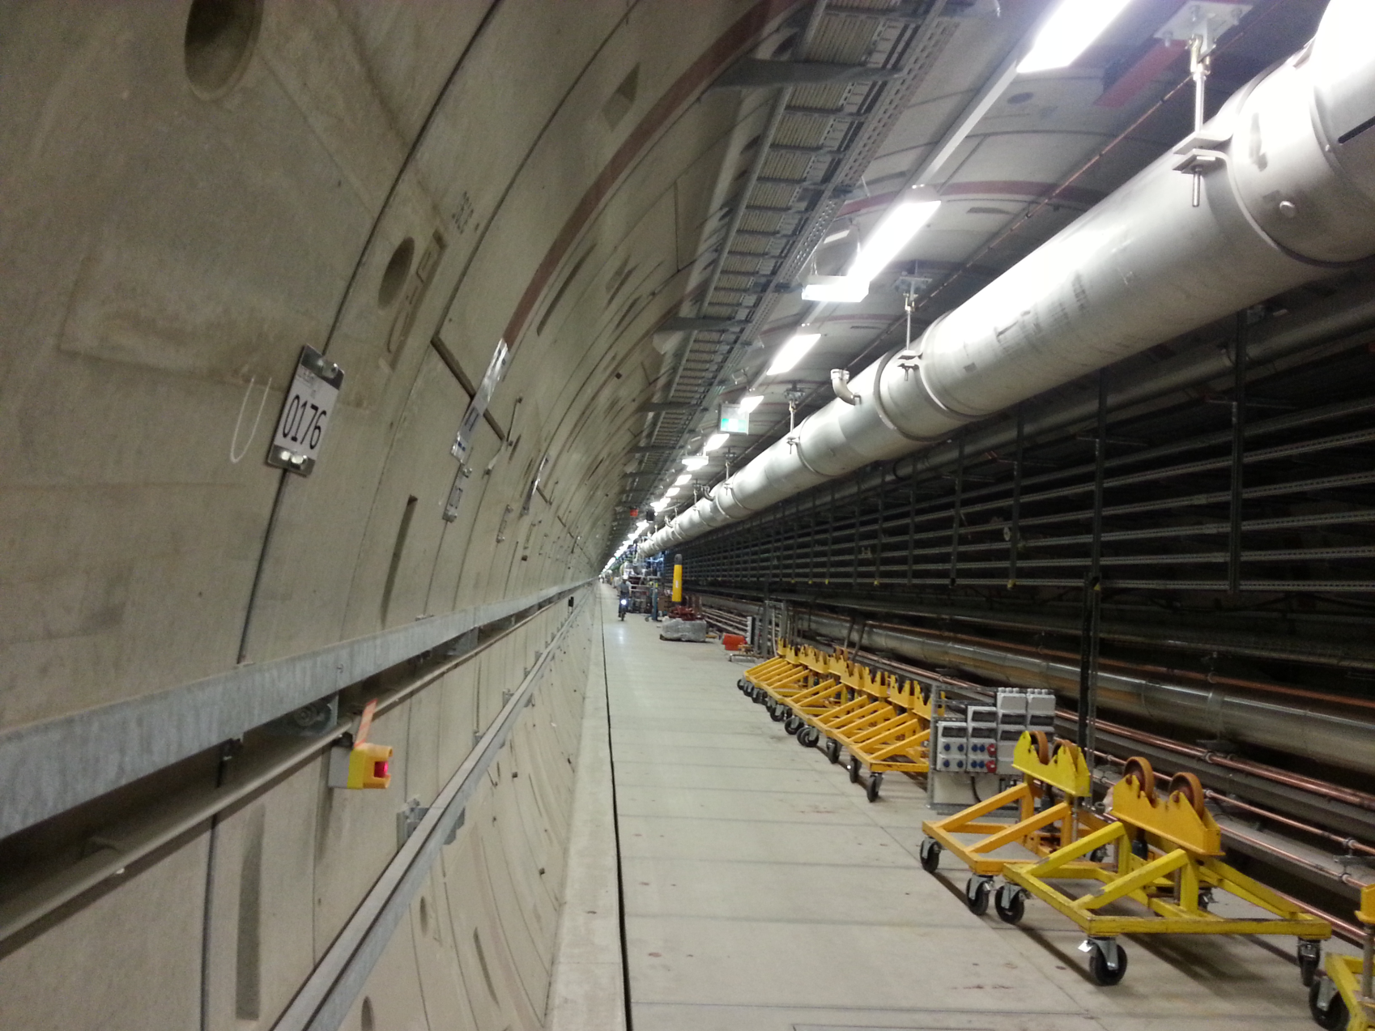
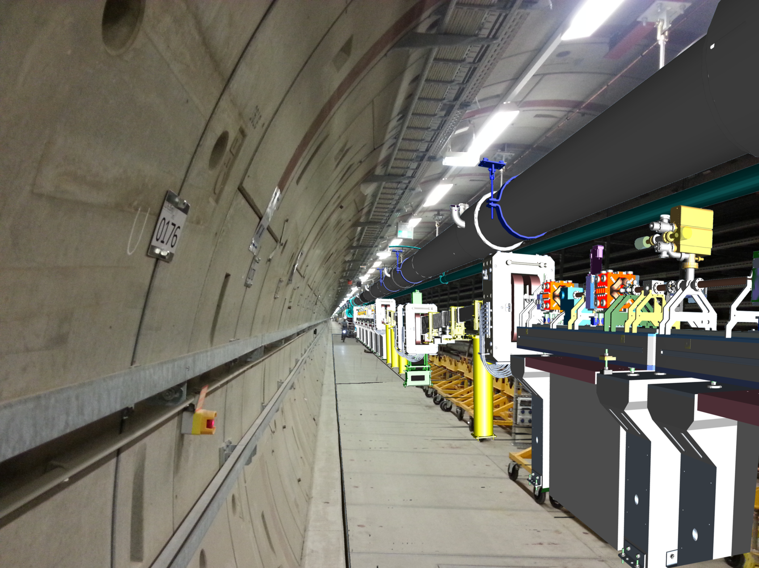
BC1

Slide 9
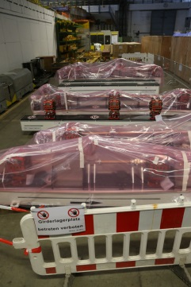

Slide 10
Cabling work
Magnet cables pulled whenever injector schedule and L1 commissioning allows
RF reference lines for L3

Slide 11
Sequence
Cryo Transfer Line
Finish
B1
Concrete Pillars&Girders
Vacuum Connections
Cryo Transfer Line
B2
Concrete Pillars&Girders
Vacuum Connections
Cables and Electronics
Summer time

Slide 12
End of L3, CL, TL
70 magnet suspension frames, 66 to be manufactured, 4 in house
Very massive to reduce vibrations
~400 m of vacuum line + vacuum suspension
At the end of XTL 3 beamlines above or besides each other

Slide 13
Beam Line Suspension

Slide 14
„Base“ of Vacuum Suspension

Slide 15
Welded Fixtures for Suspension Frames

Slide 16
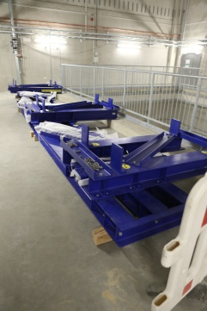
Frames already in house

Slide 17
Sequence
Manufacture Suspension Frames
Finish
Install Suspension Frames & Magnets
Manufacture Vacuum Components
Install Vacuum Components
Cables and Electronics
Summer time

Slide 18
Sequence
Cryo Transfer Line
Finish
B1
Concrete Pillars&Girders
Vacuum Connections
Cryo Transfer Line
B2
Concrete Pillars&Girders
Vacuum Connections
Cables and Electronics
Manufacture Suspension Frames
Install Suspension Frames & Magnets
Manufacture Vacuum Components
Install Vacuum Components
Cables and Electronics
Summer time
Christmas

Slide 19
Closing Remarks
Start of B1 installation presumably fits with end of injector shutdown
Does machine installation in XTD2 finish before end of summer?
Can we release manpower early to help out elsewhere?

