Slide 1
Status of downstream L3 (R28-R40) vacuum (WP19)
presented by S. Lederer
Notes:
How to edit the title slide
Upper area: Title of your talk, max. 2 rows of the defined size (55 pt)
Lower area (subtitle): Conference/meeting/workshop, location, date, your name and affiliation, max. 4 rows of the defined size (32 pt)
Change the partner logos or add others in the last row.

Slide 2
Overview
5 different beam lines:
L3 (145 m) – warm beam line downstream of the last accelerating module
Beam line design and fabrication of beam pipes, supports, bellow units and pump-crosses by BINP
Valves, pumps, fast shutters, cables and control system by DESY
RF-inserts and fiducial plates for In-line SIPs by BINP
Collimation section (200 m)
Beam line design and fabrication of beam pipes and supports by DESY
Main collimators and bellow units by BINP
Valves, pumps, fast shutters, cables and control system by DESY
RF-inserts and fiducial plates for In-line SIPs by BINP

Slide 3
Overview
Switch yard (170 m):
Beam line design and fabrication of beam pipes and supports by DESY
Valves, pumps, cables and control system by DESY
RF-inserts and fiducial plates for In-line SIPs by BINP
DN50 bellow units by BINP
TLD beam line (140 m, including XS1)
Beam line design and fabrication of beam pipes and supports by DESY
Valves, pumps, cables and control system by DESY
RF-inserts and fiducial plates for In-line SIPs by BINP
DN50 bellow units by BINP

Slide 4
Overview
T1 beam line (100 m in XTL):
Beam line design and fabrication of beam pipes, supports, bellow units and pump-crosses by BINP
Valves, pumps, fast shutters, cables and control system by DESY
RF-inserts and fiducial plates for In-line SIPs by BINP
T2 beam line (30 m in XTL)
Beam line design and fabrication of beam pipes, supports, bellow units and pump-crosses by BINP
Valves, pumps, fast shutters, cables and control system by DESY
RF-inserts and fiducial plates for In-line SIPs by BINP

Slide 5
Status
Beam line reviews took much longer as expected
Its obviously impossible to get an reliable 3d model from the CAD integration process
Changed from standing to hanging beam lines yielded a delay of over one year
Finally the clearance for production was coupled to the “Steuerskizze” (automatic placement of components depending on the lattice file)

Slide 6
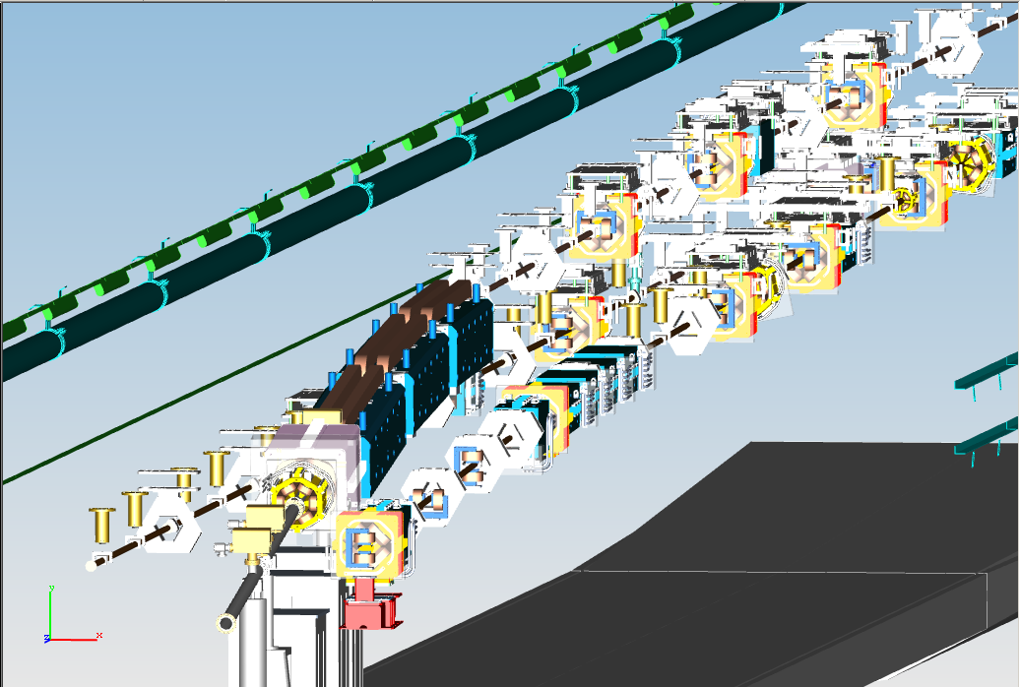
Most challenging installations, where the three beam lines (T1, T2 and TLD) go “parallel”
e⁻
T2
T1
TLD

Slide 7
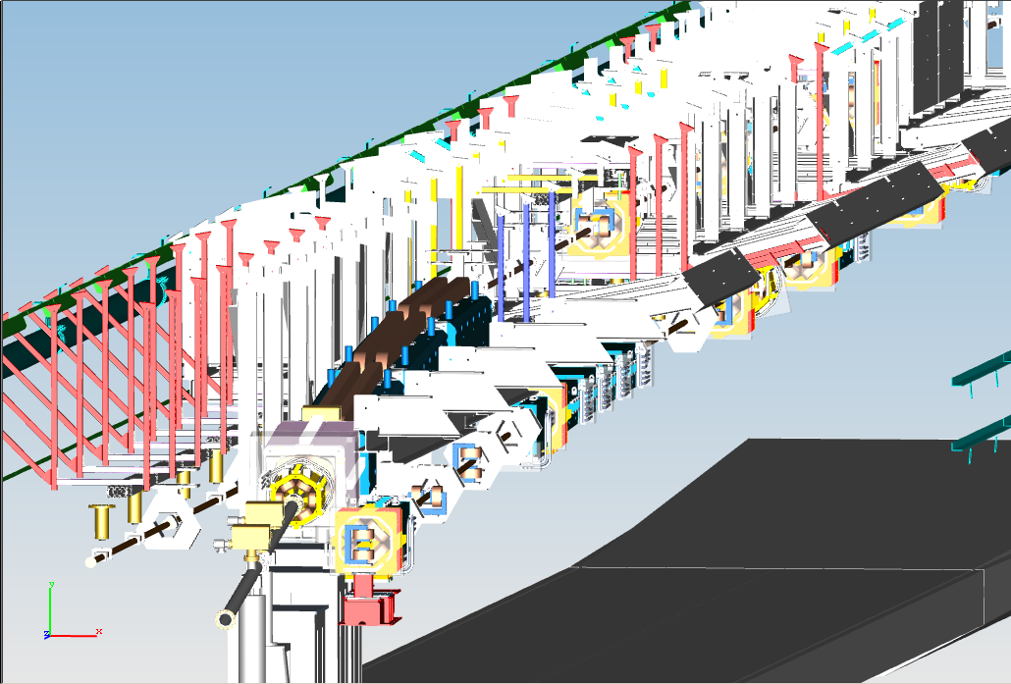
With supports things don’t look easier

Slide 8
Status - Rough number of components
Components | DESY | BINP
Standard SIPs | 50 | 0 but auxiliary parts needed
In-line SIPs | 110 | 0 but auxiliary parts needed
Gate valves | 10 | 0
DN50 beam pipes | 150 | 60
DN50 bellow units | 0 | 180
Main collimators | 0 | 4
Septa | 2 | 0
Of course for all components supports are required
* (green mean in-house)

Slide 9
Status
Fabrication of beam lines Collimation, Switch yard and TLD started – scheduled RFI 09/2015
Fabrication of L3, T1 and T2 beam lines to be started now to have them RFI 09/2015
Valves and pumps for all beam lines are available
Preparation work for in-line pumps (installation of RF-inserts, installation of plates for fiducials) depend on BNIP delivery – delayed from 03/2015 to 09/2015 w/o any given reason
Installation of Rose+Krieger supports started by WP33

Slide 10
Final remarks
Discussions on beam line installation started and will go on (WP19/WP33/WP34)
Installation of cables (not done by WP19) could be critical – has to be integrated in installation planning
Documentation of the machine is not defined at all up to now
EDMS business of the sections or even girders unclear
Pending issue of installation drawings – has to be solved centrally and not on the shoulders of WPs in principle not responsible for CAD integration
Despite the documentation issue it is also required for installation
THIS HAS TO BE SOLVED!

