Slide 1
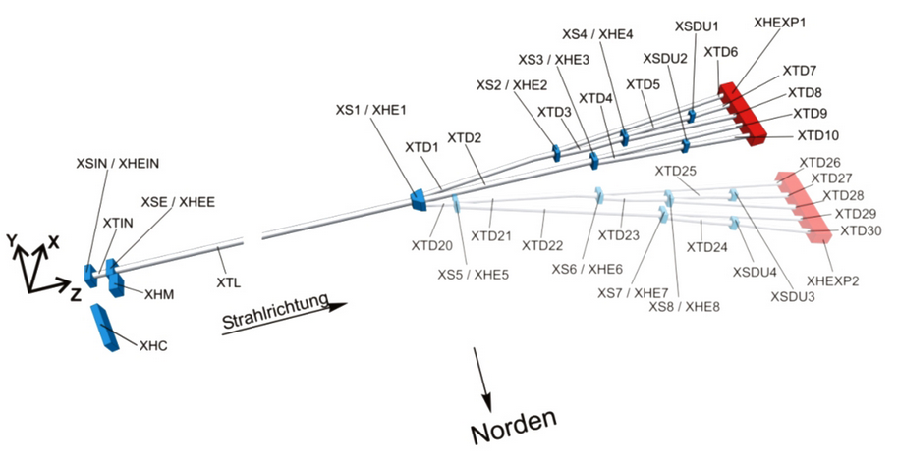
XFEL support frames
beam
north
Roland Platzer, ZM1
04/23/2015

Slide 2
XFEL support frames
Topics
Concept of support frames at XFEL
  Location, specifications, solution
Volume of construction
  Amount, manpower, production costs
Schedule
Documentation

Slide 3
XFEL support frames
Location
XFEL – accelerator tunnel XTL
Start at about Z = 1505 m, begin warm section (end of L3) – CAD room No. 28
End at about Z = 2100 m, last room of XTL – CAD room No. 40 (41)
Supported beamlines:
  CL (collimator line) – CAD room No. 28 - 35
  TL (transfer line) – CAD room No. 35 - 37
    TLD – CAD room No. 36 - 41
    T1 – CAD room No. 37 - 41
    T2 – CAD room No. 37 - 41

Slide 4
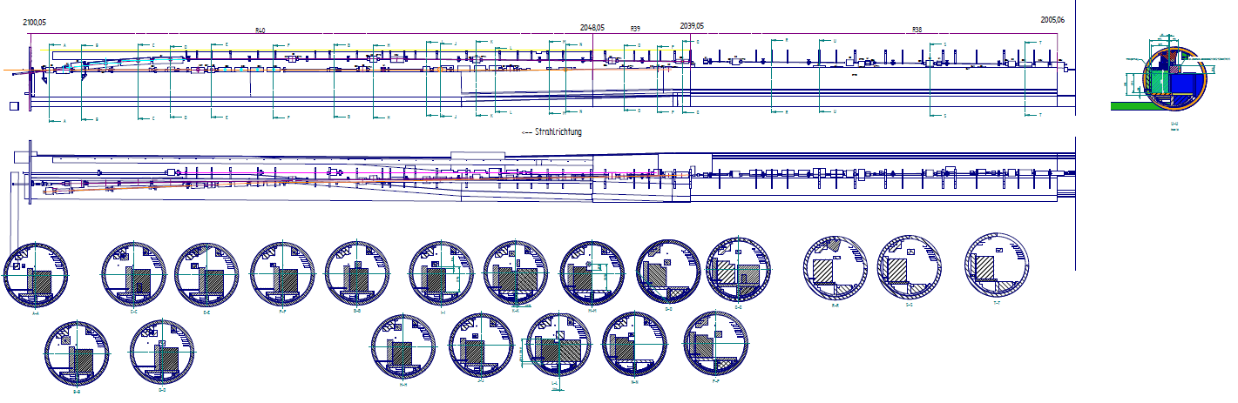
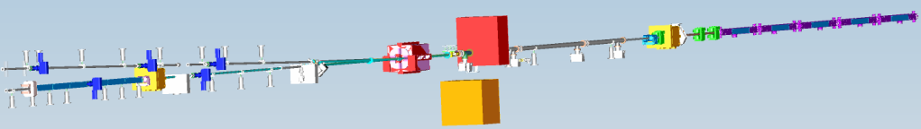
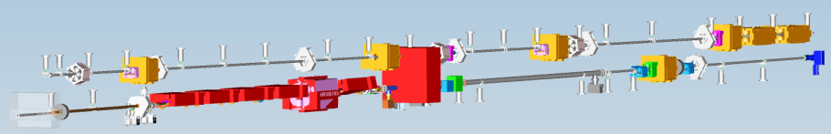
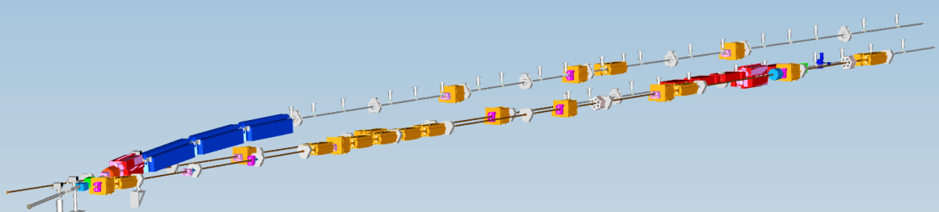
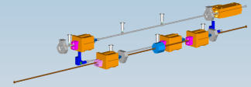
XFEL support frames
Location
XTL Room 38 till 40: - Transportation route is crossing below beamline
- Separation of beamlines
R 38
TL
R 37
TLD
R 39
T2
R 40
T1

Slide 5

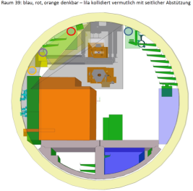


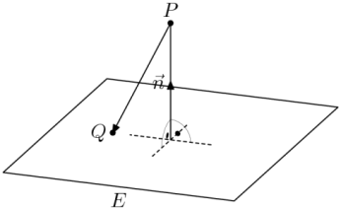
XFEL support frames
Specifications
Stable support (avoiding of additional vibrations)
  High requests: natural frequencies over 55 Hz
  Reduced requests: natural frequencies over 35 Hz
  Eigenmodes in longitudinal direction: natural frequencies over 10 Hz
Restriction of other work packages (space restrictions)
Loads:
  self weight
  Thermal and fire loads
Permeability restrictions:
  Distances of construction steel to beam line: 150 mm (TLD), 200 mm (TL, T1, T2) - transverse
  300 mm (T1) - longitudinal

Slide 6
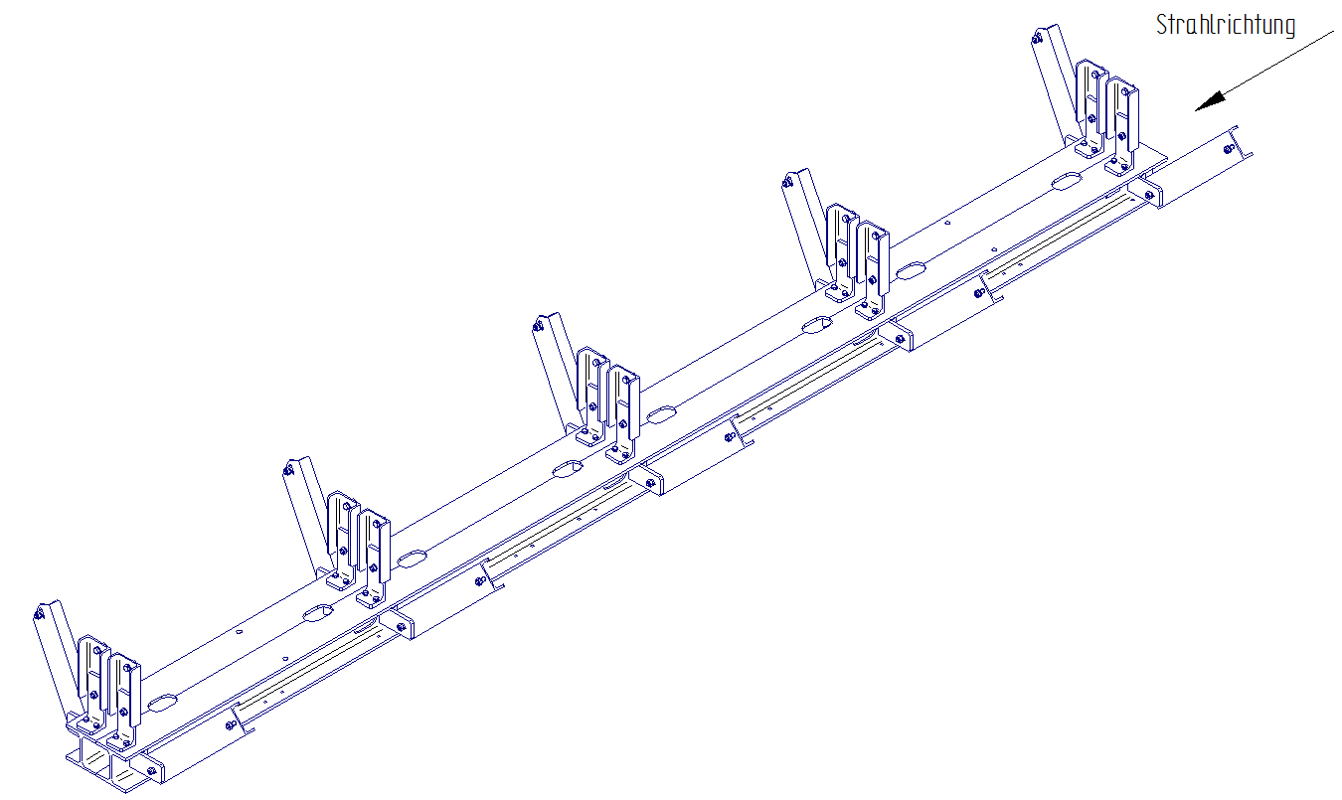
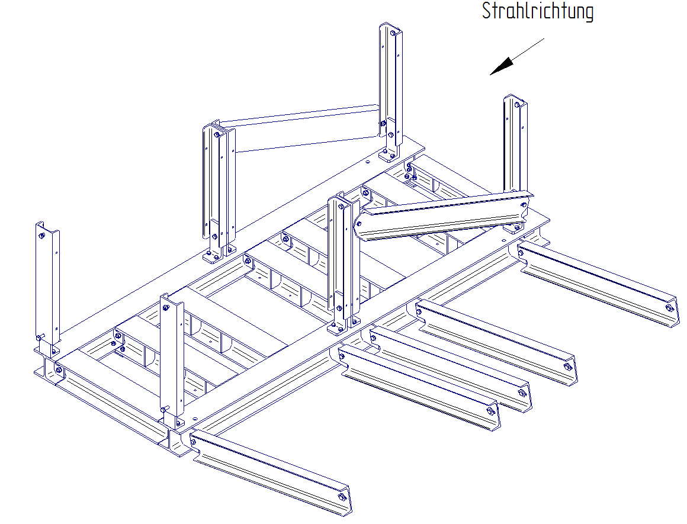
XFEL support frames
Solution
Solution as steel construction
suspended from tunnel ceiling
Support frames TLD
    Simple double I-Beam as box section
    Near ceiling
    Small bracings
Support frames TL
    Basis frame made of 2 main girders and cross members
    More stable than TLD support frames
    Bracings to tunnel wall
    In room 38-40 TL frames enclose TLD frames

Slide 7
XFEL support frames
Solution
Standardization of TL support frames in XTL Room 28 – 38
and special adapted frames
Different profile sizes (180 / 220)
Different lengths (1 / 2 / 3 segments)
Special frames with standing components instead of hanging

Slide 8
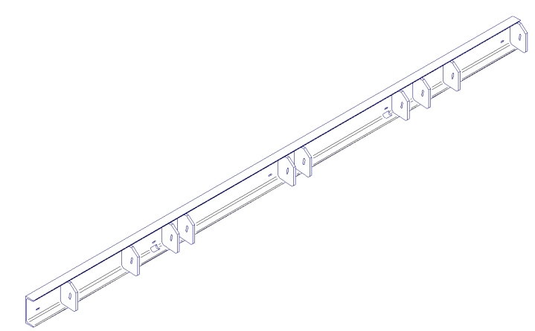
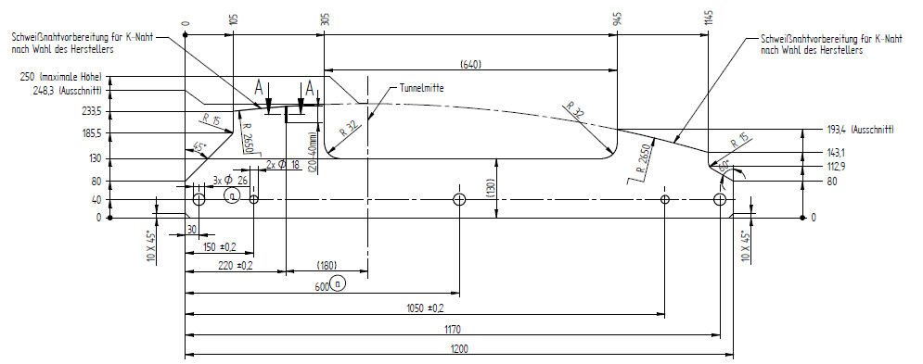
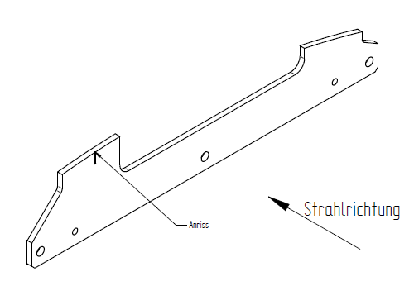
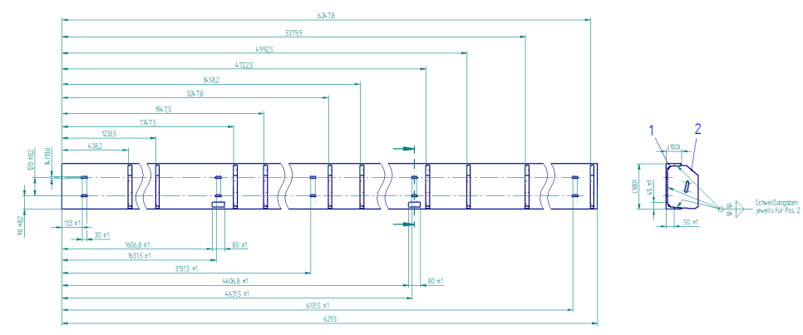
XFEL support frames
Solution
Fixation on ceiling: Fixation on wall:
welded sheet metal screwed U-profile
Beam

Slide 9
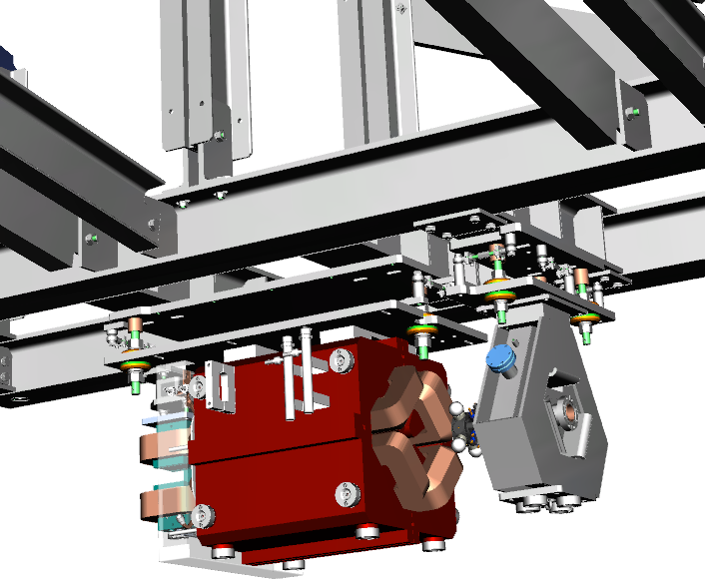
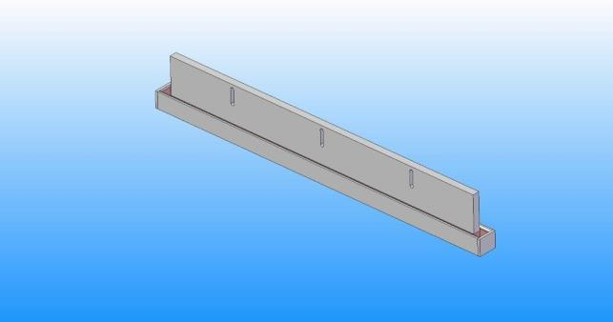
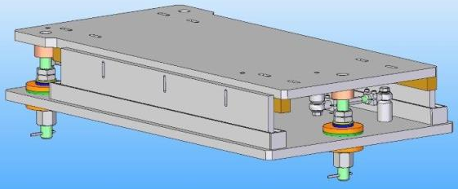
XFEL support frames
Solution
Support of beamline components via hanging adjustment device
Gluing of device for heavy magnets (after adjustment)
In special cases also possibility
to glue braces on magnets
Master Bond Polymer Adhesive EP30
Low Viscosity, Two Component Epoxy Adhesive For High Performance General Purpose Bonding

Slide 10
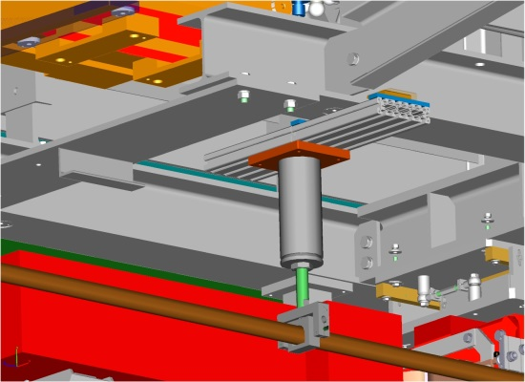
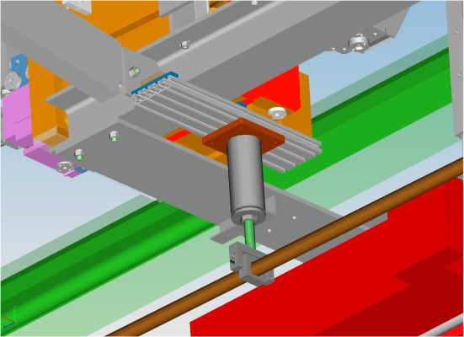
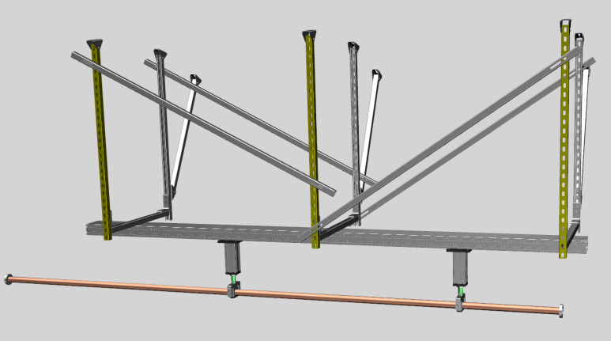
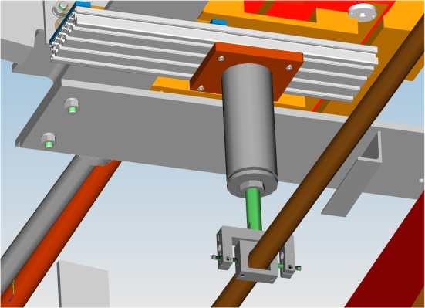
XFEL support frames
Solution
Support of vacuum components
  underneath frames via clamping
  between support frames via separate structure

Slide 11
XFEL support frames
Volume
Total length of XFEL accelerator with support frames almost 600m
Lot 1 (R 38-40): 23 frames 72 m total lenght 20 t construction weight
Lot 2 (R 28-38): 86 frames 278 m total lenght 120 t construction weight
Sum: 109 frames 350 m total lenght 140 t construction weight
Adjustment devices (without vacuum components and gluing):
  About 30 different types per Lot
  40 in lot 1, 174 in lot 2, total 214
Low priced frame production costs
Price lot 2 under 1st estimation of 2013
and comparable to old stone concept
(without gluing concrete slabs and wall bracings)
More effort in design and engineering
according to
  natural divergence beamline – building
  continuous changes during design process

Slide 12
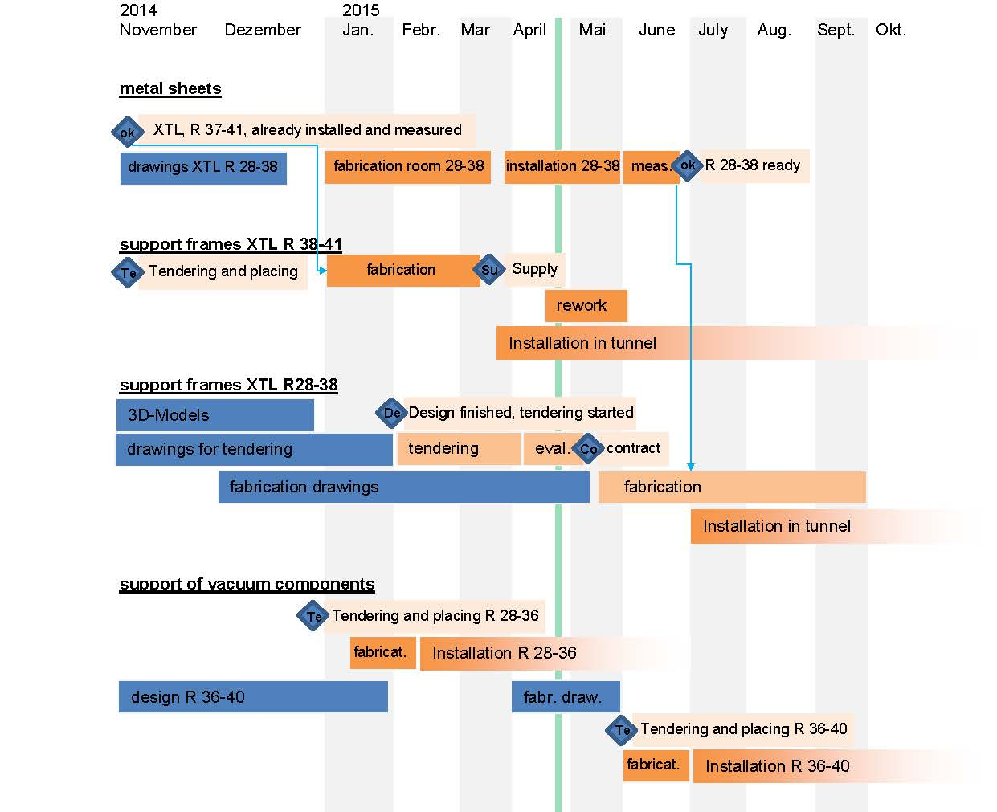
XFEL support frames
Schedule

Slide 13
Documentation
“4th Collaboration Meeting of the European XFEL” at Indico:
https://indico.desy.de/conferenceTimeTable.py?confId=11218#20150423.detailed
General JT-Files see:
S:\user\groups\zm1\4all\public\Technische_Projekte\XFEL-DMU\XTL
General overviews in CAD-Sharepoint (SolidEdge):
\\seportal\DavWWWRoot\wip\XFEL\Uebersichten
and
\\seportal\DavWWWRoot\wip\XFEL\XTL\Tunnelsegmente_Uebersichten
Documents, minutes and drawings of XFEL support frames
(„XFEL-Abhängung – Homepage“ by ZM1):
http://zm1spf1/XFEL-Abhängung/SitePages/Homepage.aspx

