Slide 1
Installation & first experiments FXE
Christian Bressler April 24, 2015

Slide 2
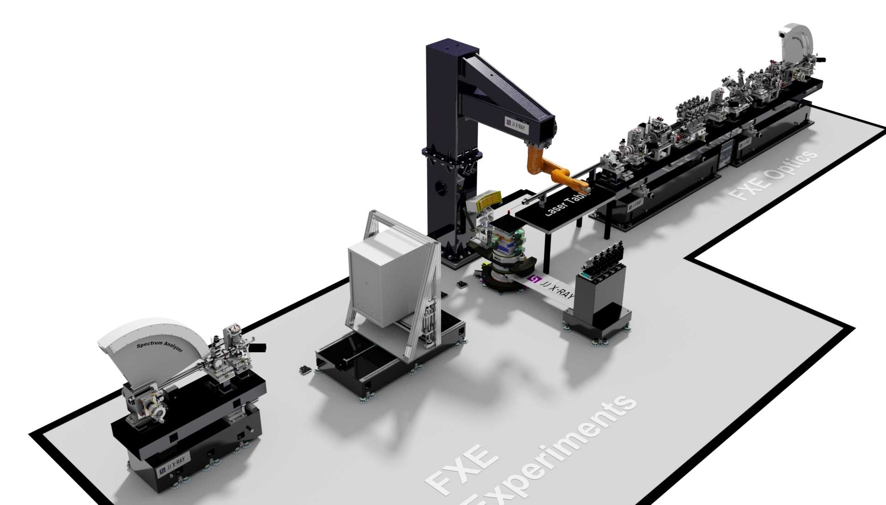
FXE Instrument
Robot Tower
SPB Transfer Tube (< 250 mm diameter)
XES Robot
LPD
IPM3
BIU4
SA2
Johann
Von Hamos
Sample Stack Goniometer

Slide 3
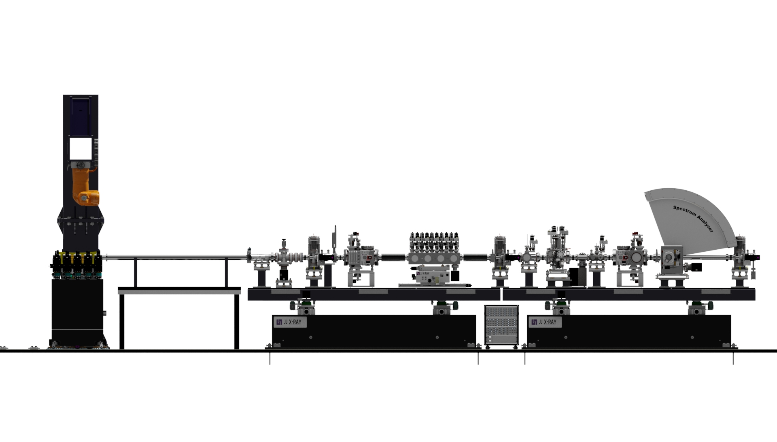
FXE Instrument: Optics Branch and Sample
Sample Environment
First things to get done :
1) Grouting (June 2015)
2) Robot Tower installation (July 2015)
Optics Branch
- He Environment (ambient conditions, liquid jets)
- Solid State Chamber

Slide 4
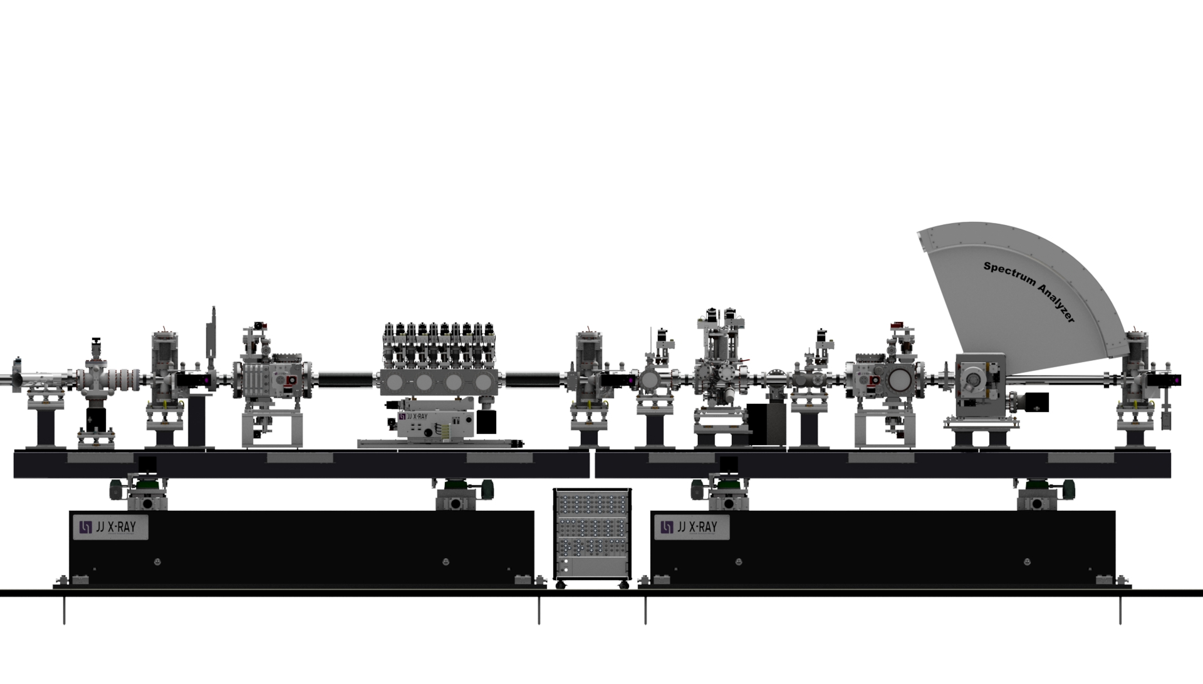
FXE: Optics Branch
Next Tasks: Plan Cabling + Racks (CIE + WP90s)
BIU3
FV
SL2
BLA
BIU2
IPM1
SAA
TAD
SL1
SA1
DiffP
BIU1
DW
DGr
Patch Panel with Lemo Connectors

Slide 5
Timeline for Component Delivery
FXE includes a Danish IKC (still on time). Delay caused by incoming milestones (XHEXP, beam on,…):
Mile-stone | Milestone title | Accomplishment criteria | Milestone date
M1 | Technical Design Report | Input to TDR approved by WP81 | Sep. 2012
M2 | Technical Design Report Update | Input to TDR approved by WP81 | Feb. 2013
M3 | FDR of each component | WP81 approval of the detailed design reports of each component | Dec. 2013
M4 | FAT of first component | WP81 approval of the FAT report of the first component set up in the list of components | Apr. 2014
M5 | FAT of last component | WP81 approval of the FAT report of all components set up in the list of components | Nov. 2015
M6 | Delivery and Storage | Storage on an agreed temporary location of each component before installation in the FXE hutch | Feb. 2016
M7 | SAT, installation and technical commissioning (no beam) | WP81 approval of the SAT report | Oct. 2016
M8 | Commissioning with beam | WP81 approval of the testing with beam | Jan. 2017
☑
☑
☑
☑
☒
☒
Milestones M5-M8 delayed due to the overall XFEL.EU delay (by ca. 12 months)
☒
☒

Slide 6
WP schedule and critical path: FXE Components
Some major milestones and time schedule:
Conceptual Design Report: Apr. 2012
Technical Design Report: Sept. 2012
Include ART recommendations to TDR (for SAC) March 2013
Final Design Review of each component: Dec. 2014
Production and Factory Acceptance Tests (FAT’s): 2014 - 2016
Delivery of all components: on demand →< June 2016
Site Acceptance Tests of mechanical performance: →June 2016
Commissioning with beam: →Jan. 2017

Slide 7
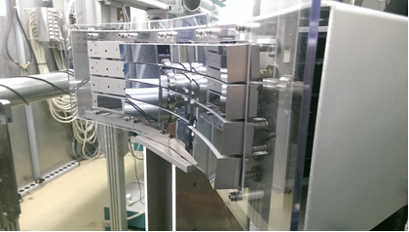
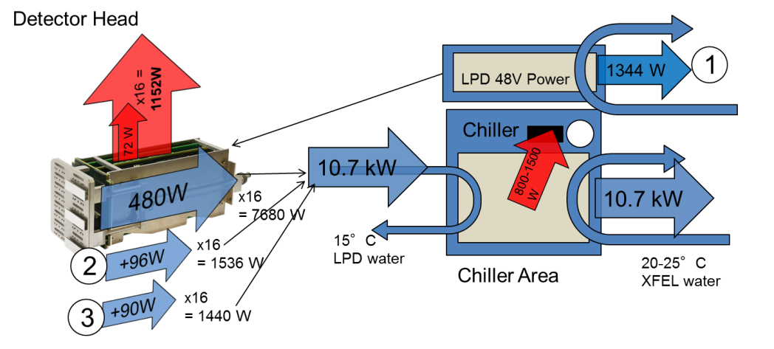
FXE activities: past months
Questionaire to WP90s (E-Plan for Motor Controls)
E-plan for Rack Arrangement
E-plan for Cabling
Von Hamos motor controls (version 0.5, in action at DELTA!)
LPD Power Management + Noise Issues + Commissioning
Alfresco (WP81 documentation, FDRs, …)
Resource-Loaded Schedule (ongoing)
Drafting Reports and Publications

Slide 8
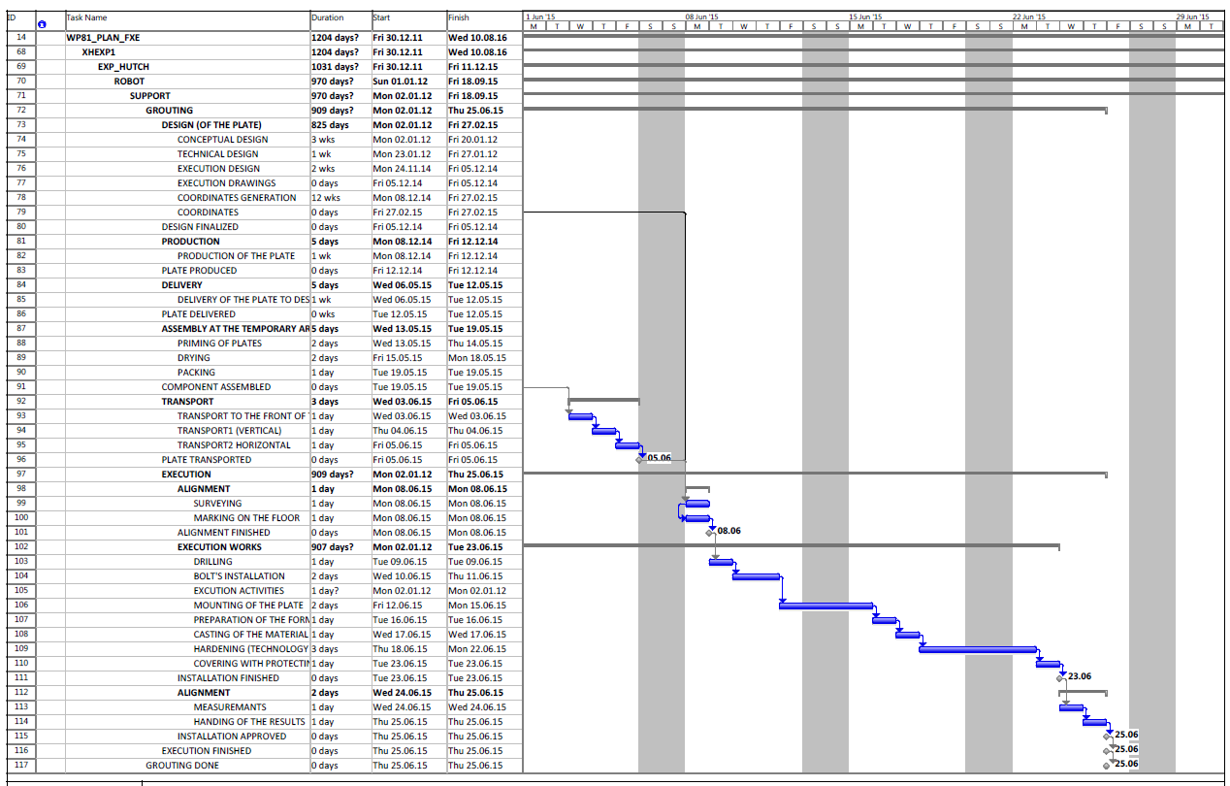
MSP Example: Grouting in FXE Hutch
June 2015

Slide 9
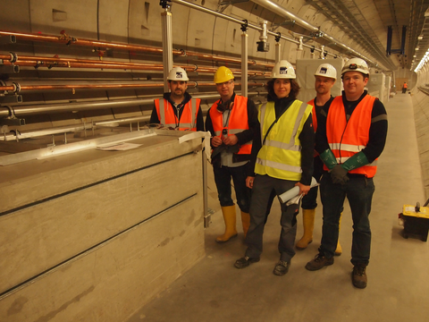
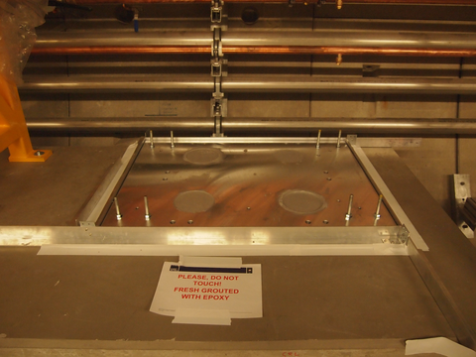
Grouting in XTD2 (CRL collimator), April 17, 2015
CIE Help (Lewis Batchelor)
WP73 Transfer of knowledge + Help (Idoia Martín)
JJ X-Ray Help (C. Mammen, J. Navntoft)

Slide 10
B-F first „testing execution” for two phases
Notes:
Copy & paste an element from the Clip Board to the particular slide: 1) Click on a box to mark it. 2) Position the mouse pointer on the box frame: Copy! 3) Click on the particular slide: Paste!
How you intend to use the elements is your choice. You can combine the text block style with the background colour in different manner.
How to change the height or the width (or both) of a box (including its background): Mark the box, and grip and draw the specific edge of the box frame.
You can position a text block inside a frame: 1) Mark the text block. 2) Click on the menu point “Format”: “Text box”, “Text Box”, “Text Anchor Point”.
Insert a new slide: Menu button “New Slide” For more bullet levels (max. 5) use the tab stop button →| on your keyboard, back with |←
The default colour scheme for font, line and fill is (1st row, from left to right): White  Violet  Grey  Black  Violet  Orange  Violet  Orange

Slide 11
Sequence for all b-f components
Notes:
Copy & paste an element from the Clip Board to the particular slide: 1) Click on a box to mark it. 2) Position the mouse pointer on the box frame: Copy! 3) Click on the particular slide: Paste!
How you intend to use the elements is your choice. You can combine the text block style with the background colour in different manner.
How to change the height or the width (or both) of a box (including its background): Mark the box, and grip and draw the specific edge of the box frame.
You can position a text block inside a frame: 1) Mark the text block. 2) Click on the menu point “Format”: “Text box”, “Text Box”, “Text Anchor Point”.
Insert a new slide: Menu button “New Slide” For more bullet levels (max. 5) use the tab stop button →| on your keyboard, back with |←
The default colour scheme for font, line and fill is (1st row, from left to right): White  Violet  Grey  Black  Violet  Orange  Violet  Orange

Slide 12
Duration after compression
Notes:
Copy & paste an element from the Clip Board to the particular slide: 1) Click on a box to mark it. 2) Position the mouse pointer on the box frame: Copy! 3) Click on the particular slide: Paste!
How you intend to use the elements is your choice. You can combine the text block style with the background colour in different manner.
How to change the height or the width (or both) of a box (including its background): Mark the box, and grip and draw the specific edge of the box frame.
You can position a text block inside a frame: 1) Mark the text block. 2) Click on the menu point “Format”: “Text box”, “Text Box”, “Text Anchor Point”.
Insert a new slide: Menu button “New Slide” For more bullet levels (max. 5) use the tab stop button →| on your keyboard, back with |←
The default colour scheme for font, line and fill is (1st row, from left to right): White  Violet  Grey  Black  Violet  Orange  Violet  Orange

Slide 13
Current FXE Manpower in 2014/2015
Christian Bressler
Wojciech Gawelda
Andreas Galler
Dmitry Khakhulin (06/2015)
Martin Knoll (instrument engineer, ca. 06/2015)
Tadesse Assefa (PhD student), UniHH (SFB925)
Alexander Britz (PhD student), IMPRS/CUI (European XFEL)
Manuel Harder (PhD student), DESY/TUD (BMBF/FSP302)
Michael Diez (PhD student), XFEL (CUI)
Dmitry Khakulin (Research Associate), XFEL (CUI)
Peter Zalden (Research Associate, 06/2015), XFEL (CUI)

Slide 14
Some Details on the Installation schedule (2015)
Survey, Drilling and Grouting (June 2015) (3 grout plates in exp. hall)
Robot Tower (July 7, 2015, with x-ray hutch walls up)
SPB tube (will be incorporated, 2015/16)
Racks, and Motor Controls (incorporated with WP90s, CIE)
Cabling with connectors: 160+ cables, ca. 2-3 km
Timing Tool R&D (0.1 MHz)
…

Slide 15
Some Details on the Installation schedule (2016)
Computer control of rack room motor controls (Ctrl Hutch)
Roll-in of FXE Components
Site acceptance test of FXE Components
Vacuum control/safety solved
Commissioning without Beam
Robot Arm programming
FXE Laser Lab Parts: tables, optics, NOPA(s)
…

Slide 16
Some Details on the Installation schedule (2017)
Commissioning with Beam, Day 1 Experiment
User Operation including 24/7(!)
Solid State Integration
Upgrade(s) commencing
…

Slide 17
Day -1 Experimental Conditions
WAXS (=XDS) experiment on solvated chromophores.
XES experiment on solvated chromophores
And each of the above Time-Resolved (< 1 ps)
TR-XANES (with 4-bounce mono)
Experimental Conditions for Incident FEL Beam
12 keV, 15, 20 keV
Pink Beam, mono (for 4)
Single Pulse (10 Hz), 100 kHz, 4.5 MHz
250 pC (arbitrary fine)
Experimental Conditions for TR Experiment
Synchronized PP Laser at same rep-rate as XFEL beam
Backup: FXE Tangerine laser (synchronizable, gatable, tunable)
(may also be borrowed from other instruments)
LPD Conditions
Dynamic Range: 10-100
SP sensitivity: must have a few 12 keV photons, really nice to have: SP sensitivity
Filled images (not sparse)
Notes:
Copy & paste an element from the Clip Board to the particular slide: 1) Click on a box to mark it. 2) Position the mouse pointer on the box frame: Copy! 3) Click on the particular slide: Paste!
How you intend to use the elements is your choice. You can combine the text block style with the background colour in different manner.
How to change the height or the width (or both) of a box (including its background): Mark the box, and grip and draw the specific edge of the box frame.
You can position a text block inside a frame: 1) Mark the text block. 2) Click on the menu point “Format”: “Text box”, “Text Box”, “Text Anchor Point”.
Insert a new slide: Menu button “New Slide” For more bullet levels (max. 5) use the tab stop button →| on your keyboard, back with |←
The default colour scheme for font, line and fill is (1st row, from left to right): White  Violet  Grey  Black  Violet  Orange  Violet  Orange

Slide 18
Summary
OVERALL: we are on track for the New Year Eve 2016/17 FXE inauguration party
Thank you for your Attention
Notes:
Copy & paste an element from the Clip Board to the particular slide: 1) Click on a box to mark it. 2) Position the mouse pointer on the box frame: Copy! 3) Click on the particular slide: Paste!
How you intend to use the elements is your choice. You can combine the text block style with the background colour in different manner.
How to change the height or the width (or both) of a box (including its background): Mark the box, and grip and draw the specific edge of the box frame.
You can position a text block inside a frame: 1) Mark the text block. 2) Click on the menu point “Format”: “Text box”, “Text Box”, “Text Anchor Point”.
Insert a new slide: Menu button “New Slide” For more bullet levels (max. 5) use the tab stop button →| on your keyboard, back with |←
The default colour scheme for font, line and fill is (1st row, from left to right): White  Violet  Grey  Black  Violet  Orange  Violet  Orange

Slide 20
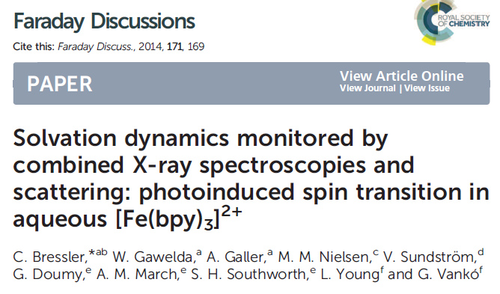
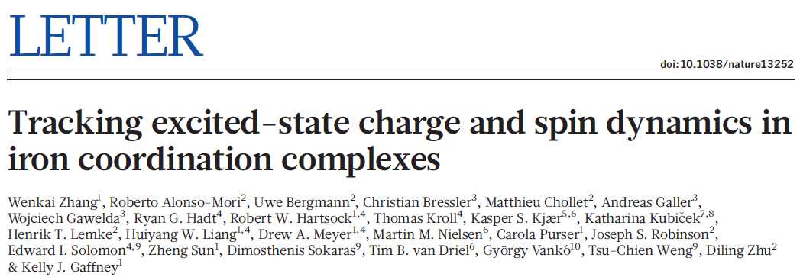
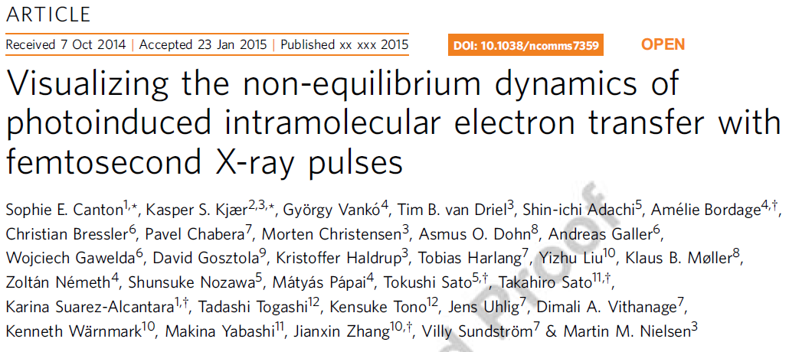
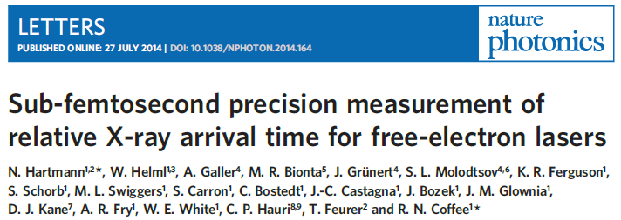
Scientific Work Done Last Year: 2014…
SFB925
SFB925
CUI
SFB925
European XFEL
CRISP
SFB925
SFB925
CUI
CRISP
SFB925
CUI
European XFEL
European XFEL

Slide 21
Upcoming Scientific Work (2015)
- Thereoretical XANES and TR experiments…. (paper-s)
- Guest-Host Interactions (paper) - ZnO nanoparticles (SwissFEL) (paper)
- Timing Tool development (experiments)
- Fe-nitrido samples (rare high valent states) (experiments)
- 7-fold coordinated Fe samples (time-dependent) (experiments)
- Ir-based donors + water-splitting acceptor, in solution (experiments)
- THz pump, wlc/x-ray probe of GS chem. Dyn. (experiments)

