Slide 1
X-ray Photon Diagnostics
Status 23 April 2015
4th XFEL Collaboration Meeting
Jan Grünert / WP74
(Grünert, Baranasic, Buck, Dietrich, Freund,
Koch, Kujala, Liu, Lübbe, Planas)
European XFEL GmbH, Hamburg

Slide 2
Status WP74
Commercial production: Pop-in monitors, HiREX
In-house production at European XFEL:
2D-imager-FEL, K-Mono, PES, Diff.Pumps
Production by DESY: XGM, transmissive imager
Production by Dubna: MCP-based detector
Design stage: 2D-imager-SR, Exit Slit Imager, Timing Diagnostics
Perspectives until fall 2015:
  Installation of vacuum chambers in XTD2
  Installations in XTD9 (depending on tunnel status)
  Production of most SASE3 / XTD10 devices
  Finalizing designs for HiREX and Exit Slit Imager
  Production of first 2D-imager-SR
  More diagnostics activities (see summary)

Slide 3
WP74 devices in XTD2 (SASE1)
619.0m: Filter chamber
620.6m: Transmissive Imager (=OTR-C screen)
639.5m: K-monochromator system, incl. 2D-imager-SR
648.9m: X-ray gas monitor (XGM)
655.9m: Differential Pumping by WP74
659.2m: Photoelectron spectrometer (PES)
681.8m: 2D-imager-FEL
698.9m: MCP detector
700.4m: Pop-in Monitor Type II-45°
All z-distances given in the PD coordinate system

Slide 4
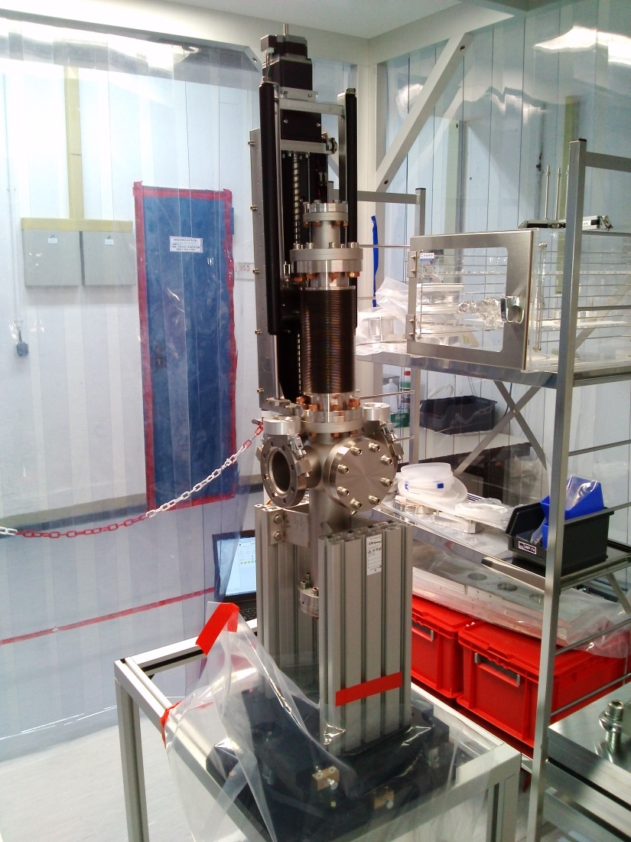
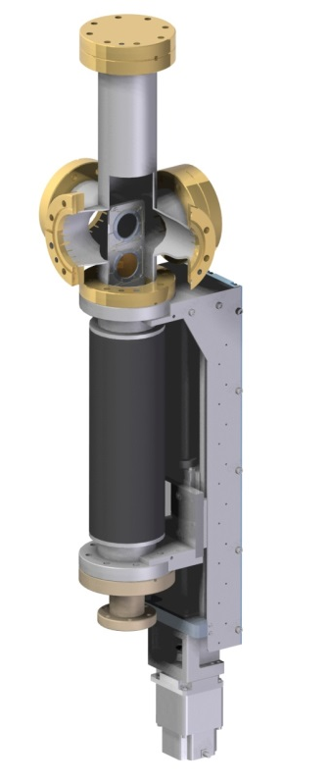
Filter chamber
Status 04/2015: assembly finished, final RGA tests
Alignment base plates done
Will now be transferred to
WP19 (warm vacuum ) for installation
N:\4all\intern\User data\wp74\Devices\31-2_K-Mono\production drawings\filter chamber

Slide 5
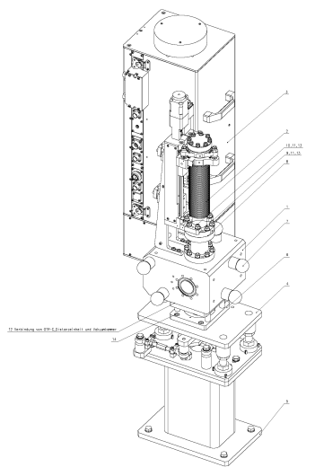
Transmissive Imager
„OTR-C“ imager = a standard WP17 device
  (only internal modification for scintillator/holder by WP74, which was done in contact with WP17)
Integration by WP17 as for their other screen stations
Modified scintillator holder was produced
N:\4all\intern\User data\wp74\Devices\31-8_Transmissive-Imager

Slide 6
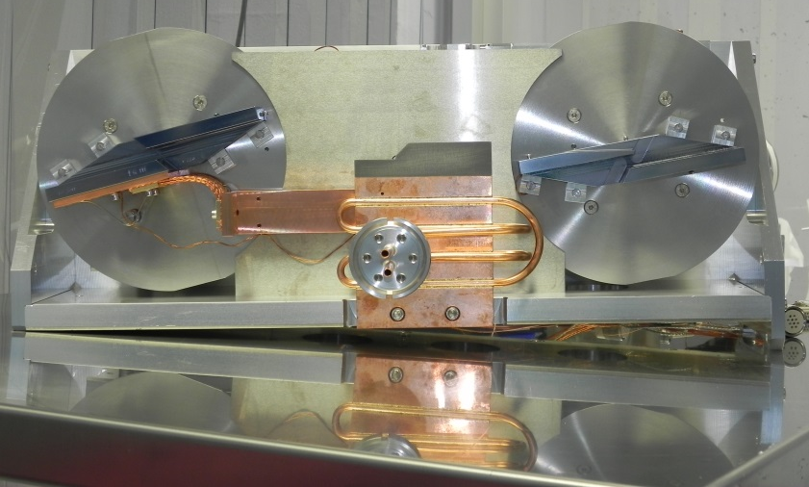
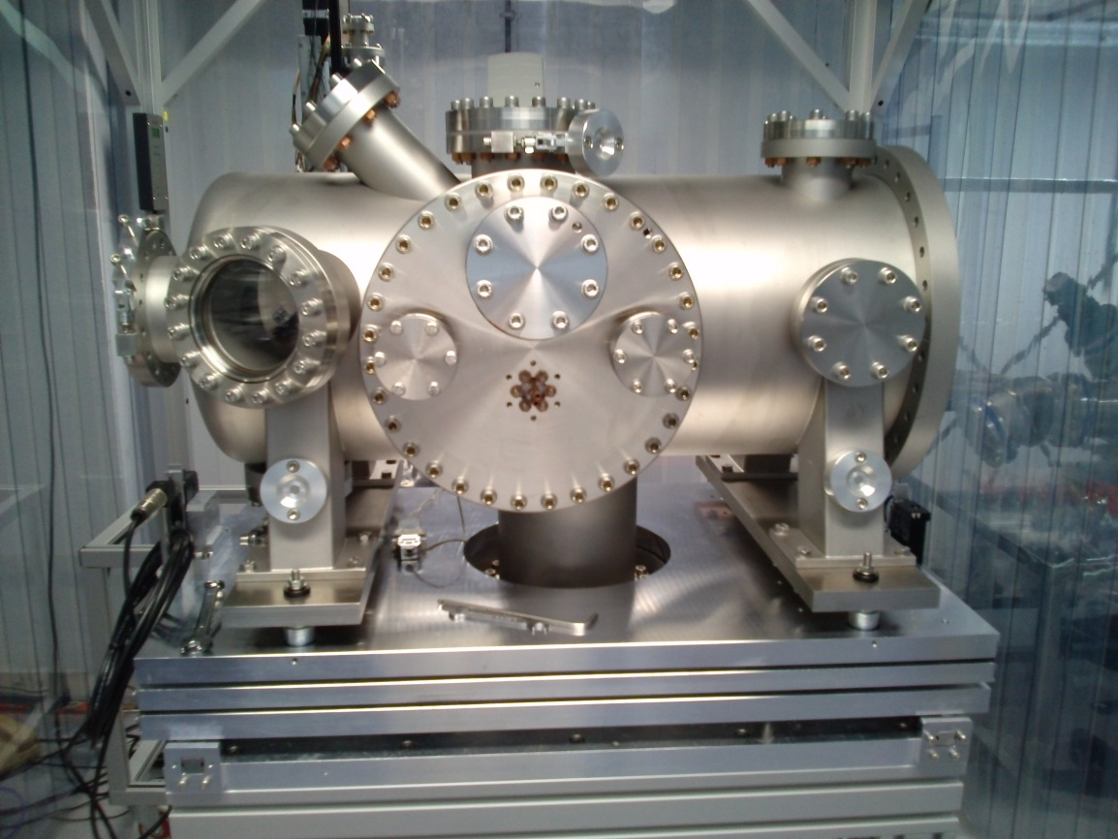
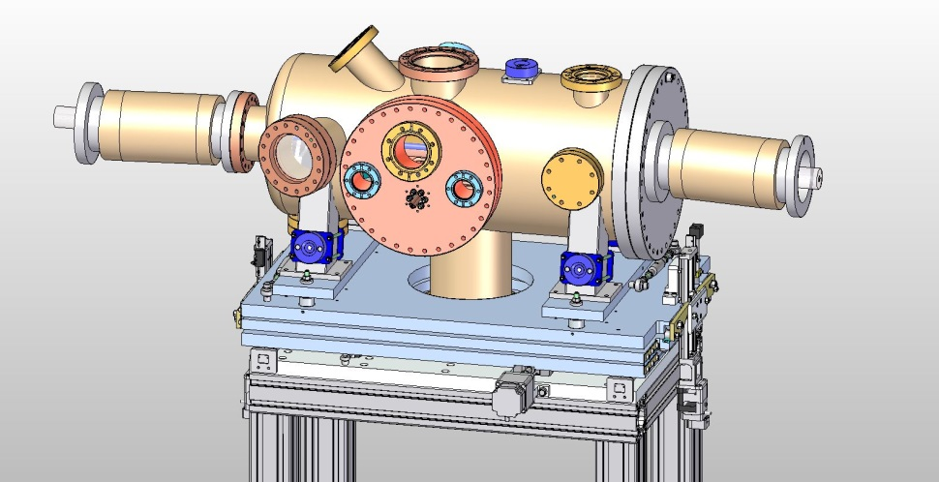
K-Monochromator
Status 4/2015: DR/PRR done, prototype was converted into SASE1 device
Final assembly done, now RGA tests; Installation in XTD2 this month
Chambers for SASE2+3 arrived, assembly SASE3 K-mono starts 5/2015
Control crate available and tested
N:\4all\intern\User data\wp74\Devices\31-2_K-Mono

Slide 7
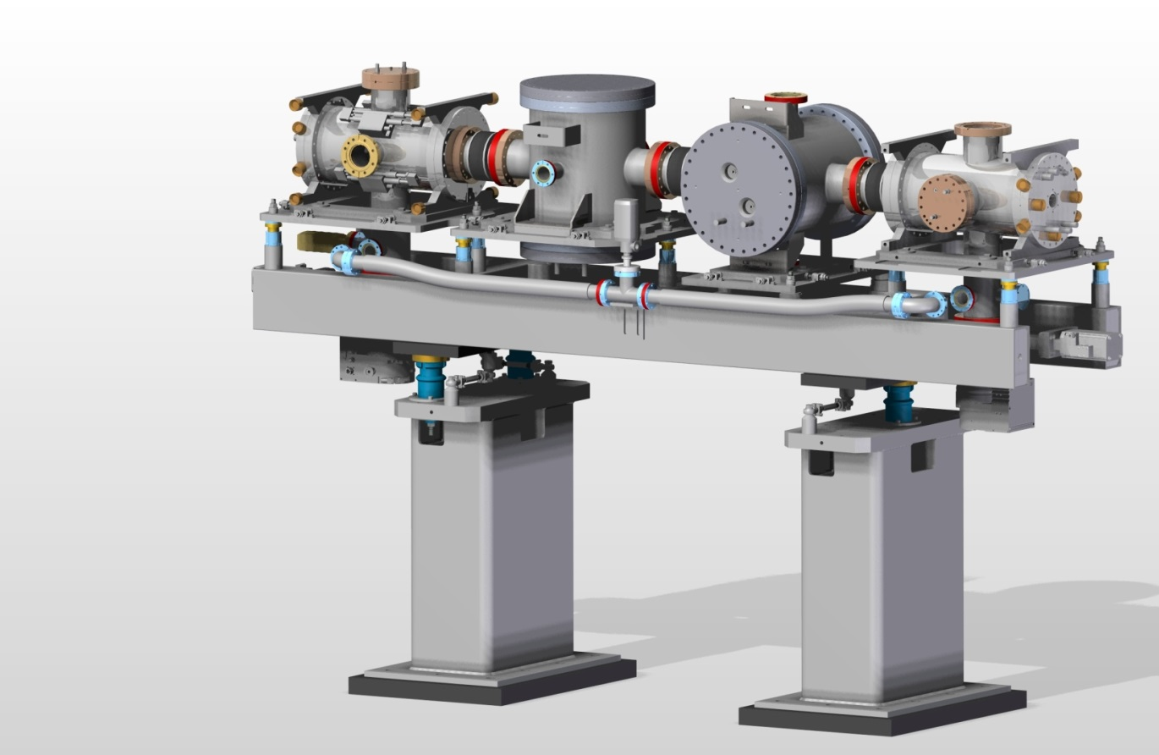
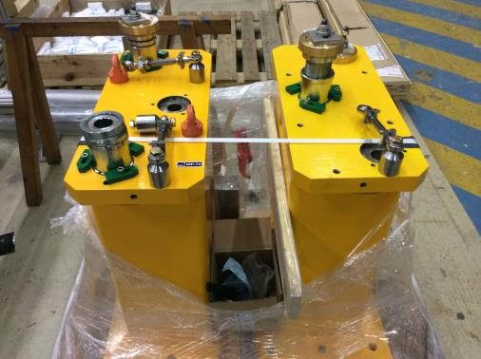
X-ray Gas Monitor (XGM)
Status 04/2015:
Two XGMs are RFI, four more are in production (Tiedtke group @ FLASH)
Transport / Installation in XTD2/SASE1: 6.May 2015
Installation in XTD9/SASE1: when tunnel is ready (temp.storage at HERA-S lab)
4 remaining XGMs will be RFI at end of 07/2015
Supports:
installed in XTD2 in 5/2014
and next week in XTD9
N:\4all\intern\User data\wp74\Devices\11-1_XGMD\Drawings\FEM steel base frame\support_pillar_pictures

Slide 8
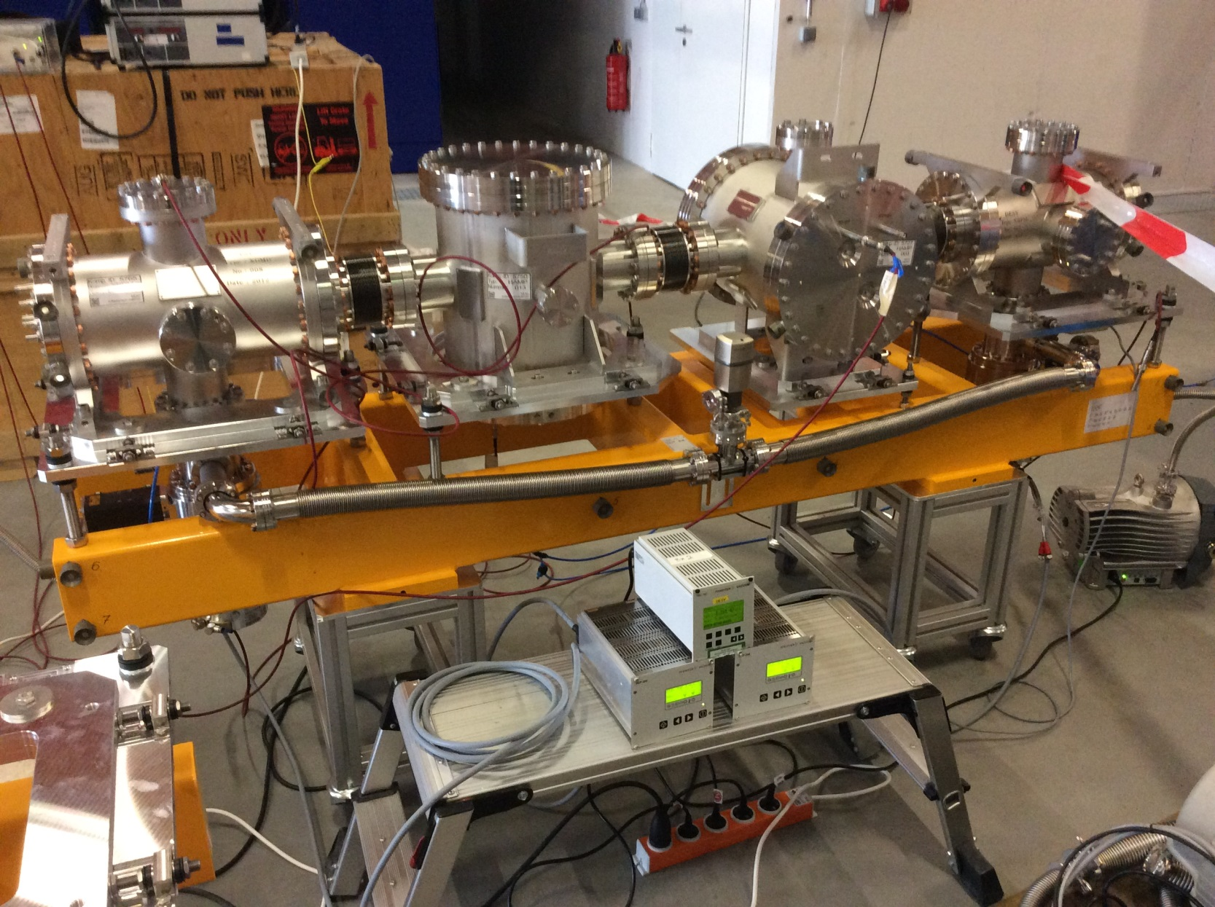
2 XGMs are RFI at FLASH2 hall

Slide 9
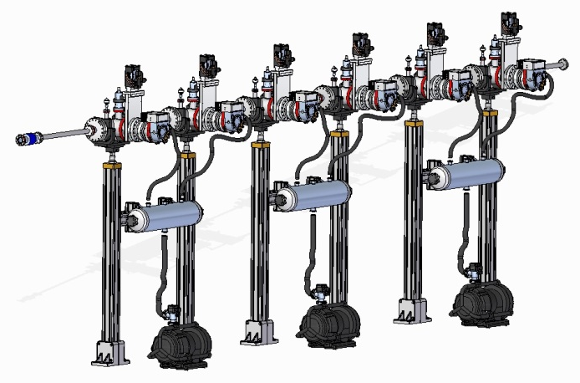
Differential Pumping by WP74
(between PES and XGM)
Status 04/2015:
Design done, mostly standard parts, simlar to WP73 systems
All vacuum components arrived except pumps (>3M delay)
May 2015: Test setup of one system for optimization in HERA-S hall
Tunnel installation will be together with the PES (first in SASE3 in Q4/2015)
N:\4all\intern\User data\wp74\Devices\11-1_XGMD\Drawings\FEM steel base frame\support_pillar_pictures

Slide 10
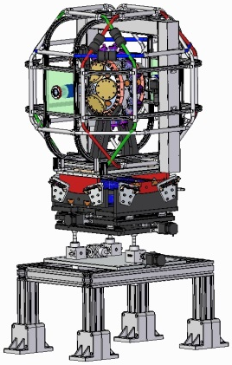
Photoelectron spectrometer (PES)
Status 04/2015:
Detailed design done for SASE3 device
and for the fully motorized support
SASE3 device fully assembled and
very successfully tested with X-ray FEL beam
(scientific beamtime L52 at AMO/LCLS)
Device returns from SLAC latest 11/2015
SASE1 device will be developed (requires
modifications for hard X-ray application)
→ not available in current XTD2 installation phase
→ temporary 1.6m long DN40CF pipe + holder
N:\4all\intern\User data\wp74\Devices\11-1_XGMD\Drawings\FEM steel base frame\support_pillar_pictures

Slide 11
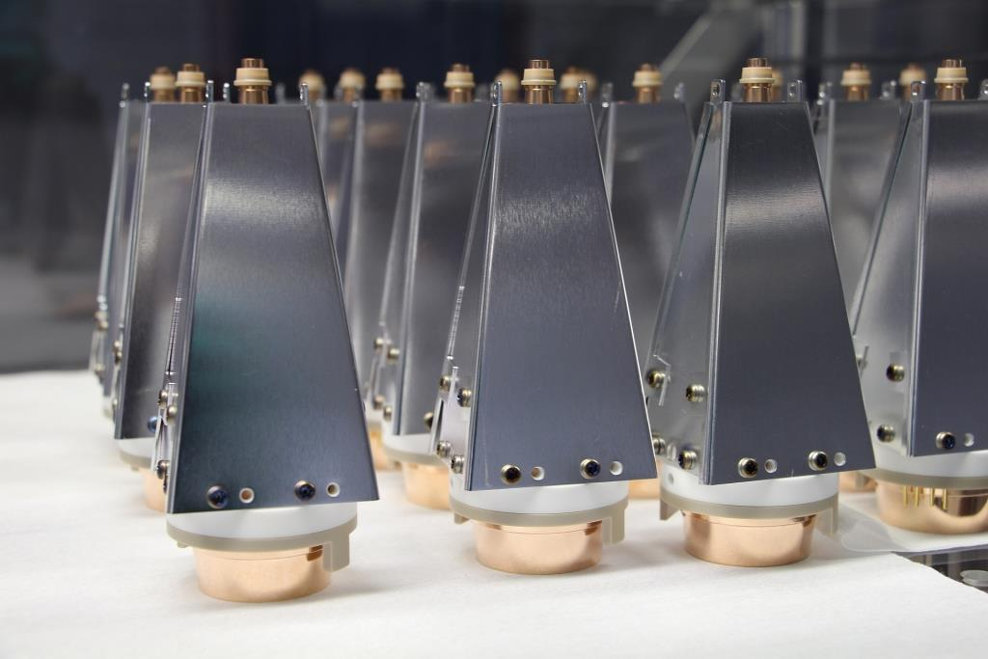
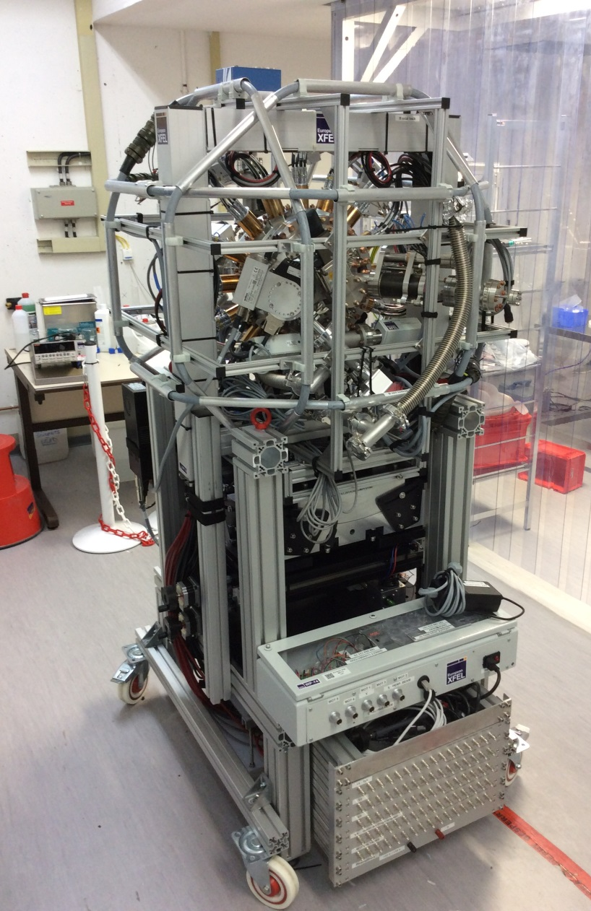
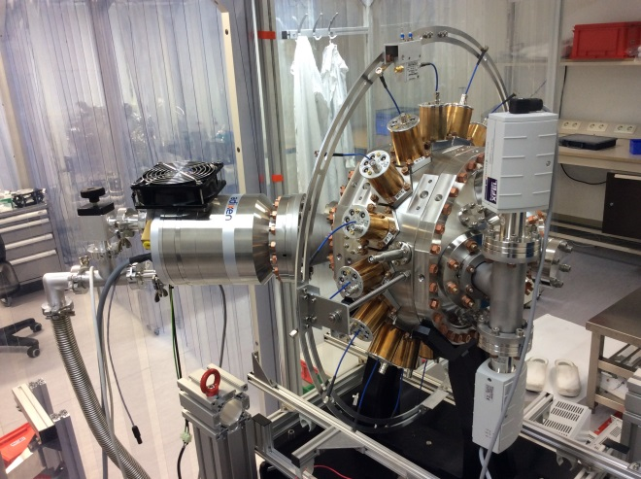
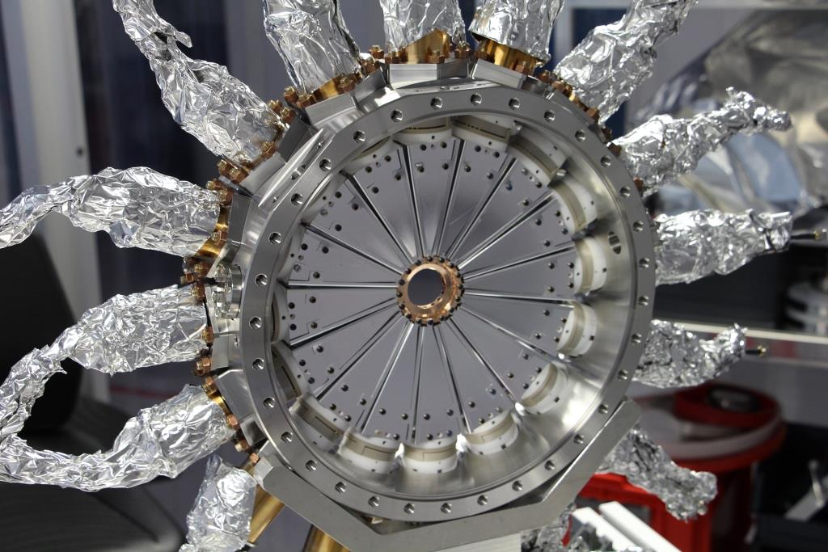
PES assembly (SASE3 device)

Slide 12
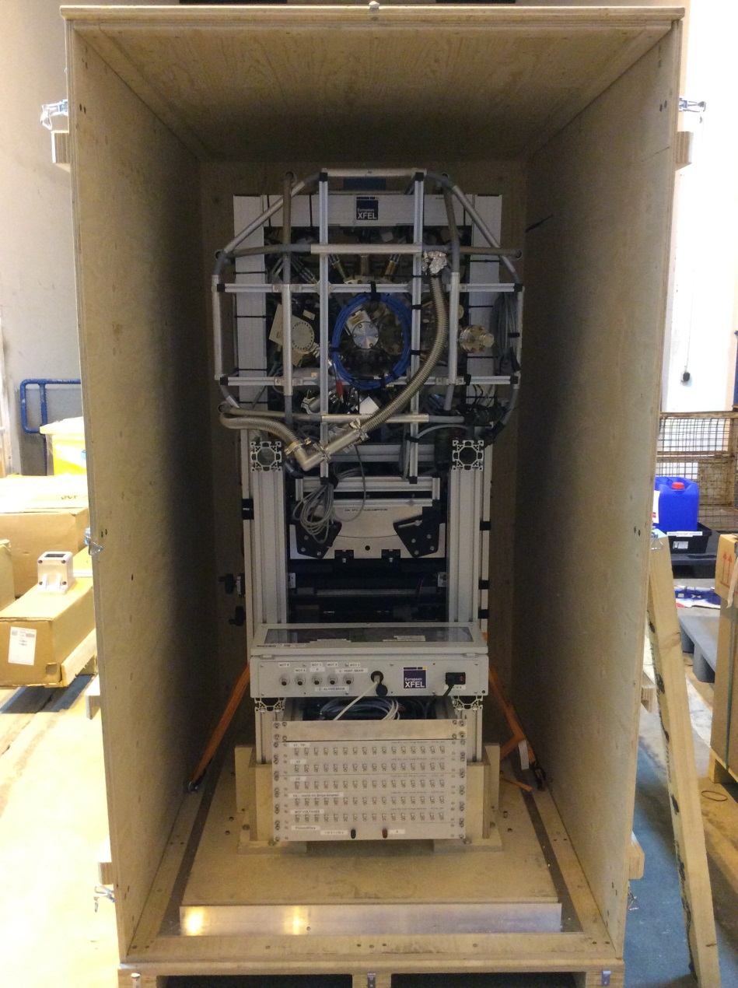
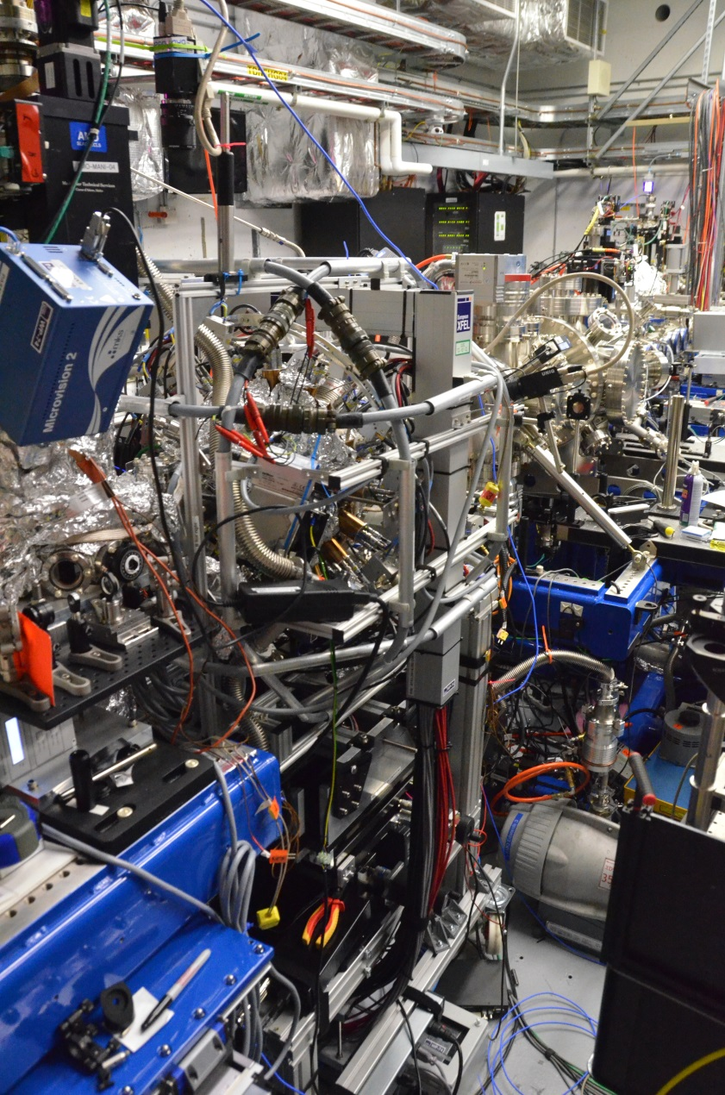
Transport to SLAC and use at AMO / LCLS

Slide 13
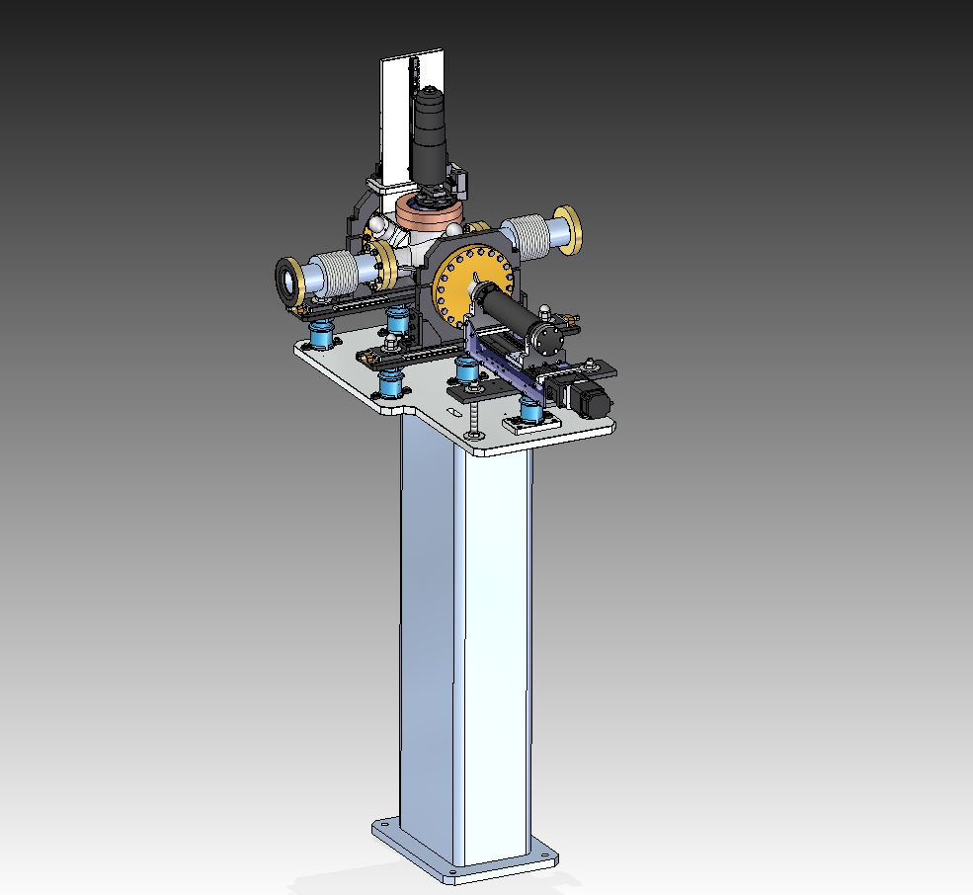
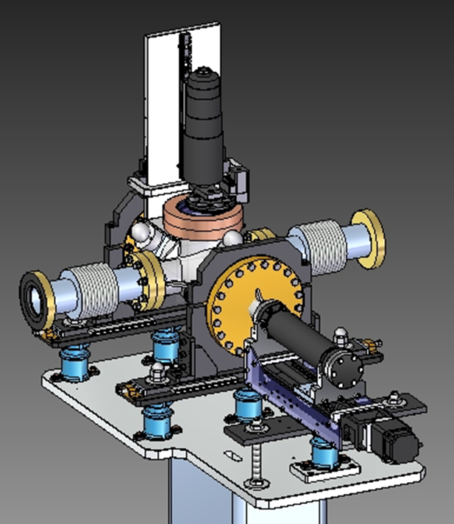
2D-imager (FEL)
Status 04/2015:
Final assembly of SASE1 device
Installation in XTD2 planned
for May/June 2015
..

Slide 14
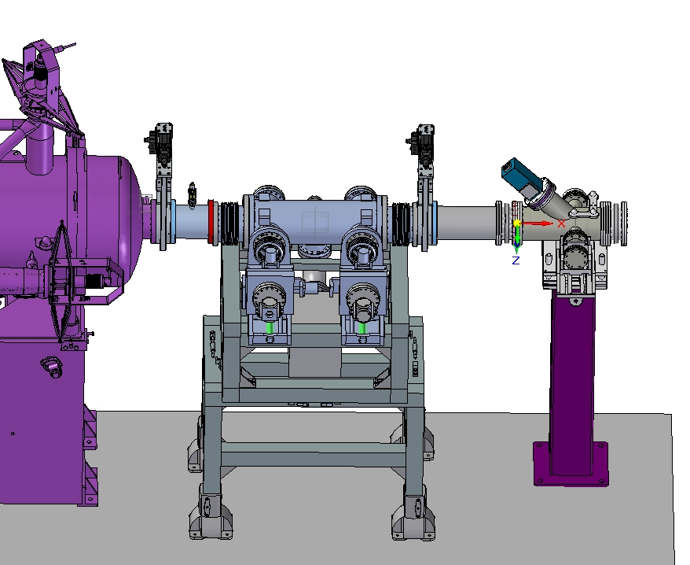
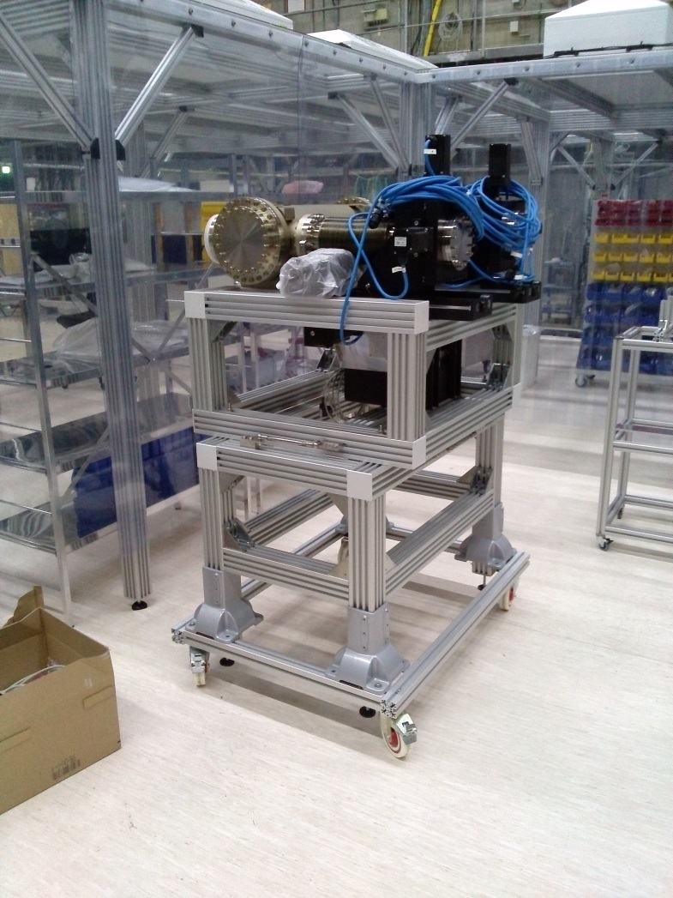
MCP-based detector (by JINR)
Status 04/2015:
Final devices SASE1 + SASE2 are RFI at HERA-S
SASE1 device to be transfered to XHE3
Camera section to come
N:\4all\intern\User data\wp74\Devices\31-1_MCP-Detector\3D-sketches

Slide 15
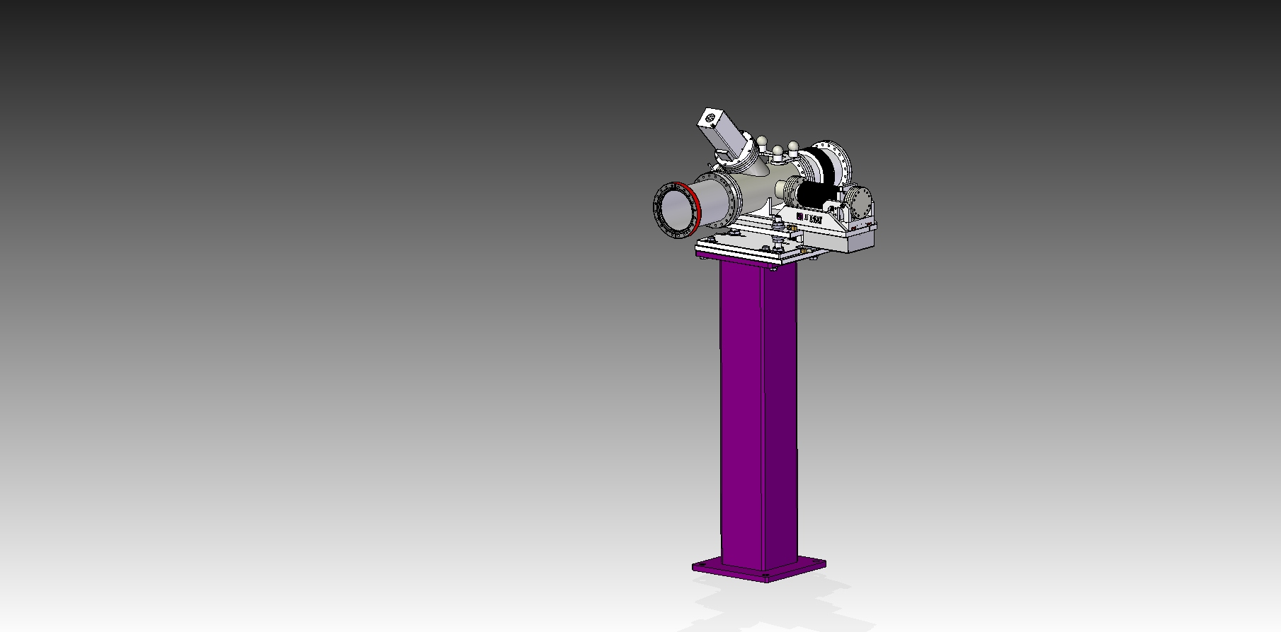
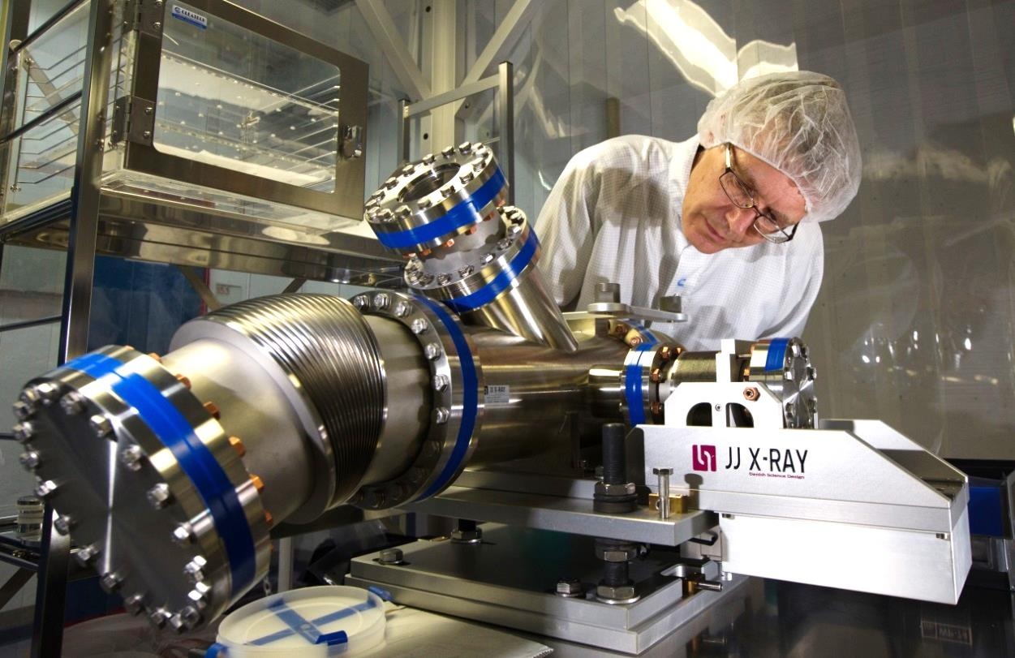
Pop-in Monitor Type II-45°
Status 04/2015
FDR/PPR/production done (JJ X-ray)
SAT of all devices for all tunnels in 10/2014
Detailed optics implementation approved 03/2015
Final assembly of scintillators and vacuum tests in 3/2015
Device for XTD2 is ok & RFI, will be installed within April 2015
N:\4all\intern\User data\wp74\Devices\31-4_Pop-In-Monitors

Slide 16
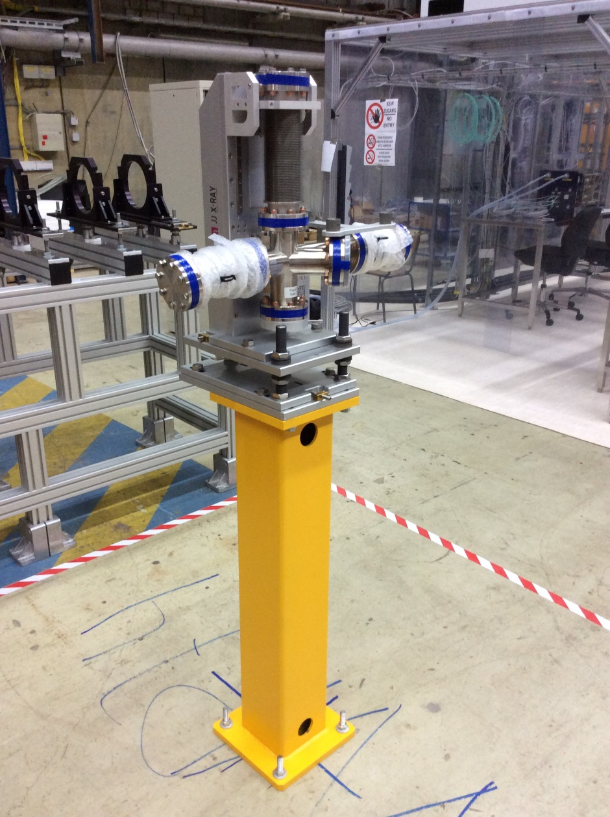
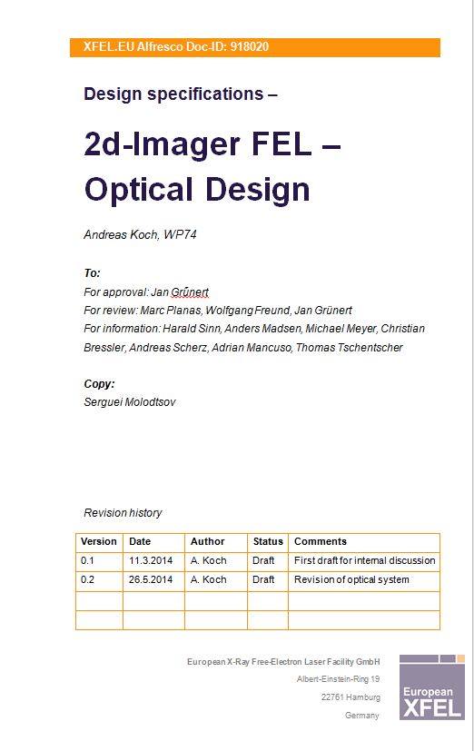
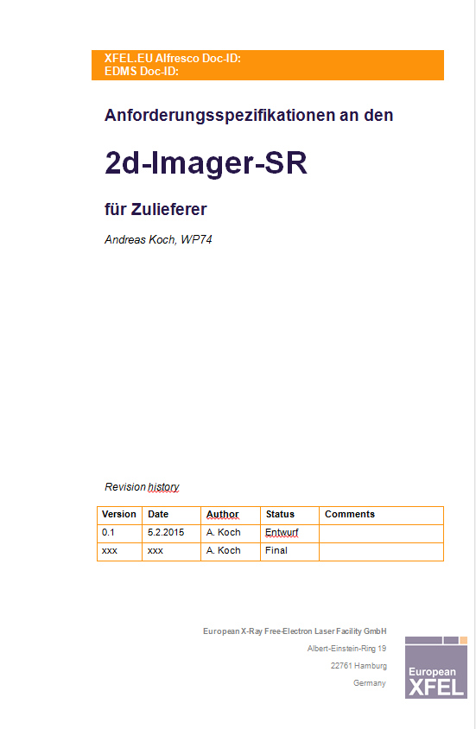
Imagers
Status SR-Imager in 04/2015:
Detailed optics design: done
Detailed 3D design: done
Workshop drawings: done and submitted to commercial providers
Company for production identified
SAT for
Pop-in Monitors

Slide 17
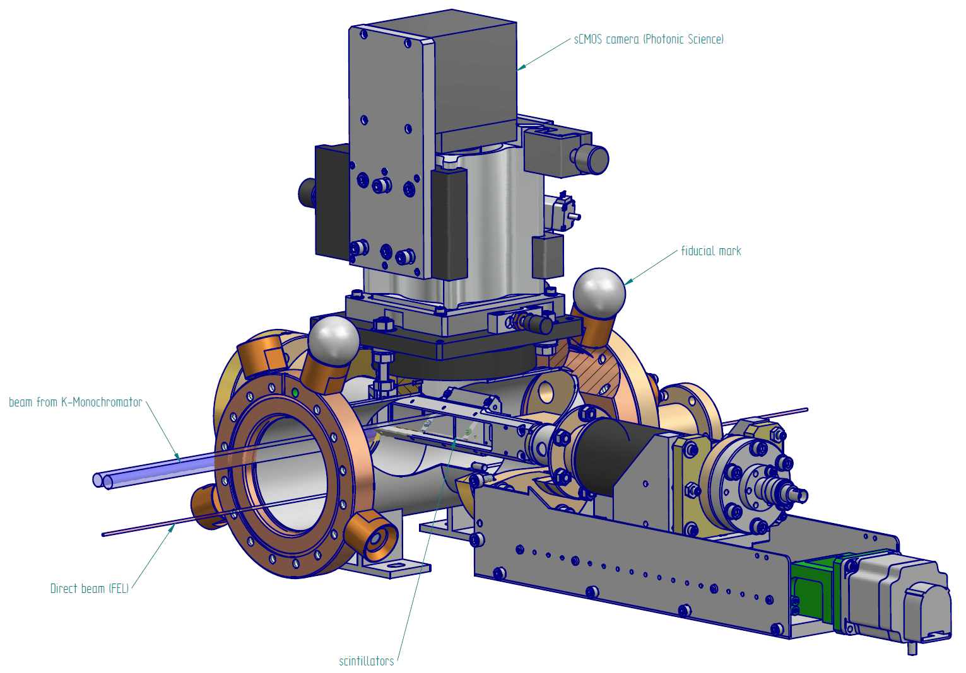
2D-imager-SR (SRimager)

Slide 18
WP74 summary for SASE1 / XTD2
Device
RFI status
Filter chamber
Transmissive Imager
K-mono
2D-imager (for SR)
XGM
Differential Pumping by WP74
PES
2D-imager (for FEL)
MCP detector
Pop-in Monitor II-45°
OK
OK
OK
11/2015
OK
OK
temp. solution
OK
OK
OK

Slide 19
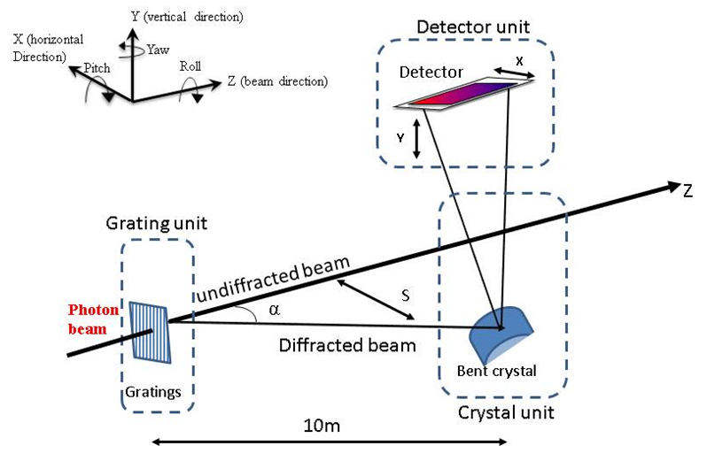
Other current WP74 design activities
(not related to XTD2 installations)
Hard X-ray High Resolution Single Shot Spectrometer
(HXHRSSS, now called HiREX)
  Design Document (physics, simulations)
  Technical Specifications Document finished and reviewed
  Public Tender started (awarding mid-May)
  detailed technical design
  by company until fall 2015
  for XTD9 / SASE1
new

Slide 20
Other current WP74 design activities
(not related to XTD2 installations)
Diamond Detectors for Intensity & Position Monitoring
Temporal Diagnostics:
THz Streaking and Spectral Encoding
Energy
Energy
Laser-based THz-generation at XFEL.EU
600 fs
White-light generation for spectral encoding
THz streaking
Time
Development work in 2015:
Prototype chamber for
THz-streaking Pulse Length Monitor (TPLM)
Prototype chamber for
Photon Arrival time Monitor (PAM)

Slide 21
Open issues
Tunnel installation planning needs more details:
sequence and dates of device vacuum installations,
cabling & other infrastructure, pumped systems in unfinished tunnels,
temporary storage in tunnels/shafts,…
Rare gas supply system
considerable effort, ~4km of pipes, currently a task within WP74
since excluded from TGA by MKK
Still: Coordination across WPs for common orders
  Control crates (Beckhoff)
  Cables for connecting devices to racks/crates
  …

Slide 22
WP74 summary
SASE1 / XTD2 devices on track
Other current WP74 design activities:
  Hard X-ray Single Shot Spectrometer
  Diamond Detectors
  Temporal Diagnostics
Need continuously, detailed, coordinated and agreed
tunnel installation planning !

