Slide 1
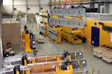
Status of the XFEL.EU Undulator Systems
J. Pflüger, European XFEL
XFEL Collaboration Meeting 23.4.2015
Notes:
How to edit the title slide
Upper area: Title of your talk, max. 2 rows of the defined size (55 pt)
Lower area (subtitle): Conference/meeting/workshop, location, date, your name and affiliation, max. 4 rows of the defined size (32 pt)

Slide 2
Overview
Overview: XFEL.EU Undulator Systems & Controls
WP71 Hardware
Undulator Segments
Status of Production
Representative Results
Intersections
Phase Shifters
Quadrupole Movers + Control Racks
Tunnel Installation
SASE1, (SASE2), SASE3
Outlook and Summary

Slide 3
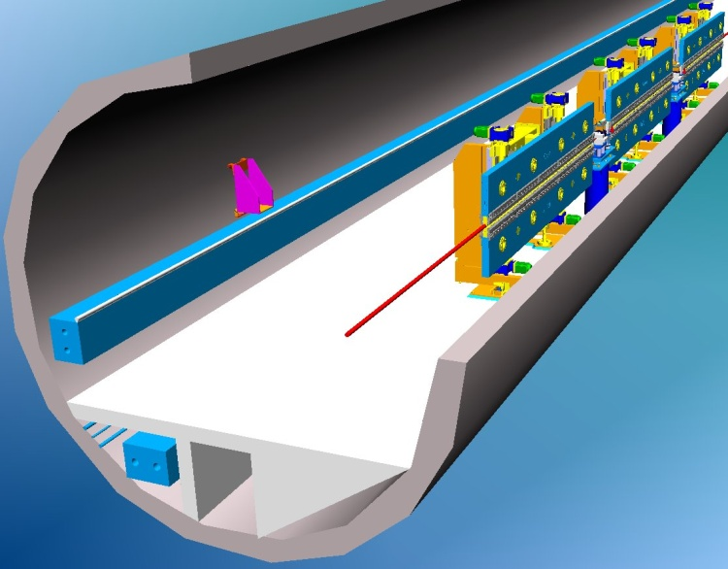
Undulator Systems

Slide 4
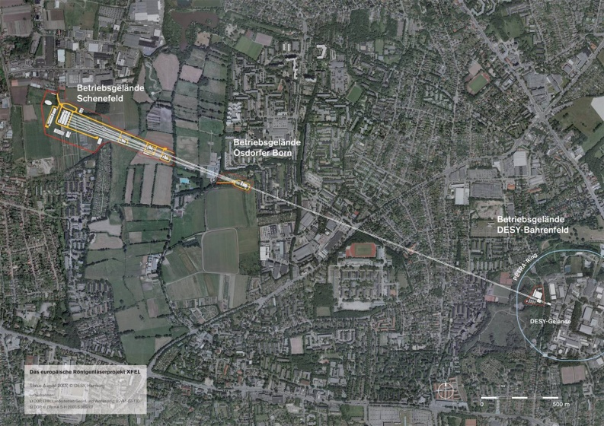
European XFEL Overview
Aerial View
Undulator
Tunnels
Dumps
SASE 3
SASE 1
Switchyard
SASE 1- 3 : Undulator Systems
SASE 2
SC Accelerator
Dogleg
Injector
Accelerator Layout
W. Decking

Slide 5
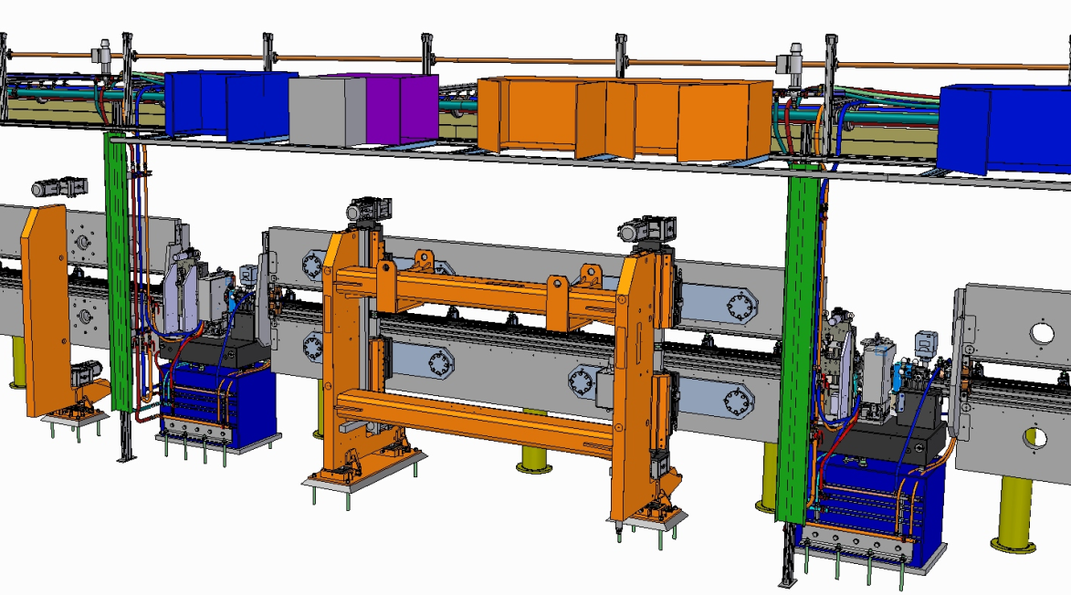
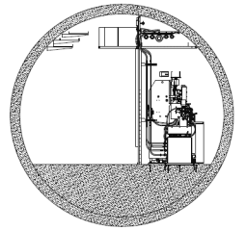
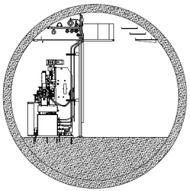
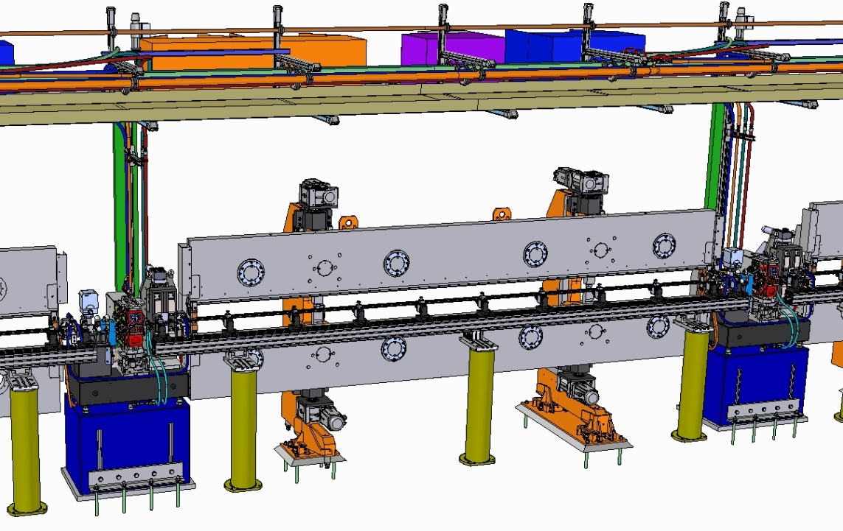
Tunnel Installation of SASE2 Undulator System – Final WP71 Deliverables
SASE2
e ⁻
Local Control Systems
e ⁻
SASE2 SASE1/3
Downstream View
 | SASE1/2 | SASE3
λ₀ [mm] | 40 | 68
Operational Gap Range [mm] | 10-20 | 10-25
K-Range | 3.9–1.65 | 9.0-4
Radiation Wavelength Range [nm]
@ 17.5 GeV | 0.147-0.040 | 1.22-0.27
@ 14.0 GeV | 0.230-0.063 | 1.90-0.42
@ 8.5 GeV | 0.625-0.171 | 5.17-1.15
# of Segments | 35 | 21
System Length [m] | 213.5 | 128.1
e ⁻
Undulator Segment 5m
Intersection 1.1 m
Undulator Cell 6.1m
W.Tscheu

Slide 6
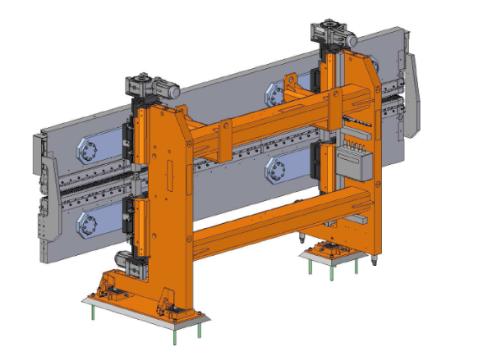
Undulator Segments

Slide 7
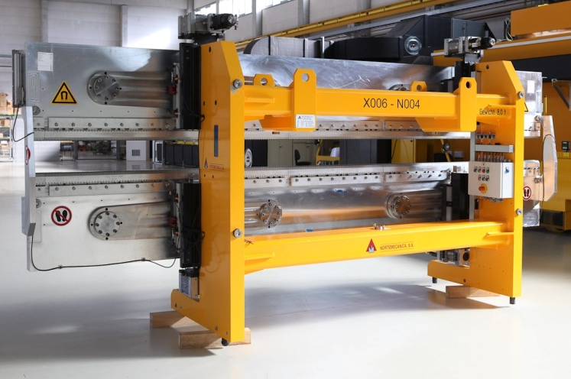
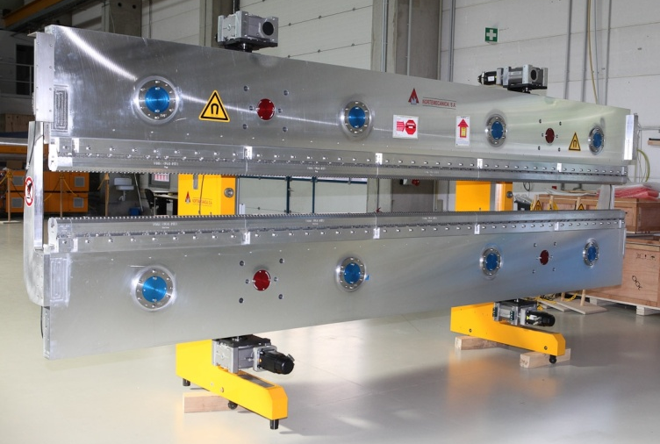
Status of Production April 21, 2015
Status of Undulator Production January 31, 2015
Delivery Status:
91 Support Systems
91 Magnet structures
Assembled and prepared for Measurements: 91
Waiting for magnetic measurements: 3 Segments
Measured, tuned, ready for Installation: 88 → Magnetic Length: 440m
Scheduled End of Production: 6 / 2015

Slide 8
Production @ XFEL.EU in Building 36; Dec 2012
New Undulator Segments
3 climatized Magnetic Labs
Steps @ XFEL.EU:
Mounting of magnetic structures
1st Commissioning
Magnetic Measurements & Tuning
Preparation for Installation
Schedule:
Total Time ≈ 2 Years (starting Oct/12)
3 Weeks/Segment !
→ 3 Magnetic Labs needed running in parallel
Scheduled End: Spring 2015
Assembly Area for Magnetic Structures
Segments waiting for Magnetic Measurements
Measured and tuned Segments
Incoming Magnetic Structures from VAC
2nd Hall with 700m² for storage

Slide 9
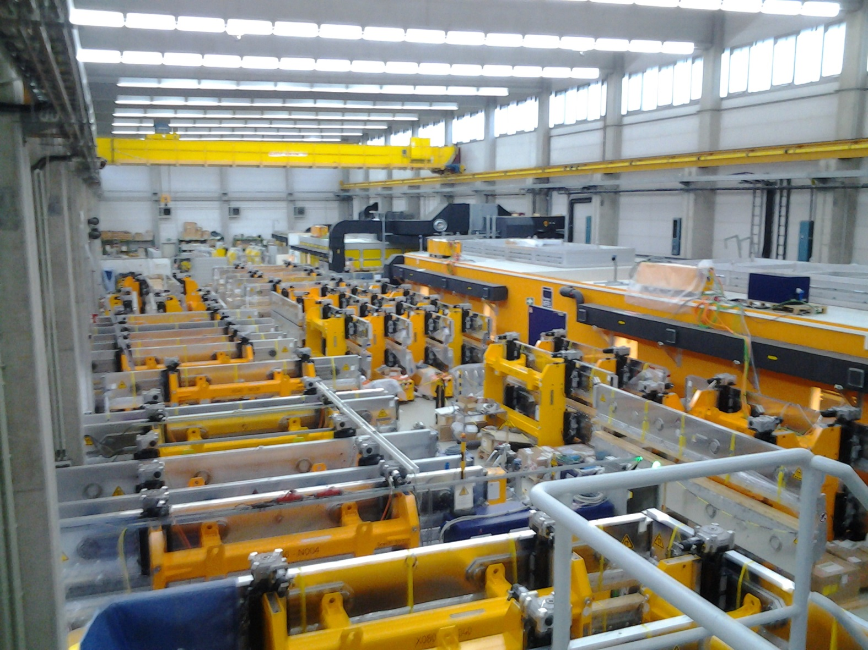
Hall 36 as of Jan 28, 2015

Slide 10
Results
Magnetic Measurements
U. Englisch, Y. Li, S.Utermann, F. Wolff-Fabris

Slide 11
Criteria for Magnetic Fields
Transversal overlap between Laser Field and electron beam → Straight trajectory; 2 nd Field Integrals I2_{y} ; I2_{x}
Longitudinal overlap (Phasing between micro bunched electron beam and laser filed) → Phase Jitter (PJ)
XFEL Specs | U40 | U68
Operational Gap Range [mm] | 10-20 | 10-20
B₀ @ 10mm Gap [T] | 1.14 | 1.66
K @ 10mm Gap | 3.9 | 9.3
RMS I2_{Y} [Tmm²] | < 100 | < 210
RMS I2_{Z} [Tmm²] | < 100 | < 100
Phase Jitter [°] | ≤ 8 | ≤ 8

Slide 12
Pole Tuning : U40-X044-K004 @ Gap=14mm
Notes:
Before you start editing the slides of your talk change to the Master Slide view: Menu button “View”, Master, Slide Master:
Edit the following 2 items in the 1st slide: 1) 1st row in the violet header: Delete the existent text and write the title of your talk into this text field 2) The 2 rows in the footer area: Delete the text and write the information regarding your talk (same as on the Title Slide) into this text field.
If you want to use more partner logos position them left beside the DESY logo in the footer area Close Master View

Slide 13
U40-X044 / X004: Comparison of Gap dependent Results
Transverse Overlap
K-Parameter
Longitudinal Overlap / Phase Jitter
 | Specs | Result
Operational Gap Range [mm] | 10-20 | ---
B₀ @ 10mm Gap [T] | 1.14 | 1.13
K @ 10mm Gap | 4 | 3.9
RMS I2_{Y} [Tmm²] | < 100 | < 50
RMS I2_{Z} [Tmm²] | < 100 | < 40
Phase Jitter [°] | < 8 | < 7
Notes:
Before you start editing the slides of your talk change to the Master Slide view: Menu button “View”, Master, Slide Master:
Edit the following 2 items in the 1st slide: 1) 1st row in the violet header: Delete the existent text and write the title of your talk into this text field 2) The 2 rows in the footer area: Delete the text and write the information regarding your talk (same as on the Title Slide) into this text field.
If you want to use more partner logos position them left beside the DESY logo in the footer area Close Master View

Slide 14
Pole Tuning: U68-X003-N001 @ Gap=16mm
Notes:
Before you start editing the slides of your talk change to the Master Slide view: Menu button “View”, Master, Slide Master:
Edit the following 2 items in the 1st slide: 1) 1st row in the violet header: Delete the existent text and write the title of your talk into this text field 2) The 2 rows in the footer area: Delete the text and write the information regarding your talk (same as on the Title Slide) into this text field.
If you want to use more partner logos position them left beside the DESY logo in the footer area Close Master View

Slide 15
U68-X003 / X004: Comparison of Gap dependent Results
Transverse Overlap
K-Parameter
Longitudinal Overlap / Phase Jitter
 | Specs | Result
Operational Gap Range [mm] | 10-25 | ---
B₀ @ 10mm Gap [T] | 1.69 | 1.66
K @ 10mm Gap | 10.5 | 9.3
RMS I2_{Y} [Tmm²] | < 210 | < 90
RMS I2_{Z} [Tmm²] | < 100 | < 70
Phase Jitter [°] | < 8 | < 8

Slide 16
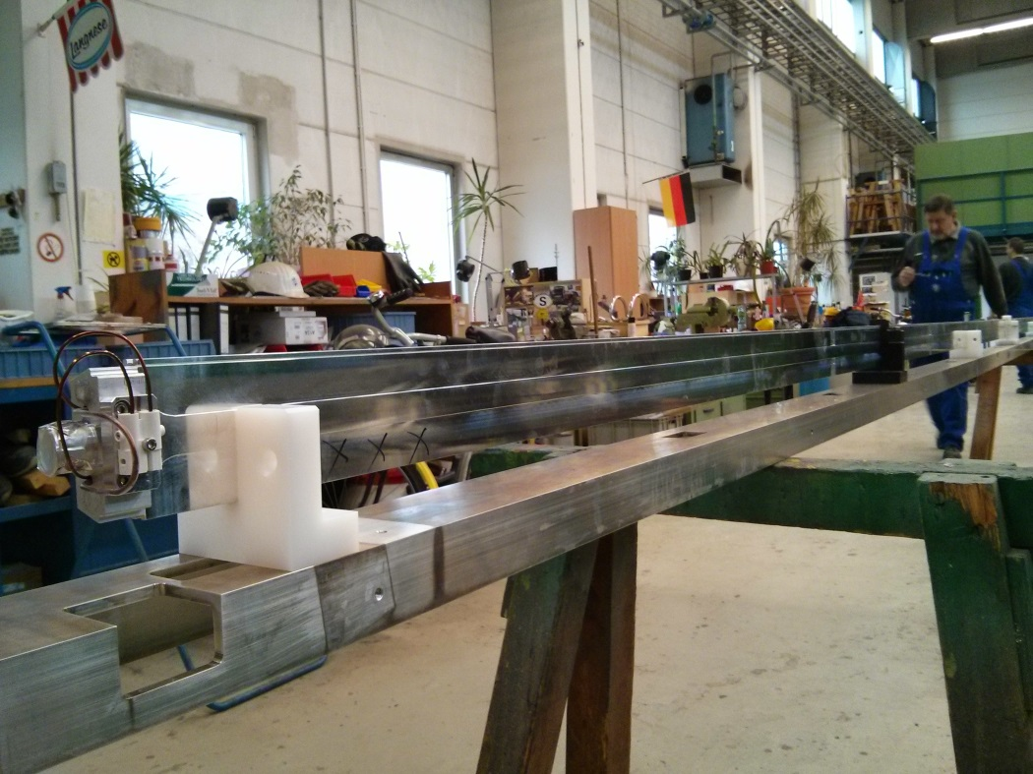
Undulator Vacuum Chamber MEA Workshop 11.2.2015
The XFEL Undulator Vacuum Chamber
T. Wohlenberg, S. Lederer DESY MVS, WP19
M. Yakopov, S. Karabekyan, WP71
First Prototype Chamber in MEA Workshop
Wire for N=2 Coil
Al Extrusion
32.0
15.0
9.5
8.6
10.0
2 Parallel Wire Correctors
Cooling Water Channels

Slide 17
Intersections
U. Englisch, Y. Li, S.Utermann, F. Wolff-Fabris

Slide 18
Intersections
WP17
SASE2 Geometry
WP17
Re-entrant Cavity BPMs+ Electronics
Beam Loss Monitors
WP71
WP19
Vacuum System
Phase Shifters
Status
WP71 Responsibility:
Phase Shifters:
IHEP all 31 finished
Bruker / Kyma 60 partially finished 60 FAT ; 40 SAT
Quadrupole Mover: finished 91 FAT + SAT
Intersection Control Racks: finished 91 FAT+SAT
Air Coils: 91 finished: FAT + SAT
Concrete Pillars: 101 delivered; 60 installed
Granite Bases: 101 waiting for installation
Vacuum system & related; WP19 in house
Cavity BPMs: WP17 in house
Loss Monitors: WP17: promised
Quadrupoles: WP19: All in house
WP12
WP71
Air Coil Correctors
Quadrupoles
WP71
WP71
Quadrupole Movers
Support Bases Adjustors Concrete Pillars

Slide 19
Intersections
WP17
SASE2 Geometry
WP17
Re-entrant Cavity BPMs+ Electronics
Beam Loss Monitors
WP71
WP19
Vacuum System
Phase Shifters
Status
WP71 Responsibility:
Phase Shifters:
IHEP all 31 finished
Bruker / Kyma 60 partially finished 60 FAT ; 40 SAT
Quadrupole Mover: finished 91 FAT + SAT
Intersection Control Racks: finished 91 FAT+SAT
Air Coils: 91 finished: FAT + SAT
Concrete Pillars: 101 delivered; 60 installed
Granite Bases: 101 waiting for installation
Vacuum system & related; WP19 in house
Cavity BPMs: WP17 in house
Loss Monitors: WP17: promised
Quadrupoles: WP19: All in house
WP12
WP71
Air Coil Correctors
Quadrupoles
WP71
WP71
Quadrupole Movers
Support Bases Adjustors Concrete Pillars

Slide 20
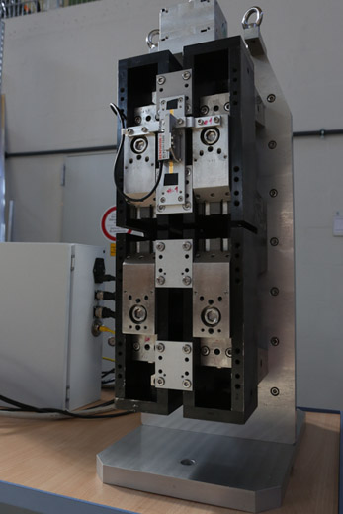
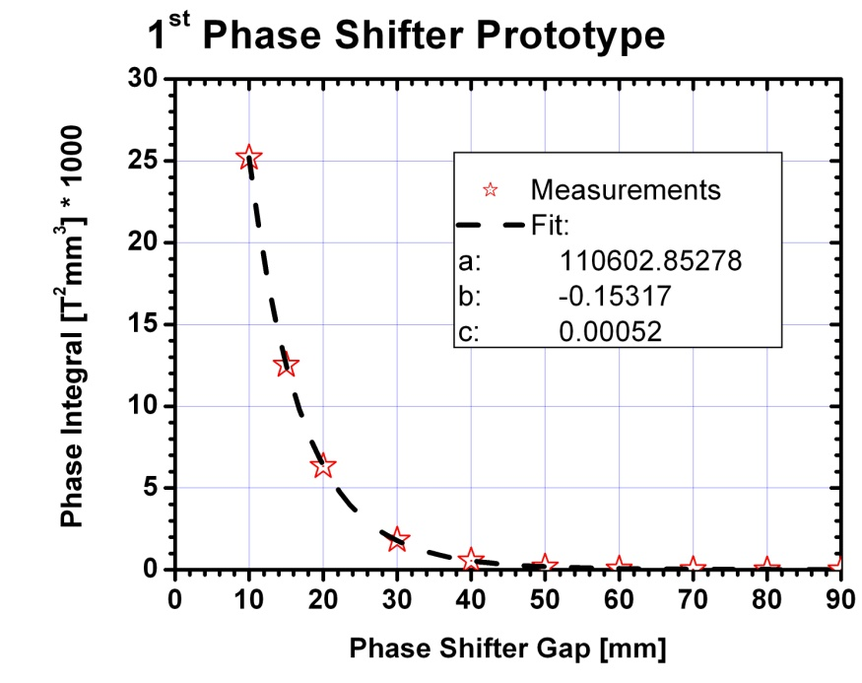
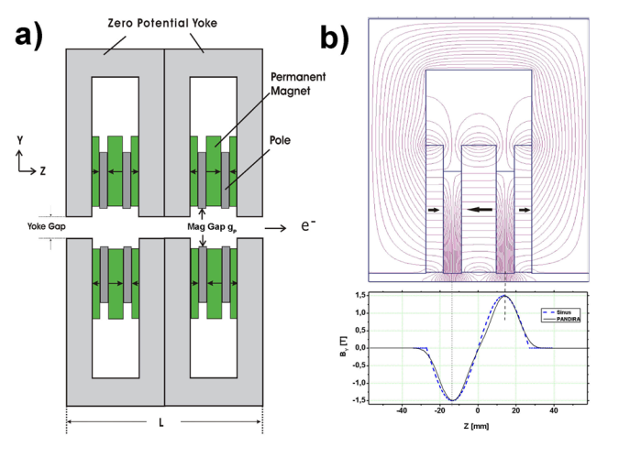
The XFEL Phase Shifters
Period length: 55mm
Gap range: 10.5 to ≈>100mm
Max. Phase Integral @ gap 10.5mm : ≥23400 T²mm³
1st Hor/Ver Field Integral Tolerance: ±0.004 Tmm
Dynamic Operation without retuning!
2nd Hor/Ver Field Integral Tolerance: ±67 Tmm²
Phase adjustment accuracy: ± 10° (5°)
Min. Gap precision for 5/10° at SASE1/2 ±15/30 µm
H. Lu, S. Sun, C. Wan, IHEP, Beijing
H. Lu, Y. Li, J. Pflueger, NIM A605 (2009),399

Slide 21
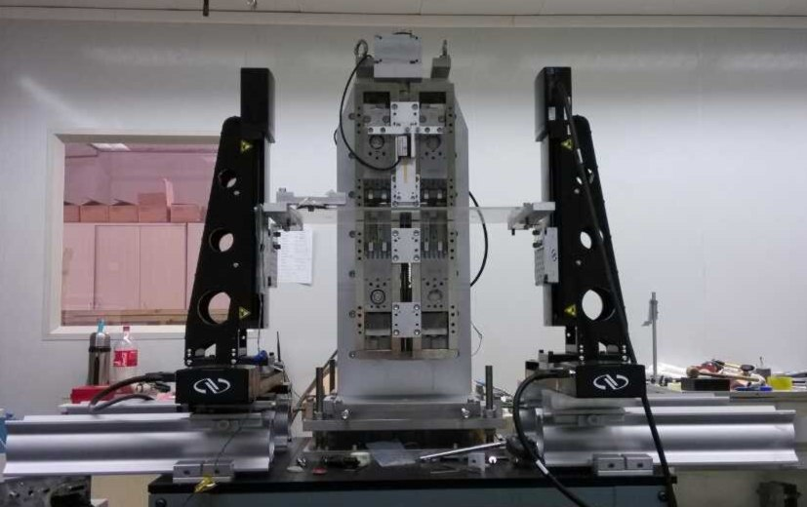
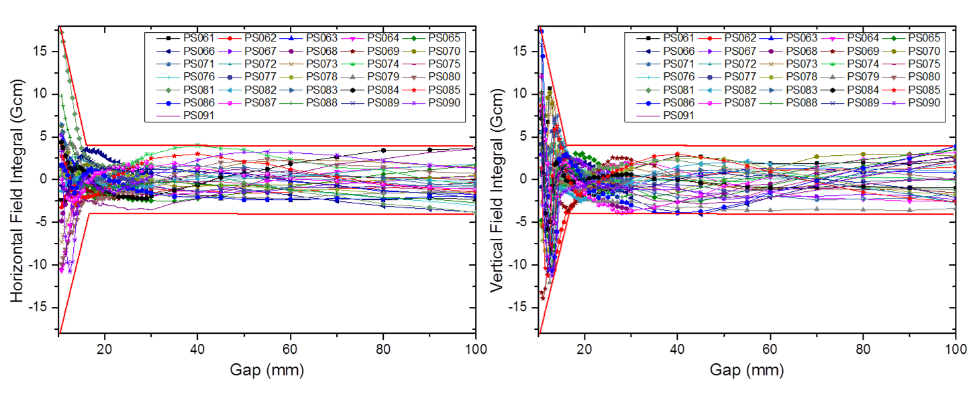
91 Phase Shifters
31 built by IHEP, Beijing, delivered in Specs
60 by Consortium Bruker/Kyma ≈50 delivered, in specs!
1st Field integral most challenging
All accepted, all in specs!
Example: 1st Field Integrals of 31 IHEP Phase Shifters
Li, Pflueger, Phys Rev STAB 18, 030703 (2015)
Spec Window
Horizontal 1st Field Integral
Vertical 1st Field Integral

Slide 22
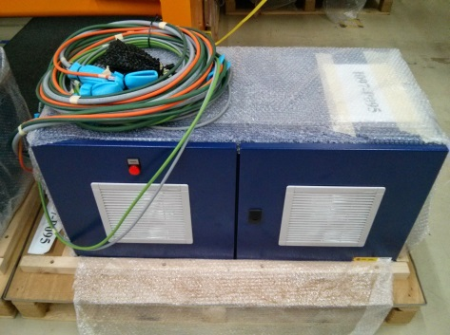
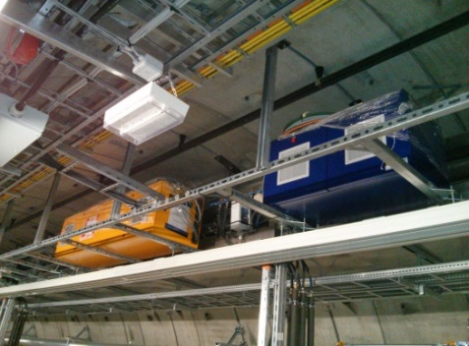
Quadupole Movers (QM), Intersection Control Racks (ICR)
Spanish IKC by CIEMAT
Status:
QMs :
91 Delivered and accepted
ICRs:
91 delivered and accepted
35 installed in XTD2
QM
ICR ICR installed in XTD2/SASE1

Slide 23
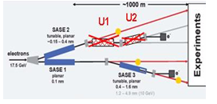
Tunnel Installation
Tunnel Installation
U. Englisch, Y. Li, S.Utermann, F. Wolff-Fabris

Slide 24
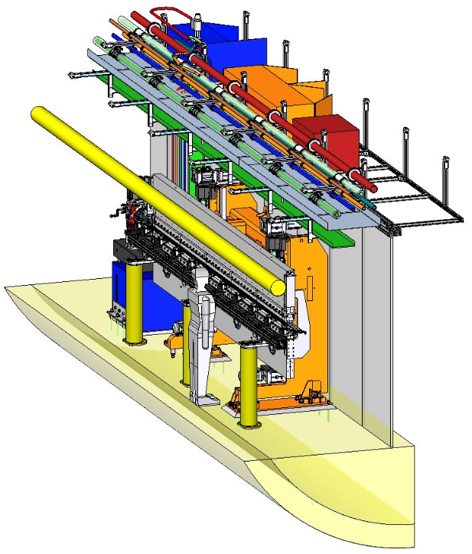
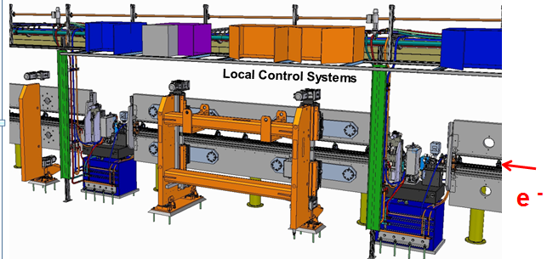
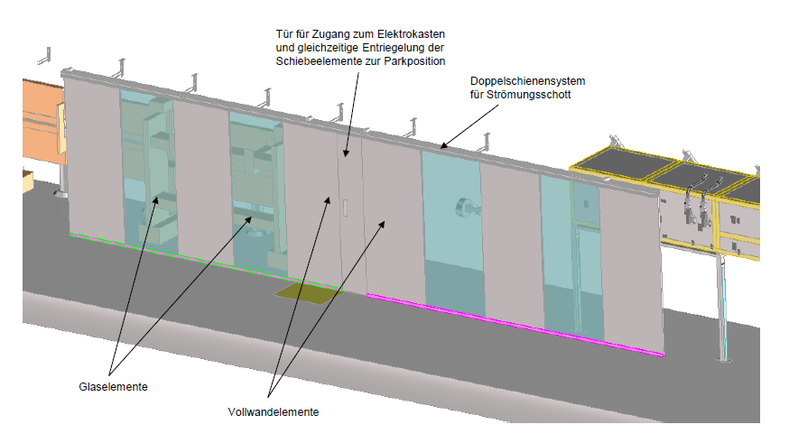
XFEL Undulator Systems in Tunnels XTD1, XTD2 and XTD4
SASE2 SASE1/3
Downstream View
With Air Conditioning & Enclosures
Naked Undulator System

Slide 25
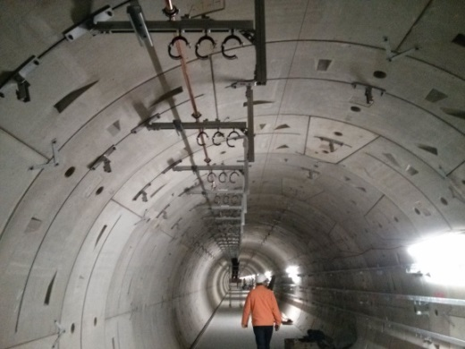
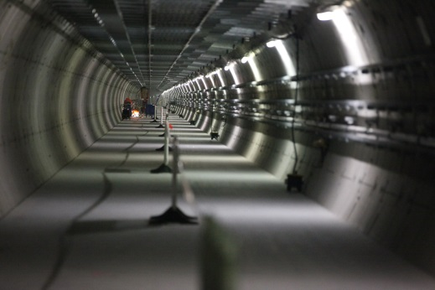
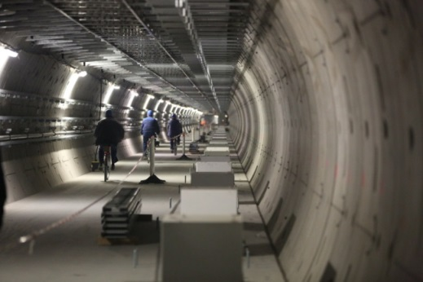
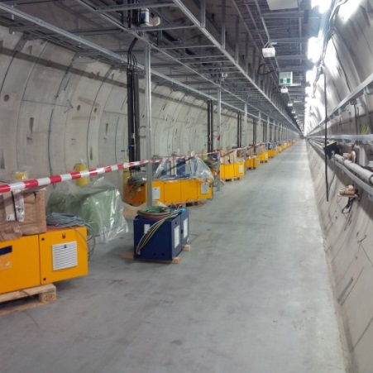
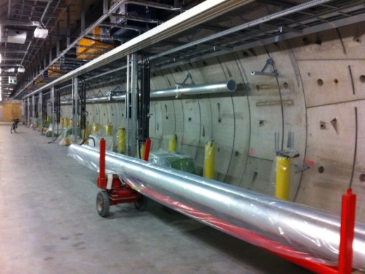
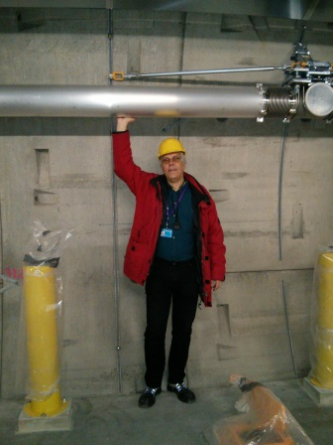
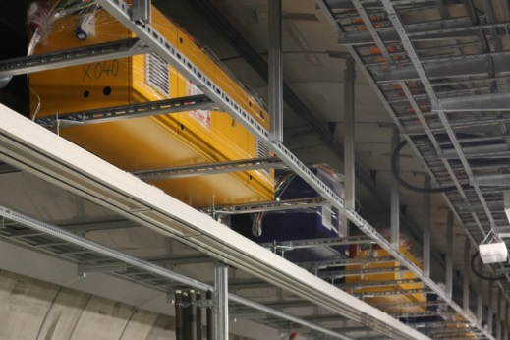
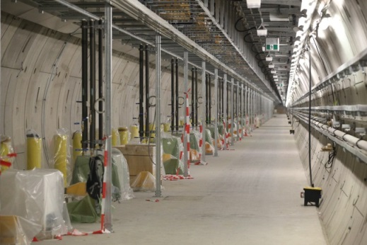
SASE1/XTD2 Installation Picture Gallery
March 2014
April 2014
May2014
| Dry Air
Oct 2014
Nov 2014
Nov 2014
Jan 2015
5.2. 2015

Slide 26
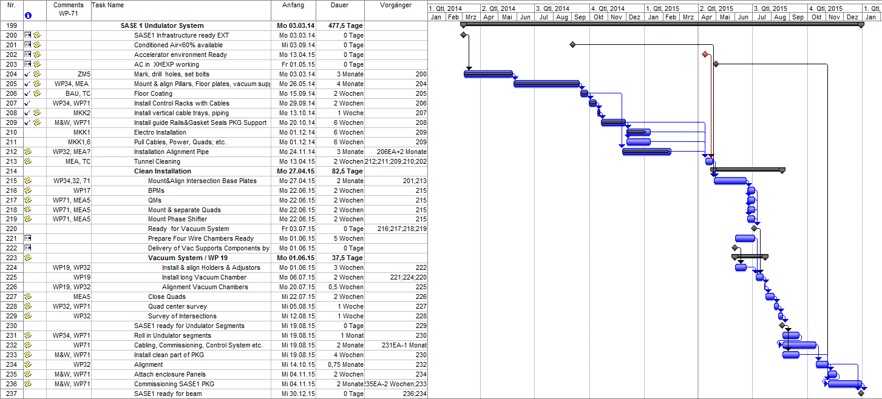
SASE1 / XTD2 Installation Schedule updated 01.04.15
3.3. 14
13.4. 15
30.12. 15
22 (15) Months

Slide 27
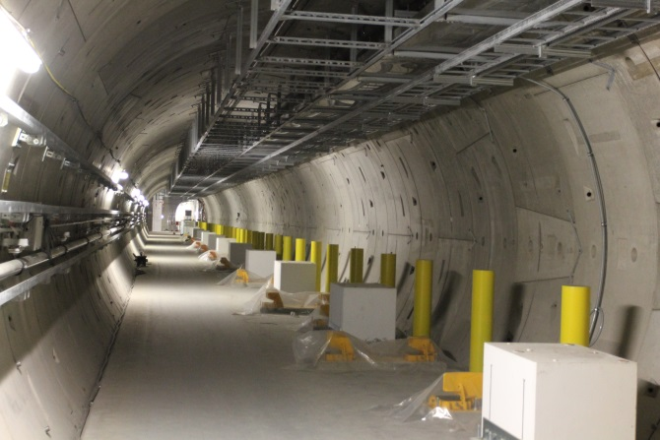
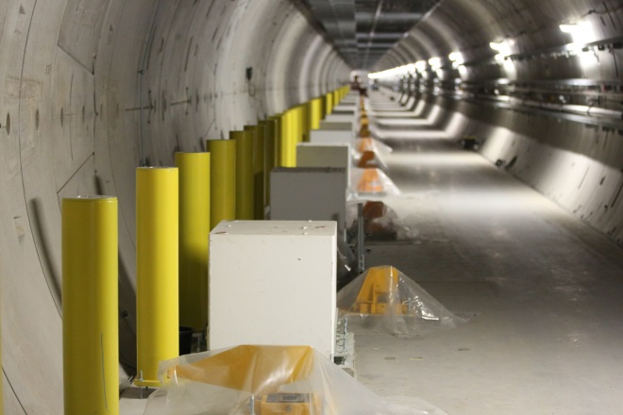
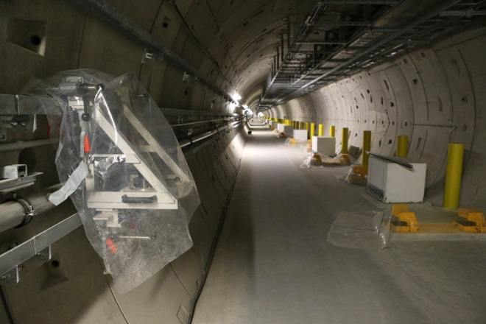
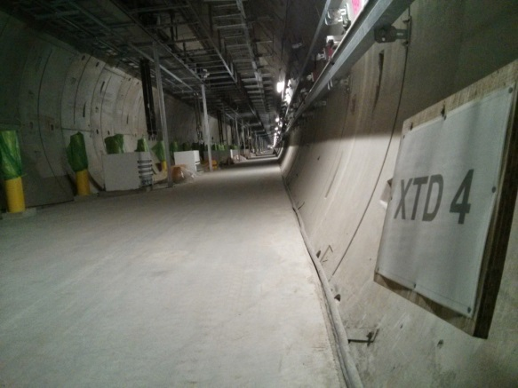
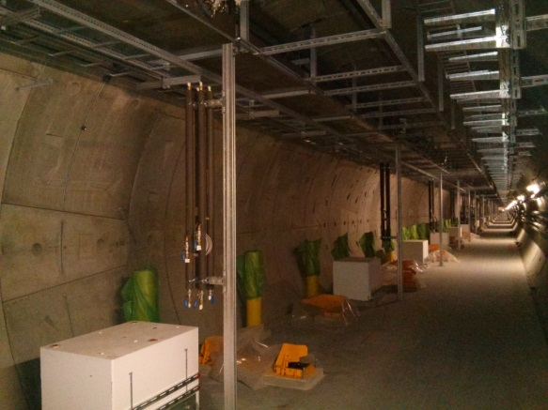
SASE3 / XTD4 5.2.15
Dec 2014
Jan 2015
2.2.2015

Slide 28
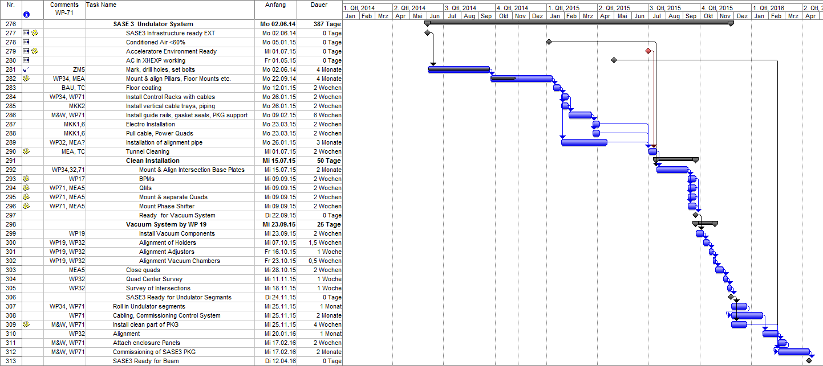
SASE3 / XTD4 March 2015
12.6.14
12.2.15
12.4.16
22 (15) Months

Slide 29
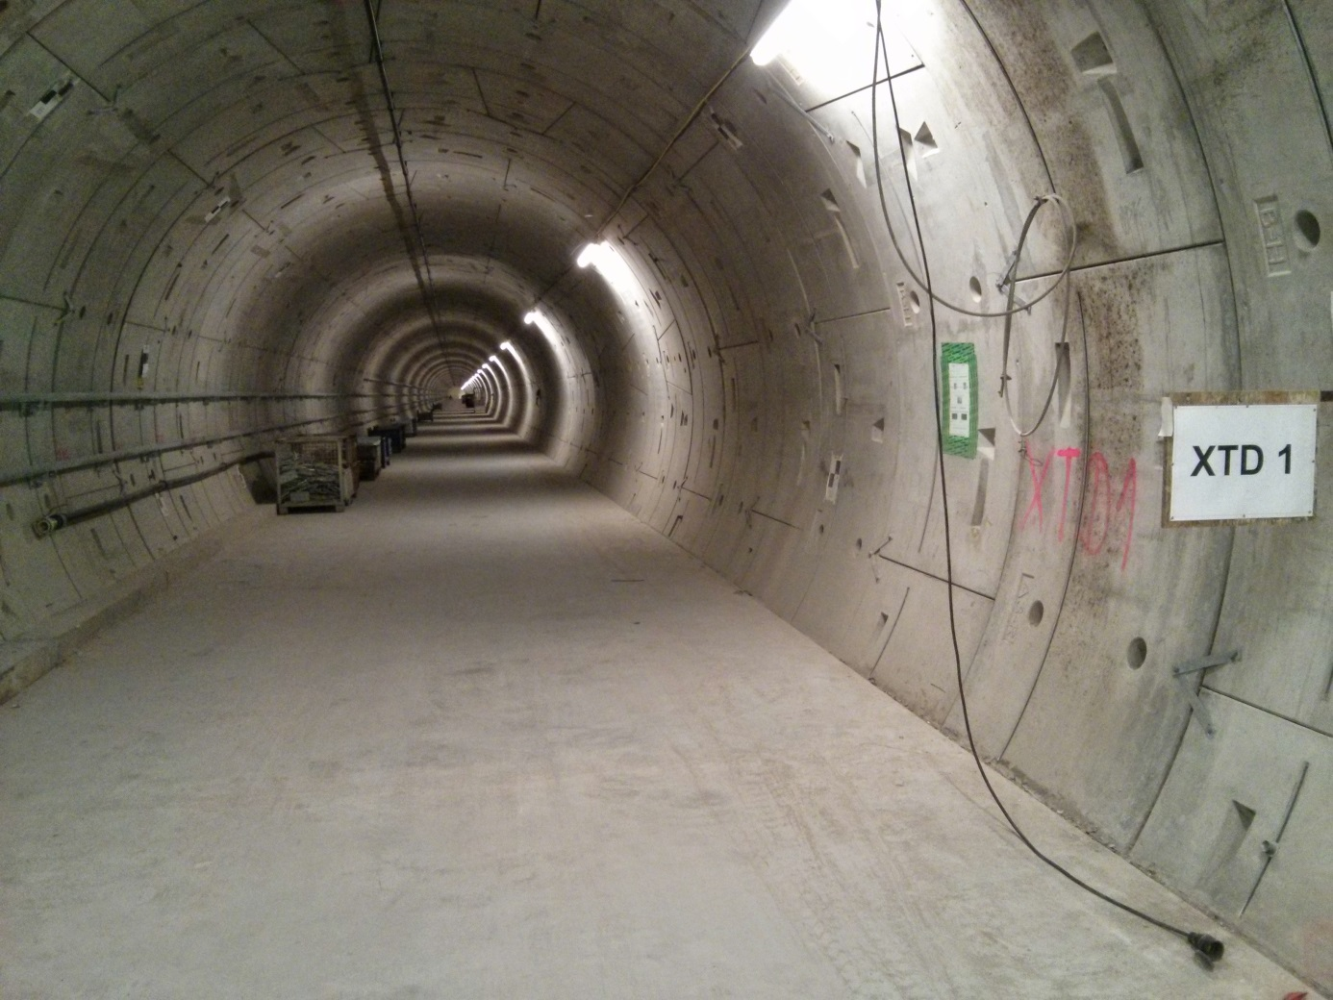
XTD1/SASE2 5.2.2015
Empty! Installation starts June 15

Slide 30
SASE2 / XTD1 Installation Schedule updated 27.11.14
Installation starts May 15
1.6.15
8.9.16
15 Months (Original Plan)

Slide 31
Next Activities
Continue Tunnel Installation as close to schedule as possible
Solution of problems
Problem 1: about 60% of the Undulator Segments are stored in Windsbergring up to 2 ½ years with poor (no) temperature control
Problem 2: limited accuracy of present Hall Probe measurements (ΔK/K ≤ 8-9 x 10⁻⁴)
Problem 3: Entrance/Exit Kicks as determined with Hall Probe measurements have limited accuracy.

Slide 32
Problems Nr. 1,2 : Better Hall-Sensors K-Gapdependence of U40-X057
Comparison of Senis#151, #152 and #153 on U40-X057
151-152 ΔK/K≈2.5x10⁻⁴
Message
Accuracy Limit: ΔK/K≈2.5x10⁻⁴
→Re-Measurement of all
91 Undulator Segments
151-153 ΔK/K≈10⁻⁵
151-152 ΔK/K≈2.5x10⁻⁴

Slide 33
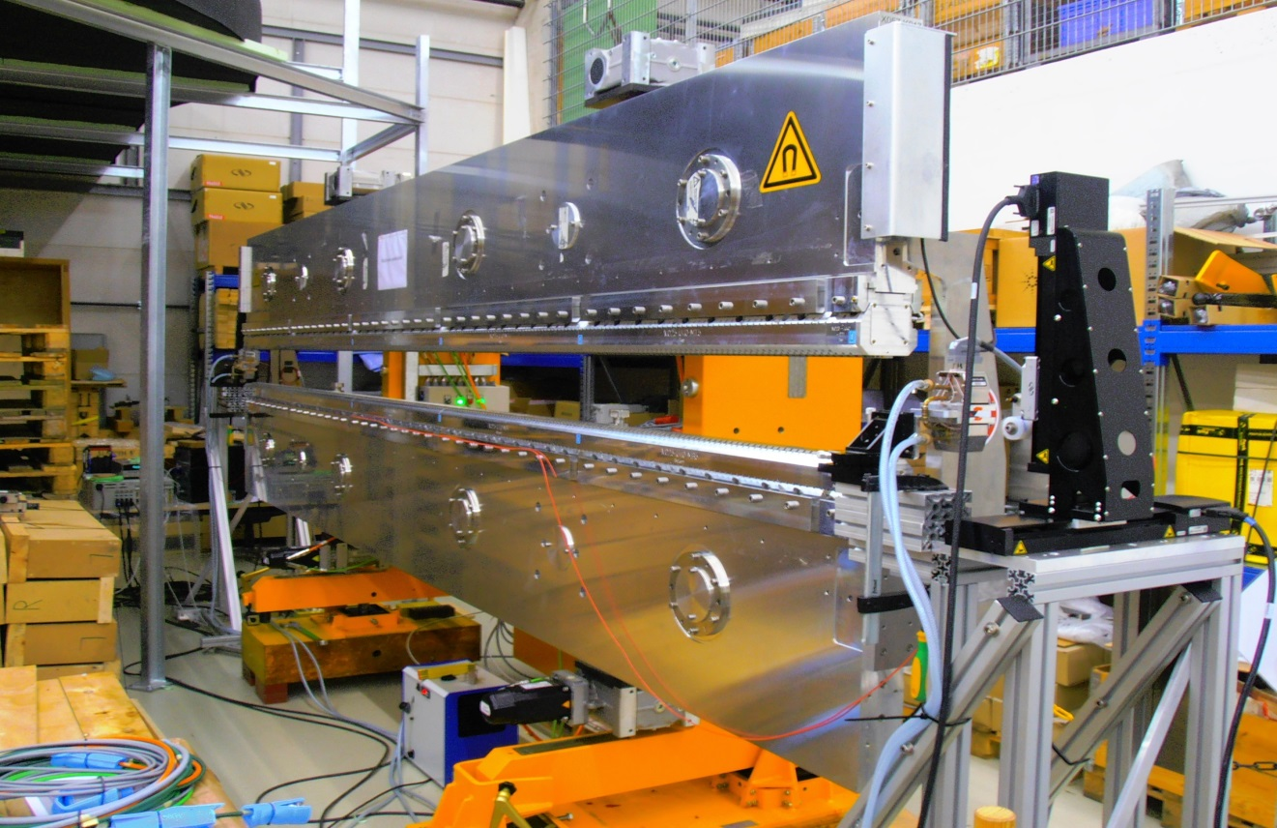
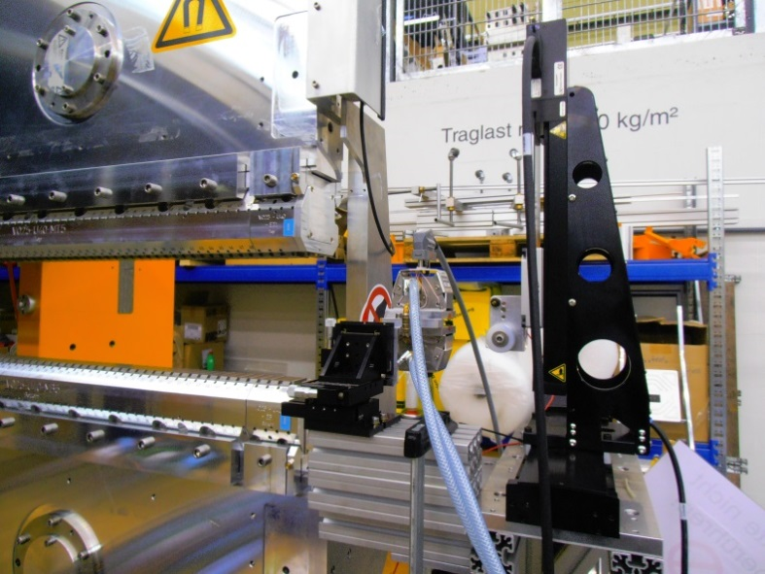
Problem Nr. 3: Precision Measurement of Entrance and Exit Kick Errors by the Moving Wire Method
Moveable stages
Undulator
Air coil
Frederik Wolf-Fabris :
1.) WP71/2014/21
2.) WPG3 Seminar 17.3.2015
All Segments to be re-measured

Slide 34
Summary
Production of Undulator Segments approaches end
Industrial / Mechanical Production is over
Magnetic measurements & Tuning @XFEL.EU continue
Magnetic Measurements & Tuning:
87 Segments tuned to Specs → “Ready for Installation”
Intersections:
Phase Shifter Production approaches end
IHEP PS finished since Dec 2014, Bruker,Kyma follow in March
Tunnel installation: Slow but steady progress
Enough time for magnetic cross checking, remeasurement

Slide 35
XFEL.EU Undulator Systems Group, WP71
WP71 Group Members; Status March, 2015, left to right: Suren Abeghyan, Martin Knoll, Uwe Englisch, Marc Viehweger, Bora Ketenoglu, Frederik Wolf-Fabris, Majid Bagha-Shanjani, Georg Deron, Karl-Heinz Berndgen, Mikhail Yakopov, Joachim Pflüger, Yuhui Li, Suren Karabekyan

Slide 36
The End

Slide 37
Production of Undulator Segments
The Focus is on Serial Production. R&D is long ago!!
Industrial Part
Mechanical Support System including Local Motion Control System: 2 Suppliers
Magnetic Structure
Documentation in EDMS
XFEL.EU Part
Integration: Mechanics & Magnetics @ XFEL.EU
Commissioning @XFEL.EU
Magnetic Measurement & Tuning
Preparation for Installation
Documentation in EDMS
100% Done
90% Done

Slide 38
Standard Undulator Segment Support Structure
Gap Measurement Accuracy ±1µm
Special Attention: 1. Shear deformation and compressive deformation 2. Material pairing / Bimetallic bending 3. Four point support of girders 4. Four Motors, electronic gears 5. Forced girder guiding 6. Precision measurement of gap / Motor feedback to ±1µm, avoiding Abbé errors

Slide 39
Magnetics I: Design
Standard Support System with Standard Interface
Different Magnet Structures may be adopted
Same Material for girder and Magnet support structure: AlMg
Structure is segmented into~ 0.9m long modules + End sections
Structure is clamped onto the interface

Slide 40
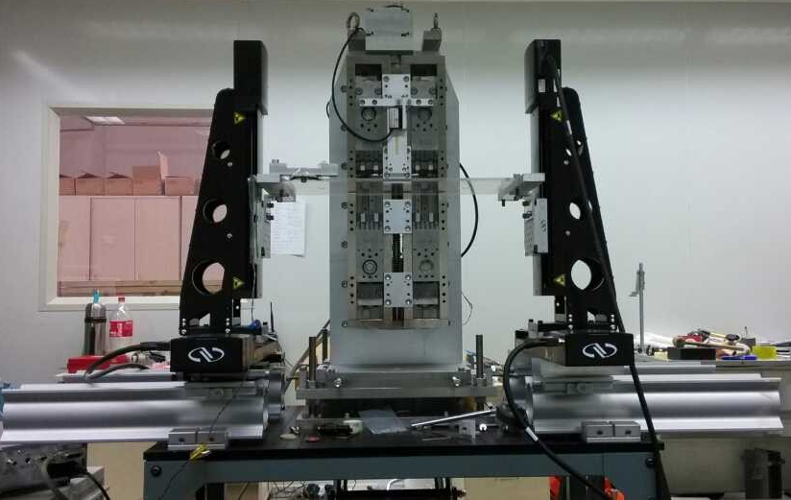
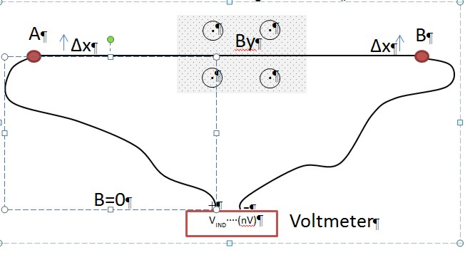
Phase Shifters & Short Moving Wire
Zhiquiang Li, IHEP; Frederik Wolff-Fabris, WP71
Parameters:
Length: ≈ 500mm
No of Strands: 50
Reproducibility: ≈ 0.3 Gcm
Absolute Accuracy: ≈ 1-2 Gcm
Parallel Wire Movement
$${I_{1y} }_{}=\int_{− L/2}^{L/2}{B_{y}\left(x\right)dx}= Δφ/N Δx$$
Anti-Parallel Wire Movement
L
$$I_{2y}=\int_{−L/2}^{L/2}{dx′}\int_{−L/2}^{x′}{B_{y}\left(x\right)dx}=\frac{L}{2}I_{1y}−\frac{L ∙ΔΦ}{2N∆x}$$

