Slide 1
Combining measurements using Best Linear Unbiased Estimators
(BLUE)
Lecture 1/2 – BLUE combination basics
Andrea Valassi
CERN, Information Technology Department
DESY Terascale Statistics School,
Hamburg 26-27th March 2015
Thanks to Isabell and all the organizers for the invitation!

Slide 2
About myself – context and disclaimer
Context
  Mainly worked as a HEP physicist until 2001
  ALEPH and LEPEWWG, LEP2 4-fermion cross-section combinations
  Mainly working in software and computing for HEP since 2002
  Collaboration with TOP LHC WG on top mass combination in 2012
  Not a member of ATLAS or CMS
Disclaimer
  No direct involvement in physics analyses for many years…
    Will use some examples that are rather outdated
  Will present personal opinions, not official views of LHC collaborations
  Will only discuss precision measurements, not limits for searches
  Will only use a frequentist approach, not a Bayesian approach

Slide 3
Outline #1 – BLUE basics
Intro to combining measurements – why, how, who?
  Simple academic examples and a glimpse of some real examples
Best Linear Unbiased Estimators – basics
  References, derivation of method, relation to other estimators
  Effect of correlations – just a glimpse (discussed in detail tomorrow)
BLUE combinations in practice – the multi-parameter case
  Preparing the relevant inputs and extracting the results
  A step-by-step example from LEP2 (statistically dominated)
Intermediate wrap-up (between lectures #1 and #2)

Slide 4
Outline #2 – the effect of correlations
Information in BLUE combinations
  Today’s example: LHC top mass 2012 (systematically dominated)
  “Relative importance” of measurements in the presence of correlations
Interpreting correlation effects and negative BLUE coefficients
  “Low-correlation” and “high-correlation“ regimes
Estimating correlations in practice
  “Conservative estimates” of correlations?
  The risks in overestimating correlations and a few hints to avoid that
Beyond BLUE?
Wrap-up and conclusions (for lectures #1 and #2)

Slide 5
Outline #1 – BLUE basics
Intro to combining measurements – why, how, who?
  Simple academic examples and a glimpse of some real examples
Best Linear Unbiased Estimators – basics
  References, derivation of method, relation to other estimators
  Effect of correlations – just a glimpse (discussed in detail tomorrow)
BLUE combinations in practice – the multi-parameter case
  Preparing the relevant inputs and extracting the results
  A step-by-step example from LEP2 (statistically dominated)
Intermediate wrap-up (between lectures #1 and #2)

Slide 6
Combining measurements – why, how?
Why combine measurements?
  Advancing knowledge (scientia) - ultimately, we are all in this game together!
  Get better result (lower errors) combining knowledge (information)
What we what to know after combining results
  Central value(s) of the unknown parameter(s)
  Total combined error(s) – (and their correlations: the covariance matrix)
  Contributions to the combined error/covariance from the different sources
  How compatible input results are with one another
  “How much” each measurement contributed (do we really need this?)
What we need to provide as input
  Central values of the input measurements
  Model of observations – which measurement measures which parameter
  Errors on each input measurement from every different error source
  Covariances/Correlations between errors from every different error source
  Some assumptions on the error distributions (Gaussian, Poisson...)
  A choice of one or more combination methods (e.g. BLUE)

Slide 7
Combining measurements – who?
First of all, different methods are combined within each experiment!
Working groups of experiments at the same collider, such as:
  The LEP Electro-Weak Working Group (LEPEWWG)
    See the final reports on LEP1 and LEP2 physics from ALEPH, DELPHI, L3, OPAL
  The Tevatron Electro-Weak Working Group (TEVEWWG)
  The LHC Higgs boson Cross Section Working Group (LHCHXSWG)
  The LHC Top quark Working Group (TOPLHCWG)
  The DESY Terascale Working Group on SUSY/BSM Fits
  Healthy examples where competition rhymes with collaboration!
The ultimate reference of HEP knowledge: the Review of Particle Physics
  Published every two years by the Particle Data Group
    See the “Procedures" section on data treatment/selection, averages/fits, rounding
All these groups interact with each other
  Large overlap of people and expertise across different groups
  Exact procedures and processes are different as the contexts are different

Slide 8
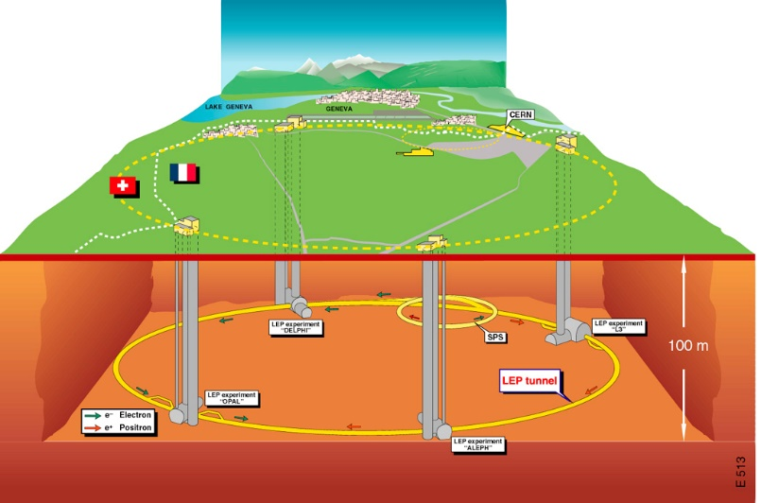
Example 1 – WW cross sections at LEP2
3 BLUE combinations
Inputs: 4+4+32 measurements
Results:1+1+8 parameters
ADLO & LEPEWWG Preliminary Combination for Summer2001 Conferences

Slide 9
Example 2 – W branching ratios at LEP2
BLUE combination
(Lepton non-universality)
Input: 12 measurements
Results:3 parameters
ADLO & LEPEWWG, LEP2 final report, Phys. Rep. 532 (2013) 119
BLUE combination (Lepton universality)
Reinterpret the same 12 measurements as measurements of a single parameter
(different parametric model of observations)
Input: 12 measurements
Results:1 parameter

Slide 10
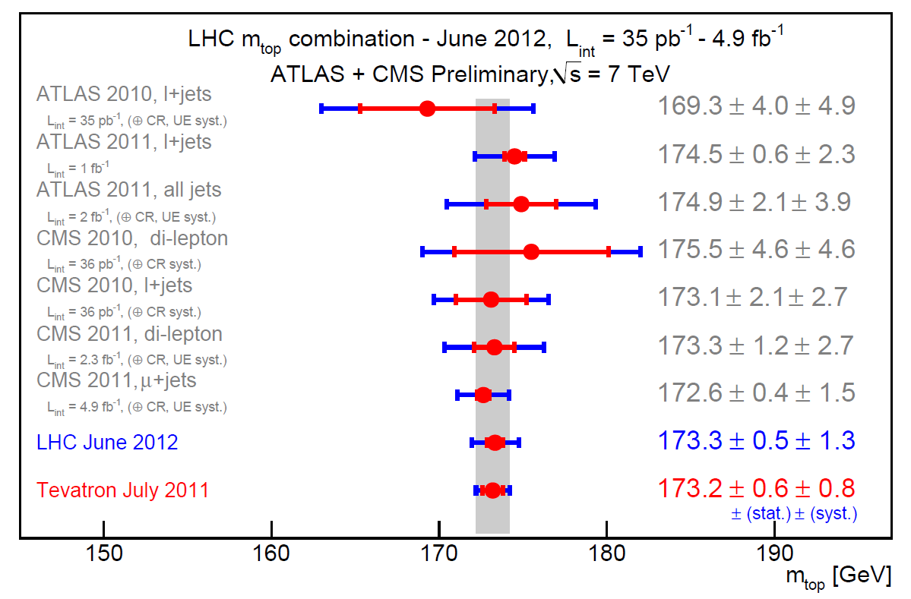
Example 3 – LHC m_{top} combination 2012
BLUE combination
Input: 7 measurements
Results:1 parameter
ATLAS-CONF-2012-095 / CMS PAS TOP-12-001

Slide 11
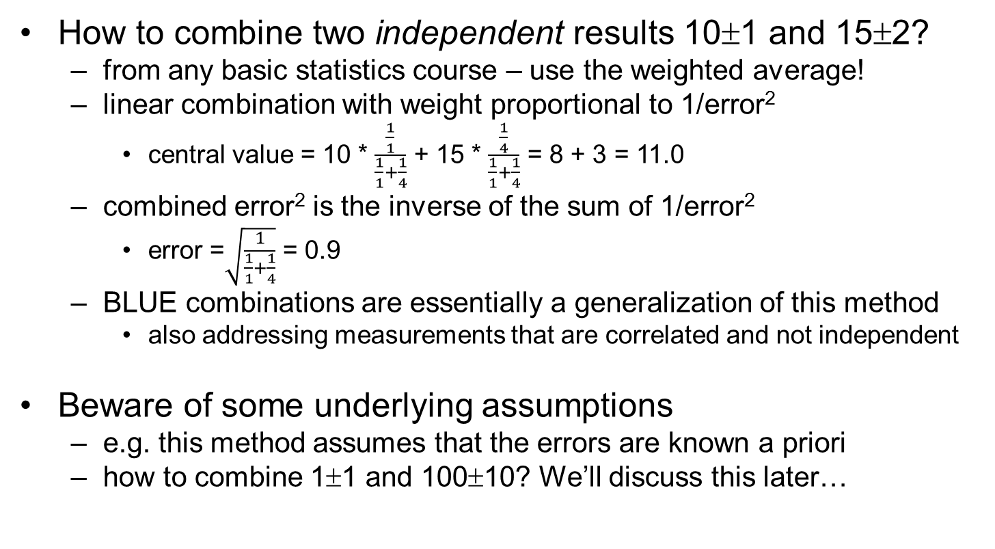
The simplest example of a combination
How to combine two independent results 10±1 and 15±2?
  from any basic statistics course – use the weighted average!
  linear combination with weight proportional to 1/error²
    central value = 10 * $\frac{\frac{1}{1}}{\frac{1}{1}+\frac{1}{4}}$ + 15 * $\frac{\frac{1}{4}}{\frac{1}{1}+\frac{1}{4}}$ = 8 + 3 = 11.0
  combined error² is the inverse of the sum of 1/error²
    error =$\sqrt{\frac{1}{\frac{1}{1}+\frac{1}{4}}}$ = 0.9
  BLUE combinations are essentially a generalization of this method
    also addressing measurements that are correlated and not independent
Beware of some underlying assumptions
  e.g. this method assumes that the errors are known a priori
  how to combine 1±1 and 100±10? We’ll discuss this later…

Slide 12
Outline #1 – BLUE basics
Intro to combining measurements – why, how, who?
  Simple academic examples and a glimpse of some real examples
Best Linear Unbiased Estimators – basics
  References, derivation of method, relation to other estimators
  Effect of correlations – just a glimpse (discussed in detail tomorrow)
BLUE combinations in practice – the multi-parameter case
  Preparing the relevant inputs and extracting the results
  A step-by-step example from LEP2 (statistically dominated)
Intermediate wrap-up (between lectures #1 and #2)

Slide 13
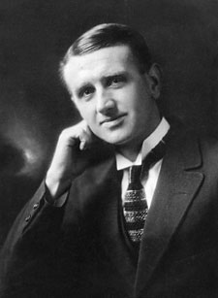
The BLUE method – Aitken (1934)
Alexander Craig Aitken (1895-1967)
  One of New Zealand’s most famous mathematicians
  Phenomenal memory and computational skills
  Brilliant lecturer, athletics champion, fine musician
The first published description of the BLUE method (AFAIK):
  A. C. Aitken, On Least Squares and Linear Combinations of Observations, Proc. Roy. Soc. Edinburgh 55 (1935), 42
    “Generalized least squares” estimation using the inverse of the covariance matrix of input measurements as the weighting matrix

Slide 14
BLUE – main references for this talk
Papers
  L. Lyons, D. Gibaut and P. Clifford, How to combine correlated estimates of a single physical quantity, NIM A270 (1988) 110 [link]
    Basic formulas for a single parameter, including extensive discussion of correlations and negative BLUE coefficients for two measurements – a must read! ☺
  A. Valassi, Combining correlated measurements of several different physical quantities, NIM A500 (2003) 391 [link]
    Generalization of Lyons formulas and computation of individual error contributions for many parameters (e.g. LEP electroweak WG)
  A. Valassi and R. Chierici, Information and treatment of correlations in the combination of measurements using the BLUE method, EPJ C74 (2014) 2717 [link]
    Generalization of Lyons discussion of correlations and negative BLUE coefficients for more than two measurements of a single parameter (e.g. LHC top quark WG)
Books
  A. van den Bos, Parameter Estimation for Scientists and Engineers, Wiley-Interscience (2007) [ebook]
    Very useful textbook covering information and estimation

Slide 15
BLUE – other useful references
Papers
  R. Nisius, On the combination of correlated estimates of a physics observable, EPJ C74 (2014) 3004 [link]
    Another very useful discussion of correlations in BLUE combinations
Books
  O. Behnke and L. Moneta, Parameter Estimation, in Data Analysis in HEP: a Practical Guide to Statistical Methods, Wiley-VCH (2013) [ebook]
    A modern reference also covering correlations in BLUE and PDG combinations!
  F. James, Statistical Methods in Experimental Physics (2nd Edition), World Scientific (2006)
    Another very useful textbook covering information and estimation
  G. Cowan, Statistical Data Analysis, Oxford University Press (1998)
    Another very useful reference textbook covering estimation
  S. Kay, Fundamentals of Statistical Signal Processing (volume 1: Estimation Theory), Prentice Hall (1993)
    A reference on signal detection and estimation theory for engineers

Slide 16
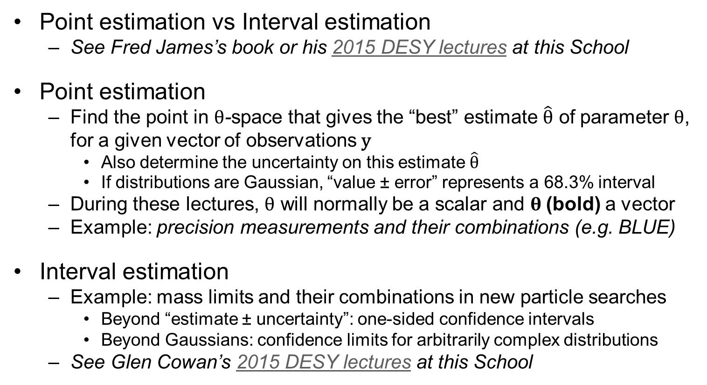
BLUE is a point estimation method
Point estimation vs Interval estimation
  See Fred James’s book or his 2015 DESY lectures at this School
Point estimation
  Find the point in $θ$-space that gives the “best” estimate $\hat{θ}$ of parameter $θ$, for a given vector of observations y
    Also determine the uncertainty on this estimate $\hat{θ}$
    If distributions are Gaussian, “value ± error” represents a 68.3% interval
  During these lectures, $θ$ will normally be a scalar and $θ$(bold) a vector
  Example: precision measurements and their combinations (e.g. BLUE)
Interval estimation
  Example: mass limits and their combinations in new particle searches
    Beyond “estimate ± uncertainty”: one-sided confidence intervals
    Beyond Gaussians: confidence limits for arbitrarily complex distributions
  See Glen Cowan’s 2015 DESY lectures at this School

Slide 17
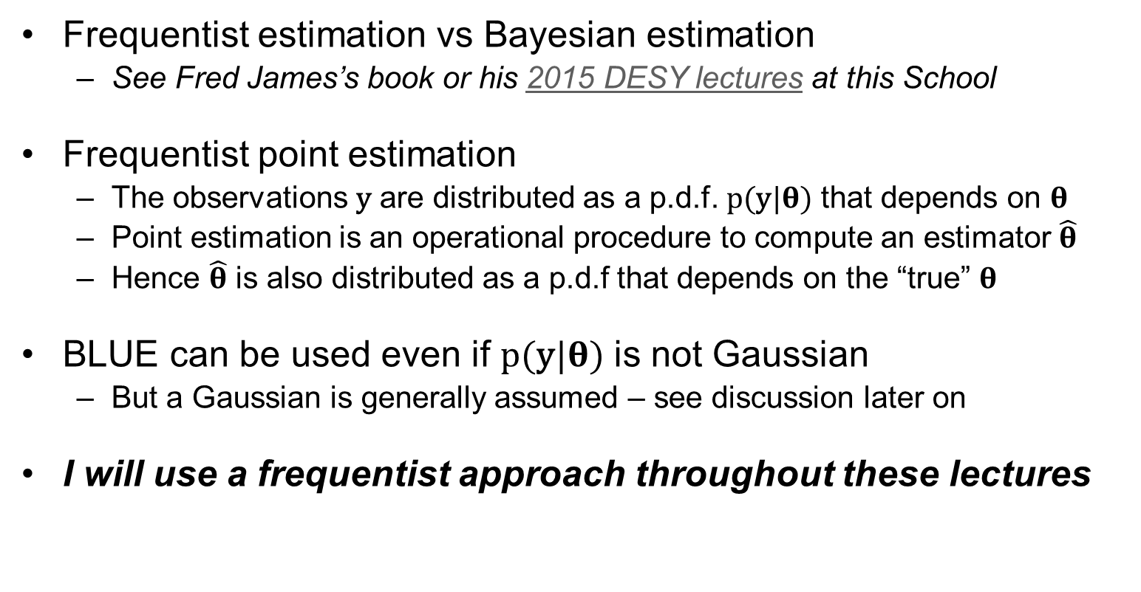
BLUE is a frequentist estimation method
Frequentist estimation vs Bayesian estimation
  See Fred James’s book or his 2015 DESY lectures at this School
Frequentist point estimation
  The observations y are distributed as a p.d.f. p(y|$θ$) that depends on $θ$
  Point estimation is an operational procedure to compute an estimator $\hat{θ}$
  Hence $\hat{θ}$ is also distributed as a p.d.f that depends on the “true” $θ$
BLUE can be used even if p(y|$θ$) is not Gaussian
  But a Gaussian is generally assumed – see discussion later on
I will use a frequentist approach throughout these lectures

Slide 18
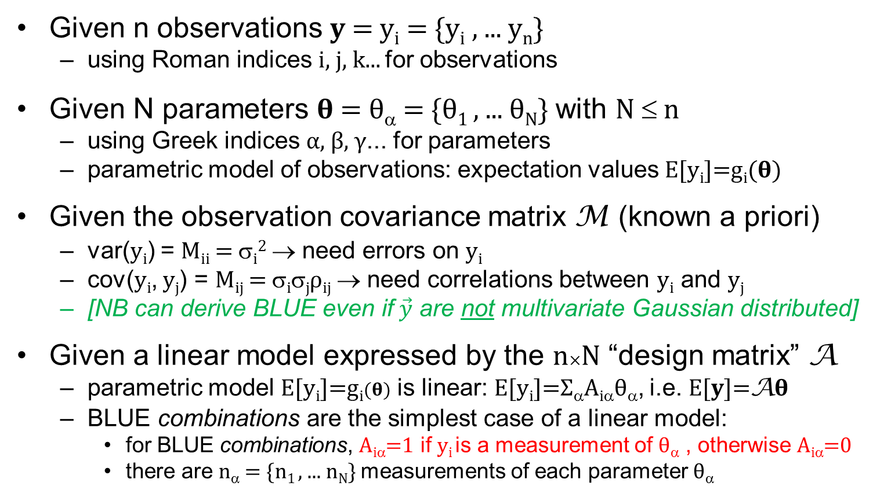
BLUE – assumptions and notation
Given n observations $y$= y_{i} = {y_{i} , ... y_{n}}
  using Roman indices i, j, k... for observations
Given N parameters $θ$= θ_{α} = {θ₁ , ... θ_{N}} with N ≤ n
  using Greek indices α, β, γ... for parameters
  parametric model of observations: expectation values E[$\text{y}\text{i}$]=g_{i}($θ)$
Given the observation covariance matrix M (known a priori)
  var(y_{i}) = M_{ii} = σ_{i}² → need errors on y_{i}
  cov(y_{i}, y_{j}) = M_{ij} = σ_{i}σ_{j}ρ_{ij} → need correlations between y_{i} and y_{j}
  [NB can derive BLUE even if$\vec{y}$ are not multivariate Gaussian distributed]
Given a linear model expressed by the n×N “design matrix” A
  parametric model E[$\text{y}\text{i}$]=g_{i}($θ)$ is linear: E[$\text{y}\text{i}$]=Σ_{α}A_{iα}θ_{α}, i.e. E[$y$]=A$θ$
  BLUE combinations are the simplest case of a linear model:
    for BLUE combinations, A_{iα}=1 if y_{i} is a measurement of θ_{α} , otherwise A_{iα}=0
    there are n_{α} = {n₁ , ... n_{N}} measurements of each parameter θ_{α}

Slide 19
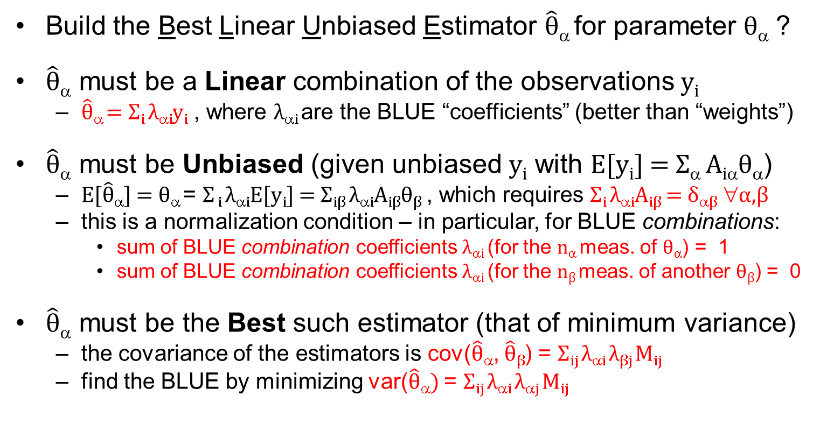
BLUE – Best Linear Unbiased Estimator
Build the Best Linear Unbiased Estimator $\hat{θ}$_{α} for parameter θ_{α} ?
$\hat{θ}$_{α} must be a Linear combination of the observations y_{i}
  $\hat{θ}$_{α} = Σ_{i} λ_{αi}y_{i} , where λ_{αi} are the BLUE “coefficients” (better than “weights”)
$\hat{θ}$_{α} must be Unbiased (given unbiased y_{i} with E[$\text{y}\text{i}$] = Σ_{α} A_{iα}θ_{α})
  $E[\hat{θ}$_{α}] = θ_{α} = Σ _{i} λ_{αi}E[$\text{y}\text{i}$] = Σ_{iβ} λ_{αi}A_{iβ}θ_{β} , which requires Σ_{i} λ_{αi}A_{iβ} = δ_{αβ} ∀α,β
  this is a normalization condition – in particular, for BLUE combinations:
    sum of BLUE combination coefficients λ_{αi} (for the n_{α} meas. of θ_{α}) = 1
    sum of BLUE combination coefficients λ_{αi} (for the n_{β} meas. of another θ_{β}) = 0
$\hat{θ}$_{α} must be the Best such estimator (that of minimum variance)
  the covariance of the estimators is cov($\hat{θ}$_{α}, $\hat{θ}\text{β}$) = Σ_{ij} λ_{αi} λ$\text{β}j$M_{ij}
  find the BLUE by minimizing var($\hat{θ}$_{α}) = Σ_{ij} λ_{αi} λ$\text{}j$M_{ij}

Slide 20
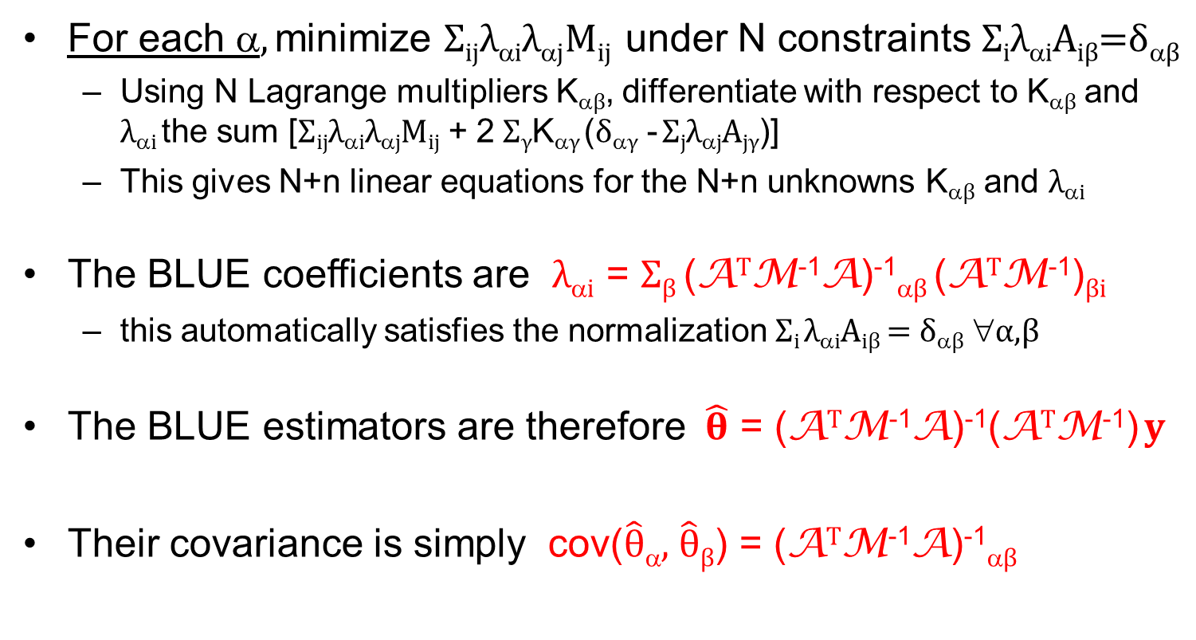
Build the BLUE!
For each α, minimize Σ_{ij}λ_{αi}λ$\text{}j$M_{ij} under N constraints Σ_{i}λ_{αi}A_{iβ}=δ_{αβ}
  Using N Lagrange multipliers K_{αβ}, differentiate with respect to K_{αβ} and λ_{αi} the sum [Σ_{ij}λ_{αi}λ$\text{}j$M_{ij} + 2 Σ_{γ}K_{αγ} (δ_{αγ} - Σ_{j}λ$\text{}j$A_{jγ})]
  This gives N+n linear equations for the N+n unknowns K_{αβ} and λ_{αi}
The BLUE coefficients are λ_{αi} = Σ_{β} (A^{T}M⁻¹A)⁻¹_{αβ} (A^{T}M⁻¹)_{βi}
  this automatically satisfies the normalization Σ_{i} λ_{αi}A_{iβ} = δ_{αβ} ∀α,β
The BLUE estimators are therefore $\hat{θ}$ = (A^{T}M⁻¹A)⁻¹(A^{T}M⁻¹) $y$
Their covariance is simply cov($\hat{θ}$_{α}, $\hat{θ}$_{β}) = (A^{T}M⁻¹A)⁻¹_{αβ}

Slide 21
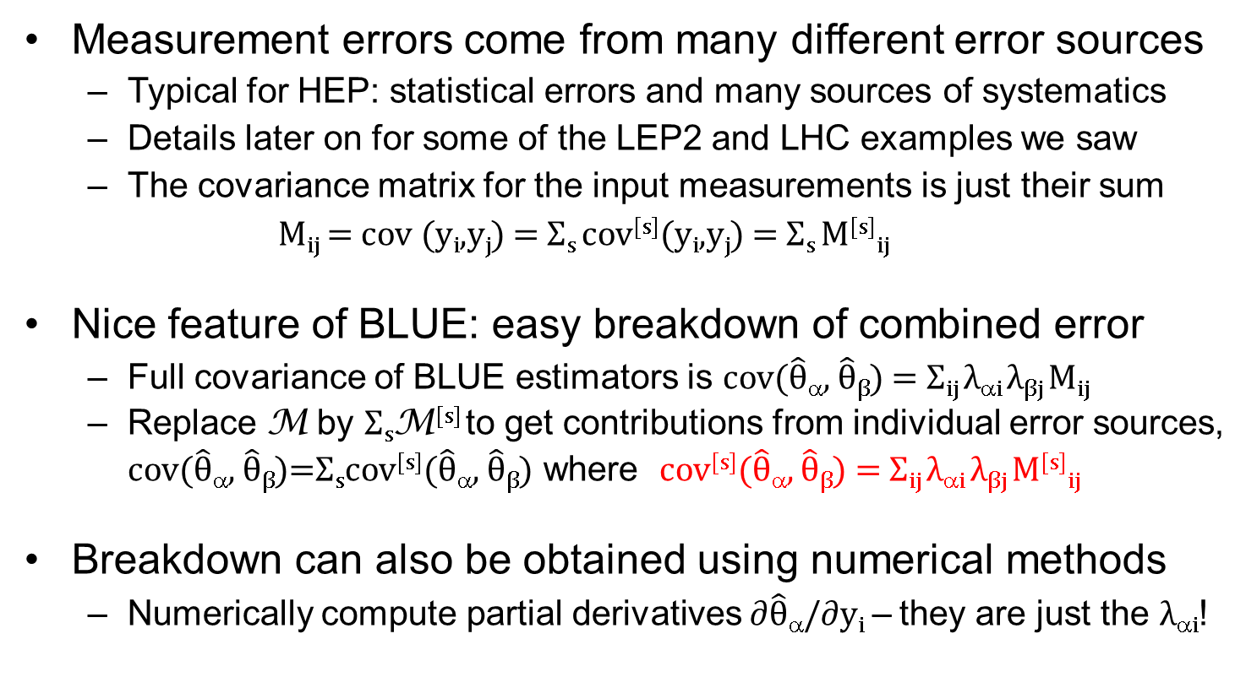
Breakdown of error contributions
Measurement errors come from many different error sources
  Typical for HEP: statistical errors and many sources of systematics
  Details later on for some of the LEP2 and LHC examples we saw
  The covariance matrix for the input measurements is just their sum
    M_{ij} = cov (y_{i},y_{j}) = Σ_{s} cov^{[s]}(y_{i},y_{j}) = Σ_{s} M^{[s]}_{ij}
Nice feature of BLUE: easy breakdown of combined error
  Full covariance of BLUE estimators is cov($\hat{θ}$_{α}, $\hat{θ}\text{β}$) = Σ_{ij} λ_{αi} λ$\text{β}j$M_{ij}
  Replace M by Σ_{s}M^{[s]} to get contributions from individual error sources, cov($\hat{θ}$_{α}, $\hat{θ}\text{β}$)=Σ_{s}cov^{[s]}($\hat{θ}$_{α}, $\hat{θ}\text{β}$) where cov^{[s]}($\hat{θ}$_{α}, $\hat{θ}\text{β}$) = Σ_{ij} λ_{αi} λ$\text{β}j$M^{[s]}_{ij}
Breakdown can also be obtained using numerical methods
  Numerically compute partial derivatives$∂\hat{θ}$_{α}/$∂\text{y}\text{i}$ – they are just the λ_{αi}!

Slide 22
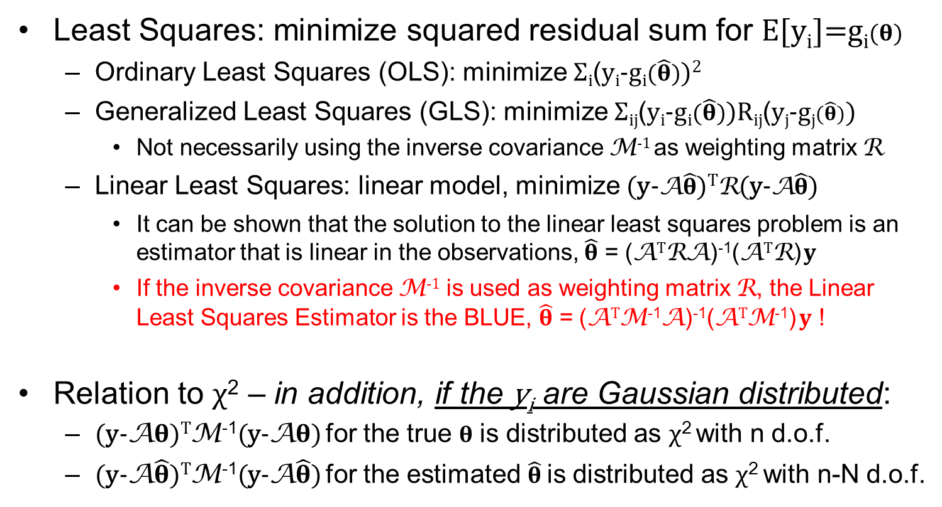
BLUE vs. Linear Least Squares
Least Squares: minimize squared residual sum for E[$\text{y}\text{i}$]=g_{i}($θ)$
  Ordinary Least Squares (OLS): minimize Σ_{i}(y_{i}-g_{i}($\hat{θ})$)²
  Generalized Least Squares (GLS): minimize Σ_{ij}(y_{i}-g_{i}($\hat{θ})$)R_{ij}(y_{j}-g_{j}($\hat{θ})$)
    Not necessarily using the inverse covariance M⁻¹ as weighting matrix R
  Linear Least Squares: linear model, minimize (y-A$\hat{θ}$)^{T}R(y-A$\hat{θ}$)
    It can be shown that the solution to the linear least squares problem is an estimator that is linear in the observations, $\hat{θ}$ = (A^{T}RA)⁻¹(A^{T}R) $y$
    If the inverse covariance M⁻¹ is used as weighting matrix R, the Linear Least Squares Estimator is the BLUE, $\hat{θ}$ = (A^{T}M⁻¹A)⁻¹(A^{T}M⁻¹) $y$ !
Relation to χ² – in addition, if the y_{i} are Gaussian distributed:
  (y-A$θ$)^{T}M⁻¹(y-A$θ$) for the true $θ$ is distributed as χ² with n d.o.f.
  (y-A$\hat{θ}$)^{T}M⁻¹(y-A$\hat{θ}$) for the estimated $\hat{θ}$ is distributed as χ² with n-N d.o.f.

Slide 23
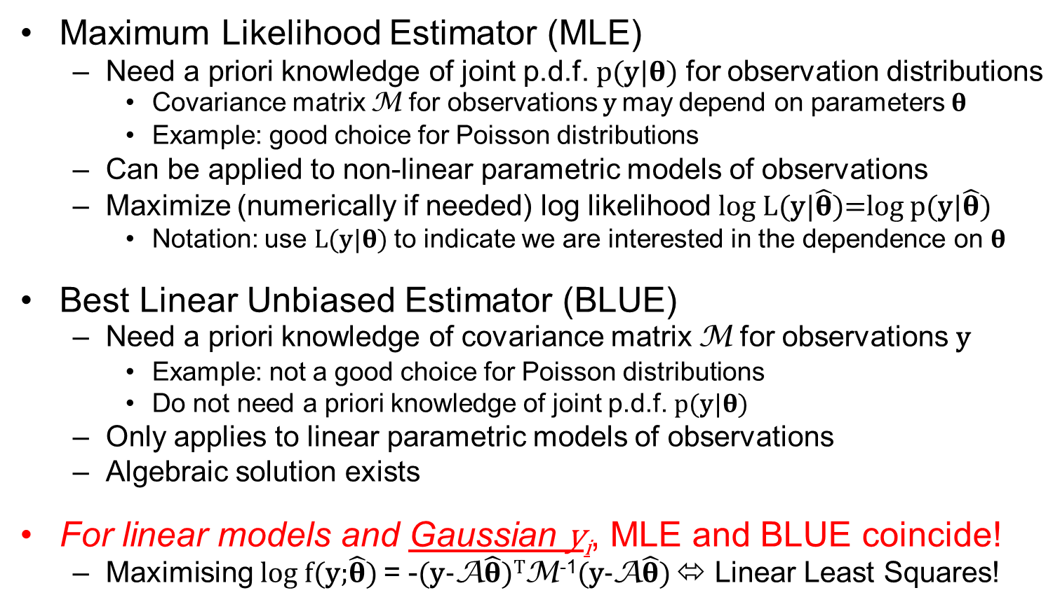
BLUE vs. Maximum Likelihood (MLE)
Maximum Likelihood Estimator (MLE)
  Need a priori knowledge of joint p.d.f. p(y|$θ$) for observation distributions
    Covariance matrix M for observations y may depend on parameters $θ$
    Example: good choice for Poisson distributions
  Can be applied to non-linear parametric models of observations
  Maximize (numerically if needed) log likelihood log L(y|$\hat{θ}$)=log p(y|$\hat{θ}$)
    Notation: use L(y|$θ$) to indicate we are interested in the dependence on $θ$
Best Linear Unbiased Estimator (BLUE)
  Need a priori knowledge of covariance matrix M for observations y
    Example: not a good choice for Poisson distributions
    Do not need a priori knowledge of joint p.d.f. p(y|$θ$)
  Only applies to linear parametric models of observations
  Algebraic solution exists
For linear models and Gaussian y_{i}, MLE and BLUE coincide!
  Maximising log f(y;$\hat{θ}$) = -(y-A$\hat{θ}$)^{T}M⁻¹(y-A$\hat{θ}$) ⬄ Linear Least Squares!

Slide 24
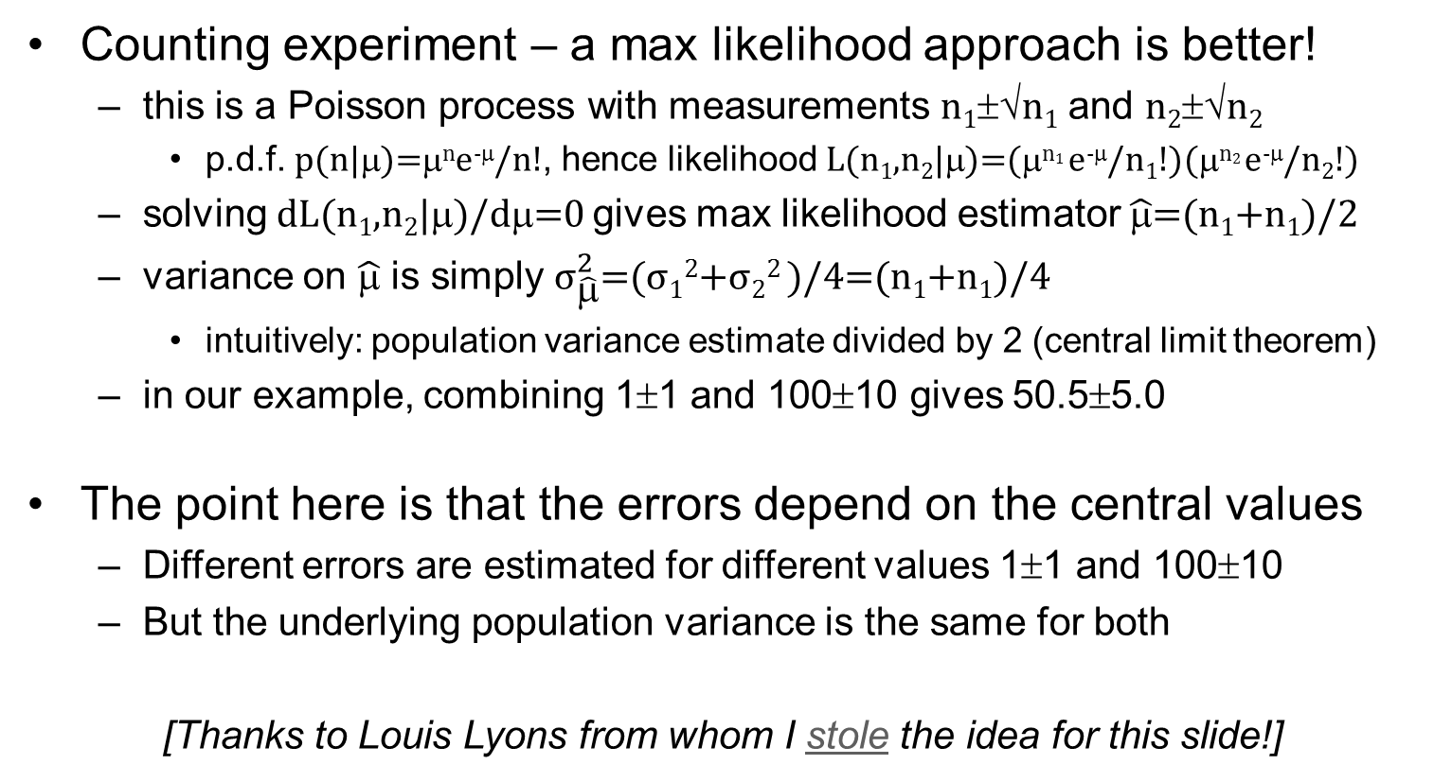
How to combine 1±1 and 100±10?
Counting experiment – a max likelihood approach is better!
  this is a Poisson process with measurements n₁±√n₁ and n₂±√n₂
    p.d.f. p(n|μ)=μ^{n}e^{-μ}/n!, hence likelihood L(n₁,n₂|μ)=(μ^{n1} e^{-μ}/n₁!)(μ^{n2} e^{-μ}/n₂!)
  solving dL(n₁,n₂|μ)/dμ=0 gives max likelihood estimator $\hat{\text{μ}}$=(n₁+n₁)/2
  variance on $\hat{\text{μ}}$ is simply ${\text{σ}}_{\hat{\text{μ}}}^{2}$=(σ₁²+σ₂² )/4=(n₁+n₁)/4
    intuitively: population variance estimate divided by 2 (central limit theorem)
  in our example, combining 1±1 and 100±10 gives 50.5±5.0
The point here is that the errors depend on the central values
  Different errors are estimated for different values 1±1 and 100±10
  But the underlying population variance is the same for both
[Thanks to Louis Lyons from whom I stole the idea for this slide!]

Slide 25
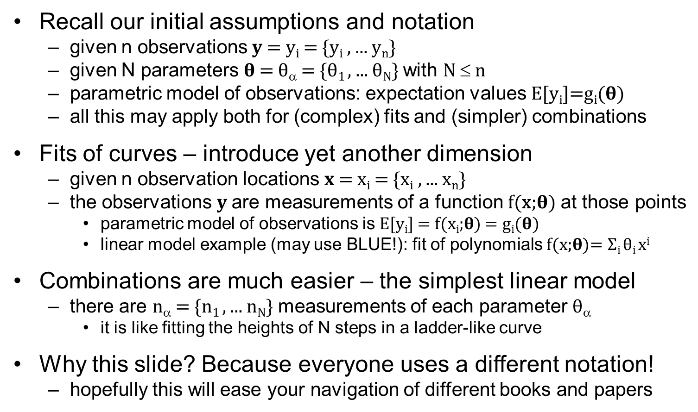
BLUE – Fits vs. Combinations
Recall our initial assumptions and notation
  given n observations $y$= y_{i} = {y_{i} , ... y_{n}}
  given N parameters $θ$= θ_{α} = {θ₁ , ... θ_{N}} with N ≤ n
  parametric model of observations: expectation values E[$\text{y}\text{i}$]=g_{i}($θ)$
  all this may apply both for (complex) fits and (simpler) combinations
Fits of curves – introduce yet another dimension
  given n observation locations $x$= x_{i} = {x_{i} , ... x_{n}}
  the observations $y$are measurements of a function f(x;$θ$) at those points
    parametric model of observations is E[$\text{y}\text{i}$] = f(x_{i};$θ$) = g_{i}($θ)$
    linear model example (may use BLUE!): fit of polynomials f(x;$θ$)= Σ_{i} θ_{i} x^{i}
Combinations are much easier – the simplest linear model
  there are n_{α} = {n₁ , ... n_{N}} measurements of each parameter θ_{α}
    it is like fitting the heights of N steps in a ladder-like curve
Why this slide? Because everyone uses a different notation!
  hopefully this will ease your navigation of different books and papers

Slide 26
Effects of correlations – just a glimpse
Correlations between measurements of different parameters
  If =0, the combination is equivalent to N combinations of the n_{α} measurements of each parameter θ_{α}, one at a time (α =1,..N)
    The full χ² with n-N d.o.f. is just the sum of N individual χ² with n_{α}-1 d.o.f
  If ≠0, whether positive or negative, they always reduce the variance on each parameter estimate (with respect to the case where they are 0)
    Minima in (n-N)-D space vs in (n_{α}-1)-D subspaces where λ_{αi}=0 if A_{iα}=0
    These correlations always add positive information on each parameter
Correlations between measurements of the same parameter
  They may reduce or increase the variance on that parameter
  This will be covered in detail tomorrow – preview in the next two slides
    Will focus only on the simpler case of N measurements of one parameter
    Analytic study for the simplest case of 2 measurements of one parameter

Slide 27
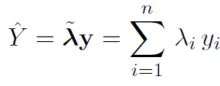
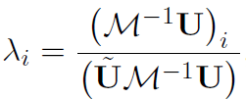
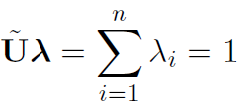
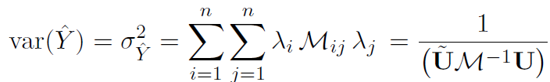
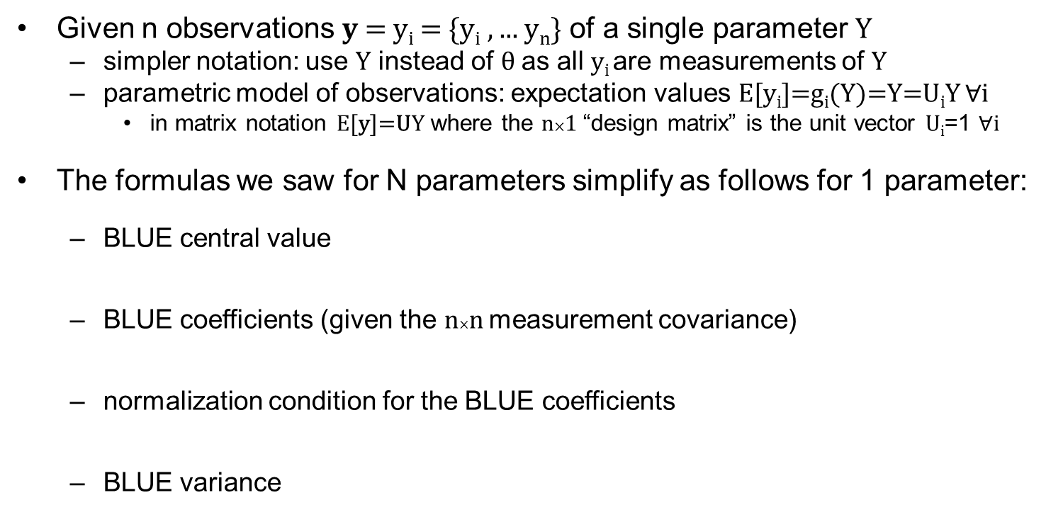
n measurements of 1 parameter (preview)
Given n observations $y$= y_{i} = {y_{i} , ... y_{n}} of a single parameter Y
  simpler notation: use Y instead of θ as all y_{i} are measurements of Y
  parametric model of observations: expectation values E[$\text{y}\text{i}$]=g_{i}(Y)=Y=U_{i}Y $∀$i
    in matrix notation E[$\text{y}$]=UY where the n×1 “design matrix” is the unit vector U_{i}=1 $∀$i
The formulas we saw for N parameters simplify as follows for 1 parameter:
  BLUE central value
  BLUE coefficients (given the n×n measurement covariance)
  normalization condition for the BLUE coefficients
  BLUE variance
Note: Using $\tilde{v}$=v^{T} here to indicate the transpose of a vector

Slide 28




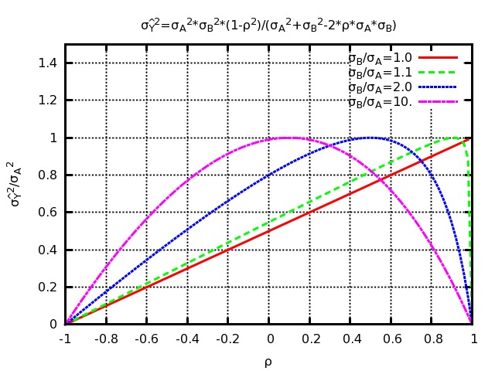
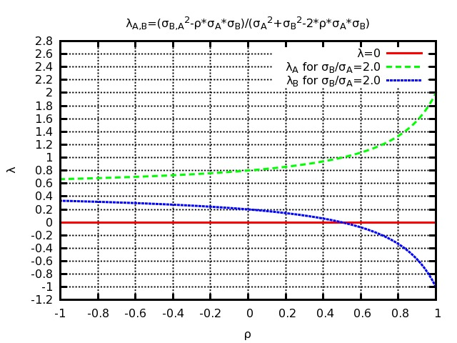
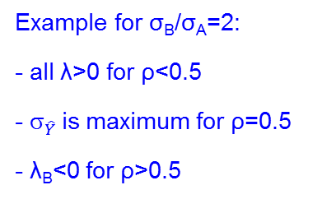
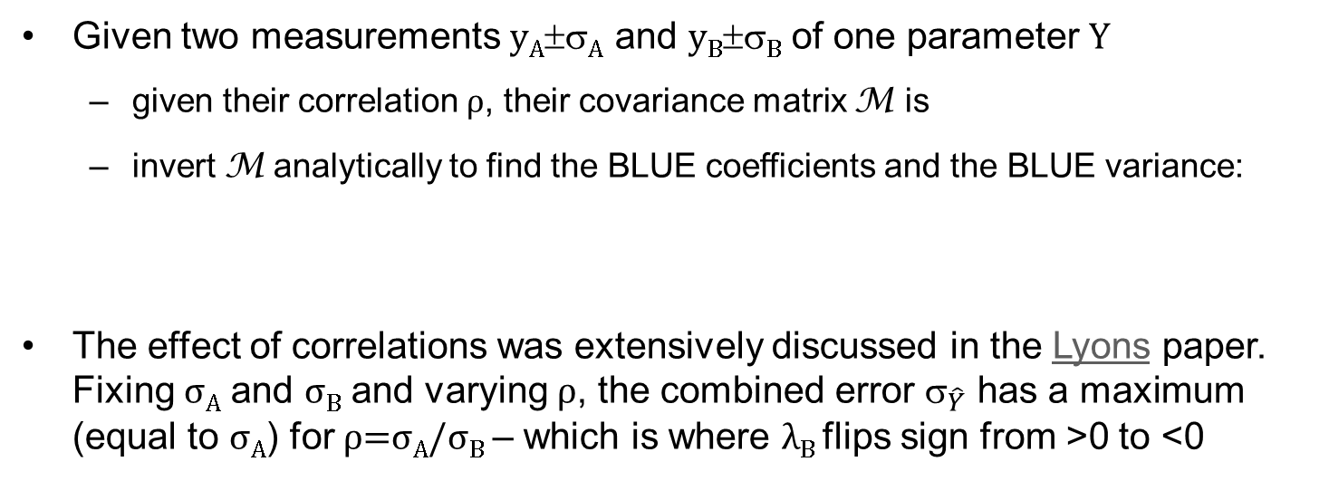
2 measurements of 1 parameter (preview)
Given two measurements y_{A}±σ_{A} and y_{B}±σ_{B} of one parameter Y
  given their correlation ρ, their covariance matrix M is
  invert M analytically to find the BLUE coefficients and the BLUE variance:
The effect of correlations was extensively discussed in the Lyons paper. Fixing σ_{A} and σ_{B} and varying ρ, the combined error ${\text{}}_{\hat{Y}}$ has a maximum (equal to σ_{A}) for ρ=σ_{A}/σ_{B} – which is where λ_{B} flips sign from >0 to <0
Example for σ_{B}/σ_{A}=2:
- all λ>0 for ρ<0.5
- ${\text{}}_{\hat{Y}}$is maximum for ρ=0.5
- λ_{B}<0 for ρ>0.5

Slide 29
Outline #1 – BLUE basics
Intro to combining measurements – why, how, who?
  Simple academic examples and a glimpse of some real examples
Best Linear Unbiased Estimators – basics
  References, derivation of method, relation to other estimators
  Effect of correlations – just a glimpse (discussed in detail tomorrow)
BLUE combinations in practice – the multi-parameter case
  Preparing the relevant inputs and extracting the results
  A step-by-step example from LEP2 (statistically dominated)
Intermediate wrap-up (between lectures #1 and #2)

Slide 30
W branching ratios at LEP2 – detailed
Between experiments: COR=100%, UNC=0%
Between channels within one experiment:
e.g. -27% W→τν / W→μν selection
cross-contamination in ALEPH
BLUE combination
Detailed input:
12 measured values, plus
12(×3) errors(×sources),
and all correlations
Detailed results:
3 parameter values, plus
3(×3) errors(×sources),
all correlations, and χ²
Detailed results:
1 parameter value, plus
1(×3) errors(×sources),
and χ²
ADLO & LEPEWWG, LEP2 final report, Phys. Rep. 532 (2013) 119
CV
CV
CV

Slide 31
WW cross sections at LEP2 – detailed
LEP/Energy Correlated/Uncorrelated (LCEC, LUEU, LUEC)
Between LEP experiments: LC=100%, LU=0%
Between Energies within one experiment: EC=100%, EU=0%
BLUE combination
Detailed input: 32 measured values, plus
32(×4) errors(×sources), and all correlations
Detailed results:8 parameter values, plus
8(×4) errors(×sources), all correlations, and χ²
ADLO & LEPEWWG Preliminary Combination for Summer2001 Conferences

Slide 32

BLUE – software implementations
Many different software implementations exist for BLUE combinations
  FORTRAN code used for LEP (one for 2f, another for 4f, and many more…)
  C++ code used for LHC (one by R. Nisius, another by myself described below)
  Basic formulas are really easy (you could prepare your own in Python to play!)
    Most boring and lengthy part is reading the inputs and displaying the results
    Different implementations have different features, also for modifying the inputs
In these lectures I will show screenshots from BlueFin
  C++ translation of FORTRAN code I wrote for 4f at LEP2
  With many features added for the studies I did with Roberto Chierici
    Several schemes to reduce correlations – and an automatic full dump to latex/pdf
  Designed more as a private tool than for wider adoption – but can be improved
    Some ugly implementation choices (Boost matrices)
    An even uglier configuration setup (need access to CERN AFS or CVMFS)
    Only really tested for a limited number of specific examples
  Do feel free to try it out if you want! https://svnweb.cern.ch/trac/bluefin

Slide 33
WW cross sections at LEP2 – again (1)
INPUT DATA FILE
#parameters is 8
#measurements is 32
#error sources is 5 (really 4, one is empty)
measurement name for 32 measurements
parameter name for 32 measurements
central values for 32 measurements
error #1 (of 5) for 32 measurements

Slide 34
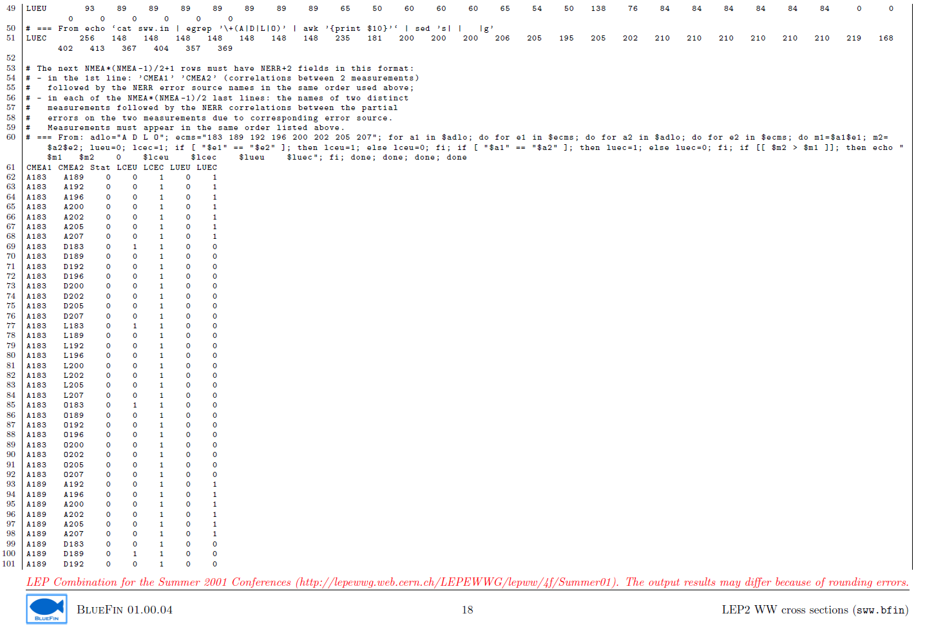
WW cross sections at LEP2 – again (2)
INPUT DATA FILE
(continued)
5 x correlations for 32*31/2 measurement pairs! (dumped to input file from a one-line bash script…)

Slide 35
WW cross sections at LEP2 – again (3)
this is LEP-Uncorrelated Energy-Correlated (LUEC):
block matrix with 4 separate 8x8 matrices for ALEPH, DELPHI, L3, OPAL
Display INPUT DATA
Covariance matrix for one error source

Slide 36
WW cross sections at LEP2 – again (4)
Display INPUT DATA
Full covariance matrix (sum of all error sources)

Slide 37
WW cross sections at LEP2 – again (5)
CVW (central value weight) is just the BLUE coefficient here
Display RESULTS (more on next slide)

Slide 38
WW cross sections at LEP2 – again (6)
BLUE for one of the 8 parameters
Central values
and total errors
(4 input, 1 output)
Individual error sources (4 input, 1 output)
Note how most errors decrease except those correlated between all 32 measurements (LCEC)
χ² for the global combination
(32-8 = 24 degrees of freedom)
BLUE coefficients for
the 4 measurements
of THIS parameter
(normalization: sum=1)
8x8 correlations between the 8 parameter BLUEs
BLUE coefficients for
the 4 measurements
of another parameter
(normalization: sum=0)
Today we almost ignored BLUE coefficients
  And note they are not even published, e.g. in the LEP2 reports
Tomorrow we will discuss them a lot!
  What they can tell us (about measurements and their correlations)
Display RESULTS

Slide 39
Outline #1 – BLUE basics
Intro to combining measurements – why, how, who?
  Simple academic examples and a glimpse of some real examples
Best Linear Unbiased Estimators – basics
  References, derivation of method, relation to other estimators
  Effect of correlations – just a glimpse (discussed in detail tomorrow)
BLUE combinations in practice – the multi-parameter case
  Preparing the relevant inputs and extracting the results
  A step-by-step example from LEP2 (statistically dominated)
Intermediate wrap-up (between lectures #1 and #2)

Slide 40
Conclusions #1 – BLUE basics
Combining measurements
  Minimize errors on combined results – examples LEPEWWG, PDG etc
Best Linear Unbiased Estimators
  Exact matrix formulas for central value, error and error breakdown
    Linear combination of all measurements, also those of other parameters
    Coefficients can be positive or negative, subject to normalization condition
  Must know covariance matrix of measurements, no need to know p.d.f.
    Prefer MLE if you know the p.d.f. distribution and it is not Gaussian
  BLUE has many nice additional properties if distributions are Gaussian
    Sum of squared residuals is c2 distributed, BLUE and MLE coincide
BLUE combinations in practice
  Multi-parameter LEP2 examples and details from BlueFin software
  Need input correlations between all measurements of all parameters
    More tomorrow on the effect of correlations and estimating them in practice

Slide 41

Entr’acte
openclipart.org
And now for something
completely different
Still about statistics,
but forget about BLUE combinations for a while

Slide 42
Us and them
– in HEP we are lucky! (spoilt?)
Statistics is used in many different fields in different ways
  Different challenges and issues imply different practices and buzzwords
    e.g. Chris Blake’s Statistics Lectures for astronomers
    e.g. Natasha Devroye’s Detection and Estimation course for engineers
    e.g. Nature “Points of Significance” open access column for biologists
  “Descriptive” vs “inferential” statistics, “internal” vs “external” validity...
  Advice for us too: make sure that people understand what is being done
    e.g. Belia, Fidler, Williams, Cumming, Psychological Methods, 2005, “Researchers Misunderstand Confidence Intervals and Standard Error Bars”
High-energy physicists are lucky!
  Data sampling? Any LHC period is representative of the Laws of Nature!
  Moving targets? The Laws of Nature (in practice) do not vary in time!
  Black swans? Event fluctuations are Poissonian in quantum mechanics!
  Distributions? Simulate models (mostly with few parameters) using MC!
  Result: spectacular agreement of experiments and statistical predictions

Slide 43
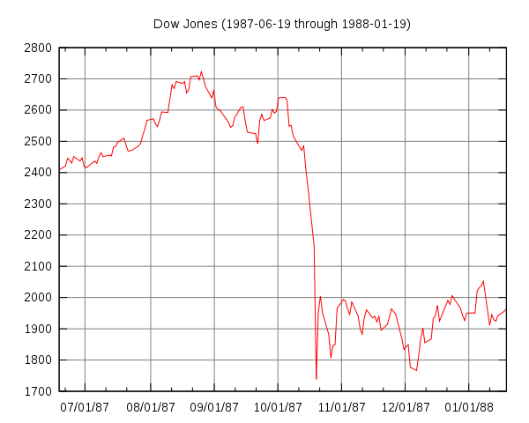
Others are not so lucky!
THE NEWS
PANIC!
THE POST
WALL ST. BLOODBATH
19 October 1987
Beware of your assumptions! And beware of “magic” tools!
  “The Black-Scholes equation was the mathematical justification for the trading that plunged the world's banks into catastrophe [….] On 19 October 1987, Black Monday, the world's stock markets lost more than 20% of their value within a few hours. An event this extreme is virtually impossible under the model's assumptions […] Large fluctuations in the stock market are far more common than Brownian motion predicts. The reason is unrealistic assumptions – ignoring potential black swans. But usually the model performed very well, so as time passed and confidence grew, many bankers and traders forgot the model had limitations. They used the equation as a kind of talisman, a bit of mathematical magic to protect them against criticism if anything went wrong.” [I. Stewart, The Guardian, 2012]

Slide 44
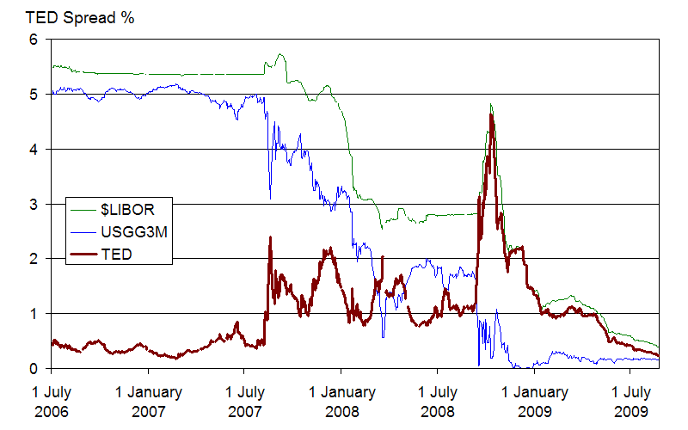
“Outliers” and “black swans”
2007-2008
What is hidden in one “sigma”? (Not everything is Gaussian!)
  “By any historical standard, the financial crisis of the past 18 months has been extraordinary. Some suggested it is the worst since the early 1970s; others, the worst since the Great Depression; others still, the worst in human history. […] Back in August 2007, the CFO of Goldman Sachs commented to the FT «We are seeing things that were 25-standard deviation moves, several days in a row». […] A 25-sigma event would be expected to occur once every 6x10¹²⁴ lives of the universe. That is quite a lot of human histories. […] Fortunately, there is a simpler explanation – the model was wrong. [...] I have outlined some elements of an agenda to address some of the failures exposed by the crisis. These measures [...] also involve much greater transparency to the wider world about risk metrics and accompanying management actions.” [A. Haldane, Bank of England, 2009, “Why banks failed the stress test”]

Slide 45
Lessons learnt?
(also for BLUE?)
Statistics is used in many different fields in different ways
  Life seems easier in HEP, but it’s not a reason to lower your guard
1. Never stop questioning (deconstructing) your assumptions!
  Especially when they are kind of long-established common sense
  Especially when these assumptions end up kind of hidden elsewhere
2. Never stop questioning your tools!
  Do not treat them as “talismans” or “mathematical magic”!
  Especially when they kind of help you hide uncomfortable assumptions
My personal preference/suggestion: aim for transparency
  Uncomfortable results may be there to ring alarm bells and help you...
  Should negative BLUE coefficients make us feel uncomfortable?
  I think instead that they can teach us a lot… more tomorrow!

Slide 46
Entr’acte - finished
openclipart.org
Back to the main show...
tomorrow!

Slide 47
Conclusions #1 – BLUE basics
Combining measurements
  Minimize errors on combined results – examples LEPEWWG, PDG etc
Best Linear Unbiased Estimators
  Exact matrix formulas for central value, error and error breakdown
    Linear combination of all measurements, also those of other parameters
    Coefficients can be positive or negative, subject to normalization condition
  Must know covariance matrix of measurements, no need to know p.d.f.
    Prefer MLE if you know the p.d.f. distribution and it is not Gaussian
  BLUE has many nice additional properties if distributions are Gaussian
    Sum of squared residuals is c2 distributed, BLUE and MLE coincide
BLUE combinations in practice
  Multi-parameter LEP2 examples and details from BlueFin software
  Need input correlations between all measurements of all parameters
    More tomorrow on the effect of correlations and estimating them in practice
QUESTIONS?

