Slide 1
Combining measurements using Best Linear Unbiased Estimators
(BLUE)
Lecture 2/2 – correlations and negative BLUE coefficients
Andrea Valassi
CERN, Information Technology Department
DESY Terascale Statistics School,
Hamburg 26-27th March 2015
Thanks to Isabell and all the organizers for the invitation!

Slide 2
Outline #1 – BLUE basics
Intro to combining measurements – why, how, who?
  Simple academic examples and a glimpse of some real examples
Best Linear Unbiased Estimators – basics
  References, derivation of method, relation to other estimators
  Effect of correlations – just a glimpse (discussed in detail tomorrow)
BLUE combinations in practice – the multi-parameter case
  Preparing the relevant inputs and extracting the results
  A step-by-step example from LEP2 (statistically dominated)
Intermediate wrap-up (between lectures #1 and #2)

Slide 3
Outline #2 – the effect of correlations
Information in BLUE combinations
  Today’s example: LHC top mass 2012 (systematically dominated)
  “Relative importance” of measurements in the presence of correlations
Interpreting correlation effects and negative BLUE coefficients
  “Low-correlation” and “high-correlation“ regimes
Estimating correlations in practice
  “Conservative estimates” of correlations?
  The risks in overestimating correlations and a few hints to avoid that
Beyond BLUE?
Wrap-up and conclusions (for lectures #1 and #2)

Slide 4
Outline #2 – the effect of correlations
Information in BLUE combinations
  Today’s example: LHC top mass 2012 (systematically dominated)
  “Relative importance” of measurements in the presence of correlations
Interpreting correlation effects and negative BLUE coefficients
  “Low-correlation” and “high-correlation“ regimes
Estimating correlations in practice
  “Conservative estimates” of correlations?
  The risks in overestimating correlations and a few hints to avoid that
Beyond BLUE?
Wrap-up and conclusions (for lectures #1 and #2)

Slide 5
Combining measurements – why, how?
(reminder)
Why combine measurements?
  Advancing knowledge (scientia) - ultimately, we are all in this game together!
  Get better result (lower errors) combining knowledge (information)
What we what to know after combining results
  Central value(s) of the unknown parameter(s)
  Total combined error(s) – (and their correlations: the covariance matrix)
  Contributions to the combined error/covariance from the different sources
  How compatible input results are with one another
  “How much” each measurement contributed (do we really need this?)

Slide 6
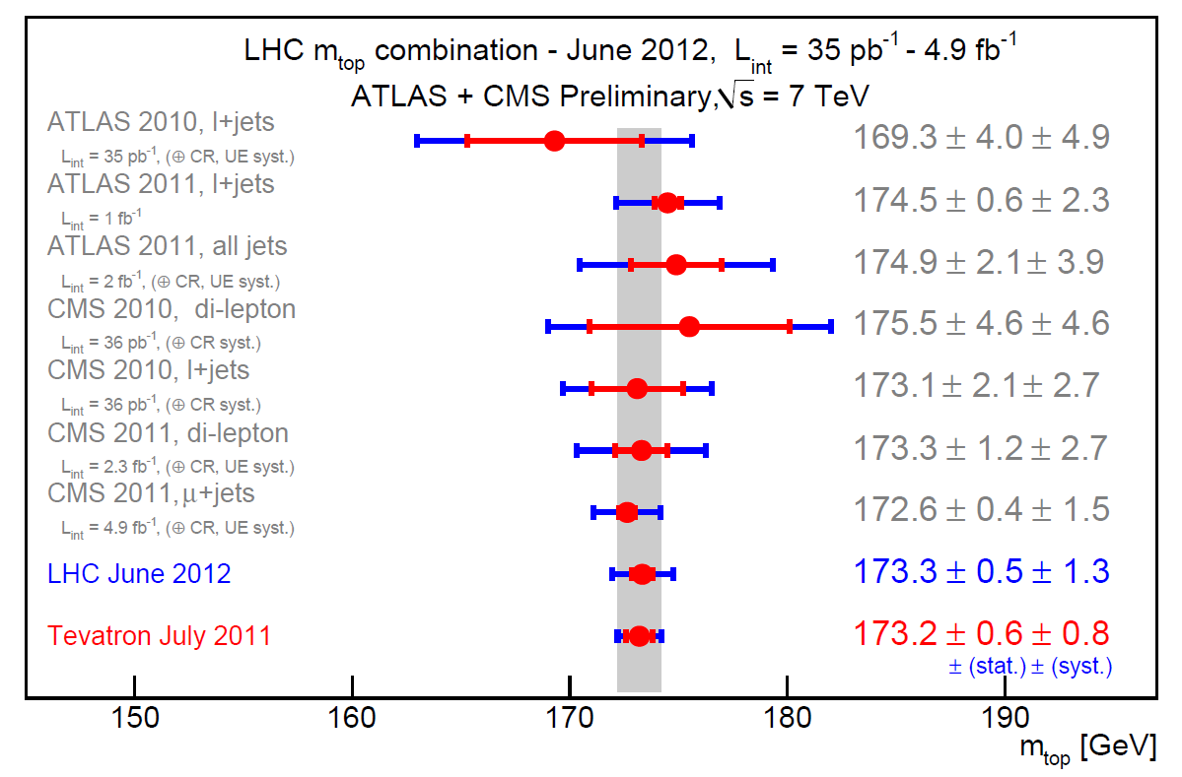
Example 3 – LHC m_{top} combination 2012
(reminder)
BLUE combination
Input: 7 measurements
Results:1 parameter
ATLAS-CONF-2012-095 / CMS PAS TOP-12-001

Slide 7
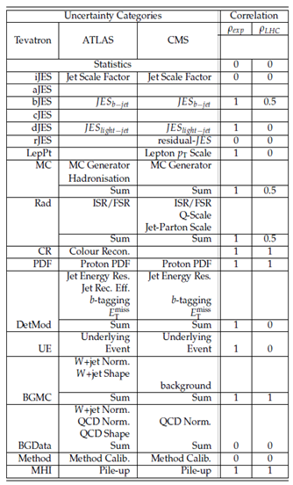
LHC m_{top} combination 2012 – detailed
ATLAS-CONF-2012-095 / CMS PAS TOP-12-001
Correlation of measurements
within one experiment – ρ_{exp}
Correlation of measurements
across LHC experiments – ρ_{LHC}
BLUE combination
Detailed input:
7 measured values, plus
7(×18) errors(×sources),
and all correlations
Detailed results:
BLUE coefficients,
1 parameter value, plus
1(×18) errors(×sources), χ²
and “relative importance” (?)

Slide 8
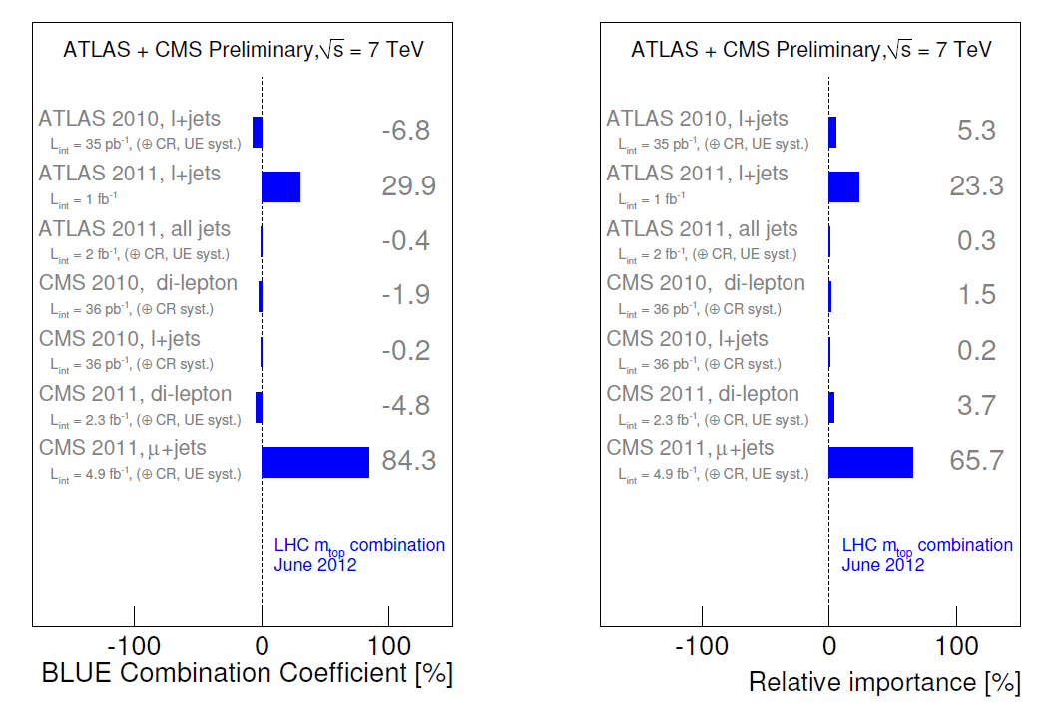
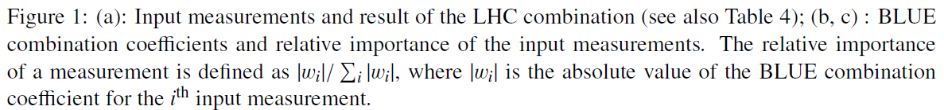
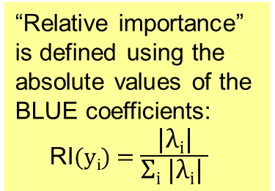
LHC m_{top} combination 2012 – negative
BLUE coefficients and their absolute values
“Relative importance” is defined using the absolute values of the BLUE coefficients:
RI(y_{i}) = $\frac{\text{|}\text{λ}\text{i}\text{|}}{\text{Σ}\text{i}\text{ |}\text{λ}\text{i}\text{| }}$
ATLAS-CONF-2012-095 / CMS PAS TOP-12-001

Slide 9
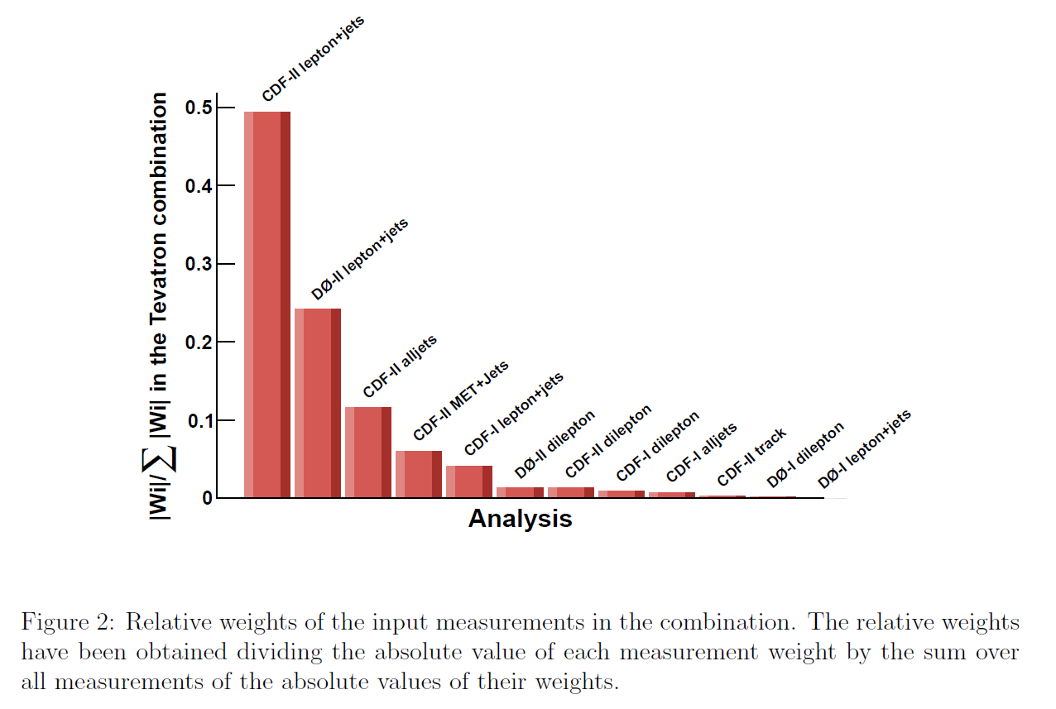
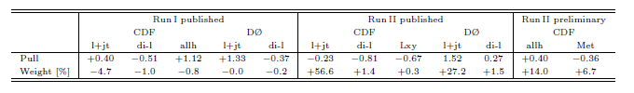
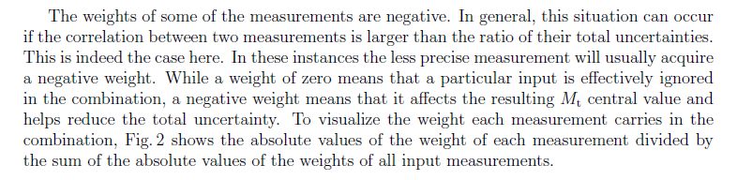
Tevatron m_{top} combination 2011 – negative
BLUE coefficients and their absolute values
“Relative importance” is defined using the absolute values of the BLUE coefficients:
RI(y_{i}) = $\frac{\text{|}\text{λ}\text{i}\text{|}}{\text{Σ}\text{i}\text{ |}\text{λ}\text{i}\text{| }}$

Slide 10
Why using absolute values?
Why relative importance?
Is there a mathematical justification for using absolute values of BLUE coefficients to assess relative importances?
  Probably not – and there are problems with this definition (next slide)
More generally, do we really need to assess “how much” each measurement is contributing to a combination?
  Especially, do we need ranking to tell which one contributed “the most”?
  I think we do not – but, just in case, let’s try to use the relevant maths
Do we have a mathematical way to quantify “information”?
  Yes, Fisher information... (a few slides later on)

Slide 11
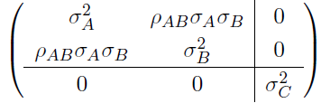
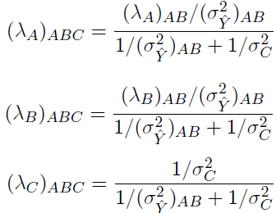


The problems with absolute values in RI
Problematic example: three measurements A, B, C
with C independent from A and B – we will focus on C
Note that λ_{C} is the same when combining ABC in one go
as when first combining AB and then adding C as (AB)C
The relative importance of C has two problems if λ_{B}<0 (i.e. ρ>σ_{A}/σ_{B})
  1.RI(y_{C}) for ABC is different from RI(y_{C}) for (AB)C
  2. In particular, RI(y_{C}) for (AB)C is the “weight” one expects for the combination of two independent measurements AB and C, while RI(y_{C}) for ABC is lower
=1 for (AB)C combination
as |λ_{A}|+|λ_{B}| is replaced by |λ_{A}+λ_{B}|
>1 for ABC combination

Slide 12
The problems in RI – example
Let’s see this again with a numerical example – concentrate on A
  [I apologise for using a different notation, AB₁B₂ vs A(B₁B₂) in this case]

Slide 13
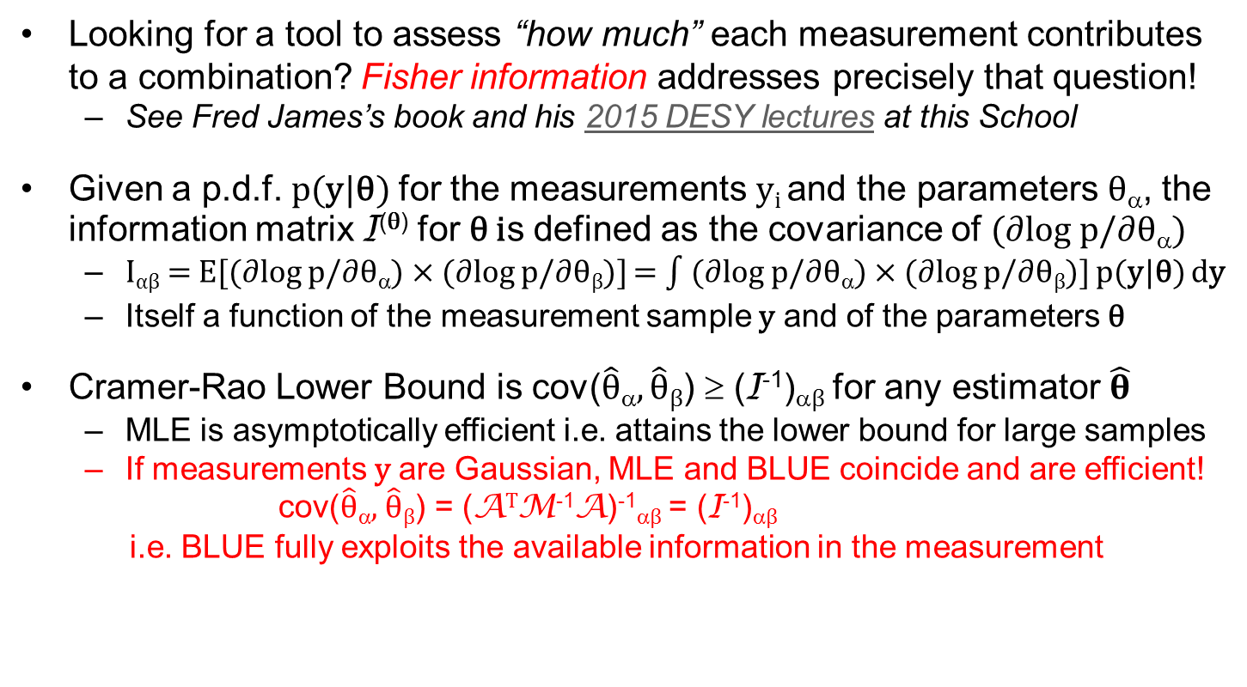
Fisher information and BLUE
Looking for a tool to assess “how much” each measurement contributes to a combination? Fisher information addresses precisely that question!
  See Fred James’s book and his 2015 DESY lectures at this School
Given a p.d.f. p(y|θ) for the measurements y_{i} and the parameters θ_{α}, the information matrix I^{(θ)} for θ is defined as the covariance of (∂log p/∂θ_{α})
  I_{αβ} = E[(∂log p/∂θ_{α}) × (∂log p/∂θ_{β})] = (∂log p/∂θ_{α}) × (∂log p/∂θ_{β})] p(y|θ) dy
  Itself a function of the measurement sample y and of the parameters θ
Cramer-Rao Lower Bound is cov($\hat{θ}$_{α}, $\hat{θ}$_{β}) ≥ (I⁻¹)_{αβ} for any estimator $\hat{θ}$
  MLE is asymptotically efficient i.e. attains the lower bound for large samples
  If measurements y are Gaussian, MLE and BLUE coincide and are efficient!
  cov($\hat{θ}$_{α}, $\hat{θ}$_{β}) = (A^{T}M⁻¹A)⁻¹_{αβ} = (I⁻¹)_{αβ}
  i.e. BLUE fully exploits the available information in the measurement

Slide 14
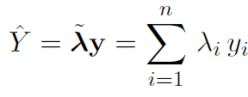
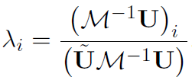
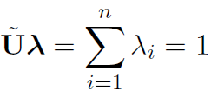
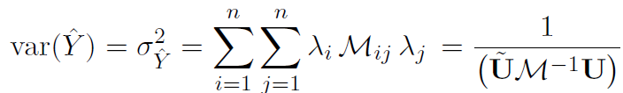

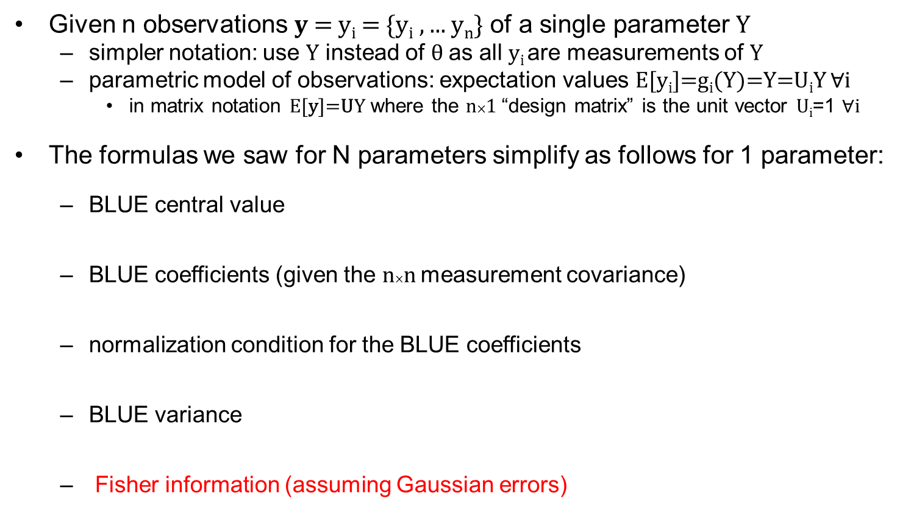
n measurements of 1 parameter (revisited)
Given n observations $y$= y_{i} = {y_{i} , ... y_{n}} of a single parameter Y
  simpler notation: use Y instead of θ as all y_{i} are measurements of Y
  parametric model of observations: expectation values E[$\text{y}\text{i}$]=g_{i}(Y)=Y=U_{i}Y $∀$i
    in matrix notation E[$\text{y}$]=UY where the n×1 “design matrix” is the unit vector U_{i}=1 $∀$i
The formulas we saw for N parameters simplify as follows for 1 parameter:
  BLUE central value
  BLUE coefficients (given the n×n measurement covariance)
  normalization condition for the BLUE coefficients
  BLUE variance
  Fisher information (assuming Gaussian errors)
Note: Using $\tilde{v}$=v^{T} here to indicate the transpose of a vector
For many practical purposes, in the following “information”
will often be a synonym for the inverse of the BLUE variance

Slide 15
Why Fisher information?
Fisher information has many useful properties for estimation [See F. James’s book]
  It is additive – its total is the sum of those from independent measurements
  I^{(θ)} (I^{(Y)}) is defined with respect to the parameters θ (Y) we want to estimate
  It is related to precision: the greater the available information, the more precise our estimates can be (Cramer-Rao lower bound on minimum variance)
  It is positive semi-definite (for one parameter Y it is a scalar ≥ 0)
Another property is especially useful for combinations [See A. van den Bos’s book]
  information is non-decreasing with the addition of an (n+1)^{th} measurement to a sample of n – easy proof for linear exponential distributions (e.g. Gaussians)
    This holds even in the presence of correlations between the (n+1) measurements
    The marginal information I_{(n+1)} -I_{(n)} from the (n+1)^{th} measurement (or information inflow) is positive semi-definite – it can be calculated exactly and we’ll use that!
[NB: Shannon information is another type of “information” commonly used in statistics and signal processing – but it has a different meaning, it measures (in bits) the “entropy” of messages]

Slide 16
The problems in RI – example (revisited)
Let’s see this again with a numerical example – concentrate on A
  [I apologise for using a different notation, AB₁B₂ vs A(B₁B₂) in this case]
Proportional to 1/σ_{A}²
i.e. to information!
(independent measurement)
But what should we do with
correlated measurements?
We want a definition where the “weight” will be 40% also in this case

Slide 17
Information weights (IW)
Intrinsic information weights (IIW)
How to handle correlations? It is not only individual measurements, but also correlations, that contribute to the total information in a combination
  Information contributed by correlations comes from collective interplay of measurements and cannot generally be attributed to any of them individually
Define Information Weights, distinguishing those from the measurements and those from the ensemble of correlations [A. Valassi and R. Chierici 2014]
  Will refer to these as intrinsic information weights (IIW)
  For n measurements of 1 parameter: (n+1) intrinsic information weighs, sum=1
  One intrinsic information weight for each measurement (always > 0)
  One intrinsic information weight for all correlations (often ≤ 0, may be > 0 too!)
Limitation – the IIW from correlations is not split up into sub-contributions
  We’ll see later another way to quantify the effect on information of correlations between individual pairs of measurements or from individual error sources

Slide 18
Marginal information weights (MIW)
Intrinsic information weight of a measurement quantifies how much of the total information it could provide if no other measurements were used
  i.e. if it is added first to the combination – what about if it is added last?
Marginal information weight of a measurement quantifies how much of the total information would be missing if we did not use that measurement
  For n measurements of 1 parameter: n marginal information weighs
  One marginal information weight for each measurement
    Always ≥ 0 because marginal information I_{(n+1)} -I_{(n)} is positive semi-definite
  No obvious way to add weights for correlations – no normalization is enforced
Comparing IIW and MIW for the same measurement
  MIW_{i} ≤ IIW_{i} is frequent – correlations make a measurement partially redundant
  MIW_{i} > IIW_{i} can happen too – correlations amplify impact: how can that be?

Slide 19
LHC m_{top} combination 2012 – IIW and MIW
ATLAS-CONF-2012-095
CMS PAS TOP-12-001
Note also how the order is different for CVW, IIW, MIW, RI
Do not use any of these for ranking!
BlueFin outputs differ from CMS PAS-TOP-12-001
because of rounding errors in the available inputs

Slide 20
Outline #2 – the effect of correlations
Information in BLUE combinations
  Today’s example: LHC top mass 2012 (systematically dominated)
  “Relative importance” of measurements in the presence of correlations
Interpreting correlation effects and negative BLUE coefficients
  “Low-correlation” and “high-correlation“ regimes
Estimating correlations in practice
  “Conservative estimates” of correlations?
  The risks in overestimating correlations and a few hints to avoid that
Beyond BLUE?
Wrap-up and conclusions (for lectures #1 and #2)
NB: for the rest of this talk, I will heavily reuse slides from a presentation I gave at the TOPLHCWG with Roberto Chierici – APOLOGIES to you and Roberto for not having the time to do this better ☹

Slide 21




2 measurements of 1 parameter (reminder)
Given two measurements y_{A}±σ_{A} and y_{B}±σ_{B} of one parameter Y
  given their correlation ρ, their covariance matrix M is
  invert M analytically to find the BLUE coefficients and the BLUE variance:
The effect of correlations was extensively discussed in the Lyons paper and we briefly discussed it in the first lecture. On the next slide we look at it again using the formulas above.

Slide 22
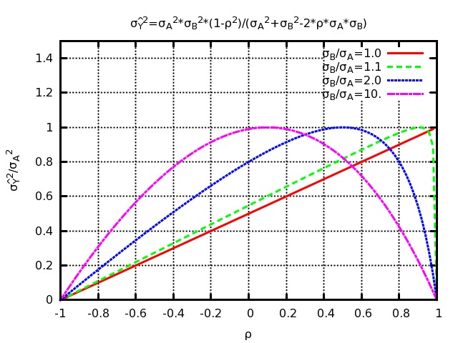
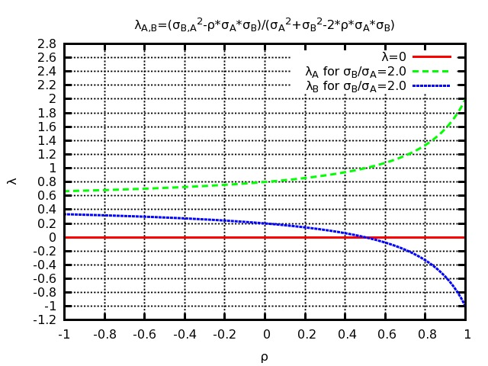
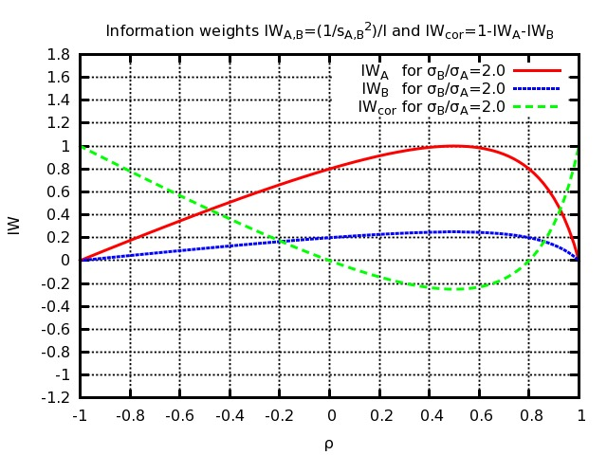
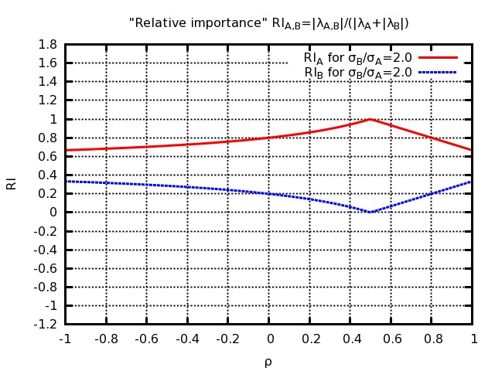
2 measurements of 1 parameter - revisited
BLUE error
Varying ρ, the combined error is maximum (equal to σ_{A}) for ρ=σ_{A}/σ_{B}, where λ_{B} flips sign: this defines two different regimes
  Low correlation regime – ρ<σ_{A}/σ_{B}
    Both λ_{A} and λ_{B} are > 0
    Info decreases (error increases) as ρ increases
  High correlation regime – ρ>σ_{A}/σ_{B}
    One coefficient λ_{B} is < 0
    Info increases (error decreases) as ρ increases
  Boundary – ρ=σ_{A}/σ_{B}
    One coefficient λ_{B} is = 0
    Error is maximum = σ_{A} (marginal info from B is 0)
    “Most conservative correlation”
    Info from correlations is minimum (most negative)
How to interpret these two regimes? And can this be generalized to n measurements?
  There are many other interesting patterns to study (did not even add a MIW plot) but will focus on this
  We will concentrate on positive correlations only
σ_{B}/σ_{A}=2
BLUE coefficients
σ_{B}/σ_{A}=2
Intrinsic Info Weight IIW
LOW
CORR
HIGH
CORR
σ_{B}/σ_{A}=2
Relative Importance RI=|λ|/Σ|λ|

Slide 23
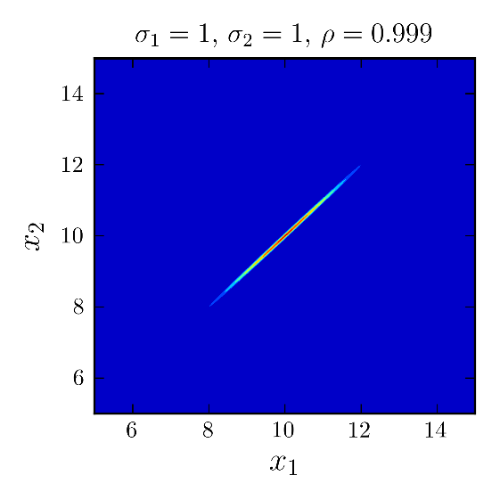
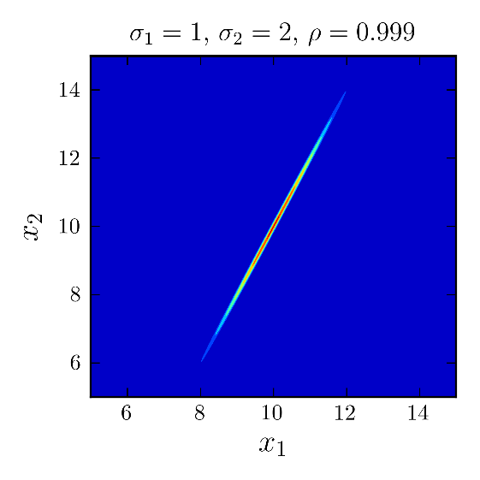
“100% correlated” is a strong statement!
Imagine two measurements x₁ and x₂ of x are 100% correlated
  Here I refer to the full errors on x₁ and x₂ from all sources of uncertainty
  Covariance matrix is singular: measurements are redundant!
Suppose their errors are different, x₁±σ₁ and x₂±σ₂ with σ₂/σ₁≠1
  If I give you x₁ and the true x, then you can exactly predict x₂
    true x=10 and x₁=11±1 with σ₂/σ₁=2? then x₂=12±2!
  If I give you x₁ and x₂ then you can determine exactly the true x
    x₁=11±1 and x₂=12±2? true value is 10(±0)!
    x₁=12±1 and x₂=14±2? true value is 10(±0)!
10
Suppose their errors are the same, x₁±σ and x₂±σ
  Then x₁ and x₂ must be equal (if they are not, assumptions are wrong – probability is 0!)

Slide 24
“100% correlated” for one error source
Previous slide: if the total errors on two measurements have different sizes and are 100% correlated, the combination has infinite precision (error=0)
  Lever-arm effect of the two different sensitivities to the same systematic bias
In real combinations, total measurement errors are never 100% correlated
  But it is frequent to assume a 100% correlation for one source of uncertainty
Even for a single source of uncertainty, taking 100% correlated errors with different sizes remains a strong statement
  The two different sensitivities to the systematic bias can be used to constrain it
  No issue at all to assume common errors (100% correlated and same size)
The net effect on combinations of 100% correlated error sources depends on the relative sizes of the many error sources (statistical and systematic)
  When statistical errors dominate, high correlations of systematic errors from a given source tend to make the combined error larger (“more conservative”)
  When the highly correlated systematic source dominates, this may reduce the combined error from that source and make the total combined error smaller

Slide 25
Two measurements - interpretation
Low correlation regime, λ_{B}>0 (i.e. σ_{A}² - ρσ_{A}σ_{B} > 0)
  The covariance can be seen as the sum of a common error and an uncorrelated error
  You can combine based on the uncorrelated error (compute weights from basic error propagation for independent measurement) and add the common error only at the end
    Remember: this happens if the off-diagonal covariance ρσ_{A}σ_{B} is smaller than the smaller of the two variances σ_{A}² (this will be used later in the “onionization” prescription proposal)
  Adding the less precise measurement B to the combination adds information because B contributes independent (uncorrelated) knowledge about the parameter
High correlation regime, λ_{B}<0 (i.e. σ_{A}² - ρσ_{A}σ_{B} < 0)
  The covariance can NOT be seen as the sum of a common error and an uncorrelated error
  Adding the less precise measurement B to the combination adds information because B helps to constrain a correlated error on A thanks to a different sensitivity
    The extra information comes from the interplay of A and B – neither can claim it as exclusive merit
Boundary is λ_{B}=0 – where B brings no additional information
  Adding the less precise measurement B to the combination adds NO information because its error has a part common with A plus an additional uncorrelated part
>0 (positive definite matrix)

Slide 26
Generalization to n measurements

Slide 27
Information inflow

Slide 28
Information inflow and correlations
This generalizes to n measurements the discussion in the Lyons paper – there is also a second way to see it (next slide)

Slide 29
Information sensitivity to M_{ij}

Slide 30
Summary on correlation regimes
If any BLUE coefficients are <0, it is because some correlations are high
  The BLUE combination is in a “high correlation” regime
The contribution to information from measurements with BLUE coefficients <0 comes only from their interplay with other measurements through correlations
  They help constrain systematic uncertainties on other measurements
If any BLUE coefficients are <0, the total BLUE error is smaller than that which would be obtained if some correlations were smaller
  Are correlations really as high or are they being overestimated?
IF any BLUE coefficients are <0
AND IF correlations were “conservatively” estimated to be 100%,
THEN correlation estimates should be reassessed
See the rest of the talk for a few tools and suggestions

Slide 31
Outline #2 – the effect of correlations
Information in BLUE combinations
  Today’s example: LHC top mass 2012 (systematically dominated)
  “Relative importance” of measurements in the presence of correlations
Interpreting correlation effects and negative BLUE coefficients
  “Low-correlation” and “high-correlation“ regimes
Estimating correlations in practice
  “Conservative estimates” of correlations?
  The risks in overestimating correlations and a few hints to avoid that
Beyond BLUE?
Wrap-up and conclusions (for lectures #1 and #2)

Slide 32
Estimating correlations in practice
Correlations are (should be) estimated separately for each error source
  Errors on result A from source 1 and on B from 2 are uncorrelated! (next slide)
Correlations within the same experiment (same or different parameters)
  Sometimes 0% or 100% is obvious a priori
    W BR example: W→qq background uncertainty affects 3 W→lν in same way (100%)
  Whenever possible they are (should be) measured on the data and/or MC!
    W BR example: cross-contamination of W→τν and W→μν selections (e.g. -27%)
  Often end up for simplicity with correlations of 0% or 100%
Correlations between different experiments (same or different parameters)
  Sometimes 0% or 100% is obvious a priori
    M_{Z} measurement example: √s energy of 4 experiments on same LEP collider (100%)
  If possible they should be measured on the data and/or MC – but much harder!
    Hard for experiments at one collider, even harder for different colliders or older data
  Often end up for simplicity with correlations of 0% or 100% (sometimes 50%)

Slide 33
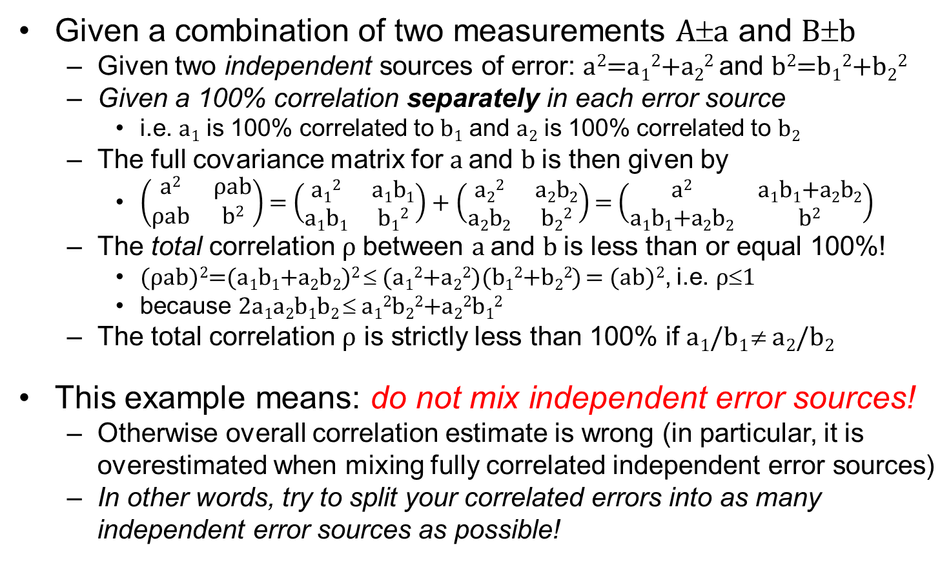
Correlations and different error sources
Given a combination of two measurements A±a and B±b
  Given two independent sources of error: a²=a₁²+a₂² and b²=b₁²+b₂²
  Given a 100% correlation separately in each error source
    i.e. a₁ is 100% correlated to b₁ and a₂ is 100% correlated to b₂
  The full covariance matrix for a and b is then given by
    $\left(\begin{matrix}\text{a}\text{2} & \text{ρ}\text{a}\text{b} \\ \text{ρ}\text{a}\text{b} & \text{b}\text{2}\end{matrix}\right)$ = $\left(\begin{matrix}\text{a}\text{1}\text{2} & \text{a}\text{1}\text{b}\text{1} \\ \text{a}\text{1}\text{b}\text{1} & \text{b}\text{1}\text{2}\end{matrix}\right)$ + $\left(\begin{matrix}\text{a}\text{2}\text{2} & \text{a}\text{2}\text{b}\text{2} \\ \text{a}\text{2}\text{b}\text{2} & \text{b}\text{2}\text{2}\end{matrix}\right)$ = $\left(\begin{matrix}\text{a}\text{2} & \text{a}\text{1}\text{b}\text{1}\text{+}\text{a}\text{2}\text{b}\text{2} \\ \text{a}\text{1}\text{b}\text{1}\text{+}\text{a}\text{2}\text{b}\text{2} & \text{b}\text{2}\end{matrix}\right)$
  The total correlation ρ between a and b is less than or equal 100%!
    (ρab)²=(a₁b₁+a₂b₂)² ≤ (a₁²+a₂²)(b₁²+b₂²) = (ab)², i.e. ρ≤1
    because 2a₁a₂b₁b₂ ≤ a₁²b₂²+a₂²b₁²
  The total correlation ρ is strictly less than 100% if a₁/b₁ ≠ a₂/b₂
This example means: do not mix independent error sources!
  Otherwise overall correlation estimate is wrong (in particular, it is overestimated when mixing fully correlated independent error sources)
  In other words, try to split your correlated errors into as many independent error sources as possible!

Slide 34
Wrong correlation estimates?
In principle, the estimate of the parameter value remains unbiased
  As long as each of the measurements is unbiased
  This is true for BLUE but also for other combination methods
The estimate of the parameter error however is badly affected
  Overestimating the error (“conservative” correlations) is more or less ok
  Underestimating the error is a problem
    For instance, when overestimating correlations into the high correlation regime
  The χ² distributions for the combination are also affected, in both cases
A frequentist interpretation of systematics helps, but needs a grain of salt
  Systematic shift from the true value is the same for repeated measurements
    Distribution of this shift (mean 0 means “unbiased”) refers to gedanken experiments
  Measurements actually are biased: systematic error is our estimation of bias
    Combination also has a bias – wrong correlations lead to bad estimates of this bias!
See also G. Cowan’s discussion of “nuisance parameters” and of “the error on the error” at his 2015 DESY lectures at this School

Slide 35
Negative correlations
Negative correlations in a combination, just like extremely high positive correlations, contribute information from the interplay of measurements
  For two measurements, their combination has more information than the measurements alone – marginal information of exceeds intrinsic information
In practice however negative correlations between measurements of the same parameter are rarely seen in combinations
  Negative correlations between measurements of different parameters are a different story and are not at all uncommon (e.g. the LEP2 BR example)
  Whether for the same or different parameters, negative correlations would normally only be used as a results of a measurement, not of an assumption

Slide 36
“Conservative” estimates of correlations
Estimating errors and correlations is not easy
  A “conservative” error is one that is more likely overestimated than underestimated (not quoting better precision than we have)
  A “conservative” correlation should be one giving conservative errors
  It was and probably it still is not uncommon to hear “we conservatively estimate correlations to be 100%” – is this statement correct?

Slide 37
Is ρ=100% “conservative”?

Slide 38
Prioritizing correlations to review

Slide 39
LHC m_{top} 2012 – information derivatives
This table is indicating about which correlations are responsible for the negative BLUE coefficients of some measurements!

Slide 40
LHC m_{top} 2012 systematics
ATLAS-CONF-2012-095 / CMS PAS TOP-12-001

Slide 41
Making correlations more conservative?
These procedures are ONLY meant to understand what goes on!
Correlations must be estimated individually by the physics groups!

Slide 42
The “onionization” prescription

Slide 43
LHC m_{top} 2012 – conservative correlations?

Slide 44
Recommendations?

Slide 45
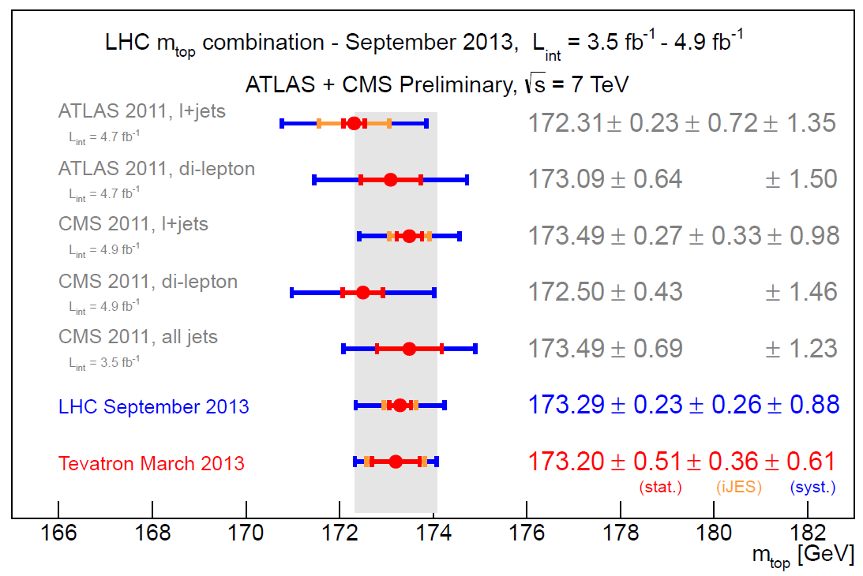
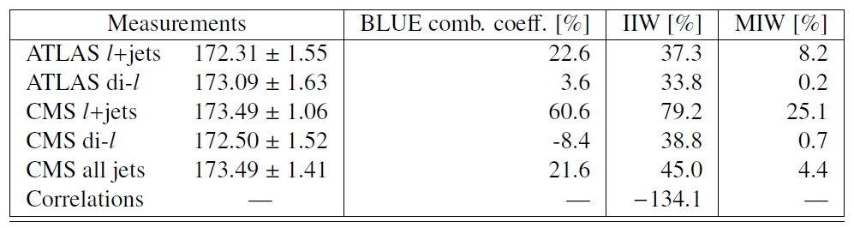
LHC combination of m_{top} in 2013 (1)
TOPLHC Note (Sep 2013)
ATLAS-CONF-2013-102
CMS PAS TOP-13-005
https://cds.cern.ch/record/1601811
Several changes with respect to the 2012 combination
  Improved individual analyses and full (i.e. much larger) data samples
  Removed absolute BLUE coefficients, list Fisher information weights
  Reassessed correlations (e.g. by splitting into more categories)

Slide 46
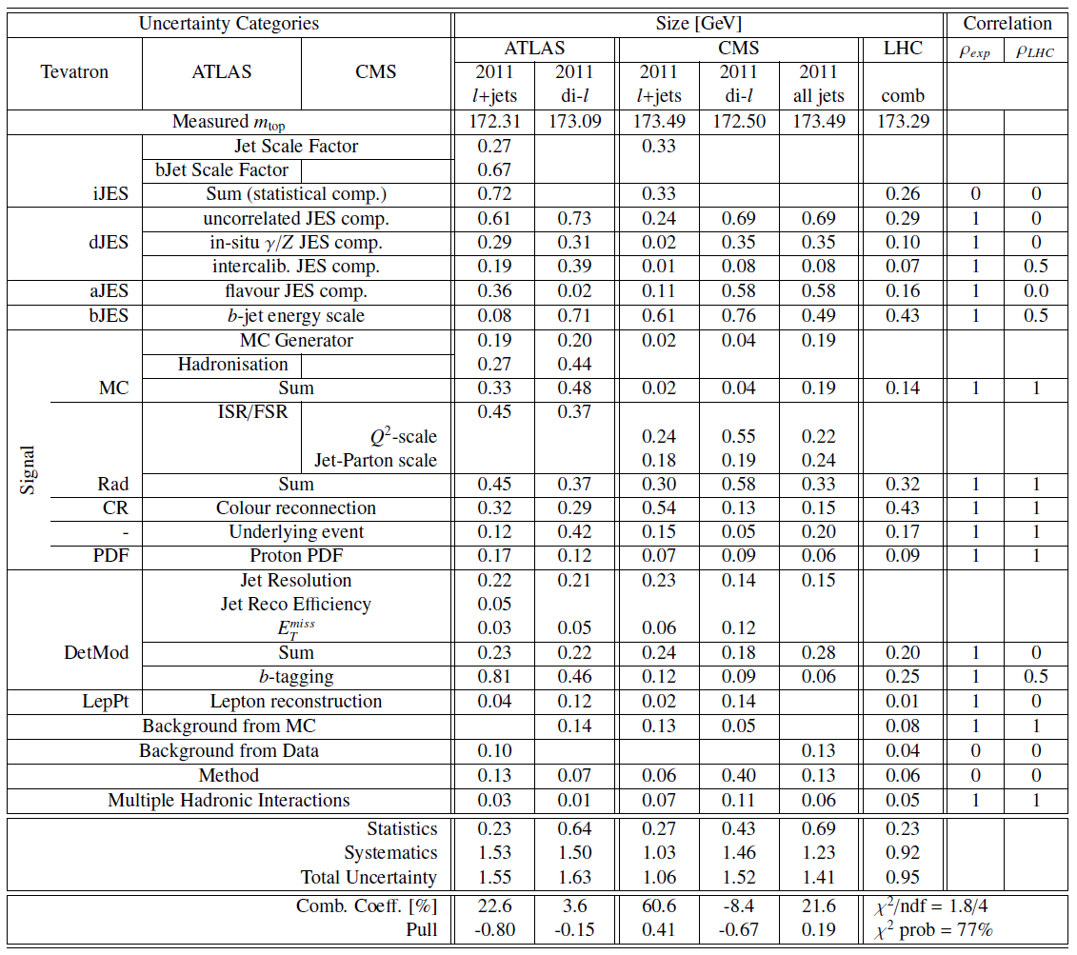
LHC combination of m_{top} in 2013 (2)
Split JES systematic errors into multiple sub-components to improve estimates of correlations
TOPLHC Note (Sep 2013)
ATLAS-CONF-2013-102
CMS PAS TOP-13-005
https://cds.cern.ch/record/1601811

Slide 47
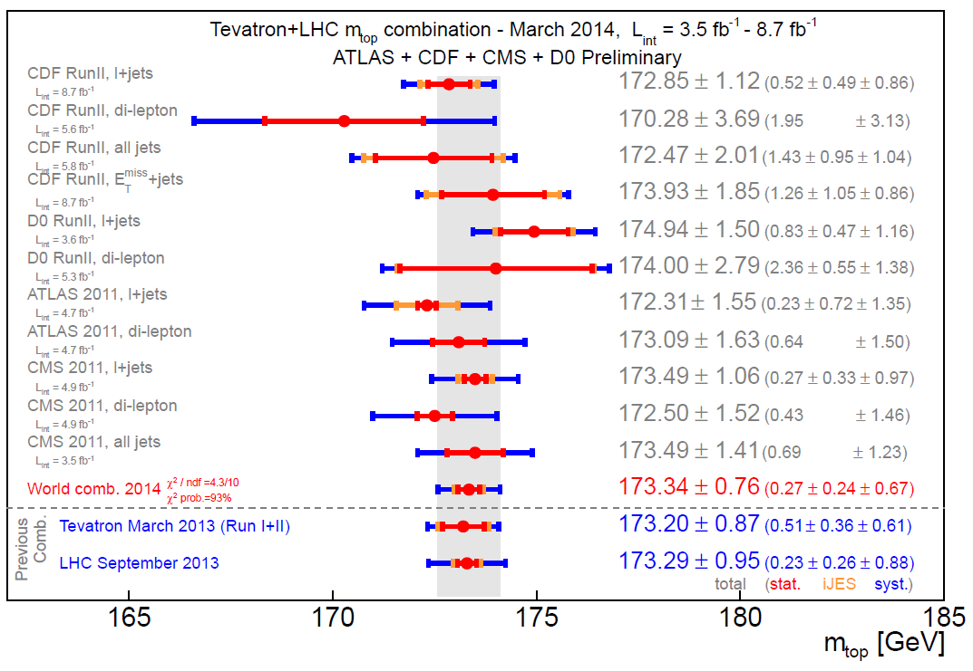
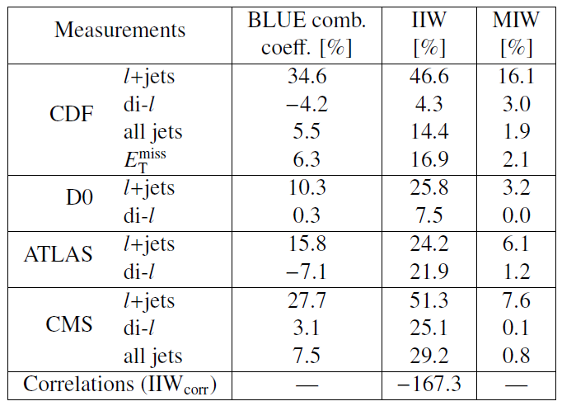
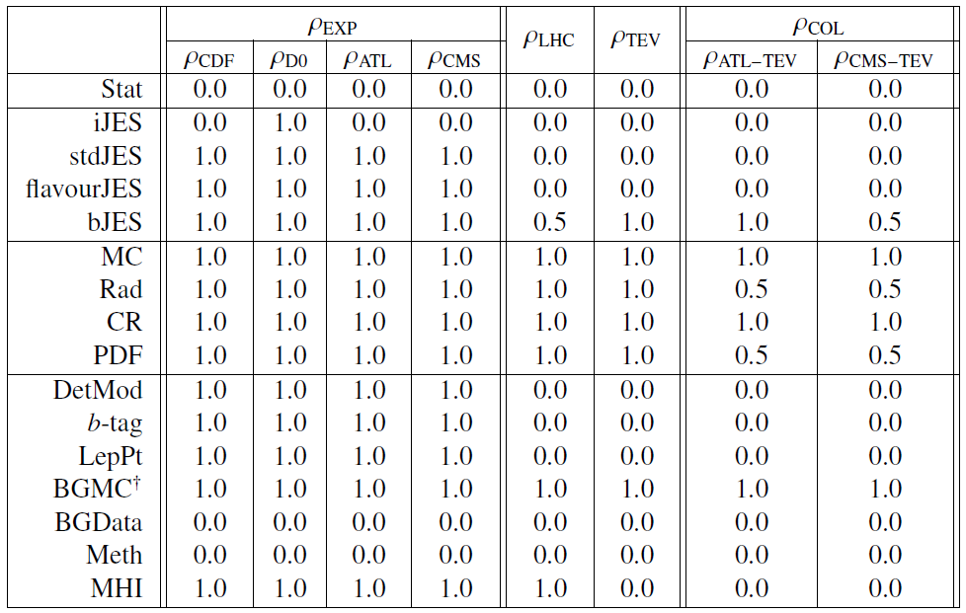
World combination of m_{top} in 2014
LHC/Tevatron Note (Mar 2014)
ATLAS-CONF-2014-008
CDF Note 11071
CMS PAS TOP-13-014
D0 Note 6416
[arxiv 1403.4427]

Slide 48
Outline #2 – the effect of correlations
Information in BLUE combinations
  Today’s example: LHC top mass 2012 (systematically dominated)
  “Relative importance” of measurements in the presence of correlations
Interpreting correlation effects and negative BLUE coefficients
  “Low-correlation” and “high-correlation“ regimes
Estimating correlations in practice
  “Conservative estimates” of correlations?
  The risks in overestimating correlations and a few hints to avoid that
Beyond BLUE?
Wrap-up and conclusions (for lectures #1 and #2)

Slide 49
Beyond BLUE?
Is the “negative BLUE coefficient” problem specific to BLUE?
  No, as the only “problem” may be that correlations are overestimated
    You may use MLE with the same correlations and get the same result
  BLUE is actually good because it makes this “problem” more apparent
Whichever other combination tool you may choose, you will need to provide input correlations in the present form or maybe another
  A “nuisance parameter” approach is attractive but also needs correlations (are different experiments using the same nuisance parameter definition?)
    This would actually force a more systematic measurement of correlations (good!)
Personal opinion: BLUE has its limitations and it may well be appropriate to use a different tool, but we should do it for the right reasons!
  e.g. not just so that we do not need to see negative BLUE coefficients again!

Slide 50
Outline #2 – the effect of correlations
Information in BLUE combinations
  Today’s example: LHC top mass 2012 (systematically dominated)
  “Relative importance” of measurements in the presence of correlations
Interpreting correlation effects and negative BLUE coefficients
  “Low-correlation” and “high-correlation“ regimes
Estimating correlations in practice
  “Conservative estimates” of correlations?
  The risks in overestimating correlations and a few hints to avoid that
Beyond BLUE?
Wrap-up and conclusions (for lectures #1 and #2)

Slide 51
Conclusions #2 – correlations
Do not assess “relative importances” of measurements using absolute values of BLUE coefficients – information weights may be a better choice
  The information from correlations cannot be attributed to a measurement alone
Negative BLUE coefficients indicate a regime of high correlations where one combined systematic error is reduced by different sensitivities to it
  This is good if correlations are correct, it is bad if they are overestimated
“100% correlated” is a strong statement, not a conservative assumption!
  If you suspect correlations are overestimated and you need to reassess them, information derivatives may help you prioritize this work
  Omitting measurements with negative λ is the most “conservative” choice
Correlations are one of the most delicate inputs to a combination
  Split your errors into as many independent sources of errors as possible
  Estimating correlations may well deserve as much effort as estimating errors

Slide 52
Conclusions #2 – correlations
Do not assess “relative importances” of measurements using absolute values of BLUE coefficients – information weights may be a better choice
  The information from correlations cannot be attributed to a measurement alone
Negative BLUE coefficients indicate a regime of high correlations where one combined systematic error is reduced by different sensitivities to it
  This is good if correlations are correct, it is bad if they are overestimated
“100% correlated” is a strong statement, not a conservative assumption!
  If you suspect correlations are overestimated and you need to reassess them, information derivatives may help you prioritize this work
  Omitting measurements with negative λ is the most “conservative” choice
Correlations are one of the most delicate inputs to a combination
  Split your errors into as many independent sources of errors as possible
  Estimating correlations may well deserve as much effort as estimating errors
QUESTIONS?

Slide 53
Backup slides

Slide 54
Preliminary conclusion

Slide 56
Main messages in our paper
1. Absolute values of BLUE coefficients should not be used
  Ill-defined as can be seen with simple counterexamples
  Weights derived from (“intrinsic” and “marginal”) Fisher information may better – maybe not for “ranking”, but do we really need that?...
2. Mathematical proof that negative BLUE coefficients indicate a “high-correlation” regime in correlation space
  They only become negative if some correlations exceed a threshold
3. Negative coefficients may signal overestimated correlations
  In particular: 100% is NOT always the “most conservative” choice!
  We suggested tools to be more “conservative” (information derivatives, “onionization”, split into more categories, exclude measurements...)

Slide 57
LHC m_{top} 2012 marginal contributions

Slide 58
Ideal models vs. Numerical solutions?
Real problems can often be solved only by numerical methods
  Maximum likelihood fits, errors depend on values, non Gaussian...
Ideal models often admit analytical or algebraic solutions
  BLUE with covariances known a priori, especially if Gaussian...
Personal opinion (stating the obvious)
  Ideal models can teach us a lot even when they are not appropriate to provide the final result for production (industry) or publication (research)
    They help us understand which variables/assumptions are most relevant

