Slide 1
Status of test kit
J. Dopke, T. Huffman, J. J. John, M. Stanitzki with help from many others

Slide 2
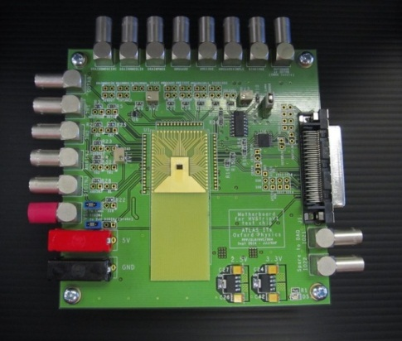
HVStripV1 hardware - stock
8 motherboards have now been produced and allocated
1 each at Argonne, DESY, Glasgow, Oxford, SCIPP and RAL
1 each will be sent to IHEP (Beijing) and KIT (Karlsruhe) pending tests in Oxford this week
The stock situation is:
Zero unbonded chips
4 daughterboards with chips – 2 alu/kapton/carbon fibre, 2 FR4/Cu
8 bare motherboards with central cutout + 5 bare without cutout
Components: stock to build 8 more motherboards
28 bare daughterboards – 14 alu/kapton/carbon fibre, 14 FR4/Cu

Slide 3
HVStripV1 build plan
Given the pending order for 100 more HVStripV1 chips,
Given that each motherboard can test 5 daughterboards (est),
We think we should order and build:
100 more FR4/Cu daughterboards
minimise gold coverage, add mounting hole to ease transport
25 more motherboards in panels
Use automated assembly (Oxford) for the passive components on the back (these are the portions of the work where you save costs by doing in bulk)
Then “freeze” production of the boards
Then complete the motherboards in small batches as needed, adding the more expensive IC and connector components, to manage costs
Jaya John to check whether we can use SMA connectors instead of Lemos to reduce costs (for after our present stock of Lemos is used up)

Slide 4
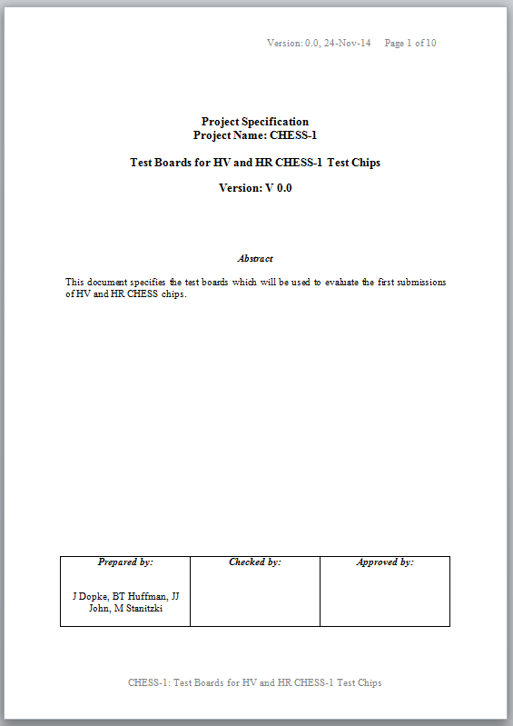
CHESS test boards
Current status:
Test board spec: first draft with authors for checking
Will shortly distribute updated draft for general review
We have improved the design to expedite testing – see next slide

Slide 5
CHESS test boards, ctd.
possible cut line for E-TCT (for HV CHESS d/b)
CHESS test chip
CHESS daughterboard
3 flavours:
HV CHESS
HR CHESS “PonN”
HR CHESS “PonP”
second set of connector pads, for post-irradiation if need be
cut line, for removing connectors prior to irradiation, if shielding cannot be used
Samtec connectors
reliable, well known to ATLAS strip community
CHESS motherboard – for both HV and HR daughterboards

