Slide 1

FCC Accelerator Studies
Daniel Schulte for the FCC team
DESY, May 2015

Slide 2
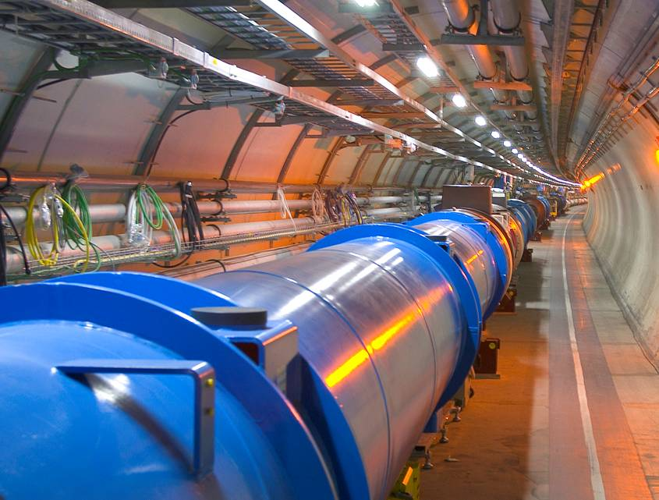
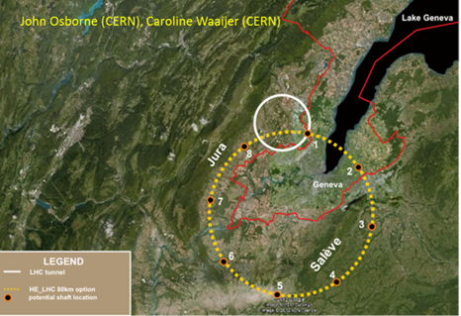
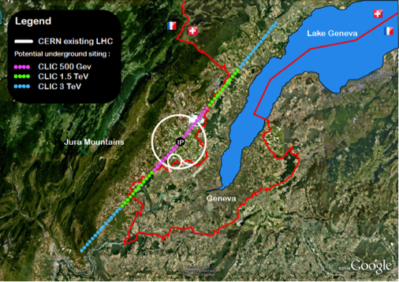
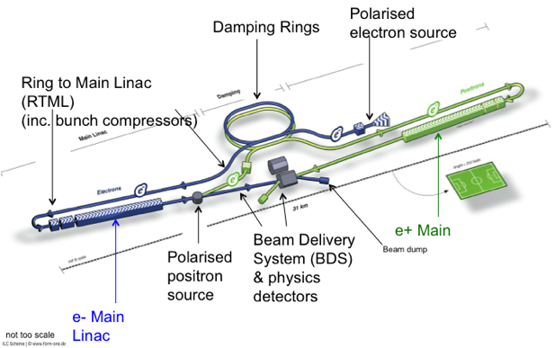
European Strategy
A year-long process initiated by the European Commission
Council has provided the particle physics strategy
Comparable processes elsewhere
Identified four highest priorities
Highest priority is exploitation of the LHC including luminosity upgrades
Europe should be able to propose an ambitious project after the LHC
Either high energy proton collider (FCC-hh)
Or high energy linear collider (CLIC)
Europe welcomes Japan to make a proposal to host ILC
Long baseline neutrino facility

Slide 3
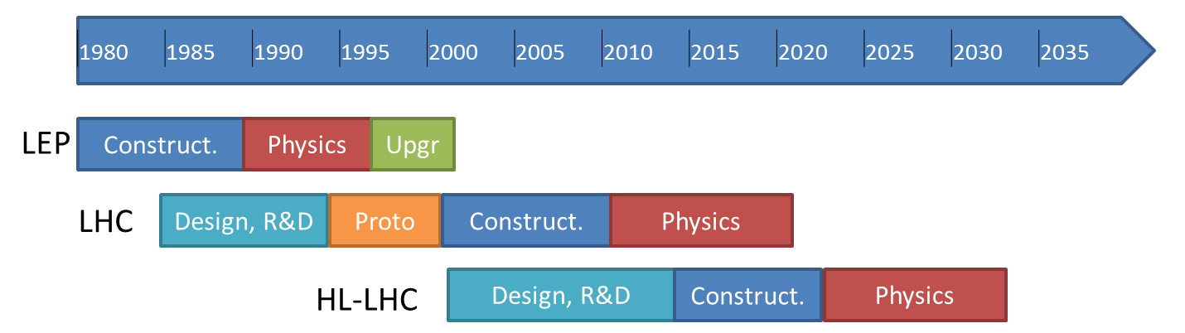
LHC Exploitation
c) ... Europe’s top priority should be the exploitation of the full potential of the LHC, including the high-luminosity upgrade of the machine and detectors with a view to collecting ten times more data than in the initial design, by around 2030. …
today

Slide 4
LHC schedule beyond LS1
LS2 starting in 2018 (July) => 18 months + 3 months BC
LS3 LHC: starting in 2023 => 30 months + 3 months BC
Injectors: in 2024 => 13 months + 3 months BC
Physics
Shutdown
Beam commissioning
Technical stop
30 fb⁻¹
YETS
EYETS
YETS
LS 2
YETS
Run 2
Run 3
Run 2
LS 2
Run 3
YETS
LS 3
Run 4
YETS
LS 3
Run 4
300 fb⁻¹
LS 4
Run 5
LS 5
LS 4
Run 5
LS 5
(Extended) Year End Technical Stop: (E)YETS
F. Bordry
3’000 fb⁻¹
LHC schedule approved by CERN management and LHC experiments spokespersons and technical coordinators (December 2013)

Slide 5
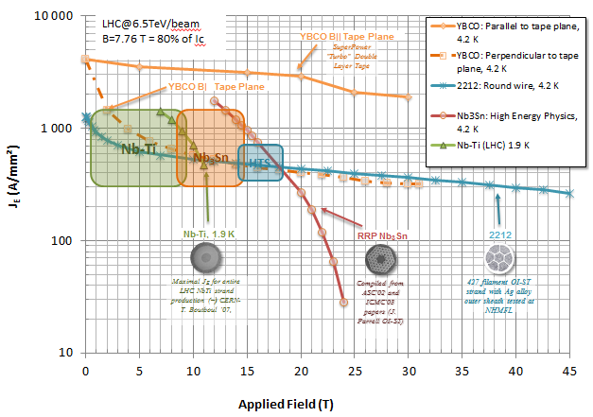
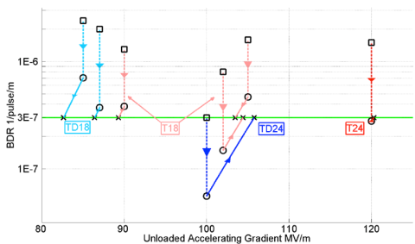
Future Project at CERN
d) …to propose an ambitious post-LHC accelerator project at CERN by the time of the next Strategy update…
… CERN should undertake design studies for accelerator projects in a global context, with emphasis on proton-proton and electron-positron high-energy frontier machines. These design studies should be coupled to a vigorous accelerator R&D programme, including high-field magnets and high-gradient accelerating structures, in collaboration with national institutes, laboratories and universities worldwide.
HFM – FCC-hh
HGA - CLIC

Slide 6
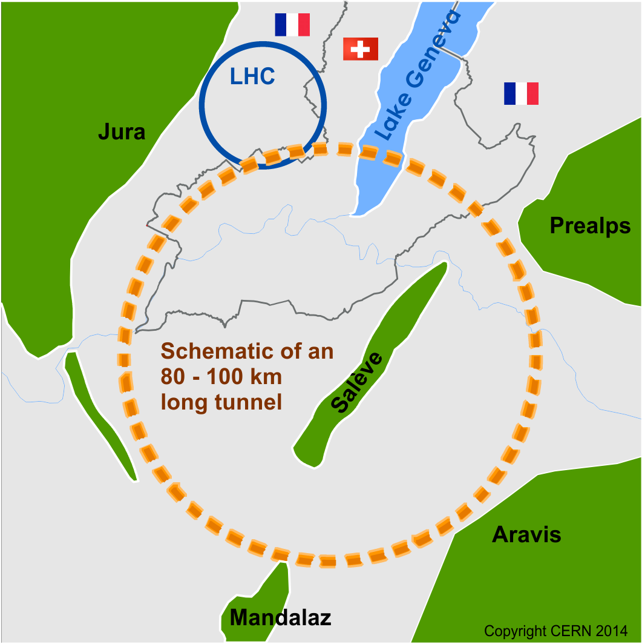
FCC Scope
Develop CDR until 2017+
FCC-hh
pp collider (ion option)
100TeV cms energy
defines infrastructure requirements
FCC-ee
e⁺e⁻ collider
potential intermediate step
FCC-he
additional option

Slide 7


Study time line towards CDR
2014 |  |  |  | 2015 |  |  |  | 2016 |  |  |  | 2017 |  |  |  | 2018
Q1 | Q2 | Q3 | Q4 | Q1 | Q2 | Q3 | Q4 | Q1 | Q2 | Q3 | Q4 | Q1 | Q2 | Q3 | Q4 | Q1 | Q2 | Q3 | Q4
Study plan, scope definition
Explore options
“weak interaction”
conceptual study of baseline “strong interact.”
FCC Week 2015:
work towards baseline
FCC Week 17 & Review Cost model, LHC results → study re-scoping?
FCC Week 2016
Progress review
Elaboration,
consolidation
FCC Week 2018
→ contents of CDR
Report
CDR ready
7

Slide 8
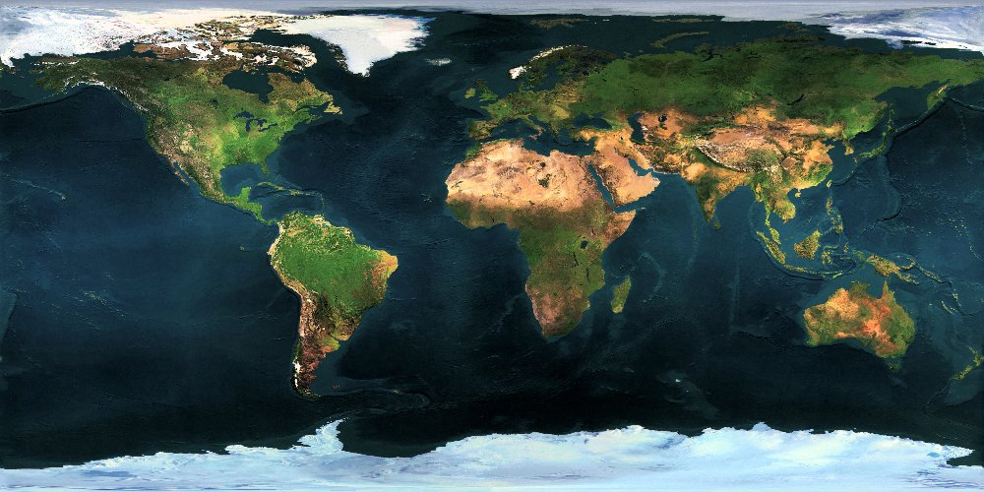




















Collaboration Status
51 institutes
19 countries
EC participation

Slide 9
FCC-hh

Slide 10
Main FCC-hh Parameters
 | LHC | HL-LHC | FCC-hh
Cms energy [TeV] | 14 | 14 | 100 | 100
Luminosity [10³⁴cm⁻²s⁻¹] | 1 | 5 | 5 | 20
Bunch distance [ns] | 25 | 25 | 25 | 25/5
Background events/bx | 27 | 135 | 170 | 680 (136)
Bunch length [cm] | 7.5 | 7.5 | 8 | 8
Two main experiments
Two reserve experimental areas used in baseline
80% of circumference filled with bunches
Baseline: 250fb⁻¹ per year (including shutdowns)
focus on 25ns spacing
Ultimate: 1000fb⁻¹ per year
more emphasis on 5ns

Slide 11
The Key Challenges
Energy
Limited by the machine size and the strength of the bending dipoles
Have to maximise the magnet strength
Luminosity
Need to maximise the use of the beam for luminosity production
Beam power handling
The beam can damage the machine
Quench the magnets
Create background in the experiments
Need a concept to deal with the beam power
Cost
The total cost is a concern, so we have to push everything to the limit to reduce cost
Most things will become difficult

Slide 12
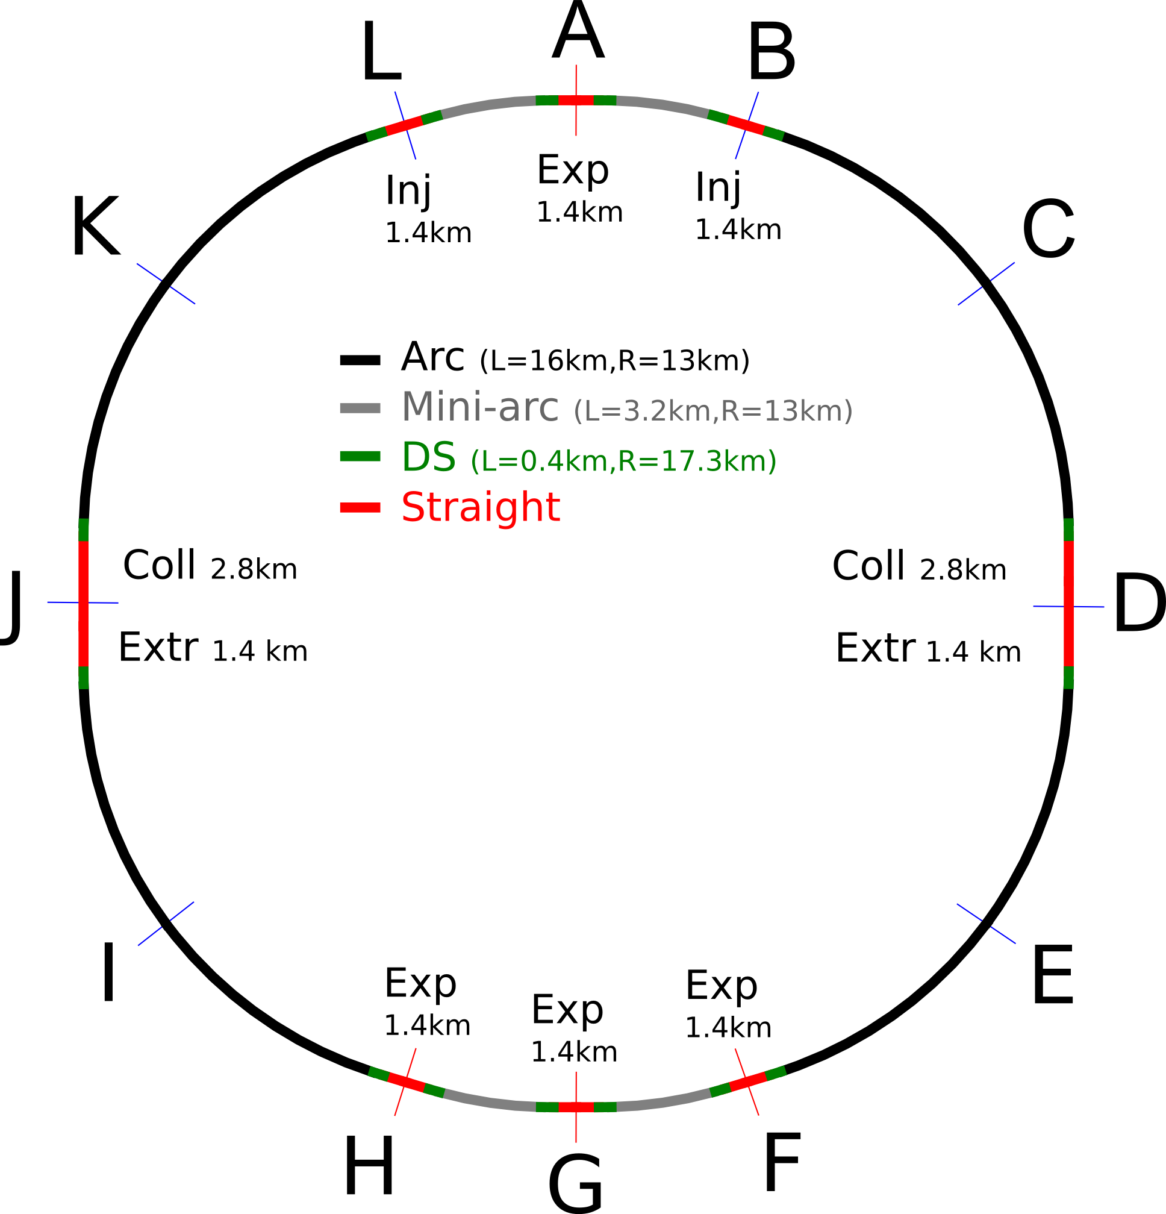
Preliminary Layout
First layout developed
Two high-luminosity experiments (A and G)
Two other experiments (F and H)
Two collimation lines
Two injection and two extraction lines
Insertion lengths are based on first order estimates, will be reviewed as optics designs are made

Slide 13
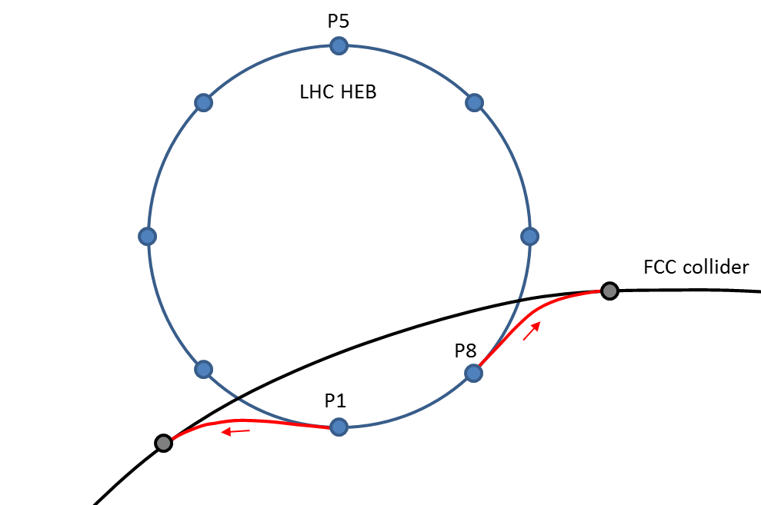
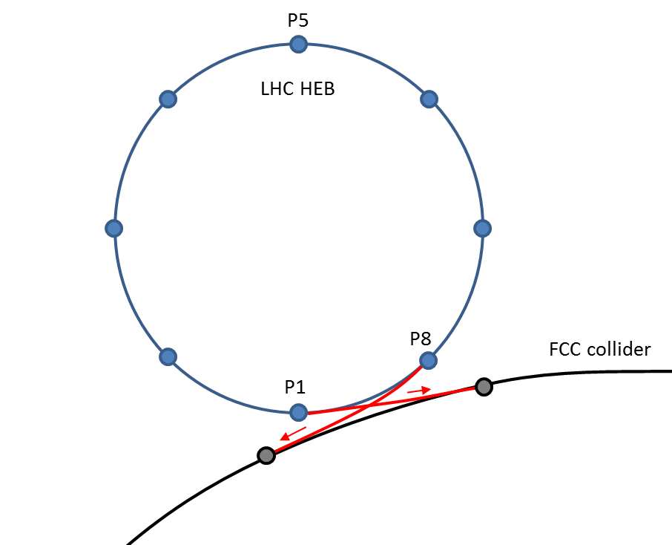
Injection and Site Study
SPS, LHC or injector in collider tunnel considered as injectors
Injection energy 3.3TeV (could be increased a bit if LHC is used)
Preliminary conclusions:
93km seems to fit the site really well, likely better than smaller ring
100km tunnel appears possible
The LHC could be used as an injector
Will also consider SPS and FCC tunnel for injector

Slide 14
Arc Cell Layout
Longer cell
better dipole filling factor
Shorter cells
more stable beam
12 dipoles with L=14.3m
L_{cell}=214.755m
Fill factor about 80%
Field (100km ring): (16-ε)T

Slide 15
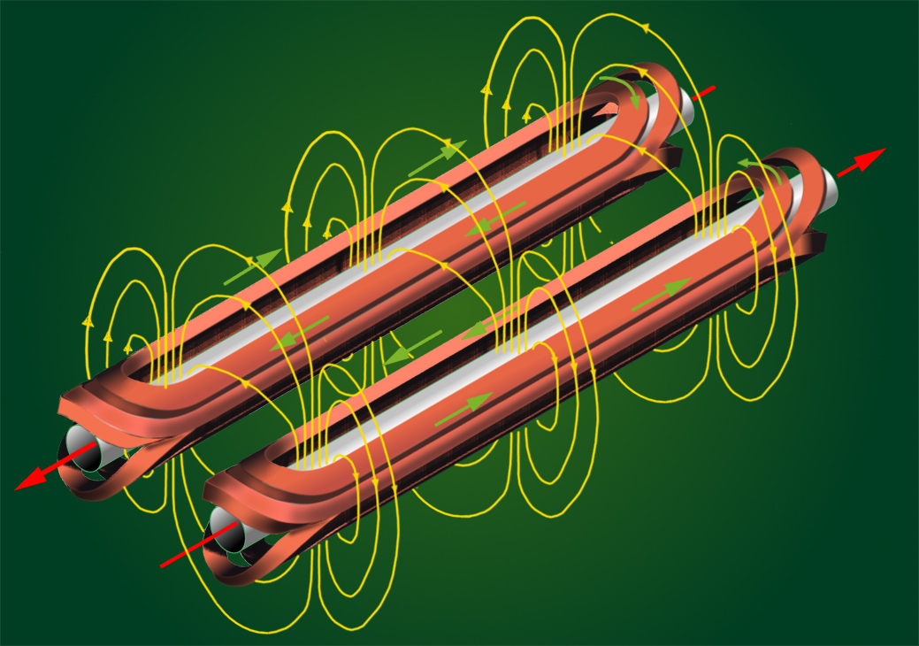
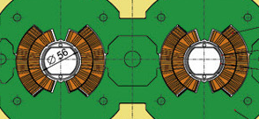
Dipole Basic Concept (“Cosine Theta”)
B
I(φ)
φ
I(φ)

Slide 16
Magnet Design Issues
Field level
Higher field level allows to use a smaller ring
But is technically challenging
Aperture
A larger aperture means more volume with the magnetic field
Larger stored energy and larger forces
Higher cost
The field quality
Unwanted non-linear field components
Especially at injection (low field)
Can make particles move chaotic and be lost
The cost
The most costly component in the machine

Slide 17

Limits for the Field
The cable can quench (superconductivity breaks down)
if the current is too high
If the magnetic field is too high
This limits the achievable field
In theory
Even lower limit in practice (shown)
Can use different materials
Nb-Ti is used for LHC
Nb₃Sn is used for high luminosity upgrade

Slide 18
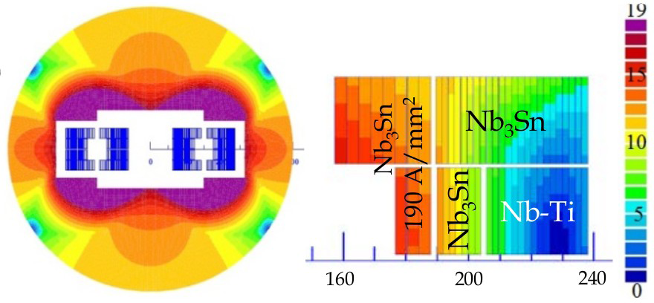
Cost Effective Magnet Design
Nb₃Sn is much more costly than Nb-Ti
Use both materials
Coil sketch of a 15 T magnet with grading, E. Todesco

Slide 19
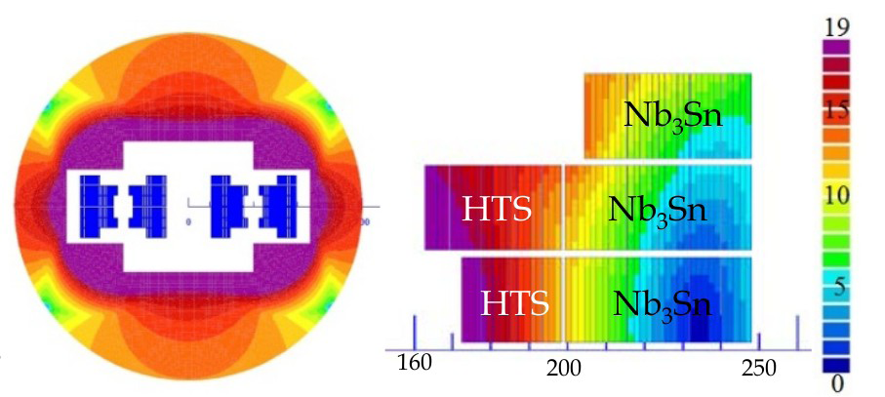
Cost Effective Magnet Design II
HTS is even more expensive than Nb₃Sn
Even more complex design
Coil sketch of a 20 T magnet with grading, E. Todesco

Slide 20
Parameters and Luminosity Target
 | Baseline | Ultimate
Luminosity L [10³⁴cm⁻²s⁻¹] | 5 | 20
Background events/bx | 170 (34) | 680 (136)
Bunch distance Δt [ns] | 25 (5)
Bunch charge N [10¹¹] | 1 (0.2)
Fract. of ring filled η_{fill} [%] | 80
Norm. emitt. [μm] | 2.2(0.44)
Max ξ for 2 IPs | 0.01 (0.02) | 0.03
IP beta-function β [m] | 1.1 | 0.3
IP beam size σ [μm] | 6.8 (3) | 3.5 (1.6)
RMS bunch length σ_{z} [cm] | 8
Crossing angle [σ’] | 12 | Crab. Cav.
Turn-around time [h] | 5 | 4

Slide 21
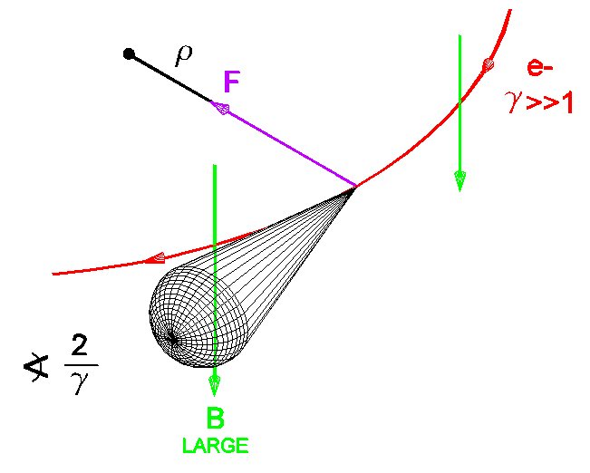
Synchrotron Radiation
At 100 TeV even protons radiate significantly
Total power of 5 MW
Needs to be cooled away
Equivalent to 30W/m /beam in the arcs
Protons loose energy
They are damped
Emittance improves with time
Typical damping time 1 hour

Slide 22
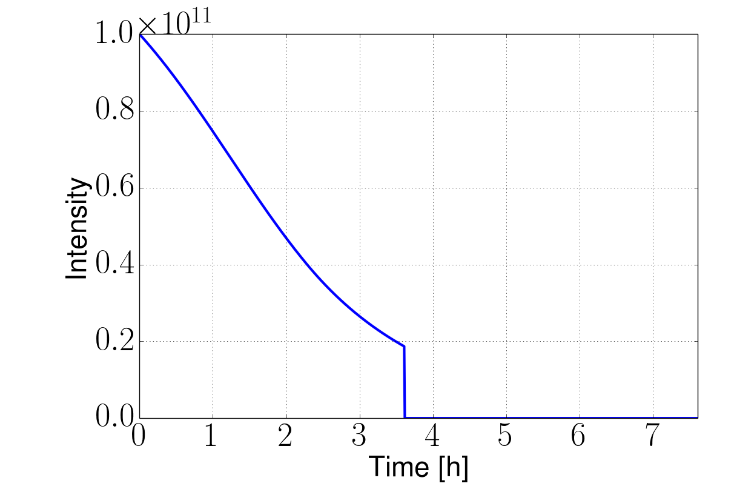
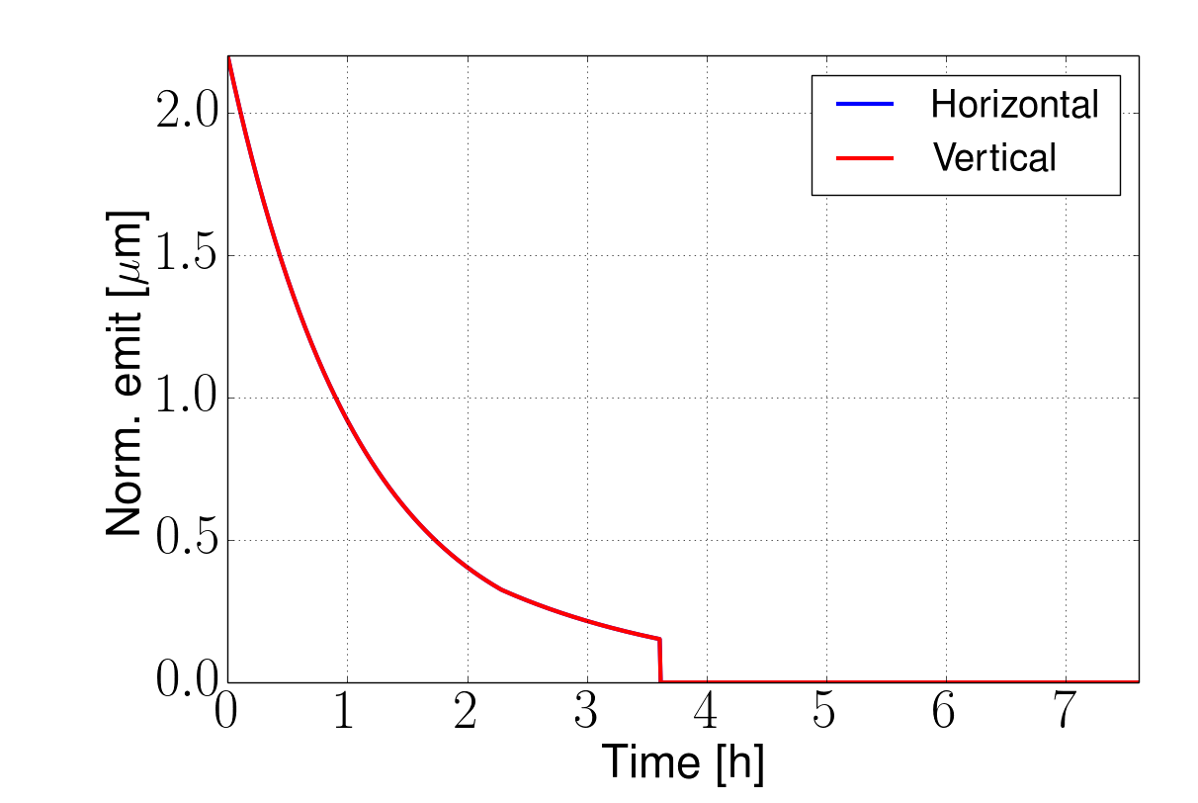
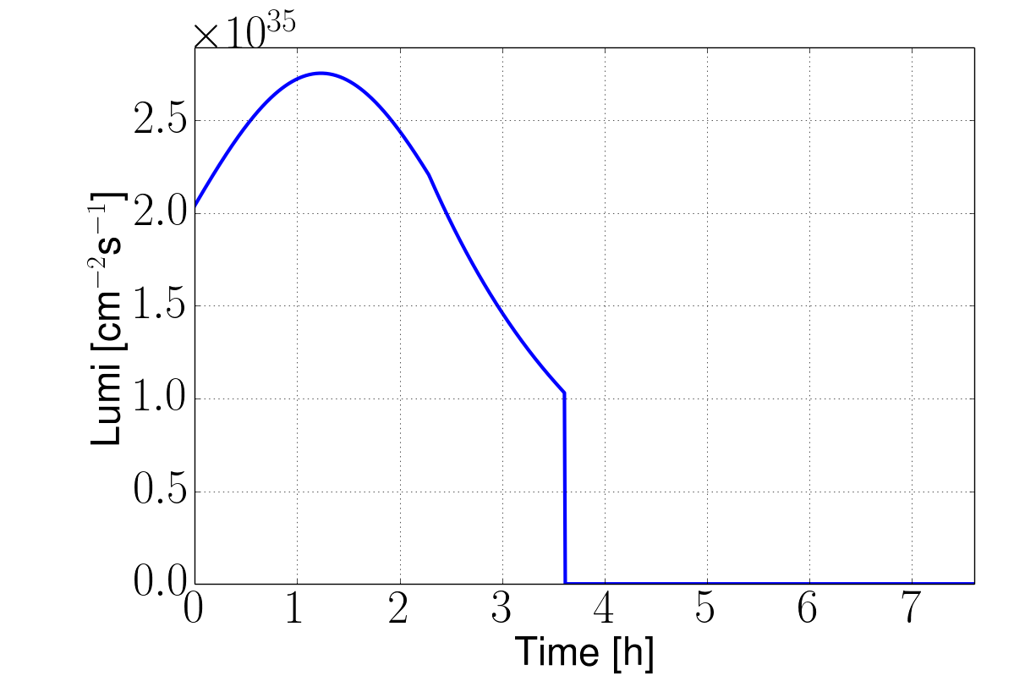
Integrated Luminosity
Developing model including all relevant effects
Iterations required
Can reach >8fb⁻¹ with ultimate for ξ=0.03
5000fb⁻¹ per 5 year run
Beam is burned quickly
Another reason to have enough charge stored
Ultimate example, 25ns, no luminosity levelling
8fb⁻¹/day
Turn-around time

Slide 23
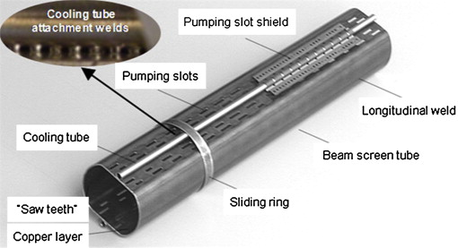
Synchrotron Radiation and Beam Screen
LHC beamscreen
Synchrotron radiation power ~30W/m/beam in arcs (E_{crit}=4.3keV), total 5 MW (LHC 7kW)
Cooling challenge
Vacuum challenge
Impedance challenge
Mechanical challenge
Electron cloud
Cost challenge
Talks by C. Garion, L. Tavian,
K. Ohmi, U. Niedermayer, …
Choice of beamscreen temperature is 50K
5MW synchrotron radiation => 100MW of cooling power
Good vacuum between 40-60K
Impedance still reasonable

Slide 24
Beam Screen Design
Complex tradeoff
Explore different directions
Need some maturity for design to make choice
But can guess magnet aperture quite well: 50mm
Impedance:
Minimum radius >13mm
Cooling:
O(5mm) outer diameter
Impedance:
0.3mm copper coating
Space for support:
O(2mm)
Cold bore and space for helium1.5mm+1.5mm
Stress in quench:
1.75mm steel
Total coil aperture 50mm

Slide 25
Power for Cooling
Beam screen cooling
Cold bore cooling

Slide 26
Choice of Temperature
Can only use some temperatures in order to maintain good vacuum
<20, 40K-60K, 100K-120K, >190K
300MW
200MW
100MW
But at 100K the impedance is about twice as high as at 50K
Choose 50K
Need 20x5MW=100MW for cooling
Proton beams emit about 5MW of synchrotron radiation
About 30W/m/beam

Slide 27
Impedances
Effects similar to wakefields in linacs also occur in many parts of a ring
Two important effects are:
Wakefields from the smooth beampipe at injection
Wakefields from collimators at full energy
Note:
At high energy more impedance can be tolerated
But the collimators are moved in at full energy
Impedance (Z) of beampipe depends on
Resistivity (ρ), temperature and magnetic field
Beampipe radius (b)
Resistivity of copper
T [K] | @0T [nΩm]
20 | 0.24
50 | 0.5
100 | 3.5

Slide 28
Estimates of Beamipe Impedance Effects
N. Mounet, G. Rumolo
Growth rate of multi-bunch instability
10 turns
Noise growths every 20-30 turns by factor e
50 turns
Need feedback within 10 turns
Challenge for RF and instrumentation
Or increase the beam screen radius
Or decrease beam current
100 turns
Many more impedance studies required
Multi-bunch effect at 50K and injection (worst case)
Only resistive wall (infinite copper layer assumed)

Slide 29
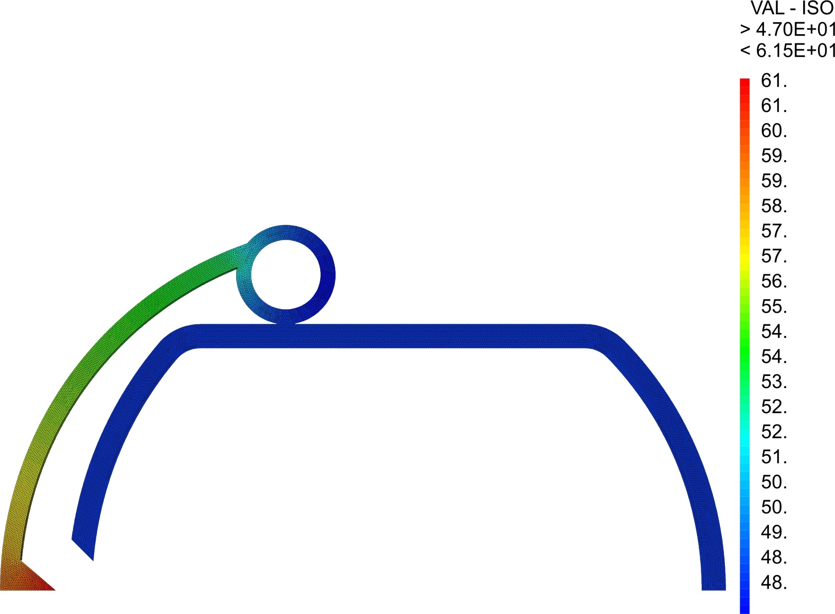
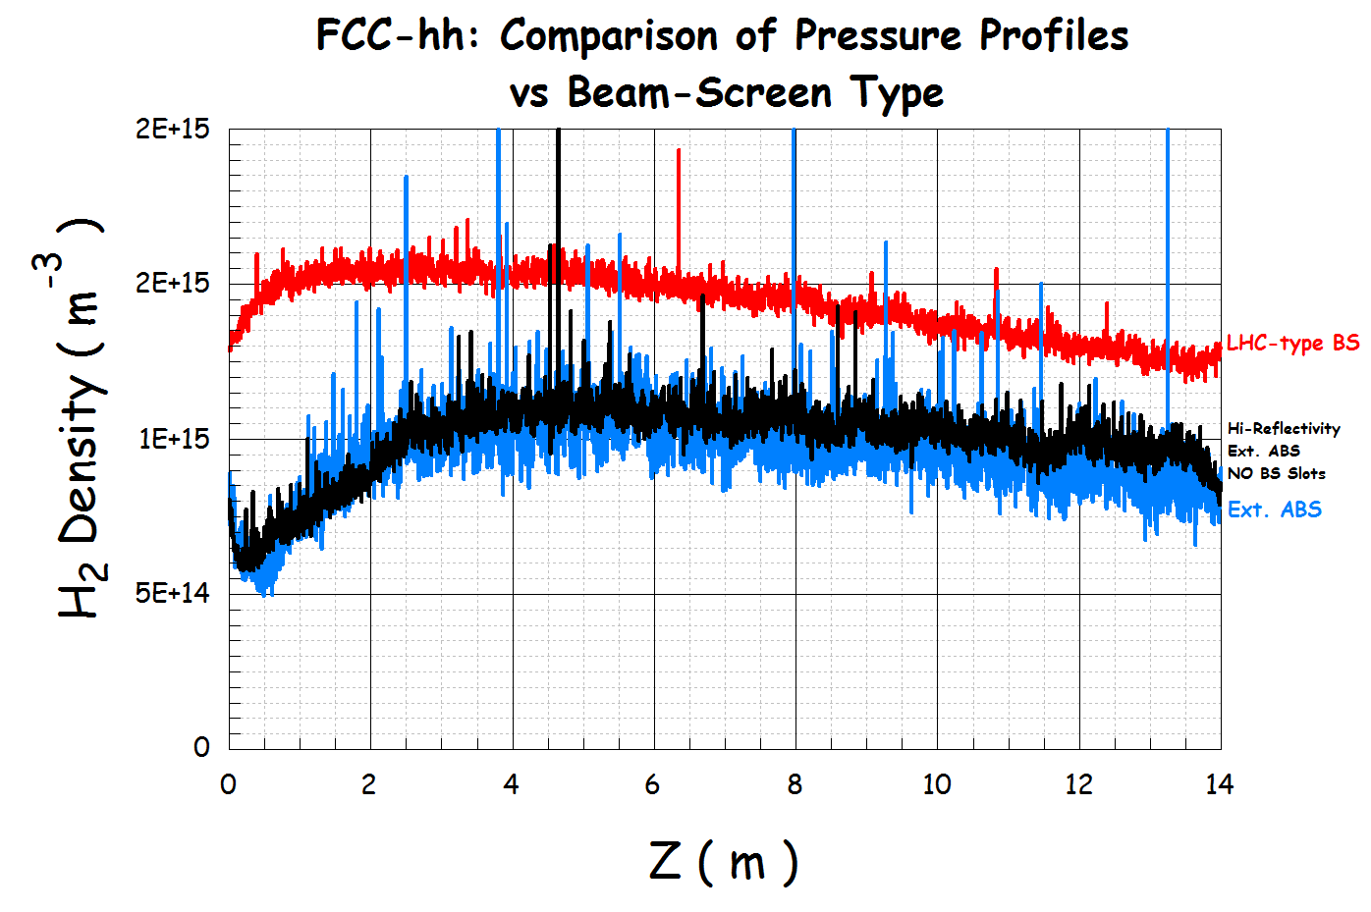
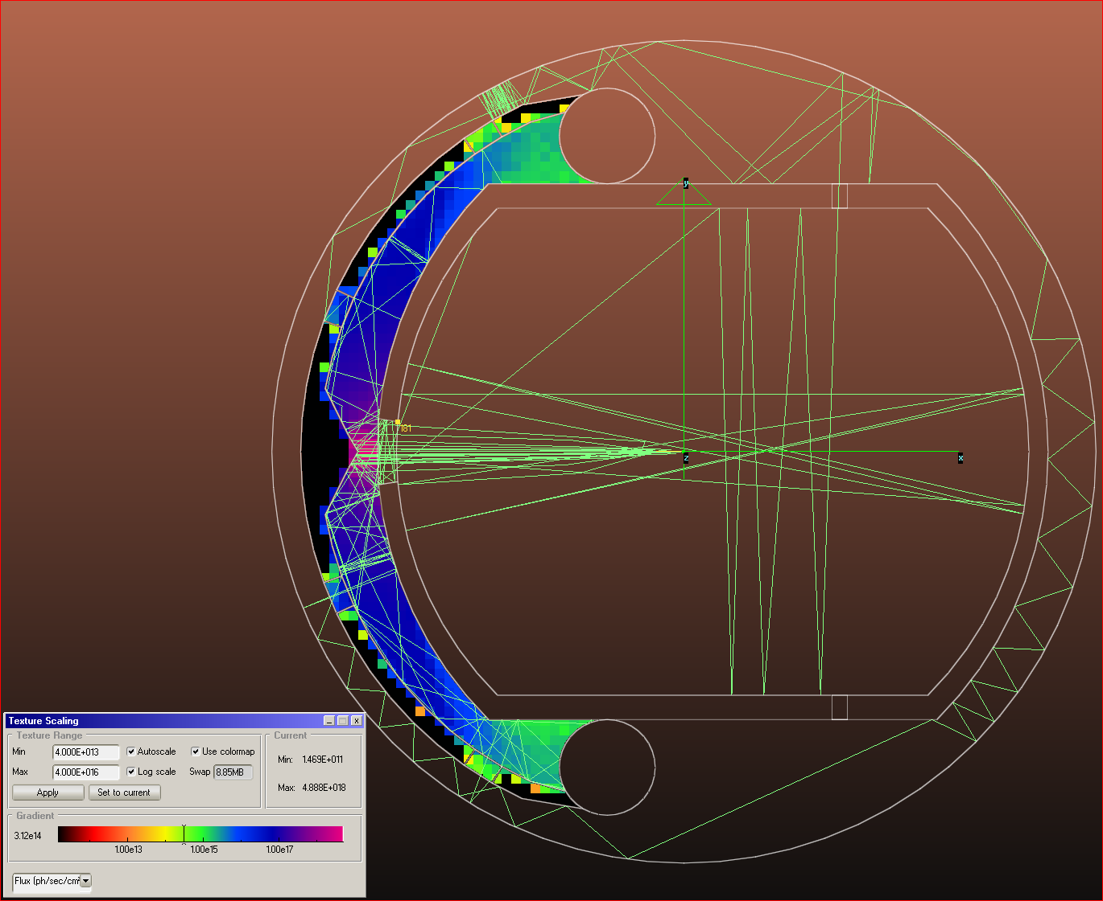
Beam Screen Example Design
Example layout
Heat transport
Vacuum quality
R. Kersevan
C. Garion
L. Tavian, et al.
Many tools for evaluation are in place
Can prepare for choice
May lead to new questions
E.g. orbit stability
Novel cooling system to reduce number of valves
Magnetic centre location
Are vibrations an issue?
Limited pumping holes in beamscreen around beam?
Photon distribution

Slide 30
Interaction Region
L* >40m allows the the triplet (Q1-Q3) and the triplet shielding (TAS) to be ‘hidden’ in the tunnel
→ very comfortable situation for cavern infrastructure and ALARA related items.
30m
Q1 TAS
TAS Q1
7.5m
7.5m
65m
80m

Slide 31
Final Focus Design
R. Martin, R. Tomas
The maximum quadrupole field limits the beta-function/beam size at the IP
Smaller beam at IP => larger beam at quadrupole
The larger L* the larger the beam
The final triplet will be a critical aperture limitation
Limits the beta-function
Why not simply reduce the emittance?

Slide 32
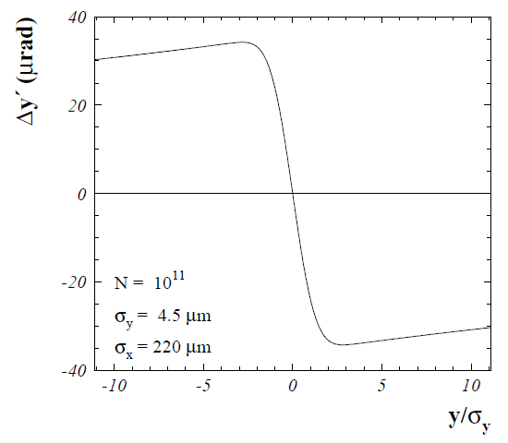
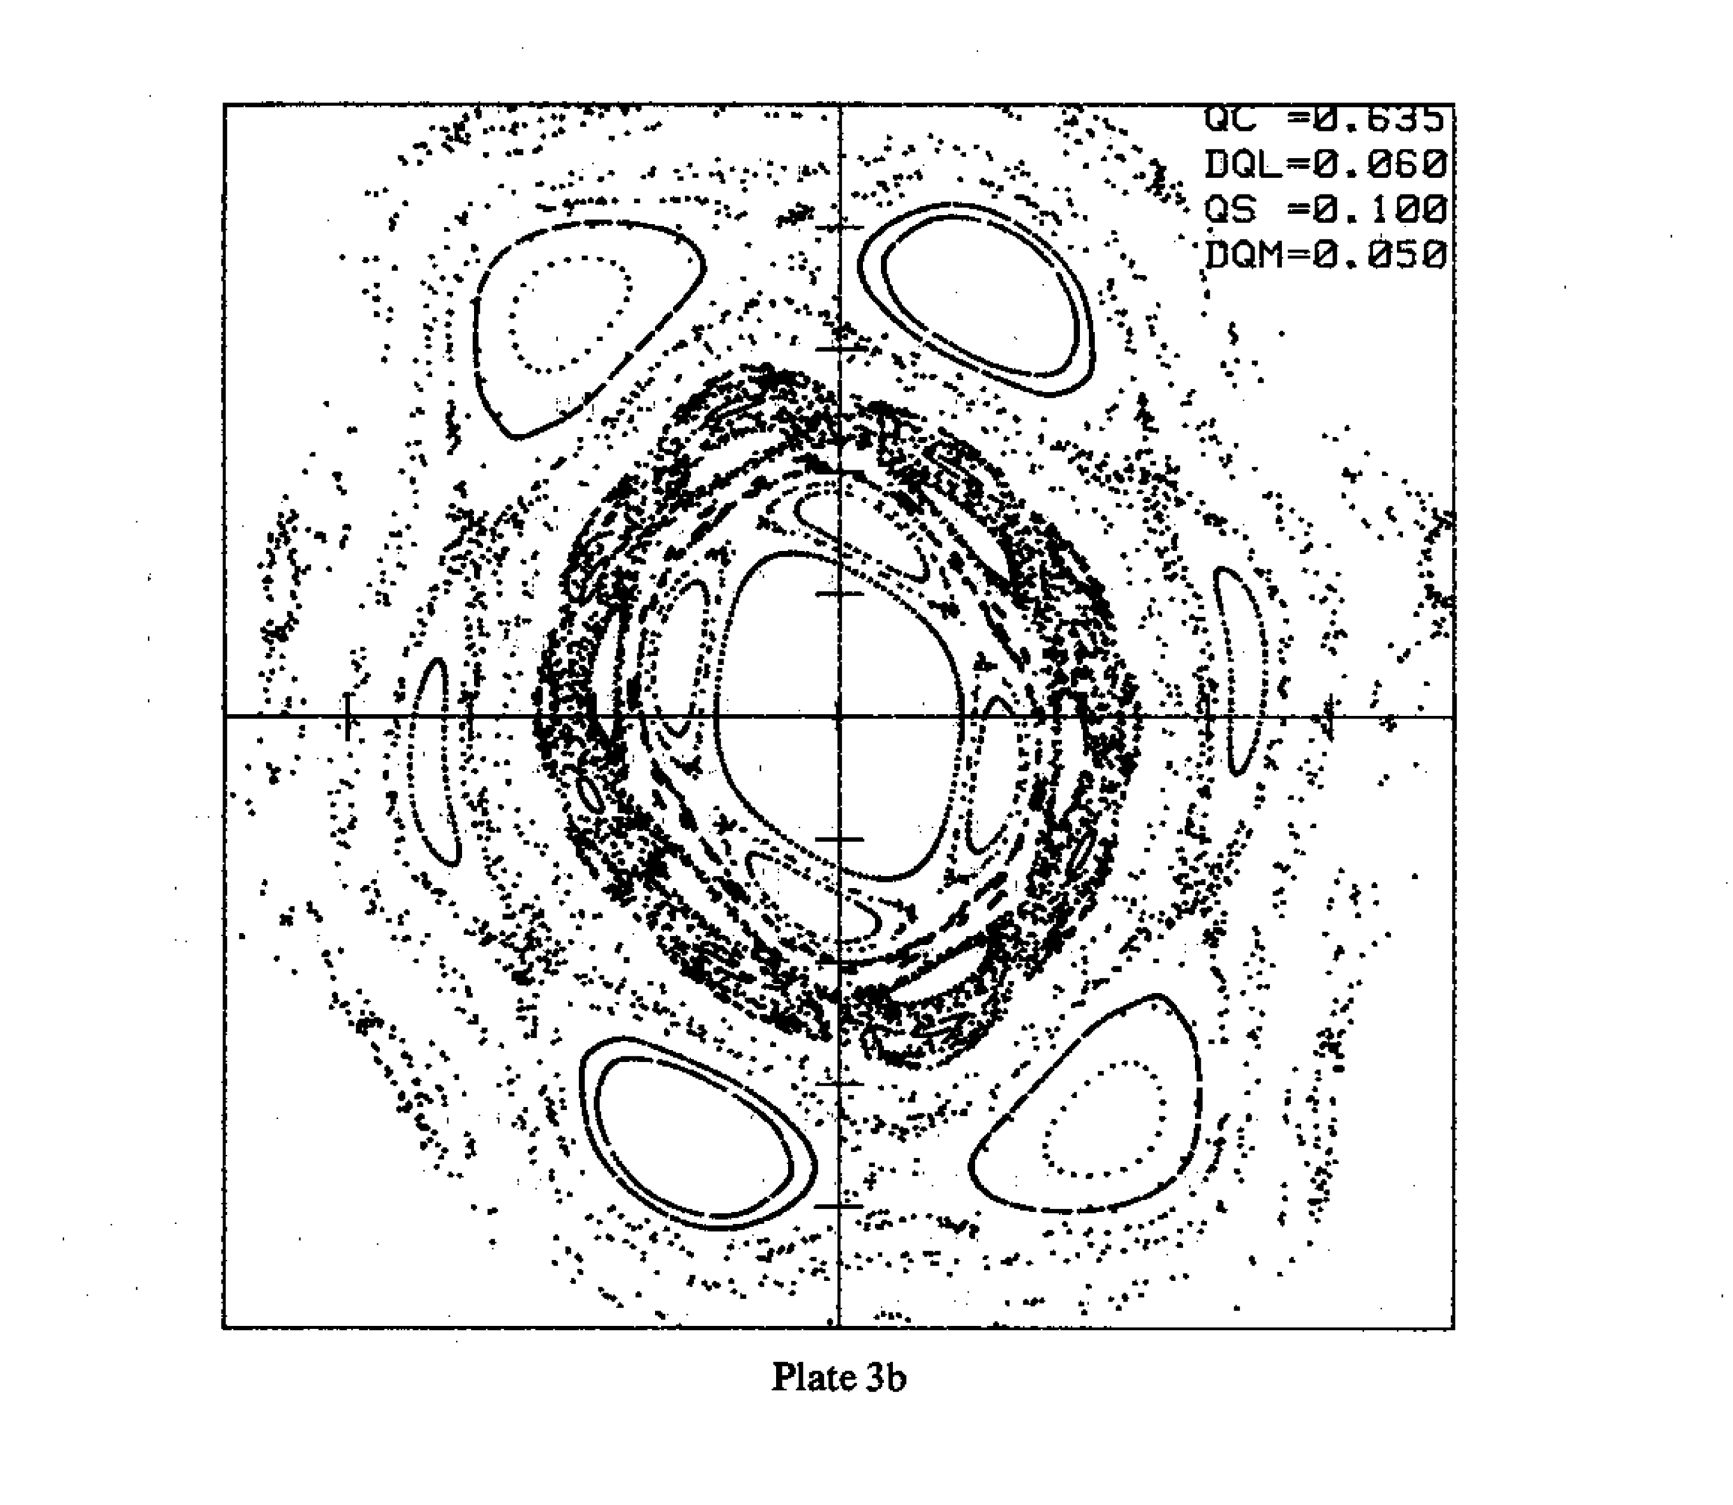
Beam-beam Effects

Slide 33
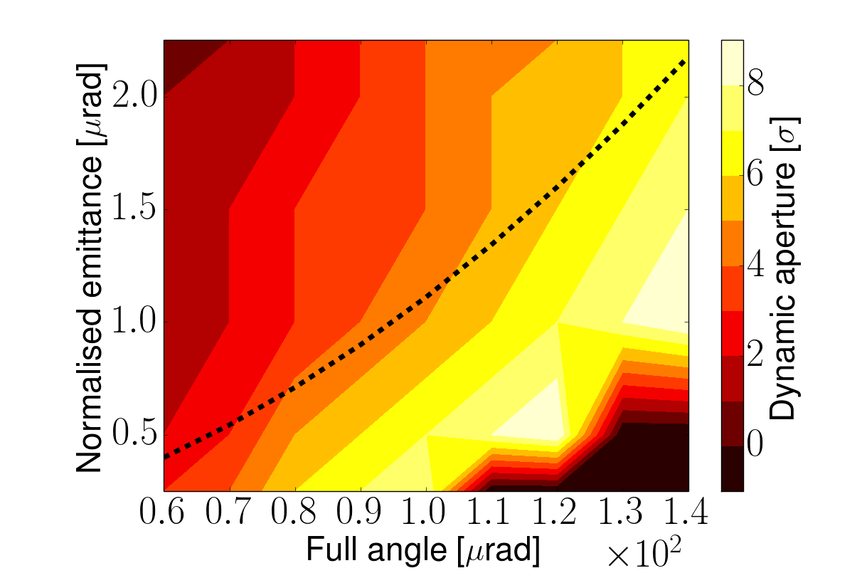
Beam-beam Effects
Effects depend on
Beam-beam tuneshift
Crossing angle
First results for head-on beam beam:
Synchrotron noise is acceptable
Likely OK for ultimate
First results for long-range beam-beam:
Separation is sufficient for baseline
Should be solvable for ultimate

Slide 34
Beam-beam Effect Mitigation
Compensating wire
Some mitigation techniques are possible:
Head-on:
Electron lens
Long-range:
Larger crossing angle (and crab crossing)
Compensating wire (to be tested for HL-LHC)

Slide 35
Radiation from Beam-beam
Shield (TAS)
Magnets
But need to open aperture
Total power of background events 100-500kW per experiment
Car or truck engine
Already a problem in LHC and HL-LHC
Lifetime of magnets, heat load and quench
Need to improve shielding

Slide 36
Radiation in Final Triplet II
Heat load seems OK for baseline and ultimate
With 20mm liner magnets survive O(3000fb⁻¹)
10% of the total dose
OK for 5 year baseline run
Not OK for an ultimate run
Need to
Further improve shielding
Improved radiation hardness of magnets
Think about replacement of triplets
Play with optics
…
F. Cerutti,
M. I. Besana, et al.

Slide 37
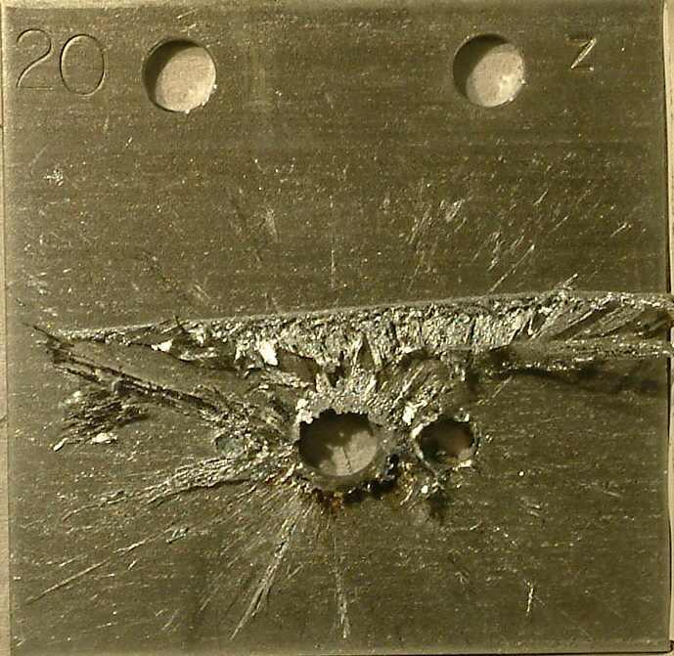
Machine Protection and Friends
8GJ kinetic energy per beam
Airbus A380 at 720km/h
2000kg TNT per beam
O(20) times LHC
Machine protection
High risk at injection and extraction
Instrumentation to detect failures
Interlock system
Passive protection and collimation system
Machine protection strategy
O(160GJ) in magnets
O(20) times LHC
Serious protection issue

Slide 38
Collimation System
S. Redaelli
Efficiency is important
Robustness in case of fast beam loss (in a few minutes)
Materials, …
Main impedance at collision energy
=> Optics, materials, …

Slide 39
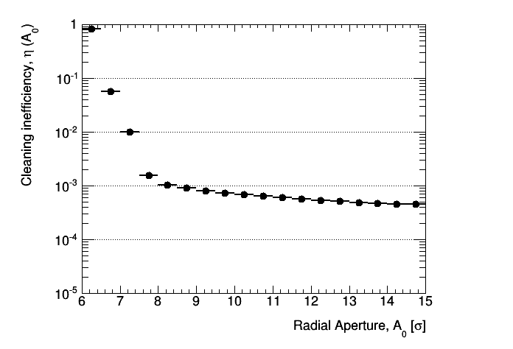
First Collimation Studies
First betatron collimation system scaled from LHC
Gaps as in HL-LHC
But 2.7km long
Starting point for exploration
Fix issues from LHC design
R. Tomas
LHC
M. Fiascari,
S. Redaelli

Slide 40
Injection/Extraction Challenge
Total energy in beam batch injected needs to be limited
With LHC limit can inject O(100) bunches
Very fast kicker (O(300ns)) for short gaps and beam filling factor of 80%
Design improvements? Massless septum?
Miss-firing of extraction kicker can lead to losses
Which strategy?

Slide 41
FCC-ee

Slide 42
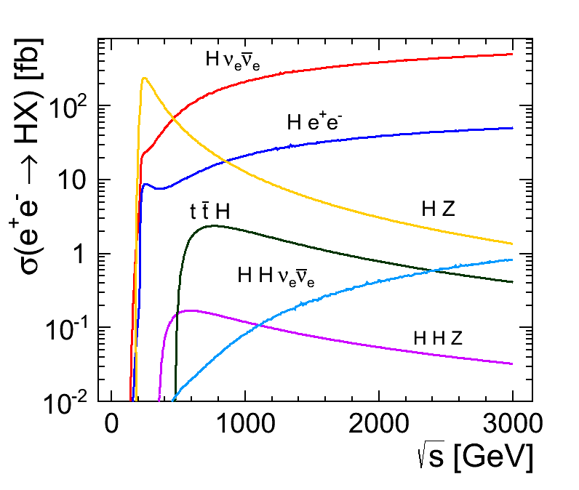
FCC-ee Rational
Can use FCC-hh tunnel
Tunnel cost has to be paid only once
Can operate at
90 GeV (“Tera-Z”)
160GeV (W pairs)
240GeV (Higgs via Zh)
350GeV (top threshold, higgs productions via Zh and WW)
Limited energy reach
But proton collider takes care of high energies
Consistent with current LHC results

Slide 43
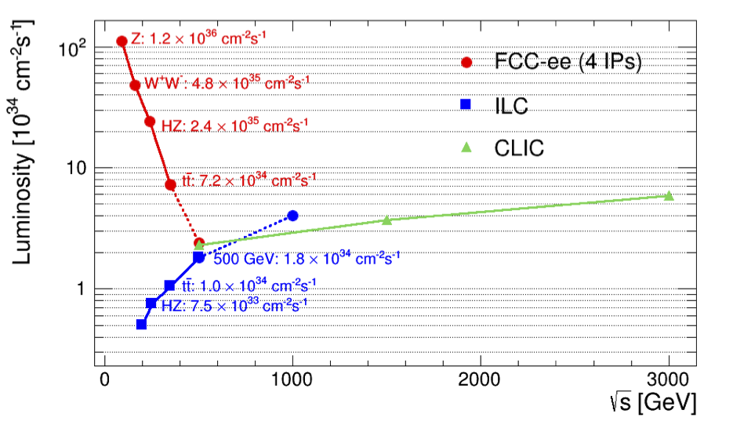
FCC-ee vs. Linear Colliders
F. Gianotti
Circular,
adding four experiments
Modified from original version:
http://arxiv.org/pdf/1308.6176v3.pdf
CepC (2 IPs)
China prepares a project similar to FCC-ee
Linear

Slide 44
FCC-ee Parameters
Parameter | Z | W | H | t | LEP2
E (GeV) | 45 | 80 | 120 | 175 | 104
I (mA) | 1400 | 152 | 30 | 7 | 4
No. bunches | 16’700 | 4’490 | 1’330 | 98 | 4
β*_{x/y} (mm) | 500 / 1 | 500 / 1 | 500 / 1 | 1000 / 1 | 1500 / 50
ε_{x} (nm)/ε_{y} (pm) | 29/60 | 3.3/7 | 1/2 | 2/2 | 30-50/~250
σ_{x}(μm)/σ_{y}(nm) | 120/250 | 40/84 | 22/45 | 45/45 | 250/3500
ξ_{y} | 0.03 | 0.06 | 0.09 | 0.09 | 0.07
L (10³⁴ cm⁻²s⁻¹) | 28 | 12 | 6.0 | 1.8 | 0.012
Using flat beams
Significant luminosity increase compared to LEP:
Smaller emittances, beta-functions, larger power consumption

Slide 45
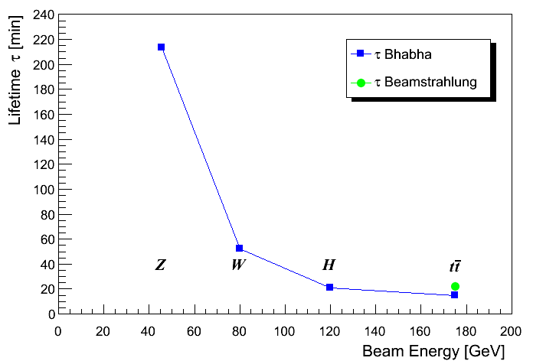
Luminosity Lifetime
Luminosity lifetime is dominated by radiative Bhabha scattering
(total cross-section σ_{ee} ≈ 0.21b )
=> Lifetimes down to ~15 minutes at 350GeV
=> Continuous top-up injection
n_{ip} = 4

Slide 46

Beamstrahlung
The colliding beams emit beamstrahlung like in a linear collider
The average photon energy is small
But a few photons have a large energy
The electrons will be lost due to the energy error
e
γ
e
To keep losses small require critical energy E_{crit} (3/2 average photon energy) to be much smaller than energy acceptance (η)
Flat beams
Beamstrahlung is an issue at higher energies

Slide 47
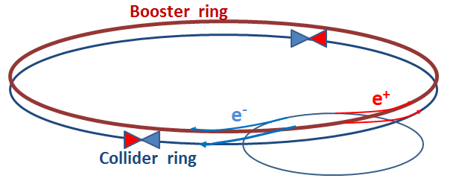
Top-up Injection
Boost energy in booster ring to collision energy
Inject into collider ring on top of circulating beam
Requires third ring
Can keep collider current almost constant, even with short lifetimes
Tested in B-factories
Injection into booster at 20GeV
Injection into collider ring very 10s or so

Slide 48
Conclusion
CERN has been requested to develop two options for the future flagship projects
CLIC, a high energy linear collider
FCC-hh, with possibly FCC-ee as intermediate step (also FCC-he option)
The FCC study aims at CDR for European strategy update (2018)
The work has just started
First baseline exists
More work to be done
Exciting technological challenges
Exciting beam physics
Exciting physics
We are looking for more collaboration
We are looking for good people
Including PhD students

Slide 49
If You Want to Contribute
Work/meeting structures established based on INDICO, see:
FCC Study: https://indico.cern.ch/category/5153/
In particular:
FCC-hh Hadron Collider VIDYO meetings
https://indico.cern.ch/category/5263/
Contacts: daniel.schulte@cern.ch
FCC-hadron injector meetings
https://indico.cern.ch/category/5262/
Contacts: brennan.goddard@cern.ch

Slide 50
Ausbildungsprogramme am CERN
Summer Students (2 – 3 Monate, ~240 Studenten/Jahr)
Technical Students (6 – 12 Monate, ~160 Studenten)
Doctoral Students (2 – 3 Jahre, ~170 Studenten)
Doktoranden mit technisch orientierten Themenbereichen
Deutsches Sonderprogramm (Wolfgang-Gentner-Programm)
BMFT finaziert
Promotion an deutscher Universität
Arbeit am CERN
O(3.7kCHF/Monat)
Am besten Kontakt vor der Bewerbung
Definition des Themas
Kontakt Professor zu Supervisor am CERN
https://cern.ch/wolfgang-gentner-stipendien/
Fellows (2 – 3 Jahre, ~550 Fellows)

Slide 51
Thanks
Thanks for your patience
Thanks to all the people who helped or from whom I stole figures
S. Stapnes, L. Rossi, Ralph Assmann, Jean-Pierre Delahaye, Lucie Linssen, Steffen Doebert, Alexej Grudiev, Frank Tecker, Walter Wuensch, Stephane Poss, Jan Strube, Joerg Wenninger, M. Benedikt, Frank Zimmermann, Bernhard Holzer, …
If you can look into the seeds of time, And say which grain will grow and which will not; Speak then to me.
(Shakespeare)

Slide 53
Expectations after Long Shutdown 1 (2015)
Cms energy 13 TeV
Bunch spacing 25 ns
Expected maximum luminosity: 1.6 x 10³⁴ cm⁻² s⁻¹ ± 20%
Limited by inner triplet heat load limit, due to collisions debris
Other conditions:
Similar turn around time
Similar machine availability
β* ≤ 0.5m (was 0.6 m in 2012)
Using new injector beam production scheme (BCMS), resulting in brighter beams.
F. Bordry
 | Number of bunches | Intensity per bunch | Transverse emittance | Peak luminosity | Pile up | Int. yearly luminosity
25 ns BCMS | 2508 | 1.15 × 10¹¹ | 1.9 µm | 1.6×10³⁴ cm⁻²s⁻¹ | ~43 | ~40-45 fb⁻¹

Slide 54
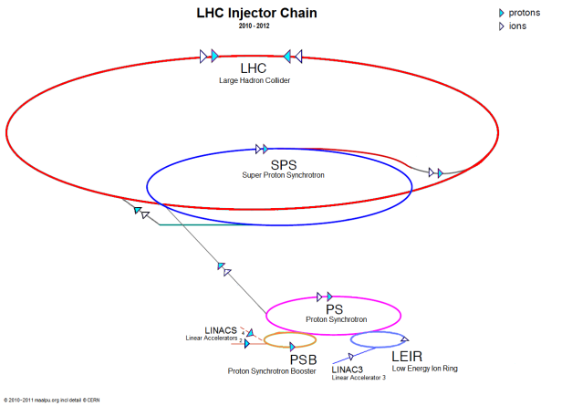
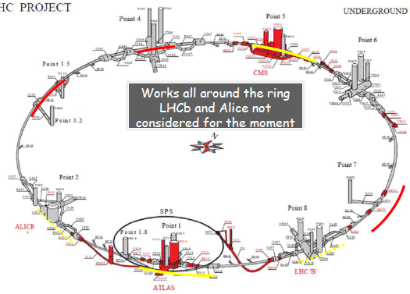
The HL-LHC Project
Goal is to obtain about 3 - 4 fb⁻¹/day (250 to 300 fb⁻¹/year)
Many improvements on the injector chain
Linac 4 - PS booster
PS
SPS
Many improvements on the LHC ring
New IR-quads Nb₃Sn (inner triplets)
New 11 T Nb₃Sn (short) dipoles
Collimation upgrade
Cryogenics upgrade
Crab Cavities
Cold powering
Machine protection
…

Slide 55

Example of International Collaboration
F. Bordry
Baseline layout of HL-LHC IR region
D2
Q4
with national laboratories but also involving industrial firms

Slide 56
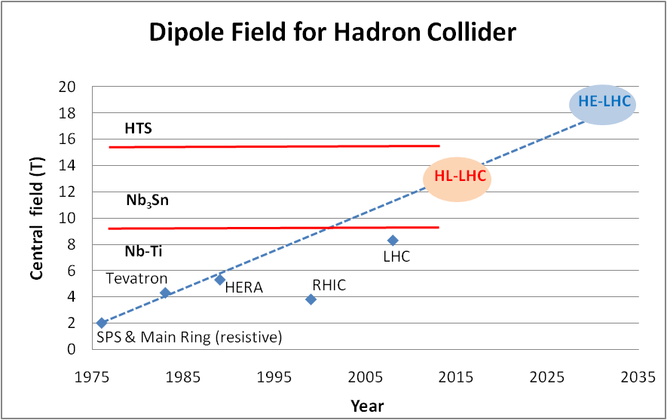
Development of Dipole Fields
Looking at performance offered by practical SC, considering tunnel size and basic engineering (forces, stresses, energy) the practical limits is around 20 T. Such a challenge is similar to a 40 T solenoid (μ-C)
LBNL, with large bore
Spring 2013
Nb-Ti operating dipoles;
Nb3Sn cosϑ test dipoles
Nb3Sn block test dipoles

Slide 57
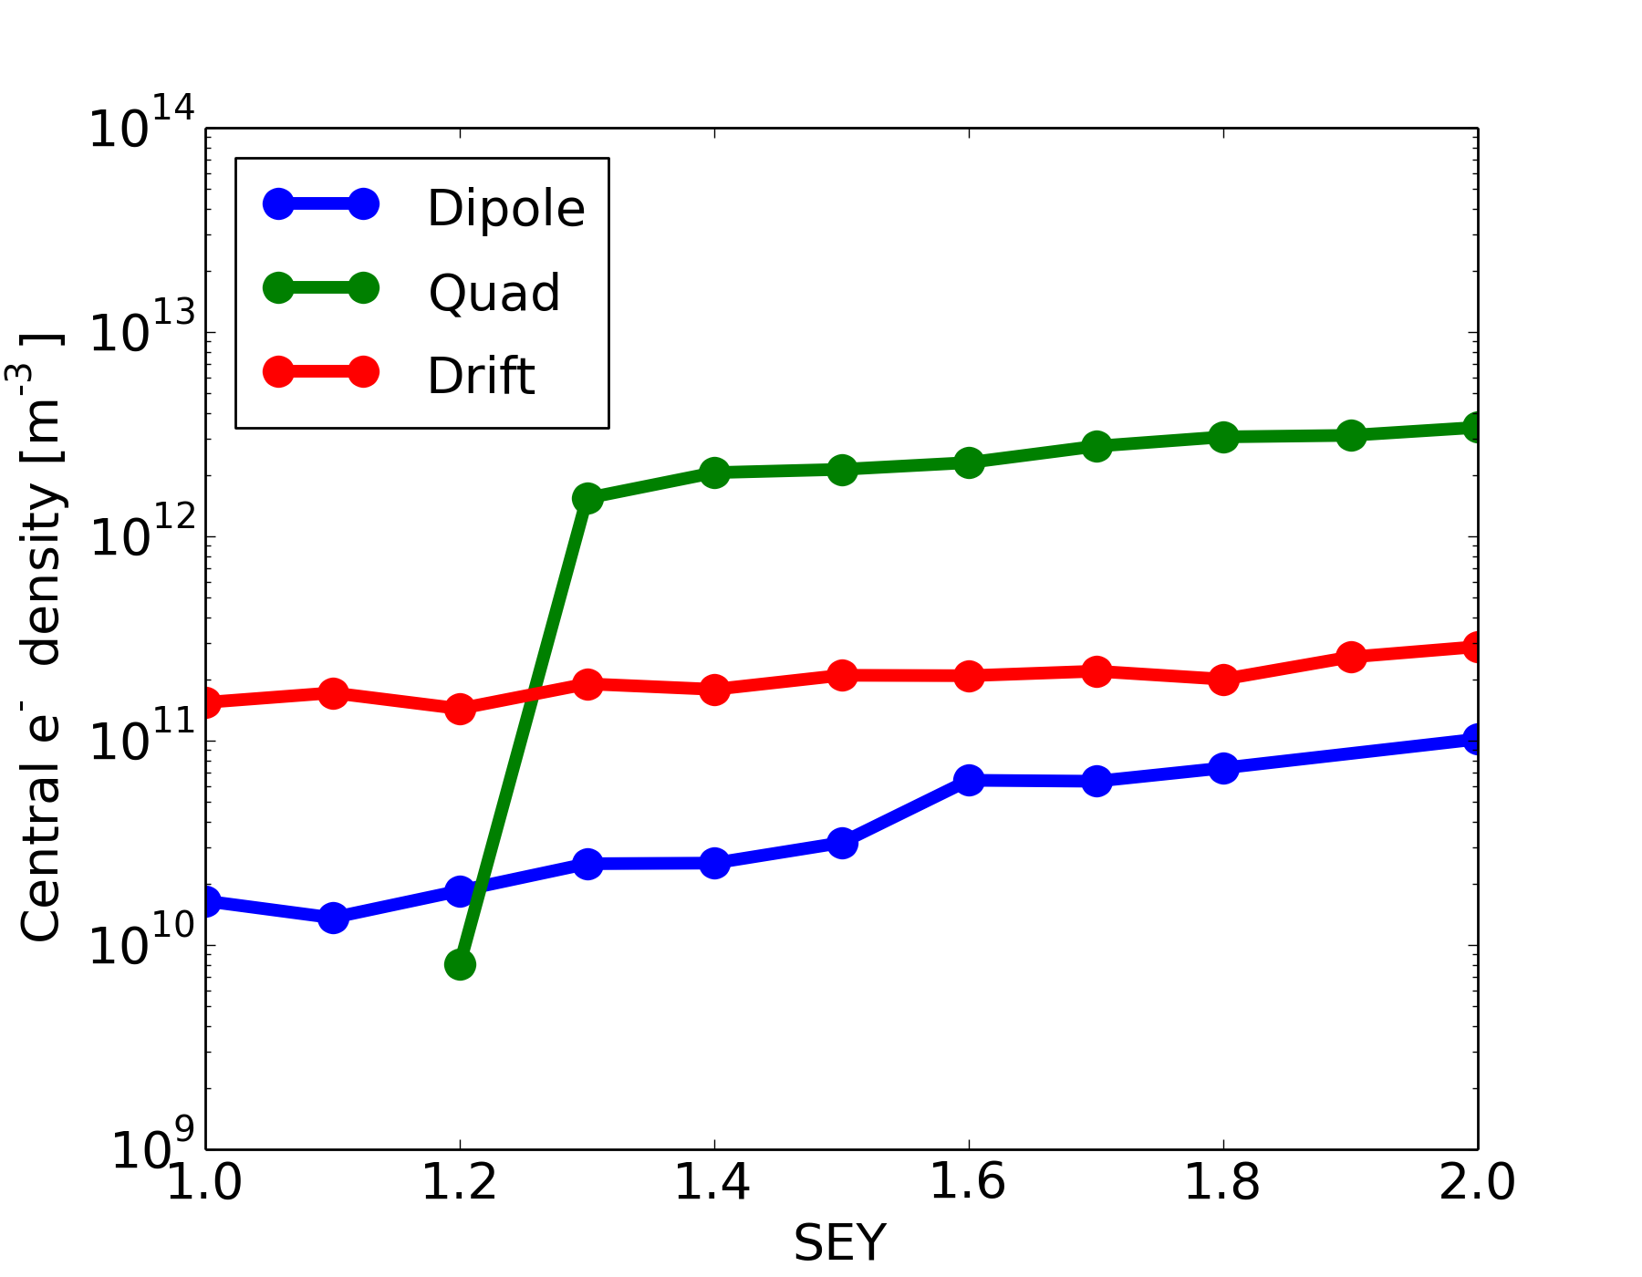
Electron Cloud Effects
Still a potential performance limitation for LHC
Heat load
Beam instability
Generate large number of electrons
First simulations for 25ns:
Photoelectron yield Υ<O(0.2)
Sawtooth should better
Secondary emission yield δ_{m}<1.2
But need to include pinch due to bunch fields
Important issue to follow up
5ns bunch spacing
Work on mitigation techniques
Experimental data
Density before bunch
L. Mether,
G. Rumolo
K. Ohmi,
L. Mether,
G. Rumolo
R. Cimino

Slide 58
Example for Loss Mechanism
Beam-gas scattering goal
>100h beam lifetime
<O(10¹⁵m⁻³) H₂ (σ≈100mb)
40kW proton losses
power for cooling @2K is <30MW, since elastic part is lost in collimation system
First studies indicate peak power density O(1mW/cm⁻³) and 3.5W/beam/dipole in cold
Seems very acceptable but need to define margin
Work in progress

Slide 59
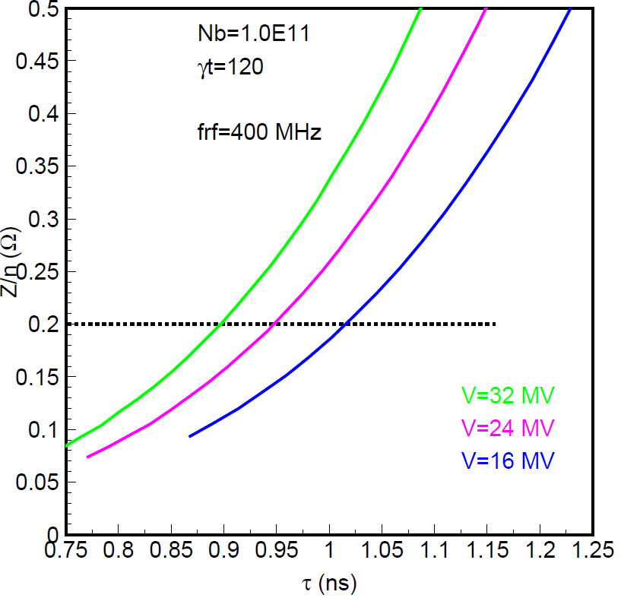
RF Design Considerations
E. Shaposhnikova
400.8 MHz seems a good baseline
16MV minimum with no margin
32MV seems fine
200MHz appear somewhat low
Needs higher voltage (>100MV)
Or longer bunches (12cm)
800MHz appears too high
Combination of 200 and 400MHz?
Assumed impedance (x2)
32MV
24MV
16MV
Bunch length
Feedback design is critical
Emittance control also

Slide 60
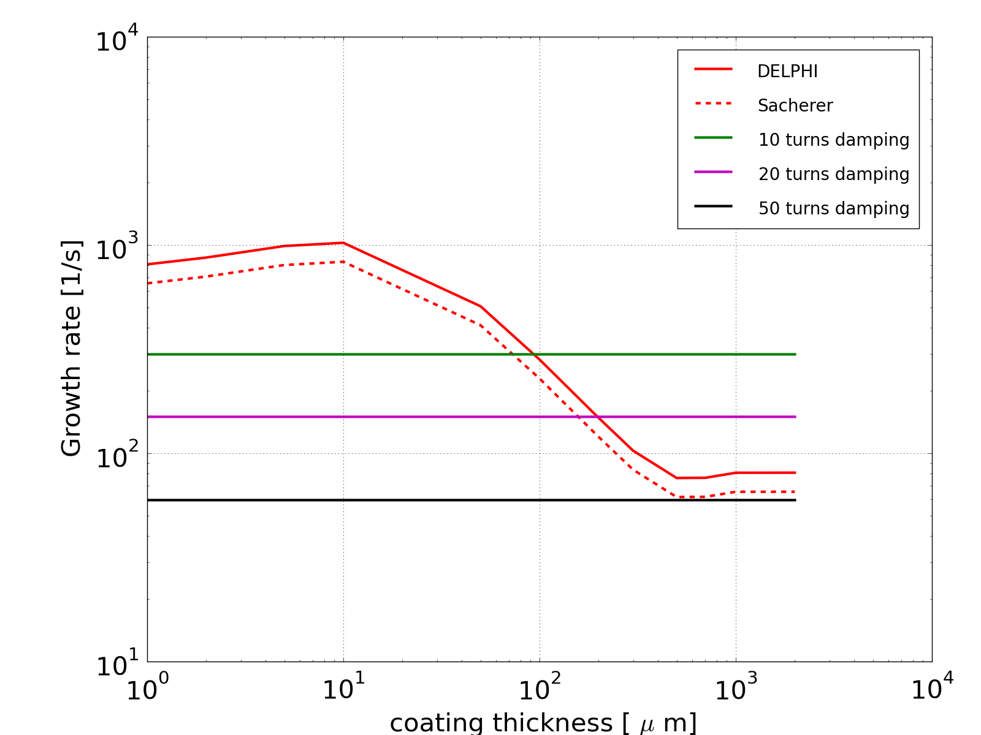
Thickness of Copper Coating
N. Mounet
ΔQ=0.5, can probably assume this upper limit on working point
Need maybe 300μm of copper coating
Difficult because of eddy currents in quench
Induces stress on beam pipe
LHC has 50μm
HTS coating? Lots of work
Impedance, coating technology, ecloud, …

Slide 61
51 FCC collaboration members & CERN as host institute,
22 March 2015
ALBA/CELLS, Spain
Ankara U., Turkey
U Bern, Switzerland
BINP, Russia
CASE (SUNY/BNL), USA
CBPF, Brazil
CEA Grenoble, France
CEA Saclay, France
CIEMAT, Spain
CNRS, France
Cockcroft Institute, UK
U Colima, Mexico
CSIC/IFIC, Spain
TU Darmstadt, Germany
DESY, Germany
TU Dresden, Germany
Duke U, USA
EPFL, Switzerland
GWNU, Korea
U Geneva, Switzerland
Goethe U Frankfurt, Germany
GSI, Germany
Hellenic Open U, Greece
HEPHY, Austria
IFJ PAN Krakow, Poland
INFN, Italy
INP Minsk, Belarus
U Iowa, USA
IPM, Iran
UC Irvine, USA
Istanbul Aydin U., Turkey
JAI/Oxford, UK
JINR Dubna, Russia
FZ Jülich, Germany
KAIST, Korea
KEK, Japan
KIAS, Korea
King’s College London, UK
KIT Karlsruhe, Germany
Korea U Sejong, Korea
MEPhI, Russia
MIT, USA
NBI, Denmark
Northern Illinois U., USA
NC PHEP Minsk, Belarus
U. Liverpool, UK
PSI, Switzerland
Sapienza/Roma, Italy
UC Santa Barbara, USA
U Silesia, Poland
TU Tampere, Finland

Slide 62
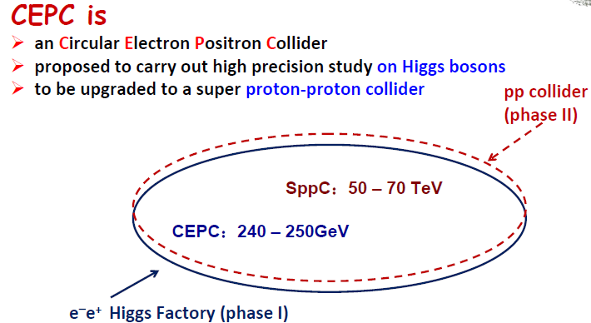
Note: CEPC
D. Wang & H. Geng
6th TLEP Workshop
50-70 km
(centre-of mass !)
A lot of synergies between FCC-ee and CEPC !

Slide 63
Ausbildungsprogramme am CERN
Summer Students (2 – 3 Monate, ~240 Studenten/Jahr)
Studierende im 3. – 4. Jahr, vorwiegend Physik, auch Informatik und Ingenieurswissenschaften
Vorlesungen + Arbeit in einer CERN Gruppe (kleines Projekt)
Technical Students (6 – 12 Monate, ~160 Studenten)
Diplom und Masterstudenten in technischen Bereichen
Sonderprogramm für FH Studenten aus Baden-W. und Rheinland-Pfalz
Doctoral Students (2 – 3 Jahre, ~170 Studenten)
Doktoranden mit technisch orientierten Themenbereichen
Deutsches Sonderprogramm (Wolfgang-Gentner-Programm)
Fellows (2 – 3 Jahre, ~550 Fellows)
Junior-Fellowships: technischer Abschluß, keine Promotion erforderlich
Senior-Fellowships (Post-Doc): Promotion erforderlich

Slide 64
Wolfgang-Gentner-Programm
Zusatzprogramm zum existierenden CERN Doctoral Student Programm
Finanzierung durch BMBF
bis zu 13 neue Doktoranden pro Jahr (derzeit 40 Doktoranden im Programm)
Enge Zusammenarbeit Universität – CERN
Promotion an deutscher Universität
Überwiegender Aufenthalt und Arbeit am CERN (bis zu 3 Jahre)
Ausschliesslich technisch orientierte Themen
Beschleunigertechnologie, Instrumentierung (Teilchendetektoren), Informatik, Elektronik, Sicherheitstechnik, Informationswissenschaften, Didaktik etc.
keine Analyse von experimentellen Daten (z.B. Higgs-Forschung bei den LHC-Experimenten), keine theoretische Physik
Mittel-/langfristige Ziele
Erhöhung des Anteils an deutschen CERN-Mitarbeitern im technischen Bereich
Verbesserung der Kontakte zwischen deutschen Hochschulen und CERN

Slide 65
Bewerbung
Bewerbung direkt beim CERN über e-recruitment
Vorauswahl der Gentner-Stipendien durch (deutsches) Gentner Programm-Komitee
Voraussetzungen: EU-Staatsbürgerschaft, Promotion an deutscher Hochschule
2 Bewerbungsrunden pro Jahr
Bewerbungsschluß: November + Mai
Themen
in der Regel bereits vor Bewerbung definiert, betreuender Hochschullehrer + CERN-Betreuer/Gruppe bekannt
oder ohne konkretes Thema bei Bewerbung, dann spätere Zuordnung auf ein von den CERN-Gruppen eingereichtes Thema
Endgültige Auswahl der Kandidaten und Themen durch CERN-Auswahlkomitee
Auswahl/Zuordnung von Kandidat zu Thema + (CERN-)Betreuer/Gruppe

Slide 66
Anstellung
nach erfolgreiche Auswahl
Doktorand erhält CERN-Vertrag
beinhaltet Beschreibung des Promotionsthema (Abstract)
unterzeichnet durch
Doktorand, CERN-Betreuer, betreuender Hochschullehrer
Beginn
frühester Zeitpunkt ca. 3-4 Monate nach Bewerbungsschluß
November → März, Mai → August
Beginn kann auch mehrere Monate später erfolgen
Überwachung der Promotionsfortschritte
regelmässige Berichte nach (6), 18, 30 Monaten
Fortschritte des vergangenen Berichtszeitraums
Vorhaben im zukünftigen Berichtszeitraum bzw. bis zur Promotion
Berichte unterzeichnet durch
Doktorand, CERN-Betreuer, betreuender Hochschullehrer

Slide 67
Aufwendungen
BMBF
Aufenthalt am CERN
bis zu 36 Monate innerhalb von 4 Jahren (unbezahlte Unterbrechung von bis zu 12 Monaten möglich)
steuerfreie Grundpauschale (ledig, keine Kinder): 3679 CHF (~3000 EUR)
4.7% Abzug für Krankenversicherung, + weitere Familien- und Kinderzuschläge
wichtig: keine Rentenversicherungsbeiträge, keine Arbeitslosenversicherung
Reisekosten
Regelmäßige Reisen zur Heimat-Universität
Fachverbandstagungen in Deutschland (DPG, VDI, etc.)
Reisen des deutschen Hochschulbetreuers zum CERN
CERN(-Gruppe)
Integrationskosten
1 Sprachkurs (französisch oder englisch)
Notwendige Arbeitsmittel (PC, Laptop ...), Sicherheitstraining, Fortbildung
Reisekosten
Reise zu einer internationalen Konferenz (mit themenrelevantem Vortrag oder Poster)
einmalige Einladung des deutschen Hochschullehrers zum CERN

Slide 68
Kontaktpersonen
Allgemeine Informationen:
Michael Hauschild (CERN), Manfred Fleischer (DESY), Lars Aprin (Univ. Wuppertal)
Bereich | Kontakt am CERN
Beschleunigerphysik und -technologie: | Rüdiger Schmidt, Uli Raich
Magnettechnologie: | Stephan Russenschuck
Hochfrequenztechnik: | Fritz Caspers, Erk Jensen
Vakuumtechnologie: | Edgar Mahner
Tieftemperaturtechnologie: | Friedrich Haug
Elektrotechnik: | Markus Zerlauth
Elektronik: | Wolfgang Hofle, Alexander Kluge
Systemsteuerung und Automatisierungstechnik: | Stefan Lueders
Computer und Netzwerk Sicherheit: | Stefan Lueders
Informations- und Kommunikationstechnologie: | Dirk Düllmann
Informationswissenschaft: | Salvatore Mele
Angewandte Mathematik: | Stephan Russenschuck
Maschinenbau: | Friedrich Haug
Materialforschung: | Stefano Sgobba
Sicherheitstechnik: | Ralf Trant
Strahlenschutz: | Doris Forkel-Wirth
Vermessungswesen: | Tobias Dobers
Bauingenieurwesen: | John Osborne
Teilchendetektoren und Instrumentierung: | Christian Joram
Physik-Didaktik und Wissenschaftsvisualisierung: | Sascha Schmeling
Internationales Recht: | Angela Goehring-Crinon

Slide 69
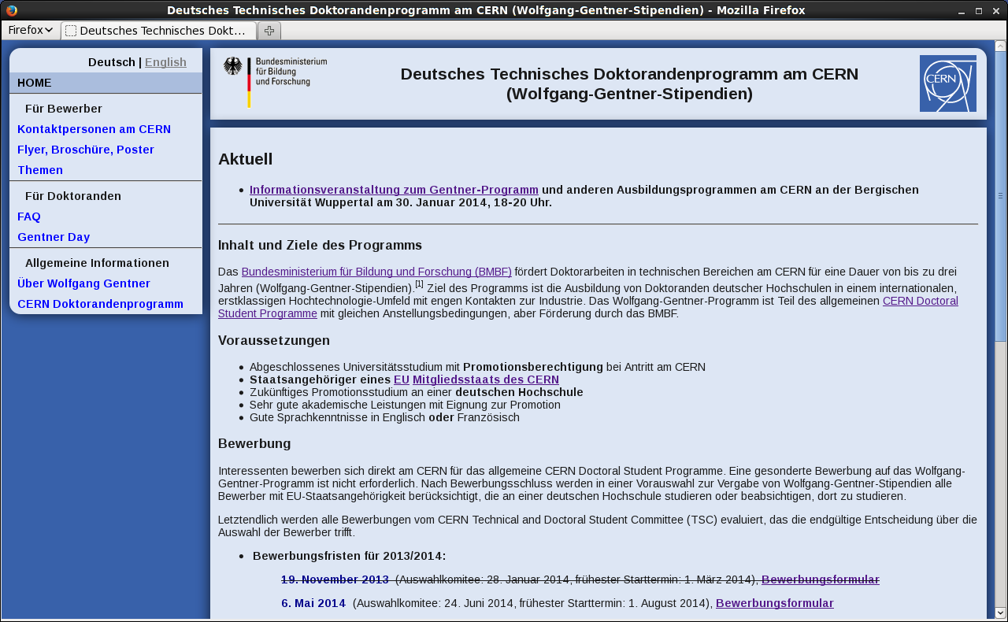
Webseite
https://cern.ch/wolfgang-gentner-stipendien/
Informationen auf Deutsch und auf Englisch

