Slide 1
Status of test kit
J. Dopke, T. Huffman, J. J. John, M. Stanitzki with help from many others

Slide 2
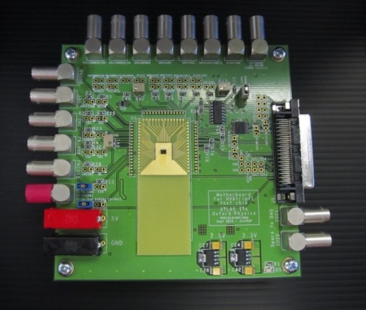
HVStripV1 hardware
Current status
Motherboard for IHEP (Beijing) being tested today; Motherboard for KIT will be tested tomorrow.
4 more motherboards built in Oxford, now at RAL for wire-bonding to daughterboards
1 of these new ones is for Cambridge
Build of more motherboards
Panelised and added ground pins for ease of testing
Artwork to be reviewed tonight, then sent for quoting
Available ~mid-January if we use 10-day turnaround
More daughterboards
Added solder mask to Cu/FR4 daughterboards to minimise gold
Added mounting holes to ease transport
Artwork to be reviewed tonight, then sent for quoting
Also ~mid-January if we use 10-day turnaround

Slide 3
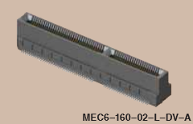
CHESS test boards
Spec tomorrow
~120 pins needed to support both HV and HR daughterboards
Proposing keyed edge connector instead
Same quality as Samtec “FTSH” connectors used for ABC130 testing, from specs
possible cut line for E-TCT (for HV CHESS d/b)
CHESS test chip
Edge connector
CHESS motherboard – for both HV and HR daughterboards

