Slide 1
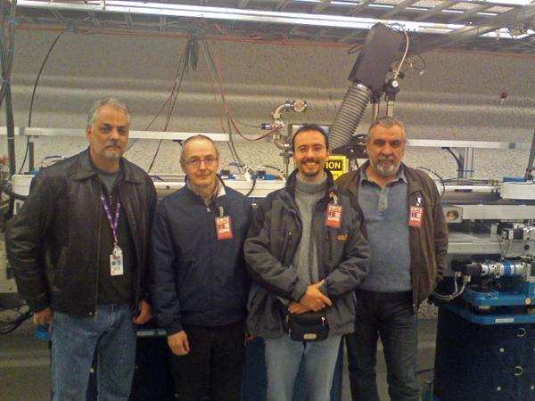
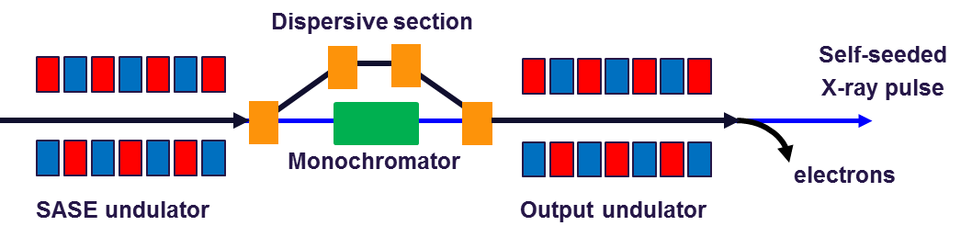
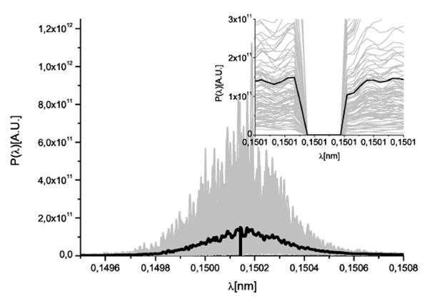
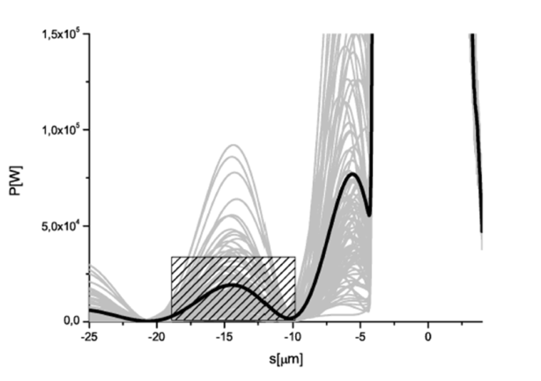
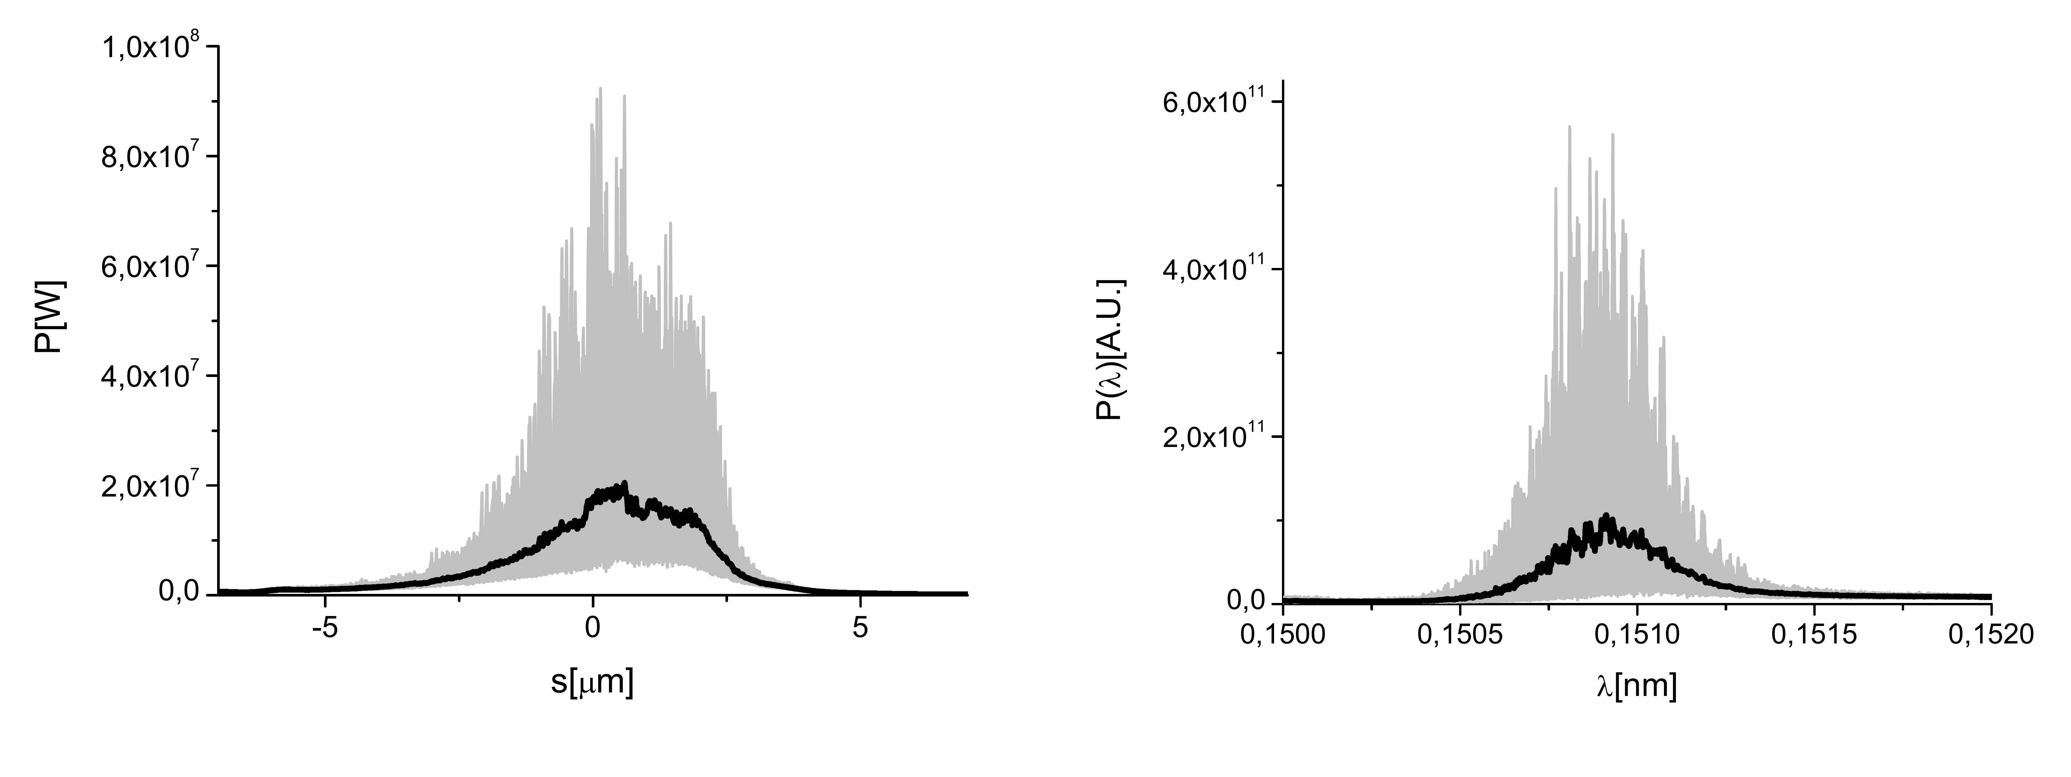
Self Seeding

Slide 2
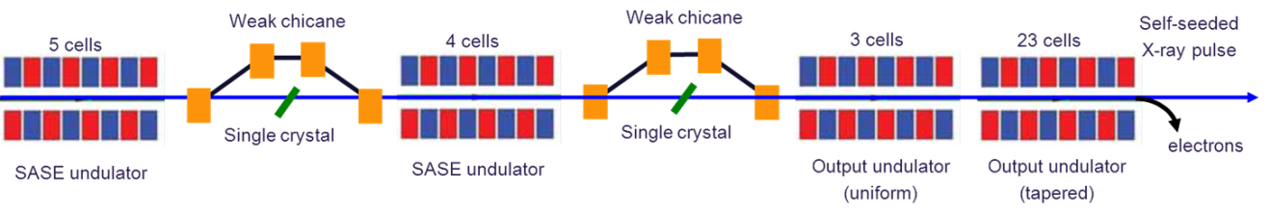
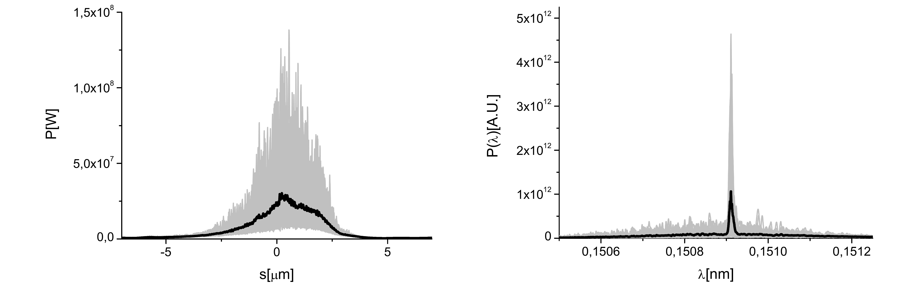
European XFEL: Double Chicane

Slide 3
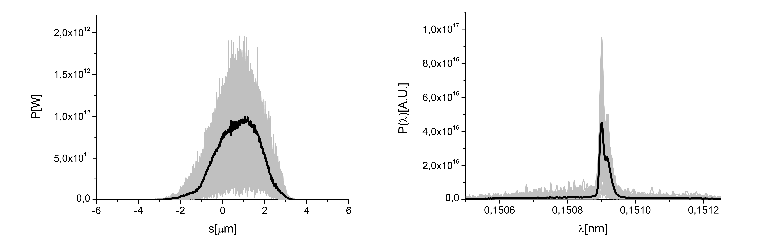
European XFEL: Double Chicane

Slide 4
European XFEL: Double Chicane
 | Chicane 1 (Segment 4,5,6,7) | Chicane 2 (Segment 11,12,13)
SASE1 (TD2) | U40.2256.SA1 to U40.2275.SA1 2256 to 2275 m | U40.2299.SA1 to U40.2311.SA1 2299 to 2311 m
SASE2 (TD1) | U40.2218.SA2 to U40.2237.SA2 2218 to 2237 m | U40.2261.SA2 to U40.2273.SA2 2261 to 2273 m

Slide 5
  Courtesy Paul Emma

Slide 6
  Courtesy Paul Emma

Slide 7
  Courtesy Paul Emma

Slide 8
XFELSEED at European XFEL
Collaboration between
  Technological Institute for Superhard and Novel Carbon Materials (TISNUM), Troitsk
  DESY
  European XFEL GmbH
Jointly funded by
  BMBF (1 MEuro -> DESY)
  Russian Science Ministry (50 MRuble => TISNUM)
Not part of the XFEL construction project
Only 2 chicanes funded in total (i.e. either SA1 and SA2)

Slide 9
XFEL SEED Organisation
Electron System (DESY) |  |  | Photon System (TISNUM)
W. Decking | G. Geloni | H. Sinn | V. Blank
Electron beam vacuum, magnet chicane, support structure, system integration | Theory and Simulations | Engineering support, system integration support | Monochromator crystals, monochromator chamber

Slide 10
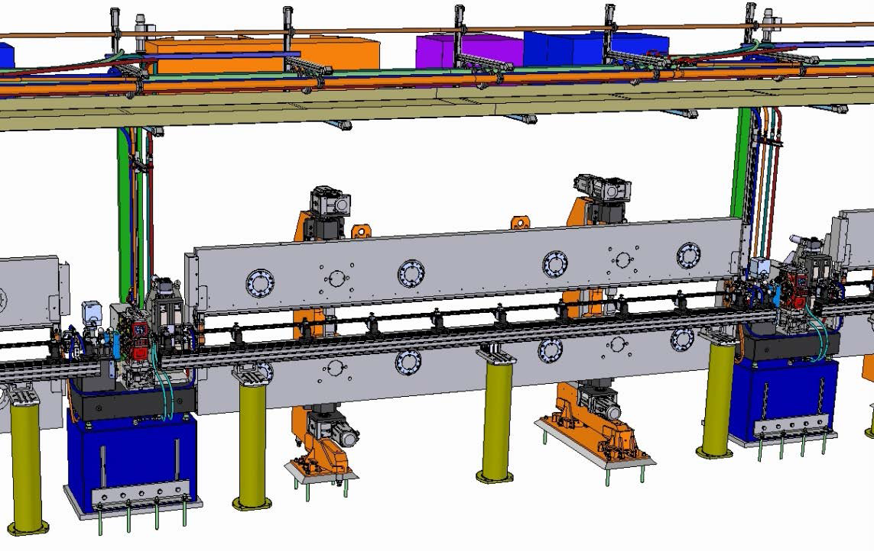
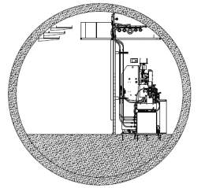
Self-Seeding Implementation
Technical Issues – Chicane
  Define size of monochromator chamber => defines size of chicane and delay-reach
  Design complete set-up to fit on one girder to be able to move in/out easily
  Fit into space constrains given by clima-chamber
Notes:
Before you start editing the slides of your talk change to the Master Slide view:
Menu button “View”, Master, Slide Master:
Edit the following 2 items in the 1st slide:
1) 1st row in the violet header:
Delete the existent text and write the title of your talk into this text field
2) The 2 rows in the footer area: Delete the text and write the information
regarding your talk (same as on the Title Slide) into this text field.
If you want to use more partner logos position them left
beside the DESY logo in the footer area
Close Master View

Slide 11
Self-Seeding Implementation
Technical Issues – Chicane
  Define size of monochromator chamber => defines size of chicane and delay-reach
  Design complete set-up to fit on one girder to be able to move in/out easily
  Fit into space constrains given by clima-chamber
Notes:
Before you start editing the slides of your talk change to the Master Slide view:
Menu button “View”, Master, Slide Master:
Edit the following 2 items in the 1st slide:
1) 1st row in the violet header:
Delete the existent text and write the title of your talk into this text field
2) The 2 rows in the footer area: Delete the text and write the information
regarding your talk (same as on the Title Slide) into this text field.
If you want to use more partner logos position them left
beside the DESY logo in the footer area
Close Master View

Slide 12
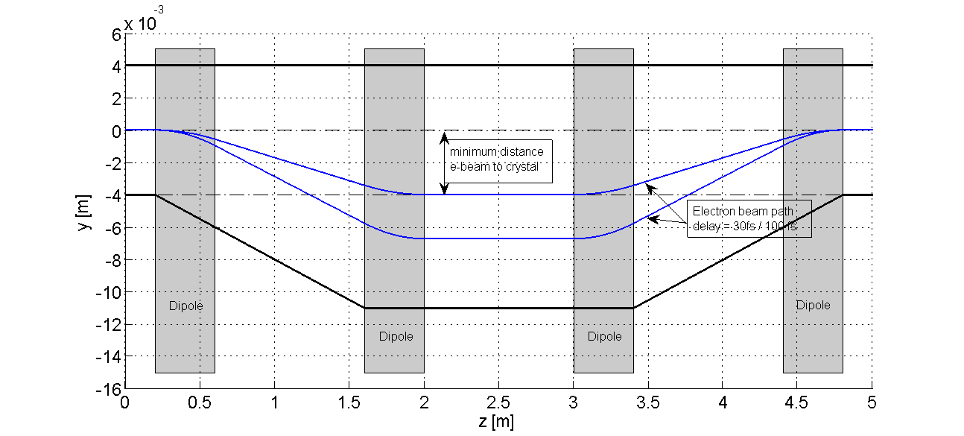
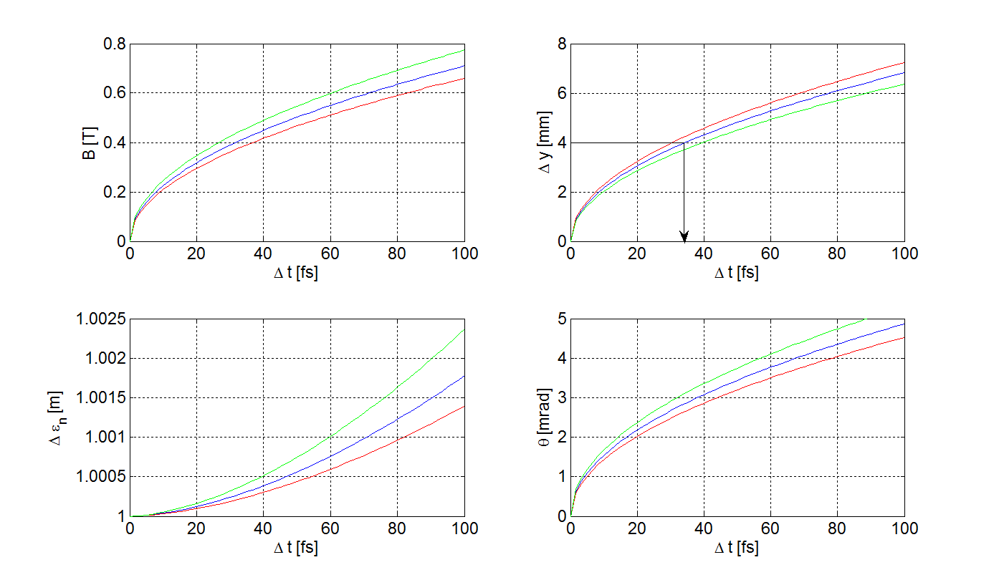
Self-Seeding Implementation
Technical Issues – Chicane – Minimum Delay

Slide 13
Self-Seeding Implementation
Technical Issues – Vacuum System
  Find solution for phase-shifter chamber
  Design dipole/chicane chamber
  Foresee spare piece for monochchromator
Notes:
Before you start editing the slides of your talk change to the Master Slide view:
Menu button “View”, Master, Slide Master:
Edit the following 2 items in the 1st slide:
1) 1st row in the violet header:
Delete the existent text and write the title of your talk into this text field
2) The 2 rows in the footer area: Delete the text and write the information
regarding your talk (same as on the Title Slide) into this text field.
If you want to use more partner logos position them left
beside the DESY logo in the footer area
Close Master View

Slide 14
Self-Seeding Implementation
Technical Issues – Magnet System
  Per chicane:
  Cable and PS:
    1x 200A/60 V
    4 x 10 A / 1V
  About 10 kW additional cooling
Primary Winding
Gap | 16 mm
Max. Field | 1.45 T
Max. Current | 190 A
Volt. Drop | 10 V
Power Loss | 2 kW
Secondary Winding
Max. Field | 0.03 T
Max. Current | 10 A
Volt. Drop | 1 V
Example, no final design exists yet
Notes:
Before you start editing the slides of your talk change to the Master Slide view:
Menu button “View”, Master, Slide Master:
Edit the following 2 items in the 1st slide:
1) 1st row in the violet header:
Delete the existent text and write the title of your talk into this text field
2) The 2 rows in the footer area: Delete the text and write the information
regarding your talk (same as on the Title Slide) into this text field.
If you want to use more partner logos position them left
beside the DESY logo in the footer area
Close Master View

Slide 15
Next Steps
Establish collaboration ✓
Decide which SASE beam line -> SASE 2 preferred
Define/hire personnel
Define urgently needed infrastructure requirements/interfaces/boundaries
  Length of monochromator ✓
  Magnet cabling and power consumption
  Other infrastructure requirements

