Slide 1
Status of test kit
6 Jan 2015
J. Dopke, T. Huffman, J. J. John, M. Stanitzki
with help from many others

Slide 2
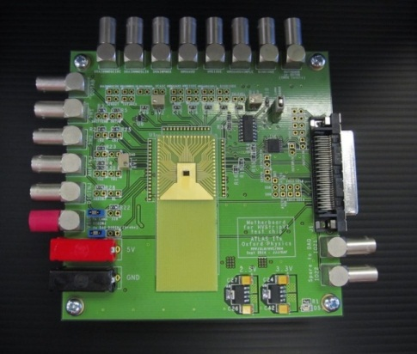
HVStripV1 hardware
Current status
  Motherboard for IHEP (Beijing) carried by hand
  Motherboard for KIT tested and ready to ship
  4 motherboards at RAL for wire-bonding to daughterboards
  (1 of these new ones is for Cambridge)
Build of more motherboards
  Artwork reviewed and completed; quoting at the moment
More daughterboards
  Artwork reviewed and completed; quoting at the moment

Slide 3
CHESS test boards
Sent Test Board Spec v0.1 to many of the regular participants on 9 December
Not much feedback so far – would be appreciated!
Spec attached to this week’s Indico page: https://indico.desy.de/conferenceDisplay.py?confId=11494
A few of us had a review at very short notice yesterday with Renato and Dipayan about HR CHESS aspects, very useful
Would it be useful to schedule a walk-through with the team at UCSC and SLAC?
Present status: working on CAD components needed for schematics and layout

Slide 4
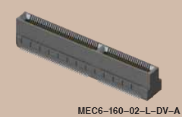
Reminder of concept
~120 pins needed to support both HV and HR daughterboards
Proposing keyed edge connector instead
Same quality as Samtec “FTSH” connectors used for ABC130 testing, from specs
Connector has a variant to lay daughterboard parallel to
motherboard
possible cut line for E-TCT (for HV CHESS d/b)
CHESS test chip
Edge connector
CHESS motherboard
– for both HV and HR daughterboards

