Slide 1
Commissioning Strategy
Commissioning and Operations Meeting
14.1.2015
Winni Decking, DESY
Thomas Tschentscher, European XFEL
Notes:
Before you start editing the slides of your talk change to the Master Slide view:
Menu button “View”, Master, Slide Master:
Edit the following 2 items in the 1st slide:
1) 1st row in the violet header:
Delete the existent text and write the title of your talk into this text field
2) The 2 rows in the footer area: Delete the text and write the information
regarding your talk (same as on the Title Slide) into this text field.
If you want to use more partner logos position them left
beside the DESY logo in the footer area
Close Master View

Slide 2
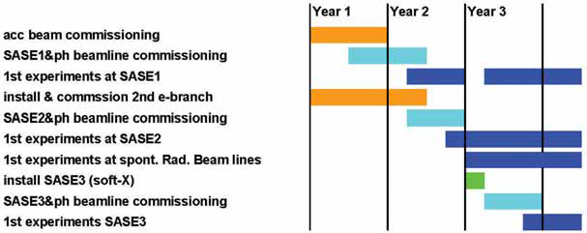
Commissioning Scenario TDR 2005
Sequential approach assuming parallel construction of SASE2 branch
15 month from start of beam commissioning to first experiment

Slide 3
Next steps - Some history
Commissioning plan in TDR (2005)
Formation of commissioning steering group in 2011
Meeting series of commissioning group 2011/2012 to define strategy and basic milestones (https://indico.desy.de/categoryDisplay.py?categId=283)
Definition of global project milestones included commissioning milestones (https://www.xfel.eu/project/construction_milestones)
Questionnaire to WPs to define commissioning needs and time in 2013
Discussion of commissioning scenarios during 2014 collaboration meeting in dedicated session (https://indico.desy.de/conferenceDisplay.py?confId=9269)
Strategy presented and reviewed in MAC and SAC meetings 2013 and 2014
‘Fast track’ scenario presented in project meeting June 2014

Slide 4
From commissioning to operation
Commissioning aims
  Commissioning of electron beam to generate hard x-ray SASE FEL radiation as soon as possible
  Commissioning of x-ray instrumentation to launch early user program
  Continue development of e⁻-beam and instruments for ~1 ½ yrs to reach extended electron and x-ray beam delivery
Early user operation
  Starts 14 weeks after first SASE and includes all instruments after 7.5 months
Full user program
  Provide full number of user hours when reaching the milestone of extended electron and x-ray beam delivery

Slide 5
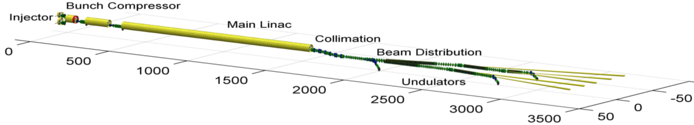

Beam Commissioning Schedule
2014
2015
2016
2017
2018
First e-beam out of RF gun installed at XFEL
Injector cooldown
Linac cooldown
SA1
SA3
SA2
Start user operation
Full TDR performance
1st lasing possible
e⁻
Gun and injector laser com.
Injector com. up to full XFEL performance (varying charges and bunch patterns, laser heater, slice diagnostics, intra-train feedbacks, automated procedures)
Initial linac com. with reduced performance
Continued accelerator com. to full performance (high beam power, bunch length flexibility, multiple bunch properties per rf-pulse, full wavelength tuneability, ….)
γ
Beam line and experiment com.
. First user operation

Slide 6
Team
Coordination
Accelerator and Photon System Specialists (i.e. M- and XFEL-groups)
  organize on call duty
  organize full shift participation as needed
  organize and run development shifts
Experiment Specialists
Infrastructure, utilities, administration, …
Combined DESY/European XFEL GmbH about 500 FTE
24/7 coverage
Accelerator Control Room (BKR):
  Shift leader (1)
  Operators for PETRA and FLASH (3)
  Operators for power/clima/water on DESY site (2)
  Cryo-plant operator (1)
  Operator and Accelerator Physicist for XFEL (2)
  Additional specialists according to program needs
Photon System (Diagnostics, Beam Line, Experiment)

Slide 7
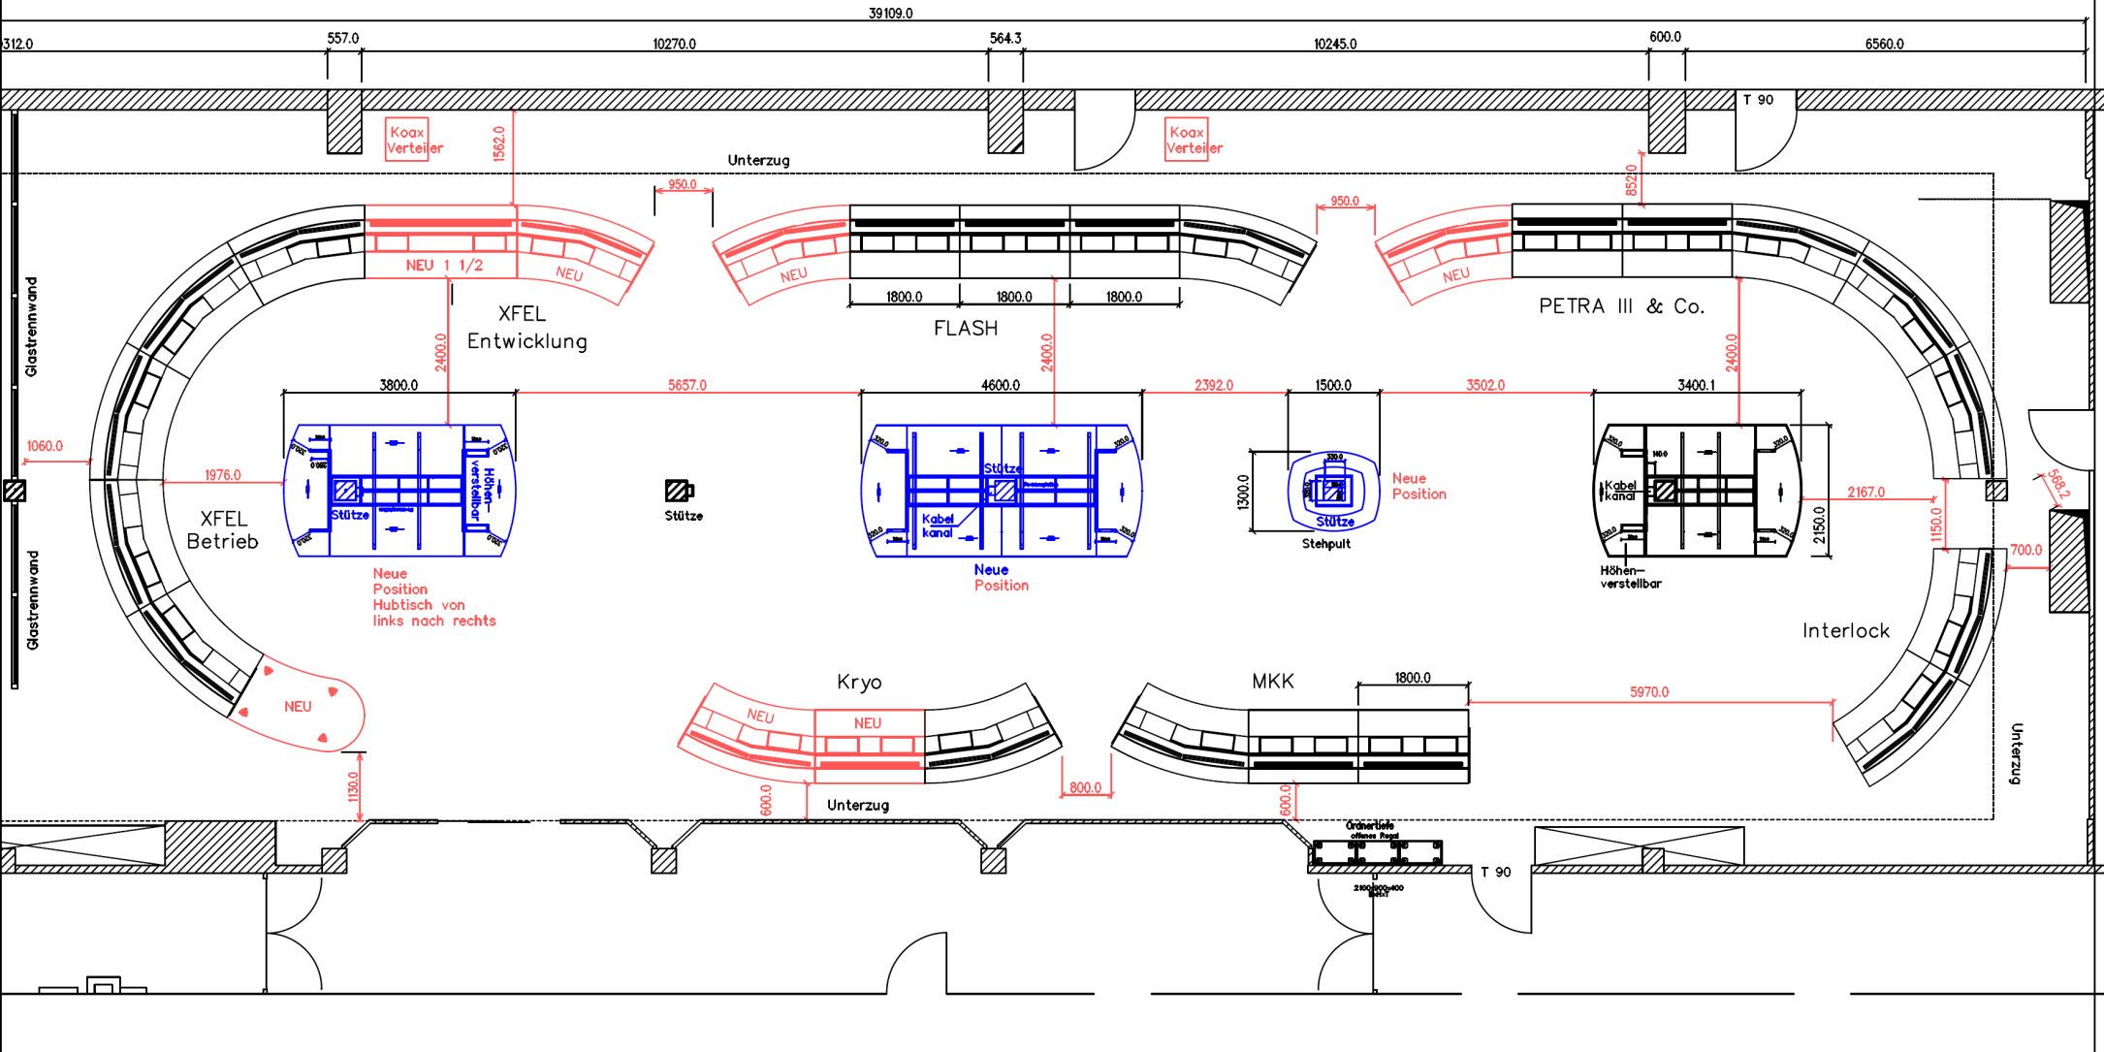
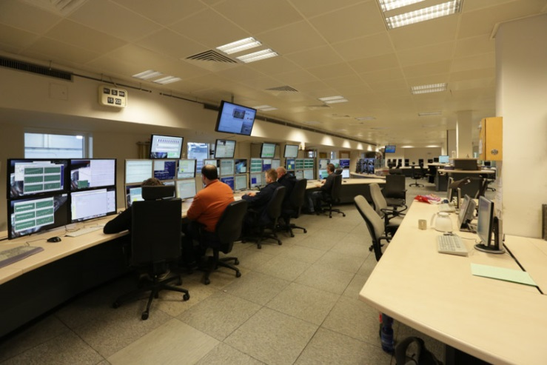
Photon systems initial commissioning from DESY BKR possible
Possibility for joined operation at Schenefeld site (?)

Slide 8
Beam Commissioning Schedule
2015
2016
2017
2018
Injector cooldown
e⁻
Injector com. up to full XFEL performance (varying charges and bunch patterns, laser heater, slice diagnostics, intra-train feedbacks, automated procedures)
γ

Slide 9
Injector Commissioning: Goal(s)
Achieve all XFEL parameters
Commission sub-components like LLRF, laser-heater, standard diagnostics, special diagnostics, …
Establish routine operation with all necessary procedures, software, …
‘Teambuilding’
Time available for tests, detours, „trial and error“, …
Quantity | Value
macro pulse repetition rate | 10 Hz
RF pulse length (useable flat top) | 600 μs
bunch repetition frequency within pulse | 4.5 MHz
bunch charge | 0.02 – 1 nC
Slice emittance (req. 60 MV/m gun gradient) | 0.4 - 1.0 mm mrad

Slide 10
Injector Commissioning Schedule
10
See more detailed presentation 25.02

Slide 11
Beam Commissioning Schedule
2014
2015
2016
2017
2018
Linac cooldown
SA1
SA3
SA2
Start user operation
Full TDR performance
1st lasing possible
e⁻
Initial linac com. with reduced performance
Continued accelerator com. to full performance (high beam power, bunch length flexibility, multiple bunch properties per rf-pulse, full wavelength tuneability, ….)
γ
Beam line and experiment com.
. First user operation

Slide 12
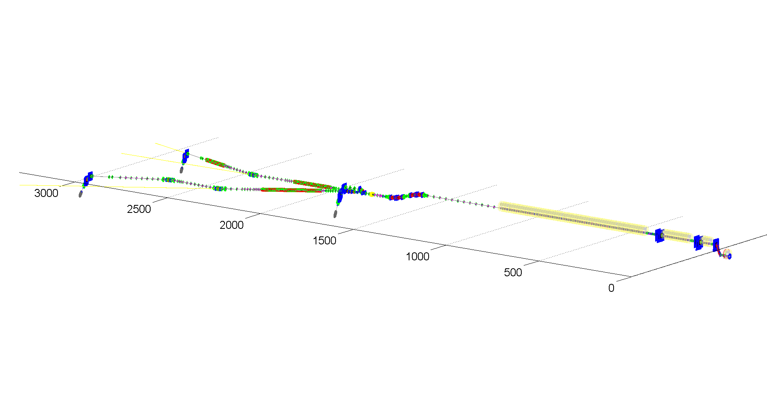
Initial Commissioning
5
injector dump
130 MeV
max. beam power (12 kW)
6
main beam dumps
up to 20 GeV
1/2 max beam power (300 kW)
4
bunch compressor diagnostic dumps
0.5 and 2.5 GeV
small fraction of max. beam power
3
2
1
Goal: Enable first lasing and user operation as soon as possible
Focus on essential functionality of systems
Restrict parameter space
Good planning with clear intermediate goals

Slide 13
Initial E-beam parameters
Quantity | Value
electron energy | 8/12.5/14/17.5 GeV
macro pulse repetition rate | 10 Hz
RF pulse length (flat top) | 600 μs
bunch repetition frequency within pulse | 4.5 MHz 100 kHz
bunch charge | 0.02 – 1 nC 0.5 nC
electron bunch length after compression (FWHM) | 2 – 180 fs 90 fs
Slice emittance | 0.4 - 1.0 mm mrad
beam power | 500 kW 5 kW
(relates to gun RF power)
beam charge around 0.5 nC good for diagnostics and LLRF
Linac operation with several tens of bunches
  single bunch operation is useless for LLRF diagnostics and studies
  many bunch operation is more demanding for machine protection

Slide 14
Initial e-beam parameters – Bunch Repetition
Linac will be operated with several tens of bunches (not single bunch) as fast as possible
RF pulse length can be varied
Initially possible repetition rates (injector laser)
Many bunches make European XFEL unique
  Should be established as soon as possible
  But puts burden on machine protection system, detectors, …
n | bunch spacing (n/9 MHz) [ns] | bunch repetition frequency [MHz] | max # of bunches in 600 μs train
2 | 222 | 4.5 | 2700
3 | 333 | 3 | 1800
9 | 1000 | 1 | 600
90 | 10000 | 0.100 | 60
- | - | - | 1

Slide 15
Undulator Sequence and SASE Wavelength
  Commissioning starts with SASE1 and continues with SASE3
  beam line first to be ready
  eases initial e-beam operation
  allows parallel commissioning of SASE1 and SASE3 photon beam lines (although FLASH experience recommends to focus activities on one beam line and commission this fully to benefit from the lessons learned and not double errors)
  if no SASE is reached in SASE1, SASE3 could be put into operation with much looser tolerances to diagnose e-beam parameters
  SASE search should be performed with fully closed gaps
  Alternative (WP71): Use tuning gaps with lowest errors (SASE1/2 14mm, K=2.7; SASE3 15mm, K=6.9)

Slide 16
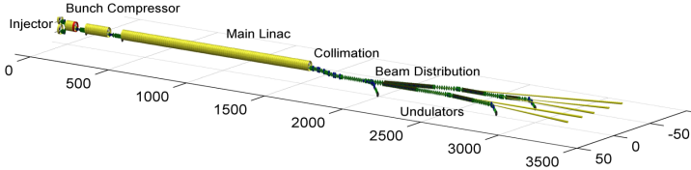
Initial Commissioning: fast track to first lasing
First lasing possible 6 month after tunnel closure with no margin
Any sub-system failure, maintenance, holiday, … will add
First experiment planed for 04/2017 – 7 month after start of beam commissioning (compare with 15 month from TDR)
Note: Duration in working days, i.e. 5 days=1 week, 20 days=1 month

Slide 17
First User Operation
One charge, one electron energy
Single bunch to 100 kHz (under discussion)
first SASE-photons as soon as possible to allow commissioning of photon beam lines and experiments
Approx. 1000 user hours in 2017, serving one undulator a time
“Conditions for 'First User Experiments'
    experiments can use x-ray beam at TDR performance, but with limited flexibility in terms of pulse pattern, pulse length and photon wavelength”

Slide 18
Ramp-up of experiments
SPB & FXE (SASE1)
  First beam end 2016
  Early user operation from May 2017
SQS & SCS (SASE3)
  First beam Feb 2017
  Early user operation from June 2017
MID & HED (SASE2)
  First beam Apr 2017
  Early user operation from August 2017

Slide 19
Beam Commissioning Schedule
2014
2015
2016
2017
2018
Start user operation
Full TDR performance
e⁻
Continued accelerator com. to full performance (high beam power, bunch length flexibility, multiple bunch properties per rf-pulse, full wavelength tuneability, ….)
γ
Beam line and experiment com.
. First user operation

Slide 20
Overview of e⁻-beam & FEL operation modes
Bunch charge/compression -> X-ray pulse length
20-1000pC -> 2-100 fs
Long. Bunch shape
Electron energy
8.5, 12, 14, 17.5 GeV
±1.5 % fast scanning
Bunch repetition –
X-ray delivery pattern
From pulse-on-demand to 4.5 MHz
Properties on demand – within bunch train
Simultaneous operation
of 3 (5) experiments
Special
Seeding
Tapering
Variable Polarization
Mulit-color
Instrument can determine
  Exact photon energy
  Focus size
  Bandwidth

Slide 21
Quasi-simultaneous operation of SASEs
Dedicate & distribute electron bunches to instruments
  Operate accelerator as continous as possible
    → stability / performance
  Distribute electron bunch train on two lines
    → 10 Hz switch (few µs duration)
  Switch on/off lasing for SASE 1/ SASE 3 line (optional)
    → 4.5 MHz switches
  Determine exact bunch pattern
    → 4.5 MHz switch
On trajectory → lases
Off trajectory → only SR
Electron bunch distribution : 27.000 bunches/sec to 3 (5) beamlines; in average 10-20 Hz and ~800 (500) pulses/train;
using kicking methods to make bunches lase only in dedicated undulator

Slide 22
A year at European XFEL
Annual operation
  4800 hrs accelerator operation for generation of x-rays
    Peer-reviewed proposals [4000 hrs]
    Internal activities [800 hrs]
      Maintenance
      R&D program & management contingency
  ~5600 hrs total accelerator operation
    Dedicated accelerator time [800 hrs]
      Maintenance (w. beam, short access) & tuning
      R&D
User experiments
  12000 hrs user time by operation of three instruments in parallel
  ~200 user experiments / year
Steady-state
operation !

Slide 23
Operating two instruments per SASE beamline
Concept
  Typical slot 5 days; start/end on machine day
  Share day with two 12 hrs shifts
  Setup /changes on machine days
  Major modifications during shutdown weeks
Optimized instrumentation
  dedicated setups
  possibility to swap entire setups (chambers or interior)
  install as many as possible instrumentation permanent
  simplify experiment setup for varying parameters
Example of 4 week slot at any instrument
Day shift (12 hrs; e.g. 10-22 hrs)
Night shift (12 hrs; e.g. 22-10 hrs)

Slide 24
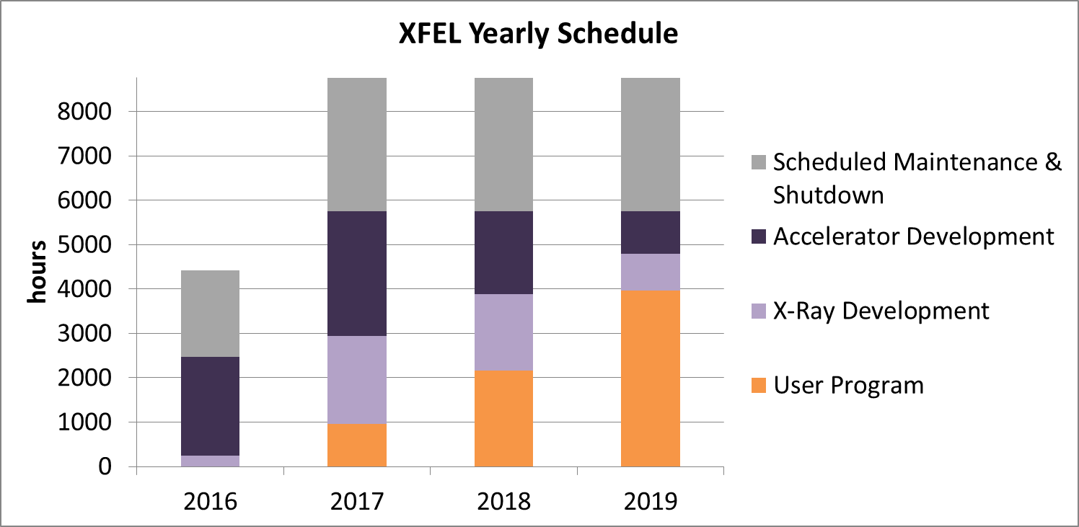
Development of beam time 2016-2017

Slide 25
Summary
High expectations in XFEL commissioning both for speed and success
Stepwise approach with parallel commissioning as soon as possible
Clear goal definition for each commissioning step
Strategy is laid out
Plan towards first lasing sketched
Parallel commissioning/development/first user experiments afterwards requires excellent communication and coordination
Some choices can only be made once operation experience exists

