Slide 1
CHESS2 architectural

Slide 2
Architecture proposal
Engineering run
3 parts – one of which dedicated to CHESS
Various substrate resistivity up to 1000Ω/☐
Design effort shared between SLAC and UCSC
Submission target: end of february

Slide 3
Architecture
Read first hit per strip + flag in case of additional hit [5+1 bit]
Read 8 hits per group of 128 strips [7 bit]
LVDS readout at 320MHz on 5+1+7 = 13 pairs

Slide 4
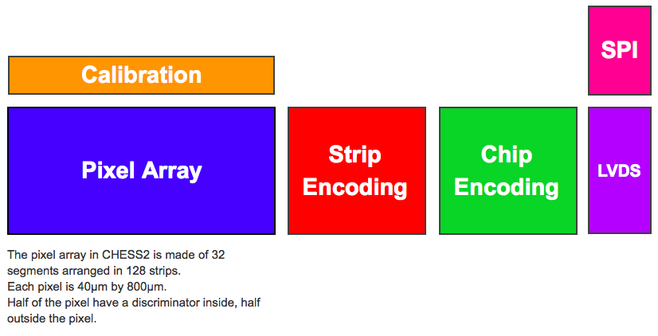
Architecture

Slide 5
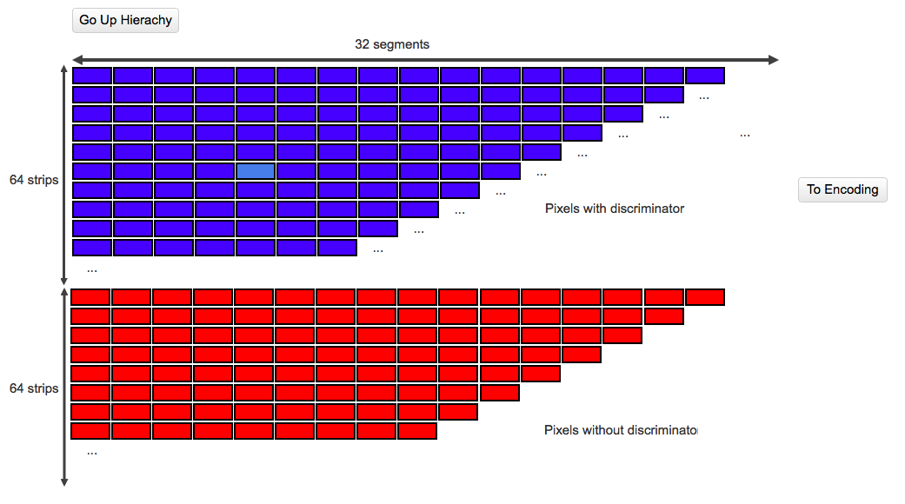
Pixel array

Slide 6
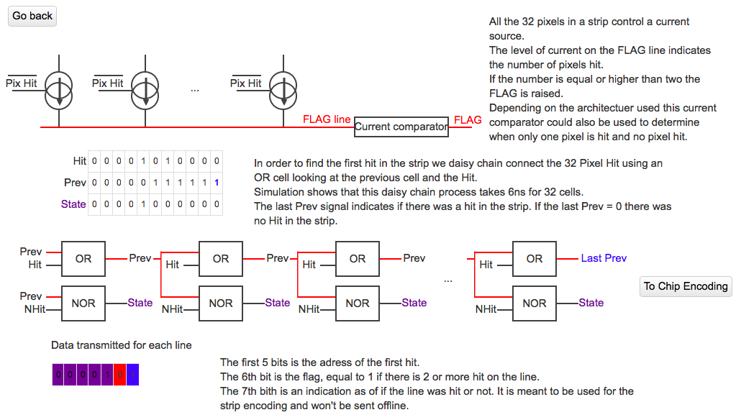
Strip encoding

Slide 7
Strip encoding – based on I. Peric strixel idea
000
+
Sum strips in groups of 8
Propagate the intermediate sum + carry
Latch in memory the sum for each group of 8 added with the intermediate sum
Multiplex addresses 000 to 111 to the output bus.
Time multiplex this stage will be necessary.
1
000
0
0
0
1
001
0
sum
010
+
1
+
010
0
0
0
1
011
0
sum
100

Slide 8
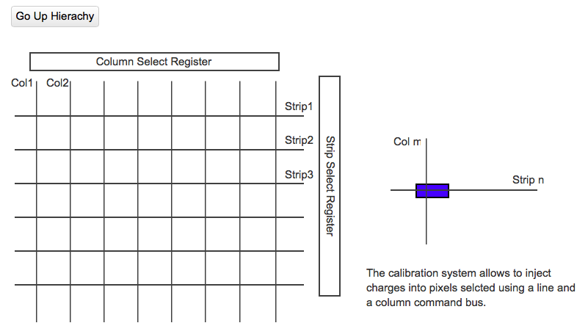
Charge Injection

Slide 9
Conclusion
Active pixel layout to be copied from CHESS1
Design of the strip encoding simulated and validated
Design of 320MHz LVDS validated
Design of 128 lines encoding to be tested
Design of pixel discriminator to be done based on I. Peric’s

