Slide 1
Data Life Cycle Lab Earth and Environment
LSDMA All-Hands Meeting Mar 25, 2015
Marek Szuba, Jörg Meyer

Slide 2
The Team
DKRZ
Carsten Ehbrecht
Stephan Kindermann
Michael Lautenschlager
KIT
Parinaz Ameri
Uğur Çayoğlu: will start his PhD in August 2015
Ahmad Maatouki: defended his Master thesis end of January 2015
Jörg Meyer
Marek Szuba

Slide 3
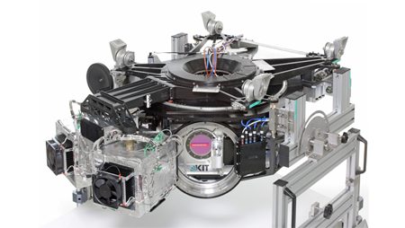
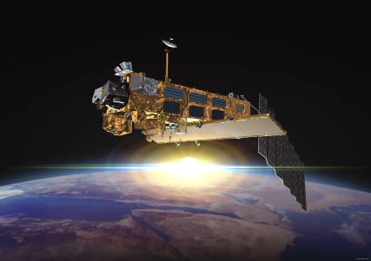
Services for Climate Research
GLORIA
MongoDB infrastructure on LSDF (7TB)
campaign will start in spring 2015
replication/redundancy required
Satellite data
MongoDB with metadata (geolocations) of 22 instruments
improved geo-matcher
EUDAT B2SAFE
Safe replication of ENES data
iRODs + PIDs (EPIC-handles)

Slide 4
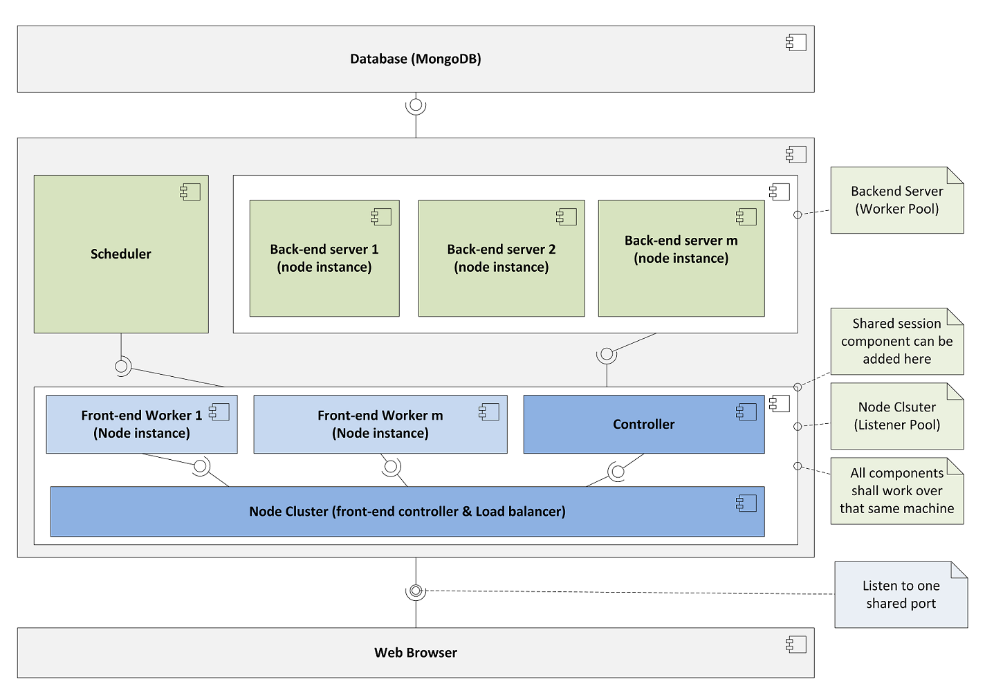
Satellite data – Scalable oriented cluster library for Node.js
Web service API for MongoDB and predefined use cases
parallel preprocessing of MongoDB data
implementation complete
to be published in 2015

Slide 5
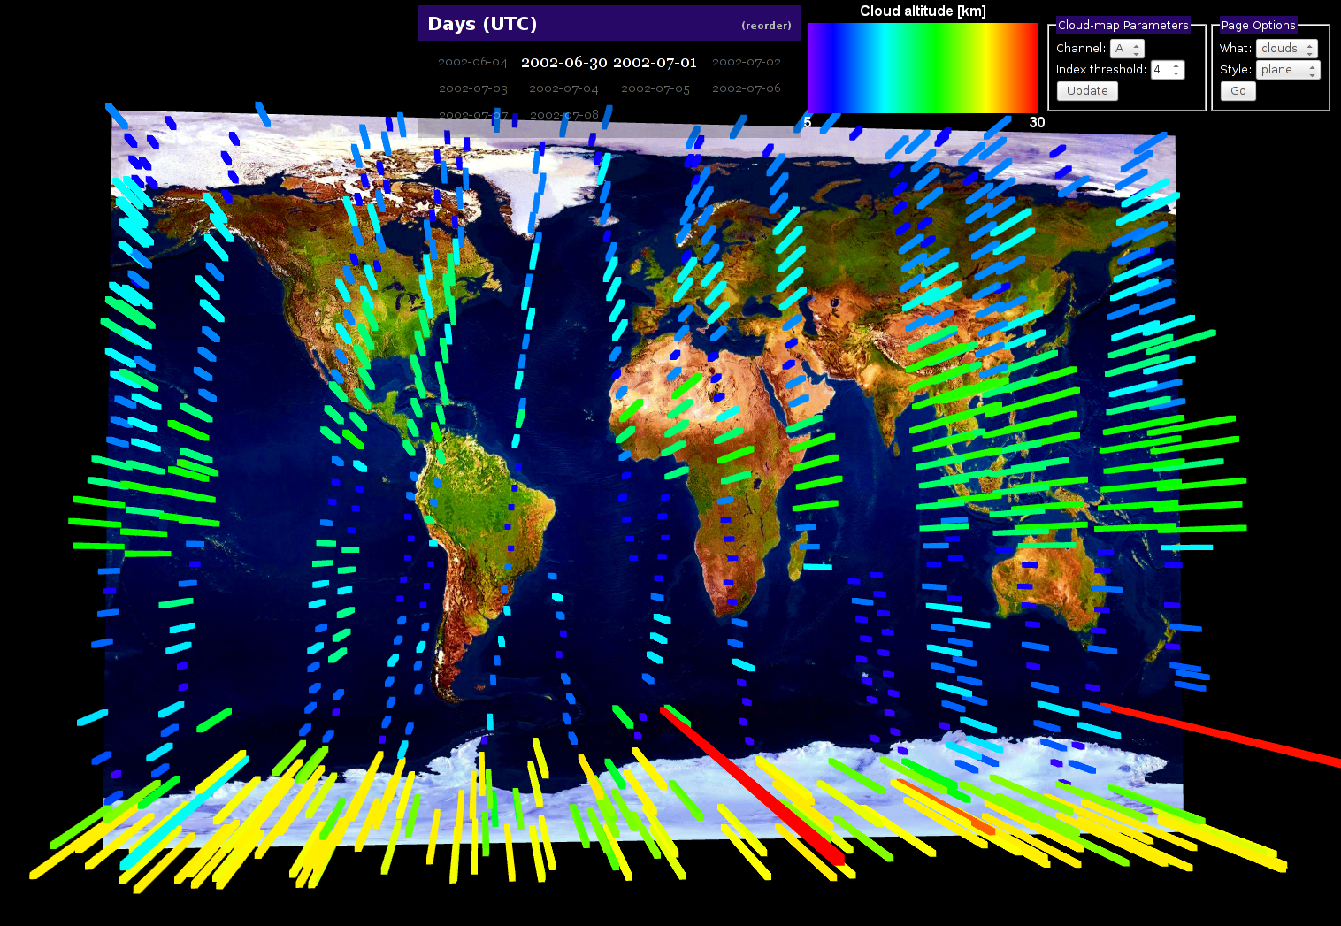
Real-time 3D Visualization of Earth-observing-satellite Data
Visualization of climate data with web browser application
Access to input data from MongoDB (via scalable Node.js cluster)
uses WebGL
to be presented at
European Geoscience
Union 2015

Slide 6
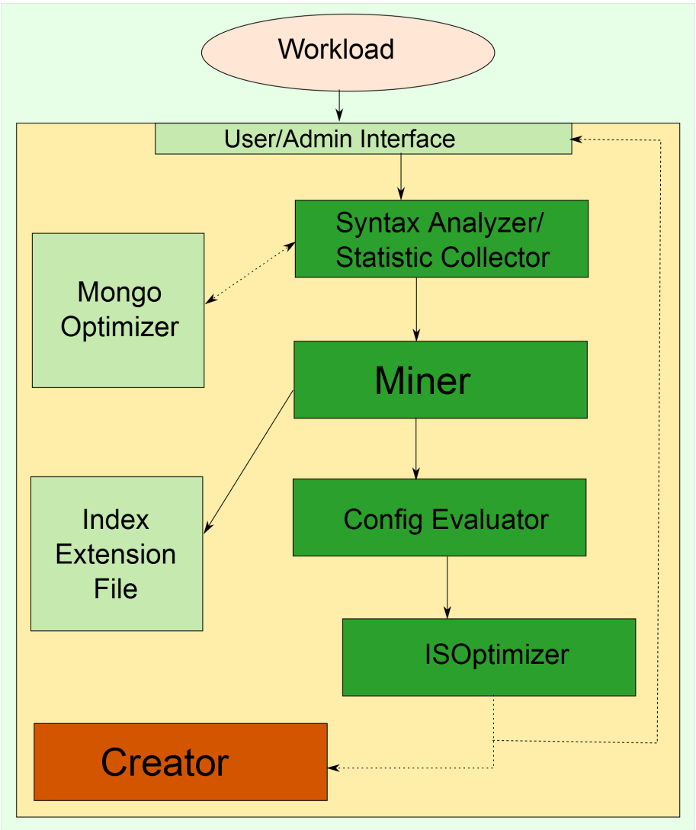
Index Selection Tool
Motivation:
Index selection problem
Database with n=10 fields:
4,268,523,260 possible indexes
(∑ (2^{k}) n! / (n-k)!)
Investigated for RDMS
Goal:
automatic creation of indexes for
MongoDB (schema free NoSQL DB)
dynamically adopt to changes in
usage pattern
climate data db as real-world use-case

Slide 7
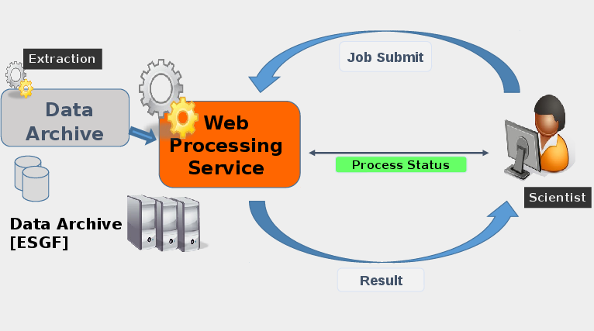
Geospatial data life cycle framework
Birdhouse
Birdhouse: Web Processing Services for climate data
code: https://github.com/bird-house doc: http://bird-house.github.io/
based on:
Malleefowl: base processes and mandatory in a bird-house
Emu: a few test cases to try out
Hummingbird: provides CDOs and CFChecker as a service
Flyingpigeon: a collection of processes useful for the impact community
Phoenix: the simple web browser application for WPS
Recent improvements:
New processes: - extract coordinates: generate time series out of gridded data for given geographic coordinates. - analog days: detection of days with analog surface pressure patterns. based on NCEP data. - CFChecker: checks NetCDF metadata compliance according to Climate and Forecast (CF) conventions.
Climate indices: - Several realizations of the simple (one variable) indices from ocgis/icclim.
Data Access: - to avoid time consuming transports of data, first realizations have been tested to connect a Birdhouse WPS directly to the ESGF data archive.
Deployment: WPS services available as Docker images, using Anaconda Scientific Python Distribution for dependencies.

Slide 8
Meta Data Catalogues and Quality
Catalogue for climate data (observations and simulations)
Collaboration: DLCL + IMK + Simlab Climate and Environment
Status: catalogue for simulation data (SimLab); needs to be extended
Automatic checks on meta data quality
correctness of syntax
completeness
consistency
compliance with conventions
correctness of semantic (community specific)
Collaboration: DLCL Earth and Environment (DKRZ + KIT) +
DLCL Key Technologies + DSIT + (RDA, EUDAT2020)
Status: first meetings and brain stormings

Slide 9
EUDAT2020
EUDAT2020 Kickoff today
KIT
Scientific communities environments and requirements
survey on data and computing landscapes, environments, and service requirements
DKRZ
B2FIND: meta data catalogue for research data

Slide 10
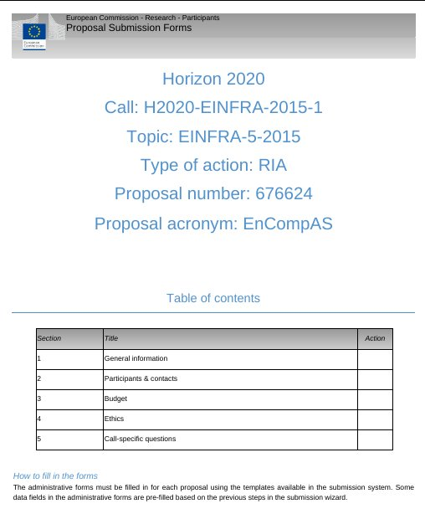
EU-Proposal
Centre of Excellence
for Environmental Application Software
(EnCompAS)
submitted on Jan, 14th
together with
SimLab Climate and Environment

