Slide 1
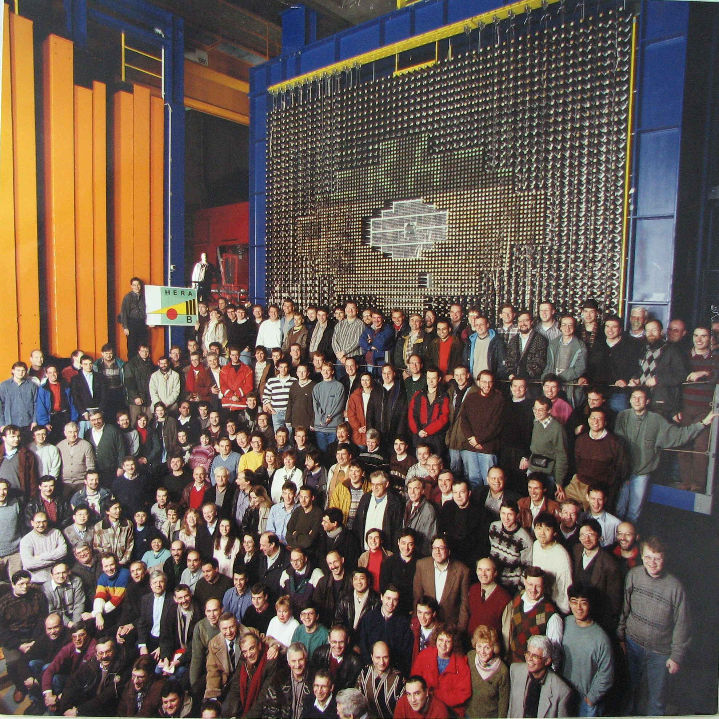

If not CP Violation, what? Disappointment, hope and action
HERA-B, 10 years after
M. Medinnis
DESY
18 February, 2015

Slide 2
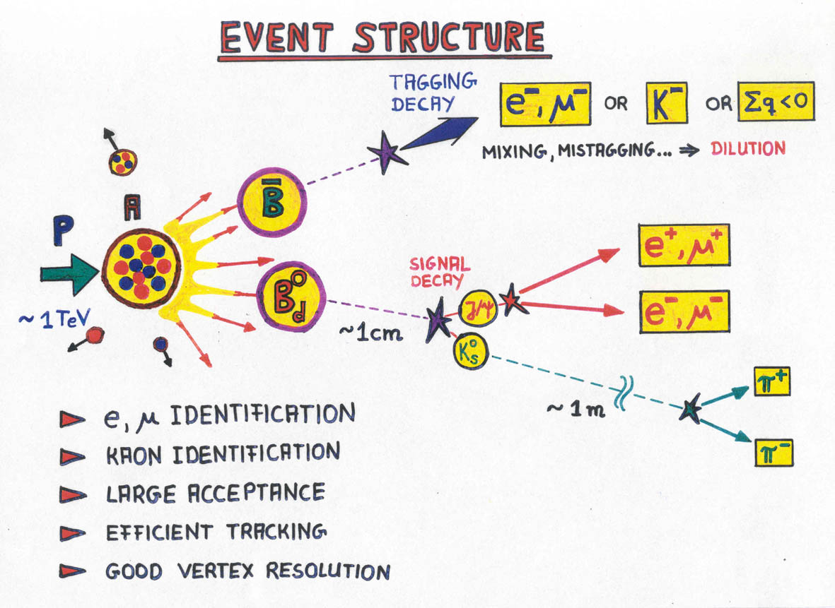
(Slide by Thomas Lohse)

Slide 3
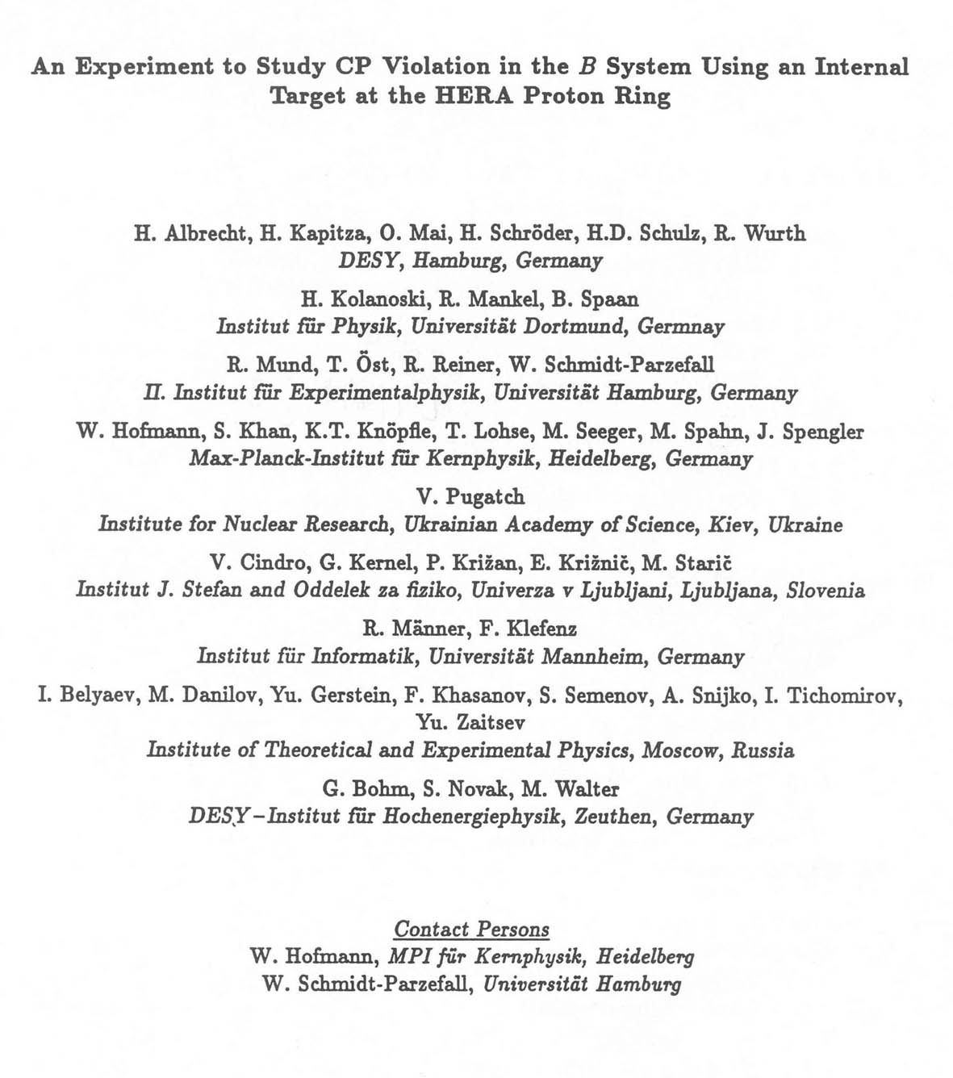
1992
Letter of
Intent
39 Signatures
9 Institutes
The group
crystallized around a
core of several
ARGUS
collaborators.

Slide 4
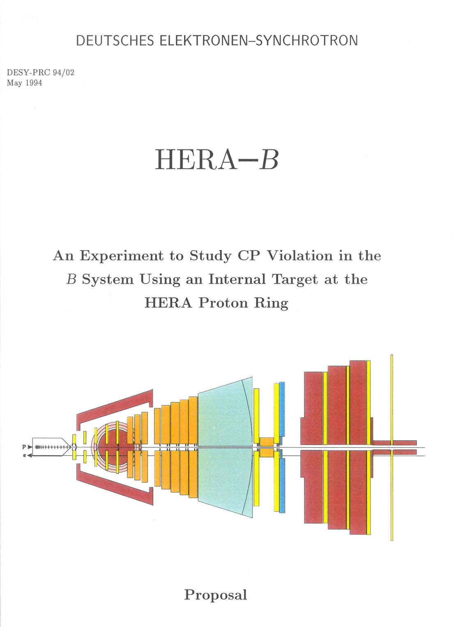
May 1994
(1 year later)
Proposal
98 Signatures
15 Institutes

Slide 5
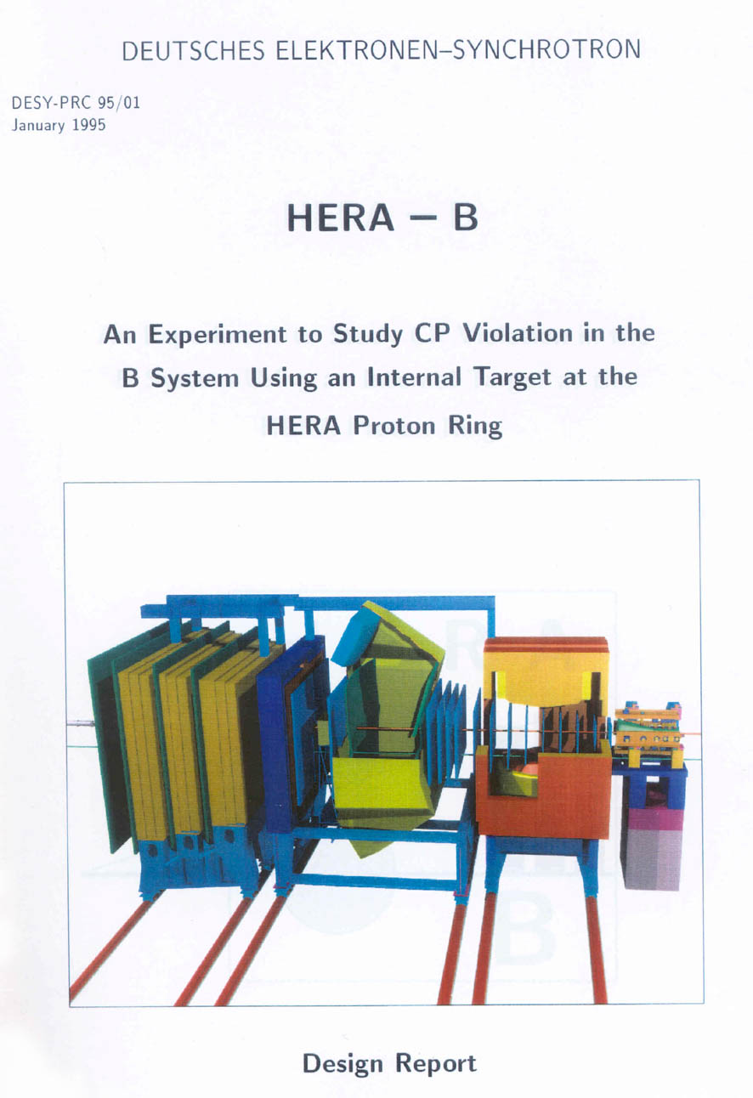
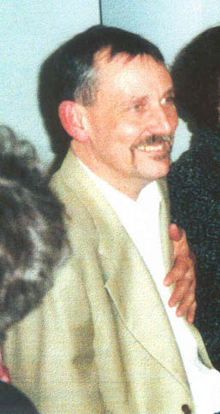
Jan 1995
(9 mo.s later)
Design Report
191 Signatures
29 Institutes
Spokesperson: Andreas Schwarz
Final Approval
Feb 1995

Slide 6
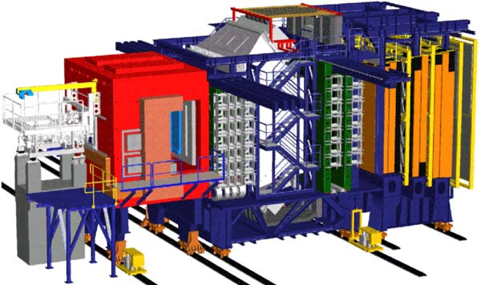
Planned completion date : early 1998
Speed was essential: heavy competition from e+e-

Slide 7
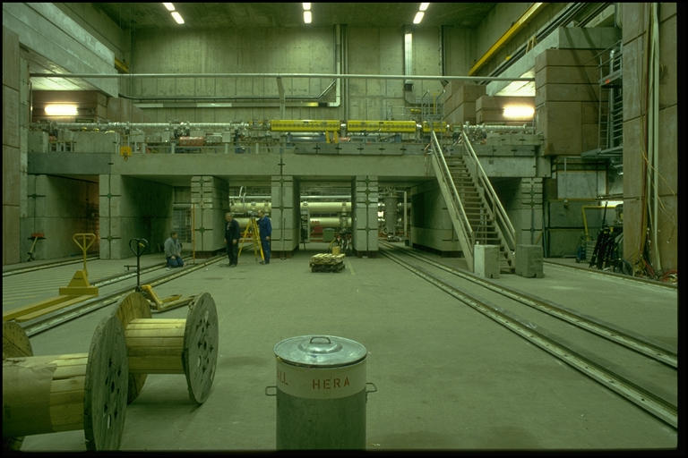
Feb 1995: the Empty West Hall
Three years to fill it with HERA-B!

Slide 8

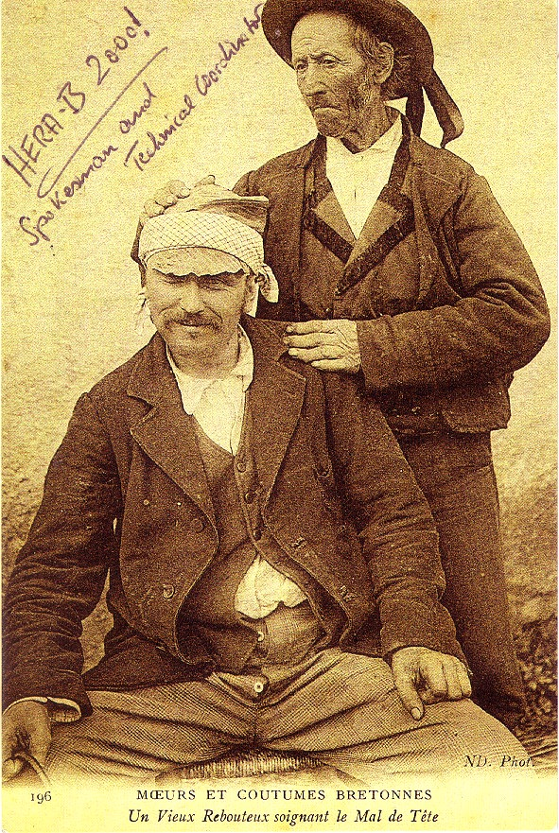
…but something got in the way
The technical coordinator
and spokesperson seem to be
showing signs of rapid aging(?)!
(Warning: the authenticity of this photo has been questioned.)

Slide 9
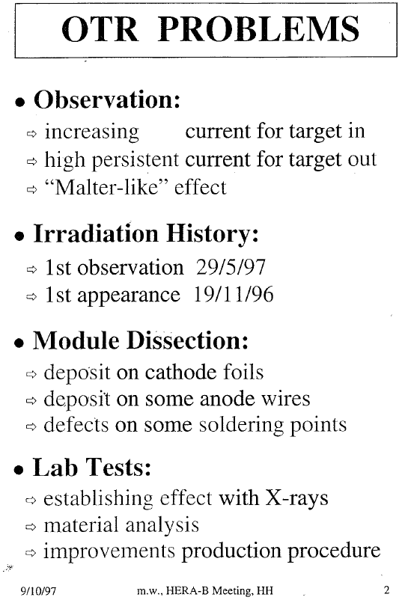
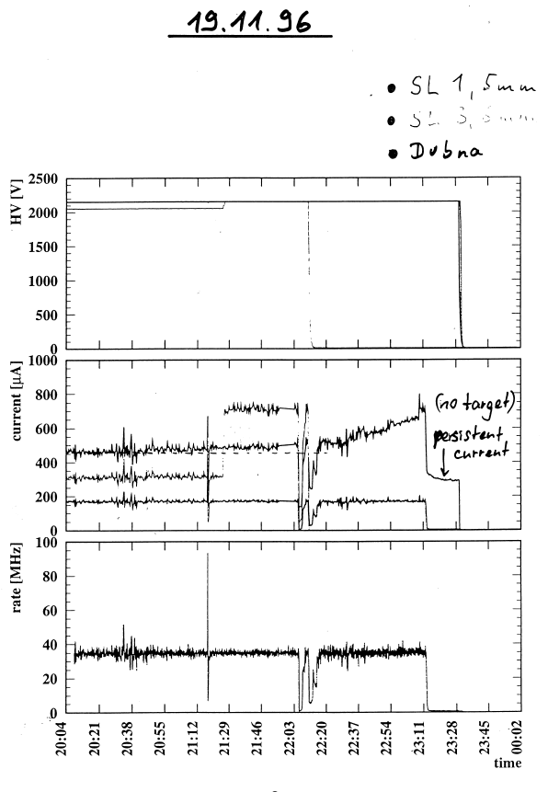
OTR Saga I
M. Walter, October ‘97
First indication of
aging in OTR
(M. Walter)
Later confirmed by tests of
prototypes in the West Hall

Slide 10
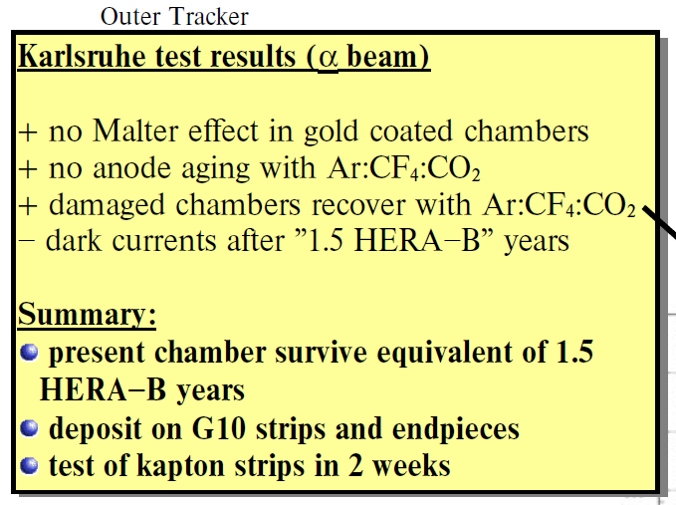
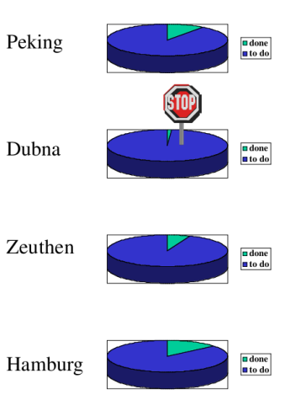
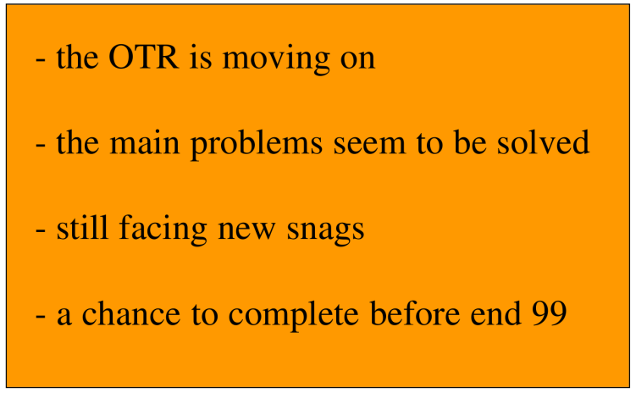
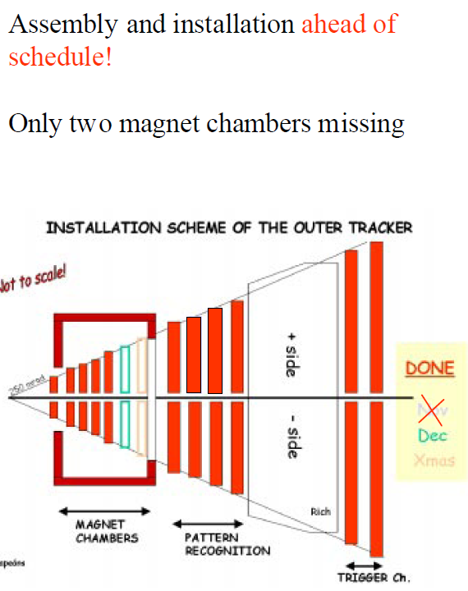
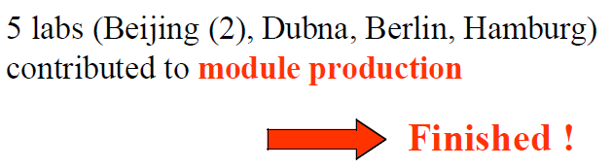
OTR Saga II
10 months after Mike’s talk:
Thorsten Oest, PRC July, ‘98
3 months later
Bernhard Schmidt, OTR mtg, Nov ‘98
13 months later
B. Schmidt, PRC Dec ‘99

Slide 11
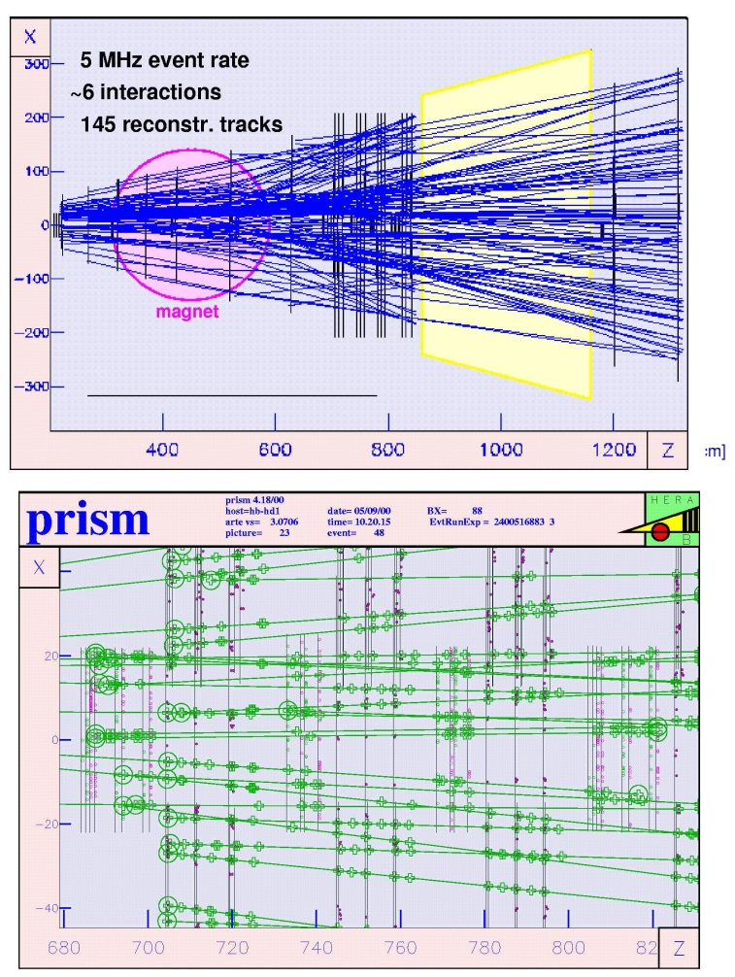
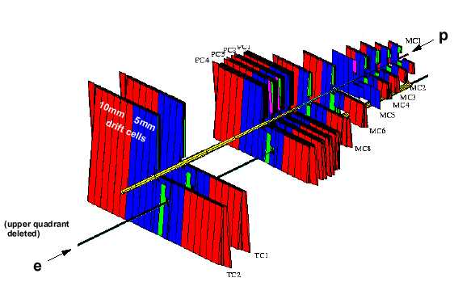
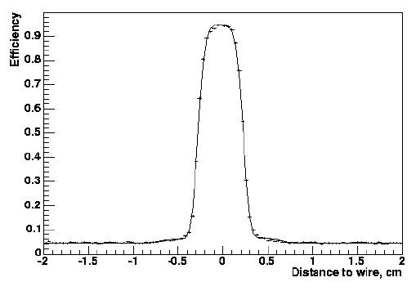
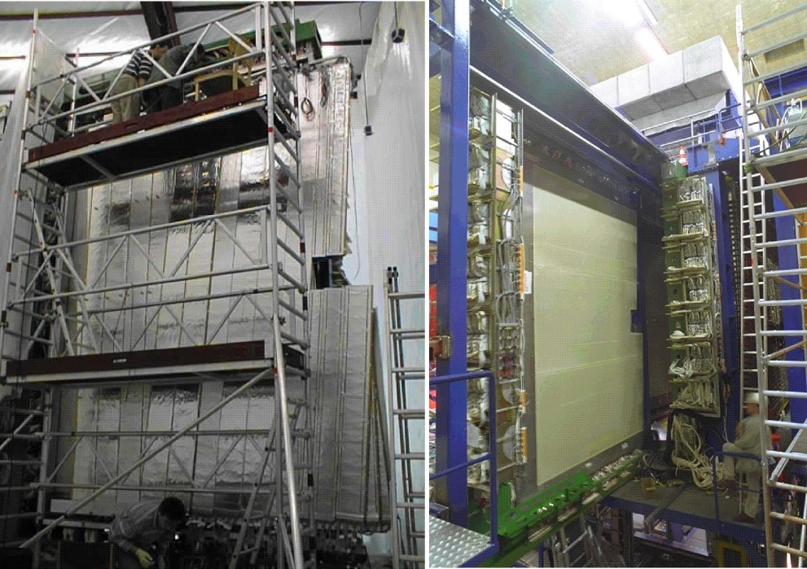
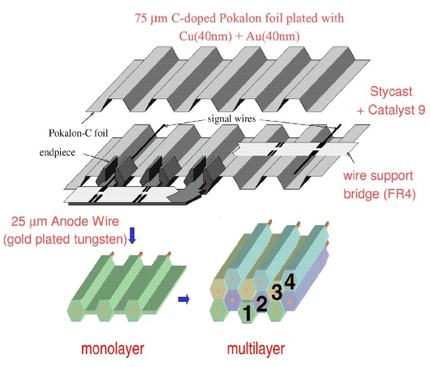
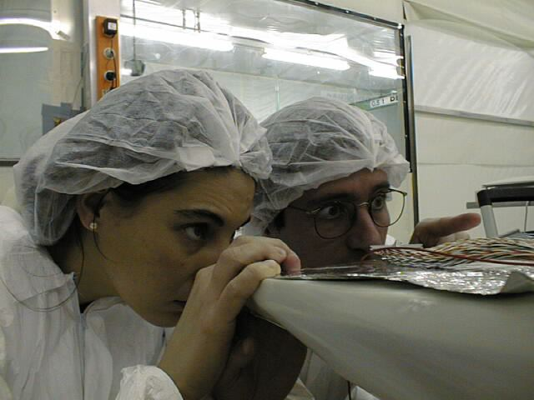
Outer Tracker Saga III
Largest system of its kind ever built: 120k channels
Finally (2002), stable operation good efficiency:
94% -- 97%
Resolution achieved ≈ 300μm.
Efficiency profile

Slide 12
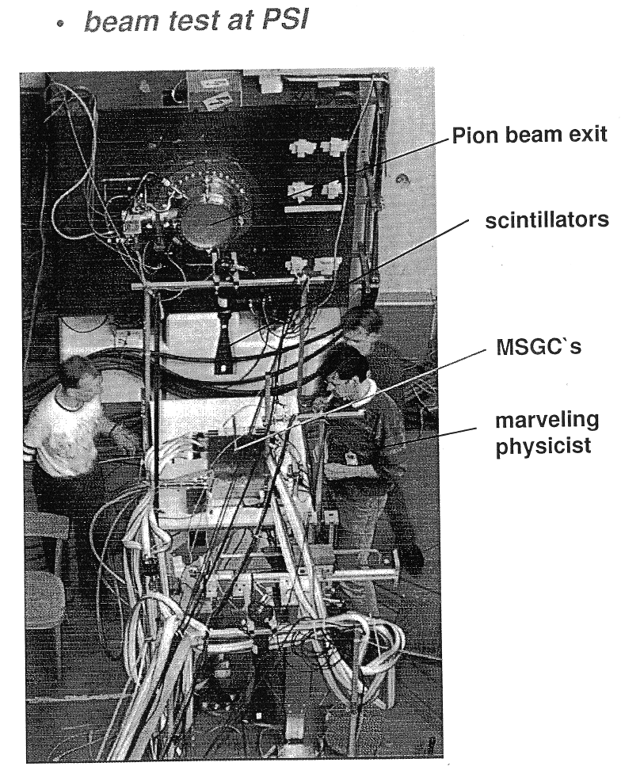
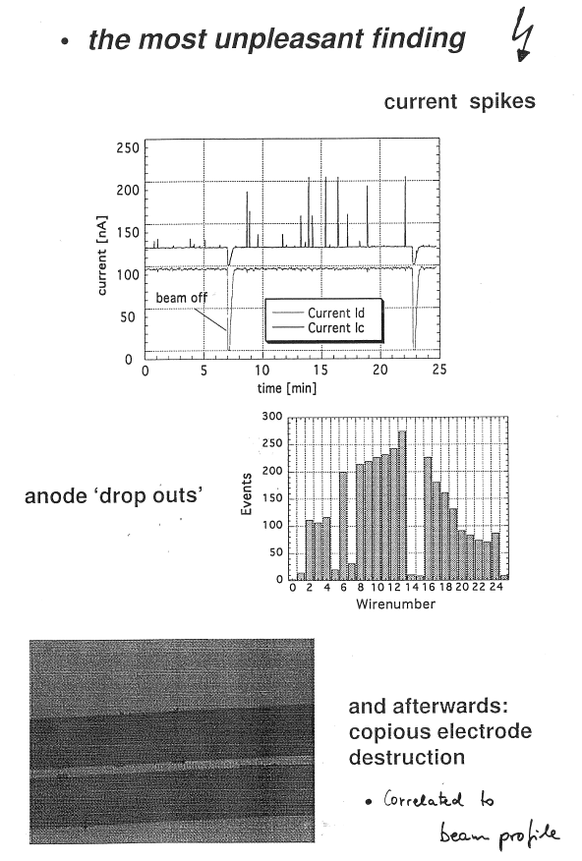
ITR Saga I
A little before start of OTR saga
π
April ‘96
B. Schmidt report, June ‘96

Slide 13
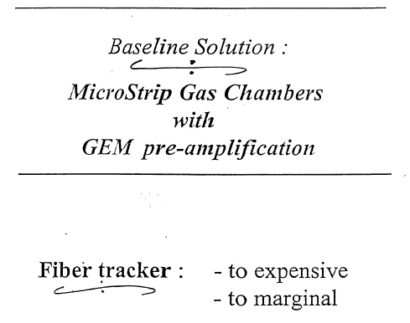
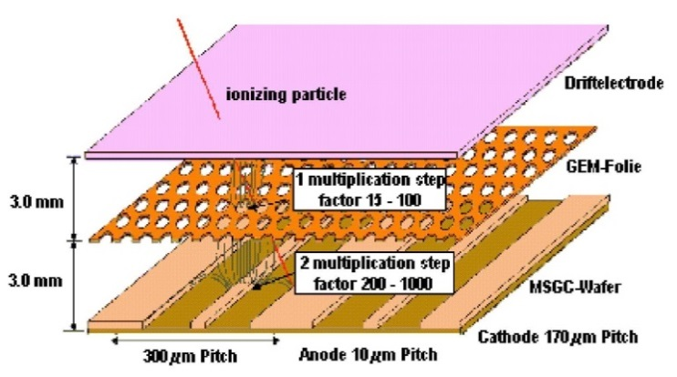
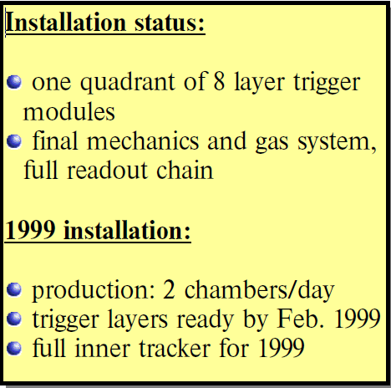


ITR Saga II
Bernhard Schmidt, Oct. ’97,
16 months later
Thorsten Oest, PRC,
Jul ’98, after 9 months
Rainer Mankel, PRC, Feb ’99, after 4 months
Minutes of PRC meeting, May 2000 (after 15 mo.s):

Slide 14
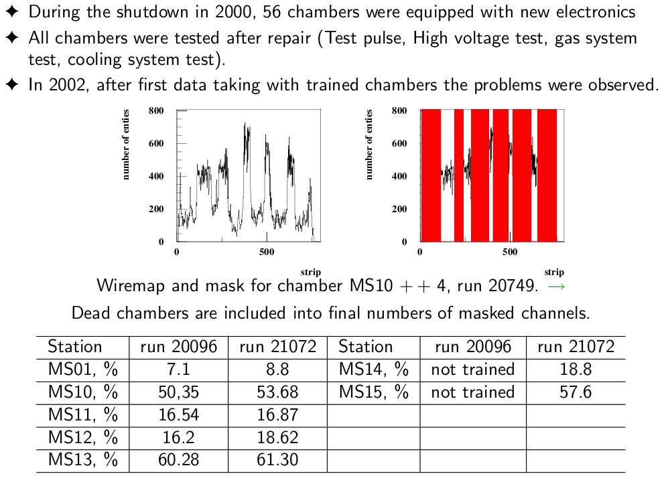
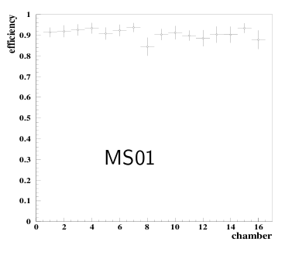
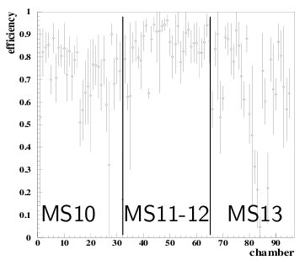
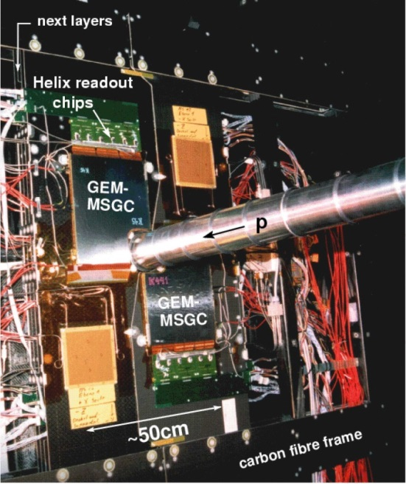
ITR Saga III
Yuri Gorbunov, May, 2002
Clearly demonstrates that GEM could be made to work
in a tough hadronic environment (particularly MS01)
But > 50% of channels masked in some chambers
Not usable for trigger
Would need considerably more effort to understand
efficiencies ⇒ more analysis effort
⇒
  ITR reco not turned on for MB analysis
  Was enabled for J/ψ runs (but little, if any, use)

Slide 15
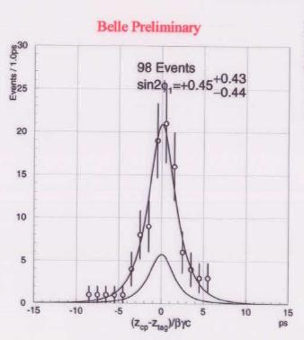
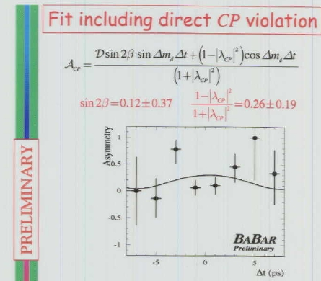
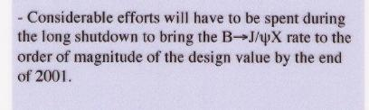
Impending Doom: ICHEP 2000, Osaka
BELLE
BaBar
HERA-B

Slide 16
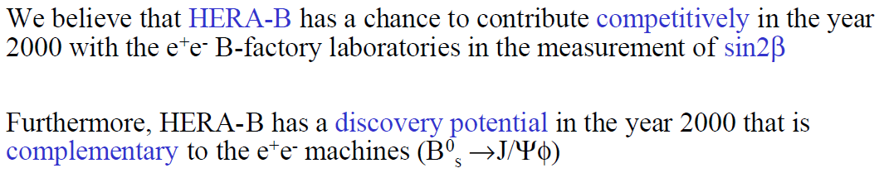
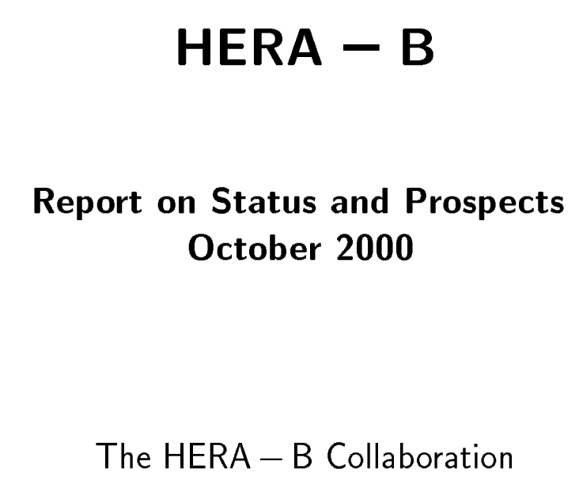
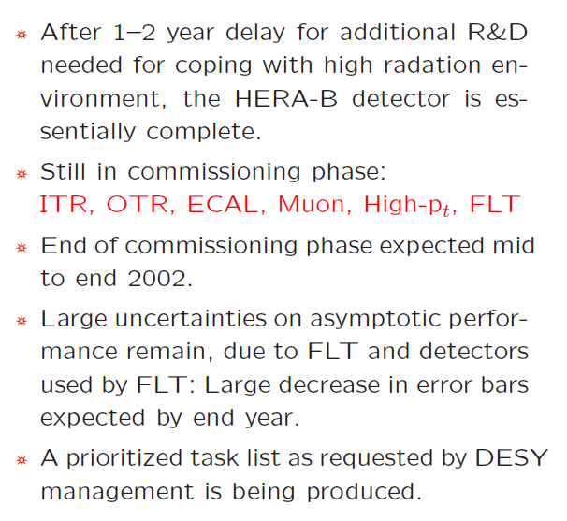

Situation at end 1999 & 2000
PRC talk Nov. ‘99
B. Schmidt
End ‘99, we were still believers!
In early 2000, Andreas announced that he would not be available for re-election. A search committee was formed and you know the result.
Summary of my talk to ESC, Nov 2000
Report for PRC/ESC:
Detector & trigger status, run 2000
results, possible physics topics.
331 pages
i.e. CP violation in B→J/ψ K_{s}⁰

Slide 17

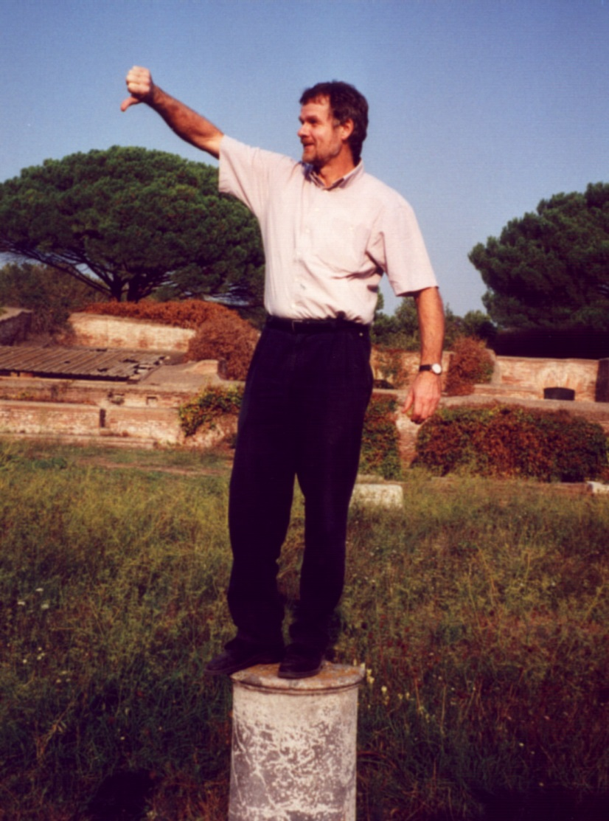
The Extended Scientific Council takes action:
October, 2000
Recommendations:
In view of the strong collaborations at electron-positron colliders and the
Tevatron, as well as the strong commitments of DESY to other projects
with considerably greater potential, we recommend an orderly termination
of HERA-B in the near future.
Collaboration reaction: the detector is nearly complete and capable of useful measurements -- finish it up and take data for a limited period with limited goals. Simultaneously, decide on a possible further continuation
…⇒ negotiation with directorate…

Slide 18
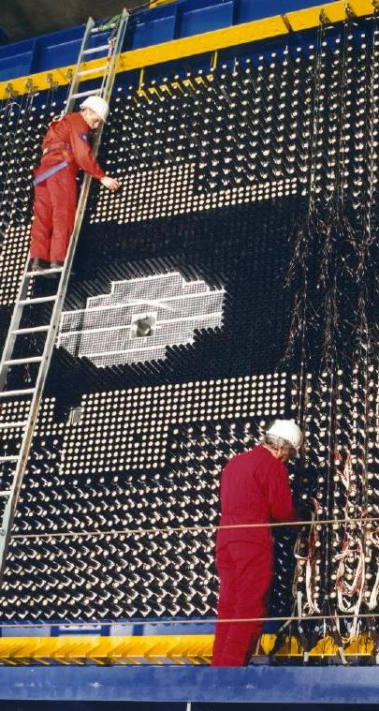
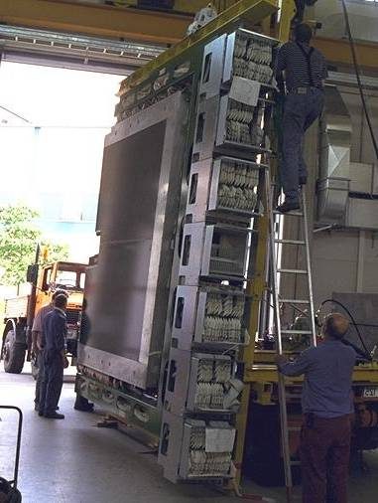
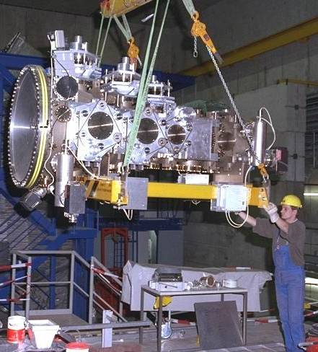
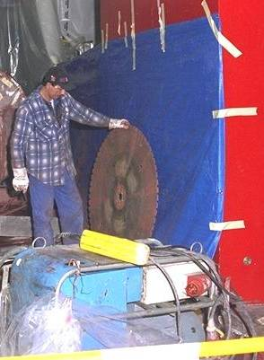
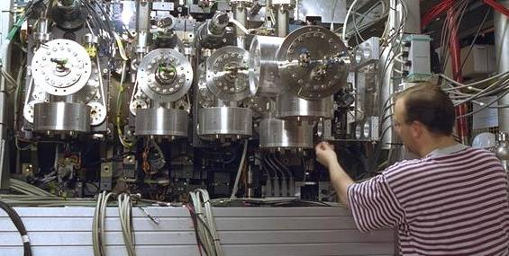
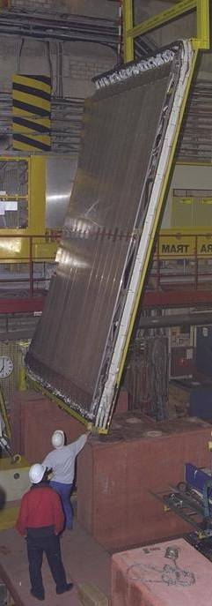
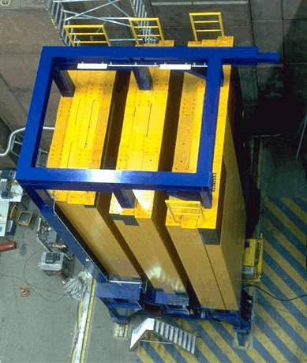
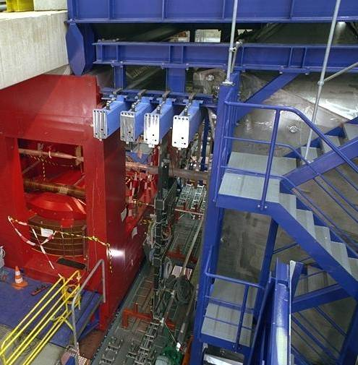
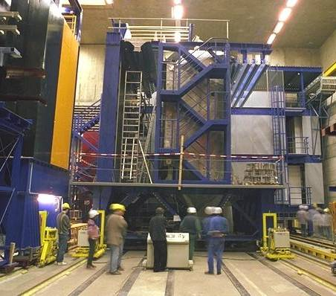
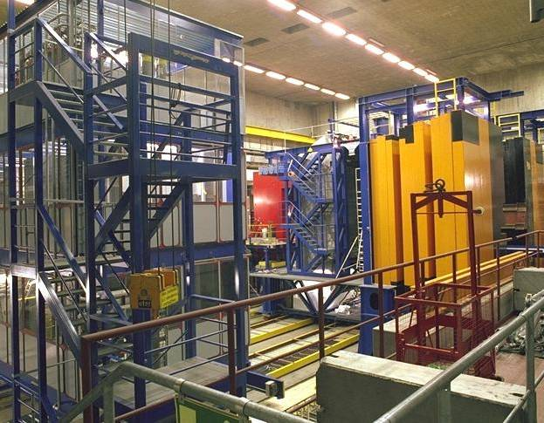
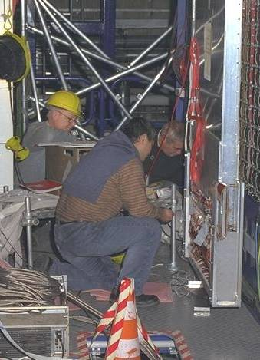
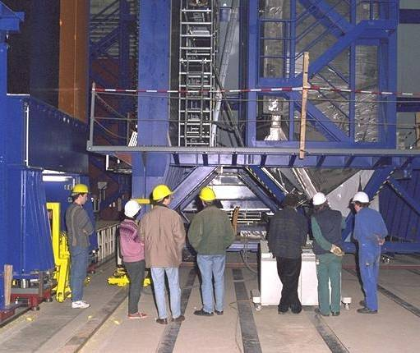


HERA-Beautiful, a few slides…

Slide 19






Target System
A unique targeting scheme:
- able to produce high interaction rates
- allows precise primary vertex positions
- minimal disturbance to other experiments
(usually)

Slide 20






Vertex Detector System
The first planar vertex detector to operate in
an experiment at a collider: stable operation, no beam interference, excellent resolution.

Slide 21






RICH Detector
First RICH to employ multi-anode
phototube readout: expensive but
well worth it. Very stable operation
excellent performance. 33 photo-
electrons for β = 1.
Deuterons!

Slide 22




DAQ & Online Trigger Farms
The first large farm-based DAQ/Trigger system. Highly
distributed DAQ, with thousand of communicating
processes on thousands of compute nodes.
CERN Courier
240
nodes
200
nodes

Slide 23







1st Level Trigger System
Dead-time free tracking at 10 MHz, decision time < 13 μsec
Production and commissioning was
slower than anticipated. 1-track trigger only became available in April 2000.

Slide 24



Back to end-2000: Rebirth
Physics program for 2001/2002
The major concern: a
deteriorating manpower situation!
Can data be taken?, analyzed?

Slide 25


Taking data
Nov 2002 – Mar 2003
Difficult running conditions after Lumi upgrade shutdown.
Long waits, low live-time.
Only 480 hours of DAQ uptime in 4 months
But still we accumulated two interesting samples:
200 million minimum bias events in 50 hours of run time
300,000 J/ψ events (10-15% of planned size) @ 1,000 J/ψ per hour
The final logbook entry

Slide 26















Party time

Slide 27





10 years (more or less) on…
We didn’t accomplish what we had started out to do but still…
We made a significant impact on detector technology
Produced 20 publications on various physics topics
& several technical publications by the subgroups
Educated a remarkable number of students & fellows
who have since built careers in HEP and related fields.
A perfect reason to celebrate!!!!

